Slide 1
Law Enforcement Training: Preventing and Responding to Violence against Key Populations to Increase Access to Justice and Strengthen the HIV Response

Slide 2
Module 1
Setting the Stage

Slide 3
Session 1.1
Welcome and Introductions

Slide 4
Objective
Introduce ourselves and discuss the role of law enforcement in [country]

Slide 5
Introductions
Name
Title
District/area you work
One reason you are proud to be a law enforcement officer

Slide 6
Session 1.2
Pre-Test

Slide 7
Objective
Determine baseline knowledge and attitudes

Slide 8
Pre-Test
Do not write your name.
Fill out pre-test.
When finished, place face down on your table.

Slide 9
Session 1.3
Learning Objectives and Agenda

Slide 10
Objective
Review training goal and objectives and discuss how modules will help us achieve all objectives

Slide 11
Training goal
To encourage policing practices that promote justice and improve the HIV response, including for members of key populations (KPs), in order to respect human rights and ensure public safety.
Key populations are
Men who have sex with men
Sex workers
People who inject drugs
Transgender (trans) people

Slide 12
Training objectives
Recognize the HIV infection risks that law enforcement officers face and gain skills to limit their own and others risk of HIV transmission
Explore the underlying causes of stigma, discrimination, and violence against key populations and the connection with HIV
Develop strategies to collaborate with traditionally underserved communities to improve policing practices and outcomes
Describe KP members’ rights to protections and services according to the national constitution, local laws, international human rights treaties, and national guidelines or strategies governing the HIV response
Strengthen their response to all victims of violence, including members of KPs

Slide 13
Agenda review
Module 1: Setting the Stage
Module 2: Building Core Knowledge
Module 3: Applying Principles and Building Skills
Module 4: Using What We Have Learned

Slide 14
Session 1.4
Group Norms

Slide 15
Objective
Develop and agree upon norms to guide the training

Slide 16
Session 1.5
What Is Possible?

Slide 17
Objective
Observe positive relationships between law enforcement and KP members in other settings and consider opportunities at home

Slide 18
Working with law enforcement globally
UNAIDS identified sensitizing law enforcement as a key component of the HIV response in 2012.
The Global Fund did the same in 2014.
Trainings to support law enforcement officers as they interact with key populations have been conducted all over the world:
  Ghana, South Africa, Malawi, Tanzania, Kenya, Kingdom of Eswatini
  Thailand, India, Nepal
  Dominican Republic, Jamaica, Haiti

Slide 19
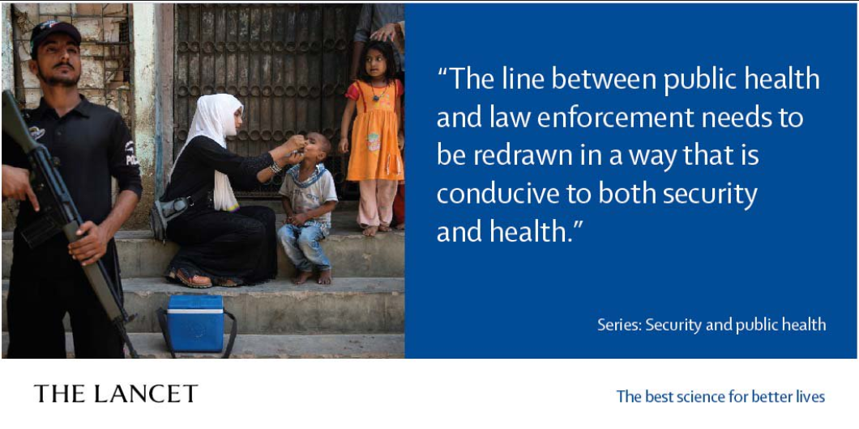
Combining forces
Law enforcement and public health officials working together can more effectively achieve a common goal: the safety and security of the population.
Source: van Dijk et al., 2019.

Slide 20
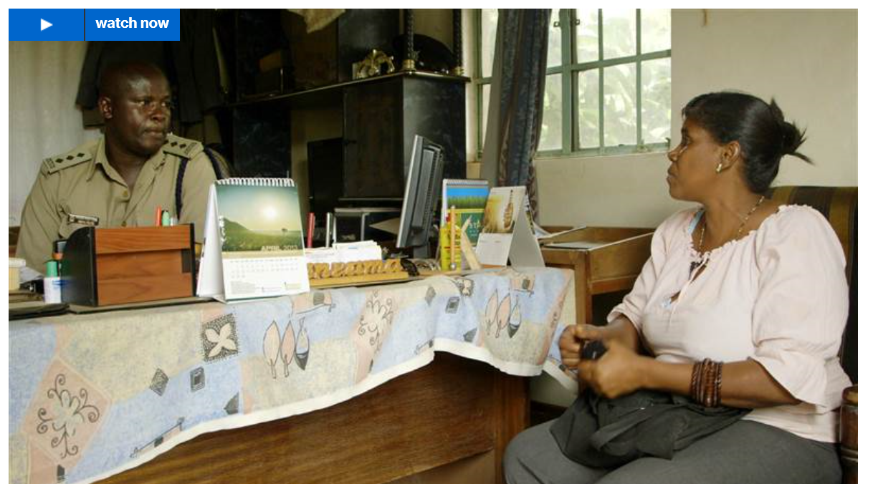
A model for law enforcement and sex worker collaboration in Kenya
http://www.msnbc.com/msnbc/how-police-can-help-prevent-hiv

Slide 21
Standing on the shoulders of giants
Describe preparatory work that happened before this training so that the training could take place
This is an opportunity to show the participants how much high level buy-in already exists for this effort

Slide 22
Discussion: Expectations
What do you want to get out of the training?

Slide 23
Module 2
Building Core Knowledge

Slide 24
Session 2.1
Basics of HIV: Epidemiology, Prevention, Available Services

Slide 25
Objectives
Review the HIV epidemic in [country], including HIV prevalence levels among key populations
Identify risks for HIV acquisition among law enforcement officers, prevention methods that decrease risk, and services available to support prevention, care, and treatment
Review national strategic plan (e.g., from the Ministry of Health) to understand KP programs’ goals and approaches and identify how/whether law enforcement agencies are recognized as part of the national HIV response
Optional: Discuss the hazards associated with needle sticks and ways to avoid this potential exposure

Slide 26
Discussion: What have you heard about HIV and AIDS? (Part 1)
What are some statements you have heard about HIV and AIDS?

Slide 27
HIV vs. AIDS
What is HIV?
Human Immunodeficiency Virus
What is AIDS?
Acquired Immunodeficiency Syndrome
What is the difference between HIV and AIDS?

Slide 28
HIV transmission
HIV is spread through direct contact with certain body fluids from someone who has HIV:
Blood
Semen and pre-seminal fluid
Rectal fluids
Vaginal fluids
Breast milk

Slide 29
HIV transmission (continued)
HIV is not spread by:
Air or water
Mosquitoes, ticks, or other insects
Saliva, tears, or sweat
Shaking hands, hugging, sharing toilets, sharing dishes/drinking glasses, or closed-mouth or “social” kissing
Drinking fountains
Other sexual activities that don’t involve the exchange of body fluids (e.g., touching)

Slide 30
HIV testing and treatment
Testing: You can’t rely on symptoms to tell if you have HIV. The only way to know for sure that you have HIV is to get tested.
  Knowing your HIV status helps you to make healthy decisions to prevent getting or transmitting HIV.
Treatment: No effective cure for HIV currently exists, but with proper treatment and medical care, HIV can be controlled.
Country team to include details on getting HIV testing and treatment in their country, including pre-exposure prophylaxis (PrEP) and post-exposure prophylaxis (PEP). This will ideally be several slides, not just one. The more specific you can be (i.e., naming sites that provide specific services) the better.

Slide 31
HIV epidemic in [Country]
[Country team to add data on the HIV epidemic in their country. Key population-specific data should be included on a later slide]

Slide 32
Key populations and HIV globally
HIV prevalence among sex workers is 10 times greater than among the general population.¹
Men who have sex with men are 24 times more likely to be living with HIV than the general population.¹
Trans women are 49 times more likely to be living with HIV than other adults of reproductive age.²
People who inject drugs are 28 times more likely to be living with HIV than the general population.³
Sources: 1. Joint United Nations Programme on HIV/AIDS, 2016. 2. Baral et al., 2013.
3. United Nations Office on Drugs and Crime, et al., 2017.

Slide 33
HIV among key populations in [Country]
Specify which KP groups—men who have sex with men, people who inject drugs, sex workers, transgender people—are the focus of the national HIV/AIDS strategy in [Country].
Insert country-specific information/statistics about HIV among these KP groups in [country]. You may also wish to include size estimation data.
Consider carefully whether data is safe to share; for example, it is likely inappropriate to share mapping data that names specific hot spots as this may result in increased chance of arrest.

Slide 34
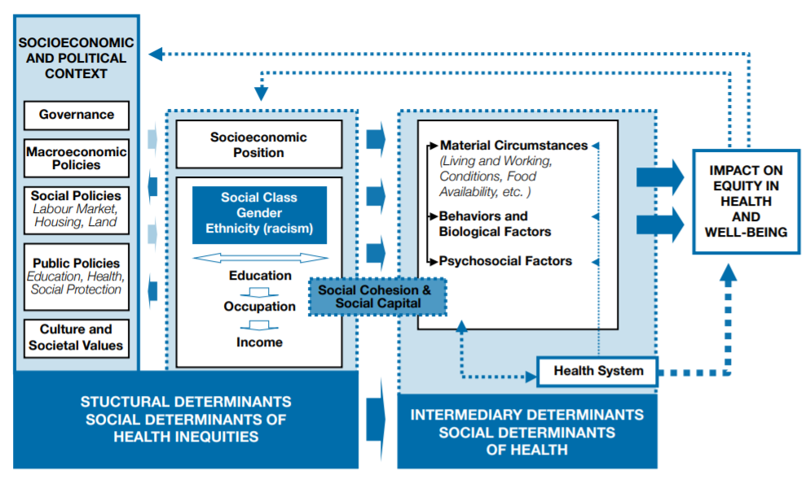
What influences people’s health, including their vulnerability to HIV?
Source: WHO, 2010.

Slide 35
Activity: What is behind high HIV prevalence rates for some populations?
Divide into five groups.
Review the two experiences given to your group.
Decide which of the experiences is a barrier to good health and which one facilitates good health. Consider HIV prevention specifically.
Be prepared to share and explain your response.

Slide 36
What influences people’s health, including their vulnerability to HIV?
Source: WHO, 2010.

Slide 37
National strategic plan
Share information here about the national strategic plan to address KP members’ needs. This is an opportunity to share information on what the program looks like on the ground so that officers at the training are aware of the activities that are sanctioned/supported by ministries (such as outreach and peer education/commodity delivery).

Slide 38
Discussion: What have you heard about HIV and AIDS? (Part 2)
Look back at the list of statements that we made at the beginning of this session about what we have heard about HIV and AIDS.
What is fact? What is fiction?

Slide 39
Thinking about our own risks
What risks of HIV exposure do law enforcement officers face?
What can officers do to lower those risks?

Slide 40
Focus on avoiding needle sticks
Law enforcement officials working with people who inject drugs may face specific risks of HIV infection related to needle sticks.
Several steps can help avoid needle sticks.

Slide 41
Questions and reflections

Slide 42
Session 2.2
Sex, Gender, Gender Identity, Gender Expression, Sexual Orientation: Understanding Ourselves and Each Other

Slide 43
Objectives
Understand the difference between sex and gender
Understand the differences between gender identity, gender expression, and sexual orientation
Explain how gender norms and other societal norms affect us all and contribute to stigma and discrimination against key populations

Slide 44
Activity: Sex and gender: What’s the difference? (Part 1)
Divide into groups (about six to eight per group).
Each group selects an artist.
The artist, taking directions from the group, will draw either a woman or a man, as assigned by the facilitator.
Add details that distinguish the figure as a woman or man. Consider using: body shape, clothing, make-up, hair style, objects being held, and anything else you can think of.

Slide 45
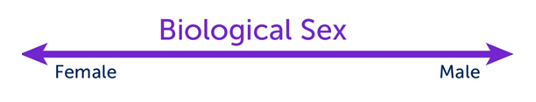
Biological sex
A medical term used to refer to the chromosomal, hormonal, and anatomical characteristics that are used to classify an individual as female, male, or intersex.
Sex is on a continuum. Intersex refers to a person born with reproductive or sexual anatomy that does not seem to fit the typical definitions of female or male.

Slide 46
Gender
Gender is a culturally defined set of economic, social, and political roles, responsibilities, rights, entitlements, and obligations associated with being female and male. It is also reflected in the power relations between and among women and men, and boys and girls.

Slide 47

Gender identity
A person’s deeply felt internal and individual experience of gender, which may or may not correspond with the sex assigned at birth
When one’s gender identity does not correspond with sex assigned at birth, a person may identify as:
Transgender: gender identity is different from sex assigned at birth
Trans woman: Assigned male at birth and identifies as female
Trans man: Assigned female at birth and identifies as male

Slide 48

Gender expression
Gender expression is the external display of one’s gender identity, through:
Appearance
Disposition
Social behavior
A person’s gender expression may or may not be consistent with socially prescribed gender roles.

Slide 49
Activity: Sex and gender: What’s the difference? (Part 2)
Refer back to the group drawings.
Circle those attributes that show gender expression in one color and those that show biological sex in another color.

Slide 50
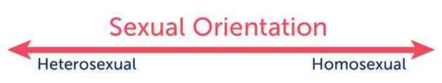
Sexual orientation
An enduring emotional, romantic, or sexual attraction to another person of a different sex or gender, the same sex or gender, or more than one sex or gender.
Terms often used to describe sexual orientation
Attraction to members of one’s own sex or gender (homosexual)
Attraction to members of the opposite sex or gender (heterosexual)

Slide 52
Discussion: Gender norms
What are the “rules” for boys/men versus girls/ women?
What kinds of toys are boys/girls expected to play with?
What kinds of emotions are acceptable for men/women?
What kinds of professions are considered most appropriate for women? What about for men?
What are women expected to contribute to their families? What about men?

Slide 53
Discussion: Gender norms (debrief)
Gender norms refer to a set of expectations or rules assigned by our society and culture that tell us how to act, look, and feel as men/boys and women/girls.
How do we learn these gender norms?

Slide 54
Discussion: Effects of gender norms
How do gender norms affect all of us?
Men may be kept from being caring parents because that role is seen as being a woman’s
Men may not ask for help when it’s needed
Men may take risks to prove their masculinity
Women/girls may do all the (unpaid) work in the home, limiting time for education or skills building
Women may be encouraged to submit to their husbands, even when abuse occurs
Women may have few options for occupations outside the home, limiting their ability to earn money and live independently

Slide 55
Discussion: Effects of gender norms (continued)
What happens when someone is perceived as nonconforming to “rules” about gender?
Made fun of
Rejected
Abused physically and sexually (including murdered)
Develops low self-esteem/depression
Does harm to themselves or commits suicide
Denied services (including health and justice services that could help protect him/her from violence or provide support if violence occurs)

Slide 56
Discussion: Effects of gender norms (continued)
How do gender norms increase HIV vulnerability among…
Men who have sex with men?
Female sex workers?
Women who inject drugs?
Transgender women?

Slide 57
What is stigma?
Stigma is shame or disgrace directed at someone perceived as socially unacceptable or not conforming to norms.
Stigma refers to the strong negative feelings or disapproval that is linked to a specific person, group, or trait.

Slide 58
What is discrimination?
Discrimination occurs when a person or group of individuals are treated unjustly or unfairly because of a specific trait they possess.

Slide 59
Stigmatization process
DISTINGUISHING AND LABELING DIFFERENCES
(HIV status)
ASSOCIATING NEGATIVE ATTRIBUTES
(immoral, promiscuous)
SEPARATING “US” FROM “THEM”
(isolate physically and socially)
STATUS LOSS AND DISCRIMINATION
(denial of family support, denial of health care, violence)
Source: Link & Phelan, 2001.

Slide 60
Stigmatization process with gender norms
DISTINGUISHING AND LABELING DIFFERENCES using gender norms
(HIV status) (she doesn’t “act like a lady”)
ASSOCIATING NEGATIVE ATTRIBUTES
(immoral, promiscuous)
SEPARATING “US” FROM “THEM”
(isolate physically and socially)
STATUS LOSS AND DISCRIMINATION
(denial of family support, denial of health care, violence)

Slide 61
Gender-based violence (GBV)
Any form of violence that is directed at an individual based on their biological sex, gender identity or expression, or their perceived adherence to socially defined expectations of what it means to be a man or woman, boy or girl. GBV is rooted in gender-related power differences, including social, economic, and political inequalities.

Slide 62
What might this look like among law enforcement?
Belief: A law enforcement officer believes that men who have sex with other men are not following the “rules.”
Impact: A victim of violence will not get the services he needs, which could ultimately result in death or other harms. His partner, who is perpetrating violence, will likely continue to do so. The victim is unlikely to ever seek police help again and may tell others to avoid the police. This will affect law enforcement’s ability to solve future crimes because it will negatively affect willingness to collaborate with them (e.g., share information).

Slide 63
Discussion: What characteristics may affect services received?
Biological sex
Gender identity/ expression
Sexual orientation
Sexual behavior
Age
Race/ethnicity/tribe
Disability
HIV status
Socioeconomic class
Drug use
Religion
Occupation
Education/literacy
Nationality/citizenship

Slide 64
Activity: The last post-exposure prophylaxis (PEP)
PEP is a drug that can prevent HIV infection. It must be initiated within 72 hours after the potential exposure.
Imagine you are the officer in charge at your station. There are five victims who all entered the police station at the same time. Read about each of them, and in your small group, decide which one will be given PEP. Be prepared to share and explain your response.
There is no one right answer. But this activity can help you identify any biases that you may have. Ask yourself how you made your decision. Did you consider who was most likely to have been exposed to HIV or something else?

Slide 65
Activity: The last PEP (debrief)
Knowing that we have our own values and biases, how can we ensure that all those who come to us for support are able to benefit from our commitment to serve others?

Slide 66
Questions and reflections

Slide 67
Session 2.3
Understanding Violence against Key Populations (Characteristics, Perpetrators, Causes, Consequences)

Slide 68
Objectives
Describe how stigma and discrimination based on gender can result in violence
Identify common types of violence experienced by KP members and perpetrators of that violence
Explain the link between violence and HIV and discuss the role of law enforcement agencies in addressing HIV

Slide 69
Types of violence
Emotional: humiliation, threats, making someone feel worthless or afraid
Physical: hitting, kicking, choking, use of a weapon
Sexual: unwanted groping, forced sex (including sex without a condom)
Economic: theft, not paying someone what is due to them, refusing to pay for a child’s basic needs
Other human rights violations: refusing services to someone, taking their condoms/injecting equipment, arbitrarily detaining them

Slide 70

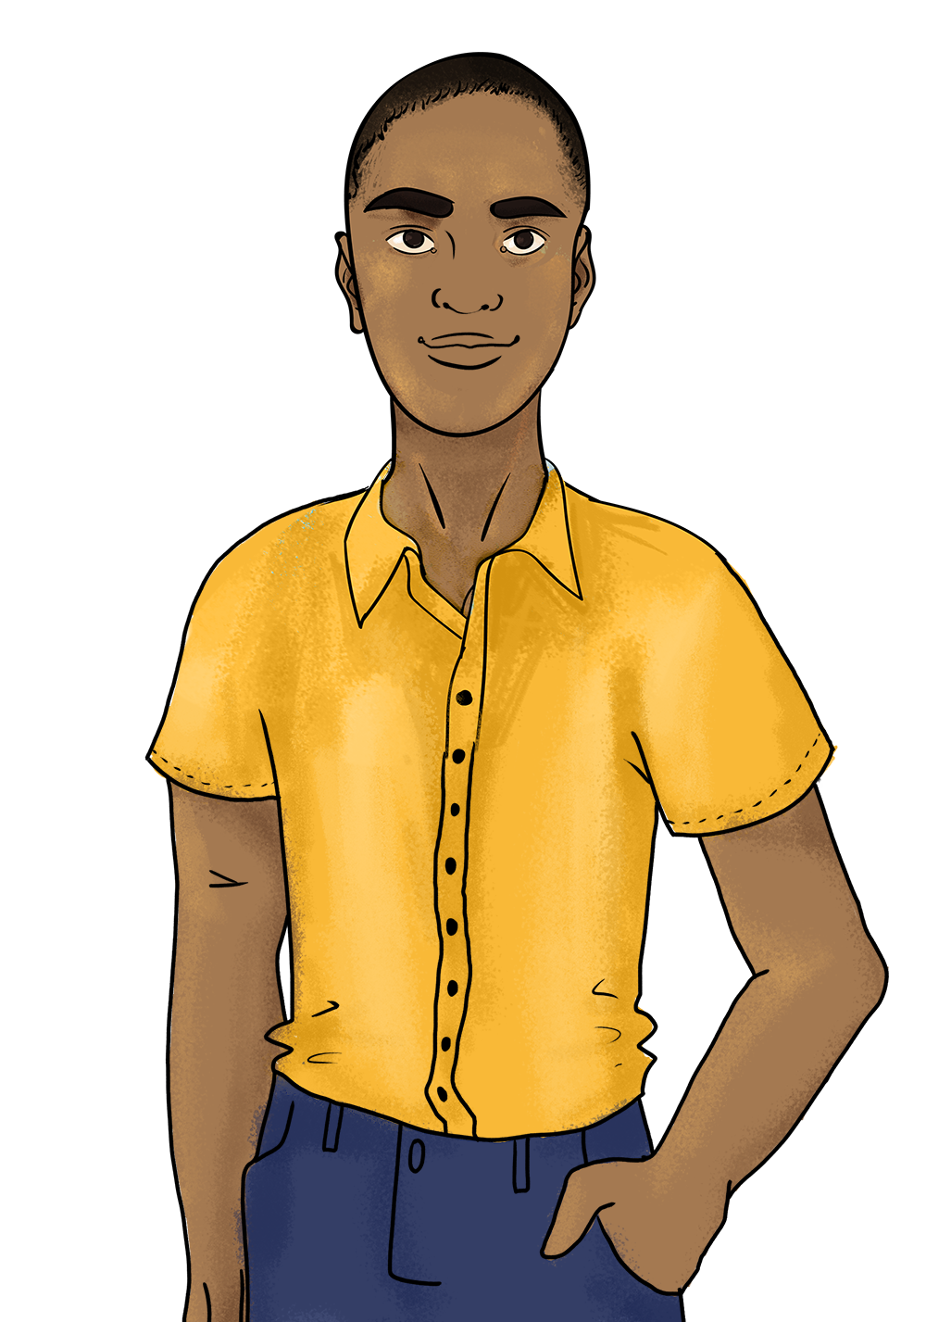
Activity: Amanda’s story
Read Amanda’s story together.
In small groups, answer your group’s question on a large piece of paper.
Select one person to present your answers back to the group.
Amanda when she is free to be herself
Amanda when she cannot be herself

Slide 71
Questions (one question per group)
Question 1: Describe at least three times that violence increased Amanda’s vulnerability to HIV infection. Describe at least three times that violence affected her access to HIV treatment.
Question 2: Describe the violence that Amanda experienced, giving at least two examples of each type: emotional, sexual, physical, economic, and other human rights violations.
Question 3: List all the perpetrators of violence. Decide which perpetrator had the most dramatic negative impact on Amanda’s life and explain your answer.
Question 4: Think about all the consequences of the violence Amanda experienced. Make a list of the consequences of each form of violence.

Slide 72
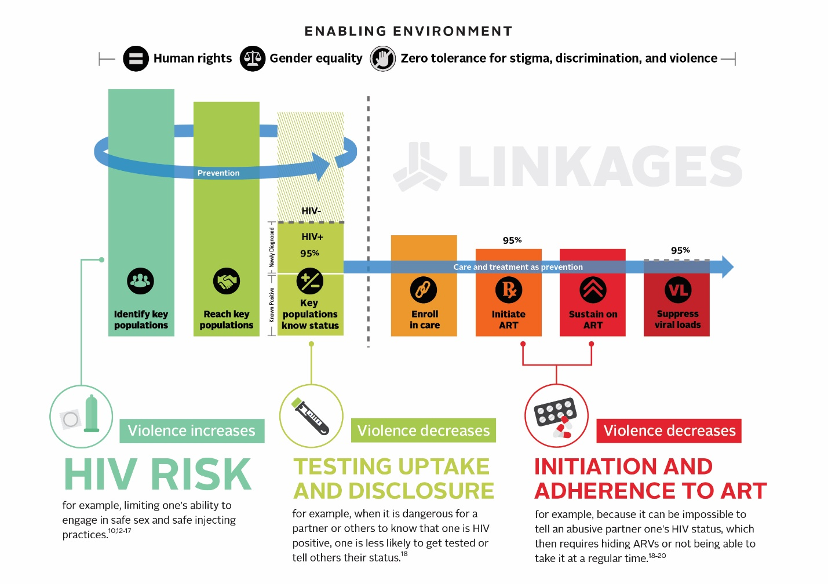
Violence affects the HIV epidemic
Violence:
Increases HIV vulnerability¹⁻⁸
Decreases testing uptake and disclosure⁹
Decreases adherence to ART⁹⁻¹²
Causes a host of other health issues¹³
Sources: 1. Beattie et al., 2015. 2. Decker et al., 2013. 3. Decker et al., 2015. 4. Decker et al., 2016. 5. Dunkle & Decker, 2013. 6. Guadamuz et al., 2011. 7. Lunze et al., 2016. 8. Wheeler et al., 2014. 9. Schafer et al., 2012. 10. Machtinger et al., 2012. 11. Mendoza et al., 2017. 12. Zullinger et al., 2015. 13. World Health Organization, 2013.

Slide 73
Violence against Key Populations in [Country]
Insert country-specific information/statistics about violence against key populations in [Country]. If there is specific data on violence perpetrated by law enforcement agencies, this data should also be added to this slide.
Example slide from Malawi training:
Many men who have sex with men in Malawi face increased levels of stigma and violence.
  A 2010 study found that 4 percent of men who have sex with men were denied health care service based on sexuality, 1 percent were blackmailed because of sexuality, and 19 percent experienced a discrimination event.
  Another study in 2013 study found that over 20 percent of men who have sex with men had experienced some form of stigma and 11.4 percent had experienced homophobic violence.
Stigma and violence experienced among men who have sex with men can be responsible for difficulties in going for an HIV test, seeking HIV services, and disclosing HIV status.

Slide 74

Questions and reflections
Injuries |  | HIV/STIs |  | Fear/shame
Sex without a condom |  | Cannot safely get tested |  | Cannot access ARVs |  | Poverty
Consequences
Cannot carry condoms/ lubricant |  | Leave education early |  | Mental health issues |  | Homelessness
Violence :
physical, sexual, emotional, economic, and other human rights violations
Normalization of violence |  | Impunity for perpetrators
Causes
Laws and polices, including those that are incorrectly enforced
Gender norms |  | Stigma

Slide 75
Session 2.4
Human Rights and Local Legal Context

Slide 76
Objectives
Identify local laws and constitutional provisions that outline the rights of all people
Recognize the laws and policies that most affect KP members and discuss their common applications and misapplications
Become familiar with strategies that KP members can use to counter the misapplication of these laws, including redress mechanisms

Slide 77
The slides used here will be provided by a local lawyer
The lawyer’s presentation should cover:
Step 1: What are human rights and what are human rights violations? (You can use or replace the next two slides as part of this step.)
Step 2: Where do we see human rights reflected in our country’s constitution, local laws, and any international agreements that our country has signed? For example, what services does everyone have the right to (e.g., justice, health, housing)? Are some rights only guaranteed to citizens while others are more broadly applied?
Step 3: What are the key local laws that impact key populations (MSM, PWID, SWs, trans people)? What laws, including laws about human trafficking, are often misinterpreted or misunderstood and how should they actually be enforced?
Step 4: What latitude/flexibility do law enforcement agencies have in how they enforce laws? For example, can they choose to warn instead of arrest if they see a violation? NOTE THAT FOR THIS ONE YOU MAY WISH TO ENGAGE SENIOR OFFICERS OF LAW ENFORCEMENT DIRECTLY INSTEAD OF THE HUMAN RIGHTS LAWYER.
Step 5: The rights of individuals even if they are engaging in illegal behavior—particularly the right to live free from violence and the right to access services if violence occurs. (Provide language on the rights of all people).
Step 6: What should a key population member do if they are arrested? What rights do they have (e.g., right to make a phone call, knowing why they were arrested, any limits on being held past a certain amount of time)?
Step 7: What can a key population member do if their rights are violated by the law enforcement (e.g., if arrested wrongly, if abused by law enforcement)? What can a law enforcement officer do if they see someone’s rights being violated?
Step 8: Time for questions from participants

Slide 78

What does it mean when we say someone has human rights?
A human right is a protection from certain abuses or a right to demand certain treatment.
Human rights are granted to all people, simply for being human.

Slide 79
Whereas...
Recognition of the inherent dignity and of the equal and inalienable rights of all members of the human family is the foundation of freedom, justice, and peace in the world.
The advent of a world in which human beings shall enjoy freedom of speech and belief and freedom from fear and want has been proclaimed as the highest aspiration of the common people.
Source: United Nations General Assembly, 1948.

Slide 80
What are examples of human rights?
Right to life, liberty, and personal security (Art. 3)
Freedom from cruel, inhuman, or degrading treatment (Art. 5)
Right to equal protection before the law (Art. 7)
Freedom from arbitrary arrest or detention (Art. 9)
Right to due process before the law (Art. 10)
Freedom of movement (Art. 13)
Freedom of peaceful assembly and association (Art 20)
Right to a standard of living adequate for health and well-being (includes right to medical care) (Art. 25)
Source: United Nations General Assembly, 1948.

Slide 81
Human trafficking versus sex work
Sex work and human trafficking are NOT the same thing.
There are victims of human trafficking who are forced to engage in sex work against their will, but many sex workers choose to engage in sex work and are not trafficking victims.
When laws designed to protect victims of trafficking are used to justify raids or other operations targeting sex workers, this can actually make sex workers less safe and cause them to fear law enforcement and other authorities.
Protecting human trafficking victims is very important and should be done in a way that does not harm sex workers who choose to sell sex.

Slide 82
Questions and reflections

Slide 83
Session 2.5
Recognizing and Challenging Violence in Law Enforcement/ Key Population Interactions

Slide 84
Objective
Recognize violence in common law enforcement interactions with KP members and reflect on how to improve such interactions

Slide 85
Activity: What went wrong, what could make it right?
In groups:
Read your scenario.
Decide how you will act it out.
Explain:
  What rights violation occurred
  The consequence of that violation
  What the police officer should have done instead

Slide 86
Discussion: Environmental factors
We all work within and are affected by our environments (e.g., the police station where you work)
What is currently in place that makes it more difficult to do what you know is right?
What could be done to make it easier for everyone to do the right thing?

Slide 87
Activity: What would you think?
Two transgender women are standing together. A police officer approaches them, and they run away.
A young gay man comes to the station to report being attacked when he was seen with his boyfriend. When the police officer asks for his address, he becomes agitated and storms out.

Slide 88
Activity: What would you think? (continued)
Two transgender women who have experienced verbal abuse from several different police officers are standing together. A police officer approaches them, and they run away.
A young gay man whose parents have told him they will kick him out of the house if he is gay comes to the station to report being attacked when he was seen with his boyfriend. When the police officer asks for his address, he becomes agitated and storms out.

Slide 89
Questions and reflections

Slide 90
Session 2.6
Focus on Intimate Partner Violence

Slide 91
Objectives
Recognize the ways in which intimate partner violence (IPV) can evolve over time
Discuss the importance of responding to all victims of IPV in a nonjudgmental way
Discuss IPV among KP members and identify additional barriers to support that they may face when experiencing IPV

Slide 92
Intimate partner violence in [Country]
IPV is ongoing or past violence by an intimate partner or ex-partner. It is common in the general population and among key populations.^{1–5}
Here is what we know about IPV in [country].
[Country team to add data on IPV in their country including both general population and key population figures as available. If this was covered in session 2.1, do not repeat the statistics here; rather, review the definition of IPV before moving to the next case study.]
Sources: 1. El-Bassel et al., 2007. 2. Panchanadeswaran et al., 2008. 3. Finneran & Stephenson, 2013. 4. McKay et al., 2017.
5. Valentine et al., 2017.

Slide 93
Activity: Thandi’s story
Thandi is a young woman from [a local city]. She is intelligent, funny, kind, and beautiful. She has a supportive family and is good at her job. She has a lot of friends, especially colleagues from work. They respect her and know she will go on to do great things.
She meets John and they fall in love. They get married and move in together. This blank flip chart paper represents Thandi, her autonomy (ability to act on her own), her self-esteem, and the wide range of possibilities she feels her life holds. Watch and listen as we describe what happens next between Thandi and John.

Slide 94
Activity: Thandi’s story (debrief)
What kind of support would Thandi benefit from? Why?
What would happen if Thandi got up the courage to report John to the police and an officer responded, “It was just a small slap! Why are you making such a big deal of this?”
Sometimes people reading about others experiences of IPV say, “I would leave the first time someone was violent toward me.”
  When did John actually “become violent” in this story?
  Why might it be difficult for Thandi to seek help by the time he used physical violence?
  What might happen if Thandi tries to leave?

Slide 95
Discussion: What about in the case of key populations?
IPV can be a complex and difficult issue for anyone.
In some ways Thandi is more likely to receive support than a member of a key population.
  She began with more resources, self-esteem, and support than many KP members of would.
  She would be considered a “sympathetic victim” by many authorities who are accustomed to stories like Thandi’s.
  Laws about IPV may only apply to women in heterosexual relationships, excluding some members of KPs.

Slide 96
Questions and reflections

Slide 97
Session 2.7
Panel Discussion with Key Population Members

Slide 98
Objectives
Get to know the issues of violence affecting KP members
Understand KP members’ perspectives and hopes regarding their interactions with law enforcement

Slide 99
Panel discussion
What do you think is important for law enforcement agencies to know about your community?
Please describe a past experience with law enforcement. What were the outcomes of that experience?
What do you wish law enforcement would do to help and support your community?

Slide 100
Thank you!

Slide 101
Module 3
Applying Principles and Building Skills

Slide 102
Session 3.1
Fundamental Principles of Violence Prevention and Response

Slide 103
Objective
Describe each of the fundamental principles of violence prevention and response service provision and explain their importance, particularly when working with KP members

Slide 104
Fundamental principles of violence prevention and response
Do no harm.
Promote the full protection of all people’s human rights.
Respect all people’s right to self-determination and the right of all victims of violence to the full range of recommended services.
Ensure privacy, confidentiality, and informed consent.

Slide 105
Principle 1: Do no harm
Those working with victims of violence are ethically obligated to consider whether their actions could cause harm and actively avoid this outcome.
This principle dictates:
  Avoid causing harm to KP members, or causing further harm to those who have experienced violence
  Act in accordance with the wishes and choices of all victims of violence
  Provide services without judgment and that respect the confidentiality of the victim
  Consider victim safety in every decision
  Get informed consent before providing services or making referrals

Slide 106
Discussion: How to avoid harm
Imagine that Robert comes to the police station to report that he is being blackmailed. Robert’s neighbor has a photo of Robert kissing his boyfriend and plans to share it on social media if Robert does not pay a huge sum of money. Which of the following actions by the police could cause Robert harm?
  Sharing Robert’s sexual orientation with other officers
  Telling Robert that this is his fault
  Refusing to help Robert

Slide 107
Principle 2: Promote human rights
Promoting the full protection of key populations’ human rights means:
Providing services to KP members who are victims of violence without stigma or discrimination
Not arbitrarily arresting or detaining KP members and not confiscating condoms, lubricant, or sterile injecting equipment
If a KP member is detained, explaining law enforcement procedure and their rights to them
Rejecting the idea that KP members must be rescued from themselves (e.g., forcing gay men to enter into reparative therapy, forcing sex workers to stop working, forcing people who use drugs into “treatment centers”)

Slide 108
Discussion: How to promote human rights
Imagine that Mary is a sex worker in a country where it is illegal to sell sexual services. An officer sees her sitting outside a restaurant and tells her that she must empty her bag. He finds condoms in the bag. He does not tell her that she has the right to make a call. He forces her to come back to the station and holds her for several days without charges. Which of these actions does not promote Mary’s human rights?
Arresting Mary for carrying condoms
Failing to tell Mary what she is charged with
Failing to explain Mary’s rights to her

Slide 109
Principle 3: Self-determination and access to all services
All victims of violence, including KP members, must be able to decide which services, if any, they wish to access
All services recommended to victims of violence should also be available to KP members
A victim-centered approach allows each person who reports violence to understand what is available and then make choices that meet their personal needs
  Effectively supporting victims of violence requires returning their power and control to them (not making decisions on their behalf)

Slide 110
Discussion: How to ensure self-determination
Olivia is a transgender woman. She comes to the police station to report that she was just raped. The officer on duty listens to her kindly and tells her that she must get an HIV test so that she can access post-exposure prophylaxis as soon as possible. Which of these actions did not ensure Olivia’s self-determination?
The officer listens to her kindly
The officer tells her she must get an HIV test
The officer tells her she must begin PEP

Slide 111
Principle 4: Privacy, confidentiality, and informed consent
Privacy and confidentiality must be assured before a victim talks about violence
Use a private consultation space (victim cannot be seen or heard outside the room).
Speak to victims alone. No one older than age 2 should overhear your conversation.
Safely secure and store all victim’s records.
Have clear policies on information sharing communicated to the victim. For example:
  Explain what will happen to the information they share before they share it, including any limits regarding confidentiality (such as mandatory reporting)
  Obtain informed consent before information is shared
  Note: victims should not be made to repeat their stories to multiple providers, especially not to those not directly involved
Train providers and staff on these procedures.

Slide 112
Activity: Privacy and confidentiality
Take out your cell phone and unlock it.
Give it to the person on your left.

Slide 113
What do we mean by confidentiality?
Keeping all information related to a victim secret and sharing it only with others who need to know to provide assistance, as requested and agreed to by the victim of violence.

Slide 114
What do we mean by consent?
When a person agrees…
To do something
To participate in an activity
For something to occur

Slide 115
What is informed consent?
Informed consent means that a person agrees to participate in an activity or for something to occur after they have knowledge of or have received all the information about the activity.

Slide 116
Discussion: Which of these statements would lead to informed consent?
A: If you report this crime, the perpetrator will go to jail for a long time.
B. If you report this crime, you will need to stand before a judge to describe what happened to you. The perpetrator will also be there. Then the perpetrator may go to jail for a long time.

Slide 117
Questions and reflections

Slide 118
Session 3.2
Needs of Key Population Members Who Experience Violence

Slide 119
Objectives
List the services that should be offered to victims of violence and describe the importance of each
Describe the process of referral for all available services
Discuss which of these services KP members can safely be referred to

Slide 120
Discussion: Meeting victims’ needs
 | Services (potentially) needed | Where available | Details
Physical and mental health services | Emergency injury treatment HIV and STI testing/prophylaxis/care Emergency contraception Rape kits/forensic examination Relevant vaccines Mental health screening/treatment for depression and post-traumatic stress disorder
Social support services | Psychosocial support (support groups, crisis counseling) Securing/replacing ID documents Shelter • Educational assistance Financial aid • Food assistance Child care • Interpreters
Legal/ justice services | Information on their rights Information on law enforcement procedures Support from law enforcement Legal counsel Ability to give a statement/document the case Ability to seek redress when wrongly arrested Access to ARVs even while incarcerated
Notes:
information on the rights of KP members, information on law enforcement procedures, legal counsel (including in cases of arrest), ability to give a statement or otherwise document the case

Slide 121
Referral process in [Country]
Country team to add information on referral process for violence services if one is established.
HEALTH SERVICES | SOCIAL SERVICES | JUSTICE/LEGAL SERVICES
[Name of Organization/Facility] Hours: Location: Focal Point: Phone: Email: Services available: | [Name of Organization/Facility] Hours: Location: Focal Point: Phone: Email: Services available: | [Name of Organization/Facility] Hours: Location: Focal Point: Phone: Email: Services available:
[Name of Organization/Facility] Hours: Location: Focal Point: Phone: Email: Services available: | [Name of Organization/Facility] Hours: Location: Focal Point: Phone: Email: Services available: | [Name of Organization/Facility] Hours: Location: Focal Point: Phone: Email: Services available:

Slide 122
A note about immediate medical services
PEP can prevent HIV infection.
  If someone may have been exposed to HIV (for example, through rape), they need to begin PEP within 72 hours.
Emergency contraception prevents ovulation to prevent an unplanned pregnancy.
  If a woman is at risk for an unplanned pregnancy (for example, due to rape), EC will be effective up to 5 days after the incident.
[Country team to include information on the local procedure for accessing PEP and emergency contraception]

Slide 123
Questions and reflections

Slide 124
Session 3.3
Barriers to Disclosing Violence

Slide 125
Objective
Recognize the barriers to disclosing violence, including victim blaming, and recognize victim blaming as counterproductive to law enforcement’s mission

Slide 126
Activity: Standing in her shoes
Nine volunteers
Stand in a line
Volunteer 1 reads their card to each person one at a time, and each person reads their card

Slide 127
Activity: Standing in her shoes (debrief)
Observations from the participants in the drama
Observations from the group

Slide 128
The importance of your response
“A victim is often in a heightened state of awareness and very emotional after an assault due to circulating stress hormones; events may be recalled in dramatic detail. Many survivors of sexual assault have described the kindness of the treating personnel as being beneficial to their recovery. Conversely, many describe comments made by police, doctors, counsellors and other persons with whom they have had contact as a result of the assault that have haunted them for years. For this reason, health workers must choose their words with great care when dealing with sexual assault patients and take care not to contribute in any way to revictimization of the patient.”
Source: World Health Organization, 2003.

Slide 129
What happens when we blame victims?
We discourage people from disclosing violence and seeking help.
We harm the mental health of victims of violence.
We place the entire solution to the problem on the shoulders of the person who has been victimized.
We do not place responsibility on the actual perpetrators (excusing behavior and creating impunity).

Slide 130
Discussion: Questions that blame
Why were you wearing such revealing clothing?
If you were really afraid, why didn’t you run or scream?
Why do you choose to put yourself in risky situations?

Slide 131
Our response to one victim affects others
Blaming any victim also makes others’ disclosures less likely.
One of the predictors for whether someone will come forward to disclose violence is what they have seen happen to others upon disclosure.
This is a phenomena called “social proof.”¹
As a law enforcement officer, each time you respond appropriately to a victim of violence and support them, you make it more likely that others will also come forward.
Source: Vedantam, 2017.

Slide 132
Discussion: Why do we blame victims?
Gender and other societal norms and myths that make violence the fault of women and individuals who are seen as nonconforming to gender norms¹⁻³
To feel safe ourselves⁴
To feel that the world is just^{5,6}
In an effort to be helpful
Sources: 1. Cortina et al., 2018. 2. LINKAGES, 2016a. 3. LINKAGES, 2016b. 4. Janoff-Bulman, 2010. 5. Lerner, 1980.
6. Lerner & Simmons, 1966.

Slide 133

Guidance from International Association of Chiefs of Police (IACP)
IACP specifically rejects the idea that victims of sexual violence cause the violence against them.
Police should “reassure victims that, regardless of their behavior, no one has the right to sexually assault them.”¹
“An eﬀective investigation will concentrate on gathering as much evidence as possible on the suspect … not on the victim’s character, behavior, or credibility.”¹
Source: International Association of Chiefs of Police, 2005.

Slide 134
Questions and reflections

Slide 135
Session 3.4
Victim-Centered Support

Slide 136
Objectives
Provide an appropriate response to victims who disclose violence
Demonstrate how to assess safety and explore safety strategies with victims

Slide 137
Victim-centered support
Use active listening skills to: Acknowledge that it can be difficult to share experiences of violence Let the person know you appreciate them sharing these experiences Provide nonjudgmental support and validate the person’s experience
Deliver core messages.
3. Ask about safety.
4. Ask about other needs.
5. Provide information and make referrals to available resources.

Slide 138
Activity: Skills of a good listener
You’ve had a bad day. Your sister is ill and her children are staying with you. You are working an extra job to help with her medical costs. You are exhausted and your work has suffered. You also had to pay late fees on your phone bill today because your payment was overdue.
In pairs, discuss:
  Who would you talk to about your day?
  Why would you choose this person?

Slide 139
Activity: Brainstorm listener do’s and don’ts
Things you want the listener to do | Things you don’t want the listener to do
Be patient and calm
Let you know that they’re listening (nod head, make eye contact, etc.)
Acknowledge how you’re feeling
Let you tell the story at your own pace
Encourage you to share
Give you time to think
Stay focused on you
Respect your wishes
Pressure you
Look at their watch or seem distracted
Judge you
Rush you
Assume they know what is best for you
Interrupt
Finish your thoughts for you
Tell you their own troubles or someone else’s

Slide 140
Discussion: Demonstrating active listening skills
How do we show that we’re actively listening?
Nodding
Saying “uh huh”
Leaning closer
Making eye contact
Giving the person time to tell their story at their own pace
Being comfortable with silence and pauses (e.g., giving person time to think)
Avoiding distractions (phone/watch)
Trying to reflect back or further inquire about what the person is saying

Slide 141
Deliver core messages
Thank you for sharing that with me.
I am here to support you and explain your options.

Slide 142
Messages to avoid
Avoid statements that
Place blame on the victim
Doubt the victim’s story
Minimize what the victim experienced
Recommend the victim change their profession, sexual orientation, or gender identity to avoid violence
Avoid questions that suggest fault
Why were you wearing such revealing clothes?
What did you do to make him angry?
If you were really afraid, why didn’t you run or scream?
Why do you choose to put yourself in risky situations?

Slide 143
Activity: Revisit standing in her shoes
Repeat standing in her shoes activity. This time, instead of rejecting the victim, deliver a core message.

Slide 144
Ask about safety
Assess current safety and identify opportunities to increase safety:
Ask: Do you have any concerns about your safety or the safety of your children (if relevant)?
Offer: The help that your law enforcement agency can make available
  Accompaniment to pick up clothing/medication
  Accompaniment to a safe location
  A protection order
  Other options?

Slide 145
Ask about other needs
Consider
Physical health (including time-bound services following sexual assault)
  PEP (72 hours)
  Emergency contraception (120 hours)
Mental health
Social services
Child protection

Slide 146
Provide information and make referrals to available resources
When providing information and making referrals
Offer printed information (but remember to offer a warning in case materials could come to the attention of an abuser)
Know specific information about referral points
Offer to call in advance or provide accompaniment if referring
Do not pressure anyone to access other services
Offer yourself as a resource in the future, even if the victim doesn’t want services today
[Country team to include key points from Session 3.1 on the referral network and process for the above services]

Slide 147
Recognizing you as a resource
Ideally someone is able to come back to you or your law enforcement agency if they experience future violence.
If appropriate, you can end conversations by saying, “Please come back if we can support you in any other way.”

Slide 148
Questions and reflections

Slide 149
Session 3.5
Responding to and Documenting Cases of Violence

Slide 150
Objectives
Practice responding to disclosures of violence appropriately while documenting the case
Discuss reporting structures

Slide 151
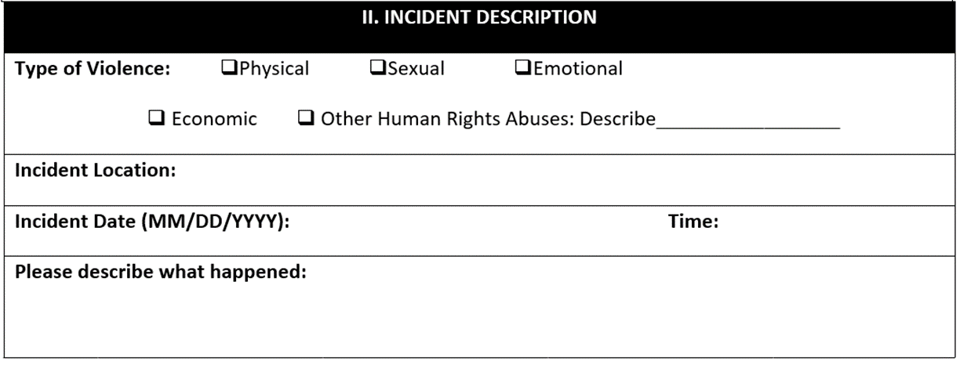
Statement-taking and reporting tools

Slide 152
Activity: Practice responding to and documenting violence
Small Group Exercise
In groups of three, rotate so that each person is a victim, a law enforcement officer, and an observer one time
During the interaction, the law enforcement officer will use their skills to provide victim-centered support and document a case of violence
Once each interaction is complete, the observer provides their feedback on what went well and what could be improved
Observer Checklist
  Active listening
  Deliver core messages
  Ask about safety
  Ask about other needs
  Provide information and make referrals

Slide 153
Activity: Practice responding to and documenting violence (debrief)
How did each of these go?
  Active listening
  Deliver core messages
  Check in on safety
  Ask about other needs
  Provide information and make referrals
  Documentation
What worked well?
What areas need improvement?

Slide 154
Forensic specimens
If local law enforcement collect forensic specimens to help identify perpetrators of crime, ensure that those collecting the specimens have been trained to work respectfully and appropriately with members of key populations.

Slide 155
Questions and reflections

Slide 156
Session 3.6
Trauma-Informed Approach to Law Enforcement

Slide 157
Objective
Understand the effects of trauma on victims of violence and how trauma affects statement-taking and law enforcement support needed

Slide 158
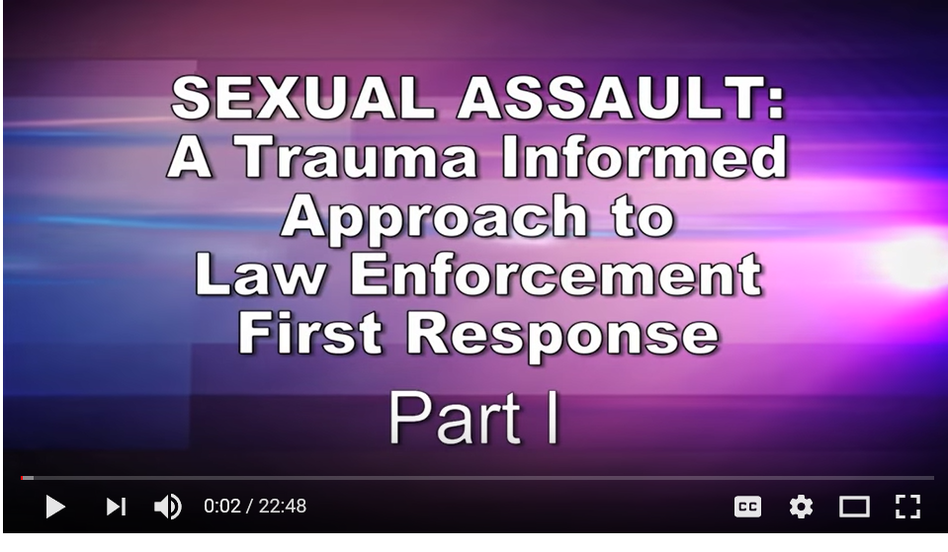
Video
http://youtu.be/gtWD1XJrhNo
Record one thing that surprised you and one time that you’ve seen a victim exhibit any of the trauma reactions you heard about in the video.

Slide 159
Discussion: Applying what you learned
What are the impacts of trauma on victims of violence?
Why is it important for law enforcement officers to understand how trauma can affect a victim?
What can you do differently now that you understand how trauma impacts victims of violence?

Slide 160
Questions and reflections

Slide 161
Module 4
Using What We Have Learned

Slide 162
Session 4.1
Taking Care of Ourselves: Identifying and Confronting Secondary Stigma and Stress

Slide 163
Objectives
Recognize and identify ways to counter the impacts of secondary stigma on law enforcement officers who work with members of KPs
Identify ways to counter the impacts of work-related stress

Slide 164
Secondary stigma
Stigma refers to the strong negative feelings or disapproval that is linked to a specific person, group, or trait.
Secondary stigma is directed toward those who support a stigmatized group. For example, health care workers who support people living with HIV can sometimes experience stigma from their family members.

Slide 165
Activity: Best response game
Being willing to stand up for and with marginalized groups takes bravery.
Trained officers will also be helpful in supporting each other.
The best response game allows you to think through scenarios of secondary stigma that could occur and come up with a response.

Slide 166
Self-care
Self-care is the intentional time taken by an individual to nurture themselves physically, mentally, spiritually, and emotionally on a daily basis.

Slide 167
Consequences of poor self-care
Mental health | Frustration, irritability, anxiety/fear, confusion, poor concentration, helplessness, hopelessness, depression, low morale, pessimism, compassion fatigue, guilt, etc.
Physical health | Stress-related illness (hypertension, ulcers, acid reflux/heartburn, skin rash, etc.); headaches, back pain, insomnia, and arthritis
Relationships (personal and professional) | Conflict, tension, misunderstanding, anger, emotional or physical abuse
Organizational health | Increased absenteeism, diminished productivity, team conflict, turnover

Slide 168
Recommendations for self-care
Be aware of our own emotional reactions and distress when confronting others’ traumatic experiences (know what traumatic material may trigger us).
Connect with trusted colleagues or other supportive people and talk about our reactions.
Maintain a balance between our professional and personal lives, with a focus on self-care (e.g., relaxation, exercise, stress management) to prevent and lessen the effects of workplace stress.

Slide 169
Discussion: Strategies for coping with stress
Turn to the person next to you and discuss:
What do you do when you’re feeling stressed?
Which of these activities do you think is most effective at helping you feel better?

Slide 170
Some examples of self care
Quiet walks by yourself
Little meditative periods (waiting for something, a cancellation of a session, a brief illness) are opportunities for a quiet, reflective, peaceful time
Time and space for meditation
Reading (spiritual, fiction, biographies)
Some light exercise
Opportunities to laugh in the company of cheerful friends
A hobby
Listening to music you enjoy

Slide 171
Activity: Stress relief

Slide 172
Questions and reflections

Slide 173
Session 4.2
Reflections on What We Have Learned and How to Integrate It into Our Work

Slide 174
Objectives
Identify and discuss specific “asks” of law enforcement going forward
Understand or create plans for continued engagement with key populations

Slide 175
What we are asking of each of you
Always
Treat all people with respect.
In the community
Caution when possible instead of arresting.
When arrest is required, arrest with dignity.
Don’t harass KP members (sexually, economically, emotionally/ psychologically, physically).
Do not confiscate condoms, lubricants, or sterile injecting equipment.
Share information on rights and police procedures whenever making an arrest.
When someone reports a crime
Don’t arrest the victim when someone comes to report a crime.
If you can prosecute, and the victim wants you to, do.
Help keep all victims safe.
Explain what is available and link each victim to desired services (e.g., PEP, emergency contraception, mental health and social services).

Slide 176
How we will support you
Continued training or expanded training that will occur for other officers
Any updates to police procedures
How supervisors will be tasked with supporting officers to implement what they’ve learned

Slide 177
Service directory
We invite everyone to add their name and contact information to a service directory that will be shared with members of key populations and those implementing HIV programs for key populations.
You do not have to add your name if you do not wish to.

Slide 178
Activity: Next steps
In regional or station-specific groups, fill out a table with the following information to plan your next steps.
Activity | With whom | When | Resources required | Possible challenges | Support needed

Slide 179
Session 4.3
Post-Test and Training Evaluation

Slide 180
Objectives
Assess newly acquired knowledge and attitudes
Provide feedback on the workshop

Slide 181
Session 4.4
Closing Ceremony and Final Words

Slide 182
Objective
Acknowledge participant effort and commitment

Slide 183
References
Baral SD, Poteat T, Strömdahl S, Wirtz AL, Guadamuz TE, Beyrer C. Worldwide burden of HIV in transgender women: a systematic review and meta-analysis. Lancet Infect Dis. 2013;13:214-22.
Beattie TS, Bhattacharjee P, Isac S, Mohan HL, Simic-Lawson M, Ramesh BM, et al. Declines in violence and police arrest among female sex workers in Karnataka state, south India, following a comprehensive HIV prevention programme. J Int AIDS Soc. 2015;18:20079.
Cortina LM, Rabelo VC, Holland KJ. Beyond blaming the victim: toward a more progressive understanding of workplace mistreatment. Ind Organ Psychol. 2018;11(1):81-100.
Decker MR, Crago AL, Chu SK, Sherman SG, Seshu MS, Buthelezi K, et al. Human rights violations against sex workers: burden and effect on HIV. Lancet. 2015;385(9963):186-99.
Decker MR, Lyons C, Billong SC, Njindam IM, Grosso A, Nunez GT, et al. Gender-based violence against female sex workers in Cameroon: prevalence and associations with sexual HIV risk and access to health services and justice. Sex Transm Infect. 2016;92(8):599-604.
Decker MR, Wirtz AL, Pretorius C, Sherman SG, Sweat MD, Baral SD, et al. Estimating the impact of reducing violence against female sex workers on HIV epidemics in Kenya and Ukraine: a policy modeling exercise. Am J Reprod Immunol. 2013;69 (Suppl 1):122-32.
van Dijk AJ, Herrington V, Crofts N, Breunig R, Burris S, Sullivan H, et al. Law enforcement and public health: recognition and enhancement of joined-up solutions. Lancet. 2019;393(10168):287-94.
Dunkle KL, Decker MR. Gender-based violence and HIV: reviewing the evidence for links and causal pathways in the general population and high-risk groups. Am J Reprod Immunol. 2013;69 (Suppl 1):20-6.
El-Bassel N, Gilbert L, Wu E, Chang M, Gomes C, Vinocur D, et al. Intimate partner violence prevalence and HIV risks among women receiving care in emergency departments: implications for IPV and HIV screening. Emerg Med J. 2007;24(4):255-9.
Finneran C, Stephenson R. Intimate partner violence among men who have sex with men: a systematic review. Trauma Violence Abuse. 2013;14(2):168-85.
Guadamuz TE, Wimonsate W, Varangrat A, Phanuphak P, Jommaroeng R, Mock PA, et al. Correlates of forced sex among populations of men who have sex with men in Thailand. Arch Sex Behav. 2011;40(2):259-66.

Slide 184
References (continued)
International Association of Chiefs of Police. Sexual assault incident reports: investigative strategies. Alexandria (VA): International Association of Chiefs of Police, 2005.
Janoff-Bulman R. Shattered assumptions: towards a new psychology of trauma. New York: The Free Press, 2010.
Joint United Nations Programme on HIV/AIDS. Prevention gap report. Geneva: Joint United Nations Programme on HIV/AIDS, 2016.
Lerner MJ, Simmons CH. Observer’s reaction to the "innocent victim": compassion or rejection? J Pers Soc Psychol. 1966;4(2):203-10.
Lerner MJ. The belief in a just world. In: Perspectives in social psychology. Boston: Springer, 1980. p. 9-30.
Link BG, Phelan JC. Conceptualizing stigma. Annu Rev Sociol. 2001;27(1):363-85.
Linkages across the Continuum of HIV Services for Key Populations Affected by HIV (LINKAGES). The nexus of gender and HIV among men who have sex with men in Kenya. Durham (NC): FHI 360, 2016.
LINKAGES. The nexus of gender and HIV among transgender people in Kenya. Durham (NC): FHI 360, 2016.
Lunze K, Raj A, Cheng DM, Quinn EK, Lunze FI, Liebschutz JM, et al. Sexual violence from police and HIV risk behaviours among HIV-positive women who inject drugs in St. Petersburg, Russia—a mixed methods study. J Int AIDS Soc. 2016;19(4 Suppl 3):20877.
Machtinger EL, Haberer JE, Wilson TC, Weiss DS. Recent trauma is associated with antiretroviral failure and HIV transmission risk behavior among HIV-positive women and female-identified transgenders. AIDS Behav. 2012;16(8):2160-70.
Mendoza C, Barrington C, Donastorg Y, Perez M, Fleming PJ, Decker MR, et al. Violence from a sexual partner is significantly associated with poor HIV care and treatment outcomes among female sex workers in the Dominican Republic. J Acquir Immune Defic Syndr. 2017;74(3):273-8.
Panchanadeswaran S, Johnson SC, Sivaram S, Srikrishnan AK, Latkin C, Bentley ME, et al. Intimate partner violence is as important as client violence in increasing street-based female sex workers’ vulnerability to HIV in India. Int J Drug Policy. 2008;19(2):106-12.

Slide 185
References (continued)
Schafer KR, Brant J, Gupta S, Thorpe J, Winstead-Derlega C, Pinkerton R, et al. Intimate partner violence: a predictor of worse HIV outcomes and engagement in care. AIDS Patient Care STDS. 2012;26(6):356-65.
United Nations General Assembly. Universal declaration of human rights. 1948 Dec 10 [Internet]. Geneva: United Nations Office of the High Commissioner for Human Rights. Available from: https://www.ohchr.org/EN/UDHR/Documents/UDHR_Translations/eng.pdf.
United Nations Office on Drugs and Crime, International Network of People Who Use Drugs, Joint United Nations Programme on HIV/AIDS, United Nations Development Programme, United Nations Population Fund, World Health Organization, et al. Implementing comprehensive HIV and HCV programmes with people who inject drugs: practical guidance for collaborative interventions (the “IDUIT”). Vienna: United Nations Office on Drugs and Crime, 2017.
Valentine SE, Peitzmeier SM, King DS, O'Cleirigh C, Marquez SM, Presley C, et al. Disparities in exposure to intimate partner violence among transgender/gender nonconforming and sexual minority primary care patients. LGBT Health. 2017;4(4):260-7.
Vedantam S. Why #MeToo happened in 2017. 2018 Feb 7 [podcast on the Internet]. Washington: National Public Radio (NPR); 2018. Available from: https://www.npr.org/2018/02/07/583910310/why-metoo-happened-in-2017.
Wheeler J, Anfinson K, Valvert D, Lungo S. Is violence associated with increased risk behavior among MSM? Evidence from a population-based survey conducted across nine cities in Central America. Glob Health Action. 2014;7(1):24814.
World Health Organization. Global and regional estimates of violence against women: prevalence and health effects of intimate partner violence and non-partner sexual violence. Geneva: World Health Organization, 2013.
World Health Organization. A conceptual framework for action on the social determinants of health: social determinants of health discussion paper 2. Geneva: World Health Organization, 2010.
World Health Organization. Guidelines for medico-legal care for victims of sexual violence. Geneva: World Health Organization, 2003.
Zulliger R, Barrington C, Donastorg Y, Perez M, Kerrigan D. High drop-off along the HIV care continuum and ART interruption among female sex workers in the Dominican Republic. J Acquir Immune Defic Syndr. 2015;69(2):216-22.

Slide 186
Stay Connected with LINKAGES
There are several ways to stay involved with LINKAGES’s work as well as new evidence, publications, and tools related to HIV prevention, care, and treatment among KP members and their partners.

Slide 187


Stay Connected with LINKAGES
Follow LINKAGES on Twitter:
www.twitter.com/LINKAGESproject
Like the project on Facebook:
www.facebook.com/LINKAGESproject
Subscribe to the LINKAGES blog
www.linkagesproject.wordpress.com
Subscribe to The LINK, LINKAGES’s quarterly
project e-newsletter
Check out LINKAGES’s quarterly research digest

Slide 188






Acknowledgments

