Slide 1
Session 8 Decentralized Drug Distribution of Antiretroviral Therapy in the Private Sector: Electronic Tools to Facilitate DDD (the DDD App, ORA, and DHIS2)
Using the standardized tools to strengthen data use and case management
Notes:
This session includes 3 tools that can be used to facilitate case management for clients receiving ART through DDD.

Slide 2
Learning objectives
By the end of this section of the session, participants will be able to:
Explain what the Decentralized Drug Distribution Application (DDD App) is
Describe the characteristics of the DDD App
Describe key functions of the DDD App, including reporting

Slide 3
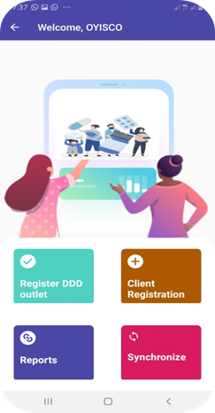
What is the DDD App?
The DDD App:
Is an online and offline platform accessible from a smartphone, tablet, or laptop
Enables interactive bidirectional communication and real-time data exchange between a public health facility “hub” and decentralized drug distribution (DDD) outlet in the community (e.g., private pharmacy)

Slide 4
DDD App characteristics
Has public health facility interface and DDD outlet interface
Documents services provided by DDD outlets to clients devolved from public facility
Includes inventory management of medications dispensed from hub health facility or central store
Has capacity to automate client reminders
Allows secure sharing of client information
Generates reports
Synchronizes data with the server
The DDD App facilitates effective delivery of antiretroviral therapy (ART).

Slide 5
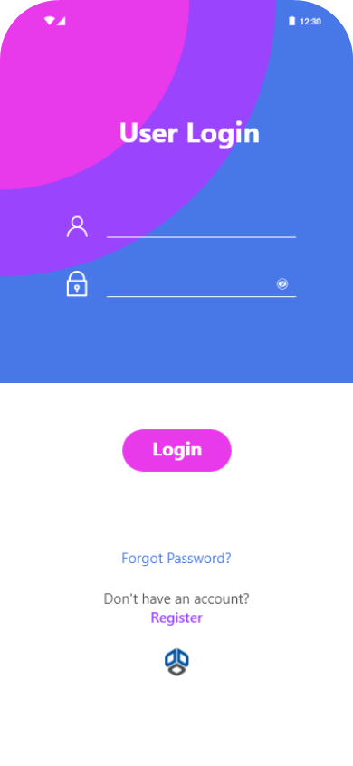
DDD App key functions: Health facility
DDD App allows users at health facilities to:
Create facility login
Register DDD outlets
Enter devolved client’s information
Manually for sites that use paper-based systems
By pulling data from electronic medical records (EMR) for sites that use them
Assign clients to DDD outlets
Manage drug dispensation to DDD outlets
Monitor activities in each DDD outlet
Use app data from outlets to complete client records where necessary
Synchronize data and generate reports

Slide 6
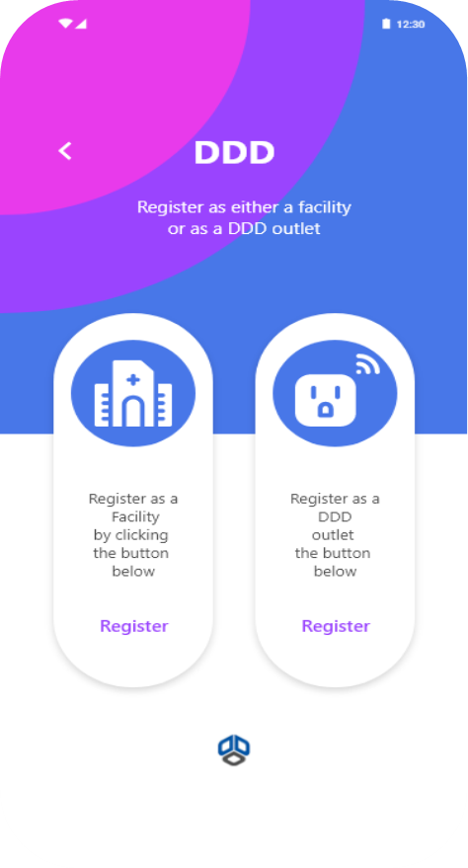
DDD App key functions: DDD outlet
The DDD App allows users at the DDD outlet to:
Receive activation code from facility
Log in using activation code and retrieve client information
Manage drug refills and review refill history for each client
Request, receive, and track drug use
Track appointments and send reminders to clients
Refer clients back to facility
Synchronize data and generate reports

Slide 7
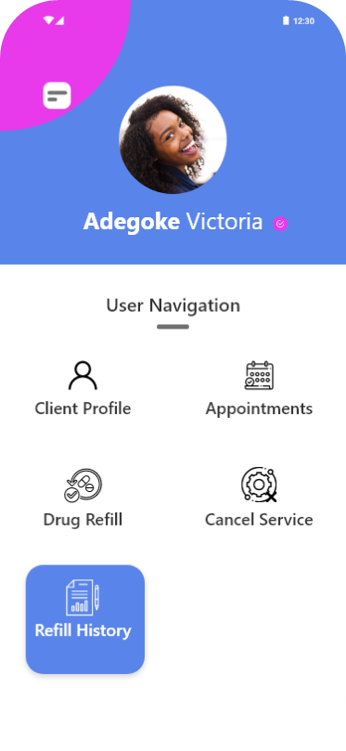
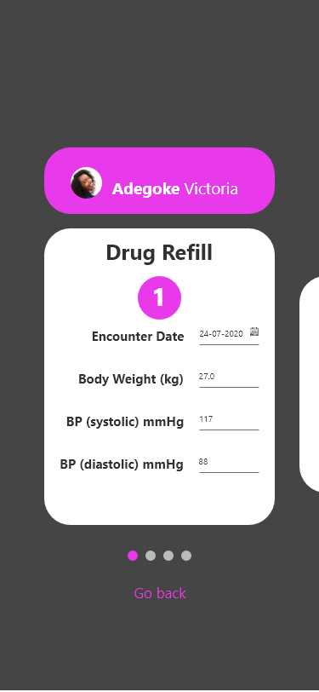
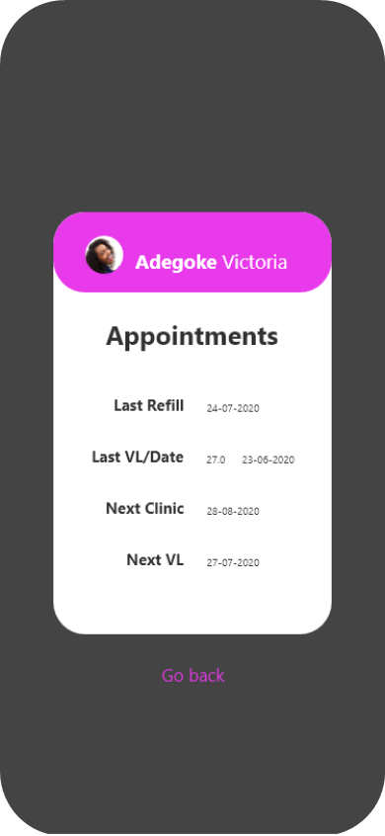
DDD App client profile
The app’s client profile consists of:
Contact information
Appointment schedule
Vitals
Date of last refill, last and next viral load test, and next clinic visit

Slide 8
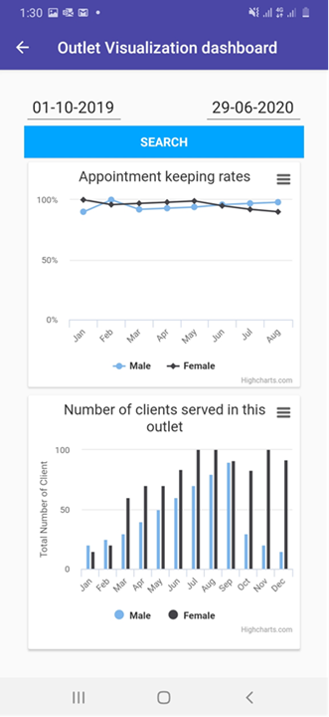
Data visualization with the DDD App
For data visualization, the DDD App:
Offers visualization of service delivery data for each DDD outlet in real time
Can be accessed by both hub facility and DDD outlet
Provides information on:
Appointment-keeping rates
Number of clients served

Slide 9
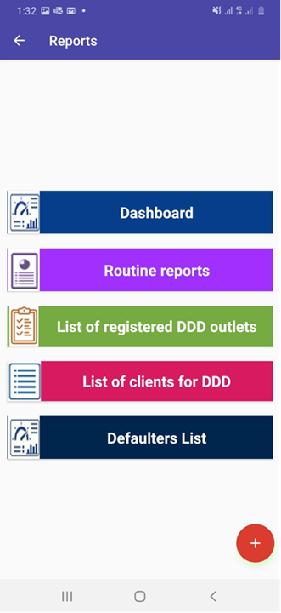
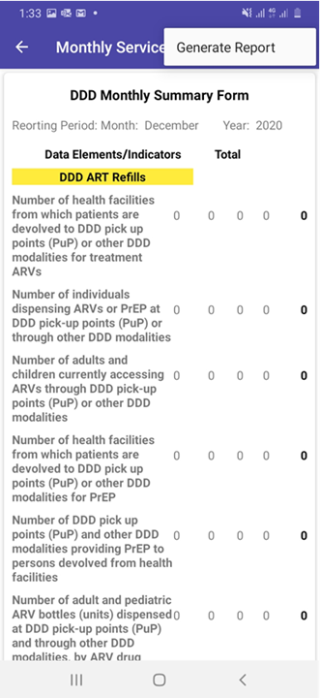
Generating reports and lists from the DDD App
Users can generate:
Monthly reports for activities at DDD outlet
Reports based on national indicators
Lists generated by the DDD App:
Registered DDD outlets
DDD clients
DDD defaulters

Slide 10
Examples of data reported from the DDD App
Examples of data reported through DDD App include:
Total number of clients devolved (cumulative and monthly)
Number of clients expected to pick up refills
Number of clients who refilled during the month
Number of clients who defaulted
Number of clients referred back to facility
Number of clients who returned to facility for scheduled review
Number of devolved ART clients eligible for viral load reassessment
Number of individual case safety report forms filled for devolved clients during reporting month

Slide 11
DDD App data security
Secure web hosting by recognized, high-capacity cloud-hosting vendors
Encrypts communication between server, DDD providers, and clients to ensure that data transmission cannot be intercepted
Any emerging vulnerabilities addressed regularly through app maintenance and updates
Secure login portal
Personal identifying information of clients removed in all exported data
Users trained on protecting privacy and handling exported data responsibly

Slide 12
Country adaptation of the DDD App
Routine reports matched to country reporting requirements
Country logos based on in-country branding guidelines
User able to select relevant country language
Cloud server/physical server for facilities without EMR can be managed by in-country health informatics officers/information technology specialists
Seamless plug-in and use by facilities with EMR
In the future, the DDD App will be available on Google Play and Apple Store for easy access.

Slide 13
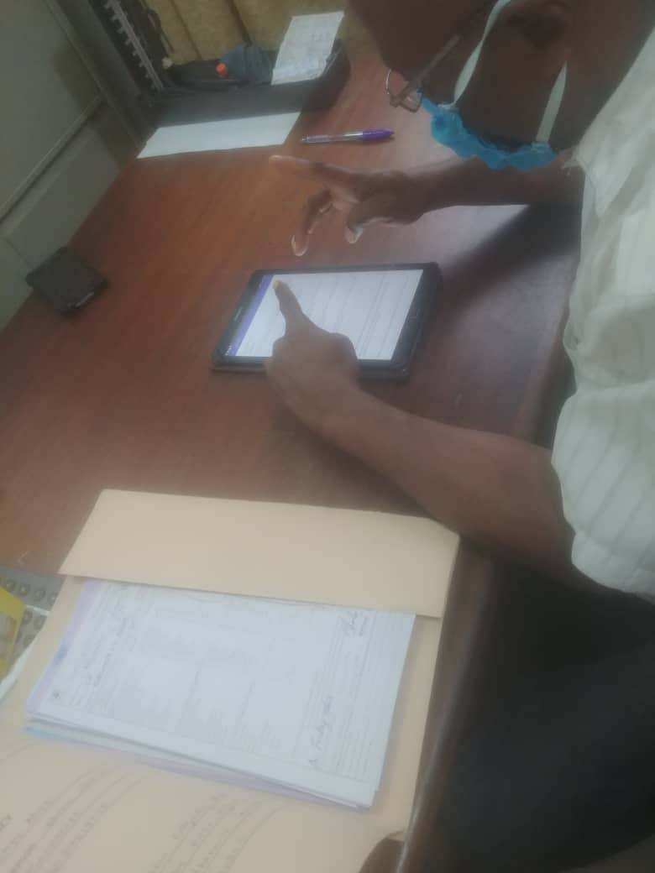
DDD App: Nigeria’s experience
Known as “CPARP Mobile”
Currently used in 44 community pharmacies with 2,773 devolved clients in Cross River State
Has helped to significantly reduce documentation gaps for devolved clients
Recurring challenges affecting synchronization of data between hub facility and community pharmacy:
Hub facility and community pharmacy staff forget to click on “synchronize” button
Poor Internet connectivity
Challenges being resolved by automated synchronization once connected to Internet, and tablets now Internet-enabled
On-site use of CPARP Mobile
Snapshot of CPARP Mobile in use at community pharmacy in Calabar, Cross River State, Nigeria

Slide 14
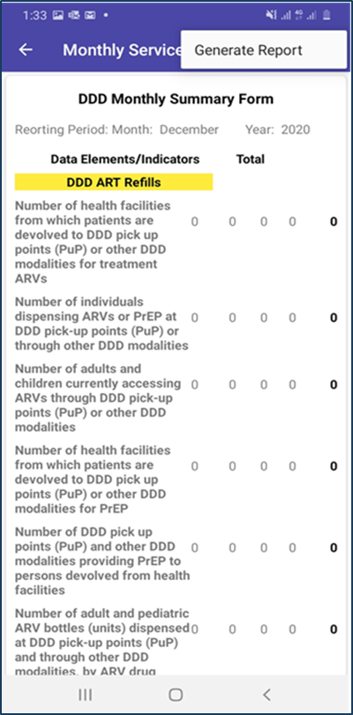
Activity
Practice reporting service delivery data using the DDD App.
Notes:
Note to facilitator: Provide guidance based on your country/program reporting requirements (as App data are customized based on country-specific indicators).

Slide 15
Summary
The DDD App supports efficient service delivery and client-centered care.
Offers seamless, synchronized interactive communication between public health facility and DDD outlet
Provides efficient data-capturing platform to document ART services provided by DDD outlets to clients devolved from public facility
Includes public health facility interface and DDD outlet interface
Works on smartphones, tablets, and computers
Has capacity for automated client reminders

Slide 16
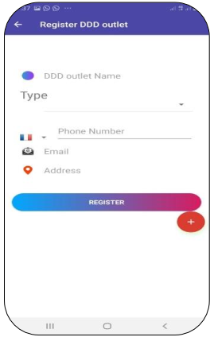
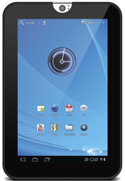
How to adapt the DDD App for your program
FHI 360 is currently using the DDD mobile application in Nigeria and Liberia
Nigeria is implementing the community pharmacy (CP), community ART refill club, and home delivery models, while Liberia is implementing the CP model.
Burundi and other countries are exploring use of the DDD App as part of the PODI model.
The DDD App can be downloaded from the Google Play and Apple Store or through a link FHI 360 can share.
Once downloaded, the DDD App is generically configured to accept local IP addresses for facilities with a local area network or manual data entry for those without EMR
Host on a cloud-based or local server
Customize for local needs e.g., add MOH logos, maps, select local language
Train front and backend users
Plan rollout and scale-up
FHI 360 can provide support for adaptation as needed.

Slide 17
Online Reservation and Case Management App (ORA)

Slide 18
Learning objectives
By the end of this session, participants will be able to:
Explain the Online Reservation App (ORA) and key characteristics
Describe how clients, providers, and program staff use ORA
Describe differences between ORA and DDD app (for DDD referrals and tracking)

Slide 19
What is ORA?
Developed in 2017 by LINKAGES Thailand project
A browser-based app (no download required)
FHI 360 manages app maintenance, upgrades, and buy-in; 27 countries investing in ORA in FY21
Supports online marketing and outreach, self-care pathway for clients to access health services, telehealth service delivery, remote case management, and private sector partnerships
ORA can be deployed as a country-specific app or multi-country deployment for cheaper/faster rollout (e.g., QuickRes.org)
Learn more: QuickRes Technical Guide
ORA application used by the EpiC HIV project in Vietnam available at SKConnect.org

Slide 20
Client functions
HIV and STI risk assessment
Appointment booking for all HIV-related services (including for HIV self-testing [HIVST] kits and many services via home delivery and virtual consultation)
Client referral tool
Live chat support
COVID-19 self-screening
SMS appointment reminders, follow-up, and notification of new diagnostic results (HTS/VL)
Video demo of several client-facing functions on QuickRes front-end. Play video above or click here.

Slide 21
Provider and program functions
Manage clinic appointments
Report service provision
Initiate WhatsApp chat/call with client
Decentralized service referrals and tracking (DDD)
Assign records to outreach and case manager staff
Track longitudinal ART and pre-exposure prophylaxis (PrEP) cohort
Track results from online campaigns and outreach
Create live data visualizations
Send SMS blasts to client cohorts
Set programmable client notifications
Video demo of several provider-facing functions on QuickRes (backend)

Slide 22
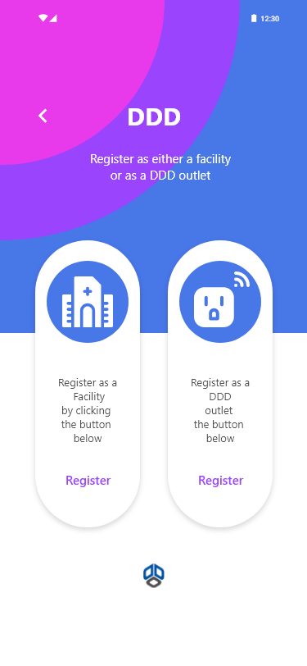
Strengths of the DDD App and ORA
DDD App
ORA
DDD-only solution
Suite of services
Only offers DDD referral and tracking capability
DDD referral and tracking are two of many online reservation and case management functions
Online + offline
VS
Online only
Can be used by facilities with intermittent Internet
Should be used by facilities with consistent Internet
Easier integration
Client booking
History of successful data exchange with EMR systems
Includes client interface for online booking
See slides notes for more detailed comparison.
Notes:
Similar functions
Facilitate referral and tracking of decentralized drug distribution between providers and DDD sites
Allows original provider to see confirmed distribution of ART/PREP by DDD site
Sends clients appt reminders
Unique to DDD
Requires app download
DDD-only solution
Offline data capture
History of integration
Detailed data sent to DDD site (client info, drug type/dosage)
Includes data visuals for DDD service delivery
Unique to ORA
Does not require app download (accessed on browser)
DDD among suite of services
Online only
Include client booking interface
Simple data shared with DDD site (ART or PrEP and days medication to dispense)
Does not include data visuals specific to DDD (but shows overall ART/PrEP delivery)

Slide 23
DDD referral and tracking on ORA
Original provider steps to refer client for DDD pick-up
Referred provider restricted access to complete reporting
Notes:
On the left hand side is a normal clinic view on ORA. They can view their client appts and for several services they can refer the client to pick them up from another provider on ORA. This includes for HIVST kit pick up, HTS, VL, STI testing and ART and PrEP pickup. When the first clinic selects a second clinic from the referral drop down, ORA will send an email to the provider at the second clinic to notify them of the referral and they will be given limited access tot view those appts and report the client’s service pick up
On the right hand side, the second clinic can login and view appts assigned to them, and only the services for which the client was referred. They can complete reporting by selecting “medication dispensed” and confirming the amount of ART/prep dispensed to the client.

Slide 24
Adapting ORA to your program
Contract FHI 360 to provide technical assistance on:
Assessing program needs and designing ORA adaptations
Developing user SOPs and training rollout
Supportive supervision and technical support
Contract developer (AD System Asia) to:
Copy ORA software onto your own server and website
Adapt ORA functions and data systems to align with program needs
HIV program will need to provide:
Local translations of ORA frontend text
Adapted ORA site branding/graphics
Details of all clinics, services, and users to add to ORA
Local SMS vendor with API (so ORA can send clients appointment reminders, follow-ups)
Devices (smartphones/tablets) and mobile data to allow backend users to access and use ORA
ORA rollout training for partners of the Open Doors Project in Zambia

Slide 25
Standardized DHIS2 Tracker Metadata Package for HIV Programs
Using the standardized DHIS2 tracker package to strengthen data use and case management

Slide 26
Learning objectives
By the end of this session, participants will be able to:
Explain what the DHIS2 tracker is
Describe the characteristics of the DHIS2 tracker
Describe key functions of the DHIS2 tracker, including reporting

Slide 27
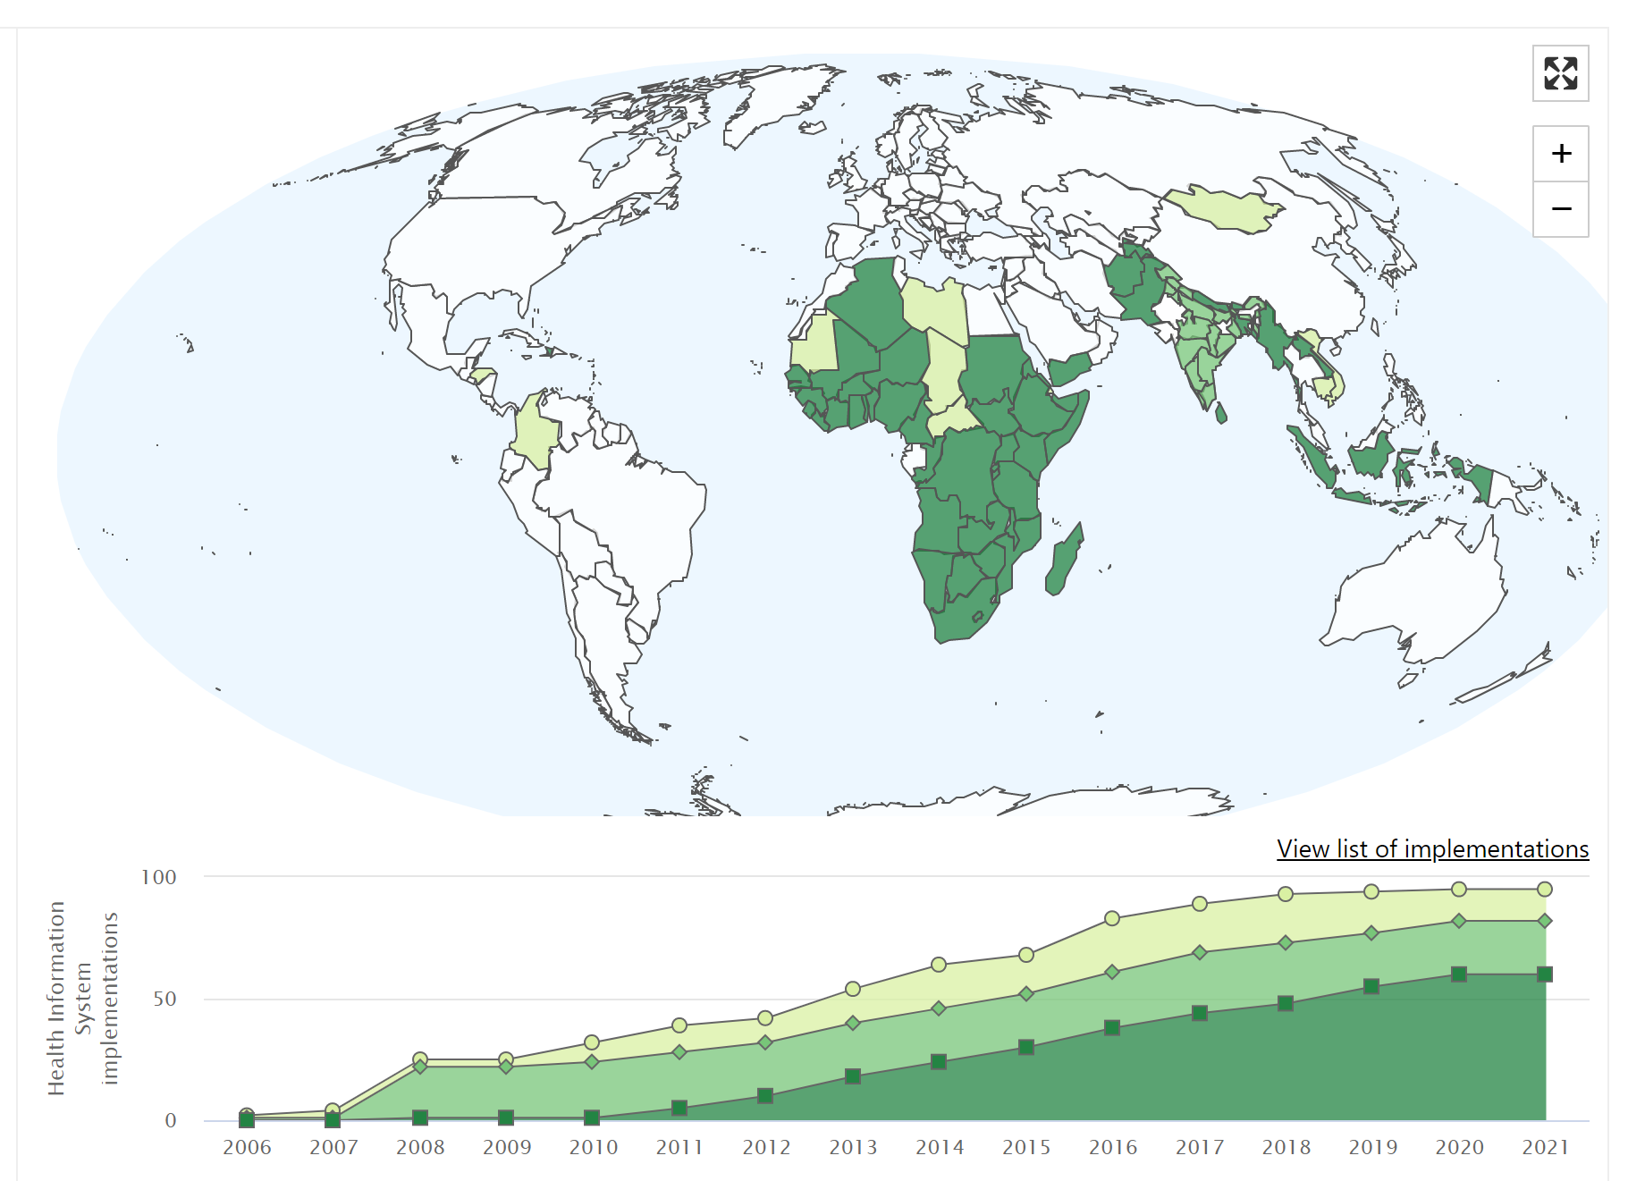
What is DHIS2?
Open-source health management information system (HMIS) platform
World’s largest HMIS platform
In use in 73 countries as a national HMIS and in 22 states in India
Supports aggregate, event, and individual- level data collection

Slide 28
Additional reasons to standardize
Global good software
Standardized, open-source format simplifies implementation and saves time and money
Integration and interoperability
Leveraging DHIS2—the most used HMIS platform globally—allows us to integrate with existing national DHIS2
Highly scalable
Supports alignment of metadata across projects, countries, and donors

Slide 29
Benefits of the Standard HIV Tracker Package
Comprehensive
Easy to adapt
Promotes data use
Simplifies reporting
One standardized system to collect data across the continuum of HIV services
Enables quick and cost-effective deployment across projects and countries
Supports better data use with a “collect once, use many” model, utilizing built-in functionality for tracking and case management
Reduces data entry burden by
automatically calculating common HIV indicators and storing them in a format appropriate for reporting

Slide 30
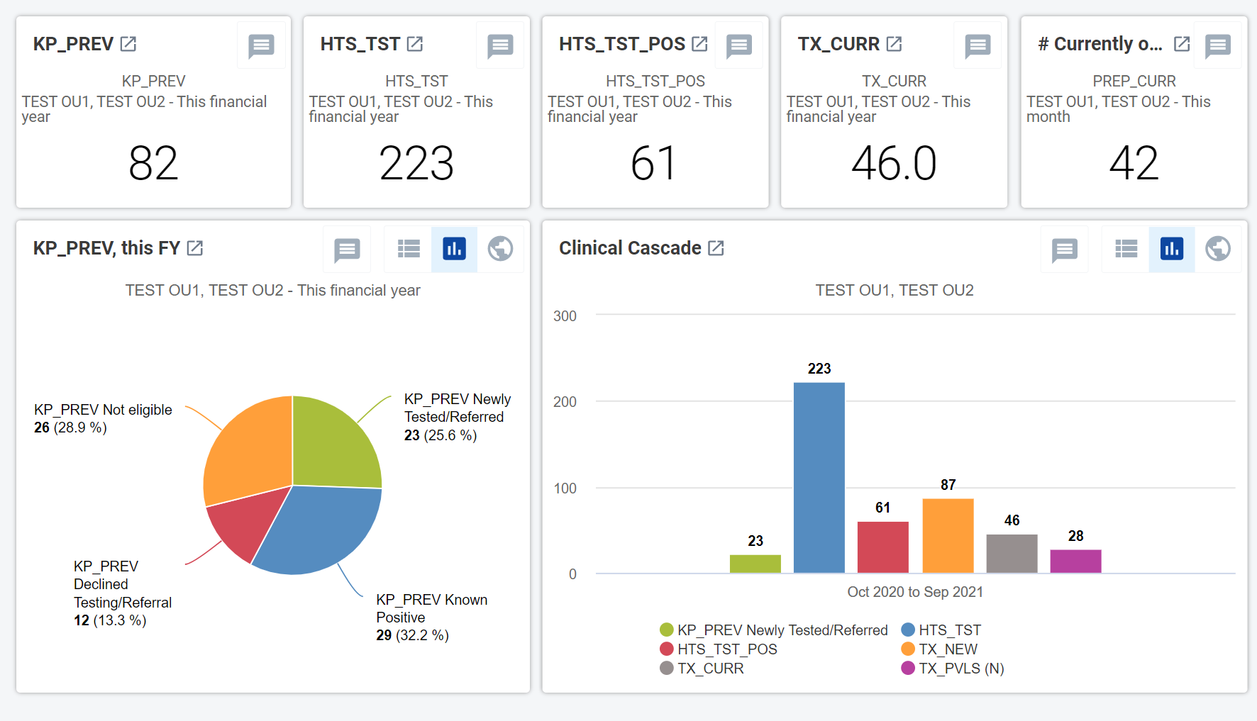
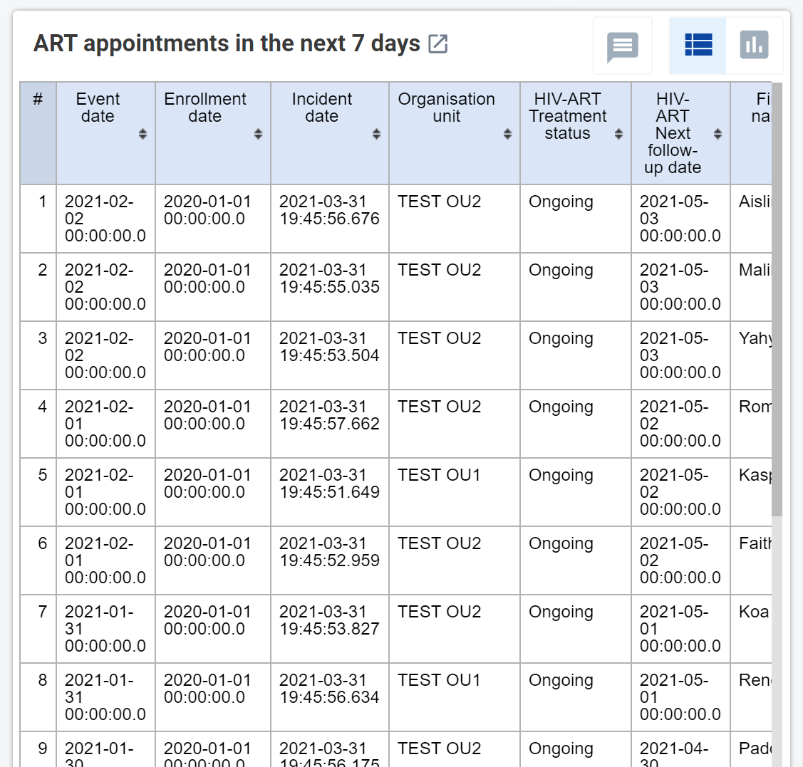
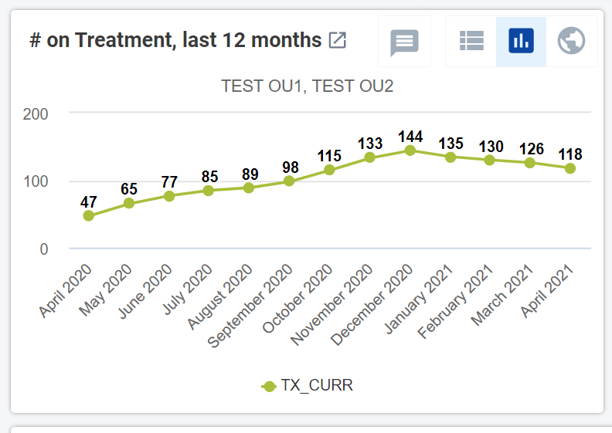
Components of the Standard HIV Tracker Package
Data collection
Reporting
Case management

Slide 31
HIV program service/data flow
HIV testing
Registration
Registration
ENROLLMENT
ART register
HIVST
Registration
Registration
Registration
Registration
Registration
Registration
Viral load
HIV +
ALL CLIENTS
HIV -
PrEP
Outreach and risk assessment
STI services
Violence and abuse disclosure
Cervical cancer
Enhanced peer outreach approach (EPOA)
TB screening
Medication-assisted treatment
All standard forms are fully customizable

Slide 32
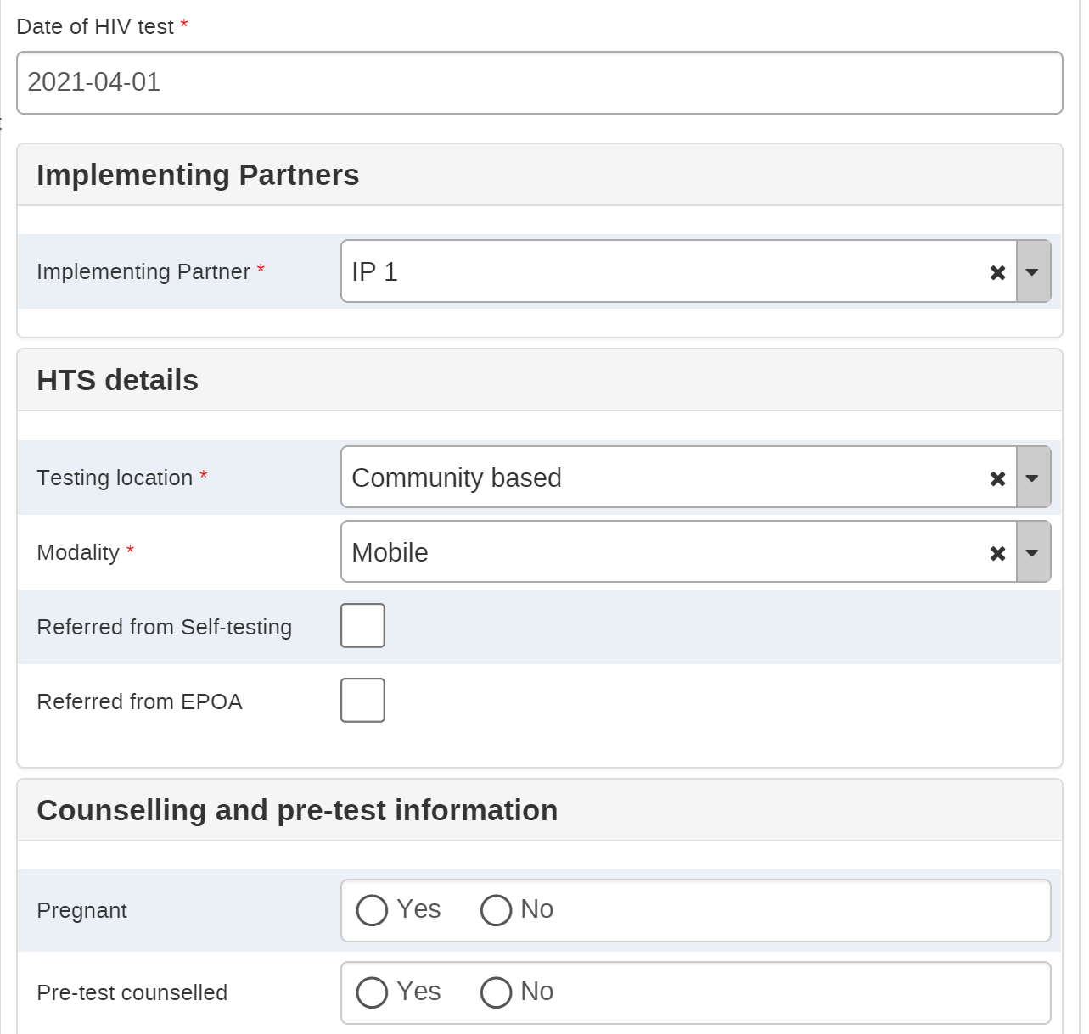
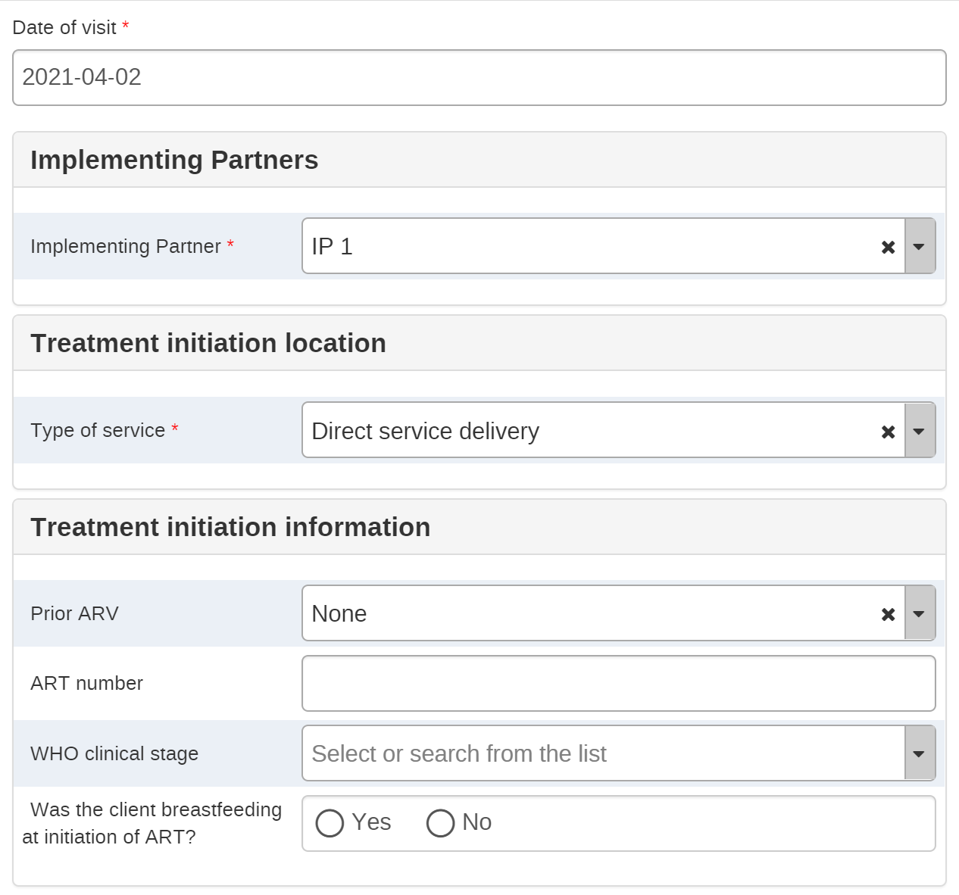
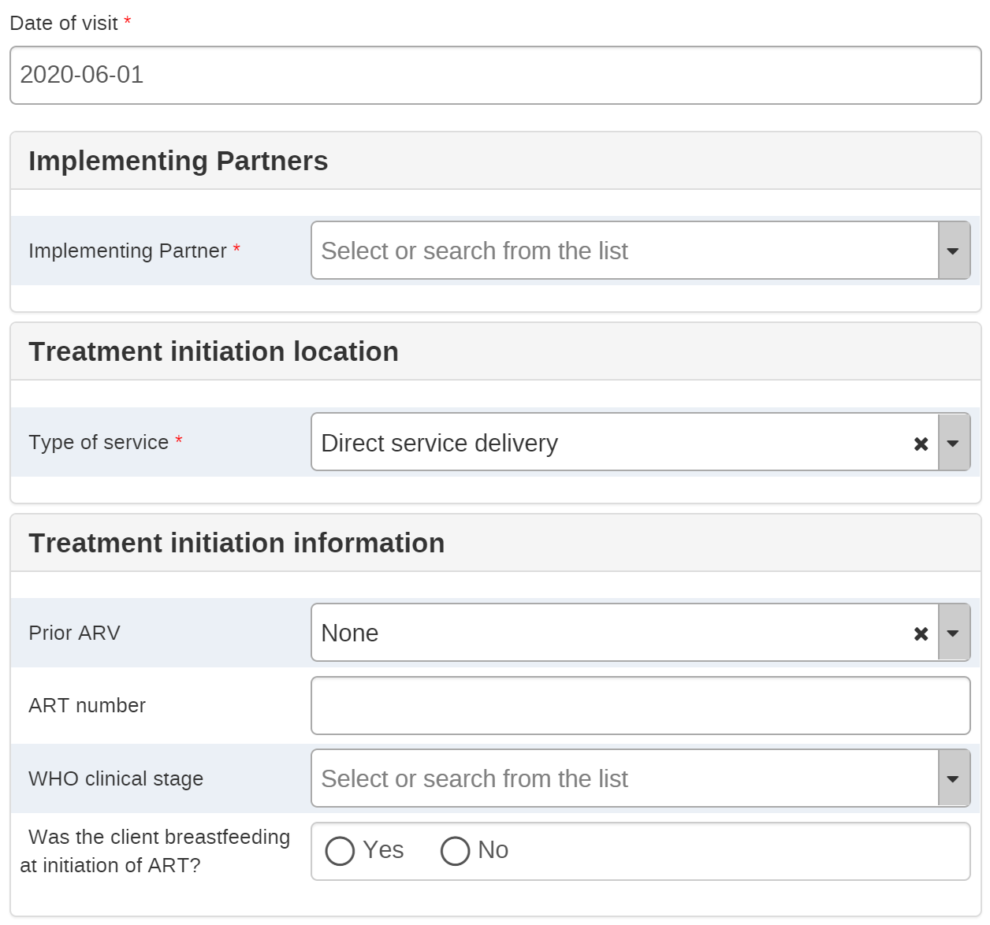
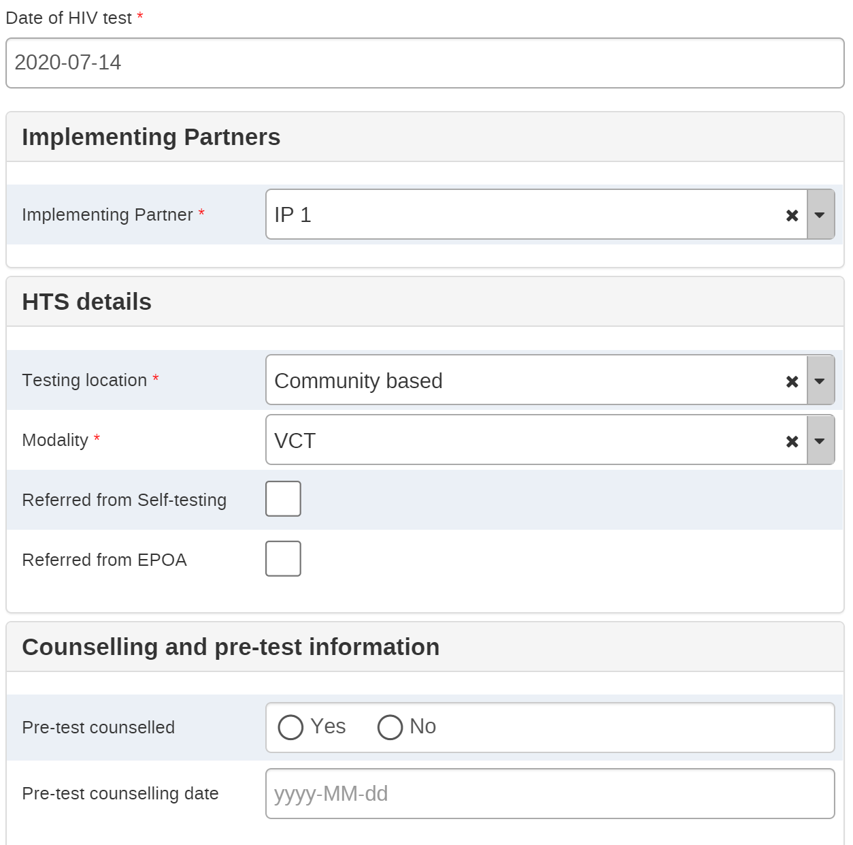
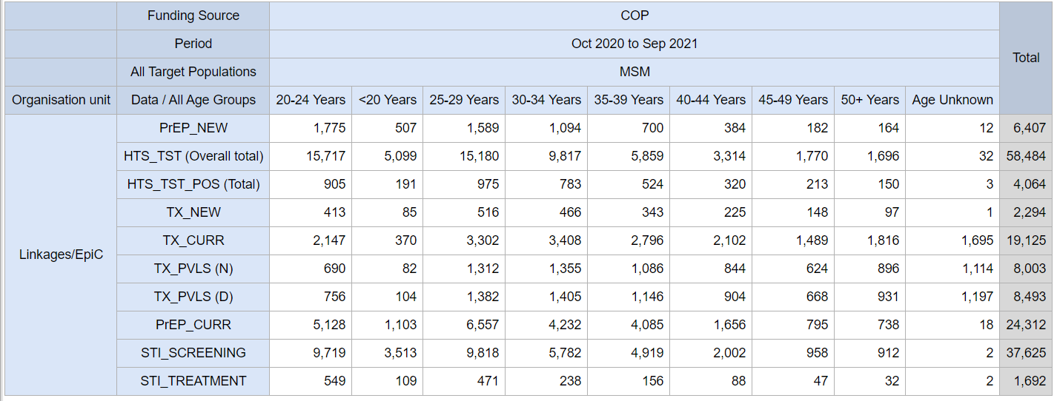
Reporting: Seamless transformation of individual-level data to indicators
Designed to capture and report on PEPFAR MER and custom indicators
70+ precalculated indicators, aligned with standard DATIM reporting format
Flexibility to customize to meet local reporting requirements

Slide 33
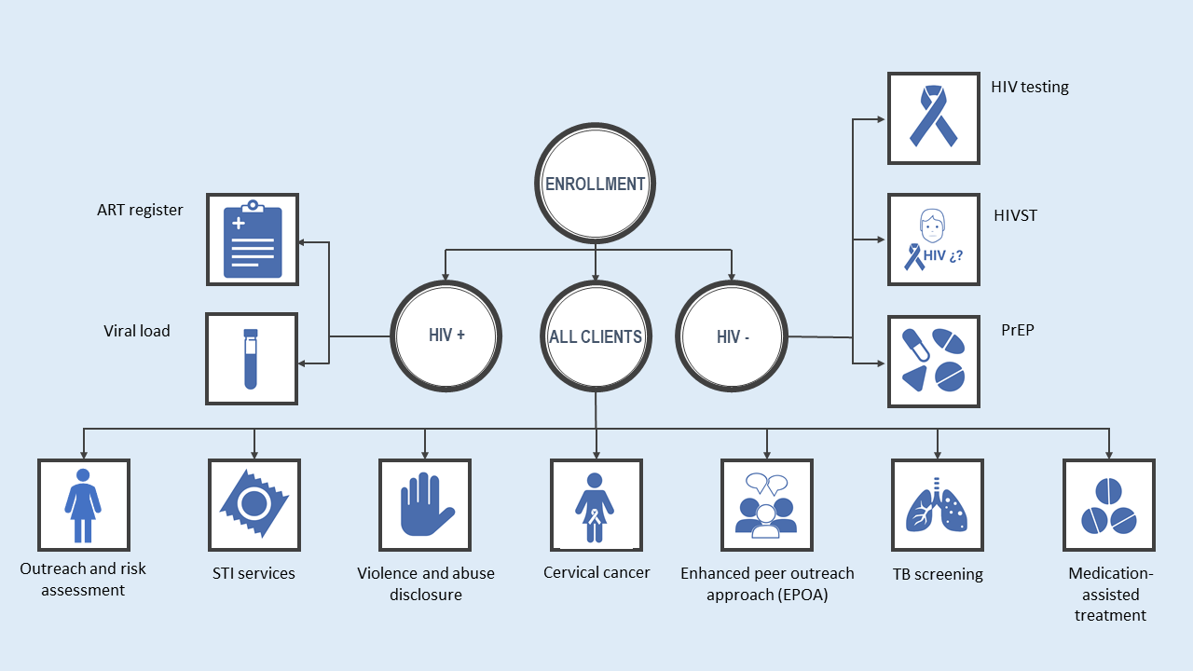
HIV Program
Other Supplementary Programs for Case Management
Peer Worker Program
Hot Spot Program
Index-testing Tool

Slide 34
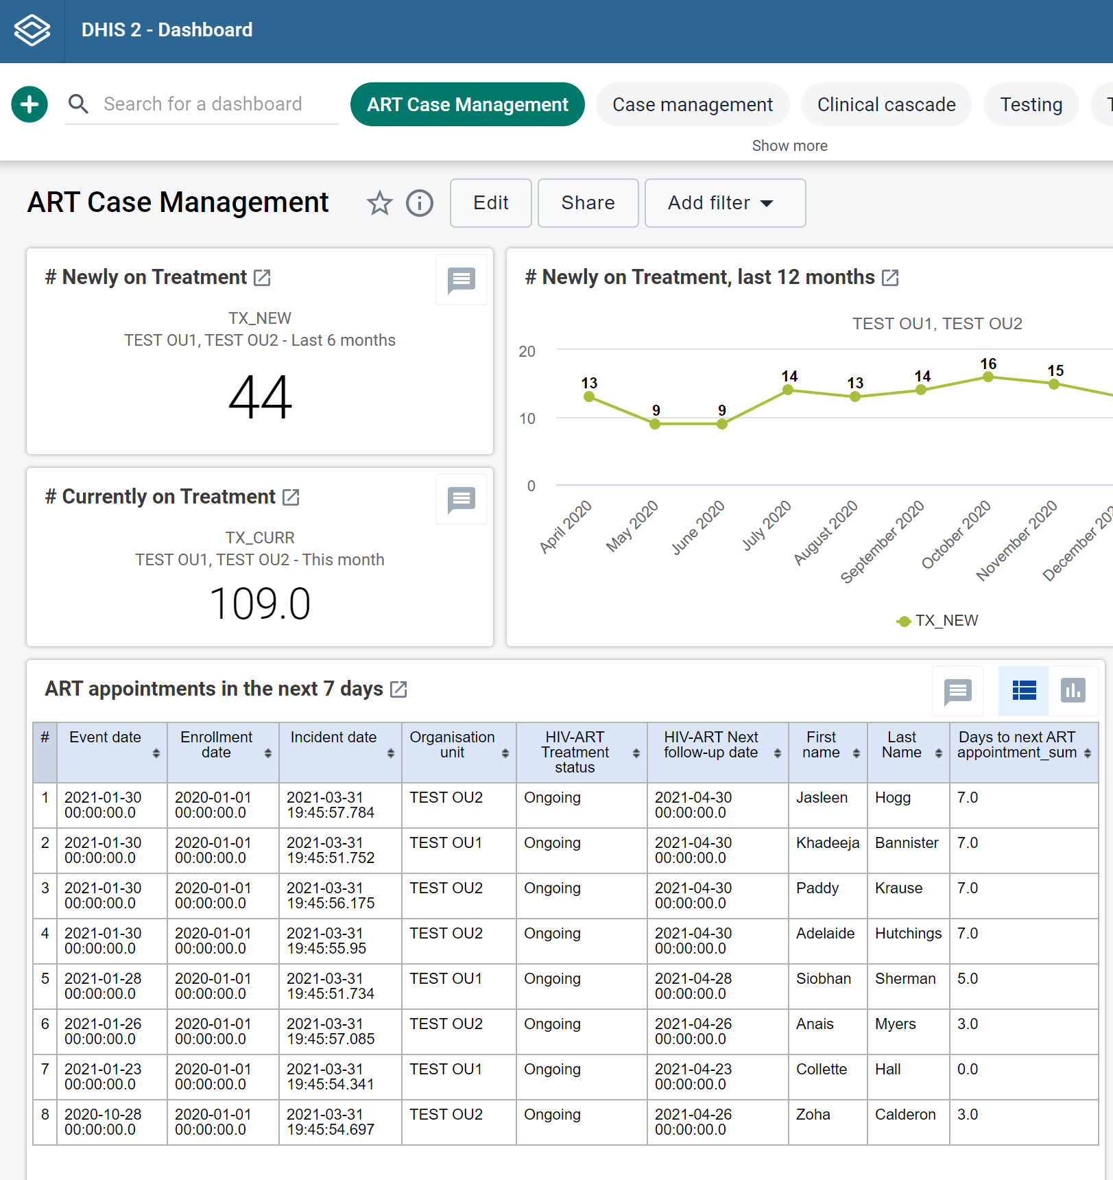
Case management dashboards
These built-in tools facilitate case management of individuals accessing HIV services, including:
Appointment scheduling
Peer worker management
Tracking of upcoming and missed appointments
Automated reports of clients who need ART or PrEP refills
Client reminders via SMS
Tracking of contact attempts for index testing
Tracking of peer worker performance
Daily achievement reports at hot spot, site, and national levels
Example of built-in dashboards to support case management

Slide 35
How to adapt the Standard HIV Tracker Package for your program
FHI 360 currently supports DHIS2 Tracker deployments in 12 countries
Standard HIV Tracker is currently being adapted for use in 7 additional countries
Can be installed on a standalone instance or integrated into an existing DHIS2 instance
Some experience with DHIS2 is needed for customization
Host locally or
on the cloud
Customize for local needs
Train front and backend users
Plan rollout and scale up
FHI 360 can provide support, or you can customize the open-source package on your own

Slide 36
How to adapt the DDD App for your program
FHI 360 is currently using the DDD mobile application in Nigeria and Liberia
Nigeria is implementing the community pharmacy (CP), community ART refill club, and home delivery models, while Liberia is implementing the CP model.
Burundi and other countries are exploring use of the DDD App as part of the PODI model.
The DDD App can be downloaded from the Google Play and Apple Store or through a link FHI 360 can share.
Once downloaded, the DDD App is generically configured to accept local IP addresses for facilities with a local area network or manual data entry for those without EMR
Host on a cloud-based or local server
Customize for local needs e.g., add MOH logos, maps, select local language
Train front and backend users
Plan rollout and scale-up
FHI 360 can provide support for adaptation as needed.

