Slide 1
Session 7 Decentralized Drug Distribution of Antiretroviral Therapy in the Private Sector: Recording and Reporting Service Delivery Data

Slide 2
Learning objectives
By the end of this session, participants will be able to:
Describe the information that needs to be collected and reported
Explain how and when to report the data
Describe how to use DDD data for decision-making

Slide 3
What are service delivery data?
Service delivery data:
Are data collected during or related to provision of services to clients
At national level, support decision-making related to health system functions
At program level, support decision-making related to program implementation

Slide 4
Sources of service delivery data
Routine health facility reporting system is most common source of information and traditionally required for public sector health facilities, but not private facilities
Routine health facility reports include regular facility data reported to regional and national levels by service providers
Private facilities participating in DDD of ART required to collect and report service delivery data
Data collection/reporting can be paper-based or electronic (electronic systems easier to manage)

Slide 5
Sources of service delivery data (cont.)
Other data sources include health facility census and health facility surveys:
Conducted by governments
Most useful at national level (not program level)
Include both public and private facilities
Labor intensive and expensive
Conducted with long intervals between each census/survey

Slide 6
Data collection forms
Forms for recording/collecting client data
Individual patient or client records (including electronic records)
Prescription
Referral forms
DDD service delivery checklist (adherence counseling, tuberculosis [TB], adverse drug reaction [ADR] screening)
ADR reporting forms
Forms for recording/collecting supply chain data
Stock cards
Daily ART registers
Monthly stock status report forms

Slide 7
Paper-based records vs. electronic records
Paper-based record system | Electronic medical record system
Requires additional staff and time (e.g., to handle and organize documents/files) and adequate storage space | Requires less staff and time, and no physical storage space, but needs computers (and electricity) or tablets
Seems less expensive initially (i.e., no upfront cost) but is more expensive over time (ongoing investment of staff time required to maintain paper records) | Has high initial cost but becomes significantly less expensive over time
Is sometimes illegible (as everyone’s handwriting is different) | Is easy to read, since typed data are always clear
May delay access to data (requires physically locating the documents) | Ensures instant access to data
Has limited space to write everything down | Provides unlimited space to document client encounter

Slide 8
Uses of service delivery data (general)
In general, service delivery data are used to:
Determine whether a program is on schedule with planned activities
Assess whether a policy, plan, or program has produced desired impacts
Make data-driven decisions
Identify programmatic gaps, factors that influence health outcomes
Make changes to improve program/maximize impact
Inform policy, planning, or program decisions

Slide 9
Uses of service delivery data (in DDD of ART)
For DDD models, service delivery data are used to:
Evaluate effectiveness of intervention by determining if intervention objectives (e.g., improving retention, improving adherence) are being met
Measure access and utilization trends, including how many clients are enrolled and their geographical distribution
Facilitate planning by projecting future numbers of DDD enrollment and potential resources required (e.g., additional training, increasing number of DDD outlets)
Identify gaps in implementation and develop action plan to address gaps

Slide 10
Data collection for DDD of ART
Relies mostly on tools used for ART services in public facilities
Additional tools developed for collection of DDD-specific data
Depending on program, service data collected manually or electronically
Examples of data:
Service utilization data
Lab data (e.g., viral load)
Commodities data (antiretroviral quantities received/dispensed)
Examples of data sources:
Client files with clinical notes
Laboratory test results
Service registers
ART dispensing registers, monthly drug utilization reports

Slide 11
Uses of DDD service data for decision-making
Support service delivery, e.g., to identify defaulters for tracing and possible TB cases, detect ADRs
Support/inform supply chain decisions
Effectiveness of drug management systems (distribution)
Anticipate and prevent drug stock outs
Monitor progress of clients devolved into DDD of ART
Assess effectiveness of demand-creation activities
Evaluate effects of DDD on retention and client satisfaction
Inform expansion plans/options (e.g., new target health facilities, new DDD outlets)

Slide 12
Challenges in data collection and reporting
Challenges | Possible Solutions
Data collection/reporting forms too complex | Simplification of data collection and reporting forms
Too much data to collect and report | Refine based on key indicators
Frequent stock outs of data collection/reporting forms | Procure sufficient stock, monitor stock levels, and reorder on time
Lack of written data collection and reporting guidelines | Develop written guidelines (e.g., data management and procedures manual)
Staff required to complete too many different forms with some data duplication across the forms | Consolidate forms to minimize number and eliminate duplication; switch to electronic system if feasible
Reporting frequencies and deadlines vary for different sets of data | Harmonize frequencies and reporting deadlines
Staff lack skills for data collection/reporting | Organize training and supervision for relevant staff
Lack of motivation | Ensure staff understand how data contribute to decision-making; introduce motivation mechanism

Slide 13
Key DDD of ART service delivery data to be collected
Data collected at health facility and DDD outlet
May be disaggregated by age, sex
Key data collected include:
Number of health facilities devolving clients to DDD
Number of DDD outlets providing services to devolved clients
Number of clients devolved to DDD outlet
Number of devolved clients who pick up ARVs from DDD outlet
Quantities of medicines dispensed
Viral load status for clients on DDD
Clients lost to follow-up, clients who missed last pick-up appointment

Slide 14
Data collection and reporting: Summary
Data should be collected by all health workers while performing day-to-day duties
Collection of essential health data required for decision-making
Data processing and analysis begins at point of collection
Keep system simple to operate and maintain

Slide 15
Country-specific data collection and reporting tools
Discuss country-specific DDD tools used
Discuss how and when to report
Include discussions on DDD app

Slide 16
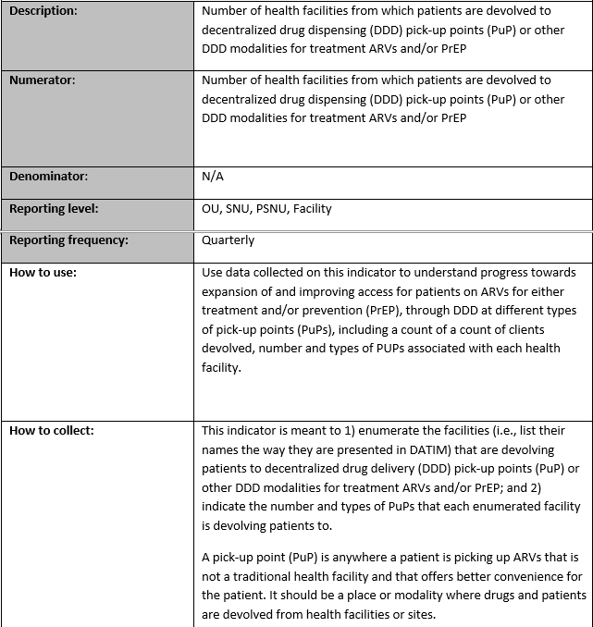
Activity: Indicators (i) DDD_HF
Review with participants the need to report DDD activities
Present the indicator reference sheet and ask participants how this indicator can be reported in their setting

Slide 17
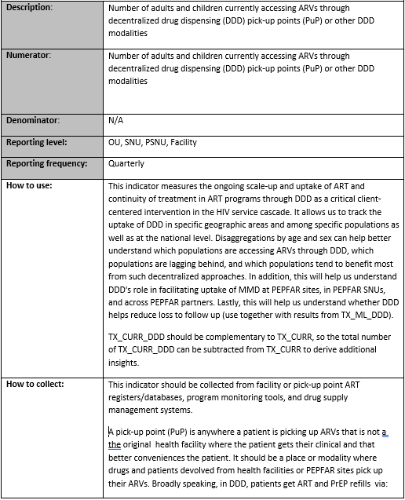
Activity: Indicators (ii) DDD_HF
Review with participants the need to report DDD activities
Present the indicator reference sheet and ask participants how this indicator can be reported in their setting
Ask participants to mention the different pick-up points that can be reported

