Slide 1
Session 4
Decentralized Drug Distribution of Antiretroviral Therapy in the Private Sector: Inventory Management

Slide 2
Learning objectives
By the end of this session, participants will be able to:
Discuss the components of drug supply management
Explain procurement and its principles
Discuss inventory management and storage principles
Name stock management tools

Slide 3
Drug supply management
Medicines are part of the national pharmaceutical supply system in many countries.
Drug supply management:
  Ensures medicines and supplies available to clients at right time, place, and cost, and in right quantity, quality, and condition
  Requires careful product selection, procurement, storage, and distribution
  Subject to same structural, financial, and human resource constraints as all products reliant on supply system

Slide 4
Drug management cycle
Management support Organization, financing, information management, human resources
Selection
Procurement
Storage and distribution
Use

Slide 5
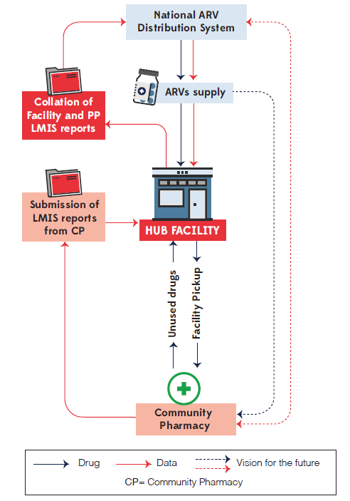
Including DDD outlets in supply chain
Illustrative logistics system
Ensure ARV availability in private sector through adjustments to supply chain. Options are:
  Supplied by national/regional distributor
  Supplied by public health facility (hub) to its affiliated private sector facilities (spokes)
  Purchased directly by private sector providers
Plan for sustainability of DDD approaches
  Advocate for and facilitate increase in health insurance coverage for people living with HIV
  Explore ways to make ARVs more affordable in private sector

Slide 6
Quantification
Quantification is the process of estimating medicine needs over specified time period.
Factors influencing the quantity of drugs include:
  Population served by health facility
  Disease pattern and seasonal variations
  Stock on hand
  Monthly rate of drug consumption (existing patients)
  Projections for number of new patients to be enrolled over specified period
  Delivery schedule and time lag between placing and receiving orders (lead time)
  Quantity of drug product serving as signal for re-ordering

Slide 7

Quantification (cont.)
Maximum quantity of drugs held in stock determined by:
Delivery schedule
Lead time (days, weeks, months) affected by transportation challenges (e.g., poor road conditions due to weather) or international supply chain disruptions (e.g., due to COVID-19)
Availability of drugs and resources needed for delivery
Size of storage space available
Number of clients served

Slide 8
Drug source and ordering
Source of drugs may be hub facility or central/regional medical stores
Discuss country-specific SOP for ordering
  Timing/schedule
  Quantification
  Transportation
  Authorization
  Receiving
  Reporting

Slide 9
Receiving stock (ordered vs. delivered)
Requires great attention to detail
New stock must always be inspected on arrival to ensure that:
  Stock received matches stock ordered
  Correct quantity received, corresponds with documentation—delivery note and invoices
  Stock received in good condition—not damaged, expired, or with early expiry date (unless previously agreed)
  Timely follow-up can be conducted for any items not delivered

Slide 10
Warning signs of quality/safety issues
When inspecting new arrivals, look for:
Discolored medicines, which may indicate deterioration and should not be accepted
Presence of particles that reflect light (cloudiness) in solutions for injections or liquid formulations (unless specified otherwise)
Broken or opened containers, half-filled or leaking bottles
Wet or soiled outer boxes
Presence of unsealed or unlabeled items, which are illegal and unethical to use
All of the above contribute to quality assurance!

Slide 11
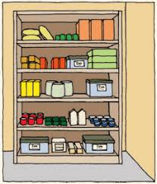
Storage and display of medicine stock
Products should have both manufacturing and expiry dates.
Stock should be shelved based on expiry date.
Use the first expired, first out (FEFO) principle, placing product with the earliest expiry date in the front row of the shelf.
Apply first in, first out (FIFO) principle for products without an expiry date.

Slide 12
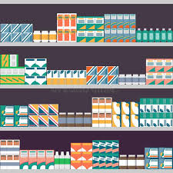
Storage and display of medicine stock (cont.)
Stock should be stored off the floor, on shelves, in locking cabinets.
A range of environmental conditions for storing medicines should be available (e.g., refrigeration, dark place, low humidity, proper ventilation).
Good housekeeping requires regular inspection and disposal of any expired or damaged stock.

Slide 13
Checklist for storage area
Is there a separate storage space or room?
Is the storage room well ventilated?
Is the storage room free of moisture?
Is storage room clean and free of spills?
Are medicines protected from exposure to sunlight?
Are medicines classified properly?
Are medicines arranged using FEFO and FIFO?
Do stock cards exist for every medicine?
Are stock cards checked against physical stock and updated regularly?

Slide 14


Stock management tools
Primary tools:
  Stock/bin cards
  Inventory form
Additional tools:
  Drug registers
  Computerized systems
  Invoice, delivery notes
  Cash sales and receipts

Slide 15
Stock card procedures
  Fill out card for each medicine upon receipt or when replenished:
      Information about item: name, form, strength, pack size
      Information about stock: price, stock levels, expiry date, supplier code/name
      Enter quantity of opening stock in the “In” and “Balance” columns
      Enter quantity of any new stock in the “In” column, with date, price, supplier, and delivery or invoice number
      Enter balance of stock brought forward and the date in the
      “Balance” column
  Attach stock card to front of shelf or container

Slide 16
Stock card procedures (cont.)
Update card every time drug received or issued
When issued, record to whom drug was issued, quantity issued (in units), date, and reference number of order and/or invoice (if applicable)
Always enter quantity of drug issued in the “Out” column
Always enter balance of remaining stock and date in the “Balance” column
Always use generic names to avoid duplication of bin cards when different brands of same drug are available

Slide 17
Physical inventory
  Count number of each type of product in facility by dosage, form, and strength to enable:
  Ensuring stock on hand equals what is listed in stock-keeping records
  Identification of drugs soon to expire or already expired
  Detection of losses through damage or pilfering
  Include in monthly reporting
  Complete physical inventory:
  All products counted at same time
  Should be done at least once a year (in large warehouses) and monthly in health facilities and pharmacies
Cyclic/random physical inventory counts selected products on rotating basis so that all products counted by the end of the cycle.

Slide 18
Key documents in ARV reporting
ARV pick-up registers for individual clients
  Record each pick-up of ARV refill by client
  Used to track patient adherence and can be used to track missed doses
  Included in client’s clinical records
Daily ARV dispensing registers
  Record all ARVs picked up by clients daily: client information (including client number, age, etc.), regimens, and quantity dispensed
  Provide information for monthly summary reports

Slide 19

Key documents in ARV drug use reporting (cont.)
Monthly ARV consumption summary reports
  Enable resupply from higher level of supply chain
  Capture details on number of clients and quantity of drugs dispensed by therapeutic regimen and formulation
  Summarize quantities received during month, quantity dispensed, and stock on hand

Slide 20

Activity: Reporting forms
Discuss and practice completing the reporting forms based on country/program requirements.
Notes:
Note to facilitator: This activity is to be conducted during facilitated session online or during face-to-face training.

