Slide 1
Session 1
Decentralized Drug Distribution of Antiretroviral Therapy in the Private Sector: Introduction to the Models

Slide 2
Learning objectives
By the end of this session, participants will be able to:
Explain the rationale for decentralized drug distribution (DDD) of antiretroviral therapy (ART)
List the various DDD of ART models
Explain the advantages of different DDD of ART models
Describe the steps for implementing selected DDD models
Describe the key factors in the success of each model
Describe modifications to DDD of ART models in the context of COVID-19

Slide 3
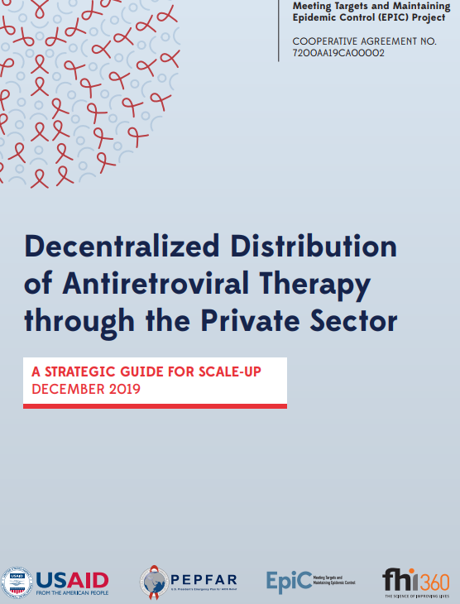
Introduction
DDD is a process that enables people living with HIV to receive their HIV medications outside of health facilities.
Before completing this session, participants should familiarize themselves with DDD by reading Decentralized Distribution of Antiretroviral Therapy through the Private Sector.

Slide 4
Why to involve the private sector in ART distribution
High HIV burden and the test-and-start approach to treatment led to:
  Growing cohort of stable clients on ART at public facilities
  Increased strain on already weak health systems
  Overcrowding at public facilities
  Further strain on limited staff
HIV services currently provided mainly at public health facilities and by nongovernmental organizations, with limited private sector participation
Long distances to health facilities and long waiting times discourage access and lead to loss to follow-up
With reductions in donor funding, governments will not be able to sustain HIV services

Slide 5
Why to involve the private sector in ART distribution (cont.)
Private sector has untapped potential and can address client needs by offering:
  Greater choice, convenience
  Confidentiality, reduced stigma
  High quality
Private sector can free up public sector resources and increase capacity to care for clients most in need, including:
  Newly enrolled clients
  Clients with comorbidities, treatment complications, or treatment failure
Growing number of clients able and willing to pay for services (see links on Nigeria’s experience):
  Mbachu, et al. 2018. Willingness to Pay for Antiretroviral Drugs among HIV and AIDS Clients in South-east Nigeria
  Nwobi, et al. 2017. Willingness to Pay for Highly Active Antiretroviral (HAART) Drugs and HIV Treatment Monitoring Tests among People Living with HIV/AIDS in Enugu State, Nigeria

Slide 6
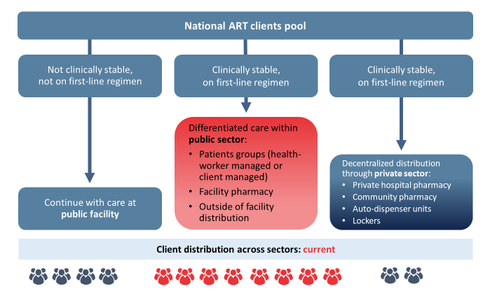
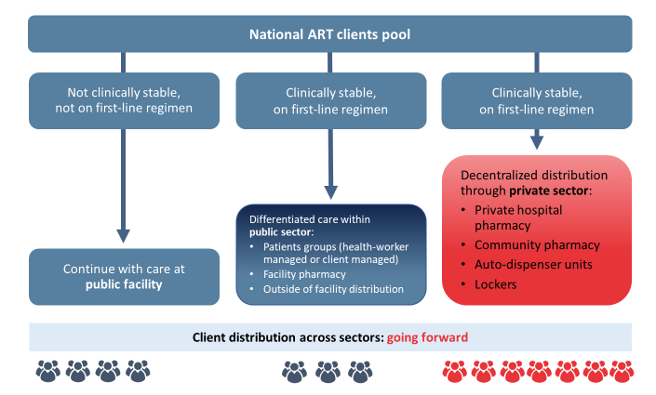
DDD: Vision for the future
Stable clients devolved into the private sector/community
Increased public-private partnerships
HIV services increasingly client centered
Sustainability achieved when clients may access antiretrovirals (ARVs) from the private sector if able and willing to pay

Slide 7




Activity
Do you know of any private facilities/outlets in your geographic area/community that provide HIV services?
If yes, what HIV services do they provide?
Notes:
For virtual training/self-learners: answer these questions before moving to the next slide.
For in-person training:, facilitator, record the answers on the flipchart.

Slide 8
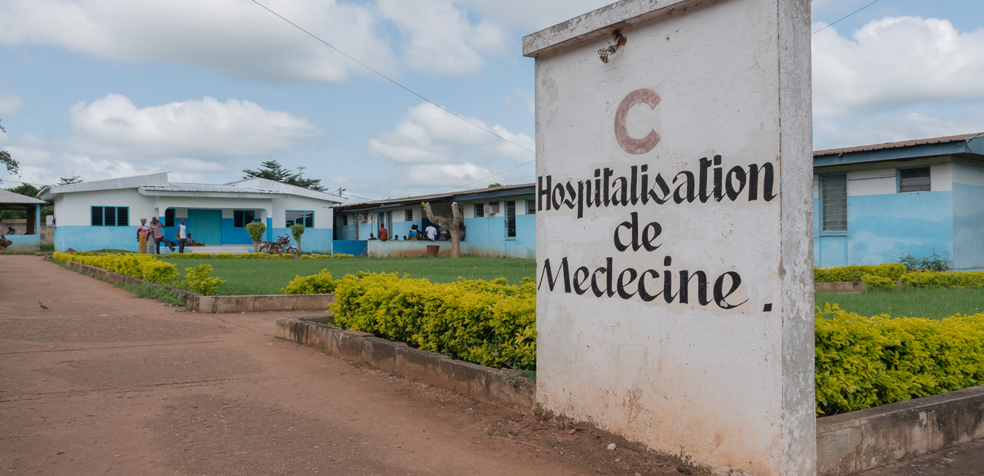
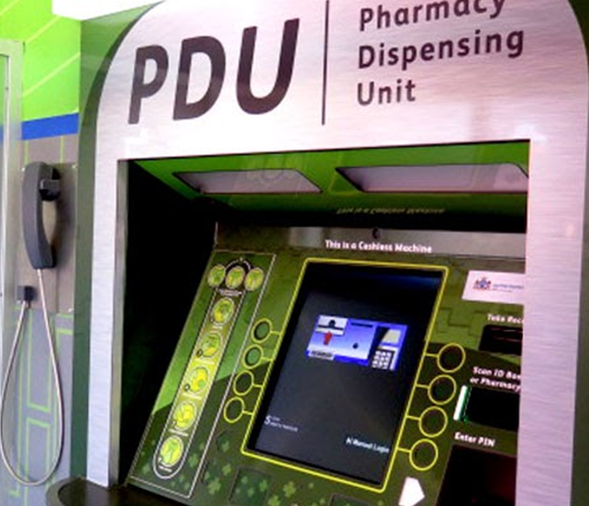
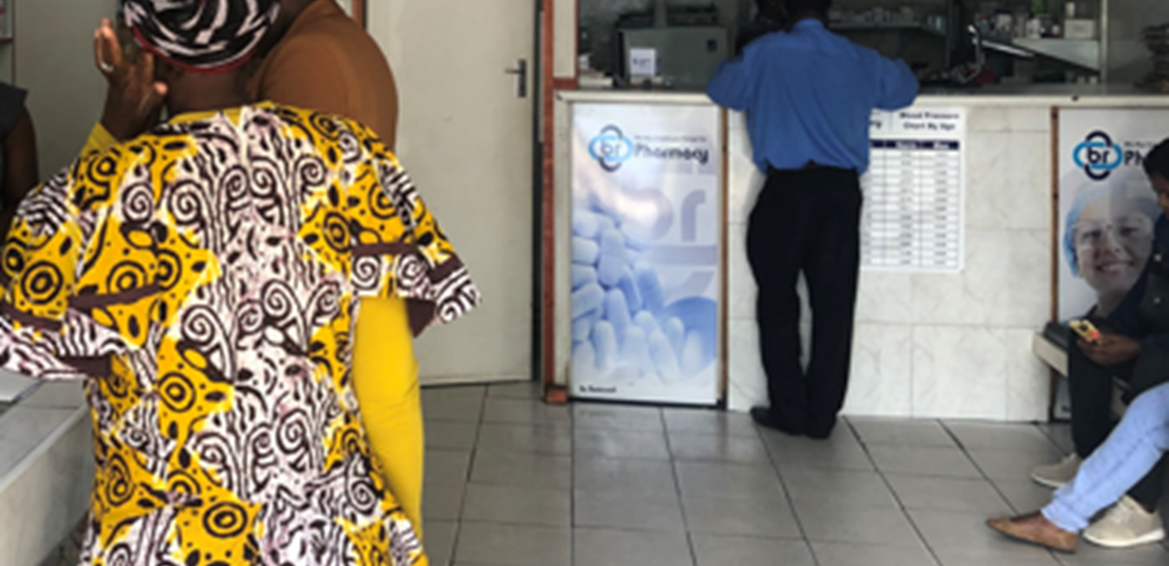
Existing DDD of ART models in the private sector
Private Hospital
Automated Models
Private Pharmacy
Notes:
Three DDD models for providing ART through the private sector are being tried in several countries with promising results. In all cases, clinically stable ART clients from public health facility are devolved to a private outlet or facility for their ARV medications refills. These models include:
Private hospital
Automated models for dispensing medications, and
Private pharmacy (also called community pharmacy).

Slide 9
Benefits provided by all types DDD of ART models
For clients
Decreased transport costs and lost wages; no waiting time
Convenience and increased choice
Privacy and confidentiality, reduced stigma
Enhanced adherence counseling, hence better adherence/viral load suppression
More time with provider/pharmacist, resulting in improved satisfaction
Improved retention
For public facilities/funders
Less crowded clinics and decreased waiting time for clients
Decreased workload for public sector providers, as fewer stable clients have repeat visits
Ability of public facilities to deliver a higher standard of care, more time per client
Decrease in human resource fatigue
Cost savings for funders (government/donors)
Notes:
Most benefits for clients and public facilities/funders listed on this slide are the same regardless of the type of DDD for ART model. A few additional DDD model-specific benefits will be addressed when a particular model is discussed.

Slide 10

Activity: Examples of African countries with existing DDD models
Nigeria
Uganda
CPs, private hospitals
Community pharmacies (CPs), private hospitals
Kenya
Private hospitals
Tanzania
Private hospitals
Zambia
CPs, CDU lockers, private hospitals
Malawi, Eswatini, Lesotho
Private hospitals
South Africa
Pharmacy dispensing units (PDUs), central chronic medicine dispensing and distribution (CCMDD), lockers,
CPs, private hospitals
Zimbabwe
Private hospitals
Based on EpiC Desk Review
Notes:
For virtual training/self-learners: identify your country and name models that you know exists in your country.
For in-person training: ask participants to identify their country and name models that they know exists in their country.

Slide 11
Activity: Examples of African countries that introduced DDD models in 2020
Cote d’Ivoire
Expanding community delivery (PODI, DIC)
Private pharmacy
Burundi
Community distribution (PODI)
Malawi
Franchised private (Tunza) clinics
Liberia
Private pharmacies
Cameroon
Community distribution
Private pharmacies
Mozambique
(i) Private pharmacies
Eswatini
Community delivery model
Private pharmacies
DRC
Expanding community delivery (PODI, DIC)
Private pharmacies
Botswana
Private pharmacies
Home delivery by courier (post office)
Viral load testing through private labs
Lesotho
(i) Automated models
Notes:
For virtual training/self-learners: identify your country and review if your countries introduced new DDD models.
For in-person training: ask participants to identify their country and name new models that they know exists in their country.

Slide 12
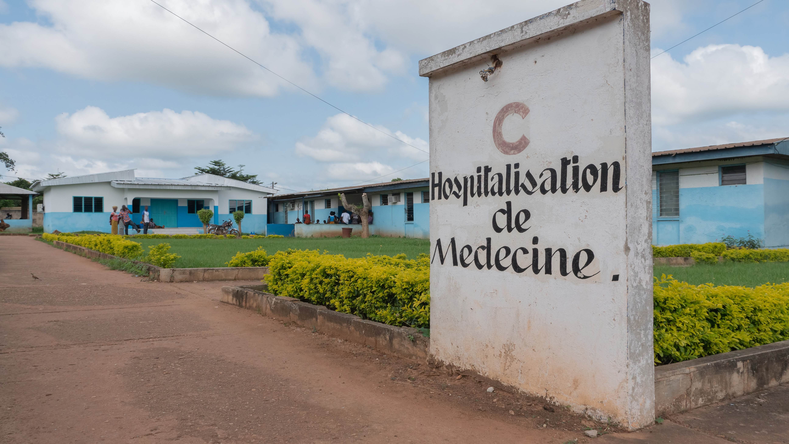
Private Hospital Models

Slide 13
Private hospital models of DDD of ART
Private Hospital Model (subsidized by donors/govt.) | Private Hospital Model (not subsidized) | Private Wing Model (subsidized or full payment)
All three private hospital models: Provide comprehensive HIV services Are licensed and have an adequate number of staff
Receives free ARVs from government/donors Receives PEPFAR support and provides free HIV services Clients pay for selected services but not ARV drugs Receives technical assistance from PEPFAR implementing partners Provides monthly reports to government/donors | Procures ARVs on their own and sells to clients Clients pay for both services and ARV drugs Serves upper quartile of population Payment either out-of-pocket or through health insurance Does not provide monthly reports to the government Often procures brand-name ARVs (e.g., Atripla) | Provides expedited care on a fee-for-service basis Located in public hospitals and health centers Funded mainly through out-of-pocket payments, leverages existing infrastructure Revenue raised from private wing used to support provision of free HIV services to other clients in the hospital
Notes:
There are three distinct versions of private hospital model: partially subsidized by government, unsubsidized, and a model where private hospital wing is located within the public facility. Advantage of the private hospital model is that they can do more than just dispense ARVs – in this setting clients can receive comprehensive HIV services in addition to ART.
Subsidized private hospitals receive government-/donor-funded ARVs that are provided to PLHIV for free, but the client may still pay for consultations and other services.
Unsubsidized hospitals purchase their own supply of ARVs and charge the patients for both medications and services. These hospitals have a wider pool of ARVs to choose from and often purchase brand name ARVs instead of generic versions.
Private wing model benefits from existing infrastructure and, while clients using this model are charged for services, part of the revenue supports provision of free HIV services to clients within the public health departments of the hospital.

Slide 14
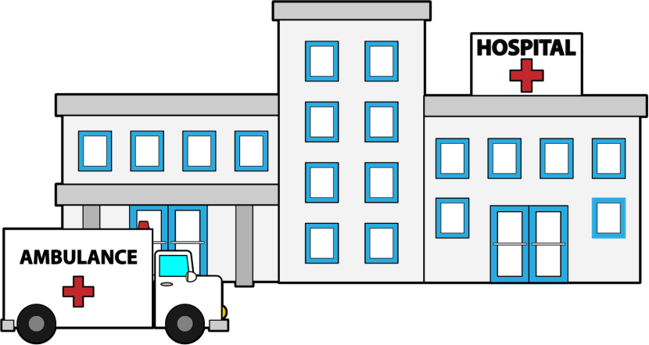
Additional benefits for clients who enroll in the private hospital model
May have option to choose between brand-name and generic versions of ARVs
VIP treatment
Comprehensive services, including other chronic disease management
Notes:
This slide lists additional benefits ART clients may expect when they enroll in private hospital DDD model.

Slide 15
Optional reading: Private hospital models
Additional information on private sector hospitals
Slides:
    EpiC. 2020. The Contribution of Private Hospitals and Clinics as Part of Sustainable Financing of the HIV Epidemic.
Q&A:
    EpiC. 2020. Selected Questions and Answers from the Session 3 of the DDD Learning Series Titled “The Contribution of Private Hospitals and Clinics as part of Sustainable Financing of the HIV Epidemic” Hosted on August 27, 2020.

Slide 16
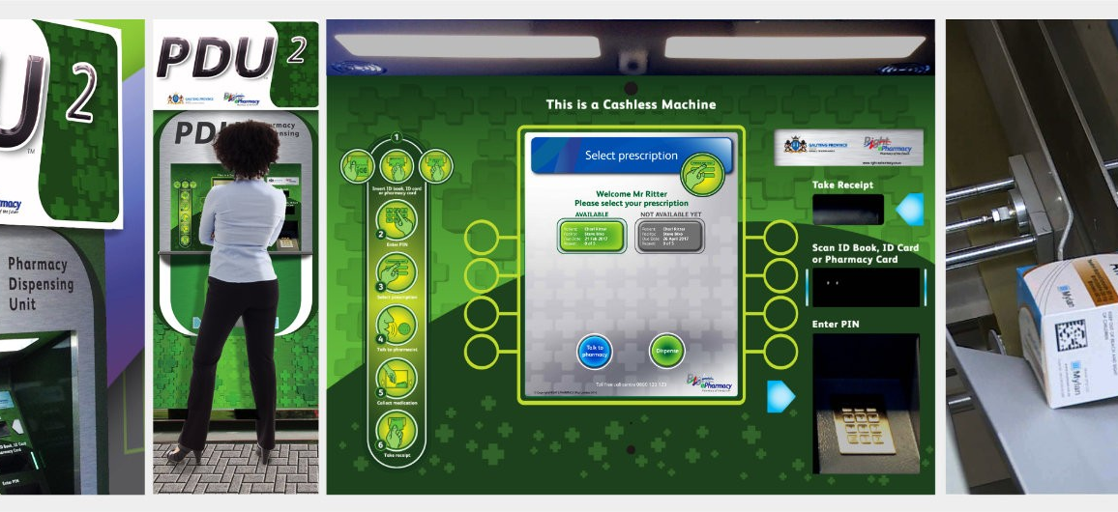
Right2Care, PDU
Automated Dispensing Models
Pharmacy dispensing units (PDUs)
Central chronic medicine dispensing and distribution (CCMDD)
Prescription collection unit (PCU) ─ lockers

Slide 17
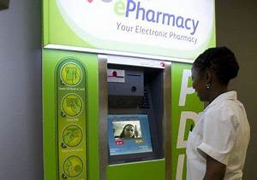
Pharmacy dispensing unit (PDU)
Works similarly to ATM and has ATM-type interface, including:
  Touch screen, handset, and earphone jack
  PIN-authenticated access
  Interactive visual and verbal communication
  Dispensing receipt printer
Clients receive SMS notifications and reminders to ensure timely collection of medication, adherence
Clients scan smart card ID to receive medications (no service fee)
Right2Care, PDU

Slide 18
Pharmacy dispensing unit (cont.)
PDUs also dispense other chronic medications, minimizing HIV stigmatization
All collected medications recorded against central client record
Electronic cloud dispensing record and telepharmacy reporting capabilities include:
  Client demographics, nationality, ID, and contact details
  Automated and manual stock monitoring and ordering
  Gender distribution and age bands
  High-volume and popular collection times and days
  11 official languages
Expensive to install: ~US$200,000 per machine

Slide 19
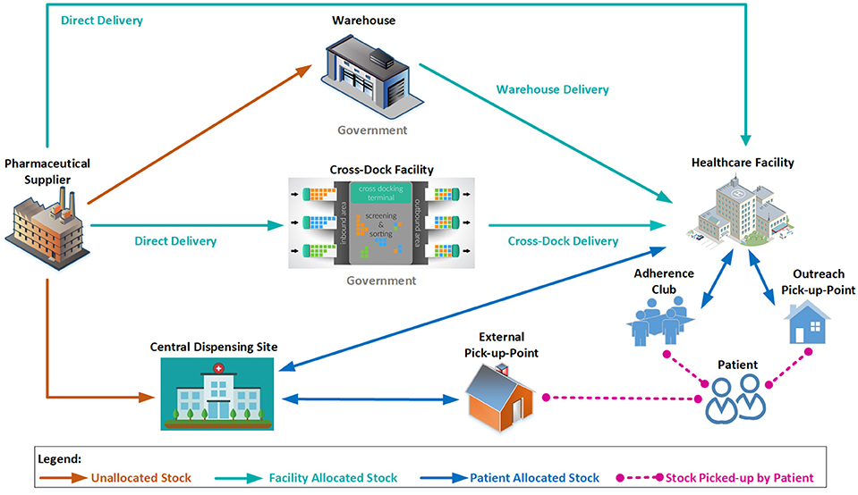
Central chronic medicine dispensing and distribution (CCMDD)
Stable clients who enroll can choose pick-up point (e.g., private pharmacy, supermarket, church, lockers)
Public facility sends allocated medicines to CCMDD
CCMDD dispenses and delivers medicine to client-selected pick-up point
Clients informed via SMS when medicines ready for pick-up
Clients collect medicines from pick-up point by appointment
https://www.frontiersin.org/articles/10.3389/fphar.2017.00751/full

Slide 20
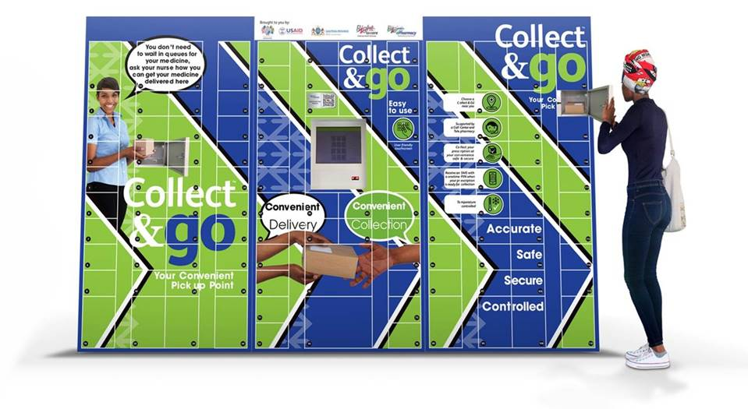
Prescription collection units (PCUs) ─ lockers
Implemented at 66 sites in Free State, South Africa and 1 site in Ndola, Zambia
Electronic locker system provides access to pre-dispensed medications
Unmanned, located at a secure locations
Client does not pay and can pick up medicine at any time
Uses smartphone technology
Can send automatic reminders to clients and track when clients pick up medicine
Cost ~US$8,300 per site to set up

Slide 21
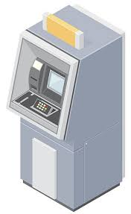
Additional benefits for clients who enroll in automated dispensing DDD models
Rapid customer service
No service fee
Accurate client and supply records
Automated reminders
No direct human contact, hence reduced risk of COVID-19 transmission

Slide 22
Optional reading: Automated models
Additional information on automated models
Slides:
      EpiC. 2020. Taking the digital step: Using automated dispensing to improve patient experiences
Q&A:
      EpiC. 2020. Selected questions and answers from the Session 2 of the DDD learning Series titled “DDD 101: Taking the digital step: Using automated dispensing to improve patient experiences” hosted on August 13, 2020.”

Slide 23
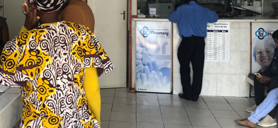
Private (Community) Pharmacy Models

Slide 24
Private/community pharmacy model
Stable clients devolved to selected private pharmacies
Clients choose private pharmacy for devolvement, can switch to another pharmacy or back to facility at any time
Pharmacy staff trained on ART
Pharmacist dispenses drugs, provides information to facility about client refills and ARV accountability
Clients receive free ARVs, but small service fee may be paid directly by client or donor/health insurance provider
Clients return to facility for clinical reviews and monitoring tests (frequency determined by facility) or any time they have problems
Private pharmacy A
Private pharmacy K
Private pharmacy B
Public health facility
Private pharmacy Z

Slide 25
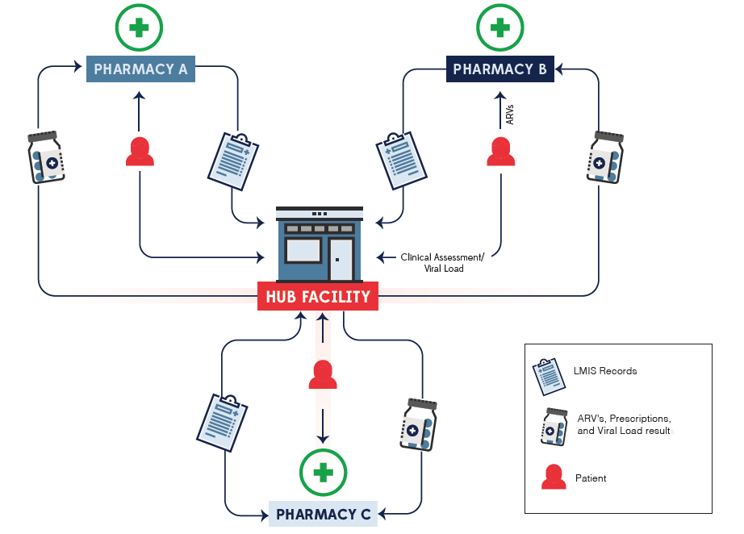
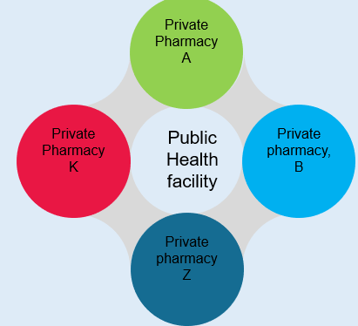
Flow of clients, commodities, and records between hub facility and private pharmacies

Slide 26
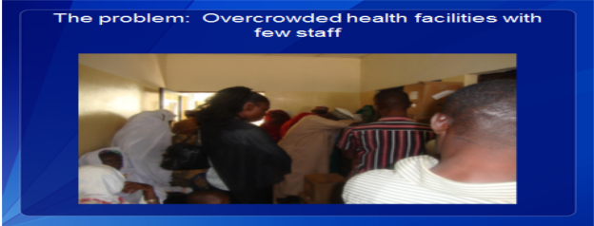
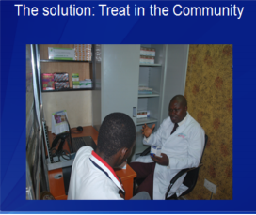
Private pharmacy: Three models
Program staff placed at private/community pharmacy
  IDI Uganda
Stipend paid to private/community pharmacy by implementing partner
  IHVN in Nigeria
  CIDRZ in Zambia
  EpiC/IHAP in DRC
  EpiC Liberia
Client pays service fee
  FHI 360/Howard in Nigeria
  (enrolled 15,000 clients)
The PROBLEM:
Overcrowded health facilities with few staff
The SOLUTION:
Treat in the community

Slide 27
Key elements of private (community) pharmacy model
Public Facility
Identifies and devolves eligible clients
Community Pharmacy
Dispenses ARV drugs (and others as required)
Schedules refill appointments
Client
Presents prescription to community pharmacy
Returns to facility twice a year
Pays for pharmaceutical services
Makes reminder calls
Tracks defaulters
Reconciles stocks
Maintains client records, shares information with health facilities
Refers clients with medical needs to health facilities
Offers pharmaceutical care
Links clients to community pharmacies
Releases medical records and drugs to community pharmacies
Reviews clients on semi-annual clinic visit (or as required)
Chooses community pharmacy where will receive drugs
Receives free drugs
Can switch community pharmacy or return to facility at any time

Slide 28
Optional reading: Community pharmacy models
Additional information on community pharmacy models
Slides:
      EpiC. 2020. DDD 101: Community Pharmacy ART Distribution Models.
Q&A:
      EpiC. 2020. Selected Questions and Answers from the Session 1 of the DDD Learning Series Titled “DDD 101: Community Pharmacy ART Distribution Model” Hosted on July 30, 2020.

Slide 29
Private pharmacy model in country X
Placeholder for describing the specifics of the pharmacy model implemented in your country

Slide 30
Activity: Review of implementation steps for DDD model rollout
Stakeholder engagement
(scoping visit)
Baseline assessment of facilities and mapping
Engagement of private pharmacies and linkage to facilities
Capacity building of private and public sector partners/M&E
Technical assistance and demand creation
Notes:
Ask participants to go through the implementation steps for the DDD models and name key elements for each step including the different stake holders, resources needed and time frame for each step.
PRESENT the next slide.

Slide 31
Activity: Review of implementation steps for DDD model rollout
Stakeholder engagement
(scoping visit)
MOHCC
Provincial/district and city health authorities
Baseline assessment of facilities and mapping
Infrastructure
Data systems
Engagement of private pharmacies and linkage to facilities
Capacity building of private and public sector partners/M&E
Selection
Orientation
Pharmaceutical regulating bodies and associations
Training/reporting
Technical assistance and demand creation
Training on DDD model
M&E system
Ongoing support
Referral
Offer to clients; enroll based on eligibility
Documentation
Scaleup
Notes:
As you review the participant contributions, please present the key elements of each step and discuss their importance. Add any other that are relevant for your setting (country) that were not mentioned by the participants.

Slide 32
Business case for private sector pharmacies
Increased involvement and visibility of community pharmacists in public health interventions
Opportunities for greater participation in public health
Increased revenue from fee for service
Benefits to Community Pharmacists
Special appreciation/recognition during national conferences
Additional revenue from ancillary drug needs
Increased footfalls
Participation in branding and accreditation scheme supported by implementing partners (e.g., FHI 360)
Robust capacity building applicable to other disease areas and contributes to professional development programs

Slide 33
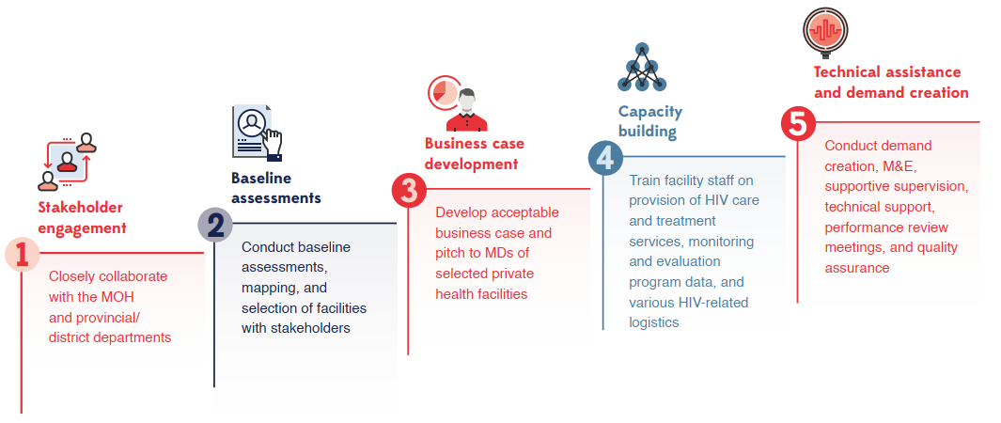
Summary of implementation steps

Slide 34
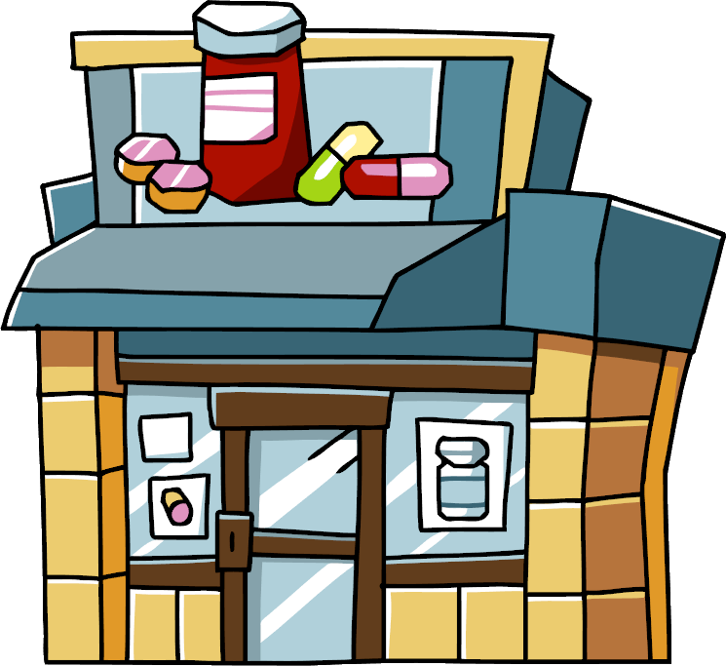
Additional benefits for clients who enroll in private pharmacy model
Reminders about refills and clinic visits
Strong links between private pharmacy and public facility, allowing for timely referrals back to facility if any problems with treatment or adherence arise
Flexibility to change pharmacy if not satisfied or if circumstances change (e.g., can select pharmacy closer to new place of residence or employment)

Slide 35
Key success factors
Involvement of all key stakeholders from the onset
Government policies enabling DDD of ART models
Strong private sector: licensed hospitals, community pharmacies, IT companies, and last-mile logistics providers
Robust supply chain system
Good governance and leadership
Memoranda of understanding between public and private entities
Clients devolved to DDD model on voluntary basis
Orientation/training of private sector providers
Robust monitoring and reporting systems

Slide 36

Key success factors (cont.)
Reasonable fees and high-quality services
Client willingness and ability to pay for certain services
Affordable ARV drugs (in case of purely private models such as unsubsidized private hospitals)
Client perception of high quality of services in private facilities
Financing mechanisms
Integration of other chronic disease medicine to reduce stigma
Presence of technical partner for continuous quality improvement
Use of technologies
Infrastructure to enable and support technologic innovations

Slide 37
Modifying DDD models to address COVID-19 disruption
Community Pharmacy
Private
Hospital
Automated Dispensing
Additional
Approaches
  Expedite deployment through electronic assessment, web-based training.
  Expand services to include both clinically stable and non-stable clients.
  Waive fees to help with uptake.
  Map clients to a limited number of community pharmacies (based on distance and client traffic).
  Ensure adequate support and monitoring through electronic and telecommunication platforms.
  Offer home delivery of ARVs.
  Schedule pick-up times to minimize interactions and maintain safety.
  Expand model to include private clinics/surgeries.
  Allow in-house pharmacies to dispense to clients from public sites.
  Waive fees to help with uptake.
  Offer clients option to receive free government ARVs in case they temporarily lose ability to pay.
  Schedule pick-up times and maintain physical distancing in all waiting areas to minimize interactions and maintain safety.
  Increase capacity of existing dispensing sites.
  Maintain safety:
  Adhere to social distancing guidelines.
  Follow strict sanitation protocols.
  For new installation (when feasible), consider lockers as the most cost-effective option that can work even without Internet access.
  Home delivery
  Helps most vulnerable avoid exposure to clinics.
  Uses variety of channels (CHWs, pharmacy support staff, program staff, expert clients, postal service).
  Obtain consent prior to home delivery and using discrete ARV packaging to reduce risk of stigma and violence.
  Provide PPE to staff doing home deliveries.
  Alternative pick-up points
  Drop-in centers (DICs).
  Identify places open during lockdowns.
  Develop guidance on safety.
Innovative examples: Home delivery by program staff (Nigeria, Kenya, Nepal), private pharmacies to client homes (Uganda, Kenya), KP-led community-based sites or DICs (Malawi, Kenya), mobile clinical teams (Eswatini, South Africa), apps and online appointments
Notes:
Title is linked to the guide: https://www.fhi360.org/sites/default/files/media/documents/epic-art-ddd-covid-19.pdf

Slide 38
DDD in the context of COVID-19
During the COVID-19 pandemic, priority areas for ART services are:
  Ensuring access to services for new ART clients and continued care/retention of existing ART clients
  Minimizing potential exposure to COVID-19 for both clients and
  clinic/program staff
DDD outlets can minimize exposure by:
  Avoiding having too many clients at the same time. This may involve scheduling ARV pick-up times individually, having clients wait outside, and ensuring clients maintain adequate physical distance while waiting.
  Ensuring strict adherence to appropriate infection prevention measures (social distancing, masks, handwashing).
  Sharing COVID-19 prevention information with people living with HIV. Where possible, informational posters can be used to limit face-to-face time with the pharmacist and minimize waiting time for other clients. Pharmacists can still answer individual questions by phone as needed, before or after ART pick-up.

Slide 39
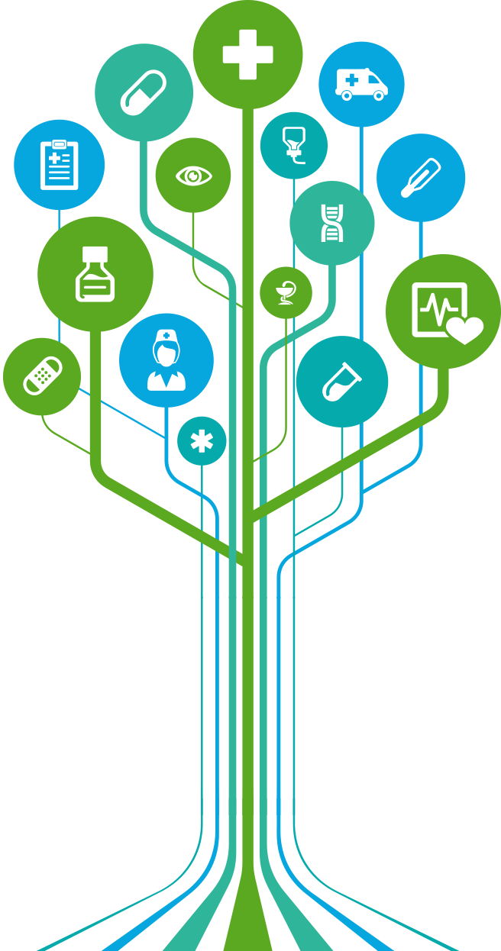
Conclusions
Private sector DDD of ART models can:
Bring services closer to home
Make services more accessible and convenient for people living with HIV who are clinically stable
Improve adherence to treatment and retention in services
Help reduce burden on congested public health facilities
Improve quality of care for clients on ART

