Slide 1
Session 3
Decentralized Drug Distribution of
Antiretroviral Therapy in the Private Sector: Pharmacovigilance, Dispensing, and Adherence
Notes:
Note: The handout/reference document, Adherence Monitoring and Client Counseling, Dispensing, and Pharmacovigilance, provides additional detail on the topics included in this session and should be considered required reading for participants.

Slide 2

Pharmacovigilance

Slide 3
Learning objectives
By the end of this session, participants will be able to:
  Describe the rationale for and history of pharmacovigilance
  Explain the limitations of clinical trials
  Define key terms used in pharmacovigilance
  Explain why adverse drug reactions (ADRs) could occur and their major causes/predisposing factors
  Describe common methods used in pharmacovigilance
  Describe their in-country ADR reporting systems

Slide 4
Definition
  The World Health Organization (WHO) defines pharmacovigilance as the science and activities relating to the detection, assessment, understanding and prevention of adverse effects or any other possible drug-related problems.
Source: World Health Organization (WHO). 2009. A Practical Handbook on the Pharmacovigilance of Antiretroviral Medicines. Geneva: WHO.

Slide 5
History of pharmacovigilance
Pharmacovigilance goes back more than 50 years.
Modern pharmacovigilance is influenced by historical adverse events related to medication use. For example:
  Thalidomide used for management of nausea in pregnancy was associated with limb deformities in newborn babies. (1960s)
  Elixir sulfanilamide (antibiotic) containing diethylene glycol caused kidney failure and led to more than 100 deaths. (1937)
  Oral contraceptives with very high estrogen content were linked to thromboembolic complications. (1970)

Slide 6
Aims of pharmacovigilance
To improve client care and safety/public health and safety
in relation to the use of medicines
To detect problems related to the use of medicines and communicate findings in a timely manner
To contribute to assessment of benefits, harm, effectiveness, and risks of medicines
To encourage the safe, rational, and more effective use
of medicines
To promote understanding, education, and clinical training in pharmacovigilance and communicate effectively about it to the public

Slide 7
Why pharmacovigilance is needed
Permits detection of less common, but sometimes very serious, ADRs
Data from clinical trials alone not sufficient because:
  Information collected during the pre-marketing phase of drug development is not complete with regard to ADRs
  Study participants may not be representative of general population; not enough data about special groups
  (e.g., pregnant women, elderly, people with comorbidities)
  Relatively short study follow-up may not identify rare and/or long-term ADRs
  Controlled sourcing of the drugs used in clinical trials
  (no generic and/or fixed-dose combination drugs)

Slide 8
Key terms in pharmacovigilance
Adverse event: Any unfavorable and unintended sign, symptom, or disease temporally associated with the use of a medicinal product, but not necessarily causally related
Serious adverse event: Any event that results in any of the following:
  Death
  Life-threatening event/reaction
  Requires or prolongs hospitalization
  Permanent or significant disability
  Congenital anomaly/birth defect
  Requires intervention to prevent permanent damage

Slide 9
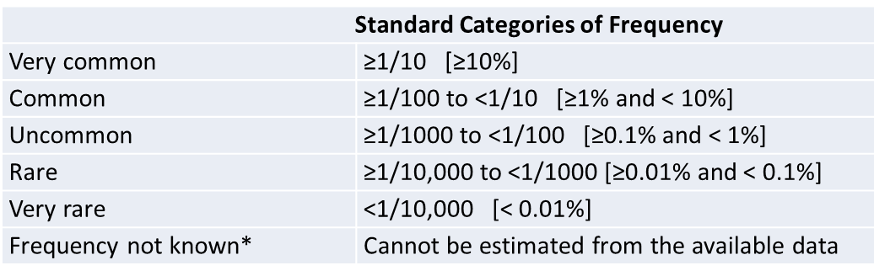
Key terms in pharmacovigilance (cont.)
Adverse drug reaction (ADR): A harmful effect suspected to be caused by a drug which is unintended and occurs at doses normally used for prophylaxis, diagnosis, or treatment of a disease
Unexpected adverse reaction: a reaction not consistent with product information or characteristics of the drug
Frequency categories:

Slide 10
Key terms in pharmacovigilance (cont.)
Side effect: Any unintended effect of a medication occurring at doses normally used and related to the pharmacological properties of the drug
Signal: Information that arises from one or multiple sources, which suggests a new potentially causal association between a drug and an event, either adverse or beneficial, that is judged to be of sufficient likelihood to justify reporting and further verification
Causal relationship or causality: A relationship between two events (A and B) in which A precedes and causes B (e.g., a medicine causing an adverse reaction)
Causality assessment: Evaluation of the likelihood that a medicine caused an observed adverse reaction. Causality assessment is usually made according to established algorithms.

Slide 11
Key terms in pharmacovigilance (cont.)
Drug interaction: A reaction between two (or more) drugs or between a drug and a food, beverage, or supplement, which can affect how a drug works or cause unwanted side effects:
  Drug-drug interaction: Reaction between 2 (or more) drugs
  Drug-food interaction: Reaction between a drug and a food or beverage
  Drug-condition interaction: Reaction that occurs when taking a drug while having a certain medical condition (e.g., use of a nasal decongestant by a client with high blood pressure may worsen the disease)

Slide 12
Do HIV medicines ever cause drug interactions?
Use of HIV medicines can lead to drug-drug, drug-food, and drug-condition interactions.
Drug-drug interactions can reduce efficacy or increase side effects. Health care providers should carefully assess what other medications the client is taking.
Food can affect the absorption of some HIV drugs and increase or reduce the concentration of the medicine in the blood. Depending on the HIV drug, the change in concentration may be helpful or harmful.
Directions on how to take HIV drugs specify whether to take the medicine with food or on an empty stomach. Some HIV drugs can be taken with or without food, because food does not affect their absorption.
Conditions such as kidney disease or hepatitis can affect how the body processes HIV drugs. The dosing of some HIV drugs may need to be adjusted in people with certain medical conditions.

Slide 13
First-line ART regimens: Drug interactions
Placeholder for adaptation:
  Insert information about common first-line regimens in country XX and possible drug interactions (use with other meds, with or without food, and in presence of another health condition)

Slide 14
Why ADRs could occur
The effects of any medical intervention cannot be predicted with absolute certainty.
There is no medicine or medical intervention that will not have a negative or undesirable effect on someone, somewhere, at some time.
By their chemical nature, medicines produce pharmacological effects and induce physiological changes.
People respond differently to medicines due to inter-individual variation.
Information about rare events may, by their very nature, not be available until they happen.

Slide 15
Some causes of ADRs
Errors in disease diagnosis
Prescription of incorrect drug for the disease, or prescription of correct drug but incorrect dose
Choice of correct drug for the disease, but may be incorrect drug for client because of predisposing factors (e.g., age, comorbidities, concurrent medication)
Full specification, indications, contraindications, and risks of drug not read or fully understood
Client not following the health worker’s advice/manufacturer’s advice in product information leaflet
Self-medication with medicines that may have an effect on ARVs and other prescribed medications

Slide 16
Major predisposing factors for ADRs
Extremes of age: The very old and the very young are more susceptible to ADRs.
Sex: For some medicines, safety profiles may differ in males and females. Women have ADRs nearly twice as often as men.
Race and genetic factors
Comorbidities such as kidney and liver diseases may influence metabolism of the drug and cause ADRs.
Drug interactions resulting from pharmacodynamic or pharmacokinetic interaction may lead to potentiate toxicity
Polypharmacy (increased drug interactions due to concurrent use of at least 5 medications)
Prolonged treatment and doses of administered medicines
Previous history of allergy
Notes:
References:
Tharpe N. Adverse drug reactions in women’s health care. J Midwifery Womens Health. 2011;56(3):205-13. [PubMed] Available: https://pubmed.ncbi.nlm.nih.gov/21535369/
Nakagawa K, Kajiwara A. Female sex as a risk factor for adverse drug reactions. Nihon Rinsho. 2015;73(4):581–585. [PubMed] Available: https://pubmed.ncbi.nlm.nih.gov/25936145/

Slide 17
Common surveillance methods in pharmacovigilance
Passive Surveillance | Active Surveillance
Spontaneous reporting | Cohort event monitoring
Targeted spontaneous reporting | Sentinel site surveillance
Case series | Registry surveillance
World Health Organization (WHO). 2009. A Practical Handbook on the Pharmacovigilance of Antiretroviral Medicines. Geneva: WHO.

Slide 18

Reporting Adverse Drug Reactions

Slide 19
Benefits of reporting ADRs
Helps identify rare ADRs
Leads to improvement of information in labeling
Prevents medicine-related tragedies
Helps detect counterfeit and substandard medicines (e.g., when health care personnel are alert to unexpected adverse reactions lack of effect)
Contributes to development of a database on ADRs that would be a useful and relevant educational source

Slide 20
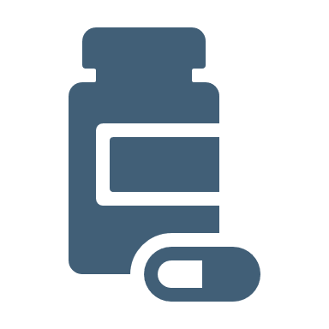
Who should report ADRs?
All health workers in private and public sectors as their professional responsibility
Manufacturers and distributors/marketing authorization holders
Members of the public
Public health programs, including research institutions, NGOs, implementing partners

Slide 21
What should be reported?
Suspected reactions, including minor ones, for all “new” medicines
All serious, unexpected, or unusual adverse drug events for all established or well-known medicines
Increased frequency of any given reaction
Suspected ADRs associated with drug-drug, drug-food, or drug-condition interactions
ADRs in special cases or conditions such as drug abuse, and drug use during pregnancy and lactation
ADRs attributed to an overdose or medication error
Cases of product quality concerns, including nonresponse or reduced response to treatment or when pharmaceutical defects are suspected/observed

Slide 22
How should an ADR be reported in your country?
Placeholder for adaptation: Insert information on reporting expectations in your country. Discuss the process, reporting mechanism, and ADR report form (manual and/or electronic available in country).
More than one slide may be needed.

Slide 23

Drug Dispensing

Slide 24
Learning objectives
By the end of this session, participants will be able to:
Explain the rational use of drugs
Describe the dispensing process/steps

Slide 25
Rational use of drugs
According to WHO:
More than half of all medicines are inappropriately prescribed, dispensed, or sold
Rational use of drugs requires that clients receive medications appropriate to clinical needs, in doses meeting individual requirements for an adequate period of time, and at lowest cost to them and their community

Slide 26
Drug use cycle
Rational use of drugs means expectations of each stage are met, including good dispensing practices.
Diagnosis
Prescribing
Dispensing
Adhering (by client)
Follow-up

Slide 27
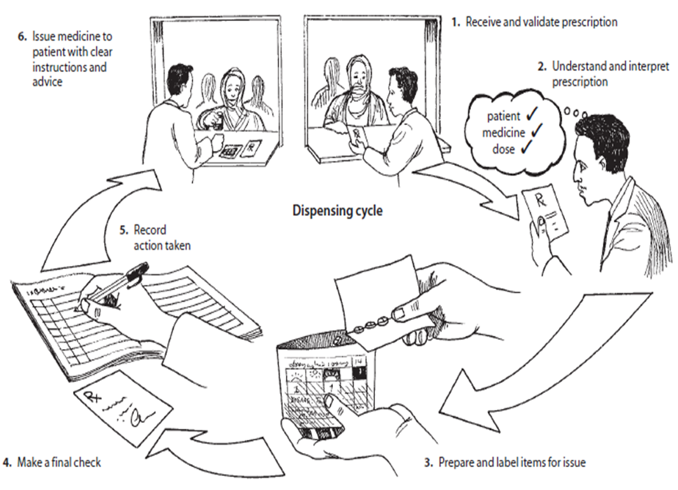
Dispensing cycle

Slide 28
Dispensing ARVs
Dispensing involves the following steps:
Receiving the prescription and checking its validity
Checking the client profile
Determining availability of the products and quantities to dispense
Generating appropriate labels
Packaging in the right containers (if in multi-user packages)
Handing out medicines to clients along with appropriate advice
Recording the transactions and prescriptions details in relevant registers (manual or electronic)

Slide 29

Dispensing steps
Step 1: Accept and cross-check
Cross-check prescription details (prescriber and client information) and confirm items to be dispensed.
Step 2: Review
Whether script meets legal requirements (e.g., date, signature/stamp)
Safety and appropriateness (safe dosing, contraindications)
Client’s dispensing history:
  New or adjusted treatment
  Possible drug-drug interactions
  Compliance issues/misuse
  Client factors (e.g., age, allergies, other health
  conditions including pregnancy)

Slide 30
Dispensing steps (cont.)
Step 3: Prepare and check products
Label and assemble dispensed product
  Client name
  Generic name of dispensed drug
  Drug strength
  Dosage instruction in symbols or words, as appropriate
  Duration of treatment
  Date of dispensing
  Name of institution where drug dispensed

Slide 31
Dispensing steps (cont.)
Step 4: Supply and counsel
Supply prescription to client and recheck
  Correct client?
  Correct medicines?
  Documentation present?
  Unusual storage/discard requirements?
  Counsel on correct use and side effects; check whether client understands instructions
  Record the transaction and prescription details in relevant registers (manual or electronic)
Additional reading: Management Sciences for Health. 2012. Ensuring Good Dispensing Practices.

Slide 32
Counseling clients about medications
Counseling should cover:
Why medicine has been prescribed
How and when to take it and for how long
How to recognize side effects and what to do if they occur
Special precautions to take, foods or medicines to avoid
Correct storage of the medicine
What to do if client thinks medicine is not working
When and how to contact the doctor, dispenser, pharmacist, or other health care provider
How to dispose appropriately of any unused medicine

Slide 33
Dispensing ARVs
As you dispense ARVs, remember to:
State the medicine names and describe their appearance one by one as you give directions on how to use them
State when to take in relation to meals, as appropriate, and caution about adverse effects of alcohol and drug interactions and what to do
Advise on storage
Ask client to repeat back to you how to use the medicines (amount per dose and frequency)
Finish by asking, “Do you have any questions or concerns?” (If any are mentioned, address as appropriate or seek advice if unsure.)

Slide 34
Documentation recording prescription details
Record prescription details electronically (on computer) or in a prescription register and in the ARV dispensing register
Records must include transaction date and client name
and address
Name and quantity of medicine(s) supplied
Name of prescriber
A unique identifying number/code for the prescription that is linked to the client file (optional)
For ART, adverse reactions should be assessed at each visit (by asking client) and recorded in client file

Slide 35
Key reporting documents for ARV drug use
Individual client ARV pick-up registers
  Record each pick-up of ARV refills by client
  Are used to track client adherence and can be used to track missed doses
  Form part of client’s clinical records
Daily ARV dispensing registers
  Record all ARVs picked up by clients each day and capture client information (e.g., client number, age), regimens, and quantity dispensed
  Provide information for the monthly summary reports

Slide 36

Key reporting documents for ARV drug use (cont.)
  Monthly ARV consumption summary reports
    Capture monthly consumption to enable resupply from a higher level of the supply chain
    Capture details on number of clients and quantity of drugs dispensed by therapeutic regimen and formulation
    Summarize quantities received and dispensed during the month and stock on hand

Slide 37
Program documentation for dispensing
A placeholder for adaptation: Include any country-specific procedures and documentation for dispensation.
Provide examples of the forms as handouts and practice completing them.

Slide 38
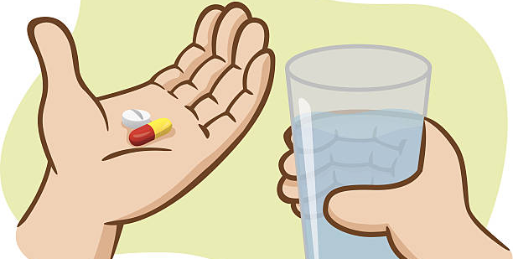
Adherence Monitoring and Support

Slide 39
Learning objectives
By the end of this session, participants will be able to:
Explain what adherence is and the role it plays in improving client outcomes
Explain the link between adherence, drug resistance, and future treatment options
Identify factors associated with nonadherence
Describe methods of measuring adherence
Describe methods and strategies to improve adherence
Describe counseling for adherence problems

Slide 40
What is adherence?
The extent to which a person's behavior—taking medication, following a diet, and/or executing lifestyle changes—corresponds with the agreed recommendations from a health care provider (WHO, 2016)
Involves mutual decision-making process between client and health care provider
It is important that health care providers supporting clients discuss adherence, as adherence is critical to achieving viral suppression and improving/maintaining health.
Source: World Health Organization (WHO). 2016. Consolidated guidelines on the use of antiretroviral drugs for treating and preventing HIV infection: recommendations for a public health approach – 2nd edition.

Slide 41

Why is adherence counseling important for people on ART?
Adherence counseling helps clients:
Develop an understanding of their disease, treatment, and its challenges
Take their medicines correctly—correct dose, frequency, and time
Develop good treatment-taking behavior
Set goals for their treatment
Adherence counseling provides ongoing support for clients to stay on treatment with good adherence over the long term.

Slide 42

Forms of nonadherence
Failure to take pills at scheduled intervals and in right doses
Missed appointments for clinical consultation, counseling sessions, laboratory testing, and ARV refill/pick-up
Interrupting treatment—taking treatment “holidays”
Failure to make the necessary lifestyle changes (e.g., exercise, stop smoking, eat healthy diet)

Slide 43
How much adherence is required for ART to be effective?
Adherence rates of 90%–95% are a gold standard (goal) to reach viral suppression.
A 2015 study (Gordon et al., 2015) compared virologic failure in clients with different levels of adherence who were taking:
  FTC/TDF + NNRTI (EFV); or FTC/TDF + integrase inhibitor (RAL); or FTC/TDF + protease inhibitor (either DRV or ATV)
Virologic failure (defined as HIV RNA PCR ≥200 copies/mL) was similar across all regimens.
Adherence was inversely related to virologic failure.
Level of adherence (%) to ART regimen | Virologic failure rate
≥ 90% | 1.1%
80-90 % | 3.5%
Notes:
Reference: Gordon et al. Comparison of HIV Virologic Failure Rates Between Patients with Variable Adherence to Three Antiretroviral Regimen Types. AIDS Patient Care STDS. 2015 Jul; 29 (7): 384-8.

Slide 44
How much adherence is required for ART to be effective? (cont.)
A recent study in the US (Byrd et al., 2019) showed that in the context of the more effective regimens available today, the adherence level needed to achieve viral load suppression overall may be as low as 82% (lower than the gold standard rate of 90% to 95%).
Nonetheless, the message to clients should be to consistently take ART as prescribed.
Level of adherence (%) necessary to achieve viral load suppression | Regimen
82% | Overall
75% | INSTI-based regimen
78% | NNRTI-based regimen
87% | PI-based regimen
Notes:
Reference: Byrd KK et al. Antiretroviral Adherence Level Necessary for HIV Viral Suppression using Real-World Data. J Acquir Immune Defic Syndr. 2019 Nov 1;82(3):245-251. doi: 10.1097/QAI.0000000000002142.

Slide 45
Consequences of poor adherence
For the individual:
Treatment failure resulting in continued immune system deterioration
Development of resistance to ARVs, requiring the need for more complex treatment, more toxicity, more uncertain prognosis
Increased chances of progression to advanced disease
Not eligible to continue ART through DDD outlet (all clients with unsuppressed viral load must return to facility for ART)
From a public health perspective:
  Transmission of drug resistant virus (subsequent ART failure)
  Increased morbidity and mortality
From a health economics perspective:
  Negative impact on the established cost effectiveness of ART
  Increased cost of treatment for drug-resistant viral strains

Slide 46
Factors influencing adherence
Disease characteristics (e.g., comorbidities, depression)
Client-provider relationship (e.g., trust, privacy, unbiased attitude)
Treatment regimen
(e.g., duration, ease of use, side effects)
Adherence
Service-related factors
(e.g., accessibility, service fee)
Client variables
(e.g., age, education, financial situation)
These factors should be explored each time a client comes for a refill.

Slide 47
Measuring adherence among clients on ART
Method | Advantages | Disadvantages
Client self-report | Easy to use, inexpensive | Is subjective, can overestimate adherence Influenced by recall or reporting bias, client may not be truthful
Pill count | Simple, inexpensive | May be inaccurate if client knows they will be blamed or shares pills with household member Difficult to determine if client is taking pills at correct time
Use one of these methods to measure adherence.
During the adherence assessment, ensure that you are not judgmental, and establish rapport to identify any challenges the client might be facing.

Slide 48
Adherence strategies prior to ART initiation: Facility level
  Prior to ART initiation, providers at public health facility are responsible for:
    Identifying potentially nonadherent clients
    Identifying and addressing barriers to adherence
  Barriers to adherence may include:
    Existing substance abuse (alcohol, drugs)
    Psycho-social issues
    Exposure to gender-based violence and stigma
  Clients devolved to private sector should be clinically stable and have demonstrated good adherence (for 6–12 months)

Slide 49
ART adherence strategies: Facility level
Prior to initiating treatment and during early stages of treatment, providers at public health facility will:
Provide intensified adherence counseling and support for newly initiated clients
Identify an adherence partner/buddy or a peer educator to provide support
Identify reminders or tools to help with taking pills
Measure client’s early adherence to medication (ensure that client demonstrates ability to adhere)

Slide 50
Ongoing adherence strategies at facility and pharmacy/community level
Continuous adherence counseling during all contacts between the client and health provider (multidisciplinary responsibility)
Intensified adherence support/counseling for clients with adherence challenges
Reminders for appointments and drug pick-up
Early identification and tracing of defaulters
Linkages to community support structures (support groups)
Multi-month scripting and dispensing
Reducing access challenges by providing services close to where clients live or work and offering fast service (short waiting time), including private sector options such as community pharmacies and community ARV distribution

Slide 51
Conducting adherence counseling
Good adherence counseling:
Should start before treatment and continue during follow-up/refill visits
Requires recognition of barriers and challenges to adherence
Should reinforce constructive interventions as appropriate
Avoids negative messaging and judgmental attitudes by the provider
Encourages participation of family and friends

Slide 52
Adherence counseling in pharmacies involved in DDD of ARVs in country XX
Placeholder for adaptation: Provide information on adherence counseling in your DDD model: who, how, when, and what.

Slide 53
Multidisciplinary team roles in adherence counseling
Client adherence counselling is done by:
Counselors and social workers
Nurses
Clinicians
Community health workers, peer educators
Pharmacists
Family and friends
Adherence should be reinforced during every contact with health workers (health facility, pharmacy, and community)

Slide 54


Activity
MISSED DOSES
Think about the most common reasons why clients might miss doses.
Write down your answers.
Move to the next slide to compare reasons.

Slide 55
Common reasons clients miss doses
FAMILY SAID NO TO MEDICATION
FORGOT OR TOO BUSY
DID NOT UNDERSTAND INSTRUCTIONS
AWAY
FROM
HOME
TAKING PILL HOLIDAYS
UNABLE TO CARE FOR SELF
RAN OUT OF PILLS
SLEPT
IN
WENT FOR PRAYERS AND GOT CURED
MISSED DOSES
FEAR SIDE EFFECTS
DID NOT WANT OTHERS TO SEE
FELT ILL
FELT BETTER
PILLS DO NOT HELP

Slide 56

Activity: Case studies
Read Case Study 1 and follow instructions/answer questions
Read Case Study 2 and follow instructions/answer questions

Slide 57
ART adherence: Summary
Excellent adherence is key to successful ART programs.
The consequences of poor adherence are poor health outcomes and increased health care costs.
Adherence support is a dynamic process that needs to be ongoing and tailored to clients’ needs and circumstances.
Innovative client-tailored interventions are required and must fit into the sociocultural context of each setting.
Family, friends, and community are key factors in improving adherence.
A multidisciplinary approach toward adherence is needed.

