Slide 1






JOB AID FOR
Providers, case workers, and other counselors to discuss ARV multi month dispensing (MMD) with adolescents living with HIV (ALHIV)

Slide 2
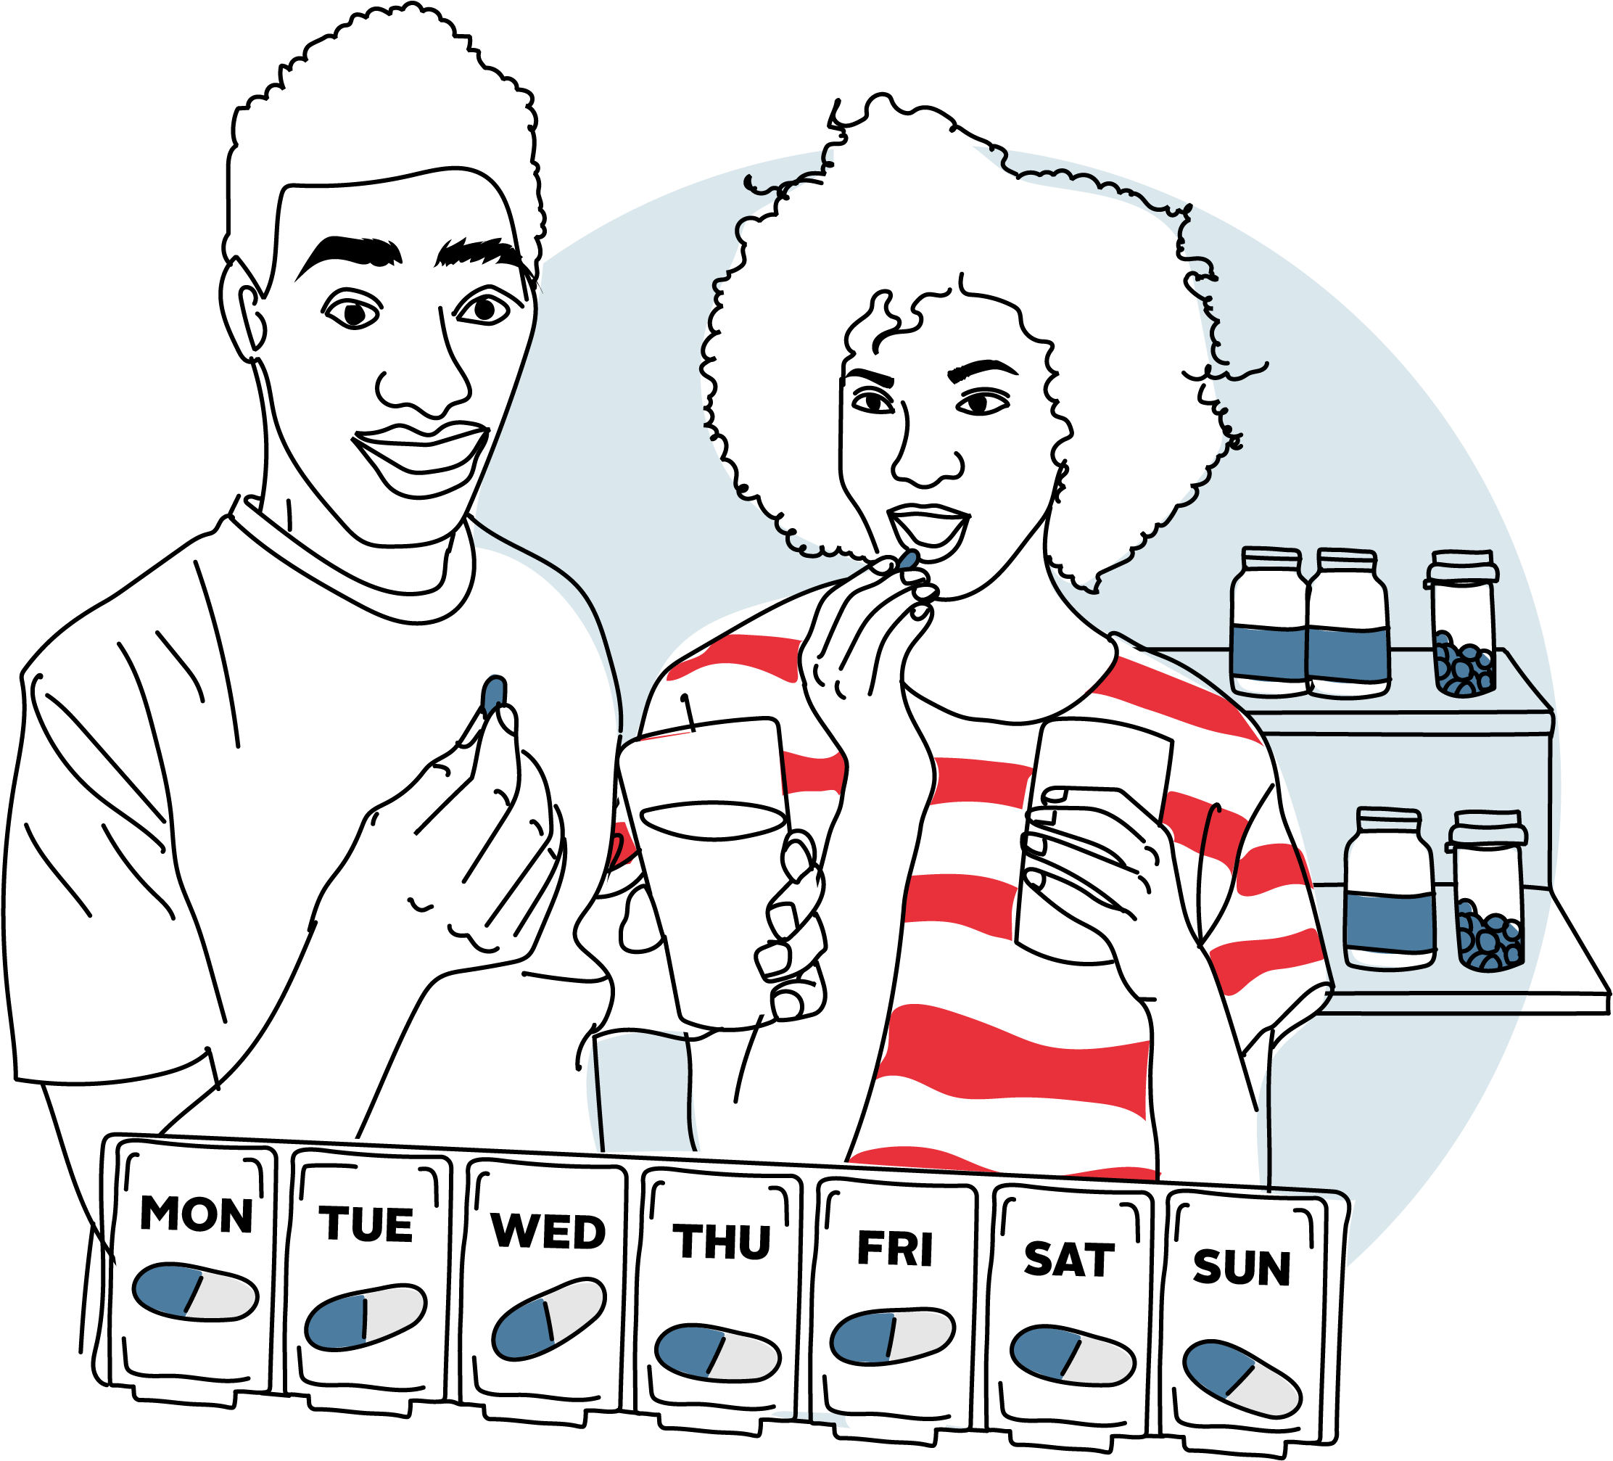
Let's talk about
Multi Month Dispensing
of Antiretroviral Medications
Adolescents Living with HIV

Slide 3
Introduction to Tool
Who can use this tool?
This tool can be used by any facility- and community-based provider, case worker, or other counselor who counsels adolescents living with HIV (ALHIV). The United Nations defines “adolescents” as those between the ages of 10 and 19.
What is the objective of this tool?
This tool will help you to orient ALHIV to MMD and support them to identify and overcome any barriers.
How to use this tool:
This tool is designed to encourage a discussion between you and your client about MMD. Each page is divided into two sections. The “ask” section, along with client-facing illustrations, will help trigger a discussion with your client. The “say” section is intended only to remind you of key messages to share.
Be sure to familiarize yourself with the tool and its contents before you use it during your counseling session. And always tailor your messages and questions to who you are counseling.

Slide 4
Notes:
Note: need to keep a blank page here so that when flipped, the images are facing client side.

Slide 5

Introduction to Tool
Remember: This tool does not replace the other tools you use for adherence or other counseling. It should be used in combination with those other tools to meet the needs of your client.
Step-by-step instructions for use
Sit facing the client.
Tell the client you would like to discuss multi-month dispensing of ARV medications with them.
Stand the job aid up between you and your client. Make sure the side with the illustrations is facing your client.
Go page by page, showing your client the illustration and posing the questions in the “ask” section.
Listen to your client and answer any questions.
After your client has finished speaking, use the “say” section to fill in any gaps.
Remember to ask your client if s/he has any questions before moving to the next page of the job aid.

Slide 6
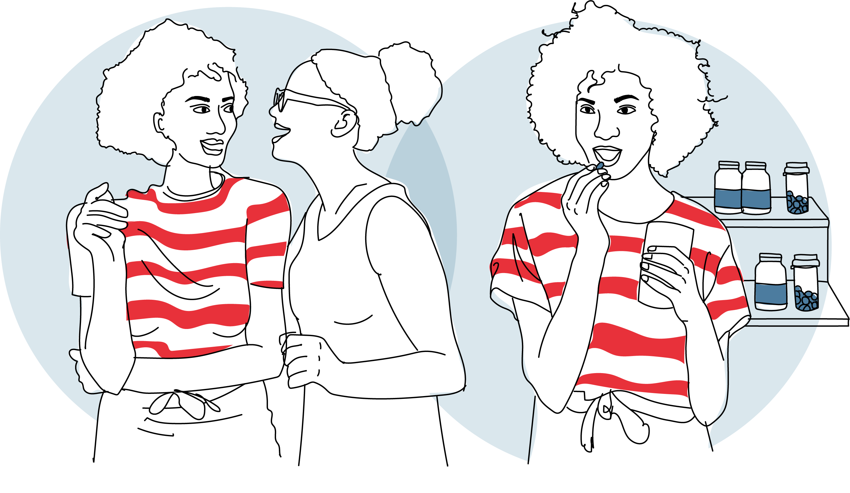
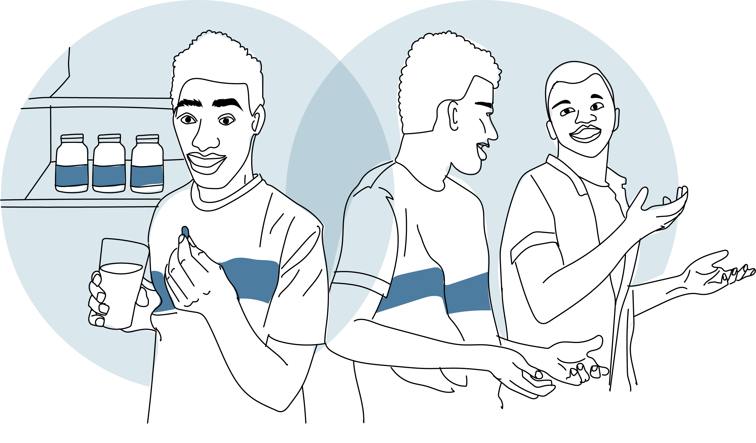
1

Slide 7



1
TALKING POINTS
Q
Ask:
What do you like best about your current ARV medications?
Say:
The newest ARV medications are safer and more effective than previous medications.
This means they help reach viral suppression faster with very few side effects.
They are also easier to take and can be used by children, adolescents, and adults.
Because they are so much better, we can give you a multi-month supply and ask you to collect your ARV medications only a few times a year, rather than every month.

Slide 8
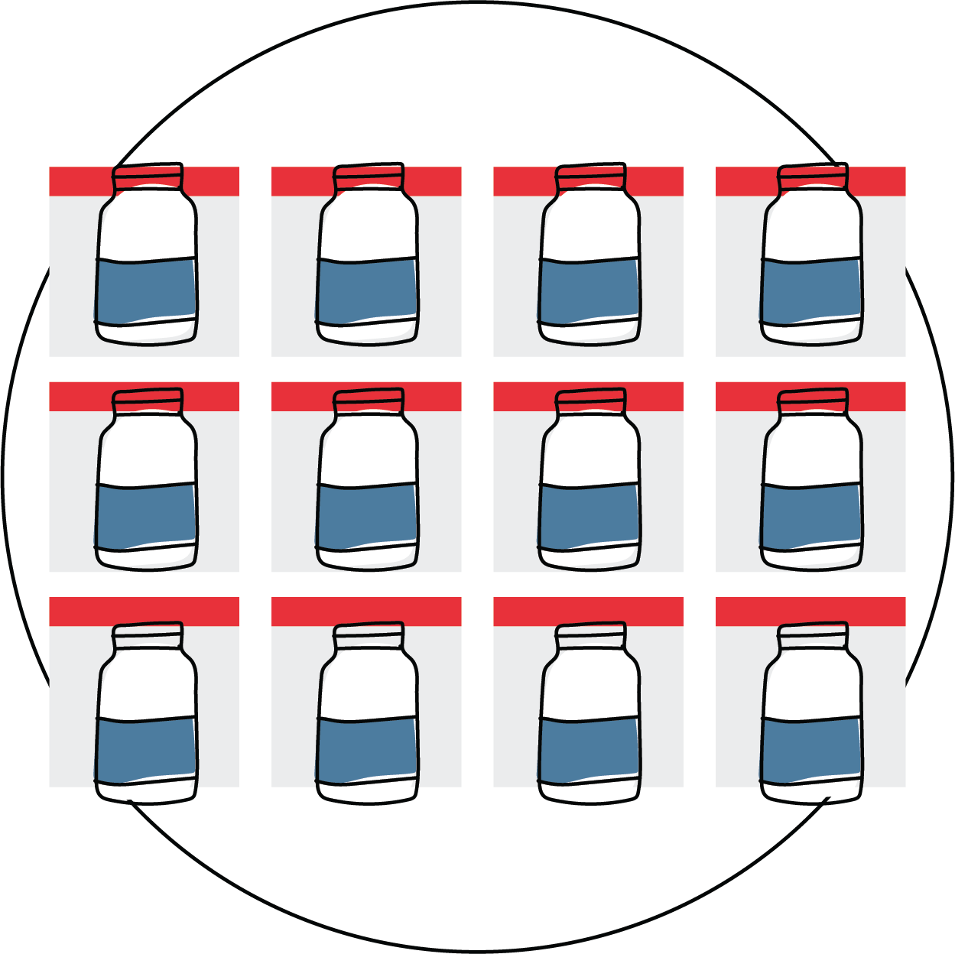
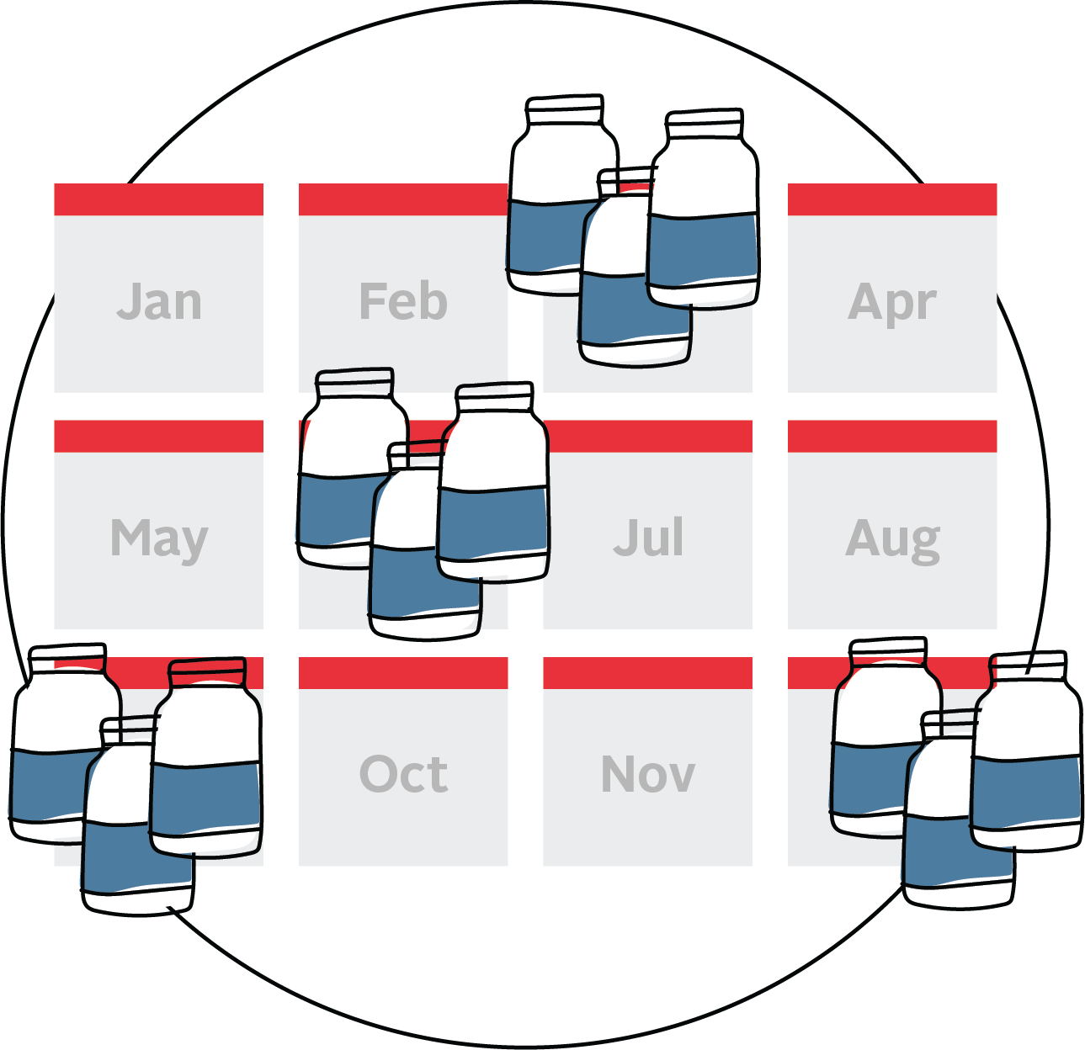
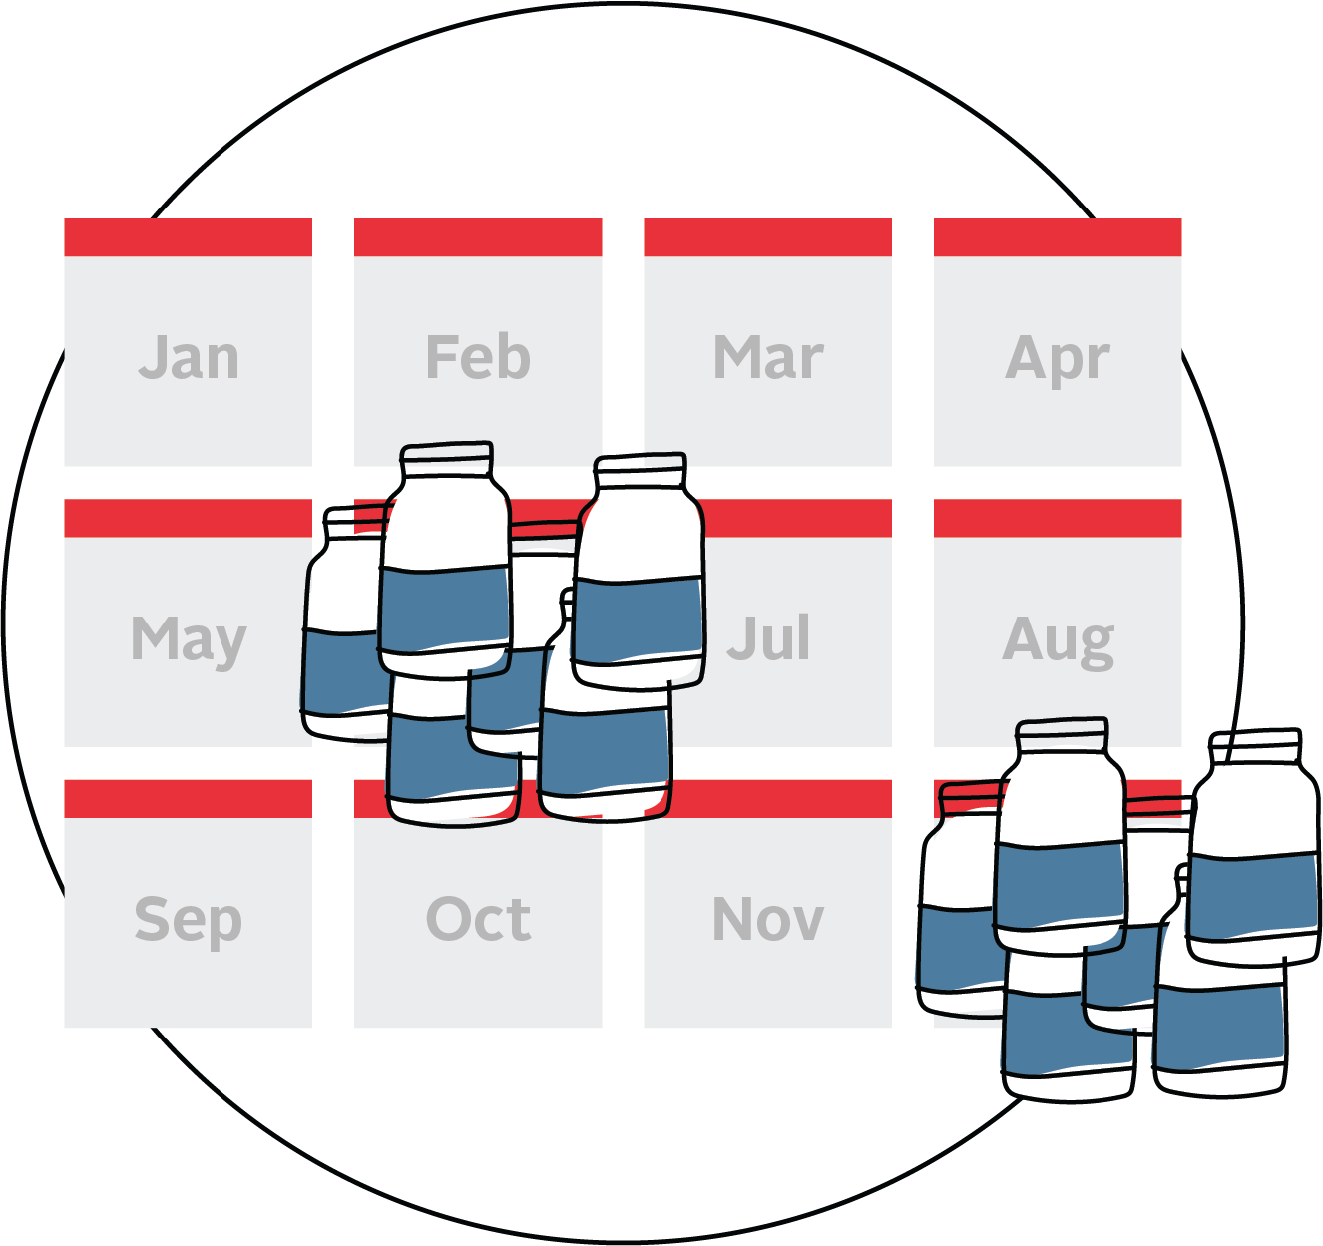
2
Monthly dispensing of ARV medications
Multi-month dispensing of ARV medications
1-month supply
3-month supply
6-month supply

Slide 9
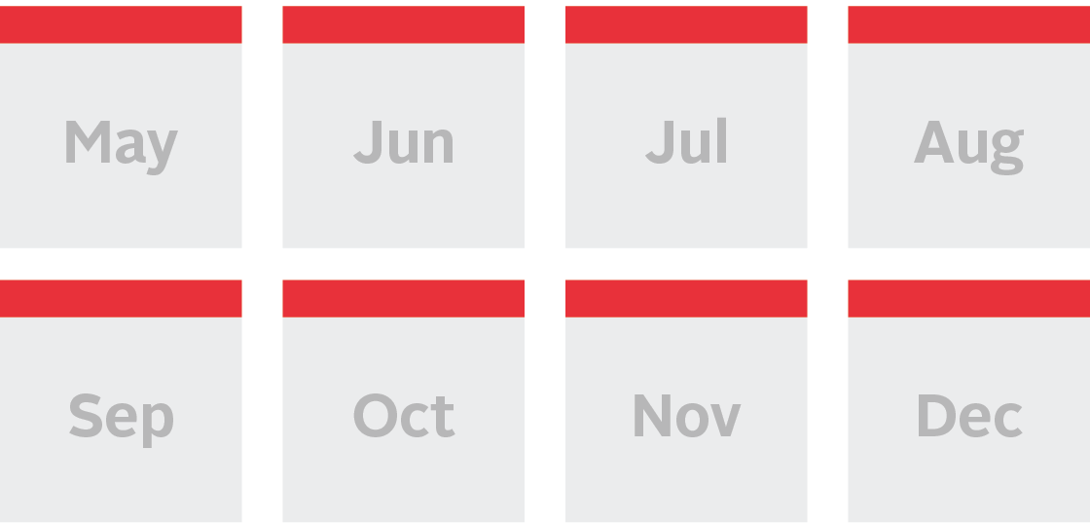
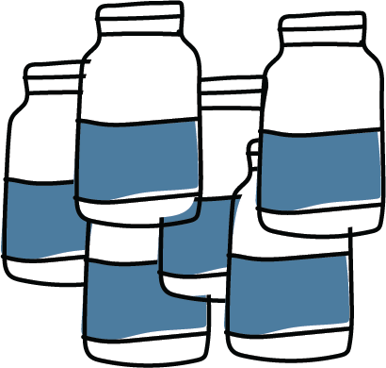
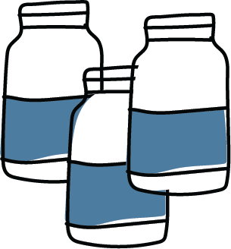
2
TALKING POINTS
Ask:
What have you heard about multi-month dispensing of ARV medications?
Say:
Instead of receiving a one-month supply of ARV medications, you would receive enough for three to six months.
This means you will only need to collect ARV medications a few times each year.
The ARV medications are exactly the same you have been taking. Nothing changes except how many months worth of medication you receive each visit.
Q

Slide 10
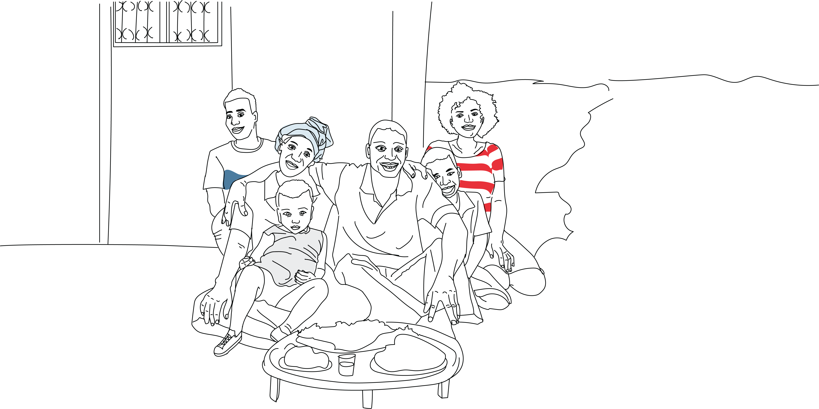
3

Slide 11
3
TALKING POINTS
Ask:
What do you think are some of the benefits of MMD?
Say:
You don’t need to come to the clinic as often, saving you time and money each month.
You can use the money you saved for other important needs like food, clothes for family, or savings.
You can use the time you save for other activities, like spending more time with your family, socializing with friends, doing your schoolwork, or additional work, if needed.
You may also find that more free time improves your mental and physical health; allowing you to take better care of yourself and your family.
You also have less chance of missing an appointment, shorter wait times, (potentially) more time to spend with your health care provider, and reduced chance of exposure to illnesses, like coronavirus.
Ask:
Which of these benefits interest you the most?
  If you didn’t need to collect your ARV medications every month, what would you do with that time and money instead?
Q
Q

Slide 12
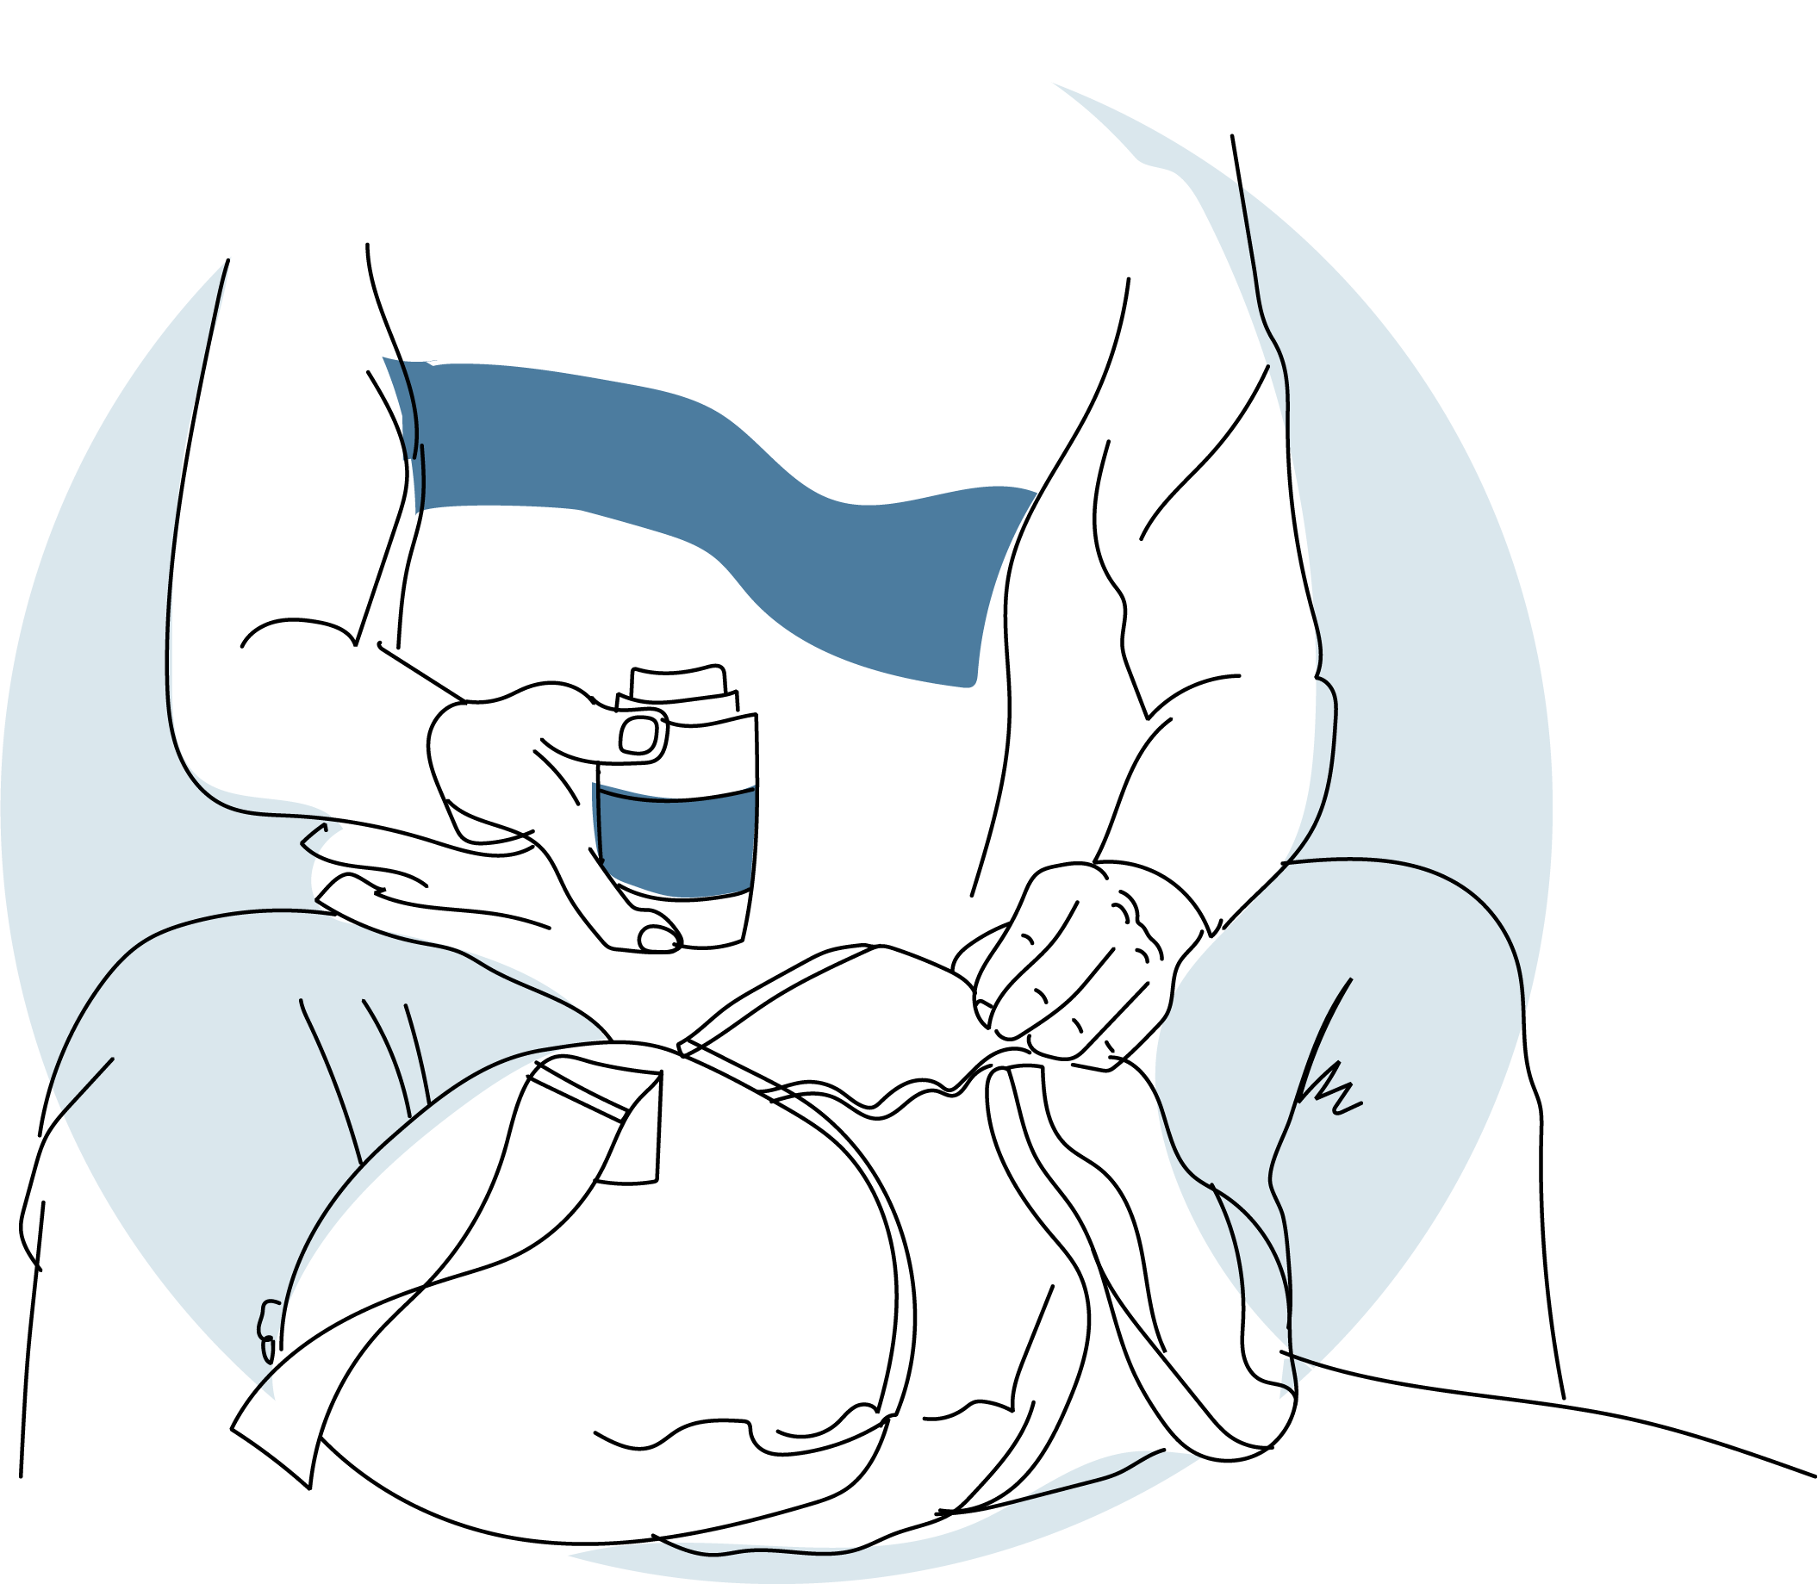
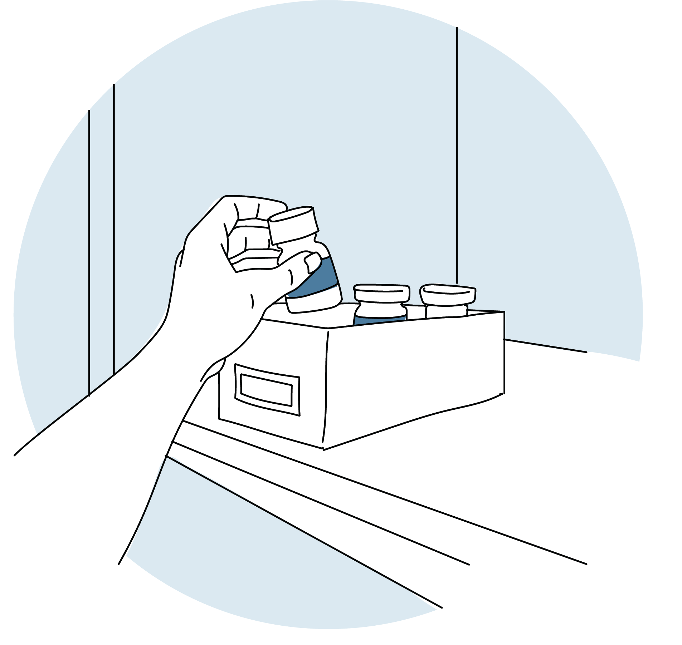
4

Slide 13
4
TALKING POINTS
Ask:
What concerns do you have about MMD?
How do you think you could overcome these concerns?
Say:
To guard their privacy, some clients use a discreet bag to collect and transport their ARV medications.
Some clients will also “double bag” their ARV medications for added privacy.
At home, you can store their ARV medications in a private, cool and secure place.
Some clients say they divide their ARV medications across different locations in the house to spread the bulk.
Some other clients will put their ARV medications in an unmarked box or cosmetic or make-up box to guard their privacy.
Don’t worry, if you need to, you can always come back to see your health care provider between appointments.
Q

Slide 14
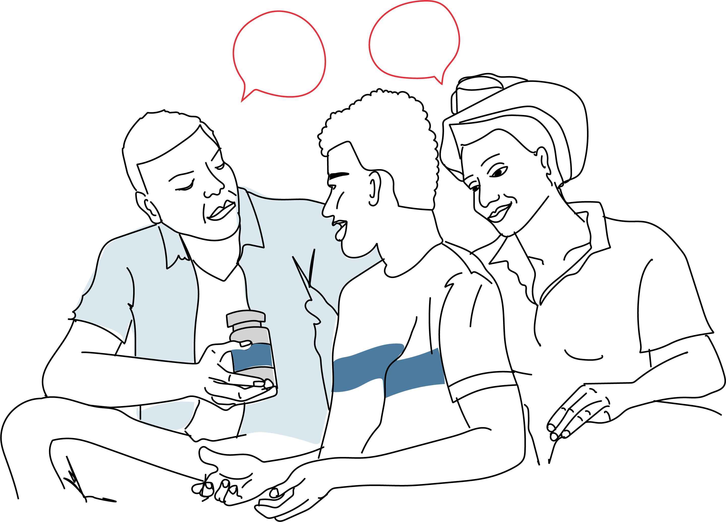
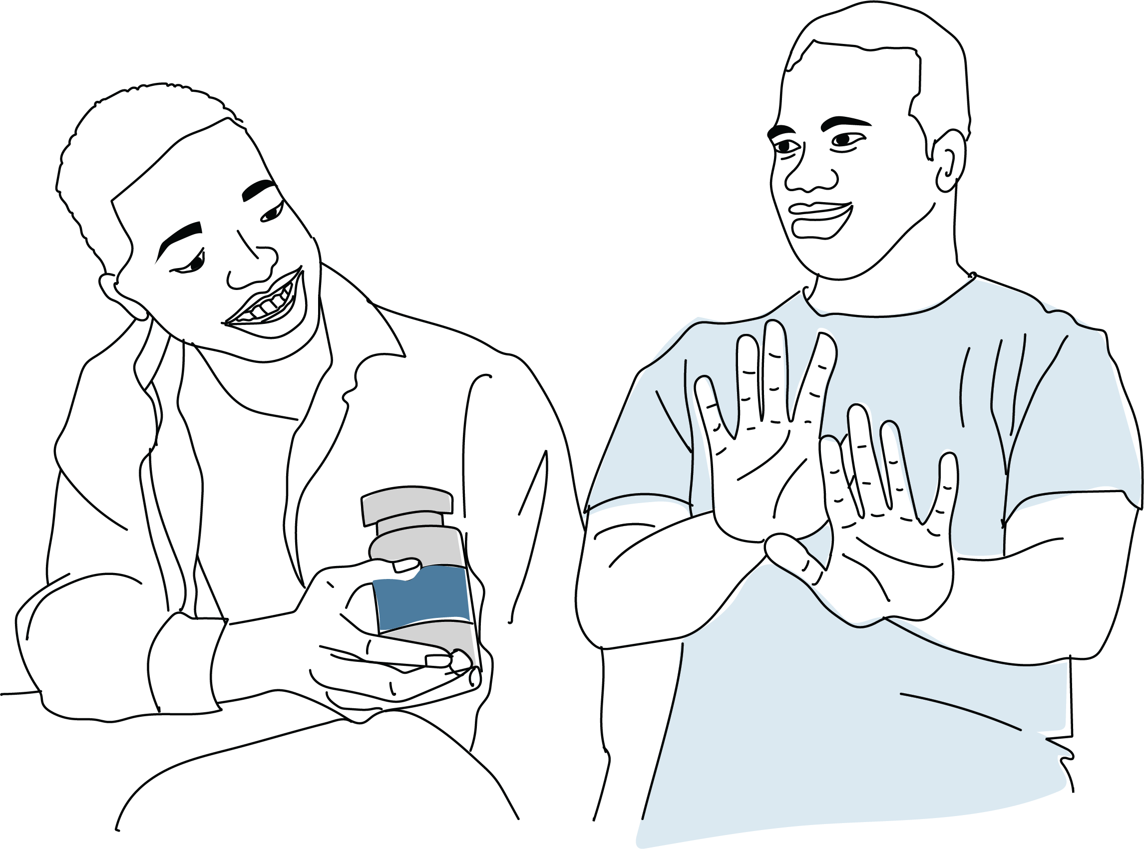
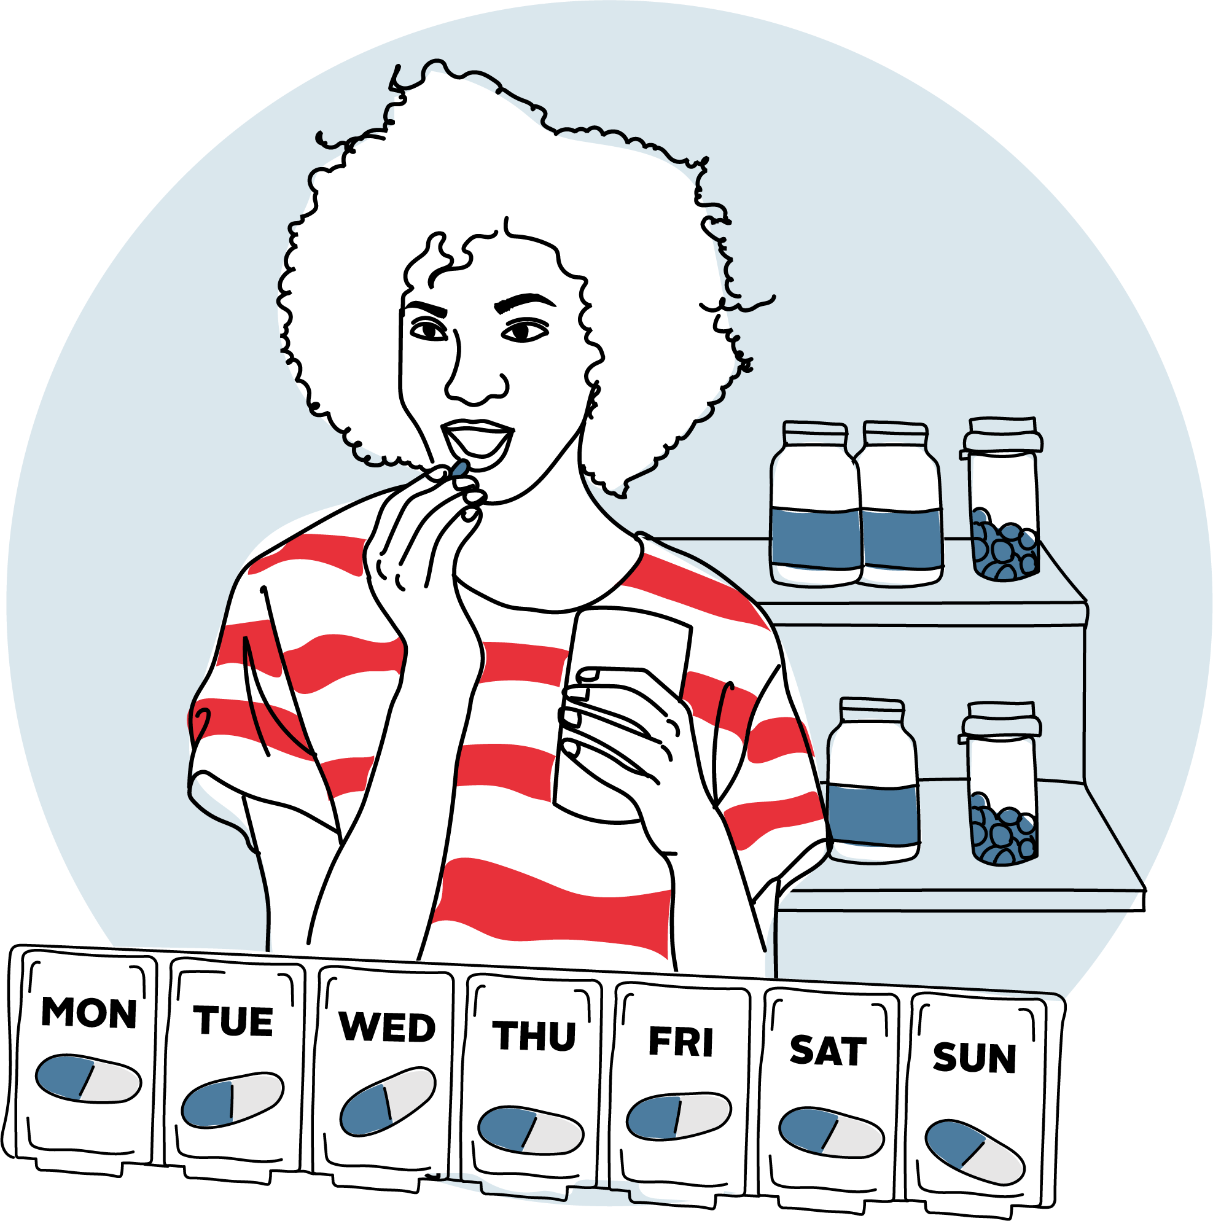
5
Talk with your family about your status
Do not share or exchange ARV medications
Keep taking your ARV medications as prescribed

Slide 15
5
TALKING POINTS
Q
Ask:
What are some of the things you can do to make sure you’re successful with MMD?
What support would you like to make sure you’re successful with MMD?
Say:
Talking with your family about your status can provide a sense of relief for you. It also makes it easier to adhere to your ARV medications. We are here to provide you with whatever support you need to disclose your HIV status.
Do not share ARV medications with someone else. Sharing ARV medications does not help anyone and can negatively impact your health.
Do not sell ARV medications to someone else. Selling them will not help you and can worsen your health.
Most importantly, keep taking ARV medications as prescribed.

Slide 16
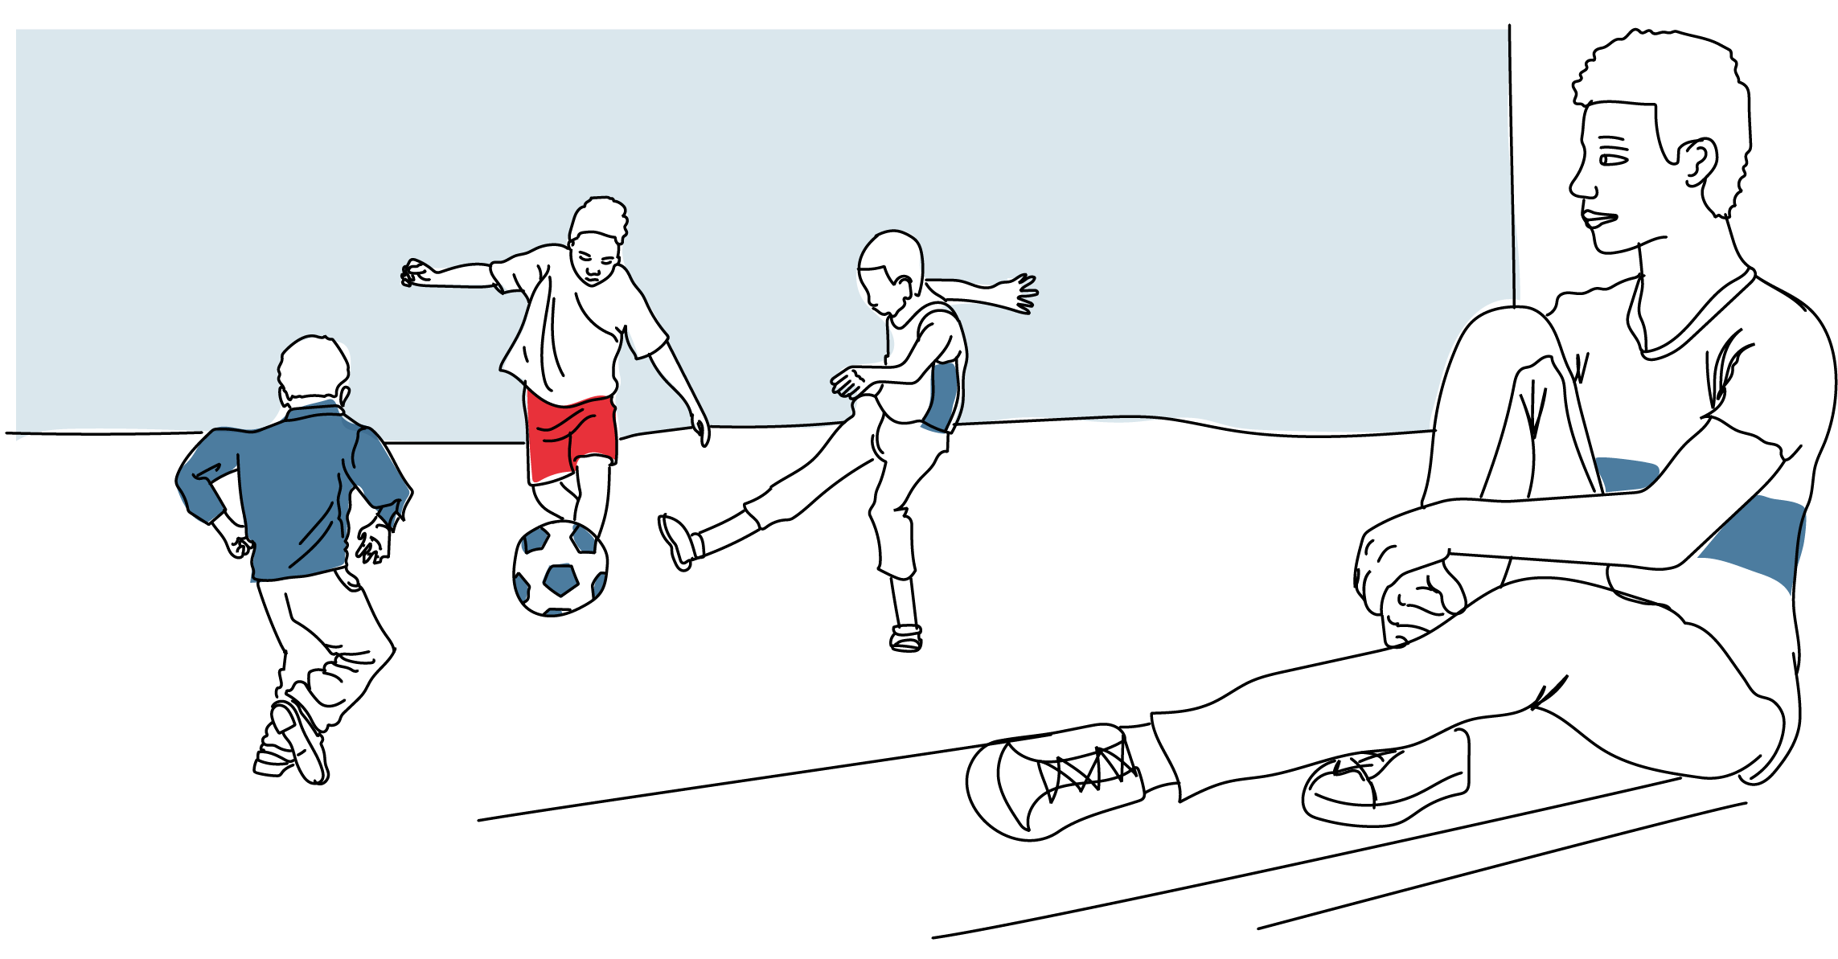
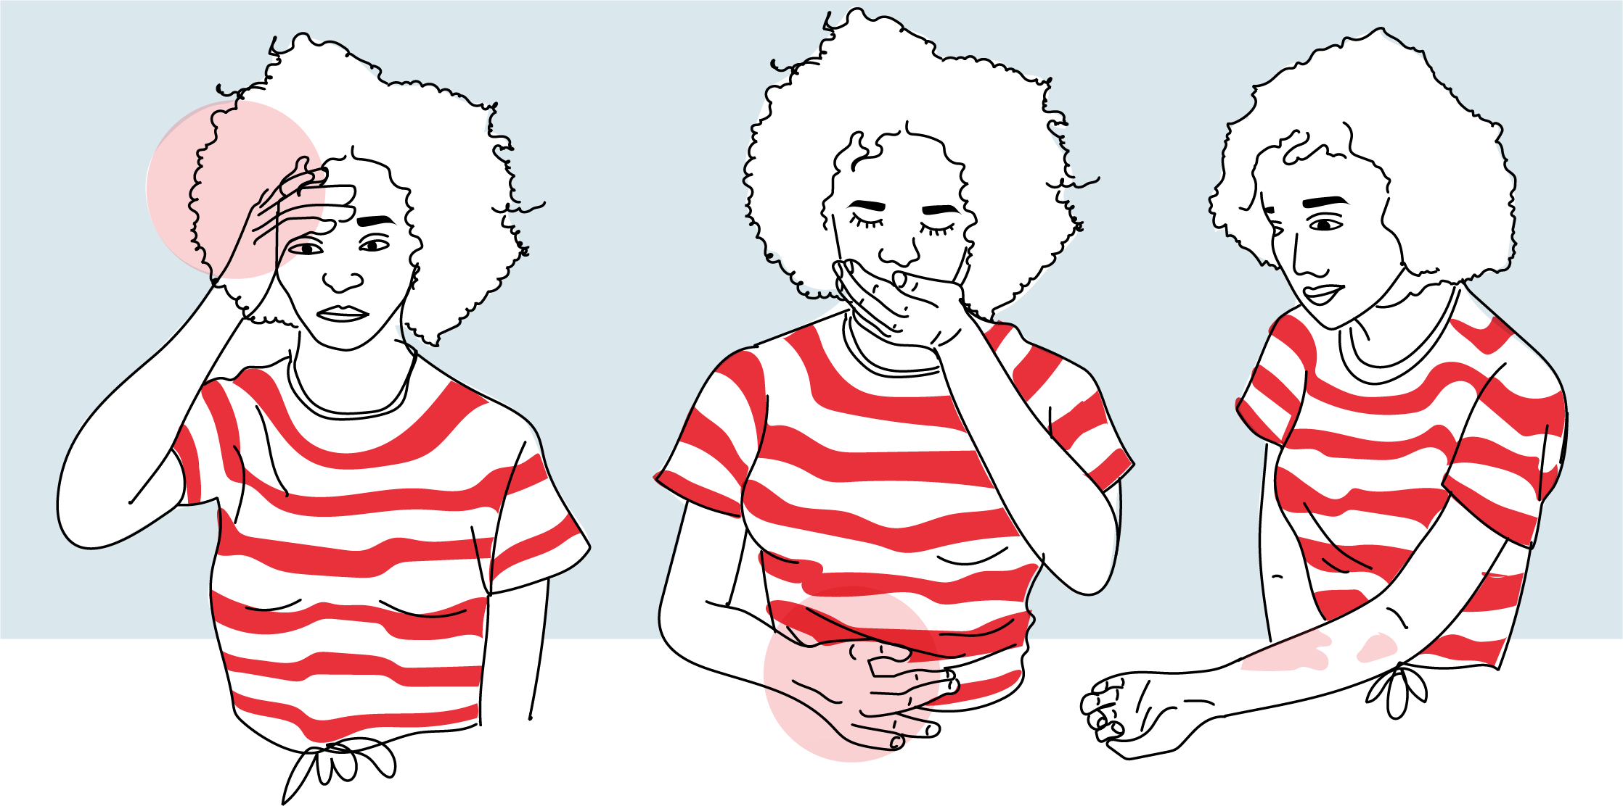
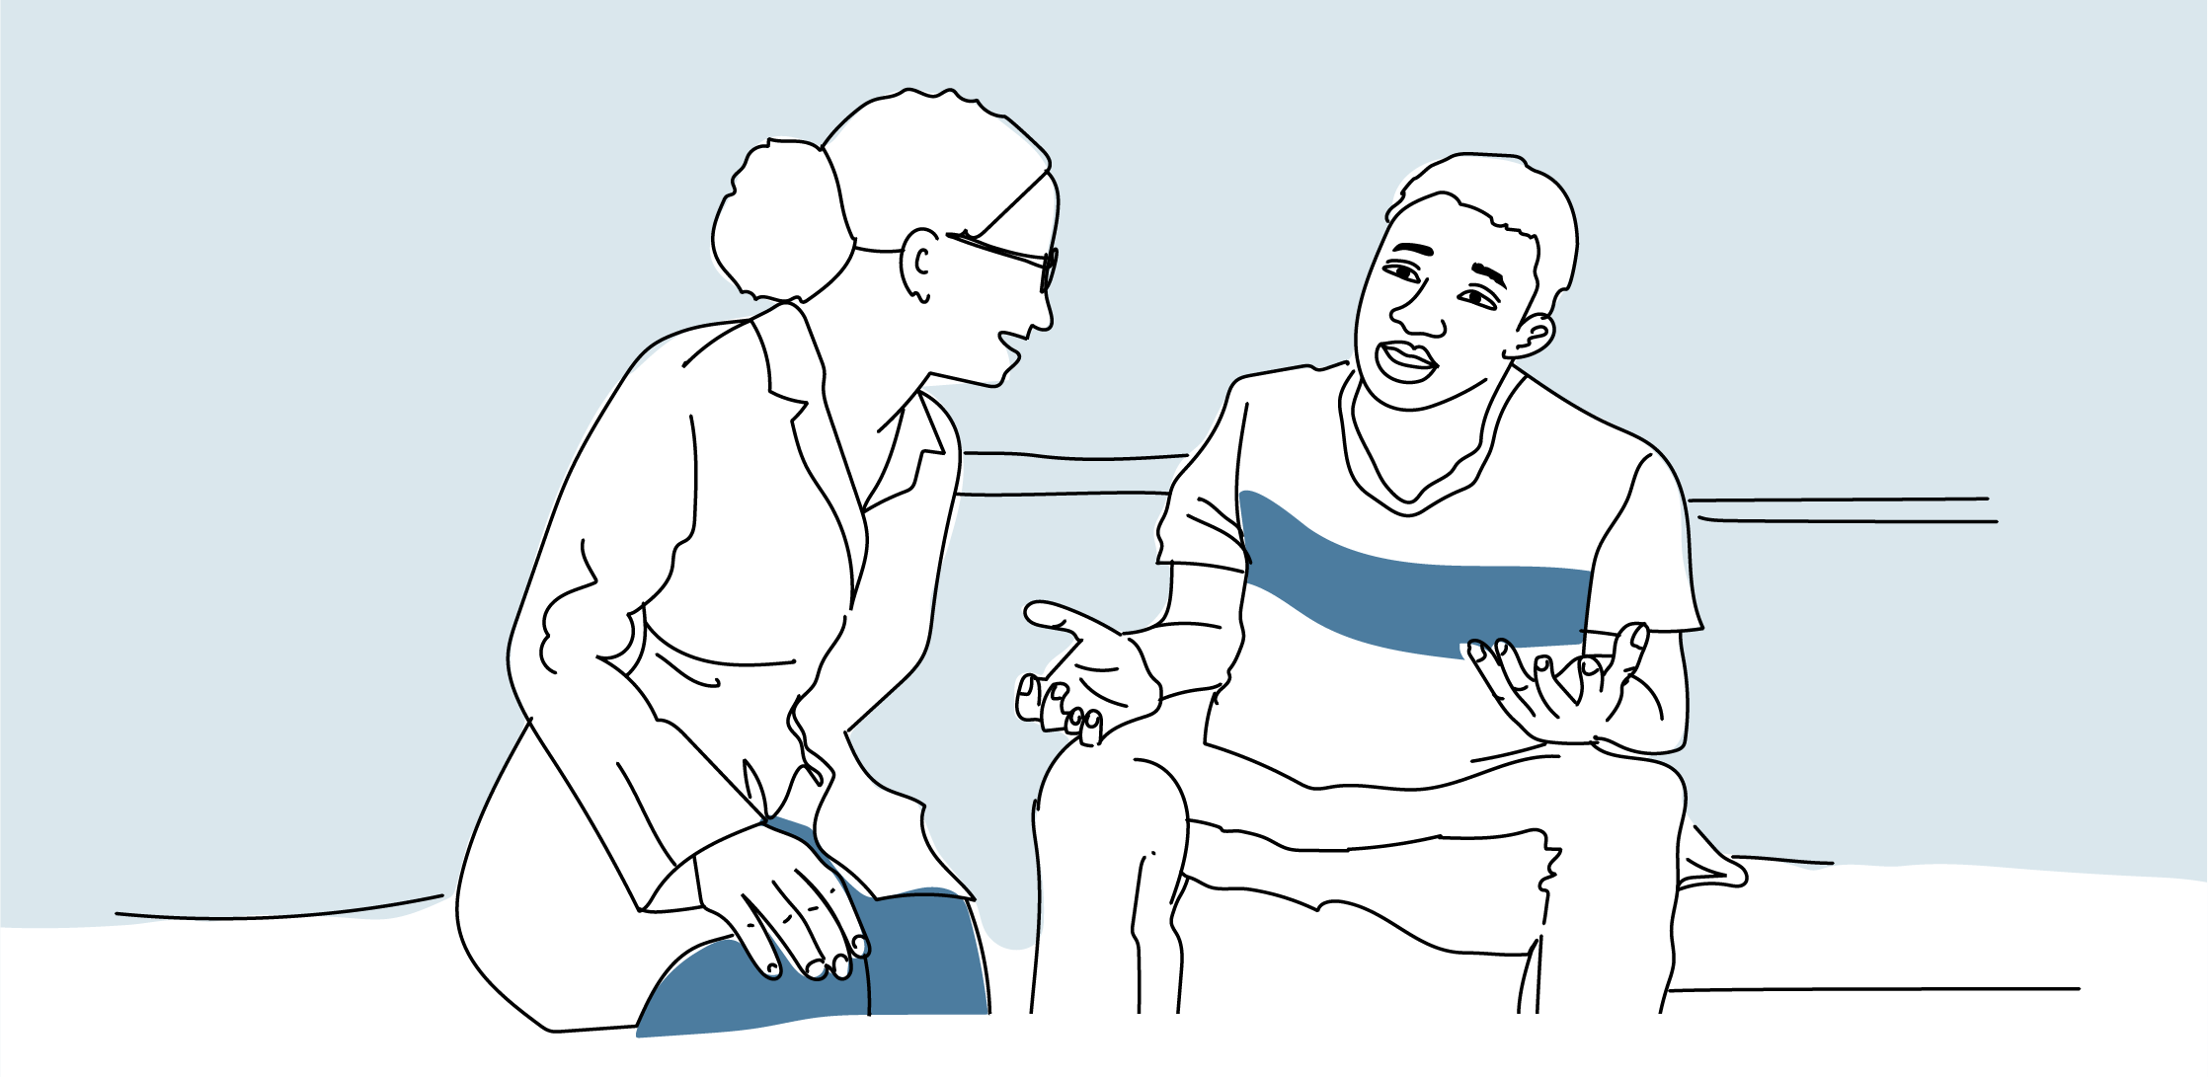
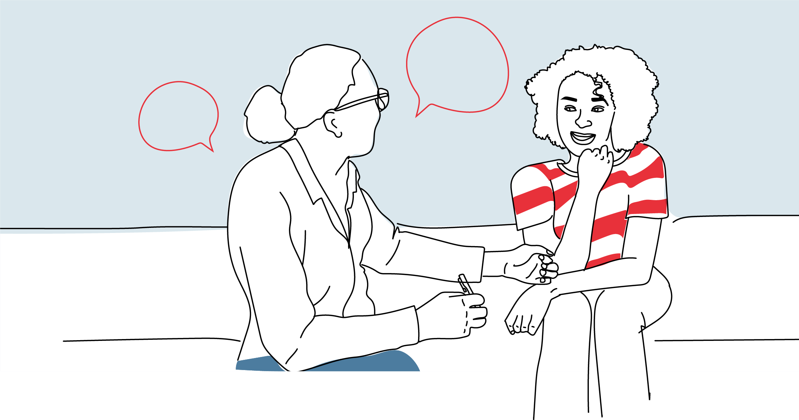
6

Slide 17
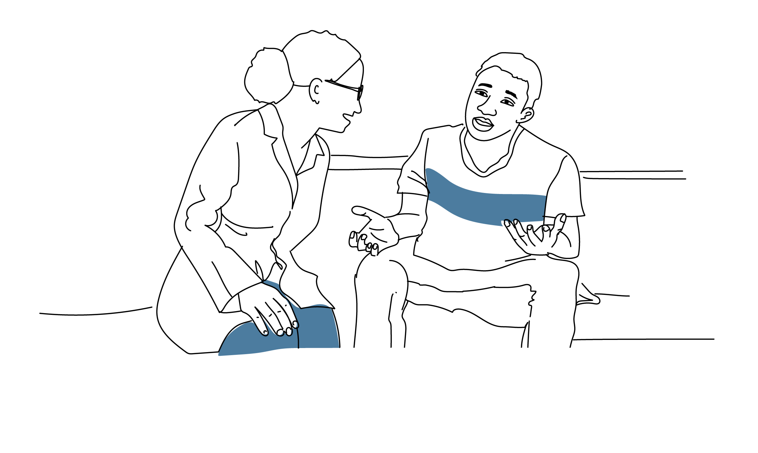
6
TALKING POINTS
Q
Ask:
When might you need to visit a health worker between visits to collect your ARV medications?
Say:
You should reach out to your clinic, case worker or expert client/peer group leader if you feel anxious or sad, hopeless and lose interest in things you enjoy.
You should reach out to your clinic if you have diarrhea, nausea, vomiting, abdominal pain, headache, skin rash, fever, or fatigue.
Be sure you have contact information for your case worker, peer support leader or expert client and clinic.
If you are having a problem, be sure to reach out as early as possible, so you don’t become too ill.
Remember, you can always reach out or visit your clinic between visits, even when you receive a 3- to 6-month supply. We are here to support you and keep you healthy.

Slide 18
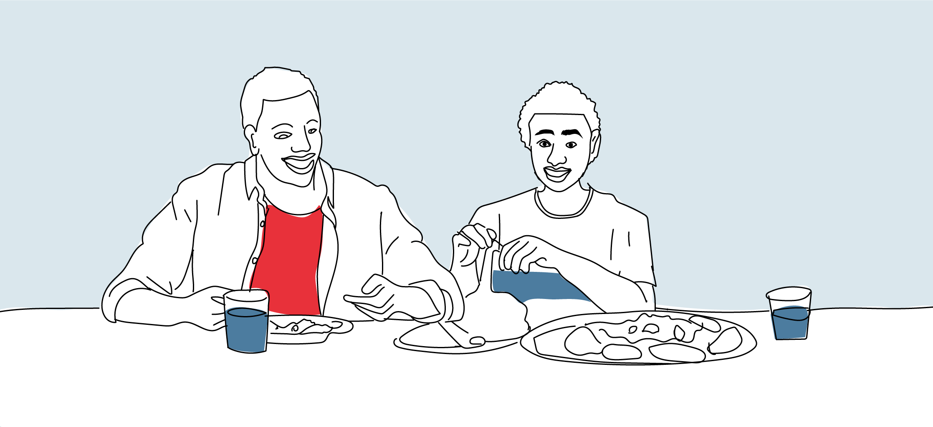
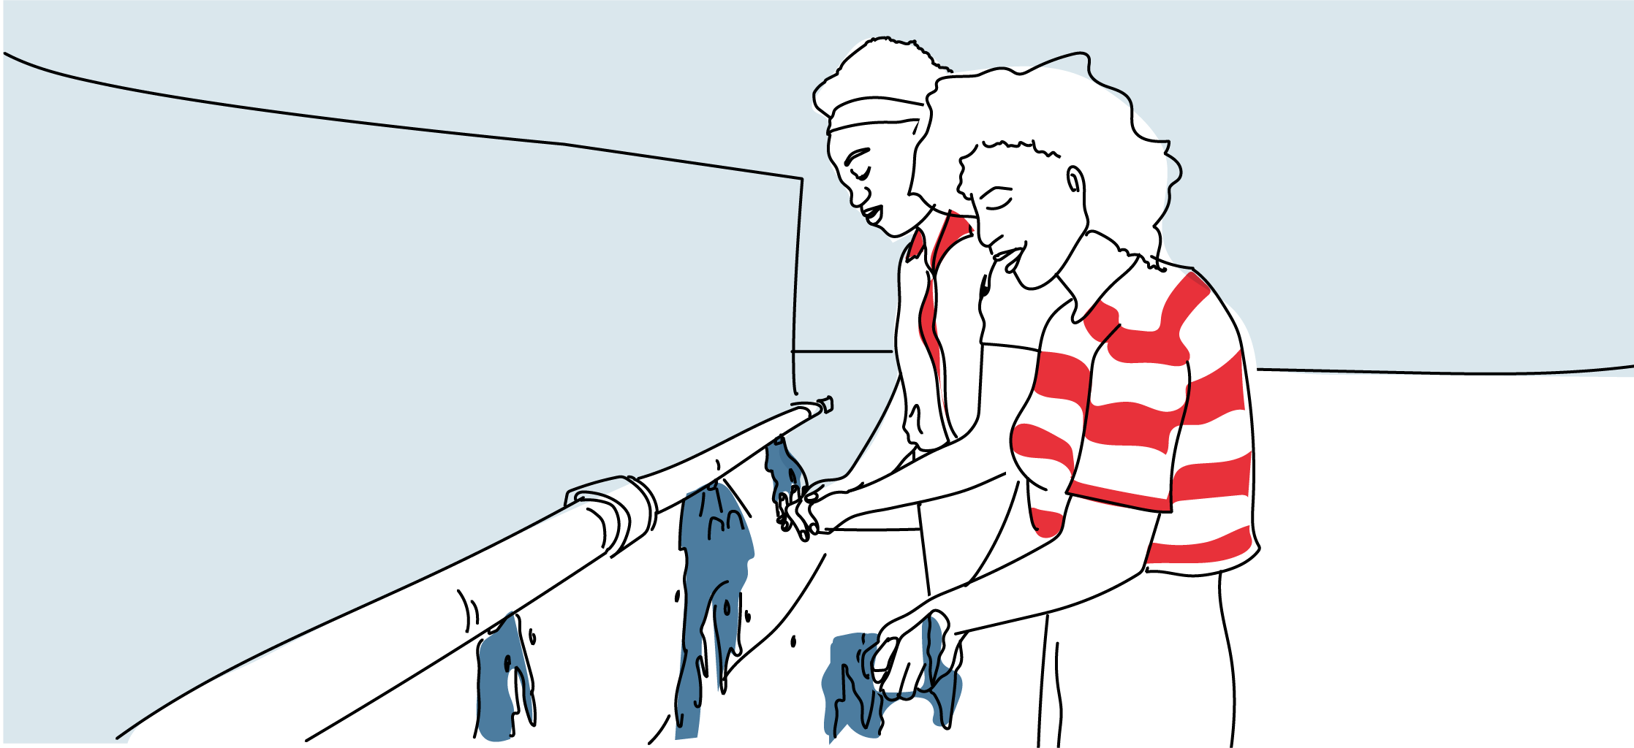
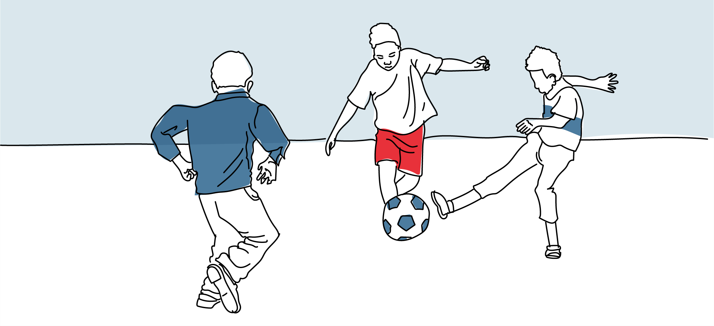
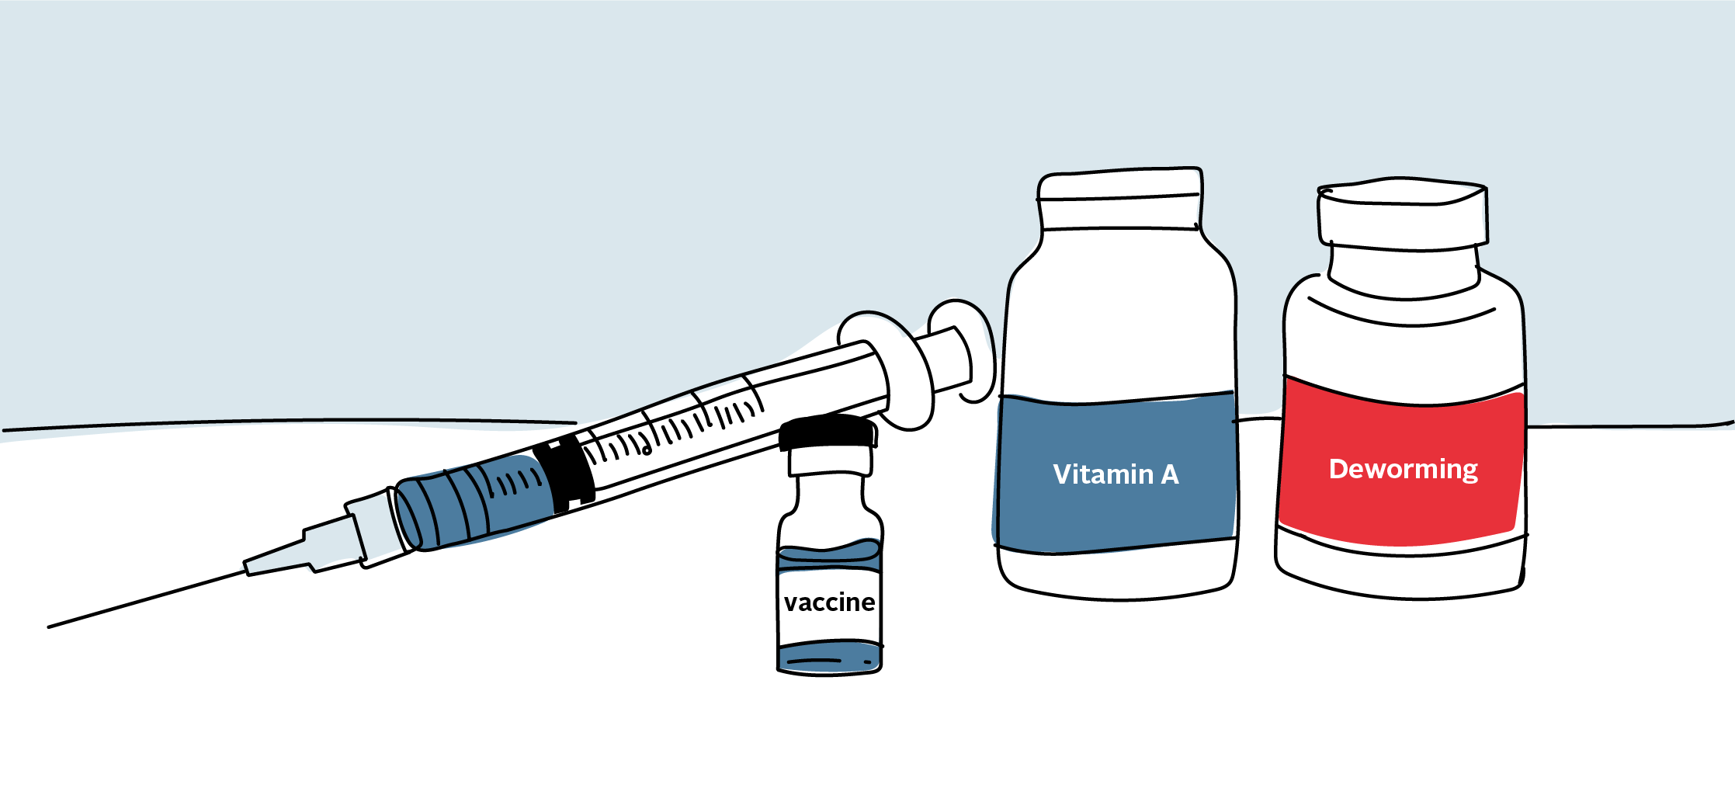
7

Slide 19
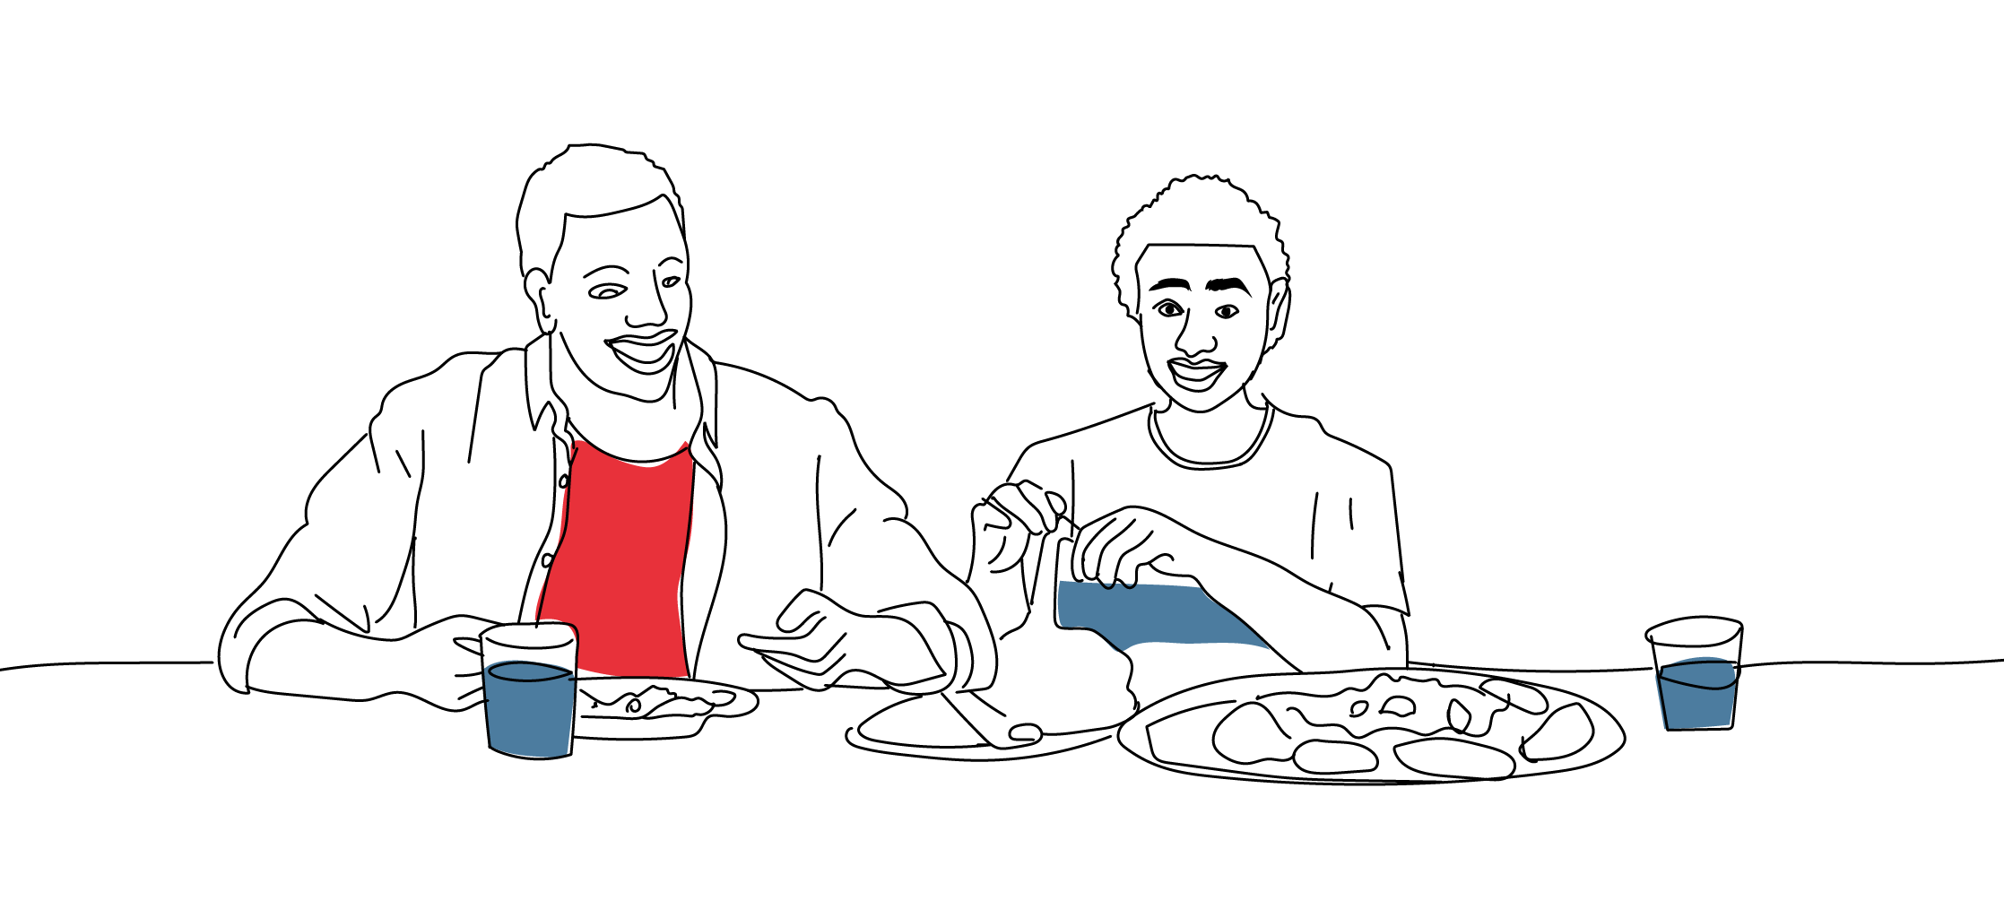
7
TALKING POINTS
Ask:
What else should you keep doing to stay healthy while on ARV medications?
Say:
Eat healthy food and access therapeutic food if you are malnourished.
Take ARV medications consistently to maintain viral suppression.
Make sure you drink safe water, use improved latrines or toilets, and practice good hygiene, including handwashing and menstrual hygiene.
Make sure you stay active and exercise or play sports regularly.
Go for immunization appointments.
Access deworming and vitamin A supplementation services.
Q

Slide 20
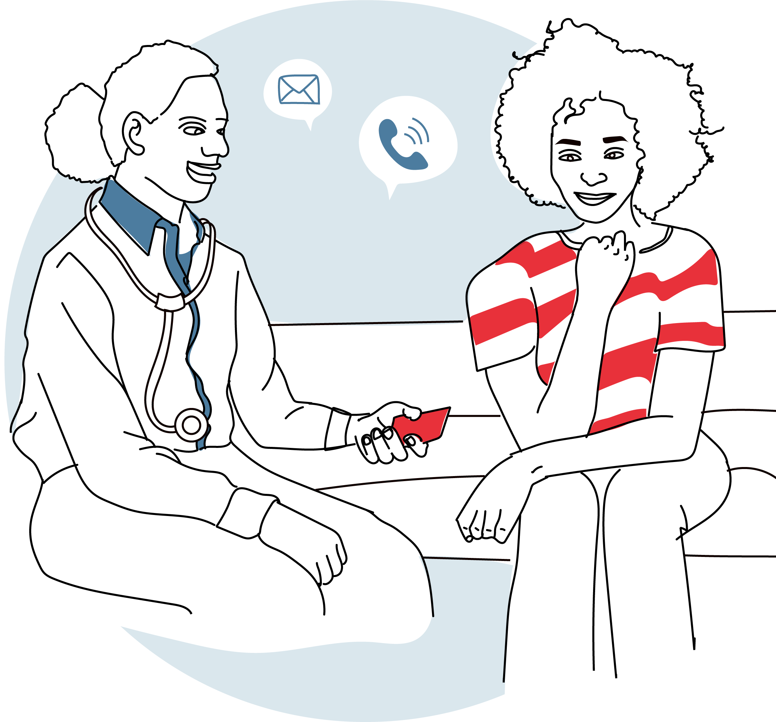
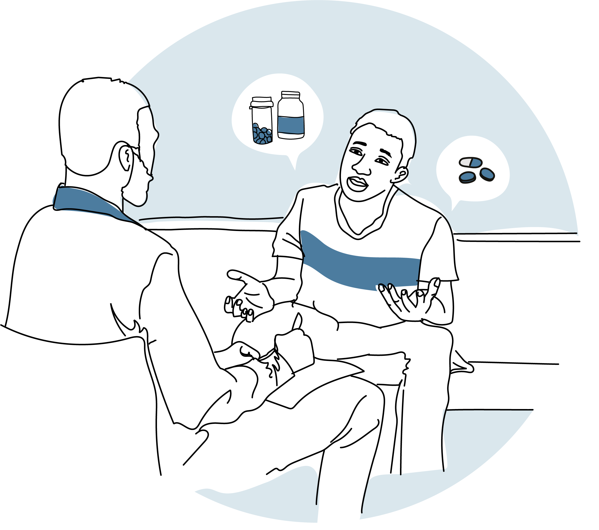
8

Slide 21
8
TALKING POINTS
Q
Ask:
Is there anything else you would like to talk about today?
Say:
We count on seeing you at your next appointment, please do not forget to tell us if you cannot make it.
If you need anything before your next appointment, reach out to your peer support leader/expert client, case worker, or contact me. We are here for you!
Let’s be sure you have the correct contact information for me and your peer support leader or case worker.
If you don’t have a case worker or peer support leader, I am happy to refer you to someone.

Slide 22


