Slide 1

LARCs and YOUTH
Let’s Talk Effectiveness, Safety, and Satisfaction
Candace Lew, MD, MPH
May 27, 2014

Slide 2

LONG-ACTING REVERSIBLE CONTRACEPTION
LARCS

Slide 3
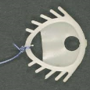
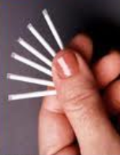
INTRAUTERINE DEVICES AND SUBDERMAL IMPLANTS
Notes:
Not to forget the past and history. But, as a recent journal commentary read: THESE ARE NOT YOUR MOTHER’S IUDS.
How far we have come, development and use: many in the room, this is a tribute to their contribution to the foundation we now have.
Studies in developing world are limited. It appears that both types of implants are similar. However, there are some significant differences between the copper and LVGL IUD, that as the latter becomes more common, client choice may vary, particularly with the advantages which may not be universally viewed as advantages.
Many US women find it hard to part with their Mirenas.

Slide 4
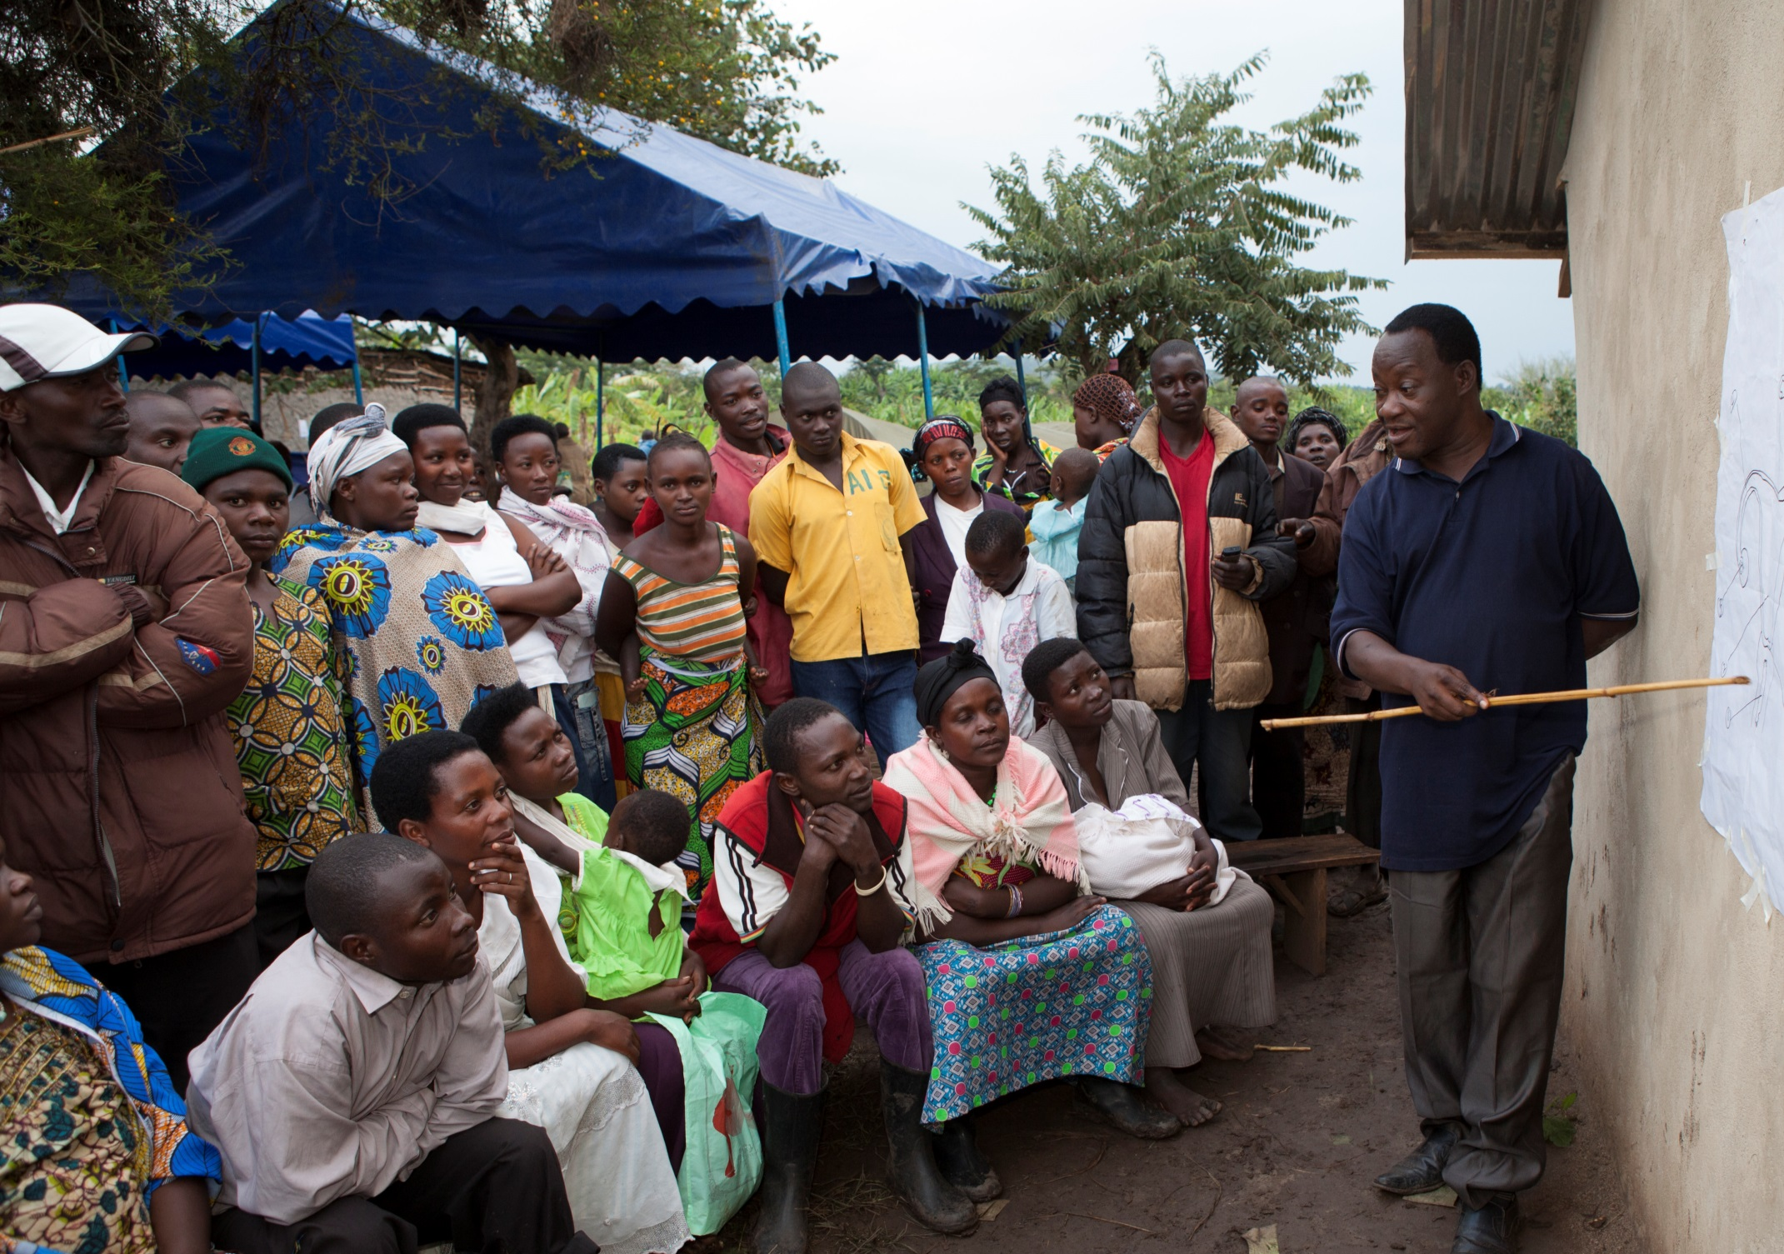
EFFECTIVENESS

Slide 5
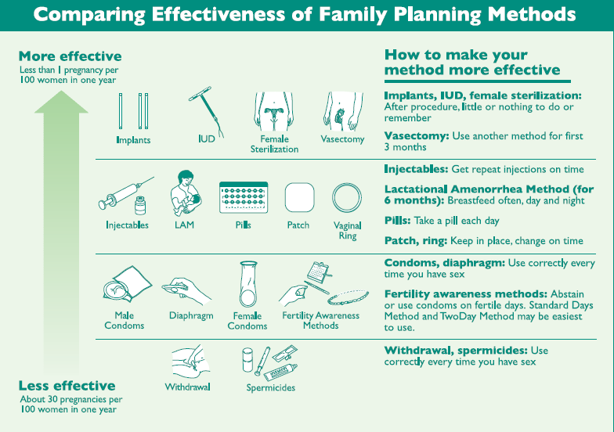
IUDs: Copper-bearing <1PG/100 women, first year
Levonorgestrel <1PG/100 women, first year
Implants: Jadelle/Sino Implant (Levonorgestrel) 2 rods
Implanon/Nexplanon (Etonorgestrel) 1 rod
<1PG/100 women first year (5/10,000)
Notes:
Copper IUD 6-8/1000 first year
Levonorgestrel IUD 2/1000 first year
Note, both IUD and implants are more effective than sterilization

Slide 6
Other considerations with effectiveness
Typical vs. Perfect use
    Implants: High rates of satisfaction in all ages (79%) and continuation (84%)¹
  Sexual activity of adolescents: sporadic, less frequent, higher discontinuation rates of short-acting methods (multiple reasons)
Expulsion rate for adolescents: women under 18 years had 3.5 X expulsion/removal than women 18-21 years; nulliparous women had a significantly increased risk for expulsion²
  ¹ Jacobstein, R., & Stanley, H. (2013). Contraceptive implants providing better choice to meet growing family planning demand. Global Health: Science and Practice, 1(1), 11-17.
  ²Alton, T. M., Brock, G. N., Yang, D., Wilking, D. A., Hertweck, S. P., & Loveless, M. B. (2012). Retrospective Review of Intrauterine Device in Adolescent and Young Women. Journal of Pediatric and Adolescent Gynecology, 25(3), 195-200.
Notes:
LIMITED LMIC ADOLESCENT DATA, but probably can assume effectiveness is similar in US and LMIC
1. US predominantly
3. Title X Louisville , Ky
3a. Removals/expulsions. Expulsions alone were greater but not statistically significant
Multiple studies: expulsions all IUD users: 3-5%. Adolescents: 5-22%
3 b. not attributable to age

Slide 7

SAFETY

Slide 8
Who medical eligibility criteria (MEC) 2010
Levonorgestrel and Etonogestrel Implants:
  Category 1 for women of all ages, including young people from menarche on.
  Category 1 for all parities, postpartum, post-abortion
  Category 1 for those at high risk, or confirmed STI, including HIV (depending on ARV tx)
Copper and Levonorgestrel IUDs:
  Category 2 for <20 years, nulliparity
  Category 1 for ≥ 20 years, multiparity
Notes:
category With clinical Judgment With Limited clinical
Judgment
1 Use method in any circumstances
Yes
(Use the method)
2 Generally use method
3 Use of method not usually recommended unless other more appropriate methods are not available or not acceptable
No
(Do not use the method)
4 Method not to be used

Slide 9
Pelvic inflammatory disease (PID)
Few studies on risk for youth
Risk of PID with placement 0-2% (no cervical infection) 0-5% (cervical infection present)
General evidence suggests slight increase in infection in the first 20 days after insertion
Usual cause of infection: contamination associated with insertion and NOT the IUD – importance of infection prevention

Slide 10
Other safety characteristics
No increase in infertility after removal; Reversible
No increase in risk of ectopic pregnancy
Notes:
Weight with hormonal methods: conflicting data
Osteoporosis does not appear to be increased.

Slide 11
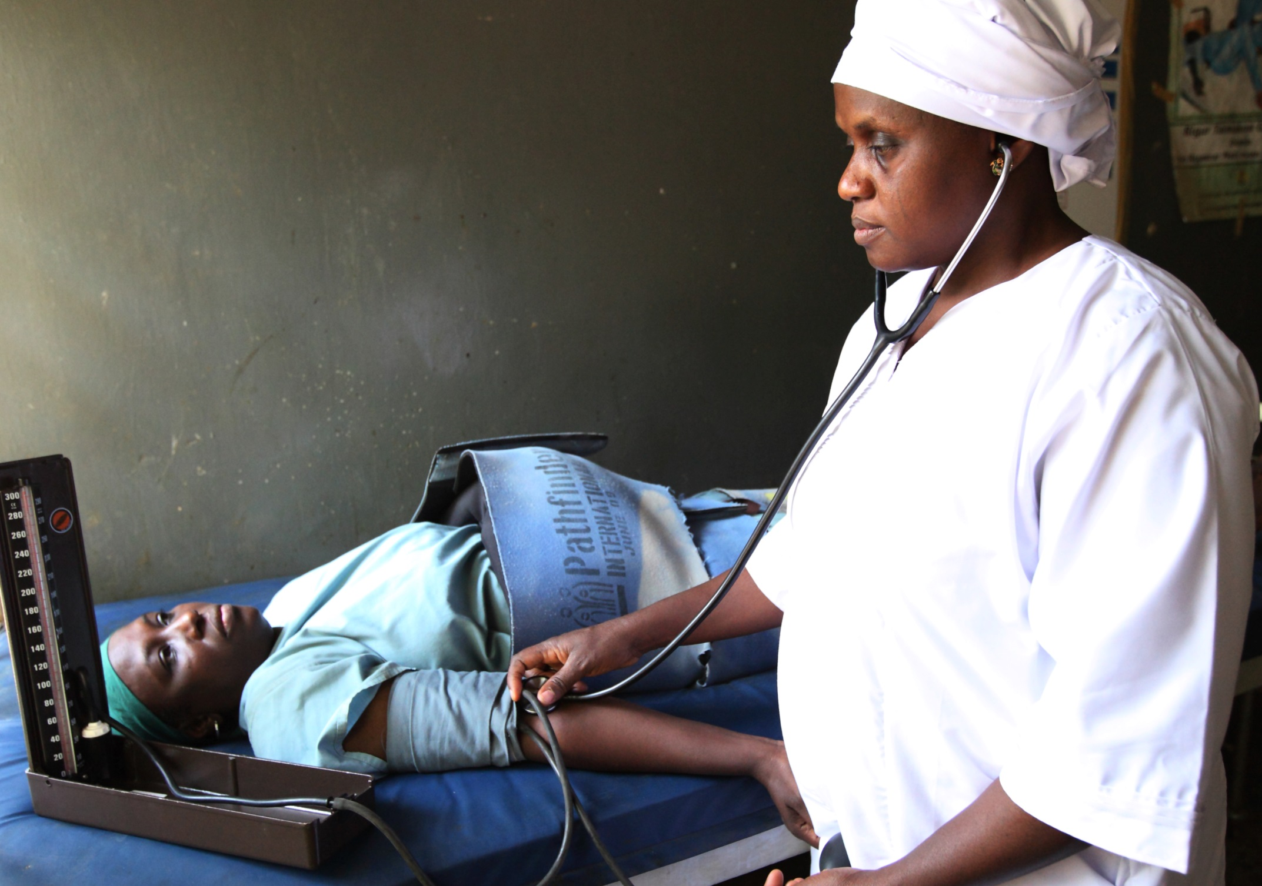
z
YOUTH
STATISTICS IN LMIC COUNTRIES

Slide 12
Unmet need for youth in LMIC
An estimated 33 million female youth have an unmet need for FP; 2/3 of these are in South and Southeast Asia, however, the highest rates in Africa¹
  West Africa – 41%
  Central Africa – 29.3%
  East Africa – 39.8%
  Southern Africa – 25.5%
In 15-19 year olds, 34-67% unmet need (unmarried women) and 7-62% (married women)²
¹MacQuarrie, Kerry L.D. 2014. Unmet Need for Family Planning Among Young Women: Levels and Trends. DHS Comparative Reports No. 34. Rockville, Maryland, USA: ICF International. - See more at: http://www.dhsprogram.com/publications/publication-cr34-comparative-reports.cfm#sthash.pEZ2D6PG.dpuf
²Chandra-Mouli, V., McCarraher, D. R., Phillips, S. J., Williamson, N. E., & Hainsworth, G. (2014). Contraception for adolescents in low and middle income countries: needs, barriers, and access. Reproductive health, 11(1), 1.
Notes:
2. LMIC

Slide 13
Pregnancy and abortion in youth in lmic
16 M adolescents (15-19 years) give birth annually; 95% are in LMIC
Unintended pregnancies in adolescents is a worldwide problem¹
In 15-19 year old females, complications of pregnancy and birth are the leading cause of death
14% of unsafe abortions occur among women < 20 years of age²
In SSA, women < 25 years of age account for 55% unsafe abortions
¹Ramos S. Interventions for preventing unintended pregnancies among adolescents: RHL commentary (last revised: 1 August 2011). The WHO Reproductive Health Library; Geneva: World Health Organization.
²World Health Organization (2005). The World Health Report: Make every mother and child count. Available at: http://www.who.int/ whr/2005/whr2005_en.pdf?ua=1
Notes:
4. Probably globally
Vs.
5. SSA!

Slide 14
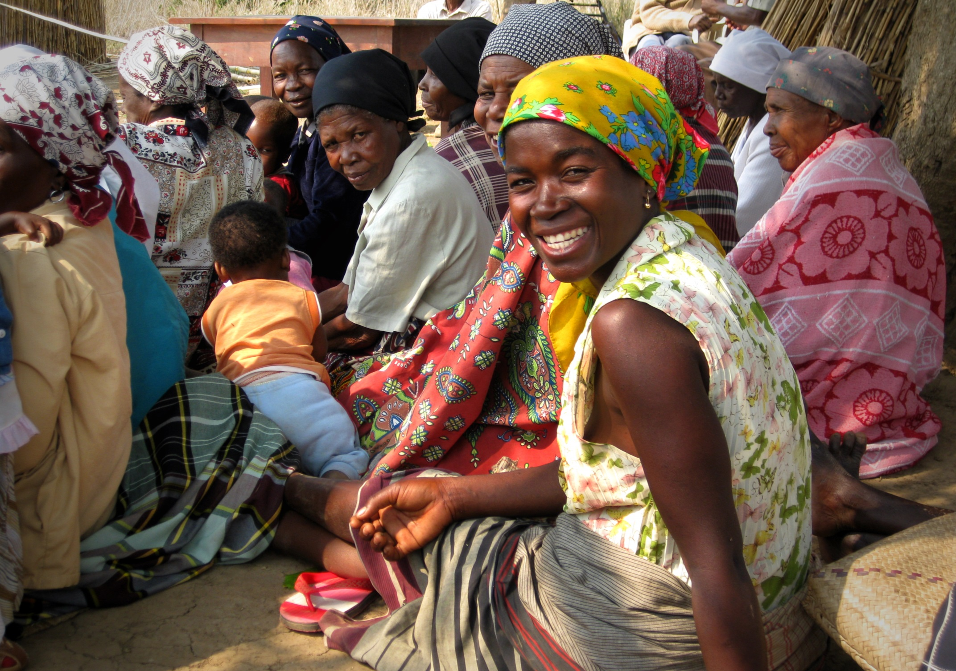
YOUTH SATISFACTION WITH LARCS IN LMIC COUNTRIES

Slide 15
Youth choice of and satisfaction with Larcs in lmic
Jacobstein & Stanley (2013) : 79% user satisfaction; 84% continuation rates
Hubacher, et al. (2011): Kenya, 24% of 18-24 year olds chose implants
Hubacher, et al. (2012): Kenya, of above 24%, 18 month discontinuation rate for implants: 21%; for short-acting methods: 42%. 22 unintended pregnancies, all occurred in short-acting group.
Abasaiattai, et al. (2008): Nigeria, 39.7% of new contraceptive acceptors chose the IUD; 27.2% were < 25 years of age
Notes:
CHOICE and satisfaction because many studies haven’t yet addressed satisfaction, takes longer.
1. Quoted with implants, mainly US.
Increased use of implants in Malawi, Rwanda, Ethiopia, TZ from 2004-5 to 2010.
2. 400 18-24 year olds seeking short term methods (DMPA or COC) at a public facility, were offered implant instead. 24% chose implant. Nairobi 2008-2009
3. Same study group, discontinuation rates during 18 month follow-up. Relative risk of pregnancy with short acting vs. implants was 7.4. 80% continuation at 18 months; but can’t assume all satisfied.
4. University teaching hospital family planning register in maternity unit. Uyo, Akwa, Jan 2000-Dec 2005 – 6 years.
Out of 852 new acceptors, 338 or 39.7% accepted IUD. 27.2% of these were < 25 years, but 8.3% were 15-19 and 18.9% were 20-24. 4.4% were nulliparous.

Slide 16
Ethiopia
E2A Community-based delivery of LARCs to youth
  Intervention: 2 week competency-based skills training for LARCS insertion and removal for YFS providers
  Preliminary findings:
    Pre-intervention phase : of 189 new acceptors, 61% LARC acceptors
    Post-intervention phase: of 384 new acceptors, 77% LARC acceptors

Slide 17
Mali
PSI Mali: ProFam network
  Intervention: midwives trained in counseling and provision of all methods including LARCs. No specific focus on youth.
  Immunization event days: integration of contraception and immunization
  Findings:
    48.8% implant acceptors were < 25 years of age
    40.9% IUD acceptors were ≤ 29 years of age

Slide 18
Bangladesh
Mayer Hashi (RESPOND Project) 2013
  Intervention: peer-led approach to provide young married couples (≤ 20 years of age) with FP information, particularly LARCs
  Findings:
    Increase of young married women’s use of contraception
    Implant: from 0 to 6%
    IUD: from 0 to 1%
    Injectables 7-21%

Slide 19

ESSENTIALS OF ACCEPTABLE AND QUALITY LARC SERVICES FOR YOUTH

Slide 20
Address youth, parent, community low levels of awareness; including myths, misconceptions, and health and non-health benefits
Address provider and facility staff bias/beliefs around sex and contraception in youth
Include respectful youth friendly counseling and service provision e.g.
  Confidentiality
  Dual protection
Provide appropriate management of side effects
Provide timely removal services as requested
Notes:
Leave you with this: Food for thought leading into activities of the latter part of this meeting.

Slide 21
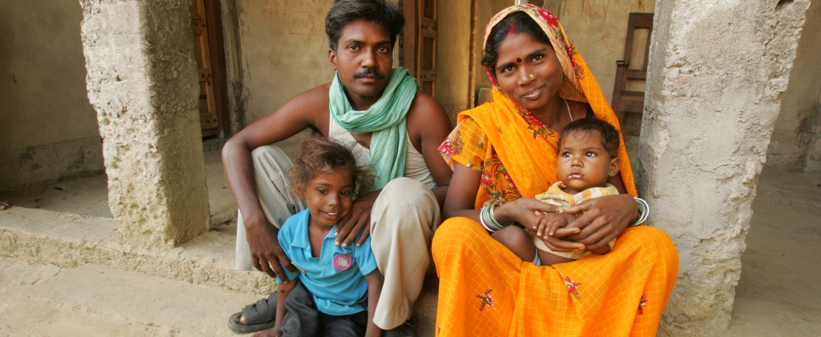
For more information contact Linda Suttenfield
Lsuttenfield@pathfinder.org

