Slide 1
Introduction to Motivational Counseling
Module 2 — Motivational counseling training
Country, Year

Slide 2


Slide 3

Making a change is…
…NOT always easy

Slide 4
The many roles of an outreach worker, navigator, counselor, and/or provider
Inform
Teach Skills
Provide Resources
Motivate

Slide 5
Motivational counseling
A client-centered communication approach to elicit and strengthen motivation for change

Slide 6
Client-centered

Slide 7

What is ambivalence?

Slide 8
Empathy

Slide 9
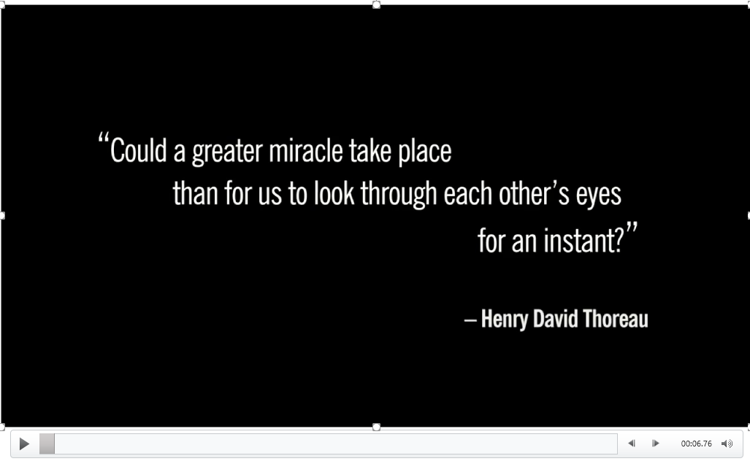
Download and play video: https://www.youtube.com/watch?v=cDDWvj_q-o8

Slide 10
Ready to get started?

