Slide 1
Stakeholder Engagement Toolkit
for HIV Prevention Trials
by Kathleen M. MacQueen, Sarah V. Harlan,
Katie West Slevin, Stacey Hannah, Emily Bass and Jill Moffett
Notes:
A Note to Facilitator/Users:
This presentation is intended as an orientation to the Stakeholder Engagement Toolkit for HIV Prevention Trials. It will show research teams how the Toolkit can be used to help you go about the practical business of stakeholder engagement and to organize your work.
The notes pages are intended to be used as a suggested script for both:
Individual viewers who will be navigating through the slides on their own; and
Presenters who wish to introduce the Toolkit to other potential users can review the script to prepare but should not read the script verbatim during the presentation.
If you will be using this slide set to present the Toolkit to your colleagues or other audiences, we suggest you have a copy of the Toolkit on hand and give each participant a handout of these PowerPoint slides to help them follow along with the material presented.
Visit http://www.fhi360.org/resource/stakeholder-engagement-toolkit-hiv-prevention-trials
To download a PDF of the Toolkit and other stakeholder engagement resources
To access the Toolkit Quick Guide—an electronic reference guide (be prepared to display the Quick Guide from the CD or the website; see slides 2, 9, 22, 43)
To request printed copies of the Toolkit and a CD containing the Toolkit Quick Guide and other stakeholder engagement resources (limited copies available)
From start to finish, this presentation should take approximately 30 to 45 minutes on average to read or present. If the scavenger hunt and discussion questions are used, allow 50 to 60 minutes.
FHI 360
T: 1-919-544-7040
www.fhi360.org

Slide 2
Stakeholder Engagement (SE) Toolkit for HIV Prevention Trials
Copyright© 2012
Notes:
Speaker Notes:
Identifying and engaging stakeholders in the research process is critically important, but in practice it is rarely approached in a systematic and thoughtful way. For that reason in 2012, FHI 360 and AVAC, with support from USAID through the Preventive Technologies Agreement, created the Stakeholder Engagement Toolkit for HIV Prevention Trials to capture a set of best practices and tools that will help research teams facilitate the initial and ongoing process of engaging stakeholders.
In 2014, based on user demand printed copies of the Toolkit were made available. The Toolkit developers also surveyed Toolkit users to determine how the Toolkit was being used and what might improve its usability. The feedback from survey respondents was used to develop the Toolkit Quick Guide and other E-resources to improve the usability of the Toolkit’s components. These resources are available on CD and on the FHI 360 web site—we will take a look at them shortly.
Discussion question: Does anyone have prior experience using the Toolkit? If so, please share your experiences with using the resources as we discuss the steps in the Toolkit.

Slide 3
Structure of this Presentation
Toolkit objectives
Who is a stakeholder?
The ongoing process of stakeholder engagement
Adapting the Toolkit to your needs
How the Toolkit is organized (7 steps)
For each step from the Toolkit:
Examine why it is important
Review goals and tasks
Consider some of the tools
Highlight a unique element
Copyright© 2012
Notes:
This presentation orients you to the Toolkit, covering topics such as:
Toolkit objectives.
Who is a stakeholder?
The ongoing process of stakeholder engagement.
Adapting the Toolkit to your needs.
How the Toolkit is organized.
What elements are included in the Toolkit to facilitate the engagement process.
For each of the seven steps from the Toolkit, we will:
Examine why that step is important;
Present the goals of that step;
Outline the tasks required to achieve those goals;
Show you some of the tools that will help you accomplish the tasks; and,
Highlight elements of particular interest from the Toolkit that relate to that step.

Slide 4
Objectives of the Toolkit
Provide step-by-step guidance to help HIV researchers engage stakeholders efficiently and transparently
Provide tools to help staff document their plans and experiences as they implement a SE engagement strategy
Make it easier for research teams in different settings to compare methods and identify best practices
Copyright© 2012
Notes:
Stakeholder engagement can be easily integrated into your research project—you simply need a system to help you prepare and to organize your work. The Toolkit provides you with this system. Specifically, the Toolkit provides step-by-step guidance and practical tools that make it easier for research teams to compare methods and identify best practices that work across settings. It also provides guidance on how to document your methods and accomplishments—adding to the field’s expanding toolbox for stakeholder engagement.

Slide 5
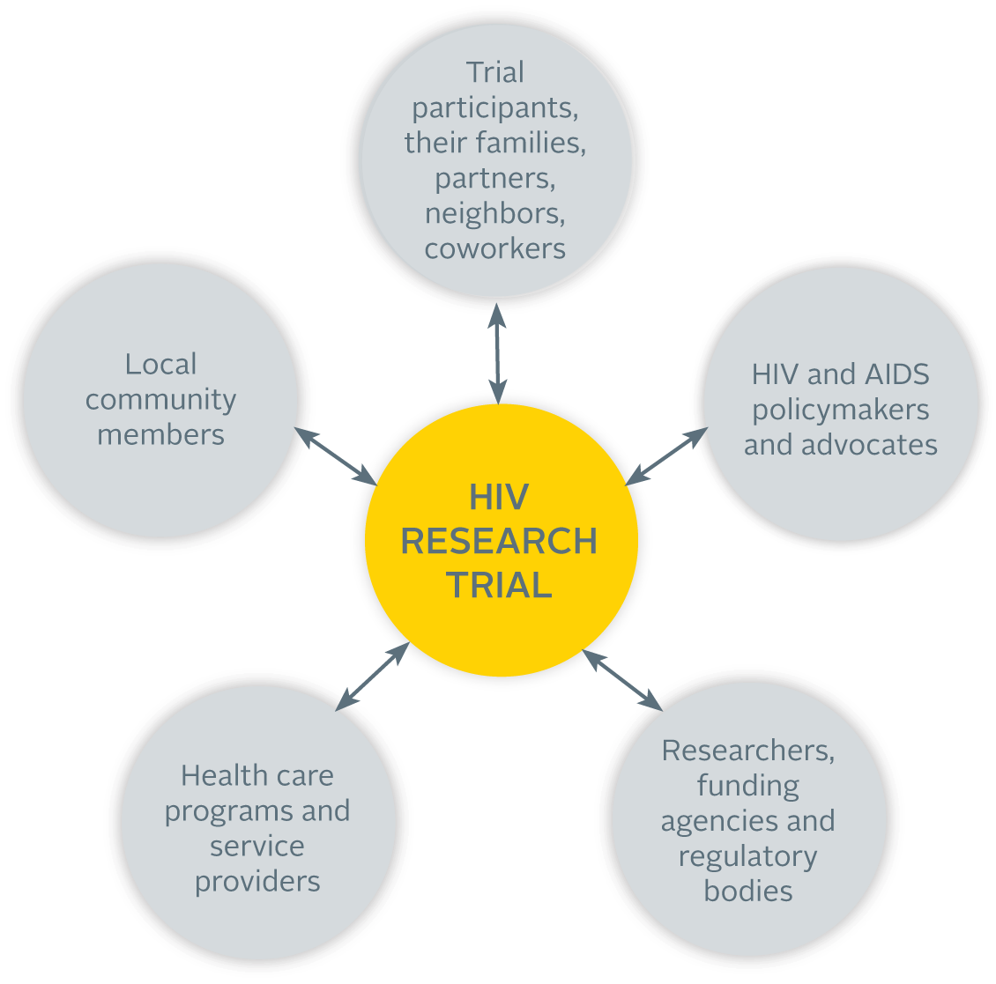
Who is a Stakeholder?
Copyright© 2012
Notes:
Before proceeding, let us first clarify ‘Who is a stakeholder’?
As defined by the Toolkit (see page ix), a stakeholder is someone at the local, national or international level who can affect or be affected by the research—potentially a large group of people who are deeply interested in the results of your trial.
Five broad groups of stakeholders are mentioned in the Toolkit, however a person may be a member of more than one stakeholder group.
It is important to note that stakeholder engagement is not the same thing as community engagement in the trial. Stakeholder engagement includes, but is not limited to, community engagement. It involves groups such as health care providers and funders, that are typically not part of community engagement activities.
The Toolkit will help you identify which stakeholders you should try to reach, and how to engage with them.
____
Note: This diagram can be found in the Toolkit on page ix.

Slide 6
Stakeholder Engagement as an Ongoing Process
predicting which challenges might arise is difficult
resources must be set aside for potential stakeholder engagement activities and to mitigate complications
asses and develop knowledge and skills
ensure everyone can appropriately and effectively engage with the research and each other
research team must be committed and capable
deficiencies in capacity for stakeholder engagement must be addressed
ensure that accurate information about the trial reaches stakeholders and the broader community
combat misperceptions or rumors that may exist
determine whether stakeholder engagement efforts are effective and reflective of the time and resources involved
identify individuals and organizations with a stake in the project
compile/organize relevant information about them in a way that makes sense
understand the relationships between stakeholder groups and the context within which the trial takes place
prepare accordingly
Stakeholder Engagement Toolkit for HIV Prevention Trials
Notes:
Speaker Notes
The Toolkit accomplishes this by providing a systematic approach to help research teams plan for stakeholder engagement through every stage of the research process—from developing an initial plan and budget before the research begins to developing the capacity of, and sustaining relationships with, a broad range of stakeholders.
As you can see from the diagram (see page xiii), stakeholder engagement is a continuous process. The Toolkit outlines the stakeholder engagement process in a series of seven steps—which are roughly sequential but with much back-and-forth as situations evolve over time. [Click mouse to advance through the descriptions of each step.]
Step One: Plan and budget for stakeholder engagement—it’s a tricky first step since it’s difficult to predict what challenges might arise during a study but financial resources must be set aside for potential stakeholder engagement activities and to mitigate complications that may develop during the study.
Step Two: Secure commitments to guiding principles of stakeholder engagement from the research team—it’s important to have an understanding of the team’s commitment and address any deficiencies in the team’s capacity for stakeholder engagement.
Step Three: Design a monitoring and evaluation system for stakeholder engagement—it’s important to determine whether your stakeholder engagement efforts are effective and reflective of the time and resources involved.
Step Four: Describe key features of the research context—it’s critical to understand the relationships between stakeholder groups and the context within which your trial is taking place so that you can prepare accordingly.
Step Five: Identify and describe stakeholders—it’s important to take the time to identify the individuals and organizations that have a stake in your project, compile relevant information about them, and organize the information in a way that makes sense.
Step Six: Engage stakeholders and sustain relationships—this is where all of the preparation pays off and allows you to ensure that accurate information about your trial is reaching your identified stakeholders and the broader community so that you can effectively combat any misperceptions and/or rumors that may exist and address issues of trust and transparency.
Step Seven: Develop stakeholder capacity—including the study community, your trial participants, and your own research team to ensure that everyone has the knowledge and skills to appropriately and effectively engage with the research and each other.

Slide 7
Adapting the Toolkit for Different Needs
Research teams planning to implement their first HIV-related clinical trial at a single site
Experienced research teams
Multi-site research teams
Research networks
Copyright© 2012
Notes:
Furthermore, the Toolkit can be adapted depending on your specific setting and situation. For instance:
Research teams that are planning to implement their first HIV-related clinical trial at a single site may wish to use the Toolkit in a simple, stepwise fashion.
A research team that already has some experience with implementing an HIV-related clinical trial, and is planning a new trial, or has an ongoing trial, can use the Toolkit as a step-by-step reference during various stages of their new or ongoing trial. For instance, during an ongoing trial, appropriate resources from the Toolkit could be selected and used to evaluate the current status of stakeholder engagement and the team’s actions adjusted as necessary.
A research team that is collaborating with teams at other sites may wish to implement a common protocol for stakeholder engagement. In such instances, the Toolkit could serve as a template for trial-wide guidance.
And lastly, the Toolkit could also be used to supplement whatever guidance is provided by larger trial networks, filling in gaps as needed on a site-by-site basis.
The ideal would be to begin working through the steps outlined in the Toolkit before your trial begins enrolling participants. However, perhaps your trial is already underway when you come across the Toolkit. It can still serve as a useful resource regardless of where you are in the research process. In some cases, it will be worthwhile to go back and retrace some of the steps from the Toolkit. In others, you may have already completed those steps on your own. In either case, for many of the steps, you will find documentation templates and systems for tracking what you’ve already started and to help you organize your work. You might also discover new activities and tools that you’d like to use.

Slide 8
How the Toolkit is Organized
Each step of the Toolkit contains:
Goals/rationale
Task list
Case studies and tips
Checklist
Tools (appendices)
Goals of Step One
Identify — and provide direction to — the other steps of stakeholder engagement that will be most useful to your trial team.
Develop a baseline: Take inventory of your organization’s resources, knowledge and skills; identify your weaknesses and strengths.
Determine your budget for stakeholder engagement and create your plan.
Develop your staff’s capacity to engage stakeholders; hire new staff members and provide training if appropriate.
Task list
Case Study
Checklist: Step Five
Use this checklist to make sure that you accomplished all the tasks required in Step Five.
List all key stakeholders.
Collect information about individuals and organizations .
Enter information into an electronic database.
Create expanded profiles.
Clearly define stakeholder groups.
Secure active involvement.
Update database throughout the project.
Copyright© 2012
Notes:
So let’s talk about how the Toolkit is organized. Each step of the Toolkit is configured in a similar manner. To get a feel for that let’s take a quick look at the various elements you’ll find in each step. As we complete this overview of the Toolkit, we’re going to conduct a scavenger hunt. Periodically I will ask a question and your job will be to find the answer in the Toolkit. The first person with the answer will get a small prize.
Each step of the Toolkit begins with an introduction that clearly outlines the goals and provides a rationale for why the step is important. Look in your copy of the Toolkit, find the Goals for Step One. Who can tell me the second goal?
This is followed by a task list (see page 4). The task list describes the process for accomplishing the goals. This is the meat of the Toolkit. Each task list provides a step-by-step approach for accomplishing the goals outlined in the introduction. The task list answers the question, “How?” Each task in the list includes the action to be completed, the expected result, and a detailed explanation of how to go about it.
Because the Toolkit is based on real-world experience from people actively working in the field of HIV prevention research, it also includes case studies (see page 12) and tips (see page 6) to highlight how others have approached various steps in the stakeholder engagement process. The case studies not only provide best practices and valuable lessons learned, but shows you how the steps work in practice.
Each step is then distilled into a comprehensive checklist (see page 16) to help you identify the tasks you need to accomplish and track your progress.
The appendices contain a series of practical tools directly related to each step. Many of these are easy-to-use worksheets—often with examples of completed worksheets—to help guide you through the seven steps of stakeholder engagement. Look in your copy of the Toolkit, find the second task in the Task List in Chapter 1. Which tool is referenced in that task? Answer=Tool 1B On which page in the Appendix can you find Tool 1B? Answer=page 112
Let’s begin by taking a look at the first of the seven steps…
____
Note to Presenters:
If each audience member has a copy of the Toolkit, encourage them to follow along by looking through Step 1 (found on page 1):
Task List, page 4
Case Study, page 12
An example of a tip, page 6
Checklist, page 16
The appendices start on page 107

Slide 9
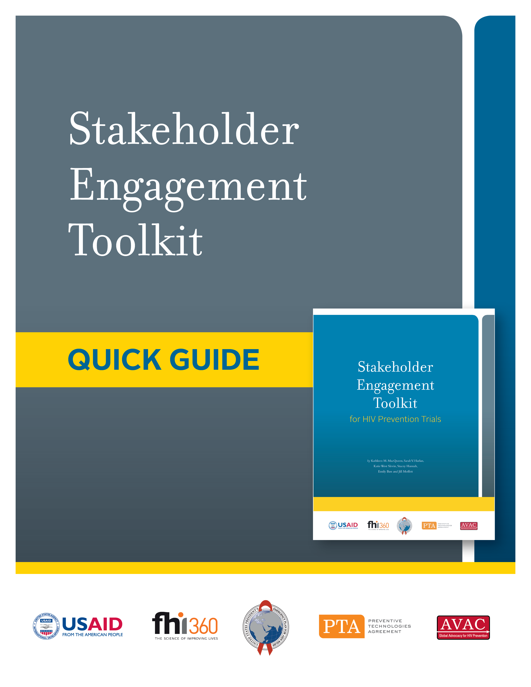
Toolkit Quick Guide
Helps users navigate and use the components of the Toolkit
Includes expanded instructions for three tasks:
Developing measures to track stakeholder engagement program progress
Developing and maintaining a stakeholder databank
Assessing knowledge and skills to determine how to build capabilities
Copyright© 2012
Notes:
The Toolkit Quick Guide was developed in 2014 to help users navigate and use the Toolkit. The Quick Guide was designed based on feedback from community liaison officers (CLOs), community educators and others working in community outreach in research settings. It gives users quick and easy access to modifiable (Microsoft Word or Excel) files of Stakeholder Engagement Toolkit tools and instructions for using them.
The central feature of the Quick Guide is a Toolkit Reference Table, which enables users to quickly identify the tools they need and provides quick links to Toolkit steps and tools.
The new resource also includes expanded instructions for three key stakeholder engagement tasks:
Developing measures to track stakeholder engagement program progress
Developing and maintaining a stakeholder databank
Assessing knowledge and skills to determine how to build capabilities
The Toolkit Quick Guide is available on the FHI 360 website and on the CD that is included in the printed copy of the Toolkit.

Slide 10
Notes:
Step 1—Plan and Budget for Stakeholder Engagement—is all about preparation and ensuring you have the necessary resources and capacity to engage stakeholders and sustain the relationships you will develop as you move forward through the stakeholder engagement process.

Slide 11
Step 1: Why you need to plan and budget for SE
A systematic approach in this step will make it easier for your team to:
Know what is expected of them
Be aware of their SE strengths and weaknesses
Measure and assess the trial’s future SE activities
Budget for SE, and account for the use of resources
Monitor progress
Maintain—and resist compromising—SE activities
Develop an organizational structure that supports SE
Ensure you are prepared to meet commitments
Copyright© 2012
Notes:
Going about planning and budgeting in a systematic way will make it easier for your team to know what it expected of them and identify their strengths and weaknesses. It will also help them to measure, assess, maintain, and monitor the progress of their stakeholder engagement activities.
Organizationally, this kind of pre-planning will ensure there is a supportive organizational structure in place (including a budget) and that your team is set up for success and can meet their stakeholder engagement commitments.
Discussion question: What is the benefit of making plans to measure, assess, and monitor the progress of your stakeholder engagement activities?
____
Note to presenters: Please take the time to lead your audience through the list outlined on the slide.

Slide 12
Step 1: Goals & Tasks
Goals | Tasks
Identify the steps of SE that will be most useful to your trial team | • Determine needs & identify opportunities
Develop a baseline. Take inventory of your organization’s resources, knowledge and skills; identify your weaknesses and strengths | • Establish baseline
Determine your budget for SE and create your plan | • Develop a budget for SE • Develop a plan for SE
Develop your staff’s capacity to engage stakeholders, hire new staff members and provide training if appropriate | • Assemble your team • Develop job descriptions • Ensure staff capacity building
Copyright© 2012
Notes:
These are the goals and tasks for Step 1. As you can see, they focus on ensuring your team has the capacity and resources to put a stakeholder engagement plan into action. You will identify the steps of stakeholder engagement that will be most useful to your team, develop a baseline, determine your budget and, finally, develop your staff’s capacity.
The task list provides practical direction on how to accomplish these ends. Notice how the seven tasks listed on the right are directly related to achieving the four goals listed on the left.
Discussion question: Why is it important to develop job descriptions for staff who will be conducting stakeholder engagement activities?

Slide 13
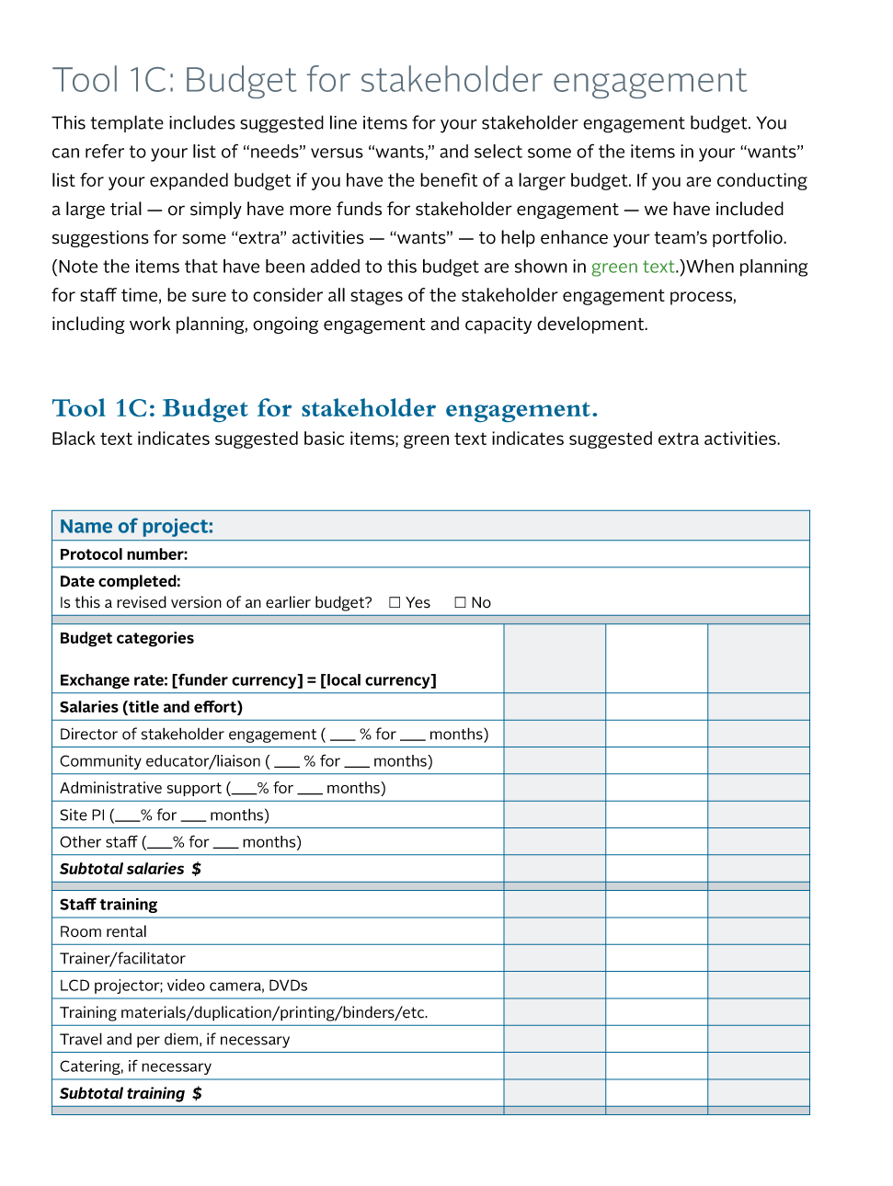
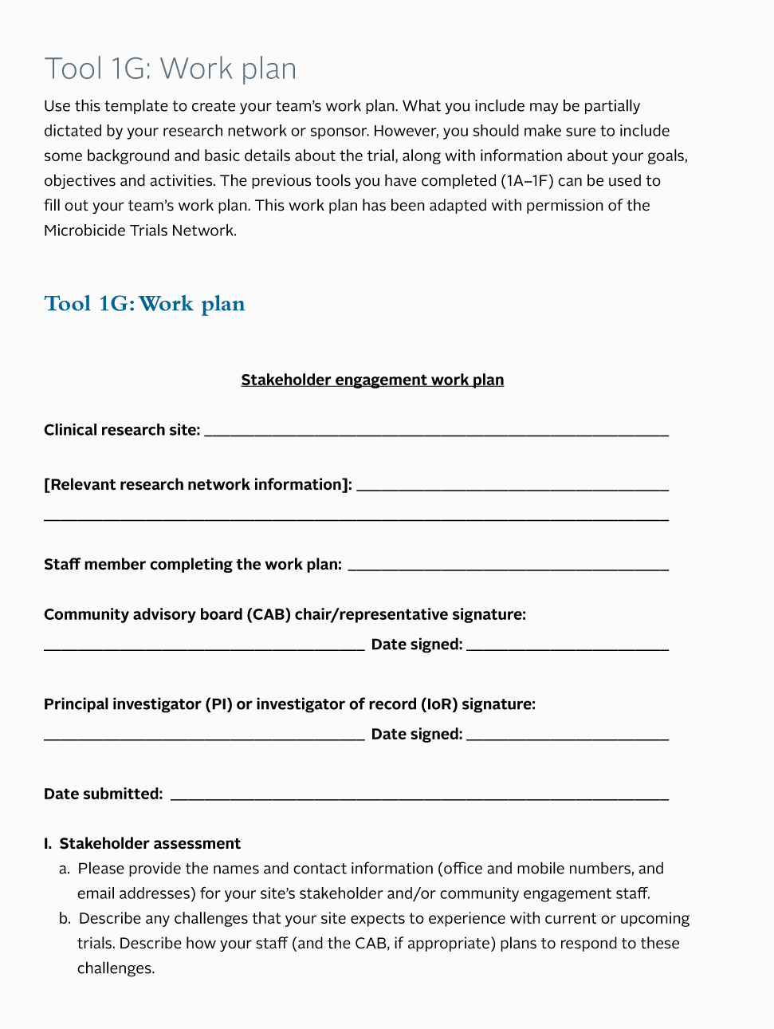
Step 1: Tools
Copyright© 2012
Notes:
The Toolkit also provides a series of hands-on tools to help you carry out these tasks and achieve each of the corresponding goals. In addition to the tools shown here that are designed to guide you through developing a budget (see Tool 1C, page 113) and a work plan for stakeholder engagement (see Tool 1G, page 121), the tools listed in the appendix for Step 1 (see page 107) will help you:
Conduct an organizational self-assessment;
Identify gaps, opportunities and priorities;
Develop action plans and timelines;
Plan your stakeholder strategy; and,
Draft job descriptions.
There are also several samples of completed tools (see page 112, for a completed example of Tool 1B) so that you have an idea of what you are attempting to accomplish.
____
Note: Tool 1C: Budget for stakeholder engagement and Tool 1G: Work plan can be found in the Toolkit on pages 113 and 121 respectively. All Step 1 tools can be found in the Step 1 Appendix on pages 107 through 130.

Slide 14
Step 1 Highlight: Case Studies
Copyright© 2012
Notes:
Each step of the Toolkit also offers practical examples of how the tasks have been applied in real world settings. This case study from Step 1 (see page 12) features an example from the FEM-PrEP clinical trial that took place at four sites in Kenya, South Africa and Tanzania. The case describes the stakeholder engagement activities coordinated by a community liaison officer at the site in Bondo, Kenya. It describes the specific actions that the team took to address issues that were identified during meetings with community members—actions which contributed to the broad-based support for the study and an overall decrease in rumors and controversy.
You’ll find similarly helpful case studies throughout the Toolkit.
Now let’s take a look at the other six steps…
____
Note: This case study can be found in the Toolkit on page 12.

Slide 15
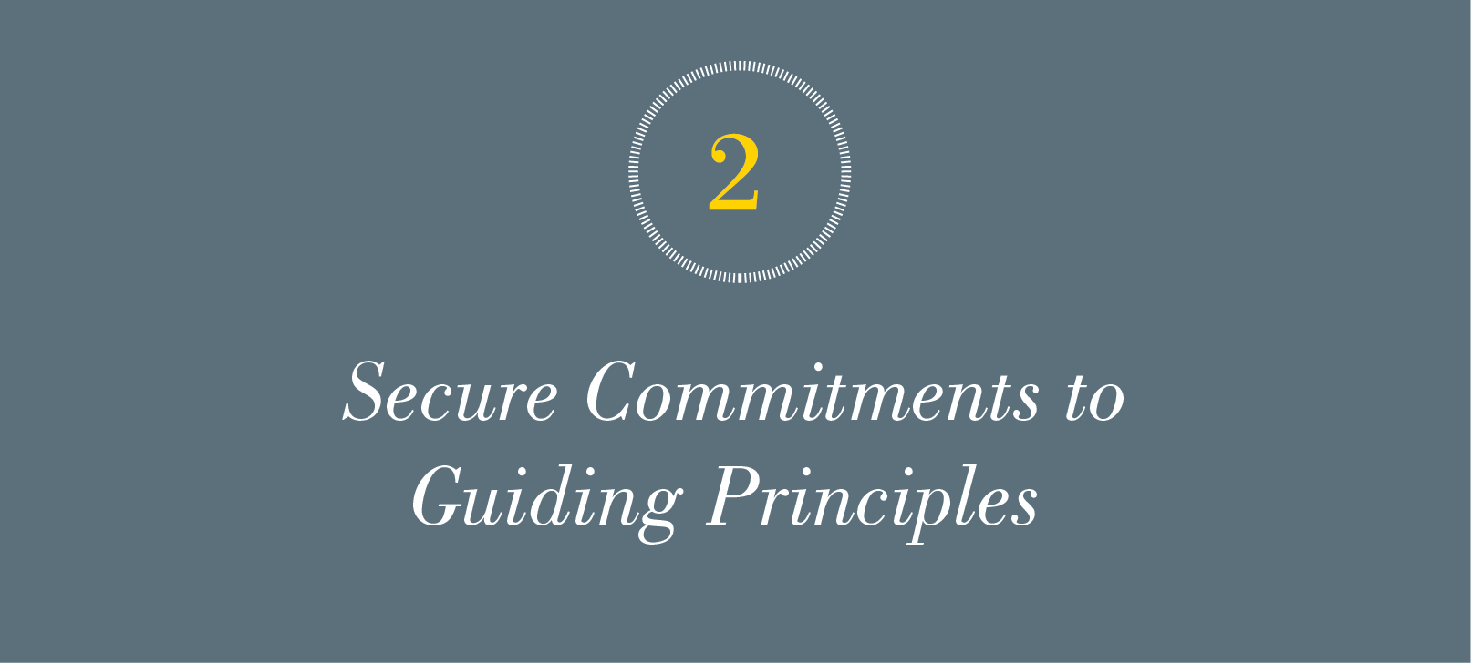
Notes:
In Step 1, you established baseline information and developed a work plan and budget. At this point, you should know about your research team’s capacity for stakeholder engagement, your ongoing efforts toward stakeholder engagement, your goals and objectives for stakeholder engagement and any gaps in your plan. Step 2 begins by summarizing some of the main guiding principles of stakeholder engagement.

Slide 16
Step 2: Why you need to secure commitments to guiding principles
A systematic approach to securing commitments will enable your team to:
Establish a common understanding of the meaning and value of SE
Gain consensus on a strategy for SE action, including key objectives and outcomes of activities
Consider equitable budgeting issues, and plan accordingly
Develop more effective engagement plans
Copyright© 2012
Notes:
Specifically, this step helps research teams to:
Establish a common understanding of the meaning and value of stakeholder engagement;
Gain consensus on a strategy for stakeholder engagement action;
Consider equitable budgeting issues and plan accordingly; and
Develop more effective engagement plans.

Slide 17
Step 2: Goals & Tasks
Goals | Tasks
Develop a plan of action for securing commitment to SE | Make an action plan for securing commitment to guiding principles
Familiarize the research team with the guiding principles and the practical applications of engaging stakeholders in clinical trials | Become familiar with information and tools
Establish consensus among the team that SE is critical to their trials | Implement your action plan for securing commitment to guiding principles
Secure written commitments to SE from key members of the research team | Secure commitment from your research team
Copyright© 2012
Notes:
The primary goal during Step 2 is to tackle some of the initial gaps—if any—in your team’s commitment to the guiding principles of stakeholder engagement. If members of the research team are not familiar with or do not value stakeholder engagement activities, you may need to sensitize them and gain this commitment before you begin your outreach efforts.

Slide 18
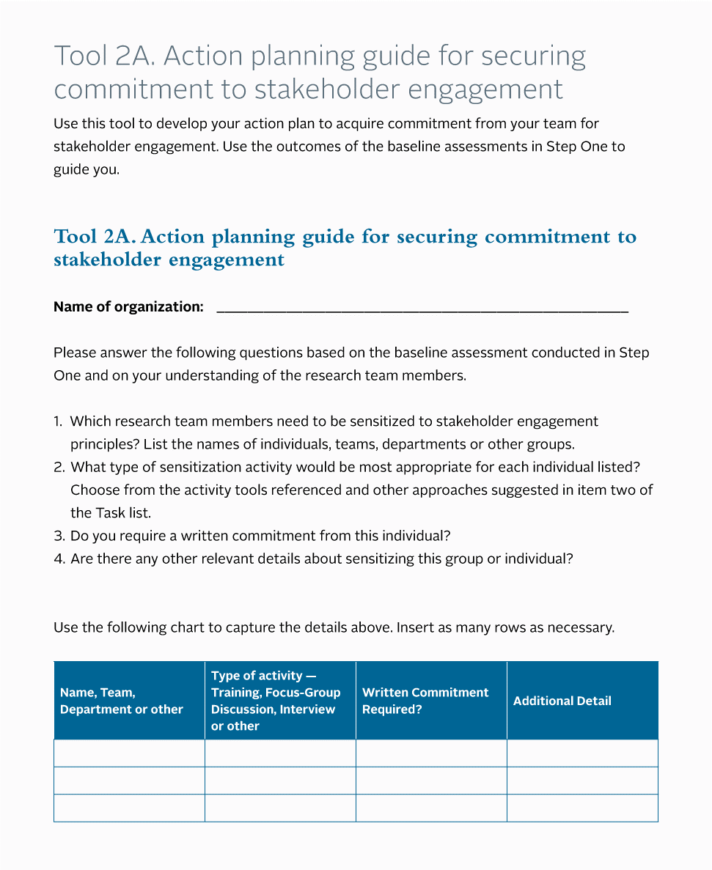
Step 2: Tools
Copyright© 2012
Notes:
In addition to the tasks that Step 2 outlines for how to achieve this goal, you’ll also find:
A tool to help you develop an action plan for securing commitments to stakeholder engagement (see Tool 2A, page 132); and
A commitment sheet that provides staff with an opportunity to formally acknowledge their agreement with the plan (see Tool 2B, page 137).
Tool 2A (shown here) helps you outline specific objectives for orienting your stakeholders to the principles of stakeholder engagement and to think through the most appropriate approaches for sensitizing them to those principles.
____
Note: Tool 2A: Action planning guide for securing commitment to stakeholder engagement, can be found in the Toolkit on page 132.

Slide 19
Step 2 Highlight: Guiding Principles
Copyright© 2012
Notes:
Step 2 is based on the guiding principles outlined in two foundational documents:
Good Participatory Practice Guidelines for Biomedical HIV Prevention Trials; and
Ethical Considerations in Biomedical HIV Prevention Trials.
The Toolkit provides a brief overview of what these principles entail and examples of how research teams have put them into practice.
data.unaids.org/pub/.../jc1364_good_participatory_guidelines_en.pdf
data.unaids.org/pub/Report/.../jc1399_ethical_considerations_en.pdf
Discussion question: Describe how you have used these documents.

Slide 20
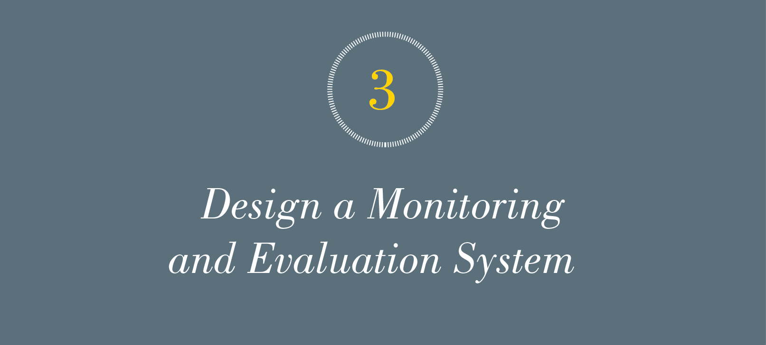
Copyright© 2012
Notes:
So let’s review: In Step 1 your team thought about concrete objectives for your work with stakeholders in light of your trial and the broader research agenda. In Step 2, you and your team made a commitment to the principles of stakeholder engagement. Now that you have defined the goals of stakeholder engagement, you are ready to move on to Step 3 and develop a framework for determining whether your efforts are effective and worth the time and resources involved.

Slide 21
Step 3: Why you need to design a monitoring and evaluation (M&E) system
A systematic approach to designing an M&E system enables your team to:
Define the desired impact of SE activities
Justify the need and budget for SE activities
Increase the rigor of SE programs
Establish your accountability with stakeholders
Copyright© 2012
Notes:
In Step 3 you will develop a monitoring and evaluation (or M&E) system for stakeholder engagement. Designing an effective M&E system is a critical component of any stakeholder engagement plan. It will enable your team to:
Define what impact they wish to have;
Justify the need and budget for your stakeholder engagement activities;
Increase the rigor of your program, including the potential need to change your strategy and action planning.; and
Establish your accountability with stakeholders.
Discussion question: What are the potential risks of not adapting your stakeholder engagement strategy to address events that occur during the course of the study?

Slide 22
Step 3: Goals & Tasks
Goals | Tasks
Define a set of indicators based on your long-term and short-term goals for SE activities | Select indicators
Agree on your team’s M&E approach; if it is participatory, identify the stakeholders to be involved | Establish a SE M&E working group Develop an M&E framework
Implement the M&E process as agreed by all relevant team members | Implement your M&E process
Copyright© 2012
Notes:
As you can see on the left, the goals of Step 3 include defining a set of indicators based on your stated goals, designing and agreeing on your team’s M&E approach, and then implementing your M&E plan.
To help in the development of an effective M&E plan, Step 3 also offers a list of tasks to complete shown here in the right-hand column.
The Toolkit Quick Guide includes enhanced instructions for completing tasks in Step 3. Let’s take a look at page 5 of the Quick Guide now.
AVAC is developing monitoring and evaluation tools for this purpose. Watch the AVAC site for their release in late 2014.
While we’re here lets take a look at the other pages of enhanced instructions.

Slide 23
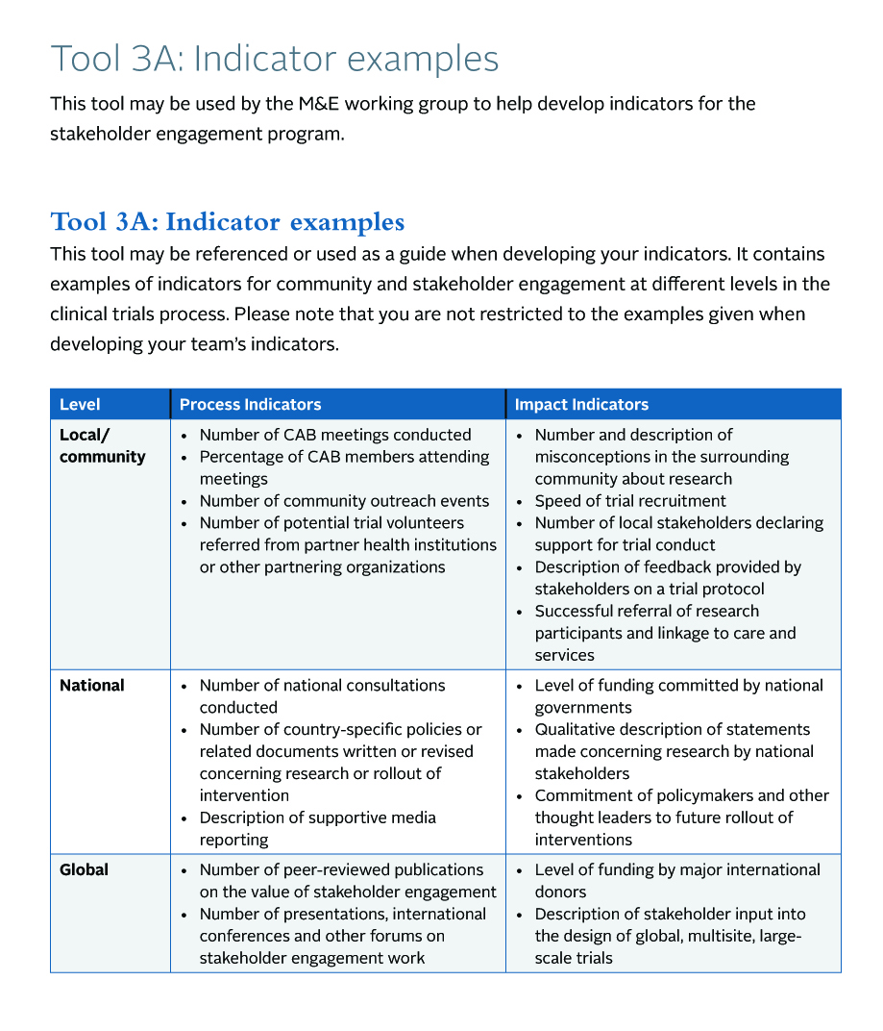
Step 3: Tools
Copyright© 2012
Notes:
In Step 3 you’ll also find detailed examples of indicators for community and stakeholder engagement at different levels in the clinical trials process. Tool 3A (see page 140) provides you with a list of both process and impact indicators for local, national and global stakeholders. Indicators range in scope from the number of community advisory board meetings held to a description of stakeholder input into the design of global, multisite, large-scale trials.
____
Note: The Indicator Example tool can be found in the Toolkit on page 140.

Slide 24
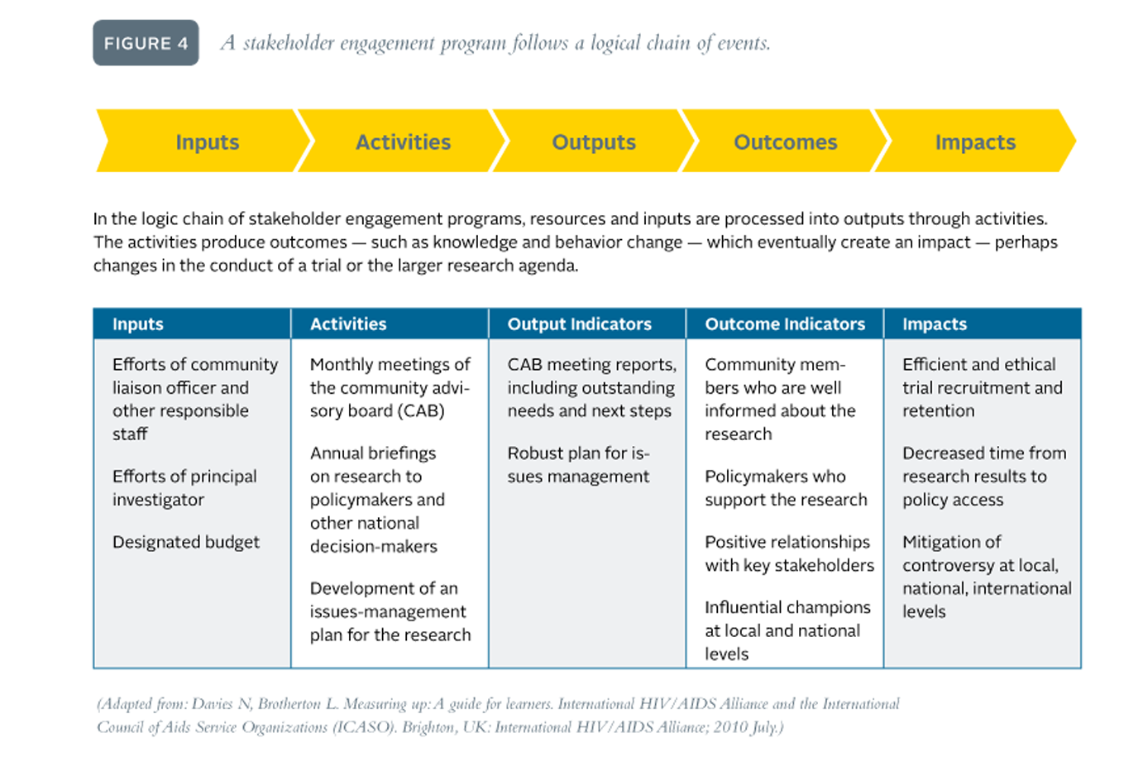
Step 3 Highlight: Tables & Graphics
Copyright© 2012
Notes:
This figure (see page 31) depicts the logic chain of stakeholder engagement, to help you to visualize how the steps of stakeholder engagement fit into a logical framework (sometimes called a “log frame”). Organizing the steps of stakeholder engagement into a log frame can help you develop an effective M&E strategy.
You will find various tables and graphics throughout the Toolkit, which help to represent some of the more complex content in an organized, visual way.
____
Note: This figure can be found in the Toolkit on page 31.

Slide 25
Notes:
As you’ve seen, some basic preparation and planning keeps your stakeholder engagement efforts focused and streamlined. Like steps one through three, Step 4 is focused on this critical preparation.

Slide 26
Step 4: Why you need to describe key features of the research context
A systematic approach in Step 4 will lead to the following benefits and outcomes. You will be able to:
More readily identify all stakeholders whose views and engagement will affect your trial
Better understand the relationships that link stakeholders and build such relationships where they are lacking
More easily communicate the research concept and explore it with stakeholders
Learn how the project’s local context relates to the national and regional context
Develop a research project that is well adapted to the broad context
Copyright© 2012
Notes:
Step 4 helps you to identify your relevant stakeholders (whether they are local, regional, national or international), understand the relationships between stakeholder groups and the context within which your trial is taking place, and to better communicate the research concept to your stakeholders.
____
Note to presenters: Please take the time to lead your audience through the list outlined on the slide.

Slide 27
Step 4: Goals & Tasks
Goals | Tasks
Partner with stakeholders to create a multilayered description of the contexts for the trial | Describe the local context for the trial Describe the broad context in which the trial will take place
Identify questions, current issues and historical precedents that may affect how your trial is perceived at the local level—as well as strategies for how to address them | Get to know the national and regional stakeholders Develop a system for ongoing engagement with national and int’l stakeholders
Incorporate national, regional and int’l issues into plans for the trial’s conduct | Identify global issues and engage int’l audiences and allies
Develop an appreciation for the complexity of the research process and the importance of relationships… | Review the implications of your information-gathering and relationship-building activities
Copyright© 2012
Notes:
Specifically, in Step 4 you will:
Become familiar with critical features that can have a bearing on how the research is conceptualized, planned, conducted and disseminated;
Efficiently overcome barriers that are specific to your context, such as a history with previous trials, access to research outcomes, and any issues related to the political, cultural and economic climate; and
Engage stakeholders as partners in the research endeavor.
Similar to previous steps, Step 4 also offers a detailed list of tasks that, if followed, will result in achieving the goals it outlines.
____
Note: There are no tools in the appendices for this step.

Slide 28
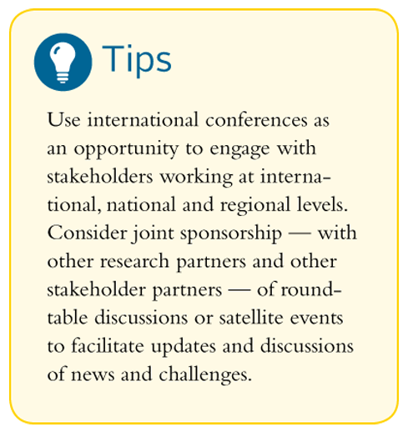
Step 4 Highlight: Tips
Copyright© 2012
Notes:
If you or a member of your research team attend international conferences, you can use the opportunity to engage with stakeholders working at international, national and regional levels. You can even work with other research partners and other stakeholder partners to host roundtable discussions or satellite events to facilitate updates and discussions of news and challenges related to stakeholder engagement efforts.
The Toolkit offers several helpful tips throughout, which you can easily find by looking for the light bulb symbol as in this Tip found on page 43.
Look in your Toolkit to find what other Tip is offered in Step 4? Answer=page 40
____
Note: This tip can be found on page 43 of the Toolkit.

Slide 29
Notes:
Next, Step 5 builds on Step 4 by helping you to:
List the individuals and organizations that have a stake in your project;
Compile background details about them; and
Organize these data is a useful way.
Taking the time to compose descriptive profiles of your stakeholders will provide an invaluable resource to you and your team throughout the project—particularly if you encounter any staff turn-over.

Slide 30
Step 5: Why you need to identify and describe stakeholders
A systematic approach in Step 5 will make it much easier for your team to:
Identify the organizations/individuals who are relevant to your project
Decide who to contact and how
Create a database for this project and for future research
Obtain suggestions for other stakeholders whose involvement may be critical to the success of your research
Ensure your research is meaningful and transparent to the community in which it is taking place
Copyright© 2012
Notes:
Identifying and describing stakeholders will help you to:
Establish who your relevant stakeholders are and keep track of them;
Decide on the best way to contact them; and
Use stakeholder information throughout the project to conduct meaningful preliminary research in the community; to explain trial goals; and to make accurate statements about the generalizability of your trial’s conclusions.
____
Note to presenters: Please take the time to lead your audience through the list outlined on the slide.

Slide 31
Step 5: Goals & Tasks
Goals | Tasks
Compile a thorough list of key local, regional, national and global stakeholders | Host a brainstorming session Refine your list Get referrals
Collect relevant data about individuals/organizations | Conduct interviews and record notes Develop stakeholder descriptions
Create an organization system | Classify stakeholders according to type
Contact stakeholders | Approach individuals/organizations
Secure the active involvement of a core group of stakeholders | Secure active involvement from partners
Maintain a stakeholder database, and update the profiles | Create an electronic database. Update database regularly
Copyright© 2012
Notes:
Step 5 will guide you through:
Compiling a comprehensive list of stakeholders and collecting relevant data on them;
Making initial contact with your stakeholders and securing their involvement; and
Establishing a database of stakeholder contact information and profiles and developing procedures for maintaining the database throughout the life of the project.
The corresponding tasks are shown in the right-hand column. These are the individual tasks that Step 5 leads you through, beginning with hosting a brainstorming session to compile a thorough list of stakeholders, through creating and maintaining a shared electronic database aimed at improving the efficiency of your stakeholder communication.

Slide 32
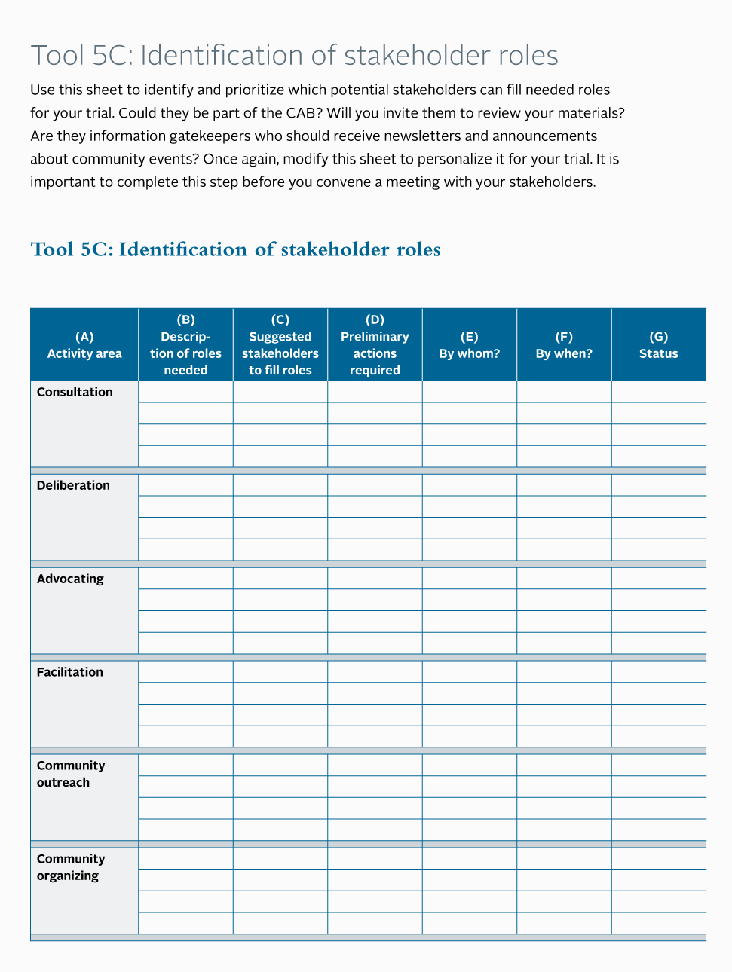
Step 5: Tools
Copyright© 2012
Notes:
The appendix for Step 5 includes a series of tools for completing the tasks. Tool 5C (see page 147) can help you to think through and prioritize which of your stakeholders can fulfill needed roles for your trial. For instance, who will sit on your advisory committee? Who in the trial community are the information gatekeepers?
Some of the other tools included in Step 5 are:
A Stakeholder identification sheet (see Tool 5A, page 142);
A Stakeholder data collection sheet (see Tool 5B, page 145) and
An example of a Stakeholder contact record (see Tool 5D, page 149).
____
Note: The appendix for Step 5 begins on page 141. Tool 5C: Identification of stakeholder roles can be found on page 147.

Slide 33
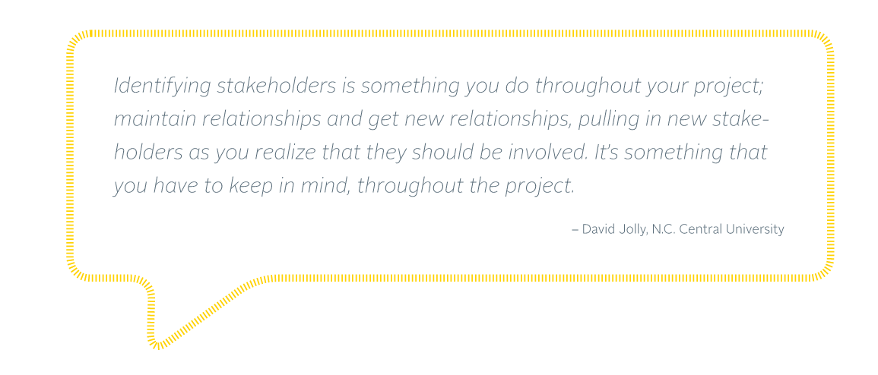
Step 5 Highlight: Quotes
Copyright© 2012
Notes:
As this quote (see page 56) reminds us, stakeholder engagement is an ongoing process, so you will likely find it necessary to identify and describe stakeholders through the lifespan of your trial.
Throughout the Toolkit, you will find quotes that bring the content to life by letting people who have been directly involved in stakeholder engagement share their insights.
Look in your Toolkit to find who else was quoted in Step 5? Answer=page 55, Sam Griffith
____
Note: This quote can be found on page 56.

Slide 34
Notes:
Finally, after using steps one through five to identify your potential stakeholders—as well as your priorities, concerns and skills—you are now ready to begin building your stakeholder relationships.
You will notice that Steps 6 and 7 tend to have longer lists of goals and tasks, checklists, as well as quite a few tools in the appendices. This reflects in part the fact that the “meat” of the stakeholder engagement work is contained in these two steps, with the other ones preparing you for the bulk of the work: actually engaging stakeholders, and building their capacity.

Slide 35
Step 6: Why you need engage stakeholders and sustain relationships
A systematic approach in this step will make it much easier for your team to:
Ensure that correct and accurate information about your trial is reaching your stakeholders and the community
Combat misperceptions and rumors about HIV and research in the community
Establish trust, transparency and two-way communication with the host community and other stakeholders
Improve your SE approaches and implement better practices
Copyright© 2012
Notes:
Ultimately, Step 6 helps you to ensure that correct and accurate information about your trial is reaching your stakeholders and the community and to combat any misperceptions and/or rumors that may exist. Step 6 also addresses issues of trust, transparency and the use of better practices.
Discussion question: How many different stakeholder groups do you work with at your site? By show of hands, how many work with only one stakeholder group?
Two groups?
Three or four groups?
Five to ten groups?
More than ten groups?
____
Note to presenters: Please take the time to lead your audience through the list outlined on the slide.

Slide 36
Step 6: Goals & Tasks
Goals | Tasks
Build lasting partnerships and alliances with a range of stakeholders | Build partnerships and alliances Be visible in local communities
Provide mechanisms by which stakeholders can offer input into the research process | Establish local stakeholder advisory mechanisms Set expectations
Disseminate correct and accurate information about HIV and AIDS, the scientific process and your specific trial | Use local media Draft and disseminate educational and informational materials
Copyright© 2012
Notes:
This slide and the next cover the goals and tasks you’ll find outlined in Step 6.
Essentially, the step provides some basic strategies and tools to help you develop relationships with a wide range of stakeholders and sustain them throughout the research process. For instance:
Establish advisory mechanisms to achieve an active and engaged group of local stakeholders who can contribute to your project.
Use local media to communicate your messages broadly.
Draft and disseminate educational and informational materials to create groups of informed, knowledgeable and supportive participants and stakeholders.
While Step 6 recommends basic strategies for engaging and sustaining relationships, it also encourages use of creative approaches—acknowledging the continuous learning that occurs during the engagement process.
Here you can see the first three goals for engaging stakeholders and sustaining relationships and the corresponding tasks.

Slide 37
Step 6: Goals & Tasks (continued)
Goals | Tasks
Educate and update stakeholders and the community about your trial and its progress | Provide regular education and updates Monitor and respond to community voices and stakeholder views
Network with staff members at other HIV prevention research studies | Continue to expand your partnerships
Document and continue to build your toolbox for SE | Maintain clearly written records Learn from others
Copyright© 2012
Notes:
The next three goals and related tasks cover:
How to educate and update your stakeholders by using a variety of methods including local media, town hall meetings, community events, individual stakeholder meetings and targeted educational materials.
How to combat misinformation by responding immediately and in a transparent manner to community rumors.
How to effectively use networking to expand your partnerships and strategies for engaging stakeholders and avoiding stakeholder fatigue; and
How to document and build your stakeholder engagement toolbox and track your engagement efforts.

Slide 38
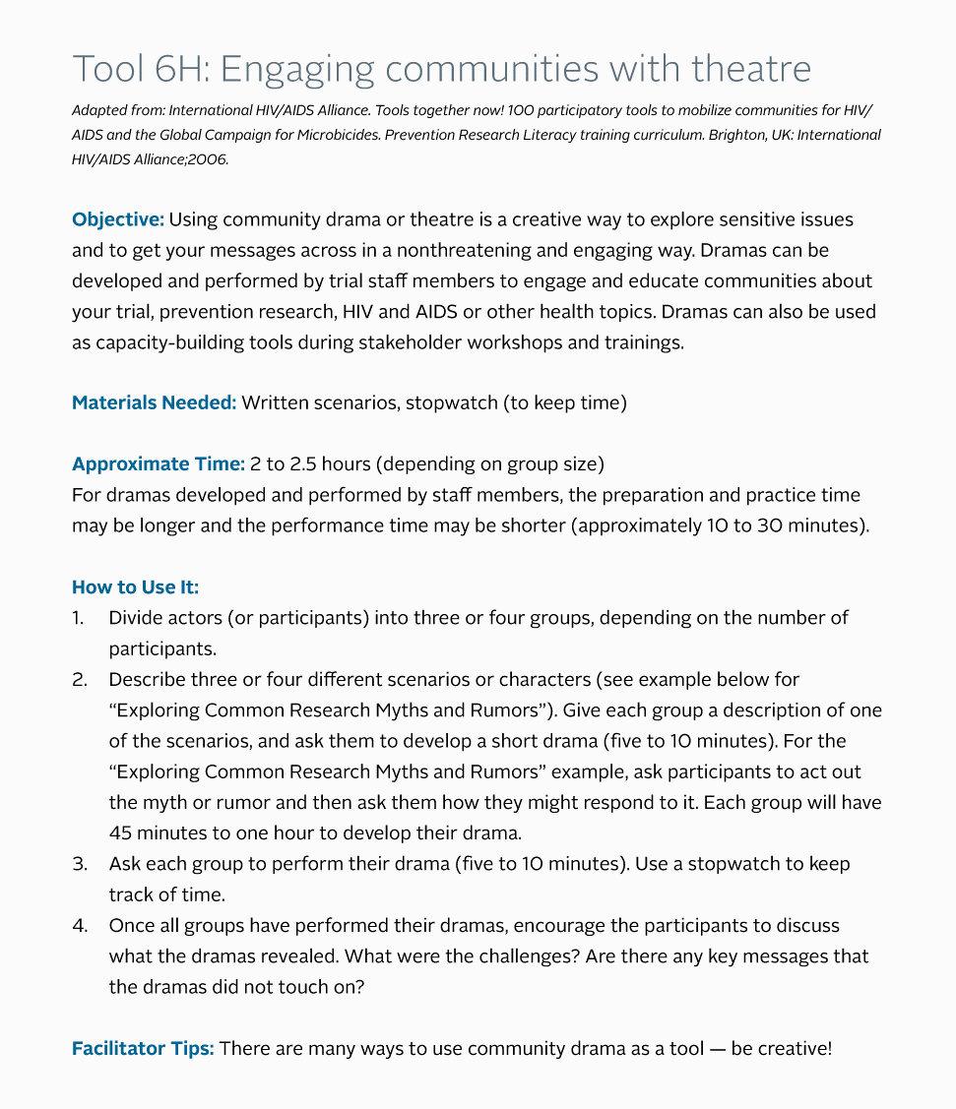
Step 6: Tools
Copyright© 2012
Notes:
Step 6 also suggests a range of worksheets and participatory tools to help you put into practice the various tasks it outlines. Some of the tools offered in Step 6 include:
How to establish advisory group guidelines (see Tool 6B, page 154),
Checklists for organizing events (see Tool 6C, page 156),
How to develop an effective meeting agenda (see Tool 6F, page 163), and
As you can see from the slide, a tool on How to engage communities with theatre (see Tool 6H, page 167). Creative strategies such as this have proven incredibly effective for engaging stakeholders and communities in a range of settings.
Discussion question: What types of techniques have you used to engage stakeholders?
____
Note: These tools can be found in the Toolkit in Appendix T6 beginning on page 151. Tool 6H: Engaging communities with theatre can be found on page 167.

Slide 39
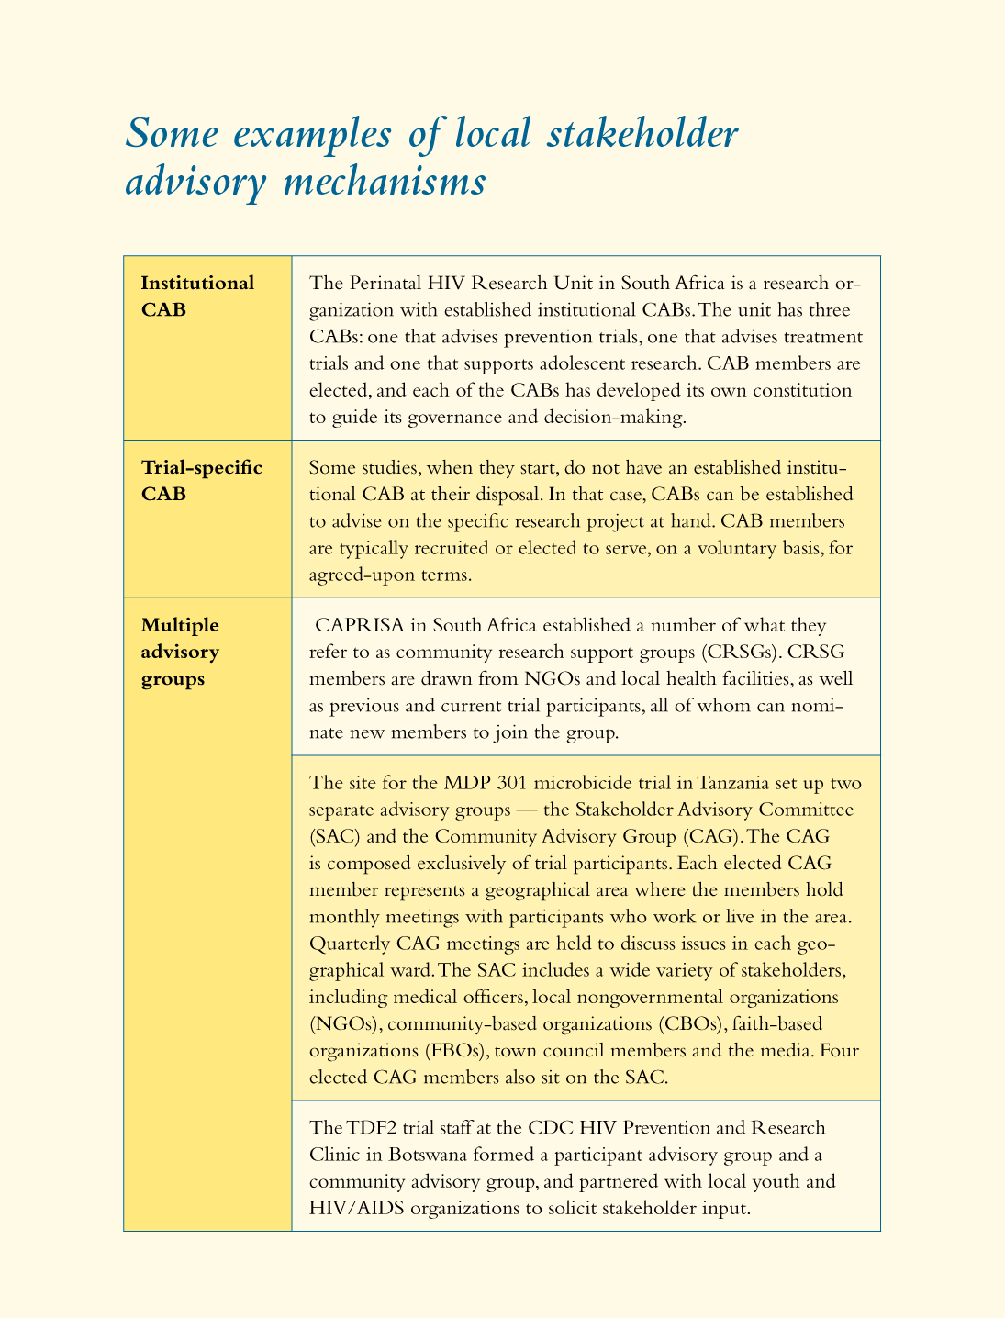
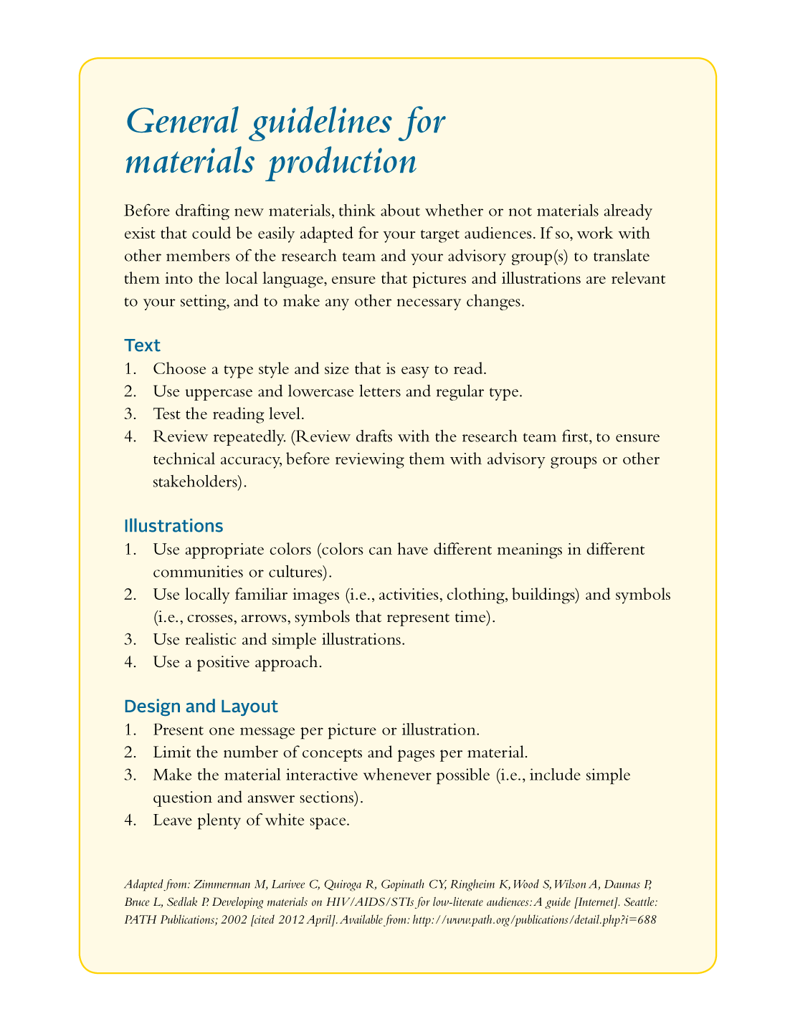
Step 6 Highlight: Practical Resources
Notes:
Figuring out how to engage with stakeholders can sometimes seem like a daunting task. There are many ways in which you can engage with stakeholders, including mechanisms like CABs—community advisory boards. You might need to develop a range of materials to support your SE efforts. The Toolkit can provide some guidance in these areas. On the left are descriptions and examples of local stakeholder mechanisms that various HIV prevention trials have employed (see page 69). On the right, are step-by-step guidelines for producing various types of education and information materials (see page 80).
Throughout the Toolkit you will find practical resources to help you in the day-to-day engagement of stakeholders, such as the ones shown here from Step 6. This type of practical information is what sets the Toolkit apart from other stakeholder engagement resources. The Toolkit provides the case studies, examples and detailed explanations that bring the step-by-step recommendations to life.
____
Note: These resources can be found in the Toolkit on pages 69 and 80 respectively.

Slide 40
Notes:
The final step in the Toolkit—Step 7—walks you through how to develop the skills and attitudes necessary to sustain your relationships with stakeholders throughout the life of your research project and beyond.

Slide 41
Step 7: Why you need to develop stakeholder capacity
A systematic approach to capacity building will make it much easier for you to:
Guarantee that all stakeholders are operating from a common base of knowledge
Provide stakeholders with the knowledge and skills to appropriately and effectively engage with the research and each other
Ensure that stakeholders are providing correct information to their communities or constituencies
Copyright© 2012
Notes:
Step 7 focuses mainly on ensuring your stakeholders—including the study community, your trial participants, and your own research team—have the knowledge and skills to appropriately and effectively engage with the research and each other and provide accurate information about HIV and your research project.
____
Note to presenters: Please take the time to lead your audience through the list outlined on the slide.

Slide 42
Step 7: Why you need to develop stakeholder capacity (continued)
Combat misperceptions that stakeholders may have about HIV, scientific research or research participants to avoid controversy over your trial
Foster a sense of collective ownership and investment in the research enterprise
Strengthen local capacity to ensure sustainable improvements in the community
Strengthen the capacity of national and global stakeholders to understand how the research fits into the broader context of HIV prevention and public health
Copyright© 2012
Notes:
Moreover, Step 7 will help your team to:
Further combat any misperceptions that may exist;
Foster a sense of collective ownership and investment in your research project; and
Strengthen capacity at the local, national and international levels.
____
Note to presenters: Please take the time to lead your audience through the list outlined on the slide.

Slide 43
Step 7: Goals & Tasks
Goals | Tasks
Identify the capacity-building needs of your stakeholders | Assess the capacity and knowledge gaps of your stakeholders
Design, plan and facilitate capacity-building activities for stakeholders | Plan capacity-building activities for: Community advisory groups Trial participants, their families and their partners The local community Other stakeholder groups, including policymakers, advocates, traditional leaders, and program and service providers The research staff
Incorporate capacity-building activities into your engagement activities
Assess what stakeholders learned | Assess capacity
Copyright© 2012
Notes:
Step 7 covers how to:
Identify the capacity building needs of your stakeholders by conducting a detailed needs assessment;
Design and plan capacity building activities including trainings, workshops, community events, ”update” meetings and staff trainings on stakeholder literacy;
Capitalize on existing opportunities to engage in education and capacity-building such as clinic wait times, planned community events and local media; and
Assess learning and collect feedback to ensure your activities met their aims.
The individual tasks outlined in Step 7 (shown in the column to the right) that correspond with the goals listed in to the left are discussed in greater detail in Step 7.
As we saw earlier, the Quick Guide includes additional instructions for tasks in this step.

Slide 44
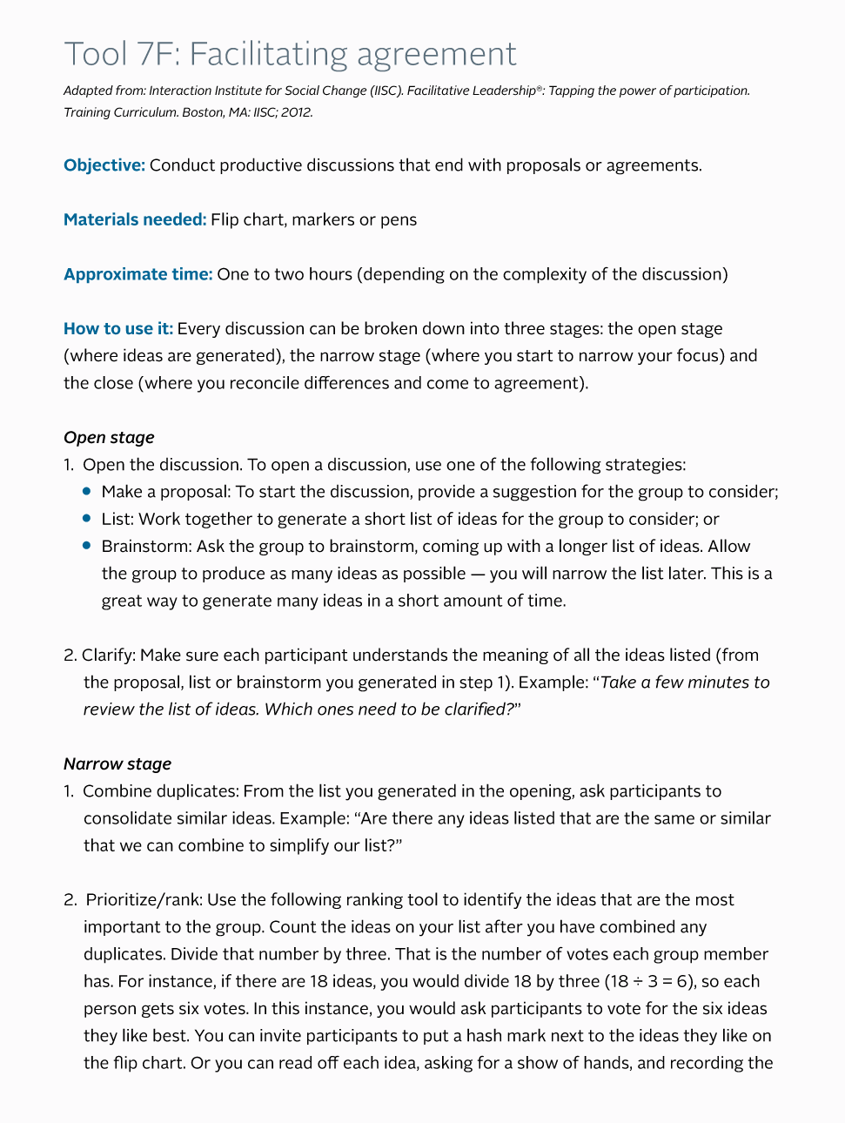
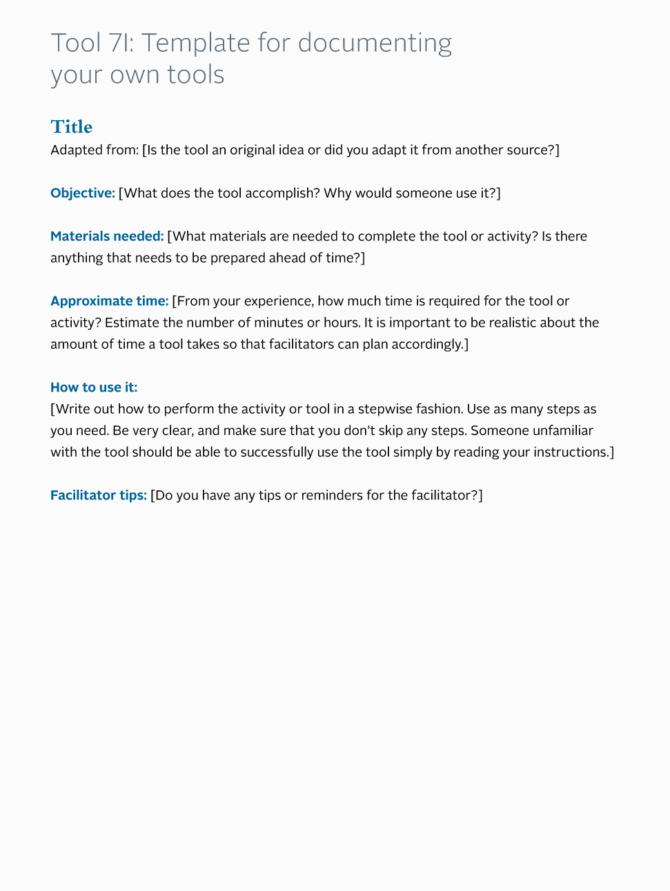
Step 7: Tools
Copyright© 2012
Notes:
What’s more, the Appendix for Step 7 offers a range of tools to help you work through these tasks and build the capacity of stakeholders. Here you can see two tools highlighted from Step 7, one that guides you through group decision making or as it’s termed here, “facilitating agreement” (see Tool 7F, page 183) and another that provides a template for your team to begin to document the unique tools they find the most useful for engaging stakeholders (see Tool 7I, page 188).
____
Note: Tool 7F: Facilitating agreement and Tool 7I: Template for documenting your own tools can be found in the Toolkit on pages 183 and 188 respectively. All Step 7 tools can be found in the Step 7 Appendix beginning on page 171.

Slide 45
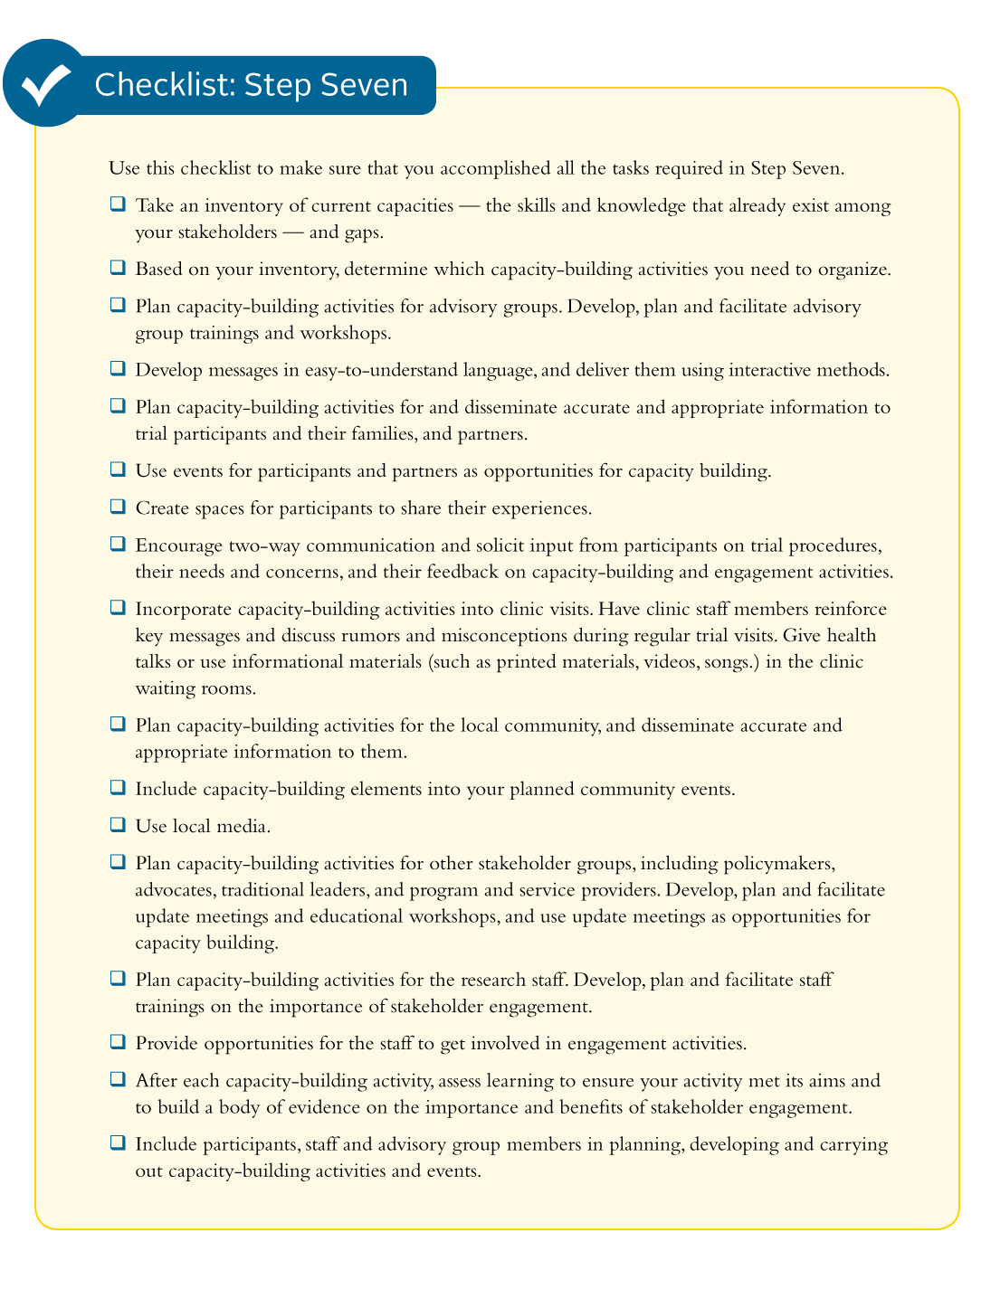
Step 7 Highlight: Checklists
Copyright© 2012
Notes:
As we mentioned at the beginning of Step 6, you will notice that Steps 6 and 7 have relatively long checklists. This reflects the extensive list of tasks required to engage with stakeholders and build their capacity. For this reason, you should take maximum advantage of the user-friendly checklist provided in the Toolkit to organize and track the progress of your SE activities.
In Step 7, the checklist (see page 106) will help you keep track of your efforts to: assess the current capacity of stakeholders; plan, develop and deliver capacity-building activities adapted to the needs of a range of stakeholders; and, assess and document your efforts.
Similar checklists appear in all the steps.
____
Note: Checklists are found on the last page of each step. This checklist can be found on page 106.

Slide 46
Additional Resources
Resources specifically related to each step from the Toolkit
Training resources related to:
Research ethics
Research literacy & HIV prevention research
Sexual and reproductive health and rights
Gender and gender based violence
HIV/AIDS
Facilitation
Copyright© 2012
Notes:
At the end of the Toolkit you will find a section entitled Additional Resources. This section lists a range of resources including printed and online guidebooks, courses, reports, training curriculum and other toolkits. They are organized according to each step from the Stakeholder Engagement Toolkit.
In addition, there is a list of training resources on topics related to stakeholder engagement for HIV prevention trials, including:
Research ethics;
Research literacy & HIV prevention research;
Sexual and reproductive health and rights;
Gender and gender based violence;
HIV/AIDS; and
Training and Facilitation.
Discussion question: Which, if any, of these additional resources have you used? Can you recommend other resources that are not included here?
____
Note: The Additional Resources can be found in the Toolkit beginning on page 190.

Slide 47
Conclusion
“Working with the churches, the local traditional healers [and] chiefs and…the mapping out of women’s groups…just constantly gave us input. It took a lot of time and investment but…it really paid off. When there were concerns in a community about the gel, about the research, about anything, we tended to be the first people that they contacted because they respected the fact that we took the time to go [to] them.” – Mitzy Gafos, co-principal investigator, MDP 301, Africa Centre, South Africa
Copyright© 2012
Notes:
The authors designed this Toolkit to help your research team plan for stakeholder engagement through every stage of your research. It should help you document your plans, your accomplishments and the approaches that did or did not work in a particular setting. The Toolkit will make it easier for research teams in different contexts to compare their approaches and to identify the best practices that work across settings.

Slide 48
Acknowledgements
http://www.fhi360.org/resource/stakeholder-engagement-toolkit-hiv-prevention-trials
Copyright© 2012

