Slide 1


Stakeholder Engagement—
Toolkit Orientation and
Practice Session
Insert:
Facilitator Name, Title
Organizational Affiliation
Facilitator Name, Title
Organizational Affiliation
Notes:
Facilitator Instructions
Use the slides, speaker notes and instructions in this presentation to support the learning activities outlined in the session plan.
Display this slide as a screen-warmer while participants are gathering for the session.
Greet participants as they enter the space and direct them to pre-configured tables arranged for small groups.

Slide 2
Introductions
Name
Title
Study site/location
Brief description of the most notable (good/bad) stakeholder engagement activity you were ever involved with
Notes:
Facilitator Instructions
Ask participants to gather in a circle and take turns stating their name, title, study site/location and a brief description of the most notable (good/bad) stakeholder engagement activity s/he was ever involved with.
To mix it up, ask the participants to toss a ball around the circle, whoever catches the ball introduces him/herself and then tosses the ball to another participant.
Encourage participants to be brief in their introductions.

Slide 3
Objectives
By the end of this session, participants will be able to:
  Describe key features and components of the Toolkit, including the E-resources
  Identify and plan for socio-cultural and other issues/factors that impact research and stakeholder engagement activities
  Interact with stakeholder groups to:
    Assess knowledge/perceptions using the Agree/Disagree activity
    Establish group norms and guidelines
    Build capacity using role plays
    Facilitate agreement through group discussion
Notes:
Facilitator Instructions
Present the objectives so that participants are aware of what they can expect to be able to do by the end of the session:
Describe key features and components of the Toolkit, including the E-resources
Identify and plan for political, cultural, religious, economic, transportation and other issues/factors that impact research and stakeholder engagement activities
Using guidance and tools from the Toolkit, interact with stakeholder groups to:
Assess knowledge/perceptions using the Agree/Disagree activity
Establish group norms and guidelines
Build stakeholder capacity using participant role plays
Facilitate agreement through group discussion
Ask participants: Do you have any personal goals or challenges related to these objectives that you would like to address during this session?
Tell participants: Your active participation in the interactive activities planned for the session will help you achieve these objectives. Think about how these learning objectives will help you address issues that you confront in your day-to-day activities. As much as possible, bring your experience and challenges into the activities. Opportunities for informal self-assessment—practice with feedback from peers—will be provided during the session.
Ask participants: Does anyone have questions before we move on to our next group decision?
Ask participants: Which norms would you like to establish to guide the groups’ conduct during today’s session? <To expedite this activity, prepare a flip chart with some common norms for consideration: turn off cell phones, one person talks at a time, everyone is entitled to their opinion, everyone participates fully, share the stage. Ask participants to add additional items. Ensure that all participants agree with the proposed norms.>

Slide 4
Toolkit’s Features and Components
Introducing the
Notes:
Speaker Notes
Identifying and engaging stakeholders in the research process is critically important, but in practice it is rarely approached in a systematic and thoughtful way. For that reason in 2012, FHI 360 and AVAC created the Stakeholder Engagement Toolkit for HIV Prevention Trials* to capture a set of best practices and tools to help research teams facilitate the initial and ongoing process of engaging stakeholders.
In 2014, based on user demand printed copies of the Toolkit were made available. The Toolkit developers also designed additional resources based on feedback from community liaison officers, community educators and others working in community outreach in research settings. The feedback resulted in the development of the Toolkit Quick Guide and other E-resources to improve the usability of the Toolkit’s components. These resources are available on CD and on the FHI 360 web site—we will take a look at them shortly.
Facilitator Instructions
Ask participants to raise their hands if they have used the Toolkit.
Encourage participants who have used the Toolkit to share their experiences with using the guidance and tools from the Toolkit during the session.
* The Toolkit was developed with support from USAID through the Preventive Technologies Agreement.

Slide 5
Objectives of the Stakeholder Engagement Toolkit
Provide step-by-step guidance to help HIV researchers engage stakeholders efficiently and transparently
Provide tools to help staff document their plans and experiences as they implement a stakeholder engagement strategy
Make it easier for research teams in different settings to compare methods and identify best practices
Notes:
Speaker Notes
Stakeholder engagement can be easily integrated into your research project—you simply need a system to help you prepare and to organize your work. The Toolkit provides you with this system. Specifically, the Toolkit provides step-by-step guidance and practical tools that make it easier for research teams to compare methods and identify best practices that work across settings. It also provides guidance on how to document your methods and accomplishments—adding to the field’s expanding toolbox for stakeholder engagement.

Slide 6
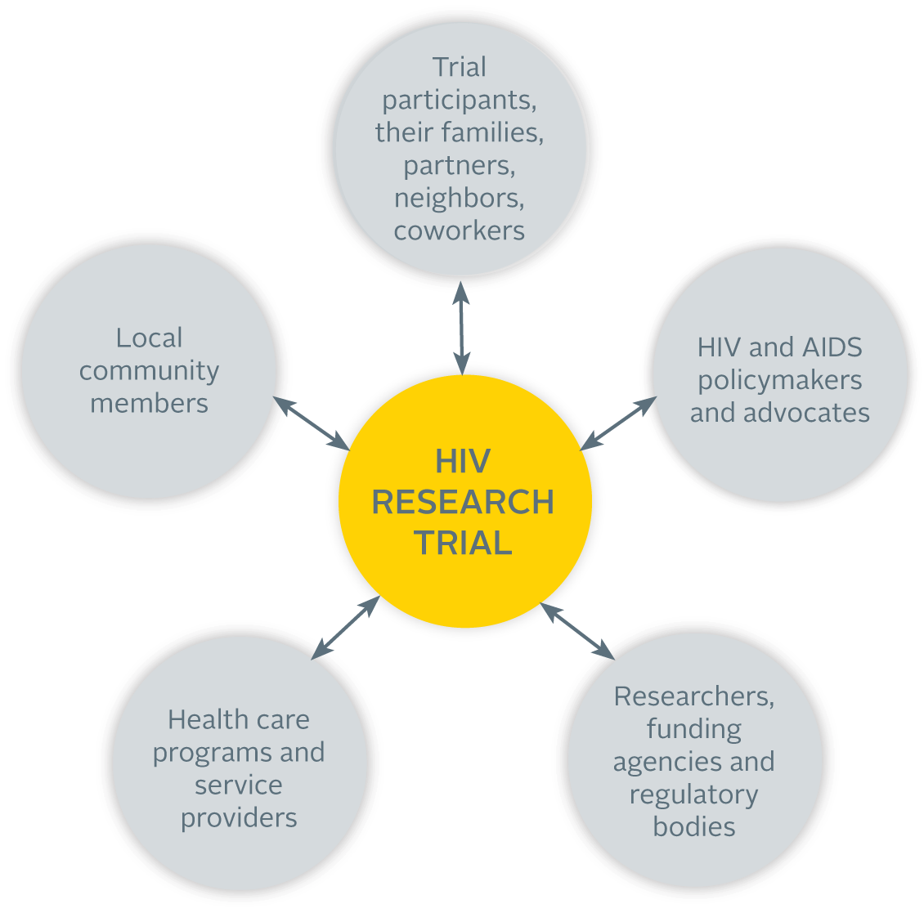
Who is a Stakeholder?
Notes:
Speaker Notes
Before proceeding, let us first clarify ‘Who is a stakeholder’?
As defined by the Toolkit (see page ix), a stakeholder is someone at the local, national or international level who can affect or be affected by the research—potentially a large group of people who are deeply interested in the results of your trial.
Five broad groups of stakeholders are mentioned in the Toolkit. However, a person may be a member of more than one stakeholder group and “local community members” comprises a broad cross section of people including representatives of the media and religious leaders.
It is important to note that stakeholder engagement is not the same thing as community engagement in the trial. Stakeholder engagement includes, but is not limited to, community engagement. It involves groups such as health care providers and funders, that are typically not part of community engagement activities.
The Toolkit will help you identify which stakeholders you should try to reach, and how to engage with them.

Slide 7
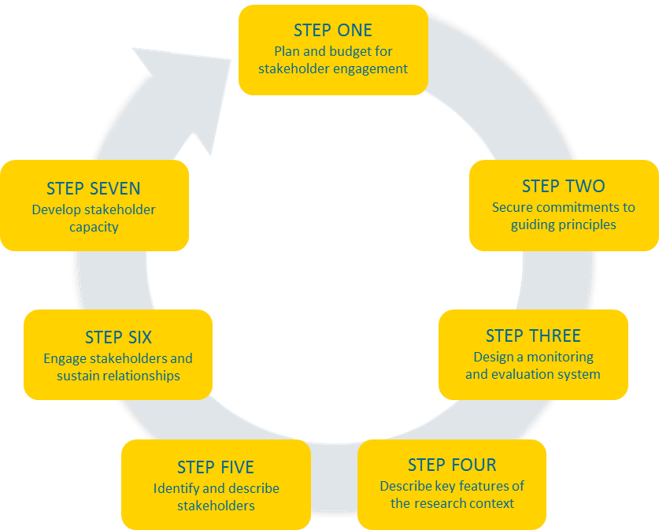
Stakeholder Engagement as an Ongoing Process
predicting which challenges might arise is difficult
resources must be set aside for potential stakeholder engagement activities and to mitigate complications
asses and develop knowledge and skills
ensure everyone can appropriately and effectively engage with the research and each other
research team must be committed and capable
deficiencies in capacity for stakeholder engagement must be addressed
ensure that accurate information about the trial reaches stakeholders and the broader community
combat misperceptions or rumors that may exist
determine whether stakeholder engagement efforts are effective and reflective of the time and resources involved
identify individuals and organizations with a stake in the project
compile/organize relevant information about them in a way that makes sense
understand the relationships between stakeholder groups and the context within which the trial takes place
prepare accordingly
Notes:
Speaker Notes
The Toolkit accomplishes this by providing a systematic approach to help research teams plan for stakeholder engagement through every stage of the research process—from developing an initial plan and budget before the research begins to developing the capacity of, and sustaining relationships with, a broad range of stakeholders.
As you can see from the diagram (see page xiii), stakeholder engagement is a continuous process. The Toolkit outlines the stakeholder engagement process in a series of seven steps—which are roughly sequential but with much back-and-forth as situations evolve over time.
[Click mouse to advance through the descriptions of each step.]
Step One: Plan and budget for stakeholder engagement—it’s a tricky first step since it’s difficult to predict what challenges might arise during a study but financial resources must be set aside for potential stakeholder engagement activities and to mitigate complications that may develop during the study.
Step Two: Secure commitments to guiding principles of stakeholder engagement from the research team—it’s important to have an understanding of the team’s commitment and address any deficiencies in the team’s capacity for stakeholder engagement.
Step Three: Design a monitoring and evaluation system for stakeholder engagement—it’s important to determine whether your stakeholder engagement efforts are effective and reflective of the time and resources involved.
Step Four: Describe key features of the research context—it’s critical to understand the relationships between stakeholder groups and the context within which your trial is taking place so that you can prepare accordingly.
Step Five: Identify and describe stakeholders—it’s important to take the time to identify the individuals and organizations that have a stake in your project, compile relevant information about them, and organize the information in a way that makes sense.
Step Six: Engage stakeholders and sustain relationships—this is where all of the preparation pays off and allows you to ensure that accurate information about your trial is reaching your identified stakeholders and the broader community so that you can effectively combat any misperceptions and/or rumors that may exist and address issues of trust and transparency.
Step Seven: Develop stakeholder capacity—including the study community, your trial participants, and your own research team to ensure that everyone has the knowledge and skills to appropriately and effectively engage with the research and each other.

Slide 8
Adapting the Toolkit for Different Needs
Research teams planning to implement their first HIV-related clinical trial at a single site
Experienced research teams
Multi-site research teams
Research networks
Notes:
Speaker Notes
The Toolkit can be adapted depending on your specific setting and situation. For instance:
Research teams that are planning to implement their first HIV-related clinical trial at a single site may wish to use the Toolkit in a simple, stepwise fashion.
A research team that already has some experience with implementing an HIV-related clinical trial, and is planning a new trial, or has an ongoing trial, can use the Toolkit as a step-by-step reference during various stages of their new or ongoing trial. For instance, during an ongoing trial, appropriate resources from the Toolkit could be selected and used to evaluate the current status of stakeholder engagement and the team’s actions adjusted as necessary.
A research team that is collaborating with teams at other sites may wish to implement a common protocol for stakeholder engagement. In such instances, the Toolkit could serve as a template for trial-wide guidance.
And lastly, the Toolkit could also be used to supplement whatever guidance is provided by larger trial networks, filling in gaps as needed on a site-by-site basis.
The ideal would be to begin working through the steps outlined in the Toolkit before your trial begins enrolling participants. However, if your trial is already underway when you come across the Toolkit, it can still serve as a useful resource wherever you are in the research process. In some cases, it will be worthwhile to go back and retrace some of the steps from the Toolkit. In others, you may have already completed those steps on your own. In either case, for many of the steps, you will find documentation templates and systems for tracking what you’ve already started and to help you organize your work. You might also discover new activities and tools that you’d like to use.

Slide 9
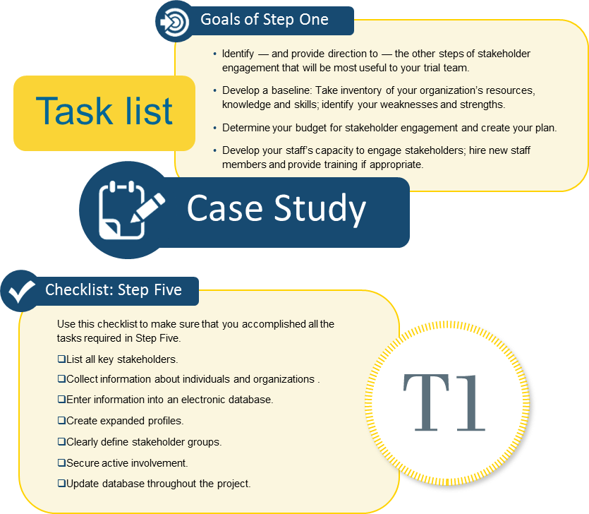
How the Toolkit is Organized
Each step of the Toolkit contains:
  Goals/rationale
  Task list
  Case studies, tips and quotes
  Checklist
  Tools (appendices)
Notes:
Speaker Notes
So let’s talk about how the Toolkit is organized. Each step of the Toolkit is configured in a similar manner. To get a sense of the configuration, let’s take a quick look at the various elements you’ll find in each step. To add a little fun, as we go through I’m going to ask a couple of questions and your job will be to find the answer in the Toolkit. The first person with the answer to each question will get a small prize.
Let’s take a closer look at Step Five; please follow along in your copy of the Toolkit. Each step of the Toolkit begins with an introduction (see page 50) that clearly outlines the goals and provides a rationale for why the step is important. Look in your copy of the Toolkit, find the Goals for Step Five. Who can tell me the second goal? Answer: page 51, Collect relevant data about these individuals and organizations using information-collection sheets.
This is followed by a task list (see page 52). The task list describes the process for accomplishing the goals. This is the meat of the Toolkit. Each task list provides a step-by-step approach for accomplishing the goals outlined in the introduction. The task list answers the question, “How?” Each task in the list includes the action to be completed, the expected result, and a detailed explanation of how to go about it.
Because the Toolkit is based on real-world experience from people actively working in the field of HIV prevention research, it also includes case studies (see pages 57 and 59) and tips (see pages 53, 54, 60) to highlight how others have approached various steps in the stakeholder engagement process. The case studies not only provide best practices and valuable lessons learned, but show you how the steps work in practice.
Scattered throughout the Toolkit, you will find quotes that bring the content to life by letting people who have been directly involved in stakeholder engagement share their insights. The quote on page 56 reminds us that stakeholder engagement is an ongoing process—you will likely find it necessary to identify and describe stakeholders through the lifespan of your trial. Look in your Toolkit to find who else was quoted in Step 5? Answer: page 55, Sam Griffith
Each step is then distilled into a comprehensive checklist (see page 62) to help track your progress and ensure that you have accomplished the tasks for this step.
Finally, the appendices contain a series of practical tools directly related to each step. Many of these are easy-to-use worksheets—often with completed examples—to help guide you through the seven steps of stakeholder engagement. Look in your copy of the Toolkit, find the first task in the Task List for Chapter 5. Which tool is referenced in that task? Answer: Tool 5A On which page in the Appendix can you find Tool 5A? Answer: page 142
Facilitator Instructions
Encourage participants to follow along by looking through Step 5 (starting on page 49). Give participants time to turn to the pages being discussed. Answer participant’s questions.

Slide 10
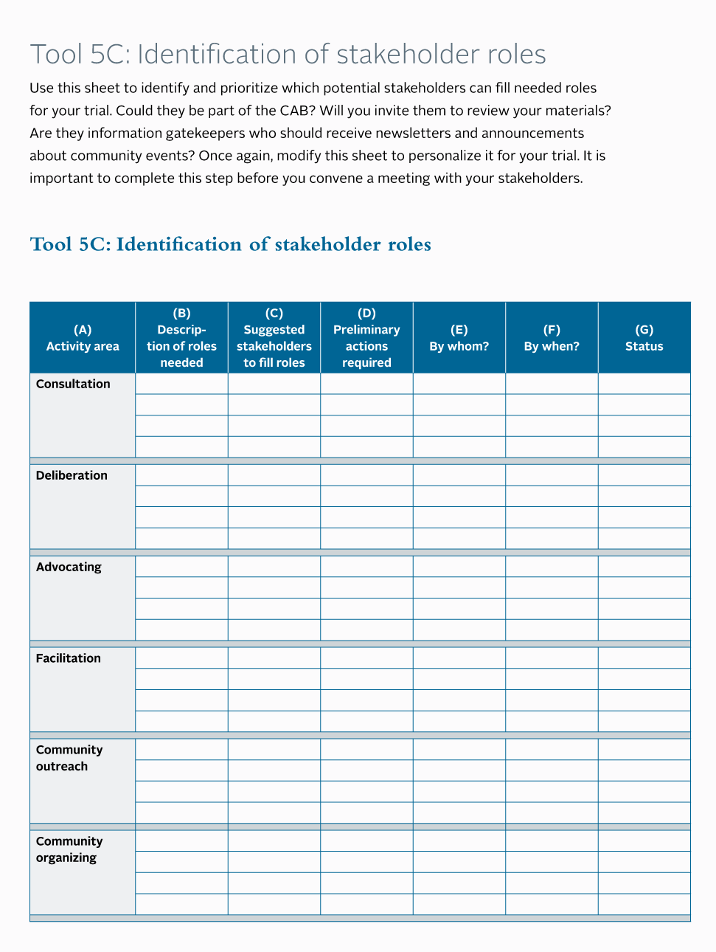
Tools Available
Step 5: Identify and describe stakeholders
Tool 5A: Stakeholder identification sheet
  Helps to organize your stakeholder list and ensure activities engage a full range of stakeholders
Tool 5B: Stakeholder data collection sheet
  Tool to collect information about stakeholders you wish to approach
Tool 5C: Identification of stakeholder roles
  Helps to determine which identified stakeholders can fill stakeholder roles that your trial needs
Tool 5D: Stakeholder contact record
  Helps to plan and track initial contact with new stakeholders
Notes:
Speaker Notes
Continuing with our exploration of the types of resources available in each step, here’s a list of all the tools from Step Five which are available in the Appendices. Notice that there are completed examples for Tools 5B and 5D (see pages 142-149).

Slide 11
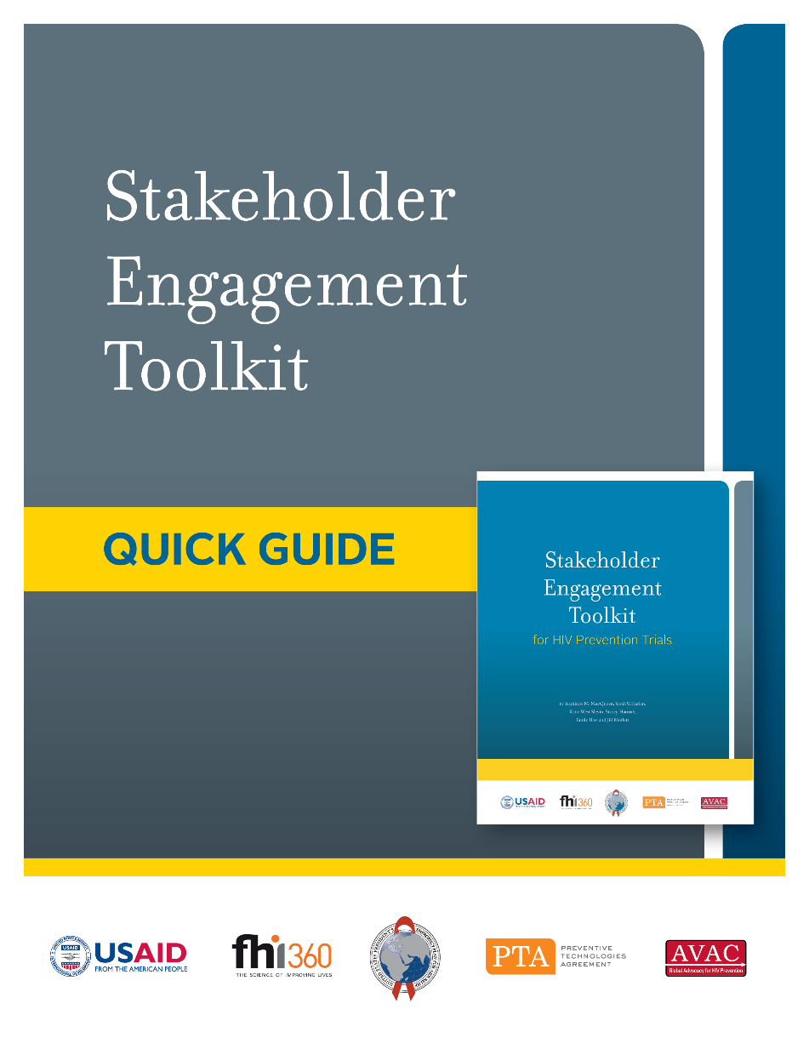
Toolkit Quick Guide
Electronic document that helps users navigate and use the components of the Toolkit
  modifiable files of the tools
  (Word and Excel)
  expanded instructions
Notes:
Speaker Notes
The Toolkit Quick Guide was developed to help users navigate and use the Toolkit. It gives users quick and easy access to modifiable (Microsoft Word or Excel) files of Stakeholder Engagement Toolkit tools and expanded instructions for using them.

Slide 12
Toolkit Quick Guide: Reference Table
Stakeholder Engagement Steps and Tasks | Toolkit Tools (Word and Excel files)
Step 1. Plan and Budget for Stakeholder Engagement
Assess your organization’s stakeholder engagement capacity and practices (identify gaps and opportunities for improvement). | 1A: Organizational self-assessment
 | 1B: Gaps and opportunities
Create a budget for stakeholder engagement activities. | 1C: Budget for stakeholder engagement
Develop a stakeholder engagement action plan including objectives, activities, staff roles, proposed timeline. | 1D: Action plan
 | 1E: Activity prioritization grid
 | 1F: Matrix of stakeholders (potential roles)
 | 1G: Work plan
 | 1H: Timeline
Develop standard operating procedures (SOPs) for stakeholder engagement staff. | 1I: Sample job descriptions
Step 2. Secure Commitments to Guiding Principles
Obtain buy-in for stakeholder engagement activities from other research team members. | 2A: Action planning guide
 | 2B: Stakeholder engagement commitment sheet
Step 3. Design a Monitoring and Evaluation System
Develop measures to track stakeholder engagement program progress. | 3A: Indicator examples
Step 4. Describe Key Features of the Research Context
Identify ways in which political, cultural, economic and climate issues impact research planning, implementation. | (There are no Toolkit tools for this step.)
Steps
Tasks
Tools
Word or Excel files
Notes:
Speaker Notes
The central feature of the Quick Guide is the Toolkit Reference Table, which enables users to quickly identify the tools they need and provides quick links to Toolkit steps and tools.
Shown here is a portion of the Reference Table from the Quick Guide. As you can see, the table maps to the steps and summarizes the key tasks from the Toolkit. In the right column, you will find links to Word or Excel files for the tools—allowing you to readily adapt and use the tools shown in the Toolkit.

Slide 13
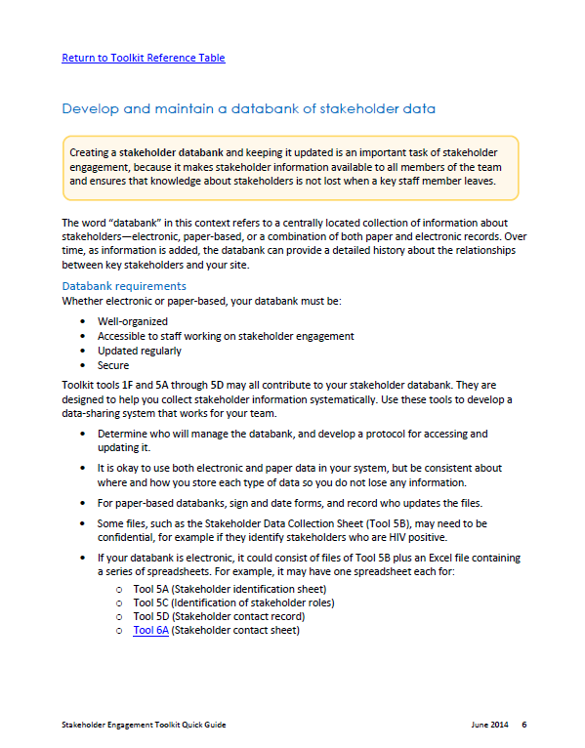
Quick Guide: Expanded Instructions for Select Tasks
Develop measures to track stakeholder engagement program progress (Step 3)
Develop and maintain a stakeholder databank (Step 5)
Assess knowledge and skills to determine how to build capabilities (Step 7)
Notes:
Speaker Notes
The Quick Guide also contains expanded instructions for three stakeholder engagement tasks:
Developing measures to track stakeholder engagement program progress (Step 3)
Developing and maintaining a stakeholder databank (Step 5)
Assessing knowledge and skills to determine how to build capabilities (Step 7)
These expanded instructions provide additional guidance about how to use the tools and resources in the Toolkit. The instructions also contain links to the Word and Excel files for the Toolkit tools and other useful resources. The image on the slide shows the expanded instructions that are provided for one of the tasks in Step 5, Develop and maintain a stakeholder databank.
Let’s take a brief tour of the Quick Guide.
Facilitator Instructions
Open the Quick Guide from the CD or web site and display it on the screen. Orient the participants to the contents of the Quick Guide and demonstrate how to navigate to the expanded instructions (from the links in the left column of the reference table) and to the files for the tools (from the links in the right column of the reference table). Show pages 5-8 which contain the expanded instructions. Encourage participants to explore the Quick Guide on their own using the CD or from the web site.

Slide 14
Socio-cultural and Other Factors that Impact Research and Stakeholder Engagement Activities
Identifying and Planning for
Notes:
Speaker Notes:
The purpose of this activity is to help you identify some of the factors that impact the research itself as well as the stakeholder engagement activities you may be responsible for planning and conducting. Although we may not be able to predict how a specific study will be received in particular community, it’s possible to make some respectable assumptions by analyzing the factors at work in a community/site in advance.

Slide 15
Discussion Question
What are some of the socio-cultural and other factors that might impact the research or stakeholder engagement activities?
What impact might these have?
Notes:
Ask participants: What are some of the socio-cultural and other factors that might impact the research or stakeholder engagement activities and what impact might these have?
Record the participants’ responses regarding the factors on a flipchart. [Allow 5 minutes.]
Probe for issues/factors and explanations such as:
Geographical location—very rural or remote locations may not have access to facilities with staff or equipment to participate in a study
Political—general unrest can interfere with day-to-day operations; shifts in political power can turn a once favorable policy/MOH environment, unfavorable
Ethnic/racial—some communities may have very similar traditions and shared history while others are diverse and require more rigorous message/usability testing
Religious—some congregations may object to practices endorsed in the study (e.g., use of condoms or contraception)
Disease—prevalence/incidence of certain diseases may be too high or too low in particular communities
Communication network—media outlets facilitate or impede the dissemination of accurate messages
Infrastructure—poor transportation and power systems cause many obvious problems
Climate—some locations may be nearly impossible to access during the rainy season; extended drought may cause study participants to migrate
Community identity—members identify as a group and recognize some individuals as leaders or group representatives; identifying and gaining the support of these decision-makers is key—where they go, community members follow
Tell participants: As you know, in real-life situations several factors converge—making it more challenging to identify and plan for the various contingencies. Each community is unique and while it’s important to consider the community level, it’s also important to consider how plans for addressing these factors will be interpreted at the national, regional and international level.

Slide 16
Benefits of Identifying and Planning for Socio-cultural Factors
Facilitates identification of stakeholders that need to be engaged
Improves understanding of the relationships and networks that link stakeholders
Facilitates communication of the research concept
Improves understanding of the relationship between local, national and regional contexts
Enables development of a research project that is well-adapted to the broad context
Notes:
Speaker Notes:
You will be able to more readily identify local, national, regional and international stakeholders whose views and engagement—whether supportive, critical or both—will affect your trial.
You will better understand the relationships and networks that link stakeholders—from the local to the international—and help to build such relationships where they are lacking.
The research concept—its relevance and potential acceptability—will be more easily communicated and explored with national, regional and international stakeholders.
You will learn how the project’s local context relates to the national and regional context; this knowledge can guide and support the conduct of formative research, the identification of potential research sites and the identification of staffing needs.
You will be able to develop a research project that is well-adapted to the broad context.
Step 4 in the Toolkit provides additional information and examples about the benefits of identifying and planning for sociocultural issues. It does not however include a tool for this step but AVAC’s GPP Blueprint for Stakeholder Engagement does so we will be using it during our next activity.

Slide 17
Small Group Activity
Read the description of the Study Design.
Two options:
  US-based study (HPTN 073)
  Africa-based study (HPTN 071)
Use your own experience and conditions in your study site to answer the Sociocultural Landscape question selected by your small group.
Discuss similarities/differences between the sites represented in your small group.
Summarize your groups’ responses on a flipchart to share with the entire group.
Notes:
Instructions to Facilitator:
If not done as participants were being seated prior to the session, break the participants into small groups of 4-5 people, arranged by US-based and Africa-based participants.
Distribute a Study Design description to each participant. More than one Study Design can be used across the groups, but each member of a small group must use the same Study Design.
Ask one representative from each small group to select a landscape question from the box.
Instruct the participants to follow along as you read aloud the instructions for the small group activity found on this slide and the Study Design handout. Approach one small group and use their Study Design and question as an example during your explanation of the task.
Although grouped by where they are based, participants in the small groups may be from different sites. Encourage each participant to consider the conditions in his/her community and share his/her insights with the other members of the small group. Encourage the group members to discuss the similarities and differences that they observe between their sites. [Allow 10 minutes for discussion in the small groups.]
Instruct the small groups to select one/two member(s) of their group to summarize on a flipchart the responses to the landscape question generated by their group. Request that each group write/summarize their question as the title of their flipchart.
Circulate among the groups to facilitate small group discussions using the Facilitator Key (contains real-life examples of issues encountered by CLOs involved with the studies) found in the small group activity file. Answer any questions raised by the groups.
Ask each small group to present the summary of their experiences to the larger group. [Allow 3-5 minutes per group.] Ask follow-up questions to encourage discussion of the small groups’ responses among the entire group (e.g., Does someone from one of the other small groups have a different experience regarding the impact of these factors/issues in their community?).

Slide 18
Assess Knowledge/Perceptions Using the Agree/Disagree Activity
Interacting with Stakeholder Groups to:
Notes:
Speaker Notes:
In the previous activity we explored the community or higher-level factors that may impact your study and acknowledged the importance of being aware of the factors that can facilitate work on a study or undermine it. In this activity, we will focus on a technique that allows you to explore the knowledge and the opinions of individual stakeholders/participants—knowing what individual stakeholders really think or feel about important issues is also very important in your efforts to gain support for a study.
Some of you may be familiar with this technique—if you have used it previously, please share your insights with the group as we move through the activity.

Slide 19
Reflection
Recall an instance when you assumed that a close friend or colleague thought like you did about a particular issue—but discovered they did not.
What was the effect of your misperception ?
Yes?
No!
Notes:
Tell participants: Take a minute to recall an instance when you felt certain that you and a close friend or colleague felt the same about a particular issue—only to discover later that you did not. It could be a simple issue like preference for a particular sports team or perhaps it was a more substantial issue like capital punishment or abortion.
Ask participants: What was the effect of your misperception?
Solicit responses (quickly) from 3-4 participants—no need to record the responses.
[Probe for responses such as: After it happened, I felt there was some distance between us. It was very awkward. Made me wonder if I had offended them previously without realizing it. I was embarrassed at first but glad that we could agree to disagree.]
Summarize the participants’ responses/observations (e.g., Sounds like in some cases, it was somewhat awkward but that ultimately it was OK to agree to disagree.).

Slide 20
Do you Agree? Or Disagree?
All HIV prevention studies must comply with the Good Participatory Practices (GPP) guidelines.
Condoms prevent pregnancy and STI transmission.
Adolescents should have access to contraceptives.
ART should be available to all people infected with HIV.
HIV testing should be mandatory for pregnant women.
Participants should have the approval of their spouses/partners prior to study enrollment.
Notes:
Facilitator Instructions
Post three signs, Agree, Disagree, and Not Sure in different parts of the space/room.
Read aloud the first item on the slide. [Click the mouse to make the item appear.]
Instruct the participants to consider the statement and decide whether you agree, disagree, or cannot make up your mind. Move to the sign that reflects how you think or feel.
Ask the participants who agree with the statement why they hold that opinion. Do the same with people who disagree or are not sure. Ask everyone to listen carefully to each group’s views and try hard to understand them.
Invite people to comment on others’ views one group at a time. Encourage participants to try to persuade each other to change their minds. Participants who change their minds can move if they wish.
Repeat the process until all of the statements have been used.
Ask participants:
What has this activity shown?
[Probe for: That it is possible to explore some potentially controversial topics in a group setting.]
Where was there most agreement and disagreement?
[Probe for: When the item is a Fact, there is, and should be—very little debate. When asking for people’s opinions—especially with a diverse participant group , you can expect differing opinions.]
Why do people have different attitudes?
[Probe for: Culture and experiences shape what individuals think—some are very deeply held convictions—some may be transformed if provided an opportunity to consider a new perspective.]
How are those attitudes linked to behavior?
[Probe for: Our attitudes and beliefs influence how we behave; changing behavior usually involves changing some part of our belief system.]
Ask participants:
How can you use (or have you used) this activity in your stakeholder engagement work?
[Probe for: As an informal knowledge and skills test; to identify attitudes of participants.]
Would you consider teaching members of your stakeholder group to conduct this activity?

Slide 21
Establish Group Norms and Guidelines
Interacting with Stakeholder Groups to:
Notes:
Speaker Notes:
In the previous activity we practiced a technique that allows us to find out what individuals know or what opinions they hold about particular—and potentially controversial—topics. Knowing that a diversity of knowledge and opinions exist in most groups, when convening a group, it’s important that individuals feel comfortable sharing their opinions and ideas.

Slide 22
Reflection
Think about positive experiences that you had in other group settings.
What was it about that group that made it successful?
Notes:
Tell participants: Early in this session, we took a few minutes to establish some norms to guide our interactions during this session—even though we are only working together for a short time today, that process helped us as strangers to establish some clarity about what to expect from each other.
Take a minute to think about positive experiences that you had in other group settings—such as meetings that you enjoyed attending because you learned a lot or the group accomplished what it set out to do.
Ask participants: What was it about the group that made it successful?
Solicit suggestions (quickly) from 5-6 participants—no need to record the responses.
[Probe for responses such as: everyone listened, mutual respect, people agreed to disagree, meeting agendas were well organized and covered, humor was used, all members were encouraged to participate, and decisions were made by consensus.]
Adapted from: The Examining Community-Institutional Partnerships for Prevention Research Group. Developing and sustaining community-based participatory research partnerships: A skills-building curriculum [Internet]. Seattle, WA: University of Washington; 2006. Available from: www.cbprcurriculum.info

Slide 23
Discussion Questions
Why it is important to establish group norms?
  in general?
  for groups that are meeting for the first time and have long-term goals that they want to accomplish as a team?
  for groups who may only meet once but have very diverse opinions and backgrounds?
Notes:
Facilitator Instructions
Ask the first question to solicit responses about the importance of a group establishing norms in general? [Probe for some of the issues mentioned on the next slide.]
Ask a follow-up question about why established norms are important for groups who are meeting for the first time but have long-term goals to accomplish?
[Probe for some of the issues mentioned on the next slide.]
Ask a follow-up question about why established norms are important for groups who may only be meeting once but have very diverse opinions and backgrounds.
[Probe for suggestions such as: discussion may become contentious or polarizing, participants may not feel comfortable sharing if they sense their opinion is not valued or is too different from that of the majority.]

Slide 24
Why establish norms/guidelines for stakeholder groups?
Guides the behavior of group members to ensure goals can be met
Specifies expectations for interpersonal interactions and other communications
Ensures that all members “own” the norms
Enables members to call each other out on dysfunctional behavior that negatively impacts group
Notes:
Speaker Notes:
In every team/group, over time, a set of rules develops around how members interact with each other. These rules or norms will form regardless of whether they are effective for the team or group. If left to develop unsystematically, some of the ways of interacting may interfere with progress and undermine a group’s efforts to succeed.
To counter that, members of stakeholder groups—like other effective teams—should consciously determine the kinds of rules, guidelines and norms they want to follow during face-to-face interactions and other verbal and written communications. The group should also decide on rules for making decisions—by consensus or majority vote and guidelines for sharing information among group members to ensure transparency and maintain the balance of power.
For this to work, all members of the group must be present at the meeting where the norms are defined and adopted so the norms are "owned" by all members of the group.
Once developed, norms are used to guide group members’ behavior. Norms allow all members of the group to assess how well the members are interacting and call each other out on any behavior that is dysfunctional or that is negatively impacting the group’s success.
Ask participants: What experience have you had with establishing group norms during community stakeholder meetings?
Ask participants: How do you politely remind a group member who is acting out that they are in violation of the norms?
Ask participants: Have you set group norms for email communications, information sharing, decision-making processes? If so, can you describe how that has worked?
Source: http://humanresources.about.com/od/teambuilding/qt/norms.htm

Slide 25
Build Capacity Using Role Plays
Interacting with Stakeholder Groups to:
Notes:
Speaker Notes:
Role plays provide an excellent opportunity to practice skills in a simulated setting. In this activity we are going to discuss the benefits of conducting this type of activity and explore how you can take roles plays to a new level using scripts and a skill’s checklist.

Slide 26
Reflection
Think about how you have used role plays or experiences where you participated in role plays.
What was it about the role play that made it effective or memorable?
How was the role play activity configured?
Notes:
Tell participants: Think about when you as a facilitator conducted a session that used role plays—what were you trying to accomplish? Or perhaps you were a participant in a role play—if so, what about the role playing experience worked for you?
Ask participants: What was it about the role play that made it effective or memorable?
Solicit responses (quickly) from 3-4 participants—no need to record the responses. [Probe for responses such as: It provided an opportunity to practice a new skill or get a sense of how it might feel to “walk in someone else’s shoes” for awhile.] Allow 2-3 minutes.
Ask participants: Briefly describe how the role play activity that you organized or participated in was configured. Write on a flip chart the role play features described. Allow 2-3 minutes.
Probe for these types of examples:
Did participants write their own scenarios for the role plays?
Did someone demonstrate the desired behavior for other participants to emulate when they conduct their role plays?
Did all participants have an opportunity to play the lead role?
Were the role plays paused and restarted to focus on particular points in the interaction?
Did some participants serve as observers and record questions about their observations?
Summarize with input from participants the pros/cons of the various configurations mentioned. For example, writing scenarios takes time (and while participants may be capable of creating relevant scenarios), the scenarios they create might not sufficiently challenge them to practice the skill that they are trying to learn. Allow 2-3 minutes. Remind participants that there are many possible ways to use role plays—no one way is correct or incorrect and the various options may be more or less appropriate for different objectives and situations.

Slide 27
Building Capacity with Scripted Role Plays and Checklists
Clarify expectations about best practices to follow when completing the task/skill
Provide a method for giving structured feedback to participants
Assess participants’ ability to perform the task/skill
Skills Checklist
Script
Notes:
Speaker Notes:
When using role plays to teach a new task or skill, consider enhancing the role play activity with a script and a skills checklist. The script helps the characters focus their role play so that they can practice a specific skill. A checklist or a job aid clarifies the best practices for how to do the task, it can be used by observers or facilitators to make notes about how a task/skill is performed during a role play, and it can serve as a skill assessment tool to formally record whether a performer has met the standard for completing that task/skill.
This level of rigor is not required in all situations; but in cases where it is applicable, you can streamline your training sessions, improve the participants’ understanding of and ability to complete the task/skill and get an idea of how competent they are.
We are going to use this technique in our final activity of this session today. Take a few moments to review the checklist in your copy of Facilitating Role Plays, found on page 7. Notice that the top portion of the checklist includes a list of general characteristics that describe effective facilitators. The bottom portion of the checklist lists the stages and specific tasks that a facilitator can use to facilitate agreement.

Slide 28
Facilitate Agreement through Group Discussion
Interacting with Stakeholder Groups to:
Notes:
Speaker Notes:
In our final activity of this session, we’re going to use scripted role plays and a skill checklist that will allow you to practice a technique for facilitating agreement during a group discussion with stakeholders. After you have a chance to practice this technique for facilitating agreement in a group, you might find it useful to use in your own meetings with stakeholders, or perhaps even decide that it’s a technique that you want to teach stakeholders to use in meetings that they might conduct.

Slide 29
Preparing for and Conducting Role Plays
Watch the demonstration role play
Decide in your group who will play which character
Read the background materials:
  General instructions for each role
  Scenario and/or specific instructions for your character
  Guidelines for giving and receiving feedback
Conduct the role play
Give each other feedback
Debrief with the other small groups
Notes:
Facilitator Instructions
Conduct a brief demonstration role play* with a co-facilitator and volunteer participants. [Allow 10 minutes]
After the demonstration, instruct the participants to decide among themselves who will play which roles—facilitator, stakeholders and observer.
Tell participants to prepare for their roles by reading the background materials intended for their role. [Allow 5 minutes]
Instruct the participants to conduct their role plays, with CLOs facilitating the mock stakeholder meeting, stakeholders responding in character for their assigned roles, and observers using the checklist to capture feedback. [Allow 15 minutes]
Circulate through the room during the role plays and provide guidance to the groups as needed. Keep track of time and alert the groups about the time remaining at 5 minutes and 1 minute.
At the conclusion of the role plays, advance to the next slide to step participants through “sharing feedback” and “processing”’ the role play.
* The brief demonstration should depict how to facilitate agreement using the approach described in Tool 7F on page 183 of the Toolkit and reflected in the checklist. Use a simple construct (e.g., seeking agreement on the time and date of the next group meeting) to demonstrate the process of coming to an agreement. During the break, prepare your volunteers to play the roles of stakeholders trying to reach agreement on a meeting date. Assign each stakeholder a “role” related to their availability for meeting so that the group needs to discuss and make some compromises in the process of finding a meeting date. Ask your co-facilitator to play the role of the observer and be prepared to share observations and constructive feedback at the conclusion of the demonstration.
When introducing the demonstration to the participants, explain that Stage One of the process is already complete as evidenced by the list of possible meeting options shown on the prepared flip chart. Encourage the participants to watch as you work through the facilitating agreement process with the stakeholders. Instruct participants to use the checklist to make their own observations during the demonstration. At the conclusion of the demonstration, ask the observer to share their observations and comments.

Slide 30
Post Role Play Discussion Questions for Small Groups
Self-assessment • Participant Perspective • Objective Feedback
What did the CLO facilitator do in this situation that was most effective?
What might the CLO facilitator consider doing differently?
Did the CLO facilitator complete the steps and meet the standards for the items included on the Role Play Observation Checklist?
Notes:
Facilitator Instructions
Instruct all participants in the group to process the role play among themselves. Specifically they should talk about what happened during the role play from the perspective of the CLO facilitator (self-assessment), the stakeholder/participants’ (personal satisfaction with the interaction, sense of engagement), and the observer (objective assessment using the Role Play Observation Checklist). Remind the observer and other participants to be constructive and follow the guidelines for giving and receiving feedback. [Allow 5 minutes]
If time permits, instruct the participants to rotate roles within their small groups and repeat the process. If the small groups are each working on different role plays, the groups can pass their role play materials to the next group.
After one or two rounds of role plays, advance to the next slide to discuss the role play activity with the entire group of participants.

Slide 31



Role Play Discussion Questions
While playing the role of the CLO facilitator…
While playing the role of the stakeholder meeting participant…
While playing the role of the observer…
Notes:
Facilitator Instructions
Conduct a discussion with the large group to process the learnings from the role plays. Use the questions below and encourage all the participants regardless of the roles they played to share their ideas/reflections. [Allow 7 minutes]
While playing the role of the CLO facilitator:
How did it feel to integrate new techniques and job aids into your interactions with stakeholder/participants?
What worked well? What still feels awkward and requires more practice?
What did you think about the pacing/length of the interaction?
Did the stakeholder/participants raise issues or questions that you did not know how to answer or retain differences of opinion that you could not negotiate?
While playing the role of the stakeholder/participants: [Click mouse to advance.]
Did the CLO facilitator adequately address your main reason for attending the stakeholder meeting? Resolve other issues/concerns raised during the meeting?
Were you able to understand and use the information the CLO facilitator provided?
Were you comfortable asking questions?
After being a stakeholder meeting participant, what changes will you make when you role-play the CLO facilitator?
While playing the role of the observer: [Click mouse to advance.]
What was it like using the checklist? Do you feel it helped with the process of both knowing what to observe and organizing your feedback to share with the CLO facilitator?
Can you share some examples of interesting interactions and creative solutions that you observed in the role plays?
Wrap up the activity by asking participants: Do you think that you might ever use scripted role plays and checklists when building the capacity of your stakeholder? Do you think you might ever use the facilitating agreement process during one of your stakeholder meetings? .
[Allow 3 minutes]

Slide 32
Please tell us what you think…
Use your green and red dots to VOTE!
MOST
BENEFICIAL
LEAST
BENEFICIAL
Notes:
Facilitator Instructions
Give each participant two green dots and two red dots.
Ask participants to vote on which activities they think were most beneficial and least beneficial by placing a green dot next to the two activities they feel will be the most useful/beneficial in their day-to-day work and a red dot next to the two activities that they found to be the least beneficial.

Slide 33
Copies of the Toolkit
Limited print copies of the Stakeholder Engagement Toolkit for HIV Prevention Trials are available by request (publications@fhi360.org)
  includes a CD with the 2014 Toolkit Quick Guide and additional resources
Access a web version of the Toolkit Quick Guide at www.fhi360.org
Notes:
Speaker Notes:
Thank you for attending and sharing your ideas. We enjoyed it and appreciate your feedback.
[Optional: Include contact information if desired.]

