Slide 1
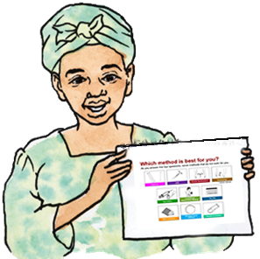
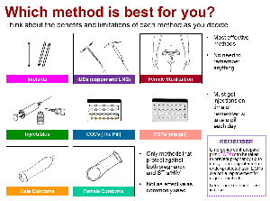
Peer Educator Tool for Informing Female Sex Workers about Contraceptive Options
Version: December 2020
Notes:
Production Notes:
Copy pages front and back in landscape page orientation and coil bind on the left edge.
Do not bind the visual aid which includes the method chart (side one), Think about which method you might like… and prevention approaches (side two), ...and how best to avoid pregnancy, HIV and other STIs (last two pages in this PowerPoint file), with the other pages.
Print the visual aid and the front and back covers of the tool/manual on heavy card stock and laminate to ensure that the materials are sturdy and last a long time.
Several pages in this PowerPoint file contain alternate illustrations on the pasteboard which can be used in lieu of those shown on the page.

Slide 2




© 2020
This tool was initially created as part of the Training Resource Package for Family Planning; it has been adapted multiple times for various uses (see User Guide for background information). The tool reflects the Medical Eligibility Criteria for Contraceptive Use, published in 2015 by WHO. This iteration of the tool is a global prototype that has been tailored for use by peer educators working with female sex workers.
Credits for illustrations: Karim Diallo, designer/illustrator based in Mali (color illustrations of FSWs); Ambrose Hoona-Kab, illustrator based in Uganda (watercolor drawings), Institute for Reproductive Health (LAM illustrations), Female Health Foundation (female condom illustrations), Rafael Avila (illustrations created/adapted for Family Planning: A Global Handbook for Providers), PATH (Sayana Press images).
This work was made possible by the generous support of the American people through the United States Agency for International Development (USAID) and the U.S. President’s Emergency Plan for AIDS Relief (PEPFAR). The contents are the responsibility of the LINKAGES project and do not necessarily reflect the views of USAID, PEPFAR, or the United States Government. LINKAGES (cooperative agreement #AID-OAA-A-14-00045) is led by FHI 360 in partnership with IntraHealth International, Pact, and the University of North Carolina at Chapel Hill.
Notes:
Adaptation/Production Notes:
Governments and other organizations may use and adapt these materials to suit their own needs and branding requirements. As appropriate, provide acknowledgements by citing the original source(s).

Slide 3
Table of Contents | page
Purpose | 4
Instructions | 5
What to expect during the session | 6
What are your needs? | 7
Benefits of family planning | 8-9
Issues to consider | 10-11
Method effectiveness | 12
Respond to myths about methods | 13
Implants | 14-15
Intrauterine devices (IUDs) (copper) | 16-17
IUDs (hormonal) | 18-19
Injectables (DMPA IM and SC) and NET-EN | 20-21
COCs (The pill) | 22-23
POPs (mini pills) | 24-25
Male condoms | 26-27
Female condoms | 28-29
Emergency contraceptive pills (ECPs) | 30-31
Lactational amenorrhea method (LAM) | 32-33
Standard Days Method (SDM) | 34-35
Female sterilization | 36-37
Closing message/contact information for facilities | 38
Notes:
Adaptation Notes:
Modify the contents and page numbers to reflect adaptations.

Slide 4
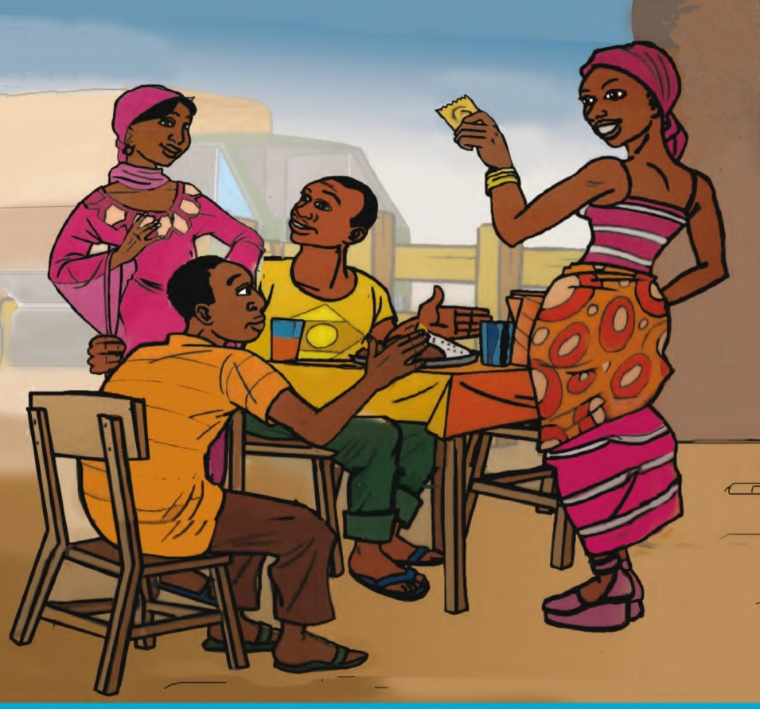
Purpose
The Peer Educator Tool for Informing Female Sex Workers about Contraceptive Options can be used by peer educators (PEs) to provide an overview of contraceptive methods for female sex workers (FSWs).
Use this tool (manual and the visual aid with a methods chart and approaches for preventing pregnancy, HIV, and other STIs) to help FSWs learn about contraceptive methods that suit their needs.
The tool helps PEs use this general process to educate FSW peers:
  encourage the FSW peer to think about and identify her contraceptive needs
  present basic information on a range of options to help the FSW identify possible methods for the prevention of pregnancy, HIV, and other STIs
  give the FSW peer information about where she can obtain the method
Notes:
Adaptation Notes:
Identify the language and terms that the PEs feel most comfortable using regarding contraception and family planning (FP) services and adapt the terminology used throughout the tool. Be careful to maintain the accuracy of the information when modifying terminology.

Slide 5
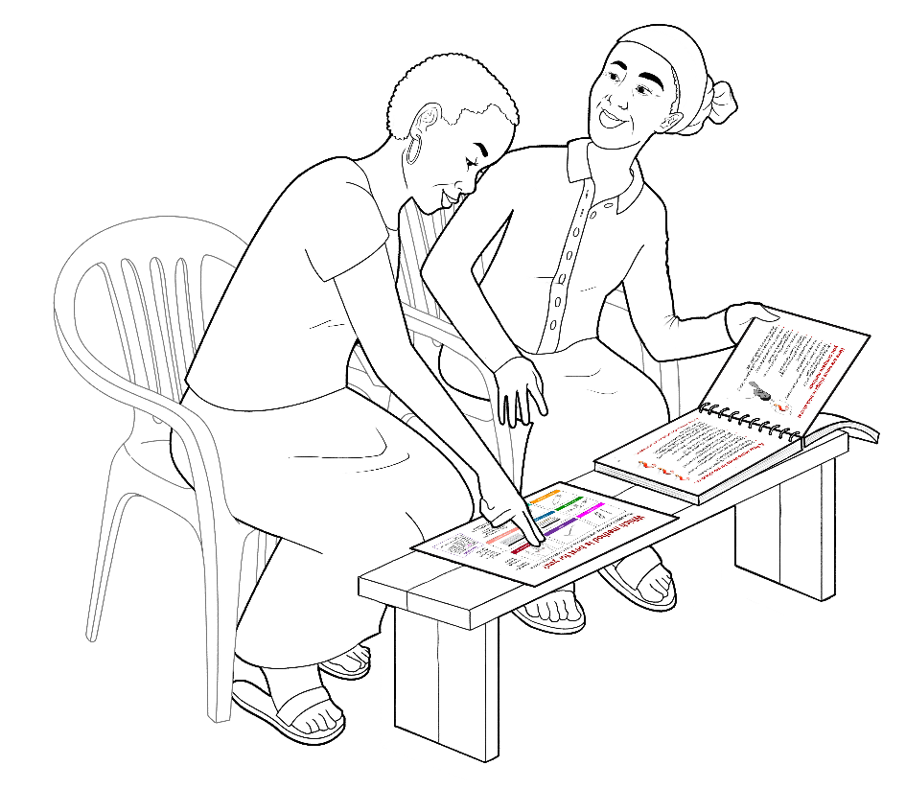
Instructions
Sit side-by-side so that you and the FSW peer can see each other’s face and talk privately.
Place the visual aid with the method chart and prevention approaches directly in front of the FSW peer with the tool where you can both see it (see illustration).
Point to information on the visual aid and the tool pages to help explain key information.
Use the color-coded bars to find information and move from one section to another in the tool.
Use pages 6–9 to tell the FSW peer what you will do during the session, learn more about what the FSW peer’s needs, and explain how the FSW peer can benefit from contraception.
If the FSW peer knows what methods she is interested in learning about, focus your discussion on those methods.
If the FSW peer does not know what method she’s interested in, listen to her describe her needs for preventing pregnancy, HIV, and other STIs. Use the visual aid to provide an overview of all the contraceptive methods and prevention approaches; then focus your discussion on the methods/approaches that seem to meet her needs using appropriate pages from the tool.
Use the first page dedicated to each specific method to provide an overview of the method.
Use the second page of the method to describe additional features of the method that may make it more (or less) appealing to a female sex worker.
At the end of the session (page 38), give the FSW peer contact information for a facility that can fulfill her needs.
Notes:
Adaptation/Production Notes:
The references to page numbers are highlighted in red in the instructions. After making adaptations, adding or deleting pages from the tool, make the necessary adjustments to the page numbers and then change the font color to black.

Slide 6
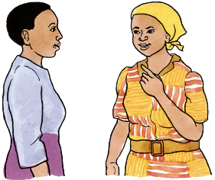
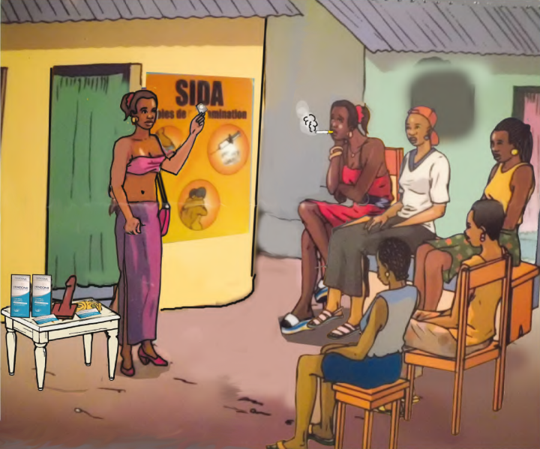
During this session…
We will listen to each other.
Ask questions about anything any time.
If I do not know the answer, I will find it for you.
Everything you say is private.
We will use this guide to help:
  talk about your needs and concerns
  learn about available contraceptive
  method options and approaches for
  preventing HIV and other STIs
  give contact information for a provider who can help you to make an informed choice of a method (if you want to use one) or assist with other needs or concerns
Notes:
Adaptation Notes:
Although the tool is designed primarily for one-on-one sessions, PEs could also use the tool to introduce contraceptive methods to FSW peers during small group discussion sessions.

Slide 7
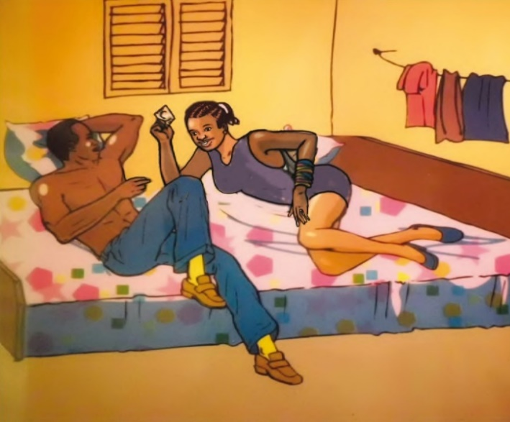
What are your needs?
Prevent or delay pregnancy
(effective contraceptive methods)
Prevent pregnancy after
unprotected sex (ECPs)
STI protection (condoms)
Protect yourself from HIV (PrEP, condoms)
Prevent HIV if you were exposed (PEP)
Prevent HIV transmission and stay healthy, if HIV-positive (ART, condoms)
Address violence in client or partner relationships (refer)
Multiple needs (trying to decide which approach or combination of approaches is best for you)
I can refer you to providers who can help.
Notes:
Adaptation Notes:
If PEP or PrEP is not available, modify this list accordingly.

Slide 8
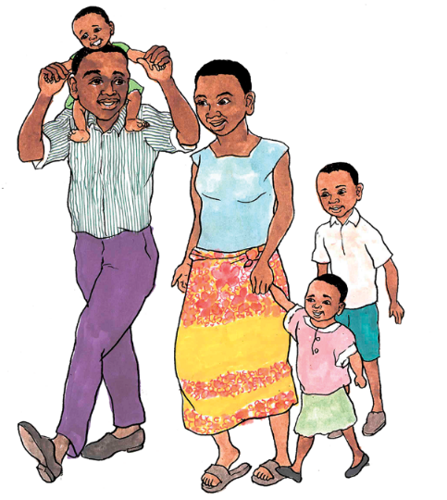
Family Planning Benefits Everyone
Benefits to woman (including adolescents):
Allows choice about if, when, and how many children to have
Earning capacity and education is not adversely affected
Benefits to mother:
Regains her strength after childbirth
More time for baby and to care for the family
Benefits to baby:
Born healthy and strong
Breastfeeds for a longer period and grows well
Benefits to boyfriend, husband, and family:
More resources for food, clothing, housing, and education
Young women, women with HIV, and women with disabilities can all benefit.

Slide 9
Keep this in mind as you decide…
Mothers and babies are healthier if women
and girls:
  wait until they are 18 to get pregnant
  wait 2 years after a birth before trying to get pregnant again
  wait 6 months after a miscarriage or abortion
  to get pregnant
  have their children before age 35
  Young women who delay getting pregnant are more likely to finish school.

Slide 10


Here are some things to think about as you compare methods.
How effective is the method? *
Is it easy to use? Can I use it without others knowing?
Does the method have any other health benefits?
Are there any unpleasant effects? What would it
be like for me if I have them?
How soon can I get it? Is there a
method I can use in the meantime?
How long will it last?
Does it prevent STIs and HIV? If I’m at risk
for STIs and HIV, what are my options?
How soon can I get pregnant after I stop?
Do I need to consider emergency contraceptive pills (ECPs)?
Should I keep some on hand just in case?
* Use page 12 and the visual aid, Think about which method you might like…to compare method effectiveness.
Notes:
Adaptation Notes:
If services are not provided free-of-charge in the public sector, consider adding this bullet:
How much will it cost?

Slide 11
A few more items for you think about...
If there are changes to my monthly bleeding, will it affect my ability to work?
Should I use one method/approach, or two, or three to prevent pregnancy, HIV, and other STIs? *
What facility can I go to for the method(s)?
Will the providers understand my needs, keep my information private, and not judge me?
Where is the facility located? When is it open?
Will knowing that I am protected from pregnancy make me less willing to discuss using condoms with clients for protection against HIV and other STIs?
Let’s learn about the methods you are interested in...
* Use the visual aid, ...and how best to avoid pregnancy, HIV, and other STIs to explain the approaches.
Notes:
Adaptation Notes:
If PrEP is not available, remove the asterisk, the footnote, and do not include the prevention approaches in the visual aid.

Slide 12
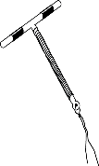
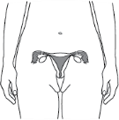
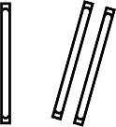
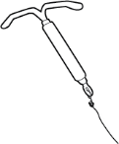


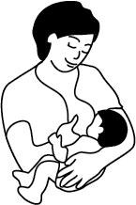
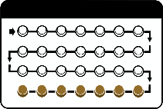
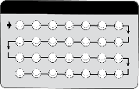

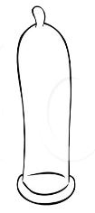
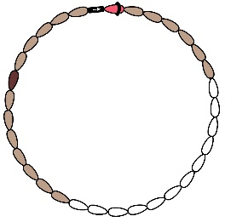

Compare Method Effectiveness
More effective
Less than 1 pregnancy per 100 women in 1 year
Implants
IUDs
(copper and hormonal)
Female sterilization
Injectables
LAM
COCs
POPs (minipills)
Male and female condoms are the only methods that also prevent STIs/HIV.
Standard Days Method
Male condoms
Female condoms
Less effective
About 20 pregnancies per 100 women in 1 year
Notes:
12
Adaptation Notes:
Include only the methods that are available to clients in your program. Ensure that the images and labels for the methods match the illustrations and terminology used elsewhere in the tool.
This iteration of the chart reflects the methods that are featured in this prototype tool.
Several contraceptive methods are not included in the tool: spermicides, because frequent use increases the risk of HIV acquisition; and vasectomy, since it is not a practicable option with commercial partners.
Source: Global Handbook for Family Planning, 2018.

Slide 13









Respond to Myths about Methods
If used correctly, condoms do not break or
get lost in the woman’s body.
They do not have holes that HIV can pass through.
IUDs do not move to other parts of the body.
It does not cause discomfort during sex.
It can be removed any time.
Pills, implants, and injectables:
  Do not cause infertility; you can have
  babies after stopping.
  Do not cause deformed babies if
  accidentally given to a pregnant woman.
  Do not cause abortion.
  Changes to monthly bleeding are normal and not harmful; regular bleeding returns when method use stops; takes longer for some methods.
  No menses while on these methods does not mean a woman is pregnant; blood does not build up in a woman’s body.
The womb is not removed during female sterilization.
It does not change a woman’s:
  menstrual cycles, sexual behavior, or sex drive
  weight, appetite, or appearance
Contraceptive methods do not cause cancer.
All methods are safe.
Notes:
Adaptation/Production Notes:
The list of concerns should be adjusted to include information related to methods available and myths/concerns that are prevalent in the community.
PEs should be instructed how to use this information to dispel myths about contraceptive methods. If an FSW peer raises any of these concerns during the session, share the facts provided; otherwise, avoid discussing specific myths and focus on the message that all methods are safe.

Slide 14
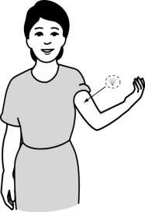
Implants
Small plastic capsules or rods placed under the skin of the inside upper arm (1 or 2 capsules or rods depending on type)
Prevent eggs from leaving the ovaries and thicken cervical mucus
Last 3 to 5 years; can be removed any time if you want to get pregnant
Can be used safely by most women, including those with HIV or AIDS
No protection from HIV or other STIs; add other methods to protect yourself (condoms, PrEP)
Benefits—Implants:
Both long-lasting and reversible.
Do not require a woman to do anything.
Notes:
14
Adaptation Notes:
Modify the characteristics and illustrations depending on the type of implant offered.

Slide 15
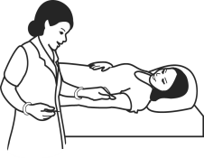
Normal changes some women may have:
  Bleeding changes are common and may
  include irregular spotting or no bleeding
  Nausea
  Headaches and dizziness
  Breast tenderness or mood changes
  Abdominal discomfort
FSWs should consider whether they can:
  Cope with irregular bleeding and spotting, which can interfere with their work and limit their ability to solicit or accept clients.
  Accept that others may know she is using implants; the rods can be felt when touched and, in some women, are visible under the skin.
  Other considerations for women living with HIV or AIDS:
  If you are on ART or being treated for TB, tell your provider which drugs you take because they may reduce the effectiveness of implants.
Notes:
15

Slide 16
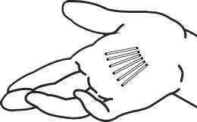
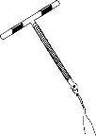
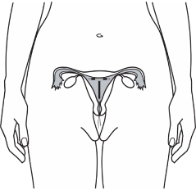
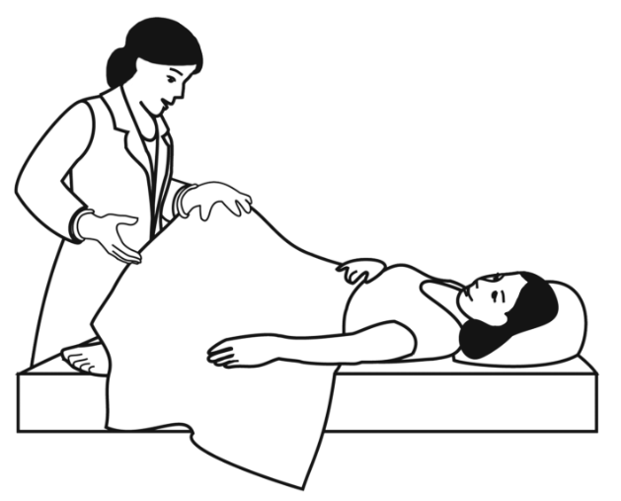
IUD
(copper)
Small, plastic "T" wrapped in copper wire placed in the womb
Stops sperm from reaching egg
Can be used for up to
12 years; can be removed any time if you want to get pregnant
Must be inserted and removed by trained nurse or doctor
  No protection from HIV or other STIs; add other methods to protect yourself (condoms, PrEP)
Benefits—IUDs (copper):
Can be used by women of any age, including adolescents.
Helps prevent certain types of cancer.
Does not require a woman to do anything.
Can be used privately.
Notes:
Adaptation Notes:
Modify the characteristics to match the type of IUDs offered; include the hormonal IUD pages if it is also available.

Slide 17
FSWs may not be good candidates for IUDs unless gonorrhea and chlamydia infection can be ruled out before insertion:
  Untreated gonorrhea or chlamydia increases the risk of developing a serious pelvic infection during the first month of IUD use.
  FSWs desiring to use an IUD should talk with a facility-based health provider.
Other considerations for women living with HIV or AIDS:
  Can generally use an IUD safely; however, women with AIDS must feel healthy on ARV therapy before starting an IUD. HIV-positive women who develop AIDS while using an IUD can continue using it.
Normal changes some women may have:
  Cramps or menstrual spotting for a few days after insertion.
  Menses remain regular but may become somewhat heavier and/or longer, with or without cramps.
  Can be used as emergency contraception if inserted within 5 days of unprotected sex.
Notes:
Adaptation Notes:
In locations where gonorrhoea and chlamydia are prevalent, but laboratory testing for STIs is limited, guidelines may recommend presumptive treatment with antibiotics for both gonorrhea and chlamydia in cases when FSWs want to initiate an IUD. This may reduce the risk of post-insertion pelvic inflammatory disease (PID).
Change the information on this page to match the national or program guidelines.

Slide 18
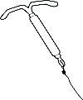
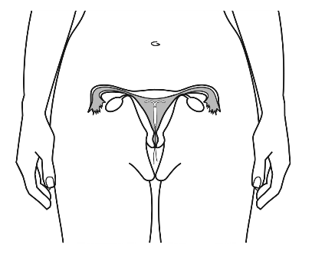
IUD
(hormonal)
Small, plastic "T" placed in the womb; slowly releases a hormone
Stops sperm from reaching egg
Can be used for up to
3-5 years; can be removed any time if you want to get pregnant
Must be inserted and removed by trained nurse or doctor
  No protection from HIV or other STIs; add other methods to protect yourself (condoms, PrEP)
Benefits—IUDs (hormonal):
Can be used by women of any age, including adolescents.
Helps prevent certain types of cancer.
Does not require a woman to do anything.
Can be used privately.
Notes:
Adaptation Notes:
Modify the characteristics to match the type of hormonal-IUDs offered (e.g., duration of effectiveness). If hormonal-IUDs are not available, remove the hormonal-IUD pages.

Slide 19
FSWs may not be good candidates for IUDs unless gonorrhea and chlamydia infection can be ruled out before insertion:
  Untreated gonorrhea or chlamydia increases the risk of developing a serious pelvic infection during the first month of IUD use.
  FSWs desiring to use an IUD should talk with a facility-based health provider.
FSWs should consider whether they can:
  Cope with irregular bleeding and spotting which can interfere with their work and limit their ability to solicit or accept clients (eventually, less bleeding or no bleeding at all becomes more common, which many women view as beneficial).
Other considerations for women living with HIV or AIDS:
  Can generally use an IUD safely; however, women with AIDS must feel healthy on ARV therapy before starting an IUD. HIV-positive women who develop AIDS while using an IUD, can continue using it.
Normal changes some women may have:
  Cramps or menstrual spotting for a few days after insertion.
  Bleeding changes are common but not harmful. Typically, lighter and fewer days of bleeding, or infrequent or irregular bleeding, or no bleeding.
Notes:
Adaptation Notes:
In locations where gonorrhoea and chlamydia are prevalent, but laboratory testing for STIs is limited, guidelines may recommend presumptive treatment with antibiotics for both gonorrhea and chlamydia in cases when FSWs want to initiate an IUD. This may reduce the risk of post-insertion pelvic inflammatory disease (PID).
Change the information on this page to match the national or program guidelines.

Slide 20
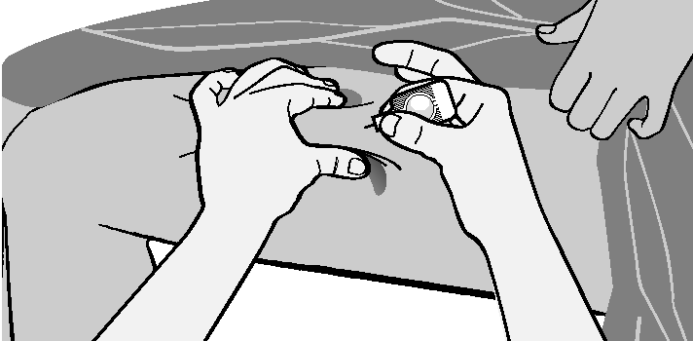
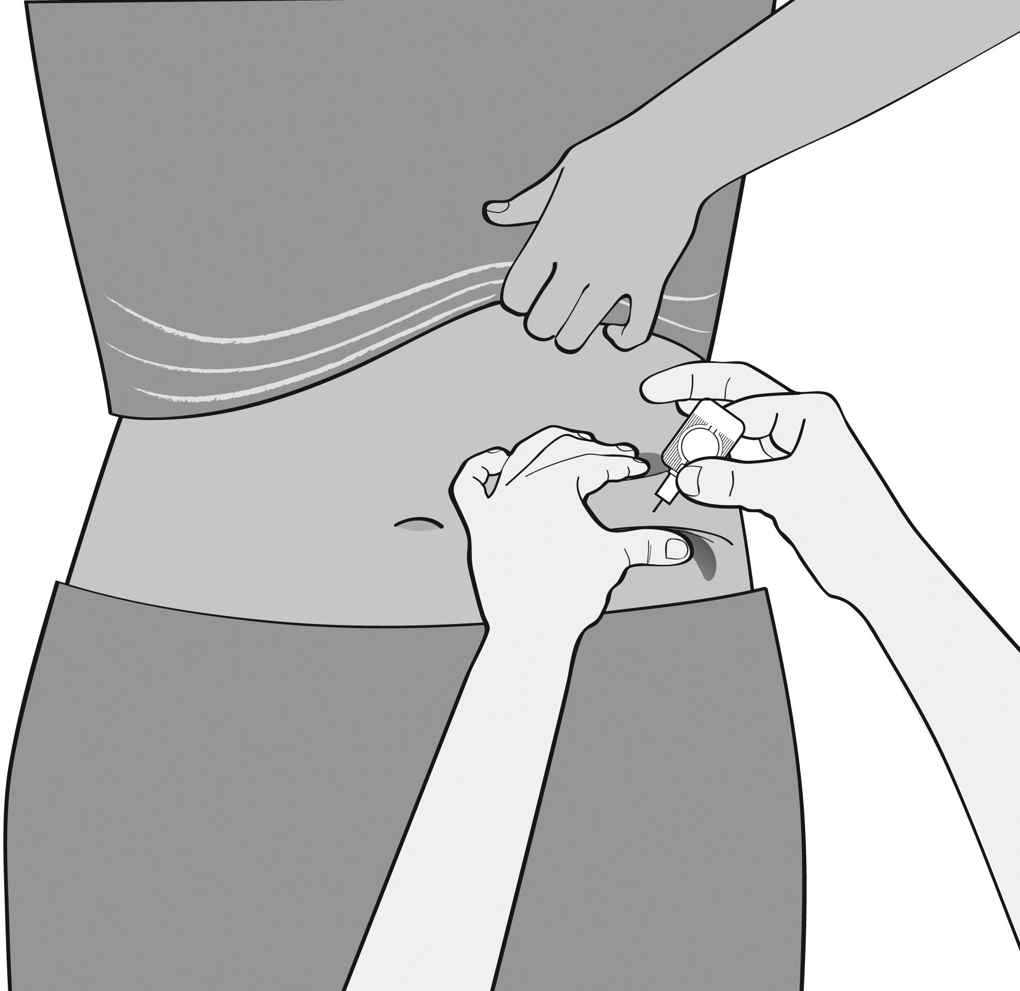
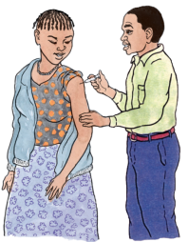
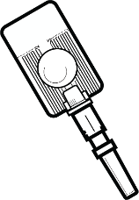
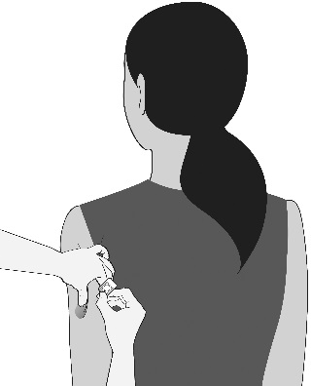
Injectables
(DMPA IM and SC and NET-EN)
Given by injection every
  13 weeks – DMPA
  8 weeks – NET-EN
Prevent eggs from leaving
the ovaries
May take a few months longer to become pregnant after stopping
Can be used safely by most women, including those with HIV or AIDS or on ART
No protection from HIV or other STIs; add other methods to protect yourself (condoms, PrEP)
Benefits—Injectables:
May help prevent cancer in the lining of the womb.
Can be used privately.
Sayana Press illustrations/photo from PATH
Notes:
20
Adaptation Notes:
Modify these pages to reflect the type(s) of progestin-only injectables available (e.g., include information on Sayana Press and modify characteristics and/or images accordingly).

Slide 21
  Normal changes some women may have:
  Bleeding changes such as prolonged or heavy bleeding, irregular bleeding or spotting, or no bleeding at all
  Headaches and dizziness
  Abdominal bloating and discomfort
  Changes in mood and sex drive
  Weight gain
  FSWs should consider whether they can:
  Remember to come for re-injections on time. Return even if late.
  Cope with unpredictable bleeding. It could interfere with work and limit the ability to solicit or accept clients.
  Other considerations for women living with HIV or AIDS:
  Effectiveness of injectable contraceptives is not reduced in women on ART or those receiving TB treatment.
Notes:
21

Slide 22
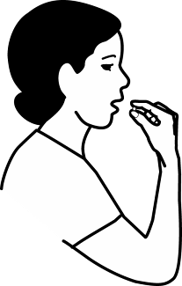
COCs (The pill)
A pill taken every day to prevent pregnancy
Prevents eggs from leaving the ovaries
  After stopping pills, can get pregnant without a delay
  Can be used safely by most women, including those with HIV or AIDS
  No protection from HIV or other STIs; add other methods to protect yourself (condoms, PrEP)
Benefits—COCs:
Periods are usually very regular and light.
Helps prevent certain types of cancer.

Slide 23
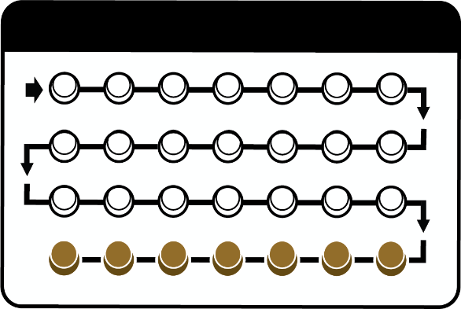
  Normal changes some women may have:
  Nausea
  Headaches and dizziness
  Breast tenderness or mood changes
  Irregular spotting (rare)
  FSWs should consider whether they:
  Can take a pill every day. Will an unpredictable work schedule, and/or use of alcohol/other drugs, make it harder to maintain a
  pill-taking routine?
  Can cope with changes. Although normal and not harmful, changes may be unpleasant and interfere with an FSW’s daily activities.
  Want to avoid having a period for 2-3 months (ask their provider).
  Other considerations for women living with HIV or AIDS:
  If you are on ART or being treated for TB, tell your provider which drugs you take because they may reduce COC effectiveness.
Notes:
23
Adaptation Notes:
If extended use of COCs is not allowed by country guidelines, remove the sentence referring to extended use: Want to avoid having a period for 2-3 months (ask their provider).
What is Extended Use?
Women take hormonal pills for 12 weeks without a break, followed by one week of nonhormonal pills (or no pills).
Monophasic pills are recommended for extended use.
Benefits of Extended Use
Women have vaginal bleeding only 4 times a year.
Reduces how often some women suffer headaches, premenstrual syndrome, mood changes, and heavy or painful bleeding during the week without hormonal pills.
Disadvantages of Extended Use
Light, irregular bleeding/spotting may last as long as the first 6 months of use—especially among women who have never before used COCs.
More supplies needed—15 packs every year instead of 13.

Slide 24
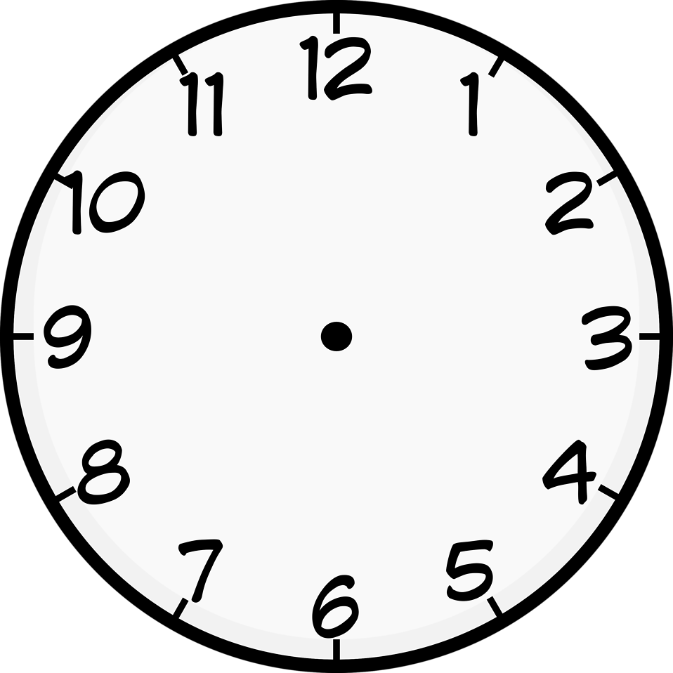

POPs (mini pills) progestin-only pills
A pill taken every day at the same time to prevent pregnancy
Prevents eggs from leaving the ovaries and thickens cervical mucus that blocks sperm from meeting an egg
  After stopping pills, can get pregnant without a delay
  Can be used safely by most women, including those with HIV or AIDS
  No protection from HIV or other STIs; add other methods to protect yourself (condoms, PrEP)
Benefits—POPs:
Safe for breastfeeding women.

Slide 25
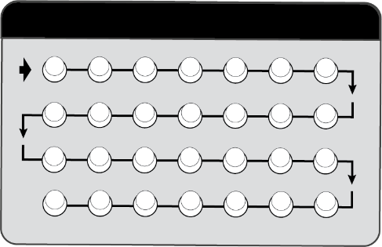
  Normal changes some women may have:
Nausea
  Headaches and dizziness
  Irregular spotting
  Breast tenderness or mood changes
  FSWs should consider whether they can:
  Take a pill at the same time every day. Will an unpredictable work schedule, and/or use of alcohol/other drugs, make it harder to maintain a pill-taking routine?
  Cope with changes. Although normal and not harmful, changes may be unpleasant and interfere with an FSW’s daily activities.
Other considerations for women living with HIV or AIDS:
  If you are on ART or being treated for TB, tell your provider which drugs you take because they may reduce POP effectiveness.
Notes:
25

Slide 26
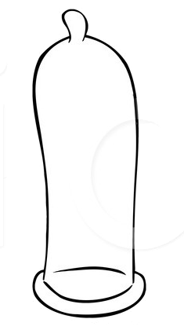
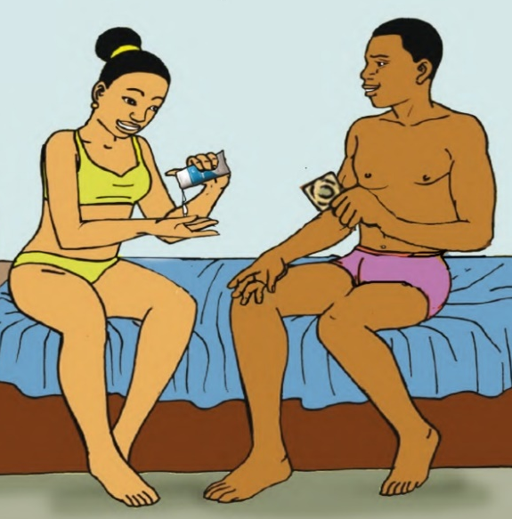
Male Condom
A thin rubber cover that fits over the erect penis
Prevents pregnancy and sexually transmitted infections, including HIV
Effective when used correctly every time you have sex
Use alone or with another method
Can be used by any couple who agrees to use it, including married couples
Benefits—Male Condoms:
Help protect against conditions caused by STIs.

Slide 27
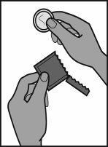
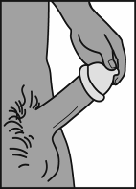
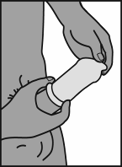
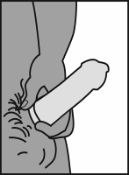
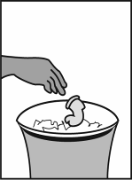
FSWs should consider whether they can:
  Negotiate condom use with clients without threat of violence or manipulation
  (e.g., client promises to pay more for sex without condom).
  Consistently use condoms to avoid transmission/acquisition of STIs/HIV
  (or re-infection with a new strain of HIV).
  Refuse “dry sex” to avoid vaginal tears and reduce STI/HIV risk.
What to Remember
  Use water-based lubricants only.
  Store in a cool dry place.
  Emergency contraceptive pills (ECPs) can be used if condom breaks or slips.
How to Use
❶
❷
❸
❹
❺
Use a new condom for each sex act. Make sure it is not expired.
Before any contact, place the condom on the tip of the erect penis with the rolled side out.
Unroll the condom all the way to the base of the penis.
After ejaculation, hold the rim of the condom in place and withdraw the penis while it is still hard.
Throw the used condom away safely.
Notes:
Adaptation Notes:
If necessary, substitute “dry sex” with the local term used to describe “the sexual practice of having sexual intercourse without vaginal lubrication.”

Slide 28
Female Condom
A thin rubber lining that fits loosely inside a woman’s vagina
Prevents pregnancy and sexually transmitted infections including HIV
Effective when used correctly every time you have sex
Use alone or with another method
Can be used by any couple who agrees to use it, including married couples
Benefits—Female condoms:
Female controlled; can be inserted in advance.
Feels more natural than male condoms.

Slide 29
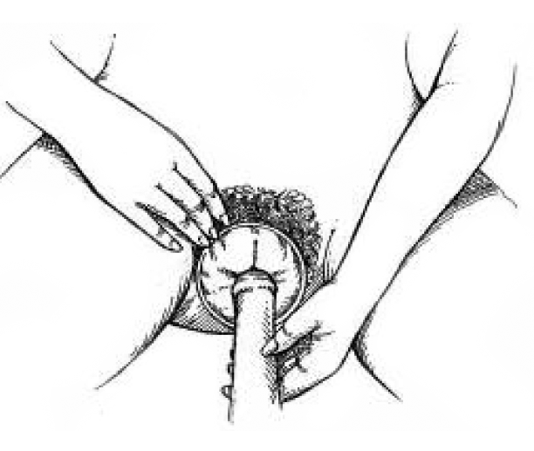
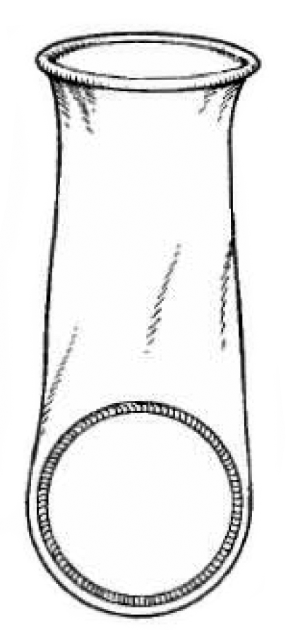
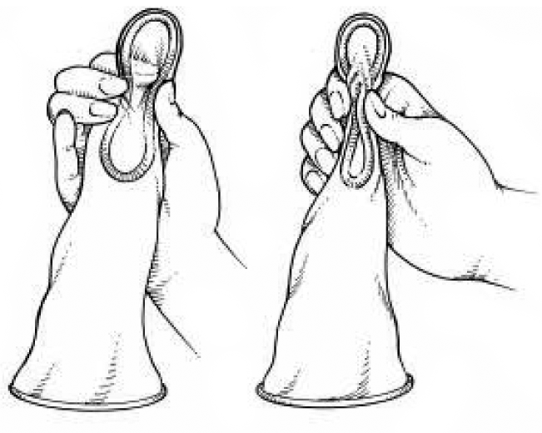
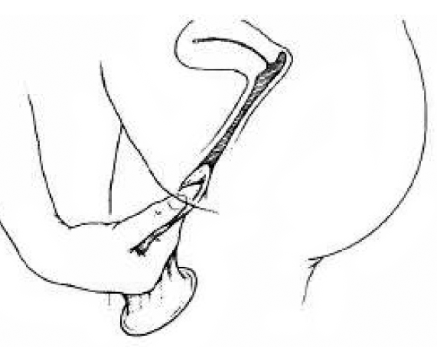
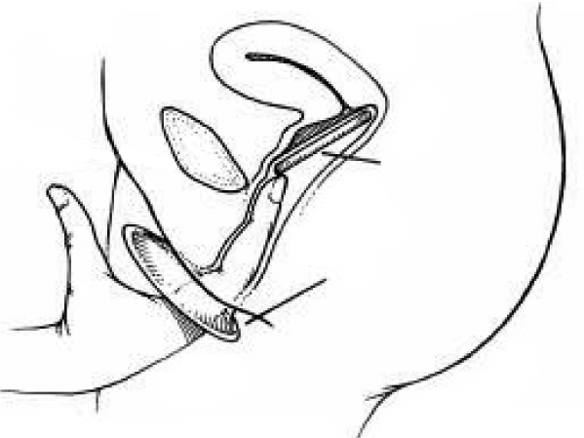
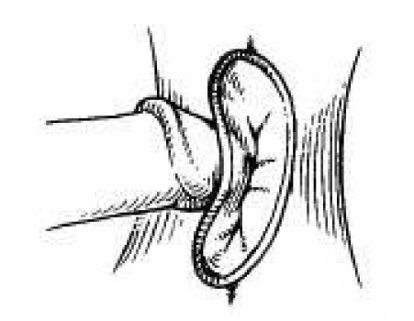
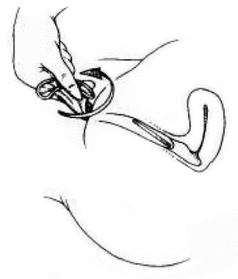
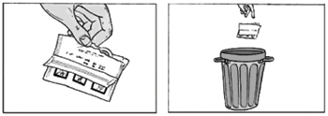
FSWs should consider whether they can:
  Negotiate female condom use with clients who refuse male condoms.
  Use emergency contraceptive pills (ECPs) if condom is used incorrectly.
❺
How to Use
❷
❸
❹
❶
Like this.
NOT like this!
• Use a new condom for each sex act.
• Make sure it is not expired.
• Wash hands if possible.
• Insert condom before any physical contact.
• Can insert up to 8 hours before sex.
• Hold ring at closed end and squeeze it.
• Insert ring into vagina as far as it will go.
• Insert finger inside condom to push it into place.
• Ensure that penis enters and stays inside condom!
❻
• After man withdraws penis, hold outer ring, twist to seal in fluids, and gently pull condom out.
  • Condom does not need to be removed immediately.
• Remove the condom before standing up, to avoid spilling semen.
❼
• Dispose of used condom safely.
What to Remember
  Be careful not to tear condom when inserting.
  Keep ECPs on hand if condom fails or is not used.

Slide 30
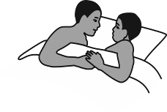

Emergency Contraceptive Pills (ECPs)
Pills taken to prevent pregnancy after unprotected sex* (effective if taken within 5 days; the sooner, the better)
Work by preventing or delaying the release of eggs
Is not a replacement for regular methods
Safe for any woman including those with HIV or AIDS, and those on ART
Benefits—ECPs:
Can be used by women of any age, including adolescents.
Second chance to prevent pregnancy; do not cause an abortion.
Can be used more than once in a woman’s cycle.
* Unprotected sex means not using a method (including unplanned sex, forced sex, or rape), forgetting to use your regular method or using it incorrectly (missed pills or late injection), or your method fails (condom breaks).

Slide 31



What to Expect
May cause nausea and vomiting and light spotting for a few days. Next period may come a few days earlier or later.
FSWs should consider whether they:
  Were exposed to HIV. While ECPs do not increase FSWs’ risk for acquiring HIV, they provide no protection from HIV and other STIs.
  Should seek post-exposure prophylaxis (PEP) in addition to ECPs, if concerned about exposure to HIV due to unprotected intercourse.
5 days to use EC after unprotected sex

Slide 32


Lactational Amenorrhea Method (LAM)
(for breastfeeding mothers)
Breastfeed only, day and night,
to prevent pregnancy
Very effective for 6 months after birth if fully or nearly fully breastfeeding and monthly bleeding has not returned
  Do not use bottles, pacifiers or other artificial nipples; these discourage your baby from breastfeeding as frequently
  No protection from HIV or other STIs; add other methods to protect yourself (condoms, PrEP)
Benefits—LAM:
Breastmilk is the best food for an infant.
No need to spend money on formula.
Notes:
Adaptation Notes:
Consider what term(s) is/are commonly used for LAM within the community. If terminology is changed here, ensure that consistent terminology is used throughout the tool. Many countries use the term exclusive breastfeeding, if that is what FSWs/clients are familiar with, use that in lieu of fully or nearly fully breastfeeding.
“Fully breastfeeding” includes both exclusive breastfeeding (the infant receives no other liquid or food, not even water, in addition to breast milk) and almost-exclusive breastfeeding (the infant receives vitamins, water, juice, or other nutrients once in a while in addition to breast milk).
“Nearly fully breastfeeding” means that the infant receives some liquid or food in addition to breast milk, but the majority of feedings (more than three-fourths of all feeds) are breast milk.
Source: Global Handbook for Family Planning, 2018.

Slide 33

FSWs should consider whether they can:
  Meet the conditions required for LAM including breastfeeding often, day and night, even when your baby is sick or
  you need to work.
  Give the infant only breastmilk; no other food or liquids.
  Be ready to switch to another method since LAM is temporary.
  Other considerations for women living with HIV or AIDS:
  Take ARVs daily to reduce the risk of transmitting HIV to your infant.

Slide 34

Standard Days Method (SDM)
Used with CycleBeads®, a color-coded string of beads to help you:
    track the days of your monthly bleeding cycle by moving a ring from bead to bead
    identify which days of the month you can get pregnant
Prevent pregnancy by using condoms or not having sex on days you can get pregnant
Effective if used correctly
  No protection from HIV or other STIs; add other methods to protect yourself (condoms, PrEP)
Benefits—SDM:
Has no bleeding changes or other effects.
Requires no resupply.

Slide 35
FSWs should consider whether they can:
  Negotiate condom use with clients without threat of violence or manipulation (e.g., client promises to pay more for sex without condom) OR
  Avoid unprotected sex for a large portion of the menstrual cycle (12 days) when pregnancy may occur.
  Remember to move the ring to a new bead every day.
  Will an unpredictable work schedule, and/or use of alcohol/other drugs, make it harder to maintain the cycle-tracking routine?
  Other considerations:
  Less effective than most other contraceptives methods
  Women with irregular monthly bleeding cannot use SDM

Slide 36

Female Sterilization
Permanent method for women and couples who do not want more children (sterilization is also an option for men)
Woman’s tubes that carry eggs to the womb are cut or blocked
Simple surgery with minimal risk that must be performed by a trained clinical provider
  No protection from HIV or other STIs; add other methods to protect yourself (condoms, PrEP)
Tubes
blocked or
cut here
Benefits—Female sterilization:
May help prevent cancer of the ovary.
Helps protect from serious infection of the womb.
Notes:
Adaptation Notes:
If the term “tubal ligation” is preferred, change “female sterilization” to “tubal ligation” throughout.

Slide 37
What to Expect
  Local pain killer is given.
  Can go home after a few hours; may have soreness for a few days.
  Monthly bleeding will continue as usual.
FSWs should consider whether they can:
  Allow ample recovery time; two-day rest (avoiding vigorous work) and avoiding sex for at least one week or, if pain persists, longer.
  Convince partners and clients to continue using condoms for protection from HIV and other STIs.
Other considerations for women living with HIV or AIDS:
  May need to postpone the procedure if there are any serious health problems related to HIV or AIDS; the health provider will decide when you are ready.

Slide 38


Seek services from a health care provider at one of these health centers.
Contraceptive services
HIV counseling/testing, PrEP, PMTCT, ART services
STI testing and treatment services
Other services
Notes:
During training on how to use the tool, instruct PEs to write the names and contact information for the facilities in their communities in the spaces provided. Other services may include legal, violence prevention, shelter, nutrition, education, etc.

Slide 39







Think about which method you might like…
Most effective methods
No need to remember anything
Must get injections on time or remember to take a pill each day
Implants
IUDs (copper and hormonal)
Female Sterilization
Injectables
COCs (The pill)
POPs (mini pill)
Only methods that protect against both pregnancy and STIs/HIV.
Are effective ONLY if used correctly and consistently every time you have sex.
REMEMBER
Emergency contraceptive pills (ECPs) can be taken to prevent pregnancy up to
5 days after unprotected sex. ECPs are not a replacement for regular methods.
Keep some on hand—just in case.
Male Condoms
Female Condoms
LAM is a temporary option for breastfeeding women.
SDM is a fertility awareness method; it requires regular cycles and avoiding sex or using condoms on fertile days.
Notes:
Adaptation/Production Notes:
This is the visual aid, method choice chart. It should not be bound with the other pages in the tool/manual. Print it double-sided with the prevention approaches (next page) on card stock and/or laminate it.
Adapt the chart to reflect the available method mix. The chart currently matches the method mix shown in this prototype.
The peer educator should give the FSW peer the chart to look at while they are discussing the various methods.
The order of the methods in the chart corresponds to the overall effectiveness of the methods facilitating the ability of the PEs to discuss effectiveness during the information-sharing process.

Slide 40


...and how best to avoid pregnancy, HIV, and other STIs
More protection
+
+
=
BEST protection from pregnancy, HIV, and other STIs
Effective FP method
+
=
+
=
Effective FP method
Effective FP method
Good protection from pregnancy; and, if partner cooperates, HIV and other STIs
Good protection from pregnancy and HIV; but,
no protection from other STIs
=
Protection from pregnancy, HIV, and other STIs; but relies heavily on partner cooperation
Less protection
Notes:
Adaptation/Production Notes:
This description of prevention approaches should be reproduced on the back side of the method choice chart (not bound with the other pages in the tool/manual; printed on card stock and/or laminated). The peer educator should encourage the FSW peer to review this information while they are discussing the various approaches for preventing pregnancy, HIV, and other STIs. If PrEP is not yet available/accessible, this page of the visual aid should not be used. If PrEP is available locally, PEs should provide contact information about PrEP providers to FSW peers who are considering PrEP.

