Slide 1
Peer and Outreach Worker Training: Preventing and Responding to Violence against Key Populations

Slide 2
Module 1
Setting the Stage

Slide 3
Session 1.1
Welcome and Introductions

Slide 4
Objective
Introduce ourselves and discuss the role of [peer educators, navigators, outreach workers] in [country]

Slide 5
Introductions
Name
Organization and role
District/area in which you work
One reason you are proud to be a [peer educator, navigator, outreach worker]

Slide 6
Session 1.2
Pre-Test

Slide 7
Objective
Determine baseline knowledge and attitudes

Slide 8
Pre-test
Do not write your name.
Fill out pre-test.
When finished, place face down on your table.

Slide 9
Session 1.3
Learning Objectives and Agenda

Slide 10
Objective
Review training goal and objectives and discuss how modules will help us achieve all objectives

Slide 11
Training goal
To equip [peer educators, navigators, outreach workers] with the knowledge and skills they need to understand, assess, and appropriately respond to violence in key population (KP) members’ lives, including through improving KP members’ access to HIV and other violence response services and supporting violence prevention efforts.
Key populations are
Men who have sex with men
Sex workers
People who inject drugs
Transgender (trans) people

Slide 12
Training objectives
Explore the underlying causes of stigma, discrimination, and violence against KP members and the connection with HIV
Identify interaction with [peer educators, navigators, outreach workers] as a key entry point into violence response services
Learn to create an environment in which disclosure of violence can safely occur
Build skills for asking about violence and providing first-line support
Understand the range of health, social, and justice/legal services KP survivors may need and make appropriate referrals
Discuss best practices for safe data collection and management

Slide 13
Discussion: Expectations
What do you want to get out of the training?

Slide 14
Agenda review
Module 1: Setting the Stage
Module 2: Building Core Knowledge
Module 3: Applying Principles and Building Skills
Module 4: Using What We Have Learned

Slide 15
Session 1.4
Group Norms

Slide 16
Objective
Develop and agree upon norms to guide the training

Slide 17
Module 2
Building Core Knowledge

Slide 18
SESSION 2.1
The HIV Epidemic in [Country]

Slide 19
Objectives
Review the HIV epidemic in [country], including HIV prevalence levels among key populations
Review national strategic plan (e.g., from the Ministry of Health) to understand KP programs’ goals and approaches

Slide 20
HIV epidemic in [country]
[Country team to add data on the HIV epidemic in their country. Key-population-specific data should be included on a later slide.]

Slide 21
Key populations and HIV globally
HIV prevalence among sex workers is 10 times greater than among the general population.¹
Men who have sex with men are 24 times more likely to be living with HIV than the general population.¹
Trans women are 49 times more likely to be living with HIV than other adults of reproductive age.²
People who inject drugs are 28 times more likely to be living with HIV than the general population.³
Sources: 1. Joint United Nations Programme on HIV/AIDS, 2016. 2. Baral et al., 2013.
3. United Nations Office on Drugs and Crime et al., 2017.

Slide 22
HIV among key populations in [country]
Specify which KP groups—men who have sex with men, people who inject drugs, sex workers, trans people—are the focus of the national HIV/AIDS strategy in [country].
Insert country-specific information/statistics about HIV among these KP groups in [country]. You may also wish to include size estimation data.
Consider carefully whether data is safe to share; for example, it is likely inappropriate to share mapping data that names specific hot spots as this may result in increased chance of arrest.

Slide 23
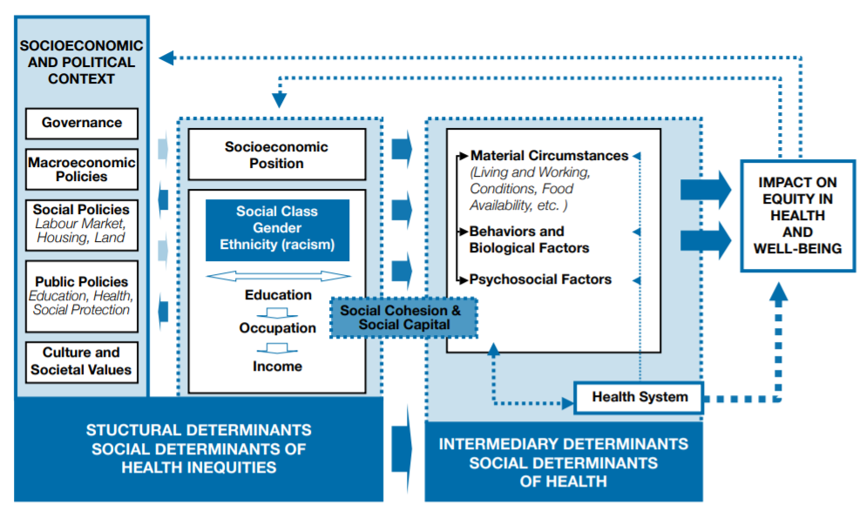
What influences people’s health, including their vulnerability to HIV?
Source: WHO, 2010.

Slide 24
Activity: What is behind high HIV prevalence rates for some populations?
Divide into five groups.
Review the two experiences given to your group.
Decide which of the experiences is a barrier to good health and which one facilitates good health. Consider HIV prevention specifically.
Be prepared to share and explain your response.

Slide 25
What influences people’s health, including their vulnerability to HIV?
Source: WHO, 2010.

Slide 26
National strategic plan
Share information here about the national strategic plan to address KP members’ needs. This is an opportunity to share information on what the program looks like on the ground so that participants are aware of the activities that are sanctioned/supported by ministries (such as outreach and peer education/ commodity delivery).

Slide 27
Questions and reflections

Slide 28
SESSION 2.2
Sex, Gender, Gender Identity, Gender Expression, Sexual Orientation: Understanding Ourselves and Each Other

Slide 29
Objectives
Understand the difference between sex and gender
Understand the differences between gender identity, gender expression, and sexual orientation
Explain how gender norms and other societal norms affect us all and contribute to stigma and discrimination against key populations

Slide 30
Activity: Sex and gender: What’s the difference?
(Part 1)
Divide into groups (about six to eight per group).
Each group selects an artist.
The artist, taking directions from the group, will draw either a woman or a man, as assigned by the facilitator.
Add details that distinguish the figure as a woman or man. Consider using: body shape, clothing, make-up, hair style, objects being held, and anything else you can think of.

Slide 31
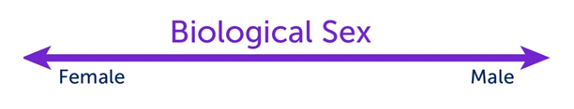
Biological sex
A medical term used to refer to the chromosomal, hormonal, and anatomical characteristics that are used to classify an individual as female, male, or intersex.
Biological sex is on a continuum. Intersex refers to a person born with reproductive or sexual anatomy that does not seem to fit the typical definitions of female or male.

Slide 32
Gender
Gender is a culturally defined set of economic, social, and political roles, responsibilities, rights, entitlements, and obligations associated with being female and male. It is also reflected in the power relations between and among women and men, and boys and girls.

Slide 33

Gender identity
A person’s deeply felt internal and individual experience of gender, which may or may not correspond with the sex assigned at birth.
When one’s gender identity does not correspond with sex assigned at birth, a person may identify as:
Transgender: gender identity is different from sex assigned at birth
Trans woman: assigned male at birth and identifies as female
Trans man: assigned female at birth and identifies as male

Slide 34

Gender expression
Gender expression is the external display of one’s gender identity through:
Appearance
Disposition
Social behavior
A person’s gender expression may or may not be consistent with socially prescribed gender norms.

Slide 35
Activity: Sex and gender: What’s the difference? (Part 2)
Refer back to the group drawings.
Circle those attributes that show gender expression in one color and those that show biological sex in another color.

Slide 36

Sexual orientation
An enduring emotional, romantic, or sexual attraction to another person of a different sex or gender, the same sex or gender, or to both sexes and more than one gender.
Terms often used to describe sexual orientation
Attraction to members of one’s own sex or gender (homosexual)
Attraction to members of the opposite sex or gender (heterosexual)

Slide 38
Discussion: Gender norms
What are the rules for boys/men and girls/women?
What kinds of toys are boys/girls expected to play with?
What kinds of emotions are acceptable for men/women?
What kinds of professions are considered most appropriate for women? What about for men?
What are women expected to contribute to their families? What about men?

Slide 39
Discussion: Gender norms (debrief)
Gender norms refer to a set of expectations or rules assigned by our society and culture that tell us how to act, look, and feel as men/boys and women/girls.
How do we learn these gender norms?

Slide 40
Discussion: Effects of gender norms
How do gender norms affect all of us?
Men may be kept from being caring parents because that role is seen as being a woman’s
Men may not ask for help when it’s needed
Men may take risks to prove their masculinity
Women/girls may do all the (unpaid) work in the home, limiting time for education or skills building
Women may be encouraged to submit to their husbands, even when abuse occurs
Women may have few options for occupations outside the home, limiting their ability to earn money and live independently

Slide 41
Discussion: Effects of gender norms (continued)
What happens when someone is perceived as nonconforming to “rules” about gender?
Made fun of
Rejected
Abused physically and sexually (including murdered)
Develops low self-esteem/depression
Does harm to themselves or commits suicide
Denied services (including health, social, and legal/justice services that could help protect him/her from violence or provide support if violence occurs)

Slide 42
Discussion: Effects of gender norms (continued)
How do gender norms increase HIV vulnerability among…
Men who have sex with men?
Female sex workers?
Women who inject drugs?
Transgender women?

Slide 43
What is stigma?
Stigma is shame or disgrace directed at someone perceived as socially unacceptable or not conforming to norms.
Stigma refers to the strong negative feelings or disapproval that is linked to a specific person, group, or trait.

Slide 44
What is discrimination?
Discrimination occurs when a person or group of individuals are treated unjustly or unfairly because of a specific trait they possess.

Slide 45
Stigmatization process
DISTINGUISHING AND LABELING DIFFERENCES
(HIV status)
ASSOCIATING NEGATIVE ATTRIBUTES
(immoral, promiscuous)
SEPARATING “US” FROM “THEM”
(isolate physically and socially)
STATUS LOSS AND DISCRIMINATION
(denial of family support, denial of health care, violence)
Source: Link & Phelan, 2001.

Slide 46
Stigmatization process with gender norms
DISTINGUISHING AND LABELING DIFFERENCES using gender norms
(HIV status) (she doesn’t “act like a lady”)
ASSOCIATING NEGATIVE ATTRIBUTES
(immoral, promiscuous)
SEPARATING “US” FROM “THEM”
(isolate physically and socially)
STATUS LOSS AND DISCRIMINATION
(denial of family support, denial of health care, violence)

Slide 47
Gender-based violence (GBV)
Any form of violence that is directed at an individual based on their biological sex, gender identity or expression, or their perceived adherence to socially defined expectations of what it means to be a man or woman, boy or girl. GBV is rooted in gender-related power differences, including social, economic, and political inequalities.

Slide 48
What might this look like among health care workers?
Belief: A health care worker believes that men who have sex with other men are not following the “rules.”
Impact: A service user will not get the STI treatment he needs, which could ultimately result in death or other harms. The service user is unlikely to ever seek services from that clinic again and may tell others to avoid the clinic. This will affect the clinic and its health care workers’ ability to improve the health status of the communities they serve.

Slide 49
Discussion: What characteristics may affect services received?
Biological sex
Gender identity/expression
Sexual orientation
Sexual behavior
Age
Race/ethnicity/tribe
Disability
HIV status
Socioeconomic class
Drug use
Religion
Occupation
Education/literacy
Nationality/citizenship

Slide 50
Discussion: Addressing values and biases
Knowing that we have our own values and biases, how can we ensure that all service users are able to benefit from our commitment to serve others?
Knowing that some service providers such as health care workers and law enforcement officers may have negative opinions about KP members, how can we ensure that KP survivors of violence feel comfortable seeking help?

Slide 51
Questions and reflections

Slide 52
SESSION 2.3
Understanding Violence against Key Populations (Characteristics, Perpetrators, Causes, Consequences)

Slide 53
Objectives
Describe how stigma and discrimination based on gender can result in violence
Identify common types of violence experienced by KP members and perpetrators of that violence
Explain the link between violence and HIV

Slide 54
Activity: Brainstorm examples of violence
Physical
Sexual
Psychological/emotional
Economic
Other human rights violations

Slide 55
Types of violence
Psychological/emotional: humiliation, insults, making a person feel worthless or afraid, controlling their movements, threats (including to take custody of children)
Physical: hitting, kicking, choking, use of a weapon
Sexual: unwanted groping, forced sex (including sex without a condom)
Economic: theft, not paying someone what is due to them, refusing to pay for a child’s basic needs
Other human rights violations: refusing services to someone, taking their condoms/injecting equipment, arbitrarily detaining them

Slide 56

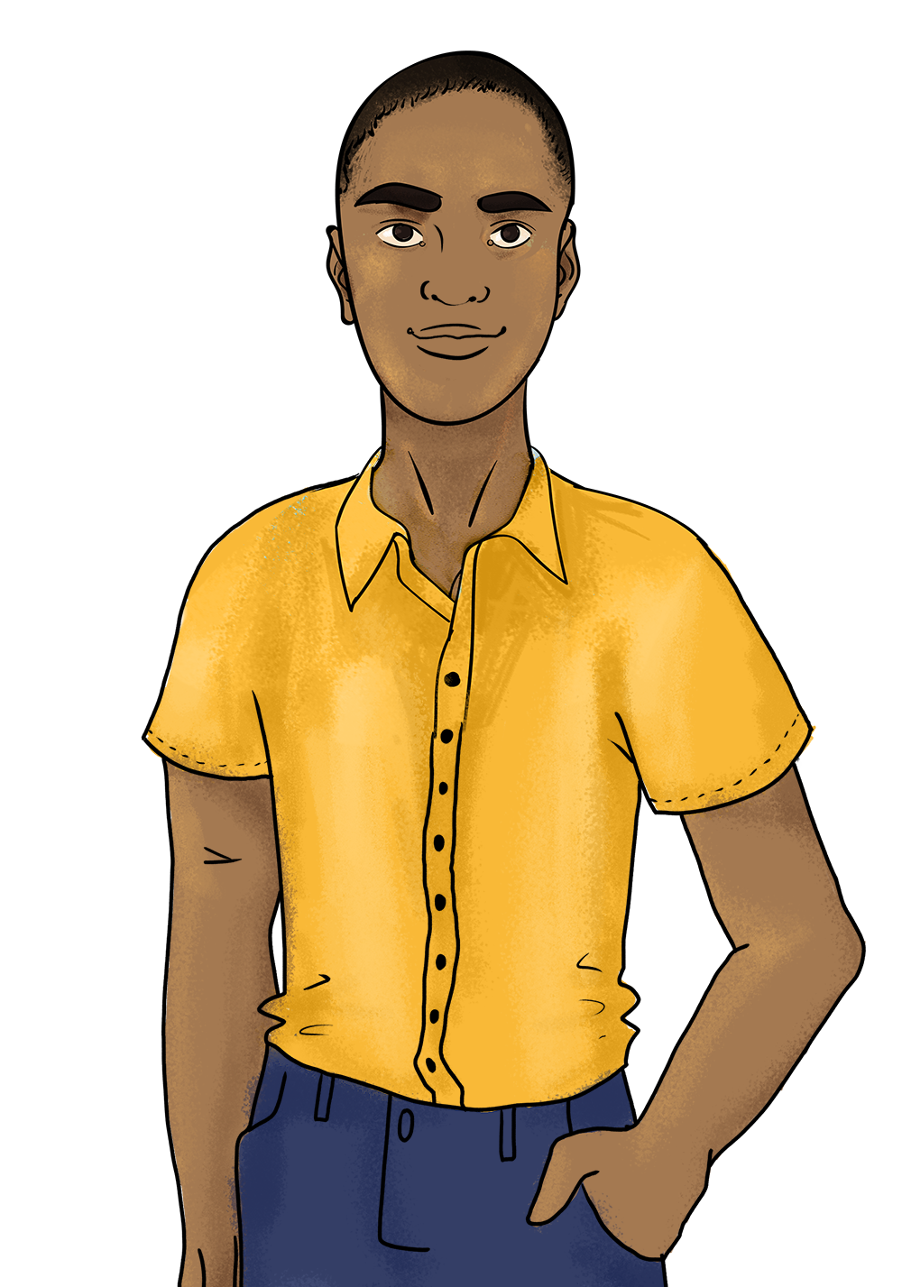
Activity: Amanda’s story
Read Amanda’s story together.
In small groups, answer your group’s question on a large piece of paper.
Select one person to present your answers back to the group.
Amanda when she is free to be herself
Amanda when she cannot be herself

Slide 57
Questions (one question per group)
Question 1: Describe at least three times that violence increased Amanda’s vulnerability to HIV infection. Describe at least three times that violence affected her access to HIV treatment.
Question 2: Describe the violence that Amanda experienced, giving at least two examples of each type: emotional, sexual, physical, economic, and other human rights violations.
Question 3: List all the perpetrators of violence. Decide which perpetrator had the most dramatic negative impact on Amanda’s life and explain your answer.
Question 4: Think about all the consequences of the violence Amanda experienced. Make a list of the consequences of each form of violence.

Slide 58
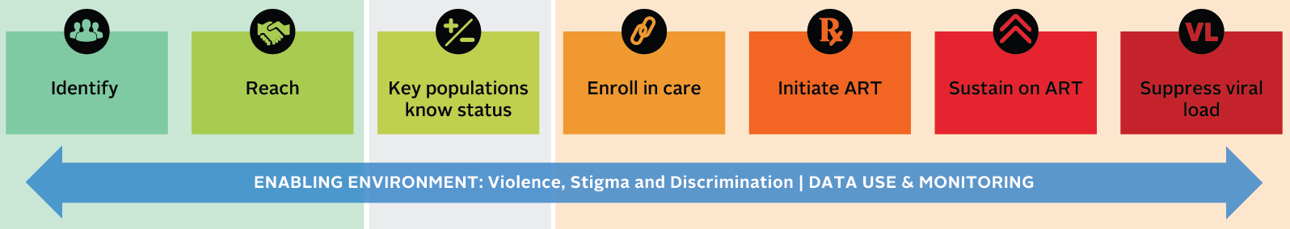
Amanda when she cannot be herself
Amanda’s story along the cascade of HIV services
Event: Emotional abuse at home and school
HIV-related outcomes: exchanging sex for shelter, limited knowledge of HIV transmission based on fear of seeking information, and public violence
Event: Emotional, economic, and sexual abuse from her intimate partner
HIV-related outcomes: unprotected sex to avoid losing shelter, avoid HIV testing for fear of partner’s reaction
Event: Emotional, economic, and sexual abuse from her intimate partner
HIV-related outcomes: avoid enrolling in care for fear that her partner would find out
Event: Emotional, economic, and sexual abuse from her intimate partner
HIV-related outcomes: poor ART adherence as medication had to be hidden, missed visits because of fear/ depression
Event: Economic, physical, and sexual assault from her partner and clients; arrest and rape in prison; employment discrimination
HIV-related outcomes: lack of access to medication during homelessness
Event: Sexual, emotional, physical, and economic violence; emotional abuse by health care worker
HIV-related outcomes: repeat STI infections, fear of health care worker disapproval, missed visits
Amanda when she is free to be herself

Slide 59
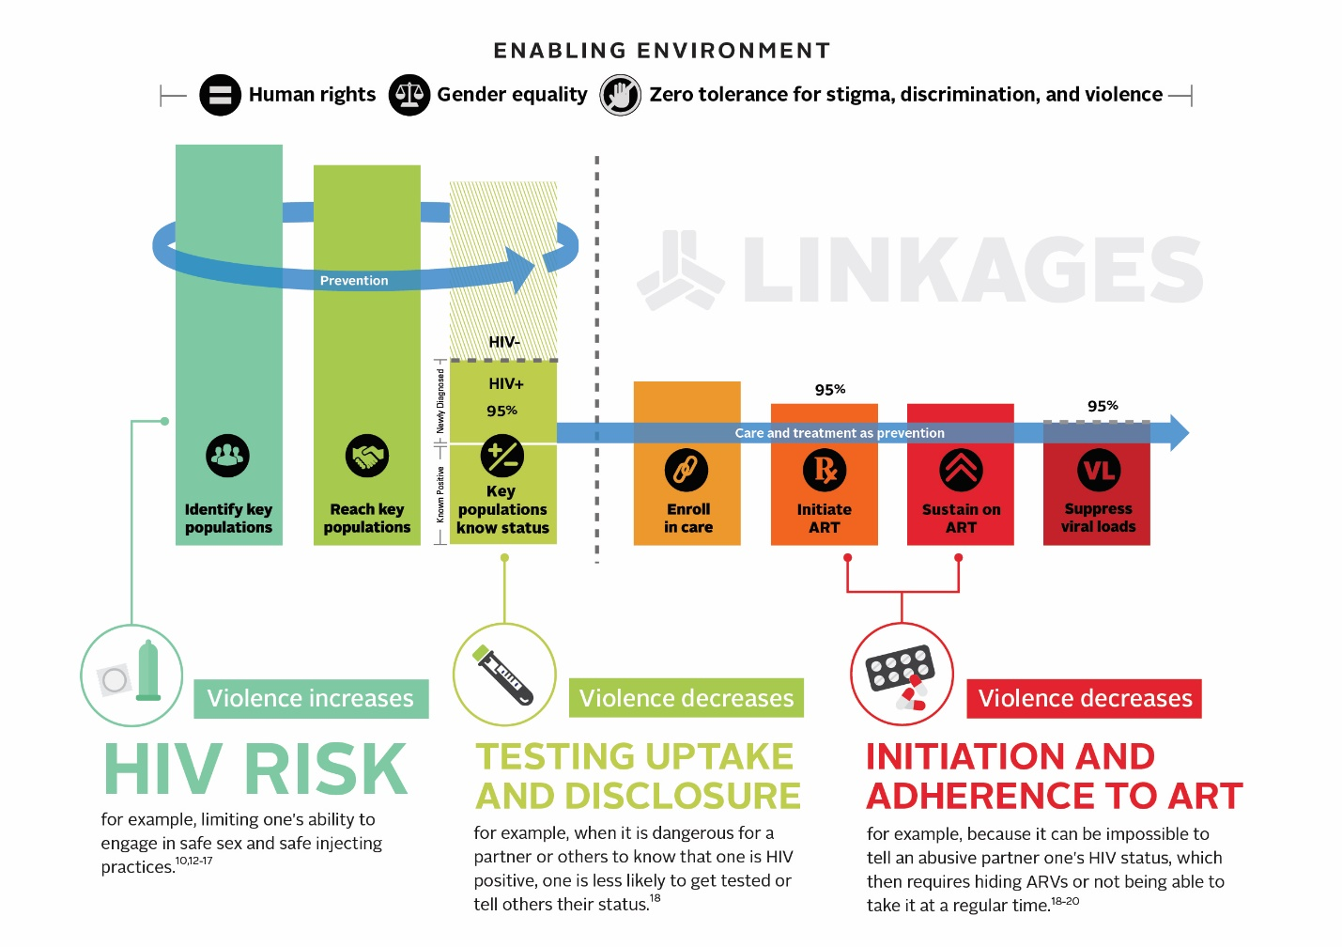
Violence affects the HIV epidemic
Violence:
Increases HIV vulnerability¹⁻⁸
Decreases testing uptake and disclosure⁹
Decreases adherence to ART⁹⁻¹²
Causes a host of other health issues¹³
Sources: 1. Beattie et al., 2015. 2. Decker et al., 2013. 3. Decker et al., 2015. 4. Decker et al., 2016. 5. Dunkle & Decker, 2013. 6. Guadamuz et al., 2011. 7. Lunze et al., 2016. 8. Wheeler et al., 2014. 9. Schafer et al., 2012. 10. Machtinger et al., 2012. 11. Mendoza et al., 2017. 12. Zullinger et al., 2015. 13. World Health Organization (WHO), 2013.

Slide 60
Violence against key populations in [Country]
Insert country-specific information/statistics about violence against key populations in [country].
Example slide from Malawi training:
Many men who have sex with men in Malawi face increased levels of stigma and violence.
  A 2010 study found that 4 percent of men who have sex with men were denied health care service based on sexuality, 1 percent were blackmailed because of sexuality, and 19 percent experienced a discrimination event.
  Another study in 2013 study found that over 20 percent of men who have sex with men had experienced some form of stigma and 11.4 percent had experienced homophobic violence.
Stigma and violence experienced among men who have sex with men can be responsible for difficulties in going for an HIV test, seeking HIV services, and disclosing HIV status.

Slide 61

Questions and reflections
Injuries |  | HIV/STIs |  | Fear/shame
Sex without a condom |  | Cannot safely get tested |  | Cannot access ARVs |  | Poverty
Consequences
Cannot carry condoms/ lubricant |  | Leave education early |  | Mental health issues |  | Homelessness
Violence:
physical, sexual, emotional, economic, and other human rights violations
Normalization of violence |  | Impunity for perpetrators
Causes
Laws and polices, including those that are incorrectly enforced
Gender norms |  | Stigma

Slide 62
Session 2.4
Focus on Intimate Partner Violence (IPV)

Slide 63
Objectives
Recognize the ways in which intimate partner violence (IPV) can evolve over time
Discuss the importance of responding to all survivors of IPV in a nonjudgmental way
Discuss IPV among KP members and identify additional barriers to support that they may face when experiencing IPV

Slide 64
Intimate partner violence in [Country]
IPV is ongoing or past violence by an intimate partner or ex-partner. It is common in the general population and among key populations.^{1–5}
Here is what we know about IPV in [country].
[Country team to add data on IPV in their country including both general population and key population figures as available. If this was covered in session 2.4, do not repeat the statistics here; rather, review the definition of IPV before moving to the next case study.]
Sources: 1. El-Bassel et al., 2007. 2. Panchanadeswaran et al., 2008. 3. Finneran & Stephenson, 2013.
4. McKay et al., 2017. 5. Valentine et al., 2017.

Slide 65
Activity: Thandi’s story
Thandi is a young woman from [a local city]. She is intelligent, funny, kind, and beautiful. She has a supportive family and is good at her job. She has a lot of friends, especially colleagues from work. They respect her and know she will go on to do great things.
She meets John and they fall in love. They get married and move in together. This blank flip chart paper represents Thandi, her autonomy (ability to act on her own), her self-esteem, and the wide range of possibilities she feels her life holds. Watch and listen as we describe what happens next between Thandi and John.

Slide 66
Activity: Thandi’s story (debrief)
What kind of support would Thandi benefit from? Why?
What would happen if Thandi got up the courage to report John to the police, and an officer responded, “It was just a small slap! Why are you making such a big deal of this?”
Sometimes people reading about others’ experiences of IPV say, “I would leave the first time someone was violent toward me.”
  When did John actually “become violent” in this story?
  Why might it be difficult for Thandi to seek help by the time he used physical violence?
  What might happen if Thandi tries to leave?

Slide 67
Discussion: What about in the case of key populations?
IPV is a complex and difficult issue for anyone.
In some ways Thandi is more likely to receive support than a member of a key population.
  She began with more resources, self-esteem, and support than many members of key populations would.
  She would be considered a “sympathetic victim” by many authorities who are accustomed to stories like Thandi’s.
  Laws about IPV may only apply to women in heterosexual relationships, excluding some members of key populations.

Slide 68
Questions and reflections

Slide 69
SESSION 2.5
Human Rights and the Local Legal Context

Slide 70
Objectives
Identify local laws and constitutional provisions that outline the rights of all people
Recognize the laws and policies that most affect KP members and discuss common applications and misapplications
Become familiar with strategies that KP members can use to counter the misapplication of these laws, including redress mechanisms
Recognize the role of [peer educators, navigators, outreach workers] in providing basic information about KP members’ legal and human rights, the links between violence and HIV, and how to access services

Slide 71
The slides used here will be provided by a local lawyer
The lawyer’s presentation should cover:
Step 1: What are human rights and what are human rights violations? (You can use or replace the next three slides as part of this step.)
Step 2: Where do we see human rights reflected in our country’s constitution, local laws, and any international agreements that our country has signed? For example, what services does everyone have the right to (e.g., justice, health, housing)? Are some rights only guaranteed to citizens while others are more broadly applied?
Step 3: What are the key local laws that impact key populations (men who have sex with men, people who inject drugs, sex workers, trans people)? What laws, including laws about human trafficking, are often misinterpreted or misunderstood and how should they actually be enforced?
Step 4: The rights of individuals even if they are engaging in illegal behavior—particularly the right to live free from violence and the right to access services if violence occurs. (Provide language on the rights of all people).
Step 5: What should a key population member do if they are arrested? What rights do they have (e.g., right to make a phone call, knowing why they were arrested, any limits on being held past a certain amount of time)?
Step 6: What can a key population member do if their rights are violated (e.g., if arrested wrongly, if abused by law enforcement)?
Step 7: Time for questions from participants.

Slide 72

What does it mean when we say someone has human rights?
A human right is a protection from certain abuses or a right to demand certain treatment.
Human rights are granted to all people, simply for being human.

Slide 73
Whereas...
Recognition of the inherent dignity and of the equal and inalienable rights of all members of the human family is the foundation of freedom, justice, and peace in the world.
The advent of a world in which human beings shall enjoy freedom of speech and belief and freedom from fear and want has been proclaimed as the highest aspiration of the common people.
Source: United Nations General Assembly, 1948.

Slide 74
What are examples of human rights?
Right to life, liberty, and personal security (Art. 3)
Freedom from cruel, inhuman, or degrading treatment (Art. 5)
Right to equal protection before the law (Art. 7)
Freedom from arbitrary arrest or detention (Art. 9)
Right to due process before the law (Art. 10)
Freedom of movement (Art. 13)
Freedom of peaceful assembly and association (Art. 20)
Right to a standard of living adequate for health and well-being (includes right to medical care) (Art. 25)
Source: United Nations General Assembly, 1948.

Slide 75
Discussion: How can we support KP service users to learn about their rights?

Slide 76
Discussion: Information, education, and communication materials
What types of IEC materials are needed to inform KP members about their rights?
What information, messages, or images would be useful to KP members?
What would encourage them to seek services if their rights have been violated?
How could these IEC materials be distributed to reach KP members?

Slide 77
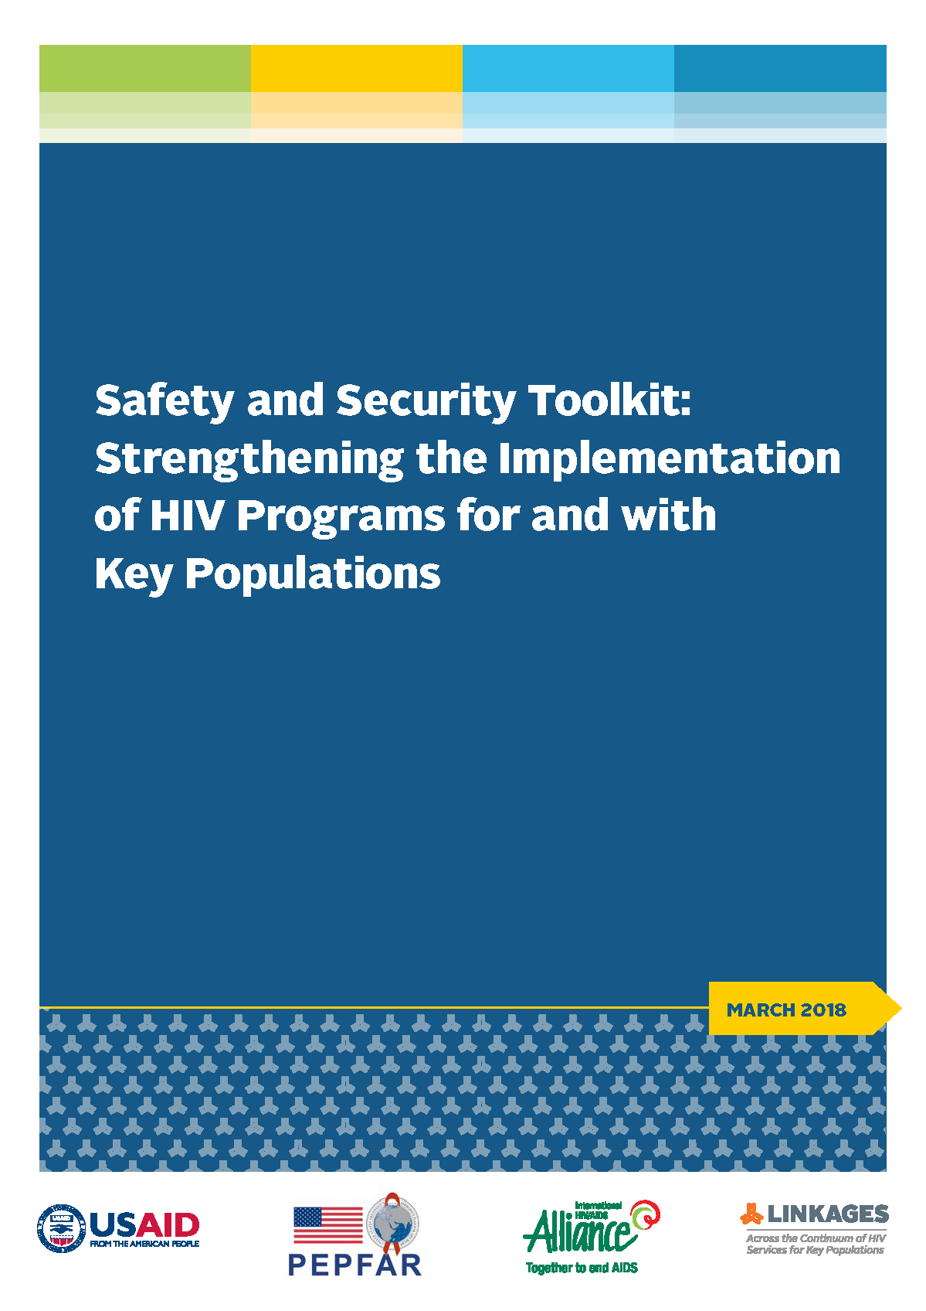
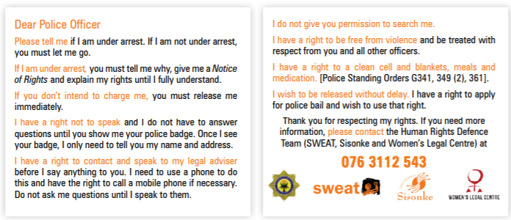
Mitigating risks
https://www.fhi360.org/sites/default/files/media/documents/resource-linkages-safety-security-toolkit.pdf

Slide 78
Questions and reflections

Slide 79
Module 3
Applying Principles and Building Skills

Slide 80
SESSION 3.1
Fundamental Principles of Violence Prevention and Response

Slide 81
Objectives
Describe each of the fundamental principles of violence prevention and response service provision and explain their importance, particularly when working with KP members
Recognize when other service providers such as health care workers and law enforcement officers uphold or neglect the fundamental principles

Slide 82
Fundamental principles of violence prevention and response
Do no harm.
Promote the full protection of all people’s human rights.
Respect all people’s right to self-determination and the right of all survivors of violence to the full range of recommended services.
Ensure privacy, confidentiality, and informed consent.

Slide 83
Principle 1: Do no harm
Those working with survivors of violence are ethically obligated to consider whether their actions could cause harm and actively avoid this outcome.
This principle dictates:
  Avoid causing harm to KP members, or causing further harm to those who have experienced violence
  Act in accordance with the wishes and choices of all survivors
  Provide services without judgment and that respect the confidentiality of the survivor
  Consider survivor safety in every decision
  Get informed consent before providing services or making referrals
  Never require that a survivor reports to law enforcement in order to receive health services

Slide 84
Discussion: How to avoid harm
(outreach worker)
Robert is HIV positive and an outreach worker is asking him about his partners as part of community-based index testing.
He discloses that his boyfriend has threatened to kill him in the past. Which of the following actions by the outreach worker would not cause harm?
Requiring Robert to report to the police in order to get services
Telling Robert that he must leave his partner
Telling Robert that he doesn’t deserve to be treated this way and asking Robert if he would like to talk to the psychologist at the drop-in-center.

Slide 85
Discussion: How to avoid harm
(law enforcement officer)
Imagine that Daniel comes to the police station to report that he is being blackmailed. Daniel’s neighbor has a photo of Daniel kissing his boyfriend and plans to share it on social media if Daniel does not pay a huge sum of money. Which of the following actions by the police could cause Daniel harm?
  Sharing Daniel’s sexual orientation with other officers
  Telling Daniel that this is his fault
  Refusing to help Daniel

Slide 86
Principle 2: Promote human rights
Promoting the full protection of key populations’ human rights means:
Providing services to KP members who are survivors of violence without stigma or discrimination
Rejecting the idea that KP members must be rescued from themselves (e.g., forcing gay men to enter into reparative therapy, forcing sex workers to stop working, forcing people who use drugs into “treatment centers”)

Slide 87
Discussion: How to promote human rights (health care worker)
Mary is a sex worker. She meets a new client and negotiates a price. They agree that he will use a condom. The client takes her to his hotel room. Three other men are there. They tell Mary that they will kill her if she does not have sex with all of them. They do not wear condoms. Mary goes to a clinic to seek emergency contraception and PEP. Which of these actions, by the health care worker, does not promote Mary’s human rights?
Telling Mary that it is her fault she was raped
Refusing to help Mary
Giving Mary emergency contraception and PEP only if she agrees to leave sex work

Slide 88
Discussion: How to promote human rights
(law enforcement officer)
Elizabeth is a sex worker in a country where it is illegal to sell sexual services. An officer sees her sitting outside a restaurant and tells her that she must empty her bag. He finds condoms in the bag. He does not tell her that she has the right to make a call. He forces her to come back to the station and holds her for several days without charges. Which of these actions does not promote Elizabeth’s human rights?
Arresting Elizabeth for carrying condoms
Failing to tell Elizabeth what she is charged with
Failing to explain Elizabeth’s rights to her

Slide 89
Principle 3: Self-determination and access to all services
All survivors of violence, including KP members, must be able to decide which services, if any, they wish to access.
All services recommended to survivors of violence should also be available to KP members.
A survivor-centered approach allows each person who reports violence to understand what is available and then make choices that meet their personal needs.
  Effectively supporting survivors of violence requires returning their power and control to them (not making decisions on their behalf)

Slide 90
Discussion: How to ensure self-determination (peer navigator)
Mercy is a woman who injects drugs. When a peer navigator asks why she missed adherence support group meetings, Mercy tells her that she’s been preoccupied because her husband is threatening to take custody of their children. The peer navigator tells her she has rights and lets her know that paralegal services are available at the drop-in center. She mentions that custody battles take up a lot of time and tells Mercy she should give custody to the father so she can focus on her HIV treatment. Which of these actions did not ensure Mercy’s self-determination?
The peer navigator offers Mercy information about her rights
The peer navigator provides Mercy with information about paralegal services
The peer navigator tells Mercy she should give custody of her children to the father

Slide 91
Discussion: How to ensure self-determination (health care worker)
Olivia is a trans woman. She goes to the health facility to get injuries treated after being raped. The provider on duty listens to her kindly and tells her that she must get an HIV test so that she can begin PEP as soon as possible. Which of these actions did not ensure Olivia’s self-determination?
The provider listens to her kindly
The provider tells her she must get an HIV test
The provider tells her she must begin PEP

Slide 92
Principle 4: Privacy, confidentiality, and informed consent
Privacy and confidentiality must be assured before a survivor talks about violence
Use a private consultation space (survivor cannot be seen or heard outside the room).
Speak to survivors alone. No one older than age 2 should overhear your conversation.
Safely secure and store all survivor’s records.
Have clear policies on information sharing, and communicate them to the survivor. For example:
  Explain what will happen to the information they share before they share it, including any limits regarding confidentiality (such as mandatory reporting)
  Obtain informed consent before information is shared
  Note: survivors should not be made to repeat their stories to multiple providers, especially not to those who are uninvolved in direct service provision
Train providers and staff on these procedures.

Slide 93
Activity: Privacy and confidentiality
Take out your cell phone and unlock it.
Give it to the person on your left.

Slide 94
What do we mean by confidentiality?
Keeping all information related to a survivor secret and sharing it only with others who need to know in order to provide assistance, as requested and agreed to by the survivor of violence.

Slide 95
What do we mean by consent?
When a person agrees…
To do something
To participate in an activity
For something to occur

Slide 96
What is informed consent?
Informed consent means that a person agrees to participate in an activity or for something to occur after they have knowledge of or have received all the information about the activity.

Slide 97
Discussion: Which of these statements would lead to informed consent?
If you take PEP, it can lower your chances of getting HIV.
If you take PEP, it can lower your chances of getting HIV. You may experience side effects such as nausea, fatigue, and headaches.

Slide 98
Discussion: Environmental factors
We all work within and are affected by our environments (e.g., the hot spot, drop-in center, or other site where you work)
What about your environment could make it more difficult for you to uphold these fundamental principles?
What could be changed about your environment to make it easier to uphold these fundamental principles?

Slide 99
Questions and reflections

Slide 100
SESSION 3.2
Barriers to Disclosing Violence

Slide 101
Objective
Recognize the barriers to disclosing violence for KP members, including victim blaming, and recognize victim blaming as counterproductive to the well-being of the survivor

Slide 102
Activity: Standing in her shoes
Nine volunteers
Stand in a line
Volunteer 1 reads their card to each person one at a time
Each person responds by reading their card and taking the action described

Slide 103
Activity: Standing in her shoes (debrief)
Observations from the participants in the drama
Observations from the group

Slide 104
The importance of your response
“A survivor is often in a heightened state of awareness and very emotional after an assault due to circulating stress hormones; events may be recalled in dramatic detail. Many survivors of sexual assault have described the kindness of the treating personnel as being beneficial to their recovery. Conversely, many describe comments made by police, doctors, counsellors and other persons with whom they have had contact as a result of the assault that have haunted them for years.”
Source: WHO, 2003.

Slide 105
What happens when we blame survivors?
We discourage people from disclosing violence and seeking help.
We harm the mental health of survivors of violence.
We place the entire solution to the problem on the shoulders of the person who has been victimized.
We do not place responsibility on the actual perpetrators (excusing behavior and creating impunity).

Slide 106
Discussion: Questions that blame
Why were you alone? Why were you walking in that neighborhood?
Why were you wearing such revealing clothes?
What did you do to make him angry?
If you were really afraid, why didn’t you run or scream?
Why do you choose to put yourself in risky situations?

Slide 107
Our response to one survivor affects others
Blaming any survivor also makes others’ disclosures less likely.
One of the predictors for whether someone will come forward to disclose violence is what they have seen happen to others upon disclosure.
This is a phenomena called “social proof.”¹
Each time you respond appropriately to a survivor of violence and support them, you make it more likely that others will also come forward.
Source: 1. Vedantam, 2017.

Slide 108
Discussion: Why do we blame survivors?
Gender and other societal norms and myths that make violence the fault of women and individuals who are seen as nonconforming to gender norms¹⁻³
To feel safe ourselves⁴
To feel that the world is just^{5,6}
In an effort to be helpful
Sources: 1. Cortina et al., 2018. 2. LINKAGES, 2016a. 3. LINKAGES, 2016b. 4. Janoff-Bulman, 2010. 5. Lerner, 1980.
6. Lerner & Simmons, 1966.

Slide 109
Questions and reflections

Slide 110
SESSION 3.3
The Importance of Peer Educators, Navigators, and Outreach Workers in Violence Prevention and Response

Slide 111
Objective
Explain why it is important for [peer educators, navigators, outreach workers] to be part of violence prevention and response, especially to support KP members

Slide 112
Why [peer educators, navigators, outreach workers]?
They are often respected, objective arbiters; survivors (especially KP members) may fear law enforcement
They live and work with KP members who experience violence and have an unmet need for services
They are best placed to share information about rights, types of violence, and violence response services available in their communities
Interactions during outreach activities are an opportunity to link survivors to support if an appropriate approach is taken
They may observe or learn of adverse events related to index testing during outreach

Slide 113
[Peer educator, navigator, outreach worker] potential roles
Sensitize KP members about their rights, the links between violence and HIV, and violence response services available
Give KP members the opportunity to disclose violence
Actively listen to and validate the experiences of KP members who disclose violence
Engage in conversations to enhance safety
Accompany/refer to violence response services including health, social, and justice/legal services (this can occur in partnership with health care workers who receive disclosures of violence and call upon peers for support of the survivor)
Tailor content or frequency of outreach visits to acknowledge the impact of past or present violence on individuals or at the hot spot

Slide 114
When defining your role…
Consider what you feel equipped to do
Be familiar with the structures in place in health care settings, so that you can help others access them (see next slide)
Know who can help you to help others
  For example, if someone tells you about violence in their lives and you can’t handle the issue, can your supervisor or CSO director play a supportive role?
Know who can help you help yourself
  Hearing about violence can be difficult. Module 4 describes the support available to you.

Slide 115






Minimum requirements that must be in place in a health care facility before asking about violence
In PEPFAR programs, index testing, secondary distribution of self-testing, and PrEP services all must include a step in which the client is asked about IPV. Providers cannot ask about IPV unless the following supportive elements are in place to limit the potential for harm to survivors.
Written protocol/
SOP for the provision of violence response services is in place
Standard set of questions are used to facilitate documentation, and safe storage mechanisms are in place
Providers are trained on how to identify, ask about, and respond to violence
Providers offer first-line support (LIVES)
Providers only ask about violence in a private setting, confidentiality ensured
System for referrals to violence response services is in place
Source: Adapted from USAID, Office of HIV/AIDS, Gender and Sexual Diversity Branch
If your project does not have the required SOPs, consider adapting those found here: https://www.fhi360.org/resource/adverse-event-prevention-monitoring-investigation-and-response-index-testing

Slide 116
Questions and reflections

Slide 117
Session 3.4
Asking about and Responding to Violence

Slide 118
Objectives
Describe the goal and steps of asking about violence, particularly for members of key populations
Identify and practice skills to provide first-line support (LIVES) to individuals who disclose violence, particularly members of key populations

Slide 119
An important note on asking about violence
The end goal is NOT simply to tick a box.
Asking about violence is an intervention.
We ask about violence to educate on the topic and let KP members know about available services and that they are not alone.
If someone discloses, we can better plan and provide them with information about critical services.
BUT if someone does not disclose violence, asking about violence is NOT a wasted exercise.
No one should ever be pressed to disclose violence.

Slide 120
Asking about violence during outreach
It is recommended that [peer educators, navigators, outreach workers] provide all KP members reached through HIV programs with the opportunity to disclose by asking about violence.
[Peer educators, navigators, outreach workers] should only ask about violence if:
They have been trained to do so
They have someone to call upon to support them as needed
A client consents to talk about violence
The discussion can occur in a private place
There is a protocol, including a referral system, to guide the response to violence

Slide 121
Steps for asking about and responding to violence
Explain types of violence and the relevance of violence to the KP member’s health. Ask KP member if they would be willing to answer questions about violence.
If yes, ask KP member about:
  The types of violence* they have experienced
  When the most recent violence occurred and if there are injuries
  * For sexual violence, explain medical options and timelines
If violence is disclosed, provide first-line support (LIVES):
  Listen close with empathy and no judgment
  Inquire about their needs and concerns
  Validate their experiences
  Enhance their safety
  Support them to connect with additional services

Slide 122
What asking about violence can look like
Initial Contact (first time meeting a service user)
Many people tell me they have been emotionally, physically, or sexually harmed. Some have been threatened, robbed, denied money that is due to them, made to pay money to avoid arrest, or denied services.
Since violence and abuse can cause health problems, I’d like to ask you about your experiences. Is that okay?
In the past [number] months has anyone:
  Hit, kicked, slapped or otherwise physically harmed you?
  Threatened to harm you, controlled your movements, or humiliated you in front of others?
  Robbed you, blackmailed you, refused to pay you, or forced you to pay to avoid arrest?
  Forced you to do anything sexual that you did not wish to do?
Follow-up Contacts: Last time, I asked you about violence and abuse. Has anything new happened since we met?

Slide 123
How to respond to a service user who discloses violence: first-line support
Task | Explanation
Listen | Listen closely with empathy and no judgment
Inquire about needs and concerns | Assess and respond to various needs and concerns—emotional, physical, social, safety
Validate their experiences | Show you believe and understand, assure survivor that they are not to blame
Enhance safety | Discuss a plan to protect the survivor from further harm if violence occurs again
Support | Support the survivor to connect with additional services
Source: WHO, 2014.

Slide 124
Listen closely with empathy and no judgment
Purpose
Give the survivor a chance to share their experiences in a safe and private place to a caring person who wants to help.
Source: WHO, 2014.

Slide 125
Activity: Skills of a good listener
You’ve had a bad day. Your sister is ill, and her children are staying with you. You are working an extra job to help with her medical costs. You are exhausted, and your work has suffered. You also had to pay late fees on your phone bill today because your payment was overdue.
In pairs, discuss:
  Who would you talk to about your day?
  Why would you choose this person?

Slide 126
Activity: Brainstorm listener do’s and don’ts
Things you want the listener to do | Things you don’t want the listener to do
Pressure you
Look at their watch or seem distracted
Judge you
Rush you
Assume they know best
Interrupt
Finish your thoughts for you
Tell you their own troubles or someone else’s
Think and act as if they can solve your problems
Be patient and calm
Let you know that they’re listening (nod head, make eye contact, etc.)
Acknowledge how you’re feeling
Let you tell the story at your own pace
Encourage you to share
Give you time to think
Stay focused on you
Respect your wishes

Slide 127
Discussion: Demonstrating listening skills
How do we show that we’re good listeners?
Nodding and saying “uh huh”
Leaning closer
Making eye contact
Avoiding distractions (watch, phone, computer)
Giving the person time to tell their story at their own pace
Being comfortable with silence and pauses (not interrupting, giving person time to think)
Asking open-ended questions (“Would you like to tell me more?”)

Slide 128
Inquire about needs and concerns
Purpose
Learn what is most important for the survivor. Respect their wishes and respond to their needs.
Source: WHO, 2014.

Slide 129
Techniques to inquire about needs and concerns
Technique | Example
Phrase your questions as invitations to speak | What would you like to talk about?
Ask open-ended questions that encourage the survivor to talk | How do you feel about that?
Verify your understanding by restating what the survivor says | You mentioned that you feel very frustrated.
Reflect back the feelings the survivor expresses | It sounds as if you are feeling angry about that.
Explore as needed | Could you tell me more about that?
Ask for clarification if you don’t understand | Can you explain that again, please?
Help the survivor identify and express needs and concerns | Is there anything that you need or are concerned about?
Summarize what the survivor expressed | You seem to be saying that…
Source: WHO, 2014.

Slide 130
Activity: Inquire about needs and concerns
Survivor statement #1: “Ever since they raped me,
I don’t want to eat or talk to anybody. I just want to sleep and stay in bed.”
Technique: Reflect back the feelings the survivor expresses
“It sounds like you’re in a lot of emotional pain.”

Slide 131
Activity: Inquire about needs and concerns (continued)
Survivor statement #2: “My partner threatens to beat me at any little thing lately. I try to do things the way he likes them, but he only gets angrier. I don’t know what he will do next.”
Technique: Help the survivor identify and express needs and concerns
“It sounds like you’re worried about your safety. Is there anywhere that you feel safe?”

Slide 132
Validate
Purpose
Let the survivor know that their feelings are common, that it is safe to express them, and that everyone has a right to live without violence.
Source: WHO, 2014.

Slide 133
Validate: Messages to use
“Thank you for sharing that with me.”
“I’m sorry that happened to you.”
“Many people experience violence, and even though they may be blamed for what happened, it is never their fault.”
“Everyone has the right to live free from violence.”
“I am here to support you and explain your options.”
“It’s not your fault.”
“This was a violation of your rights, and you did not deserve to be treated this way.”
“You are brave to talk me about it.”

Slide 134
Validate: Messages to avoid
Avoid statements that
Place blame on the survivor
Say anything that judges what the survivor has done or will do
Question the survivor’s story (doubting) or interrogate the survivor
Say anything that minimizes how the survivor feels
Lecture, command, or advise
Recommend that they change their profession, sexual orientation, or gender identity to avoid violence
Avoid questions that suggest fault
Why were you wearing such revealing clothes?
What did you do to make the perpetrator angry?
If you were really afraid, why didn’t you run or scream?
Why do you choose to put yourself in risky situations?

Slide 135
Activity: Revisit standing in her shoes
Repeat standing in her shoes activity. This time, instead of rejecting the survivor, deliver a validating message.

Slide 136
Enhance safety
Purpose
Help assess the survivor’s situation and make a plan for their future safety.
Source: WHO, 2014.

Slide 137
Ask about safety
Do you have any concerns about your safety or the safety of your children (if relevant)?

Slide 138
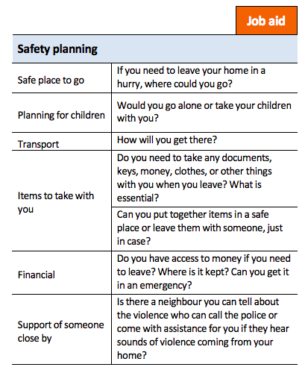
Activity: Safety planning
Break into pairs
One person pretends to be a survivor of violence
The other is a [peer educator, navigator, outreach worker] who asks these questions
Source: WHO, 2014.

Slide 139
Explore safety strategies
Identify emergency shelters
Carry emergency phone numbers
Contact international funds that may be able to help with relocation or other costs
It is important that peer educators, navigators and outreach workers do not tell KP service users how to stay safe. Safety planning is a conversation in which the service provider asks questions to help KP service users determine what is best for them. If specific safety strategies are mentioned, they should be brought up as questions.
!

Slide 140

What are safety tips for sex workers?
Negotiating payment up front
Screening clients and work locations
Working in own space or well-known locations
Avoiding drunk clients
Writing down client’s car registration number, color,
and make
Source: UK Network of Sex Work Projects, 2018.
Avoiding getting into cars with more than one person in them
Working near another sex worker who can hear you or having them on “speed dial” so that they can intervene if needed

Slide 141
Avoid putting survivor at risk
Talk about violence only when you and the survivor are alone
Maintain the confidentiality of the survivor’s health records
If the survivor lives with an abuser:
  Discuss how the survivor will explain where they have been
  Caution the survivor about taking home printed materials about violence

Slide 142
Support
Purpose
Connect survivor with other resources for their health, social, and justice/legal needs as their needs are generally beyond what you can provide during outreach.
Source: WHO, 2014.

Slide 143
Ask about immediate needs
Consider
Physical health (including time-bound services following sexual assault)
  PEP (72 hours)
  Emergency contraception (120 hours)
Mental health
Social services
Child protection

Slide 144
Provide information and make referrals to available resources
When providing information and making referrals
Offer printed information (but remember to offer a warning in case materials could come to the attention of an abuser)
Know specific information about referral points
Ask survivor if they want accompaniment to resources and, if so, make arrangements
Do not pressure survivor to accept a referral or to give details about an incident
Offer yourself as a resource to access other services

Slide 145
Identify existing strengths and networks
Help KP members identify and use their existing strengths:
  “What helped you cope with hard times in the past?”
  “What activities help you when you’re feeling anxious?”
  “How could what has helped in the past be helpful now?”
Help KP members explore existing support networks:
  “When you’re not feeling well, who do you like to be with?”
  “Who helped you in the past? Could they be helpful now?”
  “Are there people you trust that you can talk to?”

Slide 146
How to respond when a service user says they have NOT experienced violence
Task | Message
Deliver violence prevention and response messages | “If you experience violence or abuse in the future, I am here to support you. Many people have these experiences but everyone has the right to live free from violence and abuse.”
Provide information about medical options for sexual violence | “If sexual violence occurs, it is important to seek help quickly. There are medical options that can be used within three days after the assault that can reduce risk of HIV infection and within five days to reduce risk of pregnancy.”
Share resources | “I’d like to share resources in case you ever need them. Is that okay?”

Slide 147
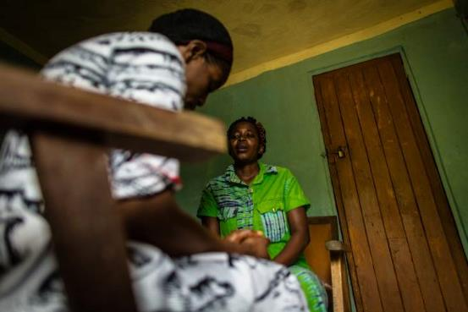
Review tool to ask about and respond to violence

Slide 148
Questions and reflections

Slide 149
Session 3.5
Referring Effectively: Overview of Recommended Health, Social, and Justice/Legal Services and Improving Access to Each One

Slide 150
Objectives
List the services that should be offered to survivors of violence and describe the importance of each
Describe the process of referral for all available services
Discuss which of these services KP members can safely be referred to

Slide 151
Discussion: Meeting survivors’ needs
 | Services (potentially) needed | Where available | Details
Physical and mental health services | Emergency injury treatment HIV and STI testing/prophylaxis/care Emergency contraception Rape kits/forensic examination Relevant vaccines Mental health screening/treatment for depression and post-traumatic stress disorder
Social services | Psychosocial support (support groups, crisis counseling) Securing/replacing ID documents Shelter  Educational assistance Financial aid  Food assistance Child care  Interpreters
Legal/ justice services | Information on their rights Information on law enforcement procedures Support from law enforcement Legal counsel Ability to give a statement/document the case Ability to seek redress when wrongly arrested Access to ARVs even while incarcerated

Slide 152
A note about immediate clinical services
PEP can prevent HIV infection.
  If someone may have been exposed to HIV (for example, through rape), they need to begin PEP within 72 hours.
Emergency contraception prevents ovulation to prevent an unplanned pregnancy.
  If a woman is at risk for an unplanned pregnancy (for example, due to rape), emergency contraception will be effective up to five days after the incident.
[Country team to include information on the local procedure for accessing PEP and emergency contraception]

Slide 153
Referral process in [Country]
[Country team to add information on referral process for post-violence services if one is established.]
HEALTH SERVICES | SOCIAL SERVICES | JUSTICE/LEGAL SERVICES
[Name of Organization/Facility] Hours: Location: Focal Point: Phone: Email: Services available: Population served: | [Name of Organization/Facility] Hours: Location: Focal Point: Phone: Email: Services available: Population served: | [Name of Organization/Facility] Hours: Location: Focal Point: Phone: Email: Services available: Population served:
[Name of Organization/Facility] Hours: Location: Focal Point: Phone: Email: Services available: Population served: | [Name of Organization/Facility] Hours: Location: Focal Point: Phone: Email: Services available: Population served: | [Name of Organization/Facility] Hours: Location: Focal Point: Phone: Email: Services available: Population served:

Slide 154
Recognizing you as a resource
Ideally someone is able to come back to you or your program if they experience future violence.
If appropriate, you can end conversations by saying, “Please come back if we can support you in any other way.”

Slide 155
Questions and reflections

Slide 156
Session 3.6
Putting It All Together

Slide 157
Objective
Practice asking about and responding to disclosures of violence appropriately

Slide 158
Activity: Practice responding to violence
In groups of three, rotate so that each person is a survivor, a [peer educator, navigator, outreach worker], and an observer one time
During the interaction, the [peer educator, navigator, outreach worker] will use their skills to ask about violence and provide first-line response, including making referrals as desired by the survivor
After each interaction is complete, the observer provides their feedback on what went well and what could be improved
Observer Checklist
  Ask about violence
  Listen closely with empathy and no judgment
  Inquire about their needs and concerns
  Validate their experiences
  Enhance their safety
  Support them to connect with additional services

Slide 159
Activity: Practice responding to and documenting violence (debrief)
How did each of these go?
  Ask about violence
  Listen closely with empathy and no judgment
  Inquire about their needs and concerns
  Validate their experiences
  Enhance their safety
  Support them to connect with additional services
What worked well?
What areas need improvement?

Slide 160
Activity: Frequently asked questions (FAQs)
What if the client says there is no violence, but I know or believe that there is violence?
What if the client doesn’t see their experience as violence?
What if the client does not want any support services?
What if I am obligated to tell law enforcement about disclosures of violence?
How do I know what GBV services are available to the survivor?
As a group, review your assigned question.
Take four minutes to discuss your response.
You will have one minute to share your suggestions.

Slide 161
Activity: FAQ 1
What if the client says there is no violence, but I know or believe that there is violence?
If the client does not wish to share, do not pressure them.
Remind them of the health harms that can come from violence (such as difficulty adhering to ARVs).
Let them know about the services available to someone experiencing violence.
Let them know they can come back at any time to share, for example, if they have a new experience of violence or remember something they wish to share.

Slide 162
Activity: FAQ 2
What if the client doesn’t see their experience as violence?
Sometimes people normalize the violence they experience, especially emotional violence.
Your responses can let the client know that they deserve to be treated respectfully and to feel safe in their own home.
Let the client know that what they are experiencing can cause harm, including health issues, and that you are concerned for their health.
Tell them that if they want to be connected to services or talk more about the issue in the future, you will be there for them.
Explain the services available.

Slide 163
Activity: FAQ 3
What if the client does not want any support services?
The provider gives information and asks questions to help the client make a decision. The provider does not make the decisions. This returns power to the client.
Pushing someone to accept services is not effective. It may mean that the client:
  promises to go to a service and then simply does not AND/OR
  worries that they have let you down by not going and then doesn’t come back to you in the future
If you have explained the availability and benefit of the services available and the client does not want to use those services, this is fine.
Let the client know that you are there for them in the future, including if they decide they would like to be linked to support services.

Slide 164
Activity: FAQ 4
What if I am obligated to tell law enforcement about disclosures of violence?
If your law requires you to report violence to law enforcement, you must tell the client this before you ask them about their experiences of violence. You can say, for example, “What you tell me is confidential. That means I won’t tell anyone else about what you share with me. The only exception to this is…”
Assure the client that, outside of this required reporting, you will not tell anyone else without the client’s permission.

Slide 165
Activity: FAQ 5
How do I know what GBV services are available to the survivor?
You can connect with clinics. They should have a service directory that lists the local GBV services.
Helping to connect clients to other GBV services is one of a provider’s central roles so you must be familiar with referral services.
HEALTH SERVICES | SOCIAL SERVICES | JUSTICE/LEGAL SERVICES
[Name of Organization/Facility] Hours: Location: Focal Point: Phone: Email: Services available: Populations served: | [Name of Organization/Facility] Hours: Location: Focal Point: Phone: Email: Services available: Populations served: | [Name of Organization/Facility] Hours: Location: Focal Point: Phone: Email: Services available: Populations served:
[Name of Organization/Facility] Hours: Location: Focal Point: Phone: Email: Services available: Populations served: | [Name of Organization/Facility] Hours: Location: Focal Point: Phone: Email: Services available: Populations served: | [Name of Organization/Facility] Hours: Location: Focal Point: Phone: Email: Services available: Populations served:

Slide 166
Questions and reflections

Slide 167
Session 3.7
Focus on Index Testing

Slide 168
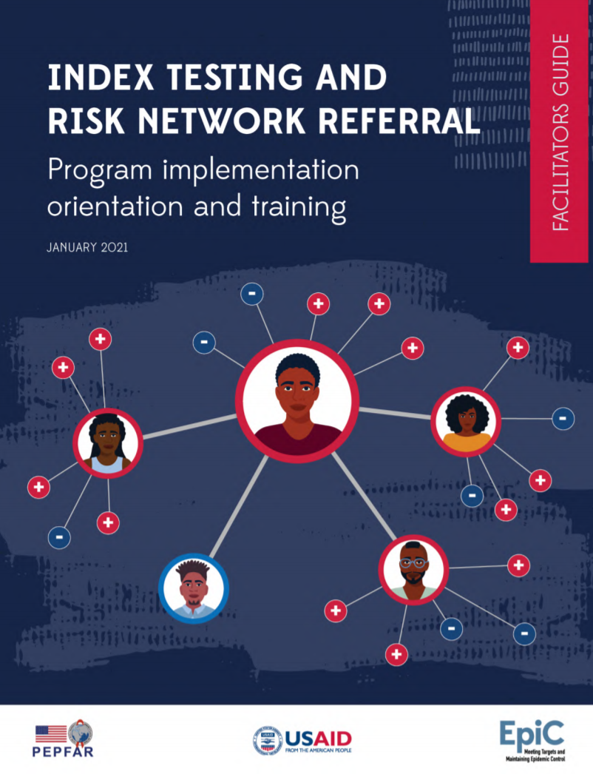
Objective
Explain the process of index testing and PEPFAR guidance on safe and ethical index testing as it relates to IPV and “adverse events.”
https://www.fhi360.org/resource/index-testing-and-risk-network-referral-program-implementation-orientation-and-training

Slide 169
Index testing
The index testing approach, also called partner notification, involves asking a person who is HIV positive (the “index” client) to provide the names and contact information of their sexual and needle-sharing partners.
One required step is asking the index service user about violence from any of those partners.
Information about violence should be used to determine which partner notification approach is most appropriate or whether to proceed with partner notification at all.
Source: WHO, 2016.

Slide 170
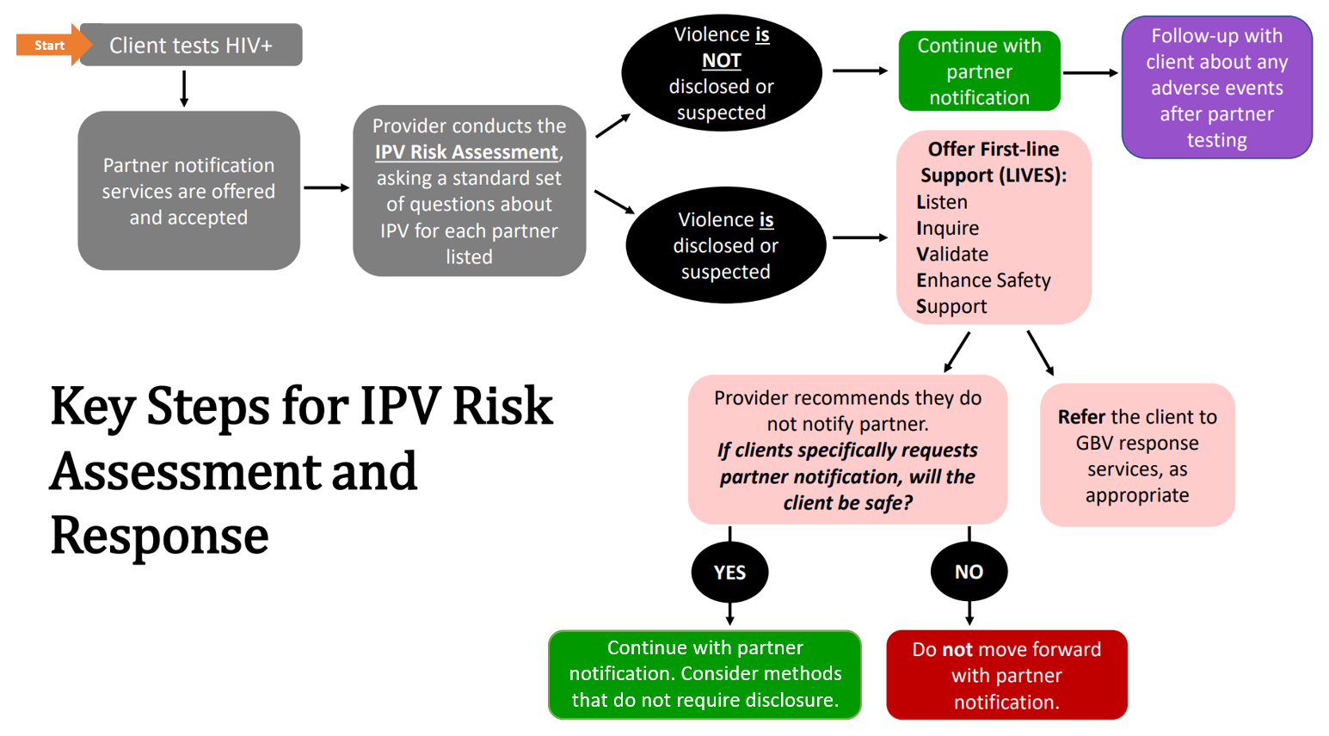

Taken from

Slide 171
Asking about violence within index testing
“Many people experience problems with their spouse or partner. This may include violence. Violence from a partner can negatively affect your health and because I care about your health and well-being, I want to ask you the following questions before we talk about partner notification. I want you to know that I will keep anything you tell me between us, unless you give me permission to share it.”
Because your safety is important to me, I would like to ask you the following questions:
Has [partner] ever hit, kicked, or slapped you?
Has [partner] ever threatened to harm you, humiliated you, or controlled your movements?
Has [partner] ever forced you to do anything sexual that made you feel uncomfortable?

Slide 172
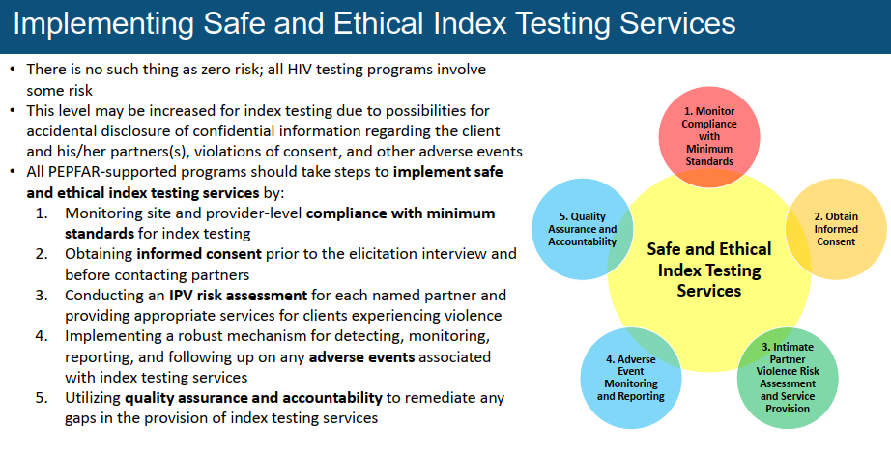
Source: PEPFAR. Guidance for Implementing Safe and Ethical Index Testing Services. July 13, 2020.

Slide 173
An adverse event related to index testing is an incident that results in harm to the client or others as a result of their participation in index testing services.
Threats of physical, sexual, or emotional harm to the index client, their partner(s), or family members, or to the index testing provider
Occurrences of physical, sexual, or emotional harm to the index client, their sexual or drug-injecting partner(s), or family members, or the index testing provider
Threats or occurrences of economic harm (e.g., loss of employment or income) to the index client, their partner(s), or family members
Abandonment or forced removal of children less than 19 years old from the home
Withholding HIV treatment or other services from the person offered index testing, their partners, or family members
Forced or unauthorized disclosure of client’s or contact’s name or personal information
Contacting partners without obtaining consent for participation in index testing and/or for notifying partners
Stigma perpetrated by health site staff (e.g., intentionally prolonging clients’ wait times, discriminatory behavior) or criminalization (e.g., sharing personal information with the criminal justice system about a KP member and/or person living with HIV who is seeking care)

Slide 174
Present local adverse event monitoring plan
If your project does not have an adverse event monitoring plan, consider adapting the protocol found here: https://www.fhi360.org/resource/adverse-event-prevention-monitoring-investigation-and-response-index-testing

Slide 175
Questions and reflections

Slide 176
Session 3.8
Data Collection and Sharing

Slide 177
Objectives
Discuss the importance of documenting violence against KP members
Identify practices for safe data collection and management in cases of violence

Slide 178
Discussion: Why do [peer educators, navigators, outreach workers] document cases of violence?
To capture information about the violence experienced (type, perpetrator, injuries)
So that the survivor doesn’t have to repeat their story to others if they decide to seek additional services
To record the services provided to the survivor and any referrals made
To manage the survivor’s care immediately and longer term
To advocate for violence prevention and response services

Slide 179
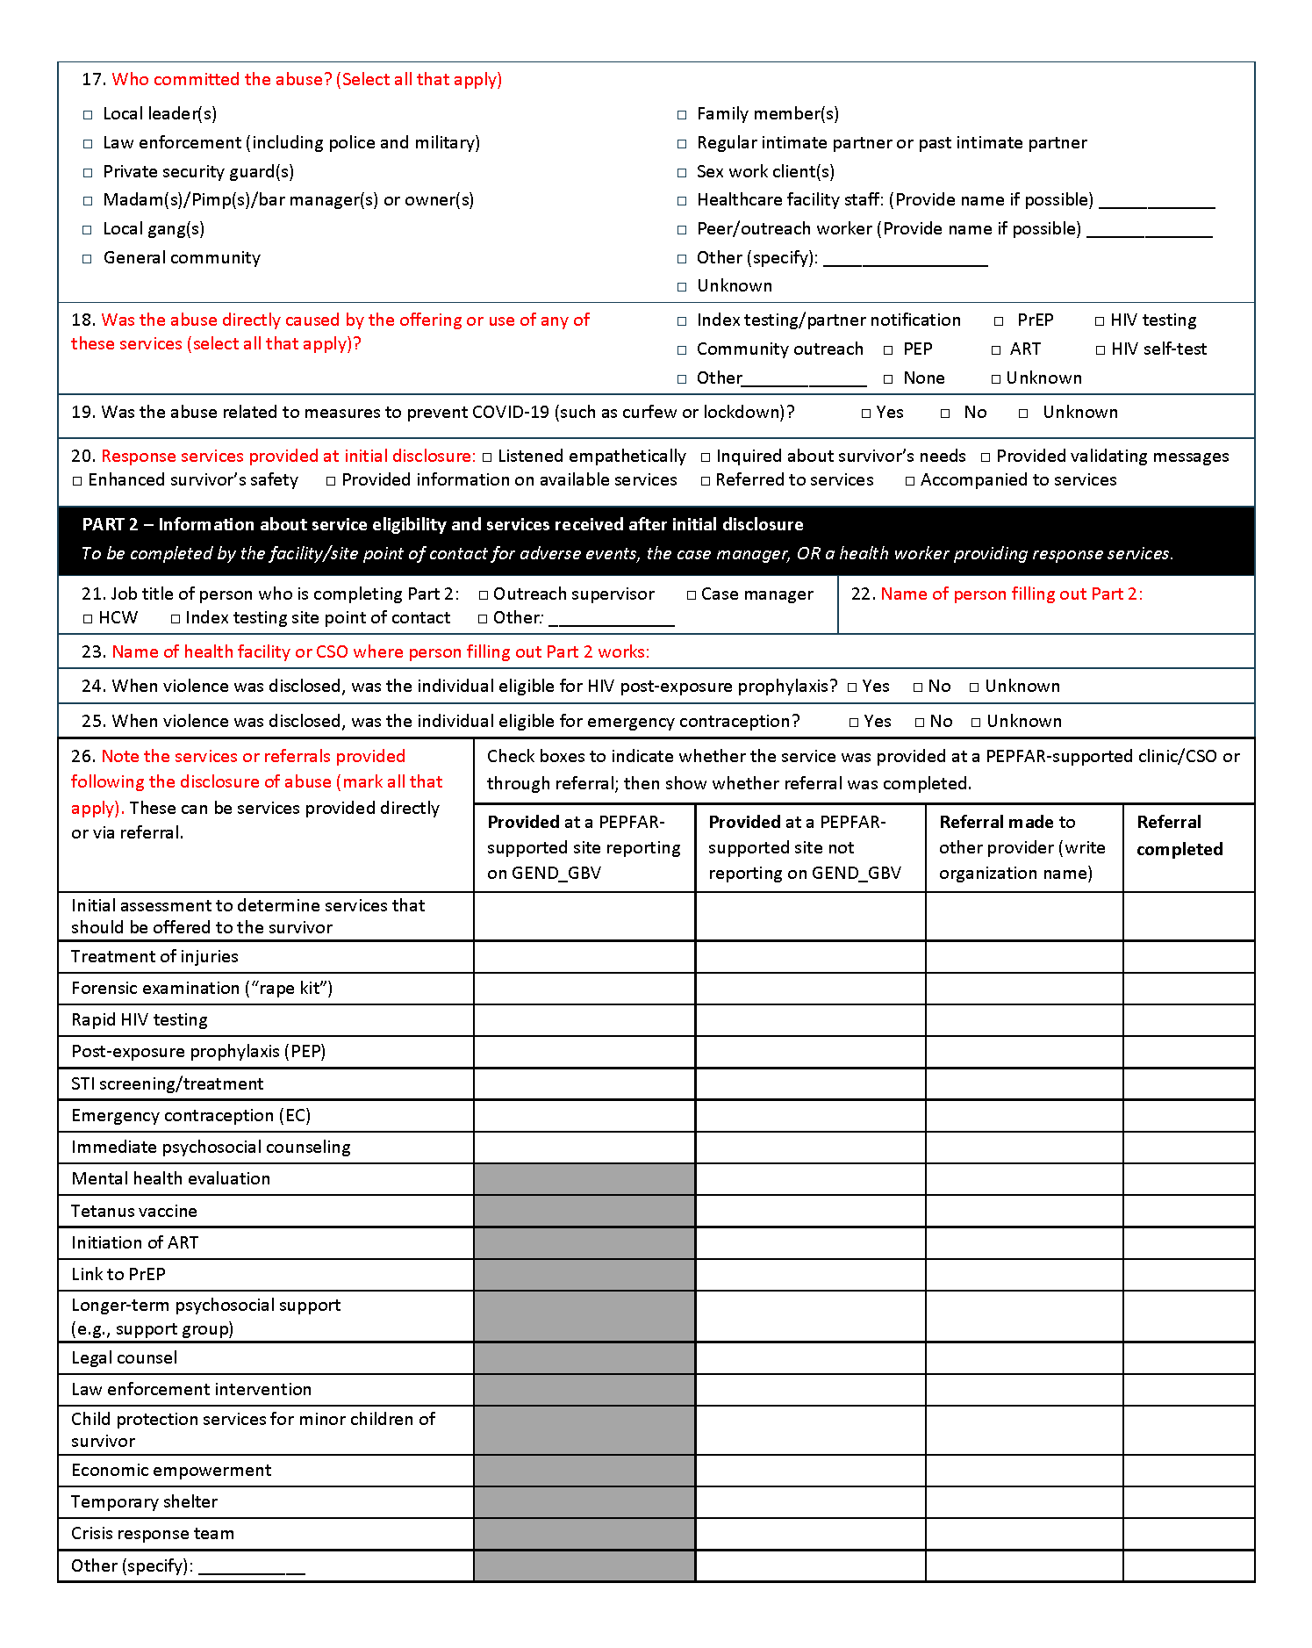
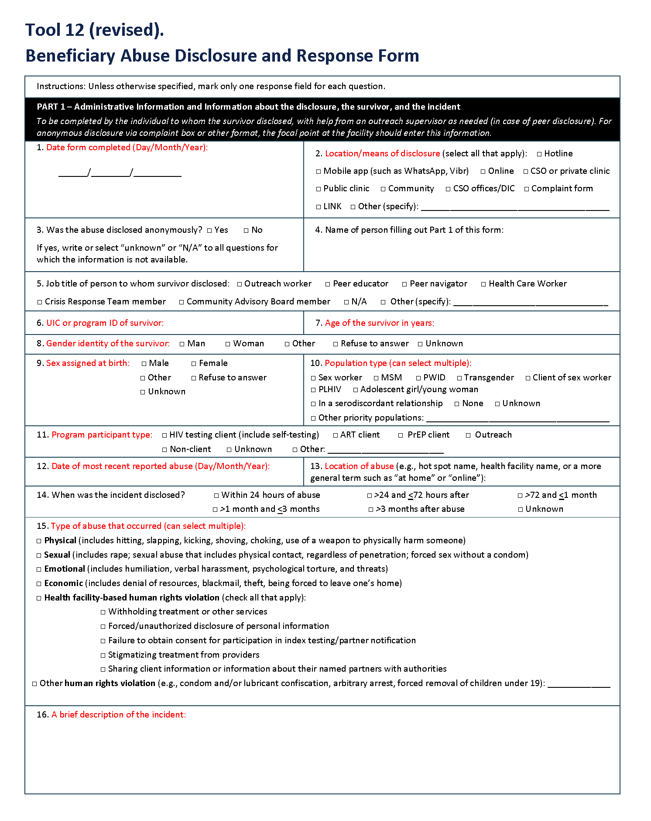
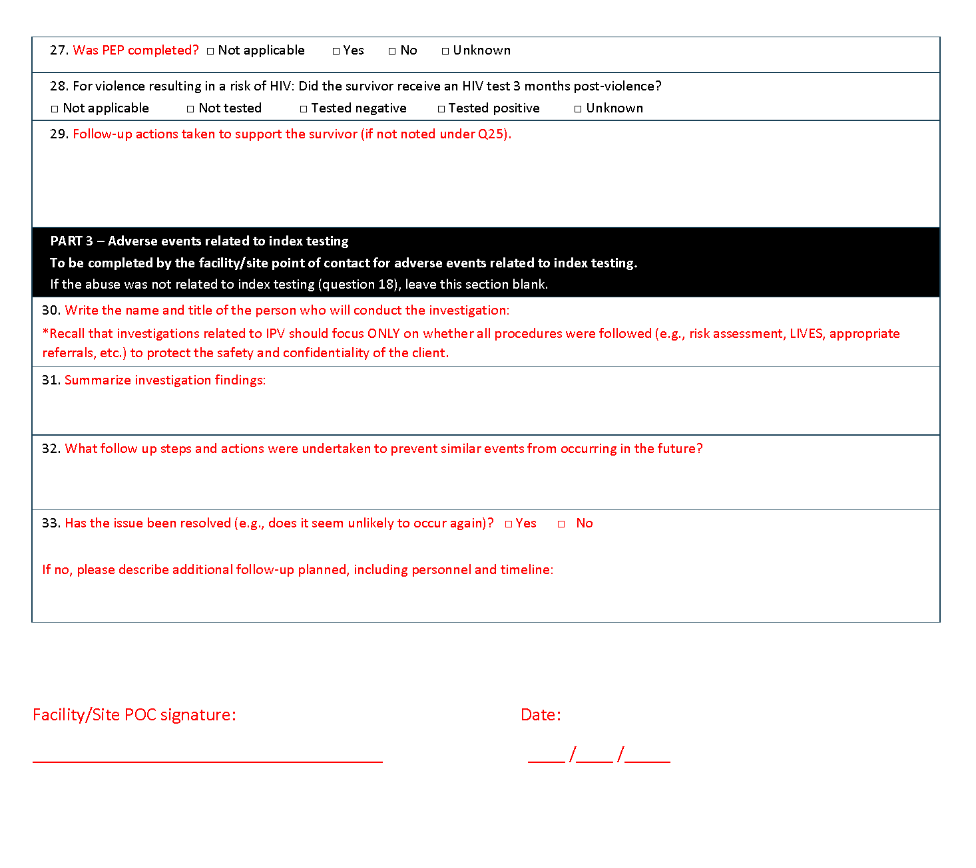
Data collection tools can cover violence and adverse events

Slide 180
Discussion: What could happen if [peer educators, navigators, outreach workers] don’t protect service users’ data?
Stigma and discrimination
Retaliation by the perpetrator
Theft of service users’ files

Slide 181
Privacy and confidentiality in data collection and sharing
Who is responsible for collecting and recording information?
Where and how is information collected and recorded?
How is information stored?
Who has access to the information, including what information is shared within the health facility or with referral points?
How do peers obtain service users’ consent before sharing any information and inform them about limits to confidentiality where applicable (e.g., mandatory reporting)?

Slide 182
Questions and reflections

Slide 183
Module 4
Using What We Have Learned

Slide 184
Session 4.1
Taking Care of Ourselves

Slide 185
Objectives
Identify ways to counter the impacts of work-related stress
Discuss the security of [peer educators, navigators, outreach workers] who are implementing violence response services

Slide 186
Self-care
Self-care is the intentional time taken by an individual to nurture themselves physically, mentally, spiritually, and emotionally on a daily basis.

Slide 187
Consequences of poor self-care
Mental health | Frustration, irritability, anxiety/fear, confusion, poor concentration, helplessness, hopelessness, depression, low morale, pessimism, compassion fatigue, guilt, etc.
Physical health | Stress-related illness (hypertension, ulcers, acid reflux/heartburn, skin rash, etc.); caregivers often experience headaches, back pain, insomnia, and arthritis
Relationships (personal and professional) | Conflict, tension, misunderstanding, anger, emotional or physical abuse
Organizational health | Increased absenteeism, diminished productivity, team conflict, turnover

Slide 188
Recommendations for self-care
Be aware of our own emotional reactions and distress when confronting others’ traumatic experiences (know what traumatic material may trigger us).
Connect with trusted colleagues or other supportive people and talk about our reactions.
Maintain a balance between our professional and personal lives, with a focus on self-care (e.g., relaxation, exercise, stress management) to prevent and lessen the effects of workplace stress.

Slide 189
Discussion: Strategies for coping with stress
Turn to the person next to you and discuss:
What do you do when you’re feeling stressed?
Which of these activities do you think is the most effective at helping you feel better?

Slide 190
Some examples of self care
Quiet walks by yourself
Little meditative periods (waiting for something, a cancellation of a session, a brief illness) are opportunities for a quiet, reflective, peaceful time
Time and space for meditation
Reading (spiritual, fiction, biographies)
Some light exercise
Opportunities to laugh in the company of cheerful friends
A hobby
Listening to music you enjoy

Slide 191
Activity: Stress relief

Slide 192
Strategies to increase security
Conduct outreach in pairs or groups of three
Always let a supervisor know where you are, checking in regularly
If someone discloses violence that occurred at the outreach site, talk to them about finding another safer place for future interactions
When giving materials on violence, first ask whether there is a safe place that such materials can be stored (one that will not be found by the perpetrator)
If you also work at a drop-in center or other facility, the center should require that all those visiting show identification and be accompanied while in the building
Others?

Slide 193
Project resources to care for care givers

Slide 194
Questions and reflections

Slide 195
Session 4.2
Reflections on What We Have Learned and How to Integrate It into Our Work

Slide 196
Objective
Identify and discuss specific “asks” of [peer educators, navigators, outreach workers] going forward

Slide 197
What we are asking of each of you
Consistently
Educate program beneficiaries on the connection between violence and HIV.
Create an environment that allows for disclosure.
Ask about adverse events related to index testing as relevant.
When someone discloses violence
Provide LIV. If additional support is available, and the survivor is willing to share with someone else, connect this person to another for E and S of LIVES.
Be prepared to discuss “E” and “S” if it is not possible to engage a supervisor or outreach coordinator.
Support any desired linkages to other services, including to a supervisor that can discuss safety and referral in more detail.
When someone discloses violence to a health care provider, be available to accompany the survivor to other services and/or act as a case manager for the survivor.
Tailor content or frequency of outreach visits to acknowledge the impact of past or present violence on individuals or at the hot spot.

Slide 198
How we will support you
Updates to protocols/SOPs for the provision of violence response services
Updates to standardized questions to facilitate documentation and safe storage mechanisms
Updates to referral system for violence response services including health, social, and justice/legal services
Continued training or expanded training on preventing, asking about, and responding to violence for other health care workers
Ongoing supportive supervision for peer educators, navigators, and outreach workers
Track outreach staff and provide safety procedures at drop-in centers or other facilities

Slide 199
Activity: Tasks and follow-up support
What tasks do you feel you can perform?
What other support do you think you will need?

Slide 200
Session 4.3
Post-Test and Training Evaluation

Slide 201
Objectives
Assess newly acquired knowledge and attitudes
Provide feedback on the training

Slide 202
Session 4.4
Closing Ceremony and Final Words

Slide 203
Objective
Acknowledge participant effort and commitment

Slide 204
References
Baral SD, Poteat T, Strömdahl S, Wirtz AL, Guadamuz TE, Beyrer C. Worldwide burden of HIV in transgender women: a systematic review and meta-analysis. Lancet Infect Dis. 2013;13:214-22.
Beattie TS, Bhattacharjee P, Isac S, Mohan HL, Simic-Lawson M, Ramesh BM, et al. Declines in violence and police arrest among female sex workers in Karnataka state, south India, following a comprehensive HIV prevention programme. J Int AIDS Soc. 2015;18:20079.
Cortina LM, Rabelo VC, Holland KJ. Beyond blaming the victim: toward a more progressive understanding of workplace mistreatment. Ind Organ Psychol. 2018;11(1):81-100.
Decker MR, Crago AL, Chu SK, Sherman SG, Seshu MS, Buthelezi K, et al. Human rights violations against sex workers: burden and effect on HIV. Lancet. 2015;385(9963):186-99.
Decker MR, Lyons C, Billong SC, Njindam IM, Grosso A, Nunez GT, et al. Gender-based violence against female sex workers in Cameroon: prevalence and associations with sexual HIV risk and access to health services and justice. Sex Transm Infect. 2016;92(8):599-604.
Decker MR, Wirtz AL, Pretorius C, Sherman SG, Sweat MD, Baral SD, et al. Estimating the impact of reducing violence against female sex workers on HIV epidemics in Kenya and Ukraine: a policy modeling exercise. Am J Reprod Immunol. 2013;69 (Suppl 1):122-32.
Dunkle KL, Decker MR. Gender-based violence and HIV: reviewing the evidence for links and causal pathways in the general population and high-risk groups. Am J Reprod Immunol. 2013;69 (Suppl 1):20-6.
El-Bassel N, Gilbert L, Wu E, Chang M, Gomes C, Vinocur D, et al. Intimate partner violence prevalence and HIV risks among women receiving care in emergency departments: implications for IPV and HIV screening. Emerg Med J. 2007;24(4):255-9.
Finneran C, Stephenson R. Intimate partner violence among men who have sex with men: a systematic review. Trauma Violence Abuse. 2013;14(2):168-85.
Guadamuz TE, Wimonsate W, Varangrat A, Phanuphak P, Jommaroeng R, Mock PA, et al. Correlates of forced sex among populations of men who have sex with men in Thailand. Arch Sex Behav. 2011;40(2):259-66.
Janoff-Bulman R. Shattered assumptions: towards a new psychology of trauma. New York: The Free Press, 2010.
Joint United Nations Programme on HIV/AIDS. Prevention gap report. Geneva: Joint United Nations Programme on HIV/AIDS, 2016.

Slide 205
References (continued)
Lerner MJ, Simmons CH. Observer's reaction to the "innocent victim": compassion or rejection? J Pers Soc Psychol. 1966;4(2):203-10.
Lerner MJ. The belief in a just world. In: Perspectives in social psychology. Boston: Springer, 1980. p. 9-30.
Link BG, Phelan JC. Conceptualizing stigma. Annu Rev Sociol. 2001;27(1):363-85.
Linkages across the Continuum of HIV Services for Key Populations Affected by HIV (LINKAGES). The nexus of gender and HIV among men who have sex with men in Kenya. Durham (NC): FHI 360, 2016.
LINKAGES. The nexus of gender and HIV among transgender people in Kenya. Durham (NC): FHI 360, 2016.
LINKAGES. Monitoring guide and toolkit for key population HIV prevention, care, and treatment programs. Durham (NC): FHI 360, 2016.
Lunze K, Raj A, Cheng DM, Quinn EK, Lunze FI, Liebschutz JM, et al. Sexual violence from police and HIV risk behaviours among HIV-positive women who inject drugs in St. Petersburg, Russia—a mixed methods study. J Int AIDS Soc. 2016;19(4 Suppl 3):20877.
Machtinger EL, Haberer JE, Wilson TC, Weiss DS. Recent trauma is associated with antiretroviral failure and HIV transmission risk behavior among HIV-positive women and female-identified transgenders. AIDS Behav. 2012;16(8):2160-70.
McKay T, Lindquist CH, Misra S. Understanding (and acting on) 20 years of research on violence and LGBTQ + communities. Trauma Violence Abuse. 2017;20(5):665-78.
Mendoza C, Barrington C, Donastorg Y, Perez M, Fleming PJ, Decker MR, et al. Violence from a sexual partner is significantly associated with poor HIV care and treatment outcomes among female sex workers in the Dominican Republic. J Acquir Immune Defic Syndr. 2017;74(3):273-8.
Panchanadeswaran S, Johnson SC, Sivaram S, Srikrishnan AK, Latkin C, Bentley ME, et al. Intimate partner violence is as important as client violence in increasing street-based female sex workers’ vulnerability to HIV in India. Int J Drug Policy. 2008;19(2):106-12.
Schafer KR, Brant J, Gupta S, Thorpe J, Winstead-Derlega C, Pinkerton R, et al. Intimate partner violence: a predictor of worse HIV outcomes and engagement in care. AIDS Patient Care STDS. 2012;26(6):356-65.
UK Network of Sex Work Projects. Keeping safe: safety advice for sex workers in the UK. Edinburgh: UKNSWP, 2008.

Slide 206
References (continued)
United Nations General Assembly. Universal declaration of human rights. 1948 Dec 10 [Internet]. Geneva: United Nations Office of the High Commissioner for Human Rights. Available from: https://www.ohchr.org/EN/UDHR/Documents/UDHR_Translations/eng.pdf.
United Nations Office on Drugs and Crime, International Network of People Who Use Drugs, Joint United Nations Programme on HIV/AIDS, United Nations Development Programme, United Nations Population Fund, World Health Organization, et al. Implementing comprehensive HIV and HCV programmes with people who inject drugs: practical guidance for collaborative interventions (the “IDUIT”). Vienna: United Nations Office on Drugs and Crime, 2017.
Valentine SE, Peitzmeier SM, King DS, O'Cleirigh C, Marquez SM, Presley C, et al. Disparities in exposure to intimate partner violence among transgender/gender nonconforming and sexual minority primary care patients. LGBT Health. 2017;4(4):260-7.
Vedantam S. Why #MeToo happened in 2017. 2018 Feb 7 [podcast on the Internet]. Washington: National Public Radio (NPR); 2018. Available from: https://www.npr.org/2018/02/07/583910310/why-metoo-happened-in-2017.
Wheeler J, Anfinson K, Valvert D, Lungo S. Is violence associated with increased risk behavior among MSM? Evidence from a population-based survey conducted across nine cities in Central America. Glob Health Action. 2014;7(1):24814.
World Health Organization. Guidelines on HIV self-testing and partner notification: supplement to consolidated guidelines on HIV testing services. Geneva: World Health Organization, 2016.
World Health Organization. Health care for women subjected to intimate partner violence or sexual violence: a clinical handbook. Geneva: World Health Organization, 2014.
World Health Organization. Global and regional estimates of violence against women: prevalence and health effects of intimate partner violence and non-partner sexual violence. Geneva: World Health Organization, 2013.
World Health Organization. A conceptual framework for action on the social determinants of health: social determinants of health discussion paper 2. Geneva: World Health Organization, 2010.
World Health Organization. Guidelines for medico-legal care for victims of sexual violence. Geneva: World Health Organization, 2003.
Zulliger R, Barrington C, Donastorg Y, Perez M, Kerrigan D. High drop-off along the HIV care continuum and ART interruption among female sex workers in the Dominican Republic. J Acquir Immune Defic Syndr. 2015;69(2):216-22.

Slide 207
Stay Connected with LINKAGES
There are several ways to stay involved with LINKAGES’ work as well as new evidence, publications, and tools related to HIV prevention, care, and treatment among KP members and their partners.

Slide 208


Stay connected with LINKAGES
Follow LINKAGES on Twitter:
www.twitter.com/LINKAGESproject
Like LINKAGES on Facebook:
www.facebook.com/LINKAGESproject
Subscribe to the LINKAGES blog:
www.linkagesproject.wordpress.com
Subscribe to The LINK, LINKAGES’ quarterly e-newsletter.
Check out LINKAGES’ quarterly research digest.

Slide 209






Acknowledgments

