Slide 1
Index testing and risk network referral Program implementation orientation and training Day 3
City, Country YEAR
Notes:
NOTE: Welcome the participants and thank them for coming to Day 3 of the training. Ask if they are comfortable with the temperature of the room before you begin.
As you will be conducting a short quiz in the next slide, you can wait until after the quiz to ask them if they have any questions before beginning with the Day 3 sessions.

Slide 2
Review of Day 2: Candy quiz!
What are four key motivational counseling techniques that are critical in index testing?
What are three specific behaviors to avoid in counseling?
What does each of the letters of LIVES stand for?
Notes:
Say: Is everyone ready for a candy quiz?
Advance one at a time and award individuals who answer correctly.

Slide 3
Session 12. Messaging
Notes:
Say: In this session, we will spend some time adapting appropriate messaging for index testing to the [COUNTRY] context.

Slide 4
Activity: Development/adaptation of appropriate messaging
Divide into small groups (5–8)
Working with existing message matrices including those developed in Session 6, adapt/revise/develop key messages and talking points to be used for both in-person and online counseling sessions for index testing and risk network referral
Notes:
NOTE: It will be helpful to have a set of messages (e.g., a message matrix) available before conducting this session. Messaging might be found in SOPs for outreach, testing, and/or counseling, or available as part of local national guidance. In the absence of an official source of messages, it may still help to provide examples of messages from another country with a similar context.
Have the participants divide into small groups of about 5-8 people each.
Explain to the participants that, using existing message matrices, messages developed in Session 6, or an example of messaging from a similar country context (pasted in the next slide), and they will have about 45 minutes to develop key messages that match the country context in the provision of index testing services.
You can design this session based on the need for the program and break up the responsibility among the participants to fill in different messages along the index testing flow chart.
For example, you can focus specifically on developing messages/scripts for:
Introducing the four index testing options in a counseling session for a recently diagnosed individual
Offering risk network referral options for contacts or individuals the client knows
Responding to common concerns that clients are likely to raise in the sessions
It may help to brainstorm these in advance of the training with representatives from the program/health sector/community partners to ensure that the time is used effectively.
Be sure to save what the groups produce (it can be faster if they draft directly into laptops). Their inputs can be used later to design SOPs and job aids.
Allow 50 minutes for the exercise, and 10 minutes to report back any challenges or interesting findings.

Slide 5
INSERT MESSAGING SLIDES HERE
As relevant, based on local context
To be used to reinforce group work if necessary

Slide 6
Session 13. Practice makes perfect
Notes:
Say: This is session is perhaps one of the most important sessions we will conduct in this training. While we have had many exercises that have given you a chance to play different roles, the activities and role-plays this morning will give you the opportunity to combine all of the skillsets you have learned so far. By no means should this be the last time you practice these skills in a safe setting. It is important to refresh these skills regularly with support from your supervisor and peers who have championed the skills. Practice makes perfect.
NOTE: This session includes roughly 105 minutes of exercises and Q&A. The total time allotted for the session is 120 minutes. This is to allow for a couple of minutes of excess time for each exercise if needed. While it is not essential to get through every scenario, it is important to observe and provide support throughout by walking around the room, listening, and gauging to what degree the material from the training has been adopted. As this is new material, some participants may fall back on old habits that are inconsistent with new recommended approaches.

Slide 7
Activity: Responding to client concerns and misinformation
Break into groups of 3–4
Brainstorm likely questions, concerns, and myths that your clients may raise in the context of index testing and partner notification
For each major question, concern, or myth, develop a potential response
10 minutes to brainstorm
5-minute report back
Notes:
NOTE: Ask the participants to break into groups of 3-4 (they may be able to stay with the same groups at their tables if the size is right).
Ask them to think about likely questions, concerns, and myths that their clients may raise in the context of index testing and partner notification.
For each major question, concern, or myth, they should develop a potential response.
Allow them 10 minutes to brainstorm, and then provide 5 minutes total for volunteers to report on their observations from the session.

Slide 8
Demonstration
Instructions: Watch the following demonstration of a partner elicitation session. Please note what the index provider did well and what he or she could improve upon.
Case study
Ghislaine is a 34-year-old FSW who was recently diagnosed HIV positive. Her infant is now 14 months and she has one older child age 6. She has been living with her male partner, Van, for 12 years.
Notes:
NOTE: Facilitators should prepare this demonstration in advance. If there is only one facilitator, then you may wish to choose a participant member in advance to go over the scenario and agree on roles and how it will play out. The purpose is to allow the participants to see an example of behaviors that are encouraged in index testing, and behaviors to avoid. Facilitators/volunteers should agree on what will be examples of appropriate messaging/behavior, and what is inconsistent with recommended approaches.
Take about 8-10 minutes to conduct the role play, then allow a few minutes for the participants to provide comments and observations (5 minutes).

Slide 9
Scenario A: Introducing index testing
Paired work
Turn to someone next to you and decide who will be the provider/counselor and who will be the client.
Case study
You are an HIV testing provider working in a voluntary counseling and testing clinic. Lang is a 21-year-old transgender woman who has come to you for HIV testing. She wants to know her status because she saw a famous transgender woman influencer on Facebook talk about the importance of knowing your HIV status. She has had boyfriends in the past and has used condoms with some of them.
Before you start the HIV test, introduce index testing and partner services to Lang.
Notes:
NOTE: Ask for a volunteer to read the instructions and the case study.
Allow the pairs 10 minutes to conduct the role-play.
Ask the groups how it went, and if they have any questions (5 minutes).
Provide answers as appropriate, and advance to the next slide.

Slide 10
Scenario B: Eliciting partner contact information
Group work
Break into groups of 3. One person serves as the client, the other the counselor/provider, and the third an observer.
Case study
Fab is a 40-year-old man who has sex with men who has recently tested HIV positive. He has multiple partners and sometimes goes to a massage parlor and hires a male sex worker at the end of the month when he has some extra money.
You need to ensure that Fab understands the importance of partner notification and elicit the names of his partners.
Notes:
NOTE: Ask the groups to break into trios. Explain that one person will serve as the client, another the counselor/provider, and the third an observer.
Ask for a volunteer to read the case study.
Allow the trios 10 minutes to conduct the role-play.
Ask the groups how it went, and if they have any questions (5 minutes).
Provide answers as appropriate, and advance to the next slide.

Slide 11
Scenario C: Supporting a client to refer
Group work
Stay in your groups of three. Switch roles (new person serves as the client, another the counselor/provider, and the third an observer).
Case study
You are counseling a female sex worker who has recently tested positive. She indicates that she uses condoms with her clients, but has two main partners that she doesn’t use condoms with. She is willing to talk to you about notifying one partner but does not want to discuss the other at all because he might beat her up.
What would you do in this situation? What messages would you give this client?
Notes:
NOTE: Ask the groups to stay in their trios, and to rotate roles (a new person serves as the client, another the counselor/provider, and the third an observer).
Ask for a volunteer to read the case study.
Allow the trios 10 minutes to conduct the role-play.
Ask the groups how it went, and if they have any questions (5 minutes).
Provide answers as appropriate, and advance to the next slide.

Slide 12
Scenario D: Supporting a client to refer
Group work
Stay in your groups of three. Switch roles (new person serves as the client, another the counselor/provider, and the third an observer).
Case study
Vadi is a 24-year-old married man with a 2-year-old daughter. He is an injecting drug user. Normally he uses clean equipment, but on a few occasions, he injected with an old girlfriend. He tested HIV positive, and now he needs to bring his wife and child for testing, but he does not know how to bring up this topic with his wife.
Notes:
NOTE: Ask the groups to stay in their trios, and to rotate roles (a new person serves as the client, another the counselor/provider, and the third an observer).
Ask for a volunteer to read the case study.
Allow the trios 10 minutes to conduct the role-play.
Ask the groups how it went, and if they have any questions (5 minutes).
Provide answers as appropriate, and advance to the next slide.

Slide 13
Scenario E: Targeted testing
Group work
Stay in your groups of three. Switch roles (new person serves as the client, another the counselor/provider, and the third an observer).
Case study
Lana is a female sex worker living with HIV. She has a stable partner/boyfriend who at times is physically violent, a preferred client with whom she never uses condoms, and other occasional partners with whom she sometimes uses condoms. She doesn’t know their last names and phone numbers.
Notes:
NOTE: Ask the groups to stay in their trios, and to rotate roles (a new person serves as the client, another the counselor/provider, and the third an observer).
Ask for a volunteer to read the case study.
Allow the trios 10 minutes to conduct the role-play.
Ask the groups how it went, and if they have any questions (5 minutes).
Provide answers as appropriate, and advance to the next slide.

Slide 14
Session 14. Quality assurance, adverse event monitoring and reporting, and monitoring and evaluation Examples of how a program might monitor, assure quality, and analyze index testing efforts
Notes:
Say: In this session we will briefly touch on some of the important ways we will be measuring the degree to which index testing is contributing to overall case-finding efforts. We will also look at how the program will report index testing service provision to PEPFAR.

Slide 15
Summary of inputs into quality assurance and accountability
5. Quality assurance and accountability
PEPFAR MER indicators
Minimum Standards Checklist for providers and sites
Supportive supervision tools for index testing
SIMS (with CEEs specific to index testing)
Community-led monitoring and feedback mechanism (LINK; Community Scorecard)
Adverse events monitoring and reporting tools
Beneficiary Abuse Disclosure and Service Provision Form
Customer Complaint Form (e.g., LINK where applicable)
Security Incident Log
Notes:
Say: Continuous quality monitoring and improvement are critical for ensuring that index testing efforts help achieve targets and epidemic control. They are also critical for ensuring that teams are effectively screening for potential violence and other risks risk, reporting instances of violence or adverse events, and following up appropriately. As we will discuss later in this session, monitoring includes efforts led by implementing partners and sites, as well as community representatives and clients themselves.
This slide lists the inputs and tools that can and should be used with a PEPFAR-supported index testing program.

Slide 16
PEPFAR indicator for reporting: HTS_INDEX
Number of individuals who were identified and tested using index testing services and received their results
Index Client
Sexual partners
Injecting partners
Biological children
Notes:
Say: Who “counts” as an index partner?
An index partner is anyone who is referred through an index testing modality who is a:
Current or past sexual partner(s), biological children/parents (if index case is child), or anyone with whom a needle was shared.
Biological child of an HIV-positive mother. Children of male index clients (fathers) should be included when the biological mother is HIV positive, deceased, or her HIV status is not known or not documented.
If the index client is child, his/her mother should be tested; if mother is HIV positive or deceased, father and all known sexual partners should be tested.

Slide 17
Who is not an index partner?
Anyone who tests in the program who was not referred or contacted using one of the index testing modalities:
Individuals within a social network who test at a mobile testing event or through community-based testing (MOBILE)
Individuals who are referred to and/or who test at a drop-in center (VCT)
Risk network referral
?
?
?
Targeted referral
Notes:
Say: Remember that we also discussed various ways that index clients (and other beneficiaries) can refer people for services. These included risk network referral and targeted referral.
While these approaches are critical complements to index testing and should be offered as part of our menu of options, when someone tests in our program who has not been referred via an index testing partner notification option, we cannot count them as index cases.
They still count as HTS_TST when they test.

Slide 18
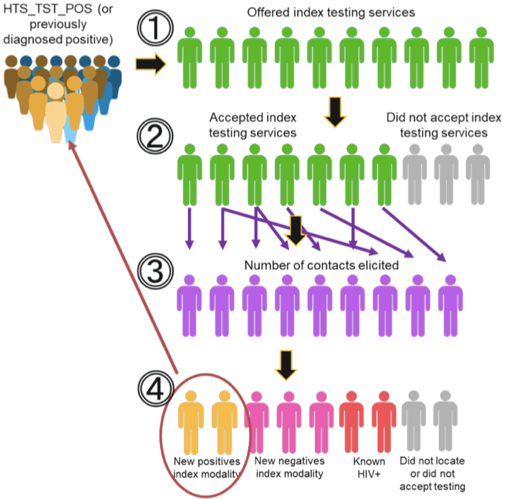
Notes:
Say: This graphic helps clarify how individuals are classified within an index testing program.
We begin with a cohort of previously diagnosed PLHIV. All of them are offered index testing services (1).
Among them, some will accept, and some will not (2). We hope that the majority will accept, based on the use of motivational counseling approaches and in the absence of the threat of violence.
From those who accept, we expect to see a cohort of individuals come for testing(the contacts provided by the index case) (3).
Among those, some will agree to test, and some will not (4). Of those who test, some will be positive, and can be offered index testing services. Among those who are negative, we can still offer risk network referral and targeted referral options.

Slide 19
Example: An index testing cascade
Number of individuals
Notes:
Say: This is an example of an index testing cascade which helps us analyze the performance of index testing.
The first bar represents the total number of index clients who were offered the service. In this case, 100 people. It disaggregates index clients who were newly diagnosed (50) and PLHIV already diagnosed and on treatment TX_CURR and those living with HIV but not on treatment, (50).
The second bar shows the number clients who accepted the service (in this case, 65 of the 100, or 65%).
The third bar shows the number of contacts provided by the index clients; 145 which is about 2.2 contacts per index client.
The last bar shows the outcomes of the contact referrals, it includes 40 people who refused HIV testing, 13 who were not found, 10 who were known PLHIV, 22 who agreed to testing and were diagnosed with HIV (27% case finding) and 60 who agreed to testing but were negative.

Slide 20
Example: Index testing cascade for a quarterly review
Notes:
Say: This graph shows an example of how a program might display data for a quarterly review to see how effective the program is at supporting clients to accept index testing (here shown as PNS – partner notification services), and the case-finding and linkage rates for the contacts of the index clients.
As you can see on the left in blue, 100% of all cases were offered index testing, and 90% accepted. That’s pretty good, though we are always aiming for 100%.
On the right are the individuals were referred through index testing by the clients on the left. 80% of those contacted accepted index testing, among whom 40% were diagnosed living with HIV, and 100% of them were linked to treatment. This is an example of a successful index testing intervention. We see high rates of acceptance and high case-finding and linkage rates as well.

Slide 21
Example: Comparing the results of index testing versus mobile HTS
Notes:
Say: In this graph, we can see how a program might compare two different modalities for case finding.
On the left you see data for mobile HTS. While the approach reached 80 people during the period, and achieved an 18% yield, index testing approaches resulted in fewer people tested but resulted in a higher yield and even more cases.
This graph is not meant to suggest that we should put all of our resources into index testing. In fact, community-based approaches for reaching and recruiting still found 14 cases in this example. But it should help convince you that implementing both approaches will effectively increase our chances of epidemic control.
If resources are highly limited, increasing focus on index testing and reducing the number of mobile outreach events may save costs and still result in case-finding rates that are on par with local or national targets.

Slide 22
What is an adverse event?
An incident that results in harm to clients, partners, children, providers, or anyone else as a result of their participation in index testing services
Adverse events (AEs) include:
Threats of physical, sexual, or emotional harm to the index client, their partner(s) or family members, or the index testing provider
Occurrences of physical, sexual, or emotional harm to the index client, their sexual or drug-injecting partner(s) or family members, or the index testing provider
Threats or occurrences of economic harm (e.g., loss of employment or income) to the index client, their partner(s) or family members
Abandonment or forced removal of children less than 19 years old from the home
Withholding HIV treatment or other services
Forced or unauthorized disclosure of client or contact’s name or personal information
Failure to obtain consent for participation in index testing and/or for notifying partners
Health-site-level stigma or criminalization (e.g., sharing personal information with the criminal justice system about KP/PLHIV seeking care)
Source: PEPFAR 2020 Guidance for Implementing Safe and Ethical Index Testing Services
Notes:
NOTE: The term adverse event may be confusing for some people, especially if translated into another language. While it is important for programs to understand what language is being used globally, it may help to agree on a local term for ‘adverse events’ that all participants can understand, and that can be used throughout this training and beyond.
Say: We previously introduced the concept of adverse events in Session 5. Can anyone remind the group what an adverse event is?
Allow a few moments for the participants to respond.
Say: It’s important for providers to be aware of the potential for adverse events, types of adverse events, and how to respond.
Adverse events include threats or occurrences of harm, including physical, sexual, or economic. These can be toward the index client, their partners, family members and/or children, a provider, or anyone else.
There are also some adverse events that may not seem like obvious harms, but that could have severe consequences. These include withholding of treatment or other services, which can be life threatening or cause harm, and forced or unauthorized disclosure of names or personal information (as discussed on the previous slide).
Other adverse events include abandonment or forced removal from home for children under 19 years of age, failure to obtain consent, and stigma or criminalization at a health service provision site (or elsewhere).
We will discuss adverse event monitoring and response in Session 15.

Slide 23
Monitoring of consent and adverse events (AEs)
4. Adverse event monitoring and reporting
All sites must have/use tools to document and monitor obtaining consent and the frequency of AEs (including IPV) and actively monitor:
Reasons for refusal of index testing services
Prevalence of IPV and other AEs (e.g., confidentiality breaches, stigmatization, coercive tactics, etc.)
Investigate each reported AE and develop a follow-up plan
Tools available for adaptation!
Notes:
Say: Why might it be important to monitor the provision of client consent and adverse events?
Allow the participants a few moments to respond, and use the bullets in the slide to fill in any answers that might not have been suggested.
Say: It is important for all sites to have a method for obtaining consent and documenting who among its clients has provided consent. As discussed previously, clients can provide either oral or written consent, depending on national guidelines. Either way, it will be the provider’s responsibility to document if the client has provided consent, and for site leaders to monitor if consent has been obtained both for listing clients and for methods chosen for notification.
Sites also will need to document reasons for refusal of index testing services and occurrences and prevalence of adverse events. For each reported adverse event, sites will need to investigate and develop a follow-up plan. This training package provides all the resources needed for tracking and guidance for response.

Slide 24
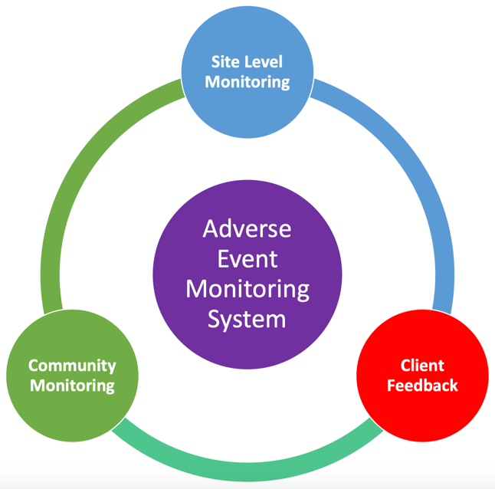
Supervision tools
Minimum Standards Checklist
Supportive supervision tools
SIMS (CEEs specific to index testing)
Monitoring and reporting tools
Beneficiary Abuse Disclosure and Response Form
Customer Complaint Form (using LINK where applicable)
Security Incident Log
Paper-based client feedback surveys; comment boxes
LINK surveys
Client exit interviews
Community Scorecard
Community Advisory Boards
Notes:
Say: Have a look at the graphic on this slide. What might we mean by including community monitoring and client feedback as part of an adverse event monitoring system? What is the difference between community monitoring and client feedback? Aren’t they the same thing?
Allow the participants a few moments to respond.
Say: An adverse event monitoring system expands beyond the site alone. At the site level, it’s important to employ standardized tools to guide supervision and ensure quality, including a Minimum Standards Checklist, supportive supervision checklists, and SIMS checklists.
Sites also need to incorporate monitoring and reporting tools, including:
Beneficiary Abuse Disclosure and Service Provision Form
Customer Complaint Form (using LINK where applicable)
Security Incident Log
At the client level, sites should incorporate tools/approaches for gauging client satisfaction with services, such as paper- or web-based surveys (using LINKS), comment boxes, and client exit interviews.
It’s also important that community organizations have platforms for monitoring and providing feedback to ensure that services meet the Core Principles and Minimum Standards, including being catered to individual client needs. These can include Community Scorecard approaches, whereby community representatives work with site leadership and providers to assess quality and accessibility of services and develop recommendations together that are then implemented and assessed again. This approach has demonstrated considerable success in a variety of contexts.
Local organizations and facility leaders can also form community advisory boards that consolidate feedback from the community and provide recommendations to improve quality and accessibility.

Slide 25
Site level monitoring
4. Adverse event monitoring and reporting
Routinely ask index clients if they experienced any AE following participation in index testing
Suggested question: “Did you experience any harm from your partner, health care provider, or anyone else during or as a result of receiving index testing services at this [facility or site]? This might include physical, emotional, sexual, or economic harm.”
Can be done at client’s next visit or via phone 2–4 weeks after index testing service provided
All reports of adverse events should be documented
Notes:
Say: At the site level, providers should routinely inquire about any adverse events. This can be done in various ways, including in person during a visit or by phone.
The script in this slide offers one way of asking about harms.

Slide 26
Why track reasons clients decline index testing?
Programs should track why clients decline index testing services, but keep in mind that clients are NOT required to provide a reason (as described in example consent form)
Reason for decline
No time for elicitation interview
Do not believe services are confidential; afraid partner will learn identity
Afraid of intimate partner violence
Partner is already stable on treatment
Partner lives/works far away
Clinic hours are inconvenient for partner
Other?_________________
Possible solution/step
Offer extended opening hours
Review and/or improve counseling on confidentiality
Strengthen network of VPR services; hire counselors within the clinic; address IPV in HIV services
Affirm positive health-seeking behaviors
Offer an HIV self test; transportation support
Revise/adjust opening hours
As appropriate
Notes:
NOTE: Use the animation in this slide to follow with the suggested script below.
Say: Why do we want to ask about and track the reasons that clients decline index testing services?
Allow the participants a few moments to respond, then advance one bullet.
Say: What might be reasons that clients decline index testing services?
Allow the participants a few moments to respond, then advance one bullet.
Say: As you noted, there are a number of reasons that clients might decline index testing services. It will be helpful to track these reasons in order to develop solutions to address whatever may be in your power to address.
Advance to show the table on the right.
Say: Here are a few examples of solutions for the reasons listed in the table on the left.

Slide 27
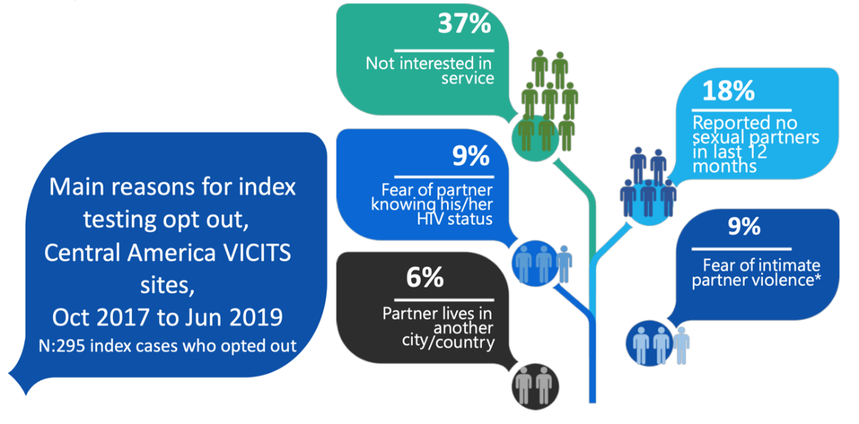
Example from PEPFAR/Central America
*Represents 3% of all index cases in the reported period.
Source: PEPFAR 2020 Guidance for Implementing Safe and Ethical Index Testing Services
Notes:
Say: As pictured in this slide, you may wish to develop a visualization that quantifies reasons for decline to allow site leadership, providers, and implementing partner staff to develop and prioritize solutions. Using continuous quality improvement measures, you can then gauge over time if changes in service provision have led to changes in uptake.

Slide 28
Steps for index testing
✔ | Introduce index testing services to index client during pre-test counseling or ART visit
✔ | Obtain consent from the client to proceed with index testing services
✔ | Obtain a list of sexual/injecting partners and exposed children under age 19 with unknown status
✔ | Conduct an IPV risk assessment for each named partner, and respond appropriately to any disclosures
✔ | Determine preferred method of partner notification for each named partner and record
✔ | Contact all named partners and biological children under age 19 using the preferred approaches
✔ | Record and track notification outcomes
✔ | Provide appropriate services to client, partners, and children
Safe and Ethical Index Testing Services
Compliance with minimum standards
Quality assurance and accountability
Obtain informed consent
Intimate partner violence risk assessment and service provision
Obtain informed consent
Adverse event monitoring and reporting
Notes:
Say: To summarize, this slide shows all the steps for index testing we have discussed in this training. While we did not have specific slides for Step 8, you discussed various referral services available here in [COUNTRY] in Sessions 6 and 10. The slide also shows how and when to ensure that the steps for safe and ethical index testing are applied. Compliance with minimum standards and continuous quality improvement are applied from the very first step. Consent is obtained first before proceeding with the client interview to obtain contacts, and for each contact and mode for partner notification where a provider is engaged (contract or client referral). And, adverse event monitoring is conducted throughout the client’s care after index testing services have been provided on subsequent visits (i.e., within 2-4 weeks of the index interview).

Slide 29
Session 15. Action planning Who will need to do what and by when to initiate index testing?
Notes:
This session should be customized according to the local context, who is in the room during this training, and what effectively can be accomplished in a planning session. For example, if the participants include government, and nongovernment (i.e., community-based) stakeholders who are all new to index testing, this session can be an effective means of planning who will do what to develop tools, job aids, and define the roles and responsibilities of each agency, department, donor, etc., with a specific date in mind for initiating implementation.
As there are significant sensitivities around notifying partners, including the potential for violence, it is important to have processes and guidance in place, as well as supportive services, before implementing the approach.
Regardless, this session can be used at minimum to make clear the role of the facilitating agency, or provide a platform for the government to make commitments to a national timeline. The following slide serves just as an example of the kind of table that can be used for this planning process.

Slide 30
What next?
Action | Lead | Supporting | Due date | Comments
Notes:
NOTE: Action planning could incorporate the use of the 7-step planning tool, which outlines specific activities/support/TA/resources necessary to achieve results.
The questions in the 7-step planning tool include:
Why are you organizing this activity? List objectives.
Who will need to be involved to successfully implement this activity?
When and where are you planning to implement this activity?
What kind of tools, materials, commodities, etc., do you have/need to successfully implement this activity?
How will you ensure the successful delivery of the activity in terms of services, finances, M&E, etc.?
What technical assistance will you need to successfully implement this activity?
Timeline: List the steps, with time frame, on how you will implement your activity.
Areas of focus could include: staffing and task shifting; tools on introducing index testing to both the index case and sexual partners; M&E tools and constructing a cascade; planning for the increased case load (linking PLHIV to treatment, support, referral to PrEP); and constructing the programmatic steps for implementation.

Slide 31
End of Day 3

