Slide 1
Index testing and risk network referral
Program implementation orientation and training
Day 1
City, Country YEAR
Notes:
NOTE: Include brief talking points by key representatives from government, donor, and/or implementing agencies as relevant.
Introduce yourself, welcome the participants to the room, and thank them for attending Day 1 of this training on index testing and risk network referral.
Note that you will be doing full group introductions shortly.
Before beginning, ask if everyone is comfortable with the room temperature and seating arrangements, or if anything needs to be adjusted.

Slide 2
Overview of sessions
 | Day 1 |  | Day 2 |  | Day 3
1 | Introduction | 8 | Client panel | 12 | Messaging
2 | Setting the stage | 9 | Building a localized index testing and RNR approach | 13 | Practice makes perfect
3 | Index testing in [COUNTRY] | 10 | Motivational counseling | 14 | Quality assurance, adverse event monitoring and reporting, and index testing MER
4 | Steps for index testing | 11 | Asking about and responding to intimate partner violence | 15 | Action planning
5 | Core principles and minimum standards
6 | Tools and flow for index testing
7 | Risk network referral (RNR)
Notes:
Say: We will be covering a lot over the next three days.
While the focus of the training is on index testing, we will also be discussing risk network referral, an approach that complements index testing.
On Day 2, we will start the day off with a panel discussion with PLHIV clients who have experienced index testing and who can help us learn from their experiences. We will then adapt the approaches we will discuss today to the [COUNTRY] context and learn about (or review) key motivational counseling skills to support these approaches. Finally, but importantly, we will learn how to ask about and respond to intimate partner violence and adverse events.
On Day 3, we will begin by adapting key messages to be used in our index testing approaches. Then we will spend a considerable amount of time introducing and counseling on index testing in role plays. Afterward, we will discuss how we can examine some basic data from our program to monitor the effectiveness of our index testing efforts in improving case finding. Finally, we will spend the last session creating a plan of action so that we are all clear on next steps, who will lead and support, and their timing.

Slide 3
Session 1. Introduction
Notes:
Say: In this session, we will be introducing everyone in the room, discussing the objectives for this training, going over training agreements, and conducting a brief exercise to mentally put aside anything that may be causing us stress.

Slide 4
Welcome and introductions
INSERT A RELEVANT LOCAL PHOTO HERE, SET BEHIND THE TEXT BELOW
Notes:
NOTE: Introduce yourself (the facilitator) again, if appropriate, and have the participants briefly introduce themselves. Consider the activity below (time permitting), or a similar activity.
Optional: Facilitate an interactive, physical activity to introduce each of the participants.
Option 1: Four corners of the room. Identify a category (e.g. favorite color), and list out four options, identifying each option with a corner in the room. Ask the participants to go to the corner that represents their preference. Repeat 5-10 times with other categories and options (e.g. foods, hobbies, dream vacations). Options can also be constructed as “what would you rather”, or as statements (e.g. I prefer to work: a) with a team, b) alone, c) sometimes with a team and sometimes alone, d) not to work at all). See example provided in training package. After a few rounds, have participants each introduce their name, organization, role and why they are in that “group”
Option 2. Ball toss. Ask participants to form circle. Demonstrate first by tossing the ball to someone and then telling them something about yourself that they didn’t know (could be anything, from your favorite food to what kitchen appliance/item you would be and why. Continue until all participants have introduced themselves.
Option 3. Line up. Identify a category and have participants line up in order (e.g. height, birthday month, # years working in HIV). Then have each participant introduce themselves from one end to the other.

Slide 5
Objectives
Orient
to index testing approaches, core principles, minimum requirements for implementation, and how index testing can be integrated with risk network referral
Examine
the benefits, barriers, and enablers for success
Review
existing protocols/guidelines, the roles of each key player, and the specific steps
Practice
introducing index testing with motivational counseling skills, and practice all steps
Review
monitoring and evaluation forms and requirements for index testing and monitoring for violence and/or adverse events
Prepare
a plan of action for further adaptation and rollout
Notes:
Say: The overarching goal of this training is to orient participants on recommended practices, core principles, minimum standards, and quality monitoring of index testing. We will look at how index testing approaches can be complemented with risk network referral to improve HIV testing uptake among those who are at highest risk to accelerate and achieve epidemic control. Will also spend some time discussing how to ask about and respond to violence, and how to monitor and respond to adverse events.
Ask participants if they have any questions or different expectations (adjust as needed before the training). Refer to the waiting room/parking lot flip chart where important comments and questions that are outside the workshop’s immediate focus/objectives will be recorded and addressed by the end of the workshop.
Be sure to revisit the objectives at the end of each day to determine progress and adjust as needed.

Slide 6

Agenda and agreements
Notes:
NOTE: Briefly review the agenda (focus on start times, breaks, meals, and plans for ending the day on time).
Brainstorm with participants what group agreements they would prefer to incorporate into the training and record them on a whiteboard or flipchart paper.
These might include respecting start, end, and break times; ensuring that cell phones and computers are used only outside of the workshop room; honoring other people’s opinions with respect; avoiding sidebar conversations, etc.
Ask if everyone feels comfortable with the rules.
Ask the participants if they are comfortable if you (facilitator) adjust the agenda as needed to accommodate the natural pace and learning of the group (the agenda is a guide). Respond to questions or concerns.
Ask if there are any specific goals or expectations the group has outside of the training, and include them on the “Parking Lot” flipchart page.

Slide 7

Notes:
Optional: Ask the participants to think about something that is weighing down on them, causing stress, or distraction.
Ask each person take a minute or two to write down on a piece of paper or notecard. whatever issue(s) may be concerning them.
After everyone has finished writing down their issue(s), ask them to fold their paper in half or quarters, and place it somewhere in their bag to be saved for later.
There is no specific follow-up for this activity; it can serve as a way of helping people turn their attention to the training.

Slide 8
Session 2. Setting the stage: History and evolution of index testing, terminology, and evidence
Notes:
Say: In this session, we will briefly introduce index testing, and discuss the origin, terminology, and evidence supporting the approach.

Slide 9

Disclaimer
Notes:
Say: It is important to note that index testing and risk network referral are not new concepts, as we will discuss shortly.
The intention of this workshop is to build on existing experience in case finding and introduce or improve approaches that prioritize and protect the safety of PLHIV and their partners while promoting case detection and linkage to care and treatment. The goal of these approaches is to help achieve epidemic control safely.

Slide 10
Insert one or two slides / graphics here to rationalize the need for index testing based on the country’s epidemiological context/data
Graphics might include
  National data on gaps in testing, ART coverage, and/or viral load suppression (i.e., 95-95-95)
  Strategies or priorities related to testing and linkage to treatment
Notes:
NOTE: Using available national data, demonstrate existing gaps in testing, ART coverage, and viral suppression, to help set the stage / rationale for an approach designed to improve case finding.
Note that because HIV testing is the entry point into the continuum of HIV services, programs will need to innovate and/or employ new evidence-based approaches to address these gaps. One way of doing this is to engage directly with existing clients who are living with HIV.

Slide 11






Index testing is a case-finding approach that focuses on eliciting the sexual or needle-sharing partners and biological children of HIV-positive individuals and offering them HIV testing services. Index testing is a completely voluntary service offered to people living with HIV, and they are free to accept or decline.
Index Client
Sexual partners
Injecting partners
Biological children
Notes:
Say: is a case-finding approach that focuses on eliciting the sexual or needle sharing partners and biologic children* of HIV-positive individuals and offering them HIV testing services. Index test is a completely voluntary service offered to people living with HIV and they are free to accept or decline this service
*Per COP20, PEPFAR is prioritizing the scale-up of index testing of biological children, including children of mothers living with HIV and, if the mother’s status is unknown, children of biological fathers.
NOTE: Highlight key words such as “voluntary”, “list and refer”, and ask why sexual and injecting partners and biological children might be the focus of index testing.
By ”elicit”, we mean allowing the index client to voluntary consent to provide the names and contact information (if available) of all individuals that fit the criteria as sexual partners, injecting partners, and/or biological children. We will discuss later in the training what to do with contacts who may pose a risk of violence for the client.
By ”refer”, we mean either contacting those individuals that they may have been exposed to HIV infection and referring them for testing, or working with someone such as a provider who can provide them that information and offer them a test, based on the modality agreed up on with the client and with the client’s consent.
The goal of index testing is to break the chain of HIV transmission by offering testing to anyone who has been exposed to HIV and linking them to HIV treatment, if positive, or prevention services including PrEP, condoms, and circumcision (where relevant), if negative.
Note that index testing should include biological children of mothers living with HIV as a way to diagnose children who were not identified through PMTCT/EID.
We will talk in detail about the specific approaches recommended in this training.

Slide 12

Index testing is sometimes referred to as:
partner notification
contact tracing
partner referral
other?
Notes:
Say: There are several different terms used to refer to the process of working with an existing HIV+ client to notify their partners of HIV exposure and encourage them to test.
In [NAME OF COUNTRY/REGION WHERE YOU ARE TRAINING], it is often referred to as [LOCAL TERM].
In order to avoid any confusion, we can take some time now to ensure everyone feels comfortable with the term index testing, and what it means. What is the best way to refer to index testing here in [COUNTRY]?

Slide 13
Steps for index testing
Introduce the concept of index testing during pre-test session or PMTCT/ART visit.
Offer index testing as a voluntary service to all clients who test HIV positive and are virally unsuppressed.
If client accepts participation, obtain consent to inquire about their partner(s) and biological child(ren).
Obtain a list of sex and needle-sharing partners and biological children <19 with unknown HIV status.
Conduct an intimate partner violence (IPV) risk assessment for each named partner.
If client consents, determine the client’s preferred method of partner notification or child testing for each named partner/child.
Using preferred approach, contact all named partners and biological children <19 with unknown status.
Record outcomes of partner notification and family testing.
Provide appropriate services for children and partner(s) based on HIV status.
Follow up with client to assess for any adverse events associated with index testing.
Notes:
Say: These are the steps for index testing. We will go into detail about each of these steps as we progress through the training, including the different ways that a client might decide to notify a potential partner that may have been expose to infection.
The steps for index testing are as follows [describe the steps as listed].

Slide 14
NOT a new concept
Used for decades for sexually transmitted infections and tuberculosis
Employed for HIV primarily with general populations, but recently with key populations
Already part of post-test and ART counseling in many countries
Notes:
Say: Although it might seem like index testing is a new concept, it has been a public health approach for many years, including for tracking sexually transmitted infections and individuals who may have been exposed to TB.
More recently, given reduced resources and the need to achieve higher yields), index testing has been employed to focus HIV testing on those most at risk, including sexual and drug-injecting partners of PLHIV clients, and their children.
Many countries already have index testing as part of their national HIV testing and treatment protocols, but the language and guidance may not be tailored to key populations.
Ask the participants why key populations might need tailored guidance. Avoid spending too much time on this discussion as there will be a group activity to explore special considerations for KP and index testing later in the day.

Slide 15
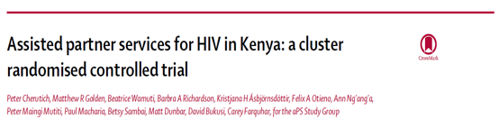

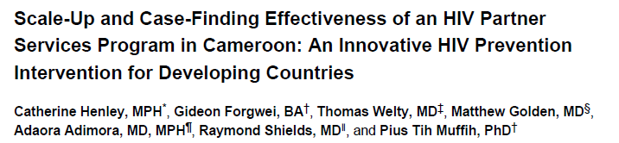

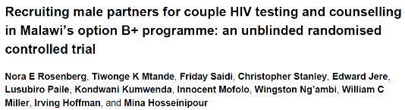
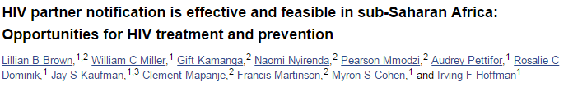
Several trials have demonstrated that index testing can increase uptake of HIV testing and identify partners with undiagnosed infection with no reports of serious intimate partner violence.
Notes:
Say: There have been several scientific studies showing that index testing—when done correctly—can lead to more timely case detection, but much of the research has focused on the general population. There are also some studies showing that index testing is safe, acceptable and effective among KP.

Slide 16
Index testing led to identification of multiple new cases in Vietnam
-
-
-
-
-
Client A
-
Client B
Client E
-
+
-
-
-
+
+
Client D
Client C
-
+
-
-
-
+
-
-
One index case linked to 9 PLHIV in the network: (10 HIV+/26 tested = 38% case detection rate)
Notes:
Say: This graphic from a program in Vietnam shows how a client who agreed to index testing services (Client A in the center) helped the program identify four more individuals who had injecting or sexual contact with the client and were also living with HIV (Clients B through E).
Each one of the four partners also agreed to index testing services, and as a result, an additional five individuals living with HIV were identified.
In all, including the first client, a total of 26 people agreed to a test. 10 were living with HIV, which represents a 38% case detection rate.
What might be the advantage of referring sexual and drug using contacts of the index clients who end up testing negative?
POSSIBLE RESPONSE: Those individuals are practicing high risk behaviors through their contact with the index client, and therefore, will benefit from prevention services and being part of the program.

Slide 17
High proportion of new HIV infections are among key populations and their partners
GLOBAL = 54%
LOCAL COUNTRY = 68%
Source: UNAIDS 2019
Notes:
NOTE: The purpose of this slide is to help demonstrate quantitatively the need for testing and linkage to treatment among key pops in the country where you are training. The pie chart on the right should be edited to reflect data from local country where training is taking place. The percentage in RED will also need to be adjusted. The pie chart on the left may need to be adjusted if UNAIDS has more recent data.
Say: So why might there be a strong push for index testing here in [NAME OF COUNTRY]?
The chart on the left, based on 2019 UNAIDS data, shows that globally, over half of new infections are among KP and their sexual partners.
In [NAME OF COUNTRY], that statistic is XX%.
Donors, policy makers and implementing partners including PLHIV and KP-led groups are searching for more effective and efficient case finding strategies, especially among populations who are most at risk of infection.

Slide 18

Summary of evidence on index testing
Effective at increasing HIV testing and early diagnosis
PLHIV-led referral usually preferred, especially with steady partners
Importance of options
Must be voluntary and protect client safety
Notes:
Say: In summary, current findings suggest that index testing is effective at increasing HIV testing and early diagnosis which, in turn, helps PLHIV get treatment and other care that they may need.
While PLHIV index clients prefer to contact their partners themselves as an option (compared to having the provider contact the partner), provider-led referral is more effective at bringing in partners for HIV testing. We will talk later about the different kinds of assisted index testing approaches.
As we will repeat frequently throughout this training, index testing must be voluntary and informed.
In addition, there can be serious risks for clients, including intimate partner violence or even death, in situations where index testing is not conducted according to standards or when client preferences and needs are ignored.
No client should ever be forced or coerced into identifying and referring their partners or disclosing their HIV status.
We will discuss the Core Principles and Minimum Standards required for implementing index testing in Session 5.

Slide 19
OPTIONAL
Session 3. Index testing in [COUNTRY]—
Local perspectives
Notes:
Say: The purpose of this session is to help orient you to index testing policies in practice in [COUNTRY].
We will be discussing the specific options for index testing over the next few days.
NOTE: This is optional and can be facilitated by a representative of the Ministry of Health, AIDS Commission, or other governmental or civil society group familiar with current index testing status and policy in the country. The training facilitator can also review the information directly (based on local input). Work with the local government or other representative in advance to ensure their presentation does not go into detail about the methods and approaches to index testing, because this information will be covered in later sessions. This session allows local representatives to help assure participants that there is a policy/platform for the skills/approaches they will be learning, or that one will be developed along with the adaption of global models for this country.

Slide 20
OPTIONAL: Country representative slides (1-2)
Insert slides providing an overview of the current policy for index testing in [COUNTRY] and the role of community-based organizations (as relevant)
NOTE: Slides should not depict the specific steps of index testing, because these will be covered in the next session

Slide 21
Session 4. Steps for index testing
Notes:
Say: The purpose of this session is to help orient you to the four options for index testing, and to address some important considerations in offering these services.

Slide 22

1. Introduce client to index testing
During pre-testing counseling or ART visit
2. Offer index testing as a voluntary service to all clients who test HIV positive and are virally unsuppressed
3. If client accepts, obtain consent to inquire about partners and exposed children
You have many options for referral…
… we want to be sure you are not at risk…
….the choice is always yours at all times.
Index client
Individual newly or previously diagnosed HIV positive, ideally enrolled in HIV treatment services
Provider
Notes:
NOTE: Advance the animation in the slide and the following slides as appropriate while using the talking points below.
Say: In index testing, it is important to note who is involved in the process. In the next series of slides, we will discuss the first three steps of index testing.
We begin with the index client, who is either newly diagnosed HIV positive, or who is currently living with HIV and ideally enrolled in treatment services.
It’s important to orient the client to what index testing is, to discuss the client’s options, and then obtain consent to proceed with the options the client chooses for each of the different contacts the client provides. We will talk more about consent and confidentiality in Sessions 5 and 6.

Slide 23
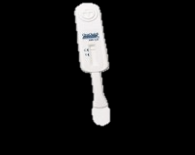






4. Obtain a list of sex and needle-sharing partners and biological children
5. Conduct IPV assessment for all named partners and children
6. Determine preferred notification method for each partner and child
7. With client consent, contact partners and children
With client consent, screen for IPV risk for each contact, then individuals are:
Contacted based on the preferred method
Informed they have been exposed
to HIV
Offered voluntary HTS
Index client
Individual newly or previously diagnosed HIV positive, ideally enrolled in HIV treatment services
Index testing:
HCW/counselor asks index client to list all:
Sexual partners within past year
Drug-injecting partners (ever)
Children <19 with unknown status
Notes:
NOTE: Advance the animation in the slide as appropriate while using the talking points below.
Say: As we noted previously, there are a variety of opportunities to invite clients to refer their:
- Sexual partners within the past year
- Drug-injecting partners (ever)
- Biological children (of mothers living with HIV)
We will discuss those options in a moment.
It is important to obtain the client’s consent for each method chosen for each contact the client has listed. In the case of children, parental consent as required per local law should be obtained. (This will be discussed later in the training).
With the client’s consent, the provider can then inform contacts that they have been exposed to HIV and offered testing services. Testing can take place in whatever form is available, including at a facility, in the community, and/or using assisted or unassisted self-testing approaches.

Slide 24


Determining a preferred method for partner referral
Client (passive) referral
Provider (active) referral
Contract referral
Dual referral
Notes:
Say: Clients can choose from four partner referral options: client referral (which is also sometimes called passive referral), provider referral, contract referral, and dual referral.

Slide 25
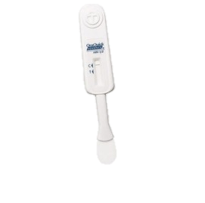


Index testing: Client (passive) referral
Index client directly encourages their partner(s) and biological children to come to the facility for a test or meet a counselor in the community to screened.
Notes:
Say: Some clients will prefer to disclose to one or more sexual and/or drug using partner directly. In this case, they agree to notify those individuals themselves, and encourage them to test. They might need coaching on how to disclose, depending on the type of partner. Other clients will invite their partner for testing without disclosing their own status. Disclosure is not required. For example, the client could invite the partner for couples testing and counseling.
Client referral is most common for biological children, given the need for parental consent for testing of children. the index client could bring their children
What could be some options for accessing testing?
NOTE: Elicit responses based on all available testing options in country and be sure to include community-based or self-testing options if available.

Slide 26
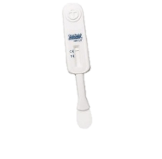

Index testing: Provider (active) referral
Counselor or other health care provider calls or visits the index client’s partner(s) and recommends that they test for HIV.
Notes:
Say: In some cases, a client may prefer not to disclose directly to a partner. This may be because they are too nervous or afraid of that contact’s initial response. They may have concerns about potential harm that this person could cause them. In provider/active referral, the provider agrees to call or visit the index client’s partner and then either refer them to testing or provide it directly. Unless the client consents to be referenced, the provider must not disclose the client’s name or HIV status.

Slide 27


Index testing: Contract referral
Index client and counselor work together to refer index client’s partner(s).
They agree on a time (e.g., within 31 days) in which the client will tell partner(s). If client does not tell within agreed time, counselor contacts partner(s).
Notes:
Say: You may have a client who is nervous about directly referring a partner, and just needs some time. One option is to come to an agreement with your client. With the contract referral option, you and the client agree on a certain amount of time that your client can take to refer their partner(s), such as one month. The client then has that amount of time to make the referral. As part of the contract, if the client does not refer their partner(s) by the end of the contract period, then the provider (you) have the right to contact the partner directly.
However, if at any time the client indicates that they do not want you to contact the partner, especially in potential cases where violence can result, you must maintain the client’s confidentiality, safety, and security.

Slide 28



Index testing: Dual referral
Counselor/provider sits with index client and partner(s) to support index client in telling partner(s) about HIV status (if they choose to disclose); or provides a safe space for testing together.
Notes:
Say: Dual referral allows for in-person support for the client to disclose to their partner(s). In this case, the provider and client agree when and where the provider will join the client and their partner to discuss the client’s HIV status, and the implications for the partner. The provider can then either refer the partner, or provide testing services at that time, if the partner chooses.
In situations where a client would like to refer his/her partner, but does not want to disclose directly, providers can also offer to test the index client (again) with his/her partner (on the same visit). The index client and provider agree that they will not talk about the initial test when the index client and his/her partner come for services, and the provider counsels and tests both. This approach has been used successfully to provide a safe space and an alternative way that an index client can reveal his/her status to his/her partner and ensure both have been tested.
Before we move on, do you have any questions about these different options?

Slide 29
8. Record outcomes of partner notification and family testing
9. Provide appropriate services for children and partner(s) based on HIV status
10. Follow up with client to assess for any adverse events associated with index testing
Important considerations
Offer index testing continuously and strategically to:
  PLHIV who are not on treatment
  PLHIV who are not virally suppressed or have acute infection
Assess client safety, security, readiness, and consent
Ensure that program has available services for clients, partners, and children
Notes:
Say: It is important to note that index testing is not a one-time event. Each person living with HIV processes and accepts their diagnosis at a different pace, and their readiness to discuss with and/or refer their partners and others who may be at risk in will differ.
Introducing index testing during outreach and at pre-test counseling will help orient beneficiaries to the service and may increase the likelihood that they opt in.
Repeating the offer of index testing when a client is diagnosed with HIV, at ART initiation, and during follow-up visits (without coercion) will increase opportunities to promote index testing, and also offer clients a chance to decide for themselves when they are ready. It may increase the chances of successful referrals.
Not all individuals referred will be members of key populations. It will be important to consider how many people might be referred as a result of index testing and where clients and their partners and children can go for support, including accessing free HIV testing, and prevention, care, and treatment services.
We will go into greater detail on Step 6. Recording and tracking outcomes, and Step 7. Provision of appropriate services in Sessions 6 and 10.

Slide 30
Session 5. Minimum standards for safe and ethical index testing
Ensuring a safe environment for index testing
Notes:
Say: In this session, we will discuss some of the benefits and potential risks and barriers to implementing index testing services for key populations. We will also discuss the critical elements of an index testing approach that ensure the safety and security of key population clients and their partners.

Slide 31

True or False?
Key populations are generally at the
same risk of violence as everyone else.
It is OK to notify an index client’s sexual partner of their risk of infection without the index client’s consent if you don’t mention the index client’s name.
Index testing can be introduced during outreach as well as pre-test counseling.
Index clients have a responsibility to refer their partners and friends.
Index clients should be informed of the HIV status of the partners they refer.
Notes:
NOTE: Begin with a short quiz/energizer to get the participants thinking about ethical considerations in conducting index testing.
Ask the participants to stand up.
Say: I will read five statements and for each statement, I would like you to decide if the statement is true or false.
If you think a statement is true, please go to the left side of the room [point]. If you think it is false, please go to the right side of the room [point]. It’s ok if you are not sure; if you prefer, you can stay in the middle.
Read each statement one by one as you advance the slide with each bullet, and give the participants time to decide (with their feet). Then ask the participants to return to their seats and advance to the next slide. You do not need to discuss the answers now, because you will conduct the quiz again at the end of the session to see if the group understood the messages in this session.
ANSWERS are provided on the last slide of this session.

Slide 32

Activity: In the context of key population programming….
Break into five groups
Assign a facilitator to remain at each flipchart station throughout the exercise
Discuss and record on flip chart:
  What aspects of the topic might help achieve index testing goals, or hinder achievement?
  What might be some barriers to success?
  What can be done to prevent or address the barriers?
5 minutes per station, then groups rotate (facilitators stay)
Can add to or disagree with previous group notes
Notes:
NOTE: Prepare five flipcharts in advance of this session and label the flipcharts separately with the following: 1) Confidentiality; 2) Safety; 3) Stigma; 4) Disclosure; 5) Legal issues. Place the flipcharts in different parts of the room.
The purpose of this activity is to get the participants thinking about the special considerations for index testing among key populations in order to help ensure the safety, security, and confidentiality of the clients they serve.
Ask each group to meet under a different flip chart, and then explain that they will be spending about 5 minutes per station responding to the three questions on the slide. They are welcome to add to or disagree with any of the previous statements.
Allow the groups 25 minutes to get through all five flipcharts, prompting them to rotate every 5 minutes. Then ask them to return to their seats. You will be discussing their findings throughout the remainder of this session.

Slide 33

Potential benefits?
Increased uptake of HIV testing among partners of PLHIV
Increased case finding
Earlier diagnosis
Improved and earlier linkage to care and treatment
Safer disclosure and/or links to violence services for those who disclose abuse
Reduced transmission among serodiscordant couples
Prevention services for partners
Notes:
NOTE: Before advancing the bullets in this slide, ask the participants to share what they think could be the benefits of index testing, using the script below, then use the bullets on the slide to add any additional points that were not covered.
Say: You have just spent a few minutes discussing some of the critical enablers and barriers to conducting safe and effective index testing. We will be discussing your findings throughout the remainder of this session. Based on your understanding of index testing so far, what do you think might be the overall benefits of index testing from an epidemiological, social, and/or other standpoint?

Slide 34
Potential barriers and risks
There is no such thing as zero risk; all HIV testing programs involve some risk, including …
Violence
Rejection
Criminalization
Forced disclosure
Confidentiality breach
Sacrificing quality for case finding
Notes:
NOTE: Before advancing the bullets in this slide, ask the participants to share what they think could be the potential risk of index testing using the suggested script below.
Say: Based on the issues you raised in your group work, what might be some of the potential barriers or risks in conducting index testing?
Allow the participants some time to respond.
Say: Based on the barriers/risks you raised, what might you be able to do to mitigate or reduce these risks?
Look for suggestions such as: integrate violence screening and referral; link clients to disclosure counseling if necessary; use motivational counseling techniques to create a supportive and safe space for the client to make an educated decision.
Display the list after several ideas have been shared.
Ask the participants if they have any questions or comments (avoid lengthy debate on specific topics, as you will go into further detail in subsequent slides).
ADDITIONAL POSSIBLE BARRIERS:
Trauma due to diagnosis
Fear reaction of partner(s)
Guilt about having put partner or children at risk
Doubts about confidentiality; think partner(s) will know that he/she gave the information
Anger over probable source of infection
Lack information about index testing services and ways to tell exposed individuals
Ignorance of the benefits of index testing services
Poor communication skills
Unwillingness to spend time, money, and energy to tell partner(s)
Don’t care about past partners (angry, depressed, unwilling to notify – infidelity)

Slide 35
1.
Monitor compliance with minimum standards
Safe and Ethical Index Testing Services
5.
Quality assurance and accountability
2.
Obtain informed consent
4.
Adverse event monitoring and reporting
3.
Intimate partner violence risk assessment and service provision
Notes:
Say: In response to community and client concerns about safe index testing, PEPFAR suspended index testing among key populations and conducted a thorough and participatory review and revision of index testing minimum standards. PEPFAR required all sites implementing index testing to complete a survey (RedCap) to assess compliance with minimum standards and to identify areas for improvement.
All PEPFAR-supported programs should take steps to implement safe and ethical index testing services by:
Monitoring site and provider-level compliance with minimum standards for index testing
Obtaining informed consent prior to the elicitation interview and before contacting partners
Conducting an IPV risk assessment for each named partner and providing appropriate services for clients experiencing violence
Implementing a robust mechanism for detecting, monitoring, reporting, and following up on any adverse events associated with index testing services
Utilizing quality assurance and accountability to remediate any gaps in the provision of index testing services

Slide 36
1.
Compliance with Minimum Standards
Adherence to 5 C’s
  Consent, Confidentiality, Counseling, Correct test results, and Connection to prevention/treatment
IPV risk assessment and first-line response
  Including safety check and referrals to clinical/nonclinical violence response services
  (if not provided on site)
Site-level adverse events monitoring and reporting system
Providers trained and supervised on index testing procedures
  5 C’s, IPV screening, adverse event monitoring, and ethics (respect for the rights of clients, informed consent. and ‘do no harm’)
Source: PEPFAR 2020 Guidance for Implementing Safe and Ethical Index Testing Services
Notes:
Say: In response to feedback from community-based organizations and stakeholders working in HIV, the US Government’s Office of the Global AIDS Coordinator PEPFAR established a set of minimum standards for safe and effective delivery of index testing services.
It is important that providers know and understand the 5 C’s.
Can anyone tell me what the 5 C’s are?
Allow the participants an opportunity to provide inputs, then continue. It is no coincidence that they are listed in plain view for participants to see ☺.
NOTE: The use of 5 C’s may not translate well in a language other than English, and the script here may need to be adjusted for the local context. It is more important that the participants understand the concepts, as opposed to trying to maintain the English language equivalents.
Say: In addition, it is important for programs to ensure that providers are able to adhere to the 5 C’s, and that they have the capacity and resources both to ask about potential violence, and respond appropriately, including referral to essential services.
We will talk more about IPV and adverse events in Session 11.
Finally, we must ensure that all providers who will conduct index testing have been thoroughly trained on:
the provision of intimate partner violence screening and adverse event monitoring; and
ethics, including respecting the rights of clients, obtaining informed consent both for provision of partner contact information and for the method in which those individuals are reached—the key principles of ‘do no harm’.
Any questions before we continue?

Slide 37
The 5 C’s and the Core Principles of HIV Testing
Adhere to the 5 C’s
  Confidential
  Consent
  Counseling
  Correct test results
  Connection to services
And to the Core Principles
Core principles of HIV testing
Client centered and focused
Confidential
Voluntary and non-coercive
Free
Nonjudgmental
Culturally, linguistically appropriate
Accessible and available to all
Comprehensive and integrative
Source: PEPFAR 2020 Guidance for Implementing Safe and Ethical Index Testing Services; & WHO
Notes:
Say: As discussed on the previous slide, index testing must meet the 5 C’s. In addition, it should adhere to universally recommended core principles for all HIV testing services shown on the right of the slide.
As you can see, there is some overlap between the 5 C’s and the Core Principles. What do you see in the Core Principles that is an addition to the 5 Cs’?
Allow the participants a few moments to respond.
Say: Is it possible for us to implement index testing services here in [COUNTRY] and adhere to all of these principles? If not, what are the obstacles, and what are some possible solutions?
Allow the participants a few moments to respond. Be sure to record their responses on flipchart paper and review the inputs at the end of the training. As with other sessions during this training where challenges and solutions are discussed, it is important to acknowledge the inputs of the participants and ensure them that in your role as a facilitator, you will compile them and provide them to an individual who can raise them in an appropriate forum (strategic planning session, taskforce, technical working group,

Slide 38

Sample
Patient Bill of Rights
At this health facility, you have the right to receive medical services that are:
Voluntary (You should be given information about the benefits and risks of the services and treatments offered at this clinic so you can make informed decisions. You can say no to any service or medical test that you do not want to receive.)
Free from Coercion (Refusing one service or declining to participate in partner notification activities will not affect your right to receive any other health care service at this facility.)
Delivered in a Nondiscriminatory Manner (You should be treated as an individual with respect and dignity. You should not be discriminated against based on your age, gender, sexual orientation, or any other personal characteristic.)
Safe (You should not feel threatened, harassed, or harmed as a result of the services you received.)
Of High Quality (All services should meet national standards.)
Confidential (Your personal information should be kept private and secure and not shared with anyone outside of the health care team.)
You have the right to make a complaint if you feel that the services you received at this facility have not met these rights.
To make a complaint, please complete the Patient Complaint Form and place it in the secure drop box by the registration desk. You can also call the Community Advisory Board at XXX-XXX-XXX. They can make a complaint on your behalf if you do not feel comfortable doing so on your own.
Notes:
Say: One way of helping providers, administrative staff, and clients know, remember, and uphold clients’ rights is to post a ‘patient bill of rights’ in large print at a place where clients and providers can easily see it within the site or facility. On the right of this slide is an example of a bill of rights.
What rights do you see are emphasized in bold?
Allow the respondents a few moments to respond.
Say: It is important that teams providing services, including receptionists, custodial staff, and guards, fully understand these rights. At minimum, site leadership should hold a meeting for all staff to review them, ensure they are understood, discuss possible scenarios, address any questions, and ultimately have each staff member sign a statement agreeing to uphold them.
An example of a confidentiality statement and this sample patient bill of rights are provided with this training package.

Slide 39

Index clients should be informed of and understand…
Purpose of index testing
What will happen, by whom, where
It’s voluntary; they will still have access to other health services if they decline
Different options available for notifying partners
Potential risks and benefits; how to minimize risks
How and to what extent privacy and confidentiality can be protected
Where support services are available; how to contact and access those services if needed, particularly if harm is experienced
2.
Obtain informed consent
Notes:
Say: What do we mean by informed consent, and why is it important?
Allow the participants a few moments to respond to the question.
Then go through the bullets on the slide sequentially to explain what clients should be aware of. Note that you will discuss each of these in detail when you adapt the index testing approaches in a later session.
Emphasize that consent (yes/no) is not enough; the client needs to make an informed decision based on sufficient information and understanding.
Examples of language per referral method include:
Contract referral, “I plan to tell my partner about my HIV and refer him (or her) to this facility (or site) for HIV testing within 14 days of today’s date. If I am unable to do this within 14 days, I give permission for the counselor to telephone my partner and offer them an HIV test. I understand that while all services are confidential and my partner will not be given my name, there is a risk of accidental disclosure or that my partner will attempt to guess my identity.”
Provider referral, “I give consent for the counselor to telephone (or visit) my partner and offer them an HIV test. I understand that while all services are confidential and my partner will not be given my name, there is a risk of accidental disclosure or that my partner will attempt to guess my identity.”

Slide 40
Consent among children and adolescents
Providers of index testing must always follow their country’s guidelines on age of consent as stated in the national HTS guidelines.
When an older child or adolescent meets the national age of consent, they must receive age-appropriate pre-test counseling.
HIV testing counselors should always communicate with children/adolescents in ways that are appropriate to their age and level of maturity.
When a child/adolescent is not of the age to provide consent for testing, providers must obtain their parent’s consent after providing appropriate pre-test information/counseling to them on the importance of knowing the HIV status of their biological child.
Notes:
Say: There are special considerations for obtaining consent from children and adolescents that are influenced by local law and policy as well as culture and social norms.
Review the considerations and ask participants if they have additional points or if they have questions or concerns about any of the bullets on the slide.
Refer participants to the resource “Maximizing Coverage of Index Testing among Biological Children of Mothers Living with HIV: Standard Operating Procedures” prepared by the Pediatric and OVC Interagency Team at PEPFAR.

Slide 41
Small-group activity: Case study
Example 1.
Bojak is a counselor who works at a district health center. He is well respected by the MSM community. One day, one of his PLHIV clients agrees to index testing and provides a list of contacts. The client agrees to contract referral for his wife, but he does not feel comfortable notifying his male sexual partner at the moment, because he is worried that his partner may do something harmful to him. Bojak happens to know the client’s sexual partner well and thinks he can prevent the partner from doing anything harmful. Bojak asks the client to let Bojak contact the partner and assures the index client that everything will be ok.
Does this approach meet the Minimum Standards and Core Principles? Why? Why not?
Notes:
Say: Let’s look at a couple of case studies to explore these issues further. Please find a partner near you, read the case study together, and spend about 3 minutes discussing the questions on the slide.
Allow the groups to work together for about 5 minutes.
Say: Based on this example, do you think that Bojak’s approach meets the Minimum Standards of index testing and the Core Principles of HIV testing? Why, or why not?
Allow the participants a few moments to respond.
CONSIDERATIONS:
Bojak sounds like a hard-working nurse/counselor who wants the best for his client. He has offered to go out of his way to help make sure that his client is safe. However, what if something goes wrong, beyond Bojak’s control?
While this approach is well meaning, it is not entirely focused on the client’s wants and needs, and further, it has the potential for causing harm. The client is much more likely to understand his own risks from his male partner than Bojak.
It is critical for index testing services to be client centered, voluntary, and non-coercive.
Say: What could Bojak have done differently?
Allow the participants a few moments to respond and affirm answers that are in line with the Minimum Standards and Core Principles.

Slide 42
Plenary activity: Case study
Example 2.
Ghislaine manages an HIV/STI clinic that provides specialized services for key populations. She learns that index testing can be highly effective at increasing case finding, and she decides to create an incentive program to encourage people to offer contacts for index testing. For all key population clients who offer at least one contact for index testing, the clinic provides a transportation allowance. Clients who refuse to offer a contact do not receive the allowance.
Does this approach meet the Minimum Standards and Core Principles? Why? Why not?
Notes:
NOTE: Ask one of the participants to read the example on the slide or have them read it on their own for a minute.
Say: Based on this example, do you think that Ghislaine’s approach meets the Minimum Standards of index testing and the Core Principles of HIV testing? Why, or why not?
Allow the participants a few moments to respond.
CONSIDERATIONS:
This is a challenging question. One could argue that risk-network referral rewards people who refer individuals within their risk networks to HIV testing, including people with home they may have had sexual contact or shared needles. However, referring someone for testing is different than agreeing to have someone contacted who may be at risk for HIV infection because of their relationship to the index client. In this example, Ghislaine’s approach does not entirely embrace the principles of being voluntary, noncoercive, and nonjudgmental because clients may feel pressure to list contacts or otherwise lose possible benefits, and/or experience stigma/judgment from their providers or from themselves.

Slide 43
What does consent look/sound like?
Contract referral
I plan to tell my partner about my HIV and refer him/her to this site for HIV testing within 14 days of today’s date. If I am unable to do this within 14 days, I give permission for the counselor to telephone my partner, tell them that they may have been exposed to HIV, and offer them an HIV test. I understand that all services will be confidential, and my identity will not be revealed to my partner.
Provider referral
I give consent for the counselor to telephone (or visit) my partner, tell them that they may have been exposed to HIV, and offer them an HIV test. I understand that all services will be confidential, and my identity will not be revealed to my partner.
Source: PEPFAR 2020 Guidance for Implementing Safe and Ethical Index Testing Services
Notes:
Say: Here are a couple of examples of what a client could say, or read and sign, that would constitute consent for a provider to contact their partner through contract or provider referral.
Ask a participant to read the first paragraph on the slide, and then ask another participant to read the other.
Ask if the participants have any questions.

Slide 44

What do we mean by voluntary and noncoercive?
Index testing is a completely voluntary service offered to people living with HIV to support them in getting their partner(s) and children tested for HIV.
Index testing should be client centered and focused on the needs and safety of the index client and their partner(s) and children.
All HIV testing clients, including index clients, should be provided with all available HIV prevention, care, and treatment services, regardless of whether they provide details about their partners or not.
Services may NEVER be withheld under any circumstances.
Clients may NEVER be pressured into sharing the names of their partner(s).
Clients should be informed of their right to decline participation in index testing services throughout the process, not just during the elicitation interview.
Clients may opt out of index testing services FOR ANY OR NO REASON. Clients do not need to provide a reason for not participating in index testing services.
Source: PEPFAR 2020 Guidance for Implementing Safe and Ethical Index Testing Services
Notes:
NOTE: Before advancing the bullets, ask the question in the script below. Then, review the points on this slide if they have not yet been discussed in this session.
Say: What do we mean when we say that index testing services should be voluntary and noncoercive?
Allow the participants some time to provide answers. Then advance the bullets using the script if the points have not already been discussed.
Say: It is important for index testing to be client centered and focused on the needs and safety of the index client and his or her partner(s) and children.
In addition, no services should be withheld from clients under any circumstances, nor should clients be pressured into sharing names of partners out of a concern for being denied services.
Clients should also be made aware that they can decline participation in index testing, or opt out, at any time.

Slide 45
Small-group activity: Case study
Example 3.
Tupac, a FSW, provides counseling and testing services at a community-based organization for sex workers. One of her counseling clients, Shakur, recently tested positive. On a follow-up visit, Shakur agrees to provide contact information for three of her regular clients. One of the clients is the boyfriend of Tupac’s friend, Amaru. Concerned for her friend’s health, Tupac decides to tell Amaru that she may have been exposed to HIV through her boyfriend.
Does this approach meet the Minimum Standards and Core Principles? Why? Why not?
Notes:
Say: Please go back into your pairs, read the case study, and spend about 3 minutes discussing the questions on the slide.
Allow the groups to work together for about 5 minutes maximum.
Say: Based on this example, do you think that Tupac’s actions meet the Minimum Standards of index testing and the Core Principles of HIV testing? Why, or why not?
Allow the participants a few moments to respond.
CONSIDERATIONS:
Tupac clearly wants to take care of her clients and her friends, and to help reduce HIV transmission in the community. She is right to be concerned about Amaru’s health and well-being. But what could the potential harms be if she informs Amaru that her boyfriend may have given her HIV? What if Amaru’s boyfriend decides to harm Shakur in some way?
Say: What could Tupac have done differently?
Allow the participants a few moments to respond and affirm answers that are in line with the Minimum Standards and Core Principles.

Slide 46

What do we mean by confidential?
Confidentiality = protection of personal information
Both the confidentiality of the index client and all named partners and children should be maintained at all times.
The name of the index client should never be shared with the partner and the partner’s HIV status should never be shared with the index client (unless consent is obtained from both parties).
Programs MUST have confidentiality protections in place prior to the start of index testing services (including safe storage of data).
Full information about the potential risk for unintended disclosure of the client’s identity MUST be discussed with the client as part of obtaining informed consent for index testing services.
Source: PEPFAR 2020 Guidance for Implementing Safe and Ethical Index Testing Services
Source: https://images.app.goo.gl/gawMhQQTLEHs5MsB8
Notes:
NOTE: Before advancing the bullets, ask the question in the script below. Then, review the points on this slide if they have not yet been discussed in this session.
Say: What do we mean when we say that services must be confidential?
Allow the participants a few moments to respond, then advance the bullets as you move through script below.
Say: Confidentiality means protection of personal information. It is important to note that confidentiality extends beyond the index client and must include all partners or children named as well.
As providers (and other staff working at sites that offer index testing), we also need to ensure that index client names are never shared with partners who are notified, and that partner HIV status is never shared with index clients (unless consent is obtained from both parties).
How can we ensure that this happens?
Allow the participants a few moments to respond.
Say: All programs must have confidentiality protections in place prior to the start of index testing services. These may include specific policies, standard operating procedures for protection including measures to store client information, and procedures for responding to breaches of confidentiality (which might include legal and/or disciplinary measures, among others).
Providers will need to discuss the potential risk for unintended disclosure of the client’s identity as part of obtaining informed consent for index testing services.
Whenever possible, names of contacts other than biological children (e.g., sex and needle-sharing partners) should be kept separate from the names of index clients to prevent accidental breaches in confidentiality.
One method for doing this is to assign all index clients a unique ID number. This number can be written in the “comments” section of the HTS register.
This ID number can then be used in place of the client’s name in the index testing register.
Programs may also consider having separate index testing registers for family testing (spouse and biological children) and partner notification (extramarital partners, same-sex partners, needle-sharing partners, etc.)
Under NO circumstances should the name of the index client be shared with community organizations notifying partners out in the community.
Only information required to contact the partner should be shared with these organizations.

Slide 47
Considerations for confidentiality among children and adolescents
Always respect and preserve children/adolescents’ rights to confidentiality during the HIV index testing process.
Give assurance to parents that their child’s information will be kept in confidence.
Assure any child/adolescent who meets the age of consent that all their information will be kept in confidence.
Never share any information provided by a child/adolescent who meets the age of consent with their parents, including their HIV test results.
Keep confidential any information that would allow others to identify the child/adolescent directly or indirectly:
  Directly: name, date of birth, address, phone number, etc.
  Indirectly: sex, geographic location, ethnic group, other descriptors,
  HIV testing history, or HIV test results
Notes:
Say: Just as we discussed special considerations for obtaining consent among children and adolescents, so too must we identify the unique aspects of confidentiality.
Ask participants to brainstorm how confidentiality among children and adolescents differs from adults. Inquire about participants’ experiences.
Refer participants to the resource “Maximizing Coverage of Index Testing among Biological Children of Mothers Living with HIV, Standard Operating Procedures” prepared by the Pediatric and OVC Interagency Team at PEPFAR.

Slide 48

True or False?
Key populations are generally at the
same risk of violence as everyone else.
It is OK to notify an index client’s sexual partner of their risk of infection without the index client’s consent if you don’t mention the index client’s name.
Index testing can be introduced during outreach as well as pre-test counseling.
Index clients have a responsibility to refer their partners and friends.
Index clients should be informed of the HIV status of the partners they refer.
Notes:
NOTE: Run the quiz that opened this session one more time.
Say: Just as we did at the beginning of this session, I will read five statements and for each statement, I would like you to decide if the statement is true or false.
If you think a statement is true, please go to the left side of the room [point]. If you think it is false, please go to the right side of the room [point]. It’s ok if you are not sure; if you prefer, you can stay in the middle.
Read each statement one by one as you advance each bullet and give the participants time to decide (with their feet). Then ask the participants to return to their seats.
ALTERNATIVE APPROACH: You can also have the participants remain in their seats and raise their hands or call out if they think the statement is true or false.
Facilitate a discussion if needed to clarify any questions/concerns the participants may have.
ANSWERS:
False – key populations are often at an increased risk of violence, including intimate partner violence. This includes same-sex couples and transgender people in relationships.
False – index clients must provide consent for anyone to be contacted through index testing, and they have the right to stop the index testing process at any time, even after providing contacts and consent.
True – introducing index testing early, even during outreach, can be one way of helping clients understand what their options are for referral if they test positive.
False – PLHIV can help their partners and friends benefit from HIV testing, but it is not an obligation. It is their choice.
False – programs must always maintain the confidentiality of all clients, including their HIV status and other personal information. This is for their safety and security.

Slide 49
Session 6. Tools and flow for index testing
Notes:
Say: The purpose of this section is to introduce you to some of the tools that are commonly used to support, monitor, and follow up on index testing, reported violence and adverse events, and associated referral services.
While this may seem like a lot of tools, they are important for ensuring client confidentiality and safety, while also helping to determine the effectiveness of index testing in achieving epidemic control. We will not be going through the tools in detail, but just reviewing them for now so that you are aware of them. Your teams will introduce the tools soon so that you can practice the skills you learn in this training while recording important information.
NOTE: If possible, determine in advance if the program has already developed or will shortly be developing tools for tracking/monitoring index testing. Ideally, program staff (such as those present in this training) will have the opportunity to practice using the tools and provide feedback before they are finalized.
While it might seem ideal to integrate the tools with practice sessions in this training, it may be a lot of information for people to take on in a single training. FHI 360 recommends that participants first learn the index testing options, flow, and counseling skills before practicing those skills with the tracking logs/forms.
You may wish to include a packet of handouts with draft versions of the tools so that participants can review them between sessions, or it may make sense to hold off on providing drafts until you are preparing to train on their use.
With a few exceptions, each of the boxes in the slides can be edited and replaced with the local language (or other language) as needed.

Slide 50

Tools/resources
Implementation
Client flow chart
Index testing register
Scripts/talking points for relevant steps
Intimate partner violence (IPV) screening, SOPs, referral forms to violence-response services
Adverse events monitoring and investigation SOPs and forms
Documentation, data, and monitoring and evaluation (M&E)
Data sharing agreement (if necessary)
Confidentiality statement (signed)
Documentation forms
Data analysis and visualization
Monitoring and evaluation tools (Session 14)
Notes:
Say: As noted when we introduced this session, we will be going through each of the kinds of tools that are likely to be included in our locally adapted index testing program. This is not intended to overwhelm you, as we will have a separate opportunity to go through each of these in detail once the draft versions have been finalized.
Many of your countries likely already have standard operating procedures (SOPs) for conducting index testing and referral to other services and the SOPs and tools listed here are likely part of those SOPs. EpiC can share examples if helpful.
For now, it is important for you just to know what they might look like, and why we need them. We will go through the steps for index testing in detail, and you will have an opportunity to determine where you might need to incorporate these tools along the way.
The tools can be divided loosely into tools for implementation, and tools for documentation, data, and monitoring and evaluation.

Slide 51
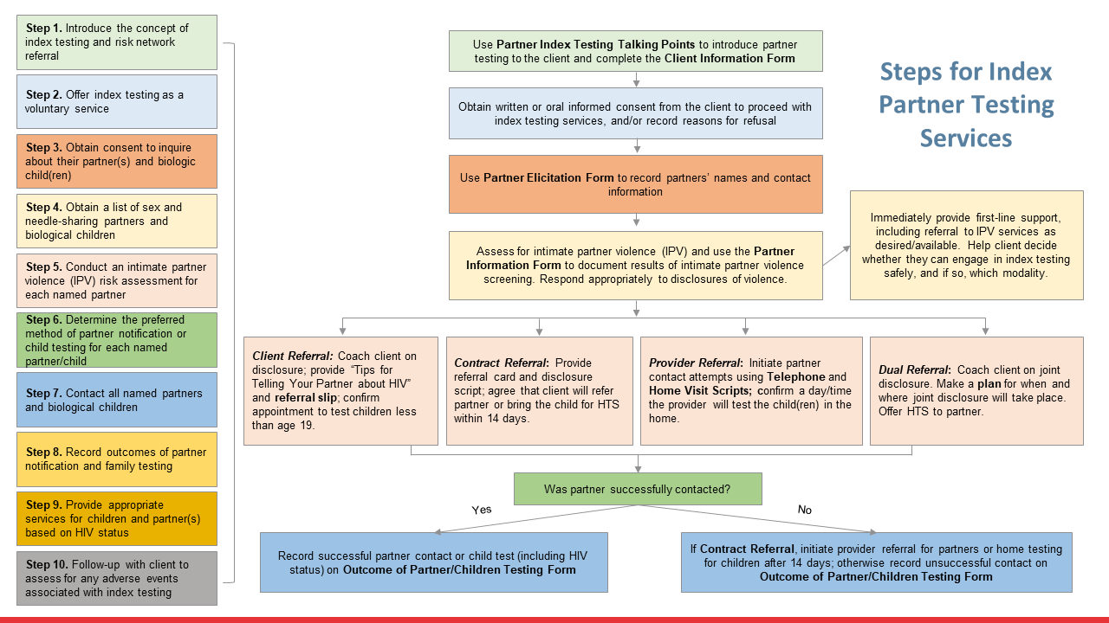
Sample standard operating procedures (SOPs)
Client flowchart
Implementing a Community-Based Treat and Test Model among Key Populations in XXX
LINKAGES XXX Project
Standard Operating Procedures (SOP) Version: 1.0
Issued:
Effective Date:
I. Purpose and Scope
This document describes standard operating procedures (SOPs) for implementing community-based index testing under a key population-led health services (KPLHS) model in XXX, as one component of an integrated program for improving HIV testing, case finding, and treatment initiation among members of key populations (KPs) under the USAID/PEPFAR-funded LINKAGES XXX program managed by FHI 360. This SOP applies to Care and Support Team members (CST) working under the employ of LINKAGES XXX community-based implementing partners. It also serves as a guide for project coordinators and/or supervisors working with CST.
Etc.
Notes:
Say: Most programs use some form of standard operating procedures to guide service steps and follow-up actions for providers and other members. Because index testing has numerous working parts, we will develop SOPs that can help guide you and your team to ensure quality services are provided consistently, and to ensure confidentiality and safety. SOPs help orient people who are new to your program and who may not have attended a training like this.
In addition, many people appreciate having a visual flowchart to help them understand what possible options or specific steps might take place based on an individual client’s choices or circumstances. We will be developing a client flowchart later in this session for the [COUNTRY] context.

Slide 52
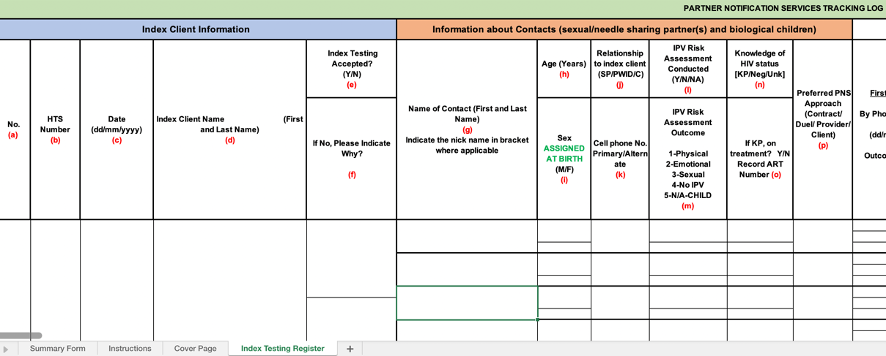
Sample index testing register
Notes:
Say: It is important to track index testing service provision for all clients who are offered the service, and ensure tracking of intimate partner violence (IPV) risk, contact notifications, and outcomes.
This process will also help you track reasons why clients declined index testing, which will be discussed in a later session.

Slide 53
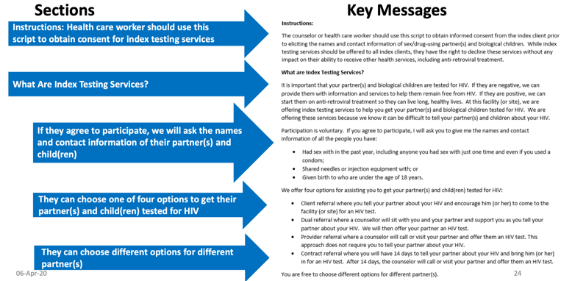
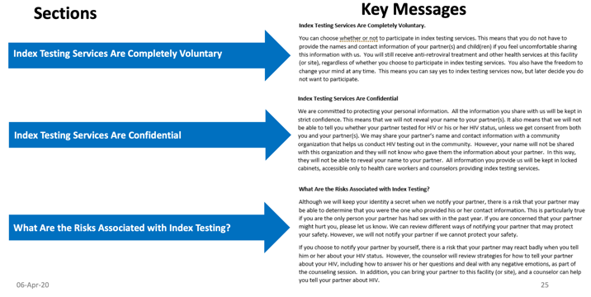
Scripts and talking points for introducing index testing
Source: PEPFAR 2020 Guidance for Implementing Safe and Ethical Index Testing Services
Notes:
Say: The program will also provide you with specific scripts for introducing index testing to your clients. It is critical to follow closely to these scripts, as they were developed with considerable input from the communities they were designed to serve. You will have a chance to practice using these scripts [during this training] or [during a follow-up session on the forms required for index testing service provision and monitoring].
NOTE: It will be important to know in advance if there will be time during the training or during a follow-up session on-site to go through each of the forms. As noted previously, it may be most effective first to ensure participants understand the main concepts from start to finish and have a chance to work through some of the practice scenarios, before providing a full script to learn/guide them.

Slide 54
IPV SOPs
Scripts and talking points for calling contacts
Violence screening questions/tool
The provision of first-line support and referral in instances of violence
Safe data storage and sharing regarding disclosures of violence
Determining appropriate notification approach
Etc.
SUGGESTED SCRIPT FOR NOTIFYING PARTNERS VIA A PHONE CALL FOR CLIENTS CHOOSING PROVIDER REFERRAL
Good day. My name is ___________ and I am a counselor/provider at __[Facility Name]_. Who I am speaking to?
[IF NOT THE PARTNER]: Is __partner’s name__ available?
[If partner is not available]: Thanks. I’ll try back later.
[If YES]: I have some important information for you. Are you in a private space where you can talk?
[If NO]: When would be a better time for me to call you?
Etc.
Notes:
Say: Our session on Core Principles and Minimum Standards for index testing revealed a number of potential harms that can result from or surface through index testing counseling. It will be important for the team to have SOPs that direct members on what to do to screen for violence, determine if disclosure can be safe, decide on the right approach for notifying a partner based on the safety determination, plan for safe disclosure, and counsel and/or refer in instances of violence, among other procedures. We will have a separate module on intimate partner violence and adverse events.
It will also be important to have specific scripts that support you to contact and discuss potential exposures with your clients’ partners, and in counseling sessions with index clients. We will have a chance tomorrow to review, revise, and/or develop specific messages that you can use in your sessions.

Slide 55
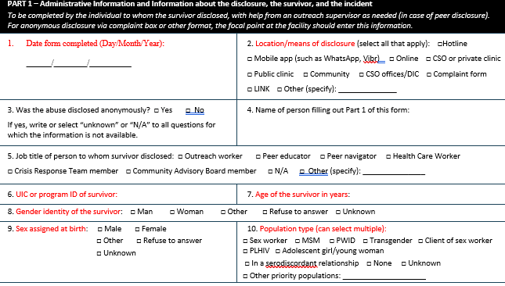
Adverse events forms
Beneficiary Abuse Disclosure and Response Form
Customer Complaint Form for HIV Services
INFORMATION ABOUT YOUR COMPLAINT
Date Incident Occurred___ Time Incident Occurred_______
Place Where Incident Occurred: __________________________________
Name of Healthcare Workers Involved (if known):_____________________
Please Tell Us about What Happened:______________________________
Implementer Security Incident Log
Security Incident Log
Question | How to Answer | Response
Security incident number | Begin with number 1 and continue; the numbering allows security incidents to be linked to one another (see question #14)
Date of incident | Type as YEAR-MONTH-DAY (e.g., 2019-02-17 for February 17, 2019) in order to organize this security event log by date
Time of incident | Specific time of day (if known), or more general (morning, afternoon, evening, night)
Notes:
Say: We introduced the concept of adverse events back in Session 5. Can anyone define what an adverse event is?
NOTE: An adverse even is an incident that results in harm to the client as a result of their participation in index testing services.
Say: We will discuss adverse events in more detail in Session 11. It will be important for teams to work together to ensure that reported adverse events are documented in addition to specific actions taken to follow up or provide support. It is also important to document any complaints clients have based on their experience at the service provision site, such as concerns about stigma or discrimination, confidentiality, or consent, among others. Incidents will also need to be recorded in a log to ensure appropriate tracking and follow-up.

Slide 56
Sample data sharing agreement
Sample confidentiality statement
Sample Data Sharing Agreement
[Date] [Version Number]
[Note: This template provides an example for a memorandum of understanding between two organizations (or health facilities) who would like to engage in a shared confidentiality relationship in order to facilitate index testing, linkage to treatment, defaulter tracing, and other HIV services. Organizations should feel free to adapt and customize this agreement as appropriate.]
I. NAME OF ORGANIZATIONS ENTERING INTO AGREEMENT
Organization 1
Name of Organization:
Address:
Organization 2
Name of Organization:
Address:
II. PURPOSE OF THE AGREEEMENT
In this section, both organizations should state in non-technical language the purpose(s) for which they are entering into the agreement. For example, data will be shared between the facility partner and the community partner to facilitate tracing and testing of partner(s) and biologic children elicited in the health facility by the community organization.
Etc.
Index Client Information Confidentiality Form
I _____________________________________ agree to maintain the confidentiality of client information and records at all times. At no time will I disclose the names of clients, their contacts, or any information within their medical records. I will also comply with the following:
I will treat all information I obtain/collect from clients and their contacts as confidential.
I will not discuss the identity of clients and their contacts with anyone except those who are authorized to have access to this information.
I will not use collected information for any purpose other than my work-related duties.
I will maintain all written medical charts, registers, forms and other materials in a locked filing cabinet.
I will store all electronic files on a password-protected computer or tablet that has current virus protection software. I will back up these files every night before I leave.
Etc.
Notes:
Say: We have already noted the importance of maintaining the confidentiality, safety, and security of each of our clients throughout the partner notification and index testing process.
We may need to develop a data sharing agreement between facilities to ensure they can communicate directly to track clients as they make referrals or request support for referrals, and to ensure that we have followed up with appropriate services.
Having the names and contact information of individuals who may be at risk of HIV infection is a serious matter. If that information mistakenly or purposefully got into the hands of individuals who are not part of our services continuum, it could put either our clients or their contacts at risk. If you have not already signed a confidentiality statement, you may be asked to sign one as part of this program.

Slide 57
Documentation forms
M&E and Data Visualization
Client contact form, including follow-up support
Partner tracking form
Etc.
Cumulative Cascade for Index Testing
Notes:
Say: We will need to document client contact information, tracking of partners, and follow up. We will need to consider how we we will track data on index testing, and standardize data visualizations so that we can have conversations about what is working and what might need improvement.

Slide 58

Activity: Make it flow
Break into groups of 6–10 persons each
Using flipchart paper, create a client flowchart using the template provided on the next slide and individual cards provided to each group
Add arrows as appropriate to indicate client flow
Feel free to adjust the language within each card or add cards to clarify the flow or additional activities. Are there tools or steps you would add? Take away? Modify?
BONUS: Place the orange ”Skills cards” wherever they might be most relevant to support a step
Notes:
NOTE: Print enough flowchart card sets in advance based on the number of breakout groups.
Go through the instructions on the slide. Explain that they will be provided with a template (shown on the next slide) to help them with the task.

Slide 59
Step 1.
Steps for Index Partner Testing Services
Step 2.
Step 3.
Step 4.
Step 5.
Step 6.
Step 7.
Step 8.
Step 9.
?
?
Step 10.
Notes:
Show this slide after ensuring that the participants fully understand the instructions for the activity as outlined on the previous slide.

Slide 60
Step 1. Introduce the concept of index testing and risk network referral
Use Partner Index Testing Talking Points to introduce partner testing to the client and complete the Client Information Form
Steps for Index Partner Testing Services
Step 2. Offer index testing as a voluntary service
Obtain written or oral informed consent from the client to proceed with index testing services, and/or record reasons for refusal
Step 3. Obtain consent to inquire about their partner(s) and biologic child(ren)
Use Partner Elicitation Form to record partners’ names and contact information
Step 4. Obtain a list of sex and needle-sharing partners and biological children
Immediately provide first-line support, including referral to IPV services as desired/available. Help client decide whether they can engage in index testing safely, and if so, which modality.
Assess for intimate partner violence (IPV) and use the Partner Information Form to document results of intimate partner violence screening. Respond appropriately to disclosures of violence.
Step 5. Conduct an intimate partner violence (IPV) risk assessment for each named partner
Step 6. Determine the preferred method of partner notification or child testing for each named partner/child
Client Referral: Coach client on disclosure; provide “Tips for Telling Your Partner about HIV” and referral slip; confirm appointment to test children less than age 19.
Contract Referral: Provide referral card and disclosure script; agree that client will refer partner or bring the child for HTS within 14 days.
Provider Referral: Initiate partner contact attempts using Telephone and Home Visit Scripts; confirm a day/time the provider will test the child(ren) in the home.
Dual Referral: Coach client on joint disclosure. Make a plan for when and where joint disclosure will take place. Offer HTS to partner.
Step 7. Contact all named partners and biological children
Step 8. Record outcomes of partner notification and family testing
Was partner successfully contacted?
Step 9. Provide appropriate services for children and partner(s) based on HIV status
Yes
No
Record successful partner contact or child test (including HIV status) on Outcome of Partner/Children Testing Form
If Contract Referral, initiate provider referral for partners or home testing for children after 14 days; otherwise record unsuccessful contact on Outcome of Partner/Children Testing Form
Step 10. Follow-up with client to assess for any adverse events associated with index testing
Notes:
Use this slide to review the steps if needed. You can also choose one of the flowcharts created by one of the groups instead.

Slide 61
Session 7. Risk network referral
Notes:
Say: The purpose of this session is to introduce you to a referral chain recruitment approach that can complement index testing and targeted referral to increase reach into social risk networks and improve case finding.
It is important to note that individuals referred through RNR who are not sexual or drug-injecting partners, or biological children DO NOT count toward index testing targets and should not be reported as such. However, if sexual or drug-injecting partners are referred through RNR, they can count toward index testing.

Slide 62



Drawbacks of index testing for key populations
Some key population members may…
not consider many risk-network contacts as “partners”
not feel comfortable disclosing to other members of their risk and social networks
know others outside of their direct network who are at high risk
?
Notes:
Say: In the standard approach for index testing, an individual presents at a testing facility or at community-based testing event and after being diagnosed with HIV, is counseled by a counselor/provider using one of the four methods previously described to encourage sexual and drug-injecting partners and potentially exposed children to come for testing.
This approach, however, may miss opportunities to dig deeper into the index case’s sexual, drug injection, and social risk networks.
Some clients may prefer not to notify their partners. What issues concerns may make it more challenging for a member of a key population to notify their partner(s)?
Allow the participants to provide their thoughts.
Say: Some members of key populations may not consider many of their risk-network contacts to be “partners”.
Some may not feel comfortable disclosing their status to other members within their risk and social networks, in part because of concerns about confidentiality in small key population communities.
In addition, a client may be aware of other people in their social network who are not necessarily sexual contacts, but who are practicing high-risk behaviors.
What can be done to ensure we are efficiently and effectively reaching everyone we can with testing and treatment services?
Allow the respondents a few moments to respond.

Slide 63
Risk network referral
Offers PLHIV additional, self-guided options to extend linkage to HIV testing and other services to a broader set of social- and risk-network members facing elevated HIV infection risks through online and coupon-based referrals
Does not require PLHIV to name — or even know the names of — these contacts to make referrals
Notes:
Say: We have been discussing the importance of providing our clients with options.
Risk network referral is one way of offering our clients additional options for referring people with whom they have had sexual or drug-using contact, or that they know practice risky behaviors within their network.
Clients do not have name these individuals and can even refer people using a coupon system without knowing their names.

Slide 64








Risk network referral
Client
Client is counseled to invite KP members in their social and risk network….
…to be tested for HIV or to enroll for ART if living with HIV.
Client
Network peers who come for testing are invited to do the same thing.
And so on…
Client
Notes:
Say: Risk network referral usually starts with a client who is part of our program (either a client we are providing ongoing prevention services to or someone living with HIV – such as an index case). In other words, anyone regardless of their status can refer their peers.
The client is oriented to the referral process and…
[ADVANCE]
…offered the chance to invite peers within their social and risk networks to come for a test or to enroll in treatment for PLHIV who have not yet started or who have stopped treatment.
Some programs offer a small incentive for each person who is successfully tested. A coupon system is used to keep track of who referred who to ensure people are provided appropriate incentives. However, incentives are not required.
Each person who agrees to meet with a program team member, such as an outreach worker, a navigator, or a counselor, to conduct a risk assessment and test (if eligible) can also be offered the chance to serve as a mobilizer.
[ADVANCE]
And the process continues with everyone who is eligible.
[ADVANCE]

Slide 65















Client
Notes:
NOTE: Practice advancing the animation on this slide to suit your preferred way of explaining/showing how you can reach deeper into various social networks through this approach. Some language is provided below.
Say: Here is another way of looking at it.
Our first client living with HIV might refer four individuals he knows who are either sexual contacts or people who practice risk behaviors within his social network.
[ADVANCE]
They, in turn, refer nine more people.
[ADVANCE]
And so on.
[ADVANCE]
And so on.
[ADVANCE].
Through a process that does not require us to develop contracts with and supervise a large staff…
[ADVANCE]
…we have reached various social networks that would have been challenging to break into if we relied solely on a peer educator or outreach worker’s social network.

Slide 66



Combining index testing, targeted referral, and risk-network referral
Index testing
Risk network referral
Targeted referral
?
?
?
Support index client to voluntarily identify, contact, and link their sexual and drug-injecting partners, spouse, and children to HIV testing while encouraging referral or supporting safe disclosure (if client chooses)
Support index client or high-risk KP to identify high-risk members within their social networks and refer them to HIV testing.
Work with client to identify sexual or drug-injecting partners for whom they have little or no contact information; determine how/where index case could be reached
Notes:
Say: This slide shows how risk network referral can be integrated as part of a comprehensive approach that includes various options for clients.
Risk network referral extends the scope of referrals beyond clients who would usually be considered (and counted as) part of a traditional index testing approach.
In targeted referral, the client may recall someone with whom they had a risk contact, but they may not know their name or number. We will discuss ways in a moment for how we might be able to reach those individuals.

Slide 67






Combining index testing, risk-network referral, and targeted referral
Index testing
Risk network referral
Targeted referral
?
?
?
Notes:
Say: And this slide helps show how these approaches can be combined.
The index client in the central circle refers a number sexual and drug-using partners and his children for testing using one of the partner-notification options we have already discussed.
In addition, he uses a risk network referral approach to refer a peer with whom he either had sexual contact (but does not want to disclose to) or knows practices high-risk behaviors (orange dashed line). That person is then invited to choose from the same set of options.
The original index client might also tell the counselor about a person he knows who may be at risk, but for whom he does not have a contact name or number. Perhaps he met that person at a bar, and he feels comfortable telling the counselor the name and location of the bar.

Slide 68








Where and how could risk-network referral take place?
Risk network referral
Similar modalities to targeted testing!
Notes:
Say: So where might risk network referral take place?
Allow a moment for participants to brainstorm and provide responses. Then advance as appropriate one at a time to show the various venues through which peers can be referred. They include in the community, at a health center, at a café or restaurant, or through any of the popular social media and dating apps that might be commonly used in this country.

Slide 69

Scenario: Which approach do you recommend?
Group work
At your tables (groups of 5–6), discuss the following.
Case study
You are counseling a man who has sex with men who has recently tested positive. He indicates that he has a boyfriend who he lives with but with whom he never uses condoms. He also likes to go to a sex club from time to time and have group sex with some friends. He always uses a condom at the sex club, but a few of his friends don’t with each other.
What would you do in this situation? What options would you offer this client?
Notes:
NOTE: Introduce this group work session by asking the participants to break into groups of 5-6 or work at their tables (if the tables are about that size).
Have a participant read through the case study and then read the questions. Ask if there are any questions and then allow the group 5 minutes to consider.
After 5 minutes, ask for volunteers from any of the groups to provide their thoughts (briefly), and after each response, ask if anyone has anything new to add.

Slide 70

Activity: Targeted referral. How to?
Break into five groups.
Your index client recalls having sexual contact with two individuals in the last year, but he does not remember their names or have their numbers. He can remember where they used to hang out.
Brainstorm three effective ways that you could reach an index client’s sexual or injecting partners in this situation.
10 minutes
Notes:
NOTE: Ask the participants to break into five groups or remain at their tables in groups if appropriate or preferred.
Ask a volunteer to read the scenario and instructions, and allow the groups 10 minutes to brainstorm.
At the end of 10 minutes, ask for a group to volunteer to report back, and limit the report to 2 minutes. Ask if any groups had different ideas, and allow them to fill in any ideas not yet stated (avoid having groups report back on the same ideas).
Advance to the next slide to assist you with filling in any gaps not mentioned in the discussion.

Slide 71
How could targeted testing be conducted?
Targeted outreach at location(s) referred by index client
Broadcast invitations to community/social testing events (e.g., parties, campaigns)
Incentivized (using coupons provided by the client, peer mobilizers, or counselors)
Social media (Facebook, dating apps, etc.)
Other?
?
?
?
Notes:
NOTE: Use this slide to fill in any possible approaches that may not have been discussed in the brainstorm session described in the activity on the previous slide.
Avoid repeating what has already been said by the groups to save time and honor the contributions of the participants.

Slide 72
End of Day 1

