Slide 1

Strengthening the Security of
HIV Service Implementers Working with Key Populations
A virtual training for
organizational leadership
Notes:
Say: Thanks for being here today! We look forward to learning with and from each of you throughout our four days together.

Slide 2
Welcome, introductions, and background
Notes:
Say: In our first session, we’ll get to know one another, discuss how we’ll be spending our time and our goals for the time, and talk a little bit about how work on security has evolved in KP programs.

Slide 3
Session Objective
Welcome all participants and introduce participants to one another.
Come to a shared understanding of training content and goals as well as participants’ involvement in the training.
Identify implementer security as an important and new area in HIV programming.
Notes:
Review slide.

Slide 4
Activity A. Introductions
Name and title
Experiences with security training
One hope/expectation for this training
Group | Person 1 | Person 2
A
B
C
D
E
F
G
H
I
Notes:
See the Facilitator’s Handbook for more detailed instructions.
Say: So, let’s get started. I would like each of you to share you name and title and any experiences you’ve had with security training. It’s no problem at all if this is new for you, it is for many people. And finally, one hope or expectation you have for this training.
While you introduce yourselves, I’ll be writing all participants’ names here to put them into groups for our first homework assignment.
Have each person, by organization, unmute and share the information above. Jot down their responses re: expectations on a separate sheet of paper. At the end, review what you heard and let the group know which of their hopes/expectations can be addressed during this training. If there is anything they think is important to address that is outside the content of this training, note that you’ll share this with the leadership of the project so it can be addressed separately.

Slide 5
Activity B. Group Norms
These sessions will be recorded.
Do not share identifying information about others when recounting security incidents.
Participate fully.
Come on time and remain for the entirety of each session.
Do not share what you hear in this webinar beyond this space.
Notes:
See the Facilitator’s Handbook for more detailed instructions.
Say: Now that we know a little bit about one another, it’s time for us to come up with some group norms. These will guide how we collaborate throughout our time together. I have written some ideas on the slide.
Review slide contents.
Are there any others that you’d like to add or any that should be revised?

Slide 6
Review agenda and expectations
Time | Session
DAY 1
8:00 | Welcome, introductions, and background
8:45 | Key terms and overarching recommendations
9:15 | Threat identification and assessment
9:55 | Day 1 closing
DAY 2
8:00 | Recap of Day 1 and HW #1
8:25 | Limiting an aggressor’s capacity to harm
9:00 | Digital security
9:40 | Review of our capacities and plan for skill sharing
9:55 | Day 2 closing
DAY 3 - Special Session
 | Group presentations
DAY 4
8:00 | Day 2 recap and special session reflections
8:10 | Using what you’ve learned: security challenge case studies
8:45 | Risk assessment formula
9:05 | Security planning
9:35 | Next steps
9:50 | Reflections and closing
Screen shot agenda here
To receive a certificate noting that you completed this training:
Participants will participant in and contribute during each session (at least twice verbally and 5 times via chat per session).
Participants will complete all homework assignments.
Participants will complete the post-test and score at least 85%.
Training dates:
Notes:
Say: Now let’s take a quick look at the agenda. You’ll see that the agenda covers all four days. Each day will last 120 minutes, or 2 hours. The third session will be a series of presentations given by each of your organizations. Otherwise, my co-facilitator and I will be leading the presentations with a lot of opportunities for your participation.
We are counting on your involvement to make this training useful to you and meaningful to your colleagues. We take seriously the idea that implementer security is an ethical obligation of a KP program, and we want to make sure you’re getting all you can from this training so that you stay as safe as possible while doing your life-saving work. As such, we have strict guidelines on the type of attendance and participation required if you’re going to receive a certificate of completion.
We ask that everyone here come to each session. While you’re here, please chat at least 5 times and speak at least twice. If you have trouble contributing verbally because of connectivity, please tell us that in the chat now.
We also ask that you complete homework assignments. One will be given today and another, for your entire CSO, will be given after Day 2. Depending how much time we have, it’s likely that you’ll also have an assignment to complete following the final session.
Finally, we ask that you score at least 85% on the post-test. You can take it over again as many times as needed if you score under this number.
The training dates for our four days together are here. If you miss any session due to an emergency, we will ask you to watch recorded sessions [or other plans for make-up sessions].
Include the training dates on this slide so that everyone understands when they will be joining each session.

Slide 7
Process Overview
Each implementer completes a checklist of their existing security approaches
Train CSOs together on prioritizing risks and mitigation strategies; develop security plans
Support implementers to achieve priority security goals
Notes:
Say: This is the overview of our process. Each of you has already completed a checklist or will do so right after this session. It showed you where your organization has gaps and strengths. The best part of this training is that we bring IPs together to learn from one another – so everyone will leave with ideas on how to build on what they already have in place. This will be reflected in your security plans. Each CSO will develop a security plan that they then advance after the training. We will be here to review those plans and help you address your priority goals.

Slide 8
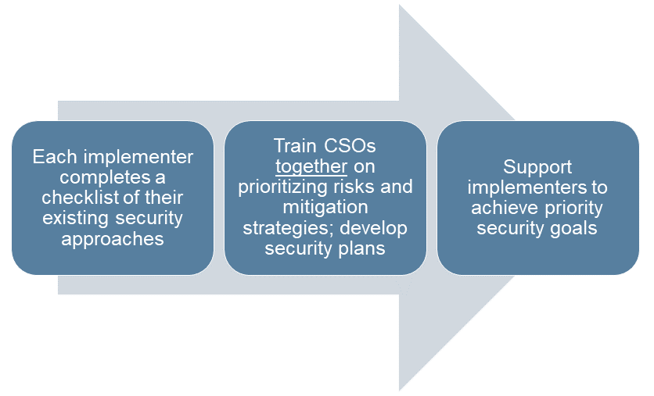
Step 1
Cultivating and sensitizing external allies
Influencing public perception of the project or organization
Documenting harms for tracking and advocacy
Protecting offices, drop-in centers, and other physical locations
Keeping workers safe during physical and digital outreach
Developing functional and institutionalized security protocols, including for emergencies
Keeping data and communications safe
Cross-cutting: emergency preparedness, digital safety, COVID-19
Notes:
Say: This is more detail on each step. Here you see the domains you recognize from the checklist.
Review domains quickly.

Slide 9
Step 2
Workshop Objectives
Identify security strengths and gaps and share strengths among implementers
Prioritize security risks faced by the program and determine the most important gaps for each CSO to address
Draft CSO-specific security plans that address priority risks and how skills will be built to manage that risk
Notes:
Say: Now we come to the workshop itself. These are our workshop objectives.
Review slide contents.

Slide 10
Step 3
Risk (of something):
Threats | Vulnerabilities | Existing capacity | Required capacity
A break-in at the clinic with client records stolen
High
Outreach workers have been followed back to clinic by yelling groups who say we promote homosexuality
Threatening messages graffitied onto clinic
We are in a neighborhood with little street traffic in the evenings
We do not have any security guards at the clinic after 5 pm
We don’t have a way to monitor visitors during the day
Staff do not always lock up patient charts
Windows and doors do not have bars; can be broken with rocks
We have a security guard while the clinic is in operation (9 am-5 pm)
We have the USAID and MOH logo on our sign
We have introduced ourselves and explained our work to senior law enforcement officers working in the district
We have locked cabinets to store all paper client records
We use UICs and keep mostly encrypted electronic information
Visitor monitoring logs
Retraining for all staff on safe document storage (clean desk policy)
Talk to landlord about the nature of our work
Install physical security measures for windows and doors
Create log for security challenges to track trends; consider using it to advocate with donor for funds for increased security presence
Notes:
Say: Finally, here is an example of a security plan. We don’t need to go over it now, it will be a big discussion on our last day. But the important thing to note is that it’s simple, and it’s all about what’s important and pressing for you and your organization.

Slide 11

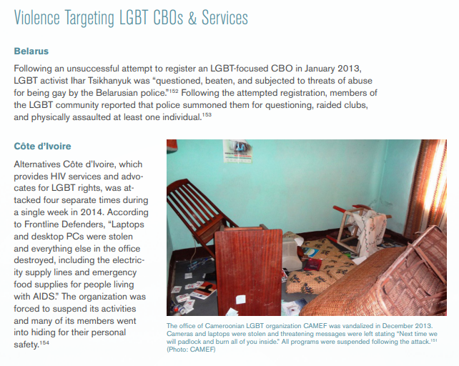
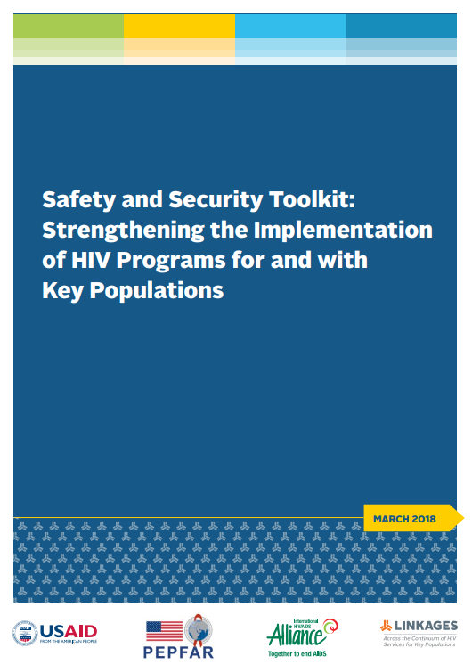

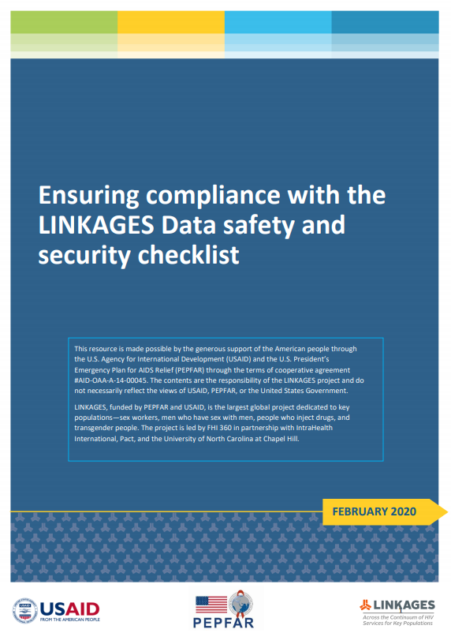

Implementer security in HIV programs: An incomplete history
Longer history of violence/crisis response for beneficiaries of KP HIV programs
(e.g., Avahan, early 2000s) and LGBT-led rights-focused organizations (e.g., Dignity for All consortium, 2012)
KP programs saw and increasingly documented implementer insecurity
  Arrests and detentions
  Offices raided/broken into
  Attacks on personnel (physical, sexual, economic, and emotional)
LINKAGES and Frontline AIDS develop a toolkit; LINKAGES with Synergia develop training materials focused on KP HIV program implementers (2018)
  Efforts to improve data safety specifically (2019)
LINKAGES/EpiC extend security work across the project, into digital security and index testing, and into new regions (MENA, 2019-21)
Notes:
Say: Now for some background. Starting this training it’s important to have an idea of how thinking on the security of KP program implementers has evolved over time.
There is a longer history of violence/crisis response for beneficiaries of key population HIV programs and LGBT-led rights-focused organizations.
Advance slide twice for images.
As KP programs became more widespread, they saw and increasingly documented implementer insecurity, especially targeted toward organizations led by KP members. Attacks included: arrests and detentions, offices raided/broken into, and physical, sexual, economic, and emotional attacks on personnel.
Advance slide once for image.
The LINKAGES project, in collaboration with Frontline AIDS, saw this gap and developed the toolkit you see here in blue.
Advance slide once for image.
LINKAGES and Synergia then worked together to develop training materials focused on KP HIV program implementers.
Advance slide once for image.
Even more recently, there have been efforts to address data safety specifically.
Advance slide once for image.
Finally, LINKAGES/EpiC extended security work across the project, into digital security and index testing, and into new regions.
Advance slide once for image.

Slide 12
What, Who, Why?
In your context:
What do security incidents affecting implementers look like?
Who perpetrates abuse against KP program implementers?
Why do attacks on implementers occur?
KP program implementers can include:
• Outreach workers/community mobilizers
• Peer educators/navigators
• Community health workers
• Community members
• Program directors and managers
• Program officers
• Drop-in center workers
• Clinicians (e.g., doctors, nurses)
• Counselors and psychosocial support providers
• Office staff (e.g., receptionists)
• Support staff (e.g., drivers, guards)
• Community activists, advocates, and campaigners
• Lawyers and paralegals
• Allies and champions
Notes:
Say: Let’s talk about the security incidents that affect KP program implementers.
We want to know what kinds of security incidents happen in your setting, who perpetrates them, and why do they occur?
And when we say implementers, we are talking about a wide variety of people from outreach workers to directors to doctors to drivers.
Review list of implementers quickly.

Slide 13
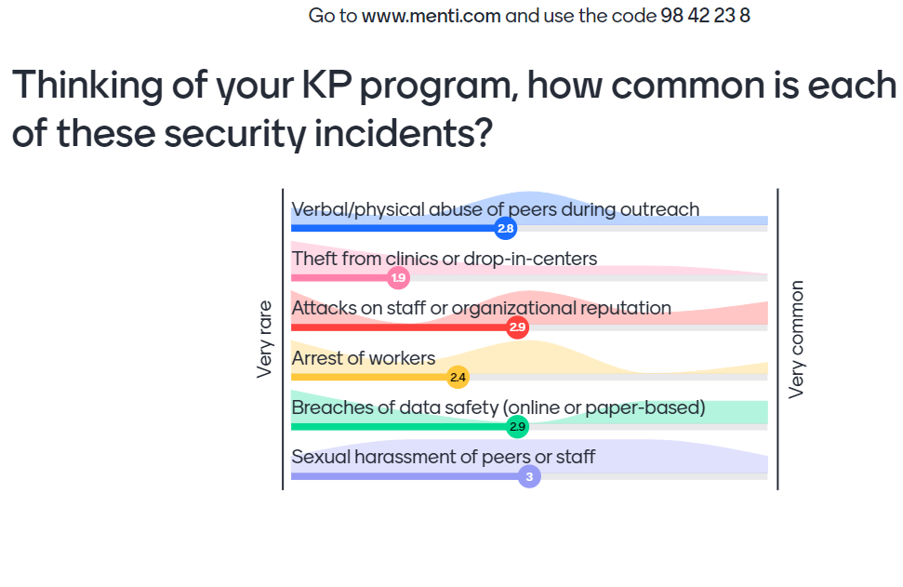
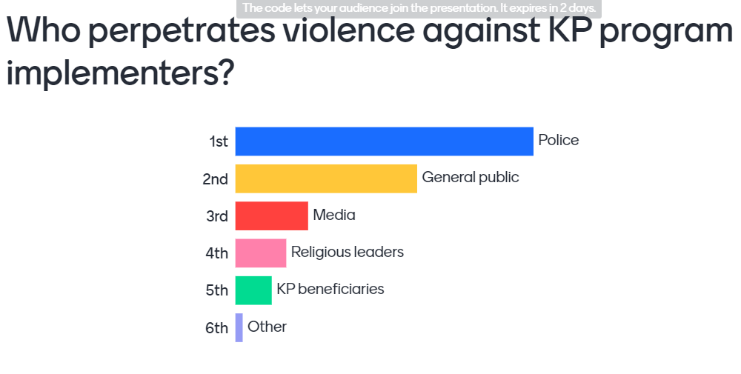
Activity C. What, Who, Why?
Notes:
See the Facilitator’s Handbook for more detailed instructions.
After soliciting answers, ask individuals to unmute to share their thinking. When they describe what is happening, ask if they have any ideas why this is occurring. When they share the “who” ask them to follow-up and describe “why” this group is perpetrating violence against KP program implementers.

Slide 14

Kicked out of home/school
Sexual harassment and assault
Damage to reputation
Blackmail
Gossip
Theft
Records being stolen/hacked
KP members being outed
Physical violence
Offices being vandalized
Arrest/detention
Stalking
Fear/ignorance/anger
Gender norms
Stigma
Religious/cultural beliefs
Criminalization
Notes:
Say: The examples you gave of violence are what we see each day—the part that is above ground. The “why” are the roots. We will work on addressing the part that we see each day. This isn’t to say that the part underground is unimportant. In fact, it’s absolutely vital to address. But we can’t wait to offer HIV services until all cultural and religious beliefs are changed. And, to have time and energy to address the root causes it’s necessary that people can safely do their day-to-day work.
Illustration credit: Tree of life, free stock photos, licensed under CC BY

Slide 15
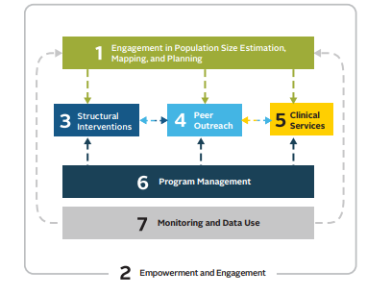
How do security challenges affect KP programs?
Seven areas of key population programs¹
It can be difficult to undertake behavioral or biomedical surveys limiting reliable data.
Hiring members of KPs or engaging civil society organizations (CSOs) led by KP members is more difficult.
Need for intensive stigma-reduction trainings for HCWs, especially if working with KP members brings secondary stigma and abuse.
Harassment limits outreach.
Clinical staff burnout increases.
Shifts in management focus make it difficult to meet programmatic objectives.
If data cannot be kept safe, what can be collected is severely limited.
1. Key Population Program Implementation Guide. Washington (DC): FHI 360/LINKAGES; March 2016.
Notes:
Say: We’ve talked about some of the different security challenges we face and how they impact our workers and programs. Let’s look at 7 different areas KP programs to gives specific examples for each one.
Advance slide.
1. It can be difficult to undertake behavioral or biomedical surveys or other health surveillance when data collectors cannot move freely due to safety concerns. Individuals conducting surveys, especially if they are peers, run the risk of arrest or having the data they have collected confiscated. Without reliable data, the HIV program is unable to understand the extent of need and to advocate effectively for a strengthened response.
Advance slide.
2. Hiring members of KPs or engaging civil society organizations (CSOs) led by KP members—which is acknowledged as a central component of effective HIV programming for key populations—is much more difficult when safety concerns require individuals and CSOs to reduce their visibility in order to prevent attack.
Advance slide.
Structural interventions such as work with law enforcement or health care workers becomes more important than ever to prevent security challenges and make sure they can be responded to appropriately. They are also often more challenging in such settings. For example, there could be the need for even more extensive stigma-reduction training with HCWs in a content in which HCWs who support the health and well-being of KP members could be targeted themselves.
Advance slide.
4. Harassment of workers during outreach by both the families of beneficiaries and law enforcement limits the times of day and locations where outreach can be safely conducted, thereby limiting the reach of the program. In many settings distributing condoms, lubricant, or harm-reduction materials is not safe under any condition or is safe only if the outreach worker carries very small quantities.
Advance slide.
5. Doctors, nurses, psychologists, and other clinical staff may be targeted for their work with KP members, increasing burnout and making it more difficult to find qualified staff.
Advance slide.
6. Managers of an HIV program might be unable to meet their programmatic objectives if a large proportion of their energy and project resources is required to respond to safety and security challenges.
Advance slide.
7. A threatening environment—such as with regular police raids and cyberattacks—makes it difficult for HIV program implementers to ensure the safety of electronic data. Theft of equipment such as laptops, especially when project budgets do not cover replacement, can inhibit data entry and management.

Slide 16
Key terms and overarching recommendations
Notes:
Say: Now let’s make sure we all agree on key terms and review some recommendations on security for HIV program implementers.

Slide 17
Session Objective
Define “security,” “risk,” “threat,” “capacity,” and “vulnerability,” and discuss the key recommendations for security of implementers in KP programs.
Notes:
Review slide.

Slide 18
Activity D. Definition: Security
What does “security” mean?
Being sure that you are completely safe.
Being free from intentional violence.
Having a first-aid kit.
While the word “security” is sometimes used interchangeably with safety, security is focused on freedom from intentional harm. Safety includes freedom from harms such as sickness and natural disasters, which won’t be touched on in this training.
Notes:
See the Facilitator’s Handbook for more detailed instructions.
Say: First, we’ll review the definition for security.
Read question and options.
Give time for chat responses.
Call on someone to answer and then advance slide to show correct answer.
Finally, advance slide again, and read clarifying text at the bottom of the slide.

Slide 19
Activity D. Definition: Risk
What does “risk” mean?
The probability that something harmful will happen.
Being careful.
Planning ahead to avoid danger.
While the word “risk” can refer to both the possibility of harm and someone/something that creates a hazard, in this training we will talk about risk as the probability that something harmful will happen.
Notes:
Say: Next, we’ll review the definition for risk.
Read question and options.
Give time for chat responses.
Call on someone to answer and then advance slide to show correct answer.
Finally, advance slide again and read clarifying text at the bottom of the slide.

Slide 20
Activity D. Definition: Threat
What does “threat” mean?
An indication/sign that someone wants to hurt, damage, or punish us.
A supportive statement.
A bad omen.
Threats can be verbal, such as, “I will hurt you.” However, threats can also be actions. In this training, we will talk about threats as coming from outside of ourselves (i.e., we will not cover ideas such as self-harm).
Notes:
Say: Next, we’ll review the definition for threat.
Read question and options.
Give time for chat responses.
Call on someone to answer and then advance slide to show correct answer.
Finally, advance slide again and read clarifying text at the bottom of the slide.

Slide 21
Activity D. Definition: Capacity
What does “capacity” mean?
A sign that someone wants to hurt, damage, or punish us.
Any resource (financial, ability, contacts, infrastructure, personality, etc.) that we can use to improve our security.
How dangerous something is.
Capacities can be almost anything. A great sense of humor can help defuse a tense situation. Being connected to someone in the national AIDS program might keep others from bothering you. A car with strong locks can protect against theft.
Notes:
Say: Now we’ll look at capacity.
Read question and options.
Give time for chat responses.
Call on someone to answer and then advance slide to show correct answer.

Slide 22
Activity D. Definition: Vulnerability
What does “vulnerability” mean?
Anything that increases our exposure to those who want to hurt us.
Anything we do to keep ourselves safe.
A sign that someone wants to hurt us.
Our goal is not to make ourselves completely invulnerable. To be alive is to be vulnerable. However, we can identify our vulnerabilities and determine whether some of them can be reduced.
Notes:
Say: Finally, we’ll review the definition for vulnerability.
Read question and options.
Give time for chat responses.
Call on someone to answer and then advance slide to show correct answer.
Finally, advance slide again and read clarifying text at the bottom of the slide.

Slide 23
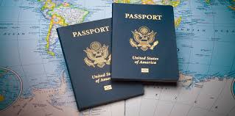
Vulnerability is a tricky concept
A “vulnerability” is not the same thing as a “weakness.”
A capacity in one context
can be a vulnerability in
the next context.
Some capacities/
vulnerabilities cannot
be changed.
The goal is to be aware of your vulnerabilities and capacities and act in a way that takes these into account, with each person deciding what is right for them.
Notes:
Say: A “vulnerability” is not the same thing as a “weakness.”
A capacity in one context can be a vulnerability in the next context. For example, one’s nationality could be protective in one setting but put you at greater risk for attack in another setting.
Some capacities/vulnerabilities cannot be changed. Some that cannot be changed are: Race/gender identity/sexual orientation/age. In past HIV programs, often transgender people were asked to stop expressing their true gender identity in order to reduce violence. While this is something that a transgender person may decide to do, it is not something that a program should tell transgender people to do to keep themselves safe. Each person has to decide what they feel comfortable with. Plus, not living in a way that is true to one’s gender identity can cause mental health harm, so the transgender person deciding to dress the way they feel most comfortable may actually be protecting themselves, even if others do not see it that way.
The goal is to be aware of your vulnerabilities and capacities and act in a way that takes these into account, with each person deciding what is right for them.

Slide 24
Activity E. Homework: Overarching recommendations
A
B
C
D
E
F
G
H
I
J
Make HIV program principles and approaches the foundation of security efforts.
Make security a priority and resource it explicitly.
Make a safe workplace the employer’s responsibility.
Plan ahead and make sure that everyone knows the plan (while maintaining flexibility).
Explicitly discuss the level of risk that is acceptable organizationally and individually.
Operate with a knowledge of both the actual risks and their underlying causes (including legal frameworks).
Acknowledge the different vulnerabilities and capacities of each worker in security planning.
Get to know all stakeholders, not just obvious allies.
Identify both threats (physical, digital, psychological) and security strategies holistically.
Be together, work in coalition, and learn from one another.
Homework #1: Recommendation reflections
Following this session, each group will be assigned to one recommendation.
Read more about your recommendation in the training cheat sheet.
Be prepared, next session to (1) describe this recommendation,
(2) share how your program is already using this recommendation, and
(3) how it could use this recommendation.
Notes:
See the Facilitator’s Handbook for more detailed instructions.
Say: There is one other basic component we want to cover. These 10 recommendations inform implementers on how to think about security. Each is important to reflect upon.

Slide 25
Threat identification and assessment
Notes:
Say: Now that we have the basics, let’s look at how to identify threats and decide how serious they are.

Slide 26
Session Objective
Identify threats and determine their seriousness.
Notes:
Review slide

Slide 27
Threat types
Direct threat – An indication that someone wants to inflict pain or damage me/my organization specifically.
Indirect threat – An indication that someone wants to inflict pain or damage a broader group of people that I am a part of, but not me/my organization specifically.
Security incident – Situations where harm occurs, but we’re unsure if the incident is a threat or more of a coincidence.
Notes:
Say: There are three threat types: direct, indirect and security incidents
Each one refers to something different.
A direct threat is an indication or sign that someone wants to inflict pain or damage me/my organization specifically. An example of this is: I work with sex workers. Someone comes up to me and says, “you are a bad person because you work with sex workers.”
An indirect threat is an indication or sign that someone wants to inflict pain on people like you. Meaning, it’s against a broader group of people that you are part of but not against you specifically. An example of this: I work with men who have sex with men, so does my friend. Someone comes up to my friend and says, “You know that working with men who have sex with men is wrong! One day you’ll pay for these sins!” While this isn’t directed at me, it could clearly have an impact on whether I feel safe doing my job.
Finally, we have security incidents. These are situations where a harm occurs or is threatened, but it’s unclear if this is meant to be a threat or is a coincidence. For example, I work with transgender women. I am writing a report about my work while at a cafe. Someone steals my laptop. Was this just an opportunistic crime by someone who wanted a laptop or did they steal my laptop to learn more about my work or to punish me for my work?

Slide 28
Activity F. Label Each Threat
Incident | Type of threat to you (direct threat, indirect threat, security incident)
A. You are the director of CSO 1, an organization that provides HIV services to MSM. An influential local leader accuses CSO 2 of promoting homosexuality. CSO 2 offers the same services to MSM that your organization does. Someone breaks the windows of CSO 2 and puts graffiti on the home of CSO 2’s director.
B. You are a peer outreach worker who distributes condoms. A police officer stops you and tells you that if he sees you again, he will have you arrested.
C. You are a nurse. An index client gives you the name and address of her sexual partner. When you visit the home of the named partner, he refuses to speak to you. Later that day, you receive three calls from an unknown number. The caller never says anything, but always breathes heavily into the phone.
Indirect threat: It’s not a threat directly to you but it does target a group that you are part of (people providing HIV services to MSM)
Direct threat: This threat is about you and directed toward you
Security incident: You don’t know who is calling and if you’re being targeted for any specific reason.
Notes:
See the Facilitator’s Handbook for more detailed instructions.
Read each incident. Ask participants to type their answers into the chat. Then, ask someone to unmute and explain their answer. Advance the slide to show the correct answer.
Repeat for each incident.
Ask at the end of anyone has questions.

Slide 29

Recording Threats
Being able to catalogue all three threats is important and can help you provide documentation, including to the donor, and track patterns
Riskier locations or activities
Common perpetrators
Whether an indirect threat to
larger group
Whether violence is intensifying
Who is most at risk
Notes:
Say: Why might you benefit from recording this information?
Review the slide.

Slide 30
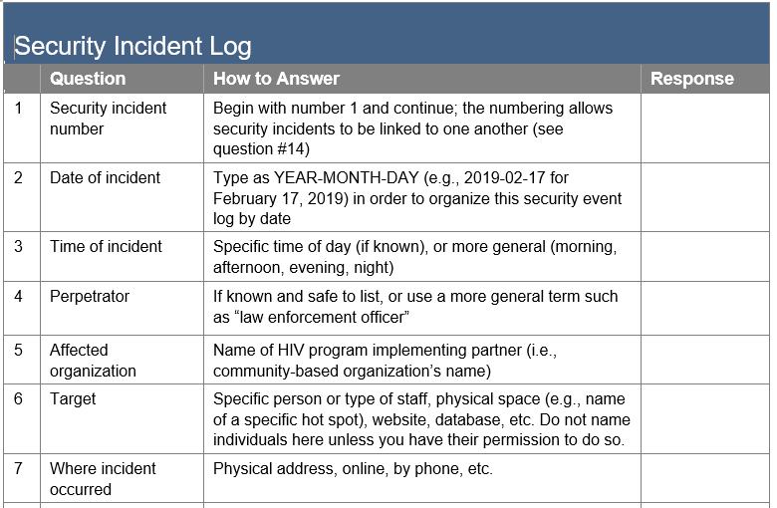
Security Log
Notes:
Say: Here is a partial example of a security log. We will share this document with you via email after today’s session. Note that it allows you to collect information on what occurred so that you can see trends over time. For example, identifying the most common perpetrators using question 4. Collective information gathered this way can also be used to advocate with donors if more investments in security are needed and/or if some project goals have been impacted negatively by security issues.

Slide 31
Assessing threats: How serious is it, really?
What are the facts surrounding the threat?
Is the threat part of a series that has become more systematic or frequent over time?
Who is the person who is making the threats?
What is the objective of the threat?
Do you think the threat is serious?
Notes:
Say: Now that we understand types of threats, let’s talk about how to determine their seriousness. Here are the five questions we will answer.
1. What are the facts surrounding the threat? (What do I actually know, not what I’m assuming, about this threat?)
This is helpful because it reminds us to move away from gossip or conjecture. Sometimes a threat can be overblown or underestimated because of the way others perceive it. Try to only think about the facts.
2. Is there a series of threats that become more systematic or frequent over time? (Does a person find you each day or do they just harass you opportunistically? Are they escalating in terms of how close they are to you, such as finding you at your home or workplace?)
If something occurs multiple times, this increases the seriousness. It shows that making this threat is something the person/people feel a commitment too. Escalation of the threat—for example, someone was yelling at you when you were conducting outreach and now they have also found you online—is another sign that it is more serious.
3. Who is the person who is making the threats? (Is this someone you know? Someone who has the ability to influence others? Someone who has information that could harm you?)
This question tries to understand how much power the person threatening has. For example, a police officer making threats is likely to be more dangerous than a stranger.
4. What is the objective of the threat? (Is it to change your behavior? Is it to scare you? Is it a political tool to get votes?)
Thinking about this can help you decide whether the person may be willing to escalate. For example, if this is just to scare me then maybe the person isn’t going to ever physically harm me, even if they say they will. Knowing this can also help you decide how to act.
5. Do you think the threat is serious? (your own personal view on the topic)
Here is where you let your intuition and your understanding of the broader context inform your thinking on the threat’s seriousness.

Slide 32
Example
Question | Answer
What are the facts surrounding the threat?
Are the threats part of a series that has become more systematic or frequent over time?
Who is the person/ people making the threats?
What is the objective of the threat?
Do you think the threat is serious?
A group followed two peer educators to three different hot spots. The group yelled at the educators and said they promoting immorality.
Yes, this is the third time that these peers have been targeted with verbal abuse. The first time occurred a month ago and happened at just one hot spot. Now they are following peers between hot spots.
They seem to be local community members who live near the hot spot. Several of them are known to be members of a church that preaches constantly against homosexuality.
To prevent outreach and to follow the teaching of their minister.
Somewhat. Our peer educators’ mental health is being impacted, which is a big concern. We do not believe the group will become physically violent.
Notes:
Say: Now, let’s go over an example. I’ll use a common example to answer each of these questions.
Review each question and then advance to reveal and review each answer.

Slide 33
Activity G. Assessing Threats Based on Impact
After you decide how serious a threat is (i.e., how likely it is to occur), don’t forget to consider the impact of the threat when assessing its potential to cause harm.
For example, a threat that could cause your organization to be shut down is more dangerous than one that could cause disruption to a few days of services.
In your opinion, how dangerous was the example threat? (type your answer in the chat)
How dangerous was the example threat?
Low
1 2 3 4 5
High
Notes:
See the Facilitator’s Handbook for more detailed instructions.
Review the text on the slide.
Ask participants to decide, based solely on what is provided in the previous slide, how dangerous was the example threat. They should put their answers in the chat. Call on someone to unmute and explain their answer. If multiple answers are chosen, call on people to defend/explain their individual different answers. Stress that there is no correct or incorrect answer as long as the answer is thoughtful. Having different responses may be because people have different appetites for risk and/or because each of our contexts is different.

Slide 34
Activity H. Considering Our Own Threats
Question | Answer
What are the facts surrounding the threat?
Are the threats part of a series that has become more systematic or frequent over time?
Who is the person/people making the threats?
What is the objective of the threat?
Do you think the threat is serious?
How dangerous was the example threat?
Low
1 2 3 4 5
High
Notes:
See the Facilitator’s Handbook for more detailed instructions.
Ask for an individual or group of participants who work together to help you fill in this table using a specific threat they face. Type your answers as they speak, asking clarifying questions as needed. Then, ask them to decide how dangerous the threat is.

Slide 35
Day 1 closing
Notes:
Say: We have reached the end of our first day. Thank you for all of your participation and for sharing your experiences.

Slide 36
Session Objectives
Evaluate the day.
Notes:
Say: We will now evaluate the session so that we can improve as we go.

Slide 37
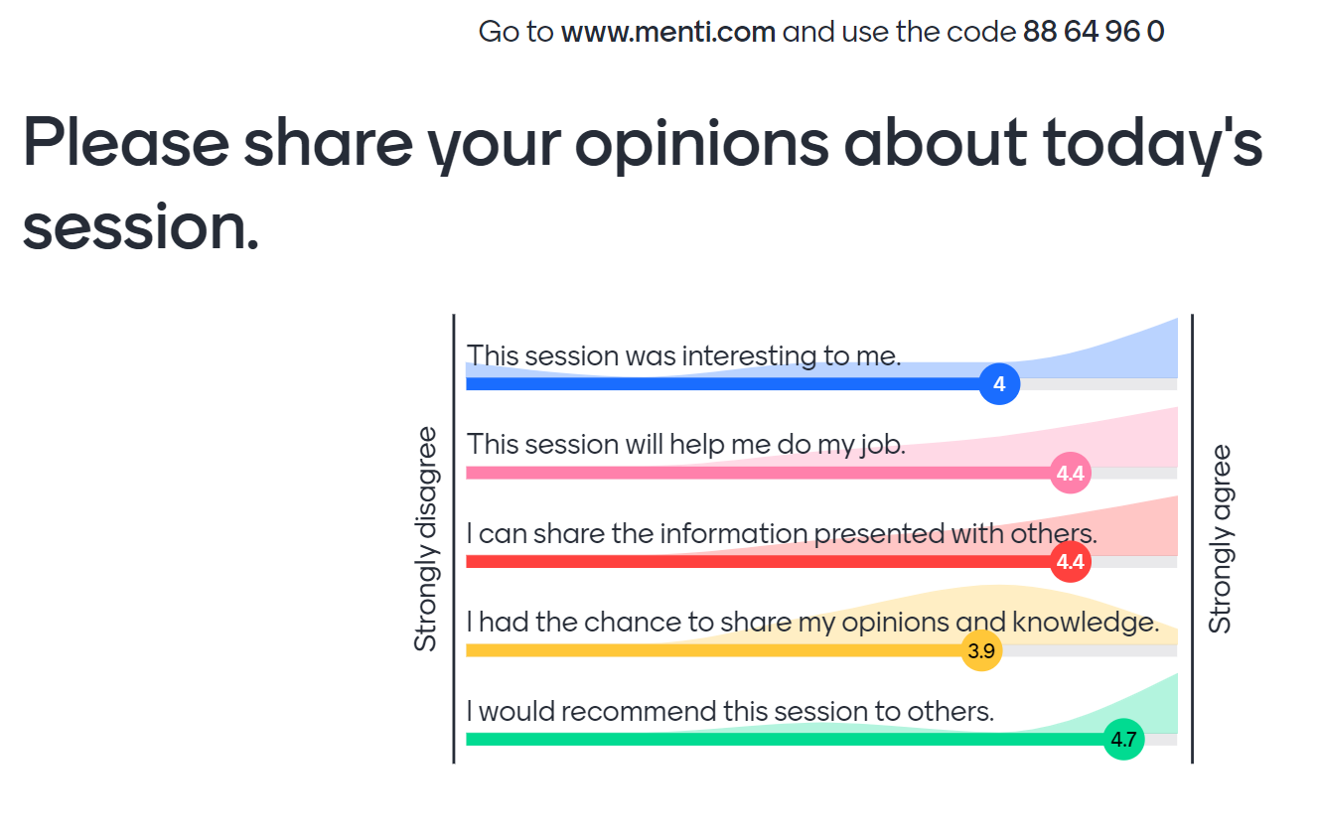
Activity I. Menti, Day 1 closing
Notes:
See the Facilitator’s Handbook for more detailed instructions.
Say: Please go to Menti.com and use the code to share your opinions about the day.
Type menti.com and the code into the chat.
While you are completing this survey, please remember that our next session is X date and Y time. We need everyone to be online a few minutes before start so that we can keep to time. Please remember to do your homework so that you’re prepared to present during the next session.
Finally, I will be sending the day’s slides to everyone, along with the cheat sheet and security log in an email for your notes and use.

Slide 38
Strengthening the Security of
HIV Service Implementers Working with Key Populations
A virtual training for
organizational leadership
DAY 2
Notes:
Say: Welcome to our second day together! It’s good to be with you all again today.
As a reminder, we are tracking participation and do expect everyone to be contributing via both the chat and verbally.

Slide 39
Recap of Day 1 and Homework #1
Notes:
Say: We’ll start by reminding ourselves what we did on day 1 and giving you all time to share your homework responses.

Slide 40
Session Objectives
Share homework #1 answers.
Remember the topics covered on Day 1.
Notes:
Say: Here are our objectives for this session.

Slide 41
Activity J. Recommendation Reflections
Make HIV program principles and approaches the foundation of security efforts.
Make security a priority and resource it explicitly.
Make a safe workplace the employer’s responsibility.
Plan ahead and make sure that everyone knows the plan (while maintaining flexibility).
Explicitly discuss the level of risk that is acceptable organizationally and individually.
Operate with a knowledge of both the actual risks and their underlying causes (including legal frameworks).
Acknowledge the different vulnerabilities and capacities of each worker in security planning.
Get to know all stakeholders, not just obvious allies.
Identify both threats (physical, digital, psychological) and security strategies holistically.
Be together, work in coalition, and learn from one another.
Homework #1
Describe: (1) the recommendation, (2) how your program is already using this recommendation, AND (3) how the program could use this recommendation.
Notes:
See the Facilitator’s Handbook for more detailed instructions.
Say: Here’s the homework from last time. As a reminder, each group was asked to explain their assigned recommendation, how their program is using it, and how their program could use it. I’ll begin by calling on the group that reviewed recommendation #1.
Go through all of the recommendations. At the end, reflect on the fact that organizations are already doing many things to protect themselves and that we all have a lot to learn from one another.

Slide 42
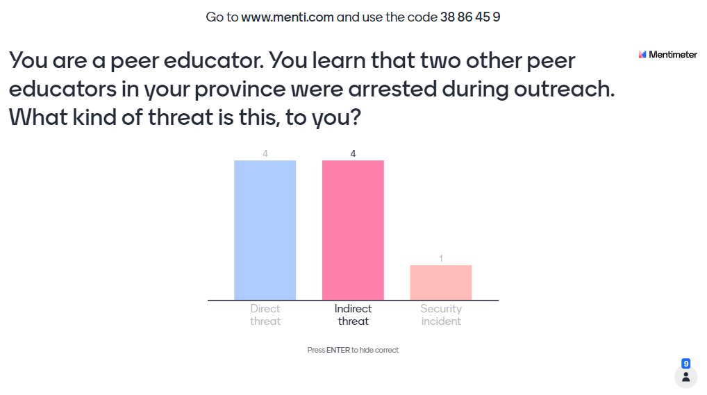
Activity K. Menti Day 1 Recap
Notes:
See the Facilitator’s Handbook for more detailed instructions.
Say: Now that we’ve gone over the homework, let’s remind ourselves of one of the key topics we covered – security challenge types. Please go to menti.com and enter the code to share your answer.
Type menti.com and the code into the chat.
While the group is answering online, ask someone to unmute and explain their answer. Highlight that this threat is indirect because it is not at you, but it is direct at someone in the same occupation or organization as you, so you are also likely to feel threatened.

Slide 43
Limiting an aggressor’s capacity to harm
Notes:
Say: Last session we talked a lot about identifying the problems, now we’re going to talk about addressing them.

Slide 44
Session Objective
Describe what can be done, and by whom, to limit an aggressor’s ability to cause harm.
Notes:
Say: In this session we’ll talk about what can be done, and by whom, to limit an aggressor’s ability to cause harm.

Slide 45
Activity L. What Does a Potential Attacker Need?
An attacker needs:
Access: to the victim physically or virtually
Resources: anything that can be used to carry out the attack – information on the victim’s location or weaknesses; weapon; transport; money; etc.
Impunity: legal and/or social
Motive: reason to act
Type in the chat: what does an attacker need to be able to carry out an attack (in a physical or virtual space)?
Notes:
See the Facilitator’s Handbook for more detailed instructions.
Say: So, let’s start by thinking about what an attacker needs to be able to cause harm. Please use the chat to share what an attacker needs to be able to carry out an attack. While I don’t think any of you have plans to attack anyone, it can help to think – what would I need if I wanted to cause someone harm? What kind of situation would I look for? What would I need to have or know?
Advance slide to show answers.

Slide 46
Activity M. Scenario 1, Outreach
Marvin is an outreach worker (ORW) for an organization that delivers condoms and lubricants. He travels alone to places, such as night clubs, where gay men socialize. While there, he provides three condoms and three lubricants to each person (in pre-packaged bags per organizational policy). Several weeks in a row, different men at one specific bar have aggressively demanded more condoms. Each time, Marvin refused, explaining the CSO policy. One night, a man who had yelled at Marvin several times throws a full beer bottle at him, striking him hard on the head.
What could be done to limit access, resources, motive, and impunity to prevent this situation from occurring again?
Notes:
See the Facilitator’s Handbook for more detailed instructions.
Say: Now let’s apply this knowledge. I’m going to go over four scenarios. In each, you’re going to hear about an attack against an HIV program implementer. You will have a few minutes to think about what could be done to prevent this situation from occurring again. Please think specifically about how you could limit the attacker’s access, resources, motive, and impunity.
Read scenario. Ask for volunteers or call on 3-4 participants to respond.

Slide 47
Scenario 1 possible answers
Marvin’s organization could:
  Change their policy re: condom distribution (motive)
  Send out peers in groups of two or more (access/impunity)
  Stop providing services to this hot spot OR only provide services if hot spot owners offer better protection to outreach staff OR leave condoms/lubricants in a bathroom or other location (access/impunity)
  Engage a local champion at the hot spot who can distribute the condoms or explain the policy (access/motive)
Marvin could:
  Report the incidents to his organization so they can respond (all)
  Meet people outside before they enter the bar (resources)
Notes:
Say: You all provided several options. Let’s look at some more potential ways to limit an attacker’s access, impunity, resources, and motive in cases like the one that affected Marvin.
Review slide.

Slide 48
Activity M. Scenario 2, Clinic
Crystal is a nurse with a CSO-supported clinic. She provides sexual and reproductive health services to sex workers. She has helped several sex workers access counseling to deal with violent relationships. One morning, an unknown man comes to the clinic and asks for Crystal. The receptionist allows him in. He finds Crystal and threatens her with a knife, saying she better, “stay out of my personal life.” Crystal finds out later that the unknown man is the abusive boyfriend of one of the sex workers who Crystal had helped.
What could be done to limit access, resources, motive, and impunity to prevent this situation from occurring again?
Notes:
Say: Now let’s look at a second scenario.
Review slide. Ask for volunteers or call on individuals to give responses.

Slide 49
Scenario 2 possible answers
Crystal’s organization could:
  Develop and implement an admittance policy that includes
    Writing down each visitor’s name and reason for a visit (impunity/access)
    Calling back to the relevant staff to ask if the visitor is expected before they are admitted (access)
    Having well-marked public areas where staff come and meet visitors who are not clients (access/impunity)
    Checking each visitor for weapons (resources)
  Remind all staff to talk to clients about circumstances under which it may be better not to share information with a violent partner (motive)
Crystal could:
  Remind her clients that it may not be appropriate to share the nature of the support they receive at the clinic with violent partners (motive)
  Remind her clients not to take home any documents about violence that their partner may see and react negatively to (motive)
Notes:
Say: You all provided several options. Let’s look at some more potential ways to limit an attacker’s access, impunity, resources, and motive in cases like the one that affected Crystal.
Review slide.

Slide 50
Activity M. Scenario 3, Going online to off-line
An online ORW, Patrick, meets new potential service users on Grindr and encourages them to get tested. The men he meets on Grindr often want to meet him off site before they are willing to go to a clinical facility. Several times, when Patrick met potential service users in person, they wanted to have sex with him. One man, Andrew, was incredibly insistent. After Patrick said he did not wish to have sex, Andrew came to the CSO’s office looking for Patrick on multiple occasions and even showed up at Patrick’s other job (waiting tables at a restaurant) after finding information about Patrick online.
What could be done to limit access, resources, motive, and impunity to prevent this situation from occurring again?
Notes:
Say: Now let’s look at our third scenario.
Review slide. Ask for volunteers or call on individuals to give responses.

Slide 51
Scenario 3 possible answers
Patrick’s organization could:
  Have clear policies and training regarding the information that each online ORW can share; e.g., no photos, no last names, no personal information (access, resources)
  Have clear policies stating that ORWs cannot have relationships with clients; the policies could be accompanied with scripts for the ORWs to use if clients ask them to be involved in a relationship (motive)
  Have a policy that states that online ORWs should never meet off site with clients being transitioned from online to off-line or that a new ORW must be the person to handle the transition (access)
  Have a policy on how to protect staff who may be at risk, including funds for relocation (access)
Patrick could:
  Limit information available about himself online (e.g., not create a LinkedIn profile that includes your organization, full name, and photo)
  Report concerning clients to the organization immediately and seek guidance
Notes:
Say: You all provided several options. Let’s look at some more potential ways to limit an attacker’s access, impunity, resources, and motive in cases like the one that affected Patrick.
Review slide.

Slide 52
Activity M. Scenario 4, Index testing
An index client shares the names of three sexual partners. Mary, a health care worker, successfully links named partners #1 and #3 to services but cannot reach partner #2 by phone. Mary tries to find partner #2 at home. She uses public transport, as per program policy. When Mary tells partner #2 why she has come,
partner #2 threatens Mary with a pot of boiling water. Mary leaves immediately. While Mary must wait for public transport to return to the office, she is extremely frightened.
What could be done to limit access, resources, motive, and impunity to prevent this situation from occurring again?
Notes:
Say: Now for our final scenario.
Review slide.

Slide 53
Scenario 4 possible answers
Mary’s organization could:
  Make sure all index clients are screened for intimate partner violence (IPV) so ORWs do not go to the homes of violent clients (access)
  Have policies that dictate no client home visits without permission/voluntarism (access)
  Have policies that allow for private transport during community visits or in special circumstances (access)
  Have clear guidelines for index testing that dictate which modalities are appropriate in different circumstances (access, motive)
  Have policies that dictate no one does outreach alone (access/impunity)
Mary could:
  Suggest that an outreach event occur in partner #2’s community; several people can be invited to attend, including partner #2 (motive)
Notes:
Say: You all provided several options. Let’s look at some more potential ways to limit an attacker’s access, impunity, resources, and motive in cases like the one that affected Mary.
Review slide.

Slide 54
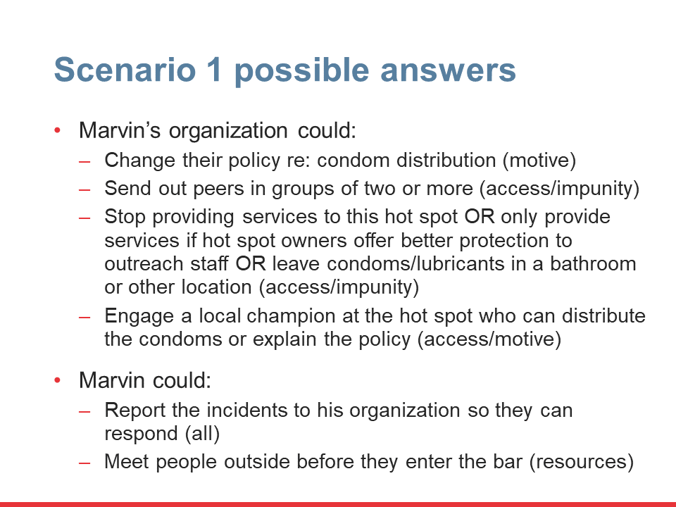
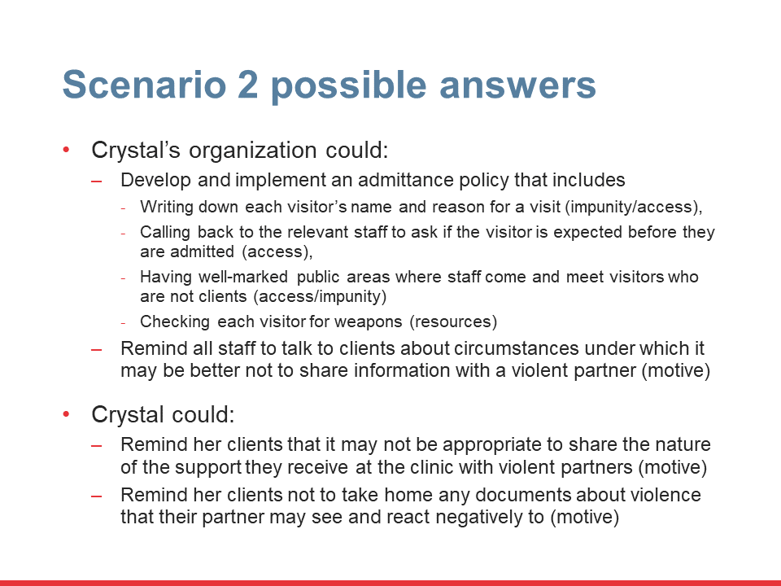
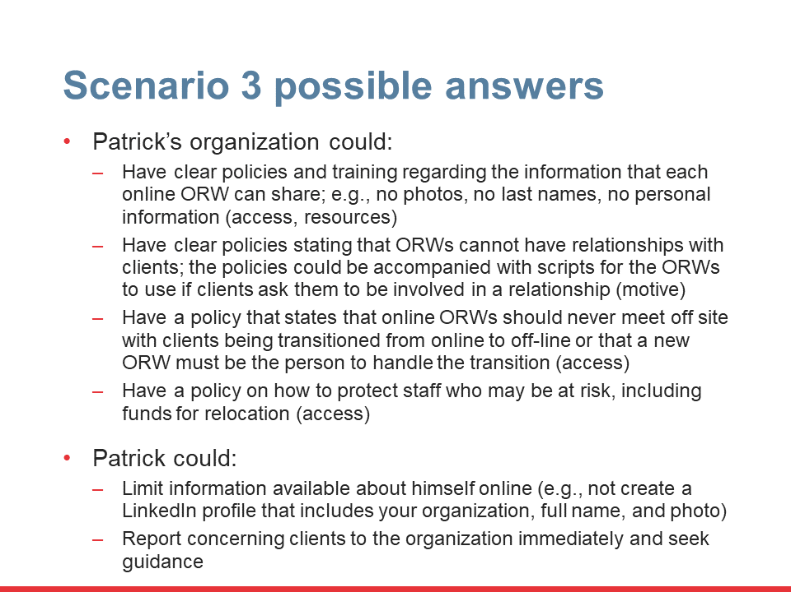
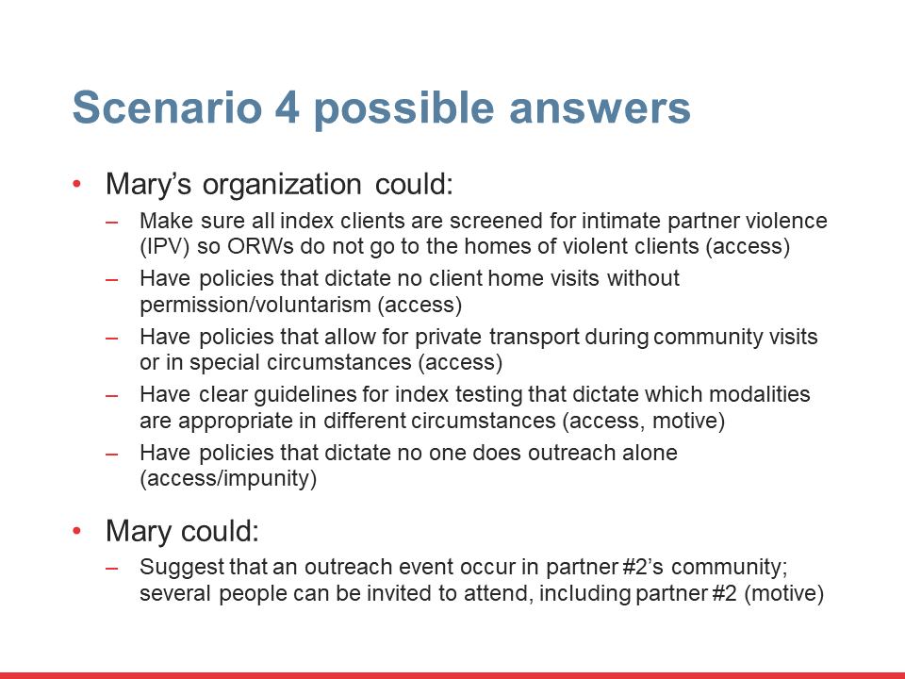
Activity N. What do these solutions have in common?
In each scenario, the solutions are primarily the responsibility of the organization and not the individual.
Organizations acknowledge their responsibility to their workers’ safety. They do not simply rely on staff/volunteers’ best judgment.
Notes:
See the Facilitator’s Handbook for more detailed instructions.
Say: Looking at all four of our possible answer slides, what do these solutions have in common? In particular, I’m thinking about who had the biggest role to play in limiting access, information, motive, and impunity.
Ask for a volunteer to respond.
Advance the slide.
Say: What they all have in common is that, in each case, it’s the organization with the biggest role to play.
Advance the slide again.
The organization has the primary responsibility for the protection of the workers. Workers need to follow instructions and report harms, but it’s the organization that needs to think, in advance, about what guidance to give workers in each area. You’ll note that this corresponds to the overarching recommendations we reviewed at the start of the day and that it also makes both ethical and logical sense. We don’t want each person using their best judgment in these situations. We want policies and protocols that keep everyone as safe as possible.

Slide 55
Digital security
Notes:
Say: Now that we’ve gotten a general sense of what we need to do to limit an attacker’s ability to cause harm, let’s speak specifically about digital spaces.

Slide 56
Session Objective
Describe the vulnerabilities inherent to digital platforms and identify risk-reduction strategies within each.
Notes:
Say: In this session we’ll describe the vulnerabilities inherent to digital platforms and identify risk-reduction strategies within each.

Slide 57
Activity O.
Menti: What devices are you using and what do they say about you?
What devices do you use in your daily life?
What could someone learn about you if they had access to your phone/tablet/computer?
Notes:
See the Facilitator’s Handbook for more detailed instructions.
Say: Let’s begin by thinking about ourselves. Please go back to Menti, enter the code, and answer two questions.
Type menti.com and the code into the chat box.
After everyone has filled them out, note that we all use a range of devices every day. More and more of our most private information is available online if others know how to access it. So, it’s up to us to use these devices as safely as possible, which is what we’ll talk about now.

Slide 58
Use passwords and make them strong
Have more than one.
Change your passwords on a regular basis (Tip: reset your passwords, then set a reminder on your phone three months from that day to change them, repeat).
A strong password has about 10 characters or more; ideally including: upper case letters, lower case letters, numbers, and symbols.
Notes:
Say: First of all, use passwords and make them strong.
Review slide.

Slide 59

Use two-step verification
Email, social media, and other sites allow you to turn on two-step verification, which asks for a code from an app or texts you a number to enter when you or someone else tries to log in to your account from an unfamiliar browser or computer.
It’s a small annoyance for you, but a huge annoyance to someone who is trying to break into your account.
https://iheartmob.org/resources/tech
Notes:
Say: Another important tip - use two-step verification.
Email, social media, and other sites allow you to turn on two-step verification, which asks for a code from an app or texts you a number to enter when you or someone else tries to log in to your account from an unfamiliar browser or computer. It’s a small annoyance for you, but a huge annoyance to someone who is trying to break into your account. This page lists current sites with two-step verification options and includes links that you will help you set it up.
This URL - https://iheartmob.org/resources/tech -̶̶̶ takes you to a technical safety guide that can explain more about how to turn this on within different websites.

Slide 60
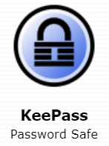
KeePass
Free, open source, password manager
Keeps passwords safe
You only have to remember one single master key to unlock the whole database of your passwords
https://keepass.info/
Notes:
Say: If you have trouble keeping track of your passwords, consider using KeePass. It is free to use and is open source, so it’s not owned by someone else. It keeps your passwords safe. You just remember one password to get into your full set of other passwords. Visit the website for more information.

Slide 61
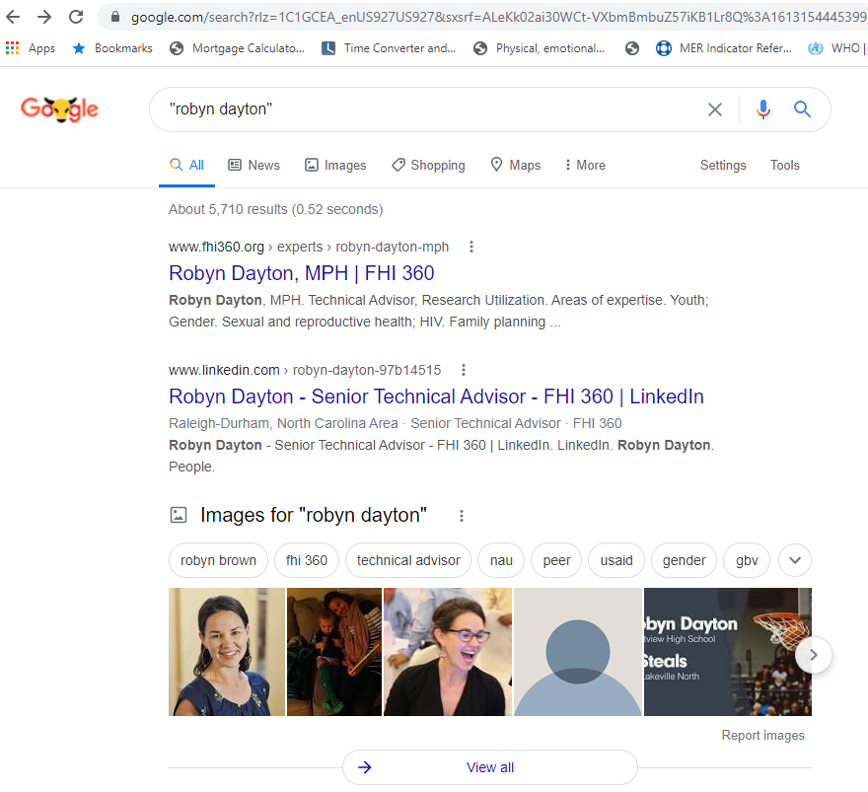
Search for yourself
Everything from our name and email address to our home address and bank information is online.
Once you find
information about
yourself online,
go about getting it
removed.
Notes:
Say: Also consider searching for yourself. This will tell you what others can find out about you online. It can be easy to find your name, your purchases (especially if you review them online), your home address, your bank information.
Once you find information about yourself, go about getting it removed from the various websites that have it. For example, if you accidentally put your home address on your LinkedIn profile, remove it.

Slide 62


Limit what you share about yourself
Do not mention details about where you live or where you like to hang out
Don’t tag a location that you’re in or post pictures that allow people to identify your location
Watch out for automatic
sharing of location on
social media
(GPS-enabled devices)
Photo credit: Tomas Nozina
Where are these people?
Photo credit: Loly Galina
Notes:
Say: Next, limit what you share going forward.
One way of reducing your risk is to restrict what you share online. For example, do not mention details about where you live or where you like to hang out (and don’t tag a location that you’re in or post pictures that allow people to identify your location).
Sometimes your photo might give you away, for example – where are these people?
Advance slide.
If you guessed Eiffel Tower, you’d be correct. So even if they didn’t tag their location, someone who wants to know where they are would be able to figure it out.

Slide 63

Limit what you share about yourself (cont.)
Avoid sharing information that will allow others to know your daily schedule.
Be careful about posting information that can be used to figure out your security question answers:
  name of a childhood pet
  your full birth date
https://safequeers.org/ has more on safe use of dating websites, etc.
Notes:
Say: Limiting what you share also means not sharing info, such as photos of yourself at the gym each day, that allow others to know your daily schedule. Also be careful posting information that could be used to answer your security questions. If you want to think about what to share on dating apps or websites, check out the safequeers link here: https://safequeers.org/.

Slide 64
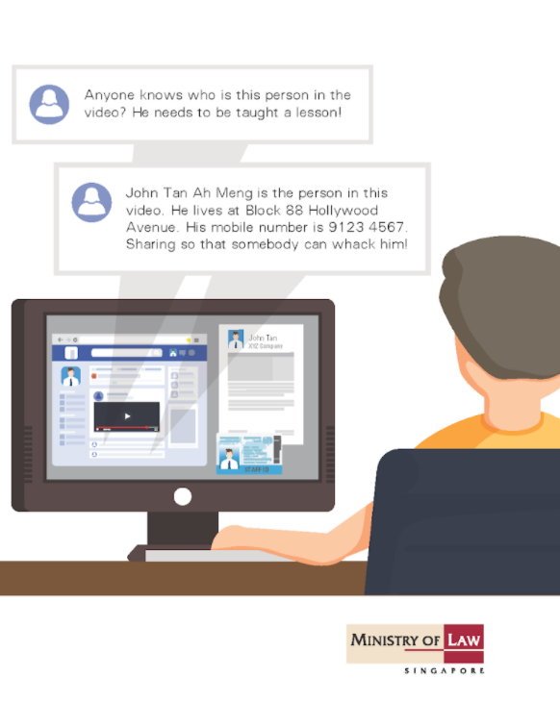
When information is used against us
Doxxing occurs when people search for and publish private or identifying information on the internet about someone else that they wish to harm.
It is a tactic used to
make individuals feel
unsafe.
Doxxing is easier than
ever because much
of our information is
online.
Notes:
Say: One of the reasons to limit information about yourself online is because one person who is against you could share your information with a larger group and coordinate efforts to harass you online. This is called doxxing.
Doxxing occurs when people search for and publish private or identifying information on the internet. It is a tactic used to make individuals feel unsafe. Doxxing is easier than ever due to the fact that so much of our information is online.
Review the text of the graphic

Slide 65






Activity P. What are we sharing on social media?
What social media do you use?
What could someone learn about you there?
Notes:
See the Facilitator’s Handbook for more detailed instructions.
Say: Now, let’s think about what we share on social media, in particular. Use the chat to tell us what social media you use and what someone could learn about you there.

Slide 66
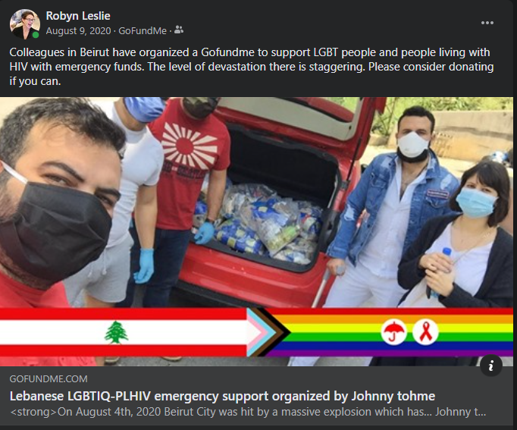
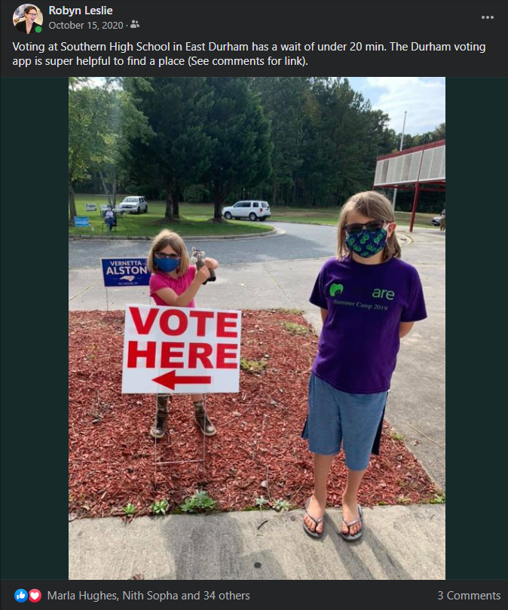
Question Q. What could someone learn about me from these social media posts?
Notes:
See the Facilitator’s Handbook for more detailed instructions.
Say: Let’s look at some relatively benign posts from Facebook. What could you learn about me from these posts?
Ask for a few people to comment out loud.
End by saying: It’s not wrong to share online. It’s fun to post on social media. However, we need to think about exactly what information we’re giving to others because once something is online, it can be deleted by the owner but that doesn’t mean it won’t be circulated by others.

Slide 67

Limit what you share about others
Photos and videos quickly reveal identities, locations, and personal information.
Get consent before taking and posting photos.
Cameras will embed hidden data. Photo sharing sites may include this content when you upload the photo. Be careful!
If no photographs are allowed in certain spaces, share this information widely.
Notes:
Say: Just as we want to be careful about ourselves, we also want to limit what we share about others.
Photos and videos can reveal people's identities very easily. It's important that you have the consent of the subject/s of any photo or video that you post. If you are posting an image of someone else, be aware of how you may be compromising their privacy. Never post a video or photo of anyone without getting their consent first.
Many cameras will embed hidden data (metadata tags), that reveal the date, time and location of the photo, camera type, etc. Photo and video sharing sites may publish this information when you upload content to their sites
If you are creating programmatic spaces where no photographs or video are allowed, use posters to make this clear. This can also help program participants remind one another about the norms of the space.

Slide 68
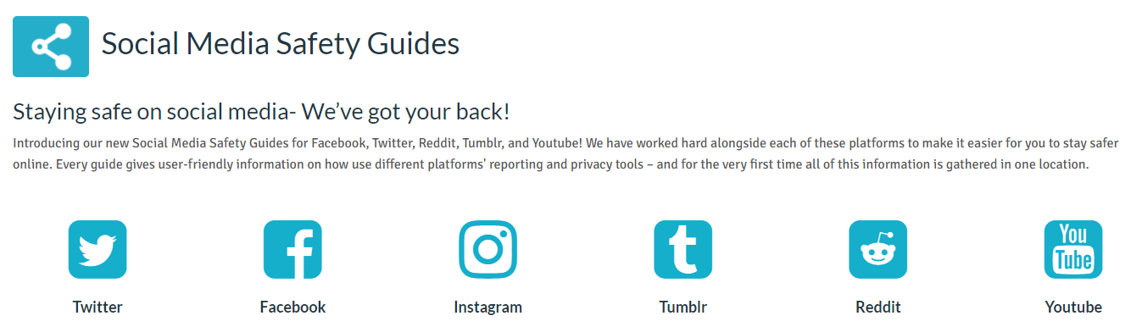
If you are harassed online, you can act
Ignore/block them – engaging can become overwhelming
Report them – and ask your friends to report them! Use Social Media Safety Guides to see more on how to report on Facebook, Instagram, etc.
Expose them – you can take photos of the harassment and hold them accountable by sharing proof of their harassment
Engage them – by explaining the stance that you took
Seek support – it can be traumatizing; speak to someone supportive
Go anonymous – e.g., attach another email to your social media account
Activity R.
Have you used any of these methods? What was the result?
Notes:
Say: You can take action if you end up being harassed online.
According to Take Back the Tech!, many people do nothing because they think they are overreacting. That is not the case. Being harassed online can be scary and exhausting. Here are some ideas:
Ignore them. We know that this is easier said than done. Sometimes it seems like the best thing that you can do is fight back and respond to every message or comment telling the trolls that they’re wrong or trying to clarify a point that you made. You don’t have to engage if you don’t want to or if it’s becoming overwhelming. It’s perfectly okay to step away and ignore the trolls.
Report them. Using Heart Mob’s Social Media Safety Guides, find the place to report the harassing messages or comments directly to the platform. Google, Twitter, Facebook, Reddit, etc. need to know that you are being harassed in order to help.
Expose them. You don’t have to hide. If you feel comfortable doing so, you can take a screenshot of your harassment and re-post it with an explanation of what is happening.
Engage them. If you feel like you need to have your voice heard, you can engage. Remember, though, the point isn’t to fight fire with fire but instead to fight fire with water. Instead of responding to an insult with an insult, you can explain the position that you took.
Seek support. Seeking support and telling your story to a trusted person who understands your experience can be a great way to reduce some of the trauma.
Go anonymous. Use a pseudonym or attach another email address to an account. Then you can still be online without being the target of harassment.
Advance slide. See the Facilitator’s Handbook for more detailed instructions on Activity R.

Slide 69


Texting options
WhatsApp is a popular
communication option
(2 billion monthly users)
owned by Facebook
Communication is encrypted end-to-end, but BIG security gaps remain:
  Anyone with your phone number can see: your “about” blurb and photo, when you were last online, and whether you’ve read a message (check privacy settings to change).
  Facebook can access: who you contact, when, how often, and from where (this cannot be turned off).
  Police with a warrant can ask Facebook for: who you’ve called or texted, or who has called and texted you.
  If you choose to back up your WhatsApp data to iCloud or Google Drive, messages are not encrypted there.
https://www.consumerreports.org/privacy/how-to-use-whatsapp-privacy-settings/?EXTKEY=YSOCIAL_FB&fbclid=IwAR2du8xBV9DPWCBUyELt5kxQdd41glfDyzhe0_tRe7TXbC8n3ScqZ7m1kCY
Notes:
Say: OK, so what about texting? Almost all of us are probably on WhatsApp. It has 2 billion monthly users. It’s also owned by Facebook.
The communication between parties is encrypted end-to-end but some serious gaps remain.
Anyone with your phone number can see: your “about” blurb and photo, when you were last online, and whether you’ve read a message (check privacy settings to change).
Facebook can access: who you contact, when, how often, and from where (this cannot be turned off).
Police with a warrant can ask Facebook for: who you’ve called or texted, or who has called and texted you.
If you choose to back up your WhatsApp data to iCloud or Google Drive, messages are not encrypted there.

Slide 70

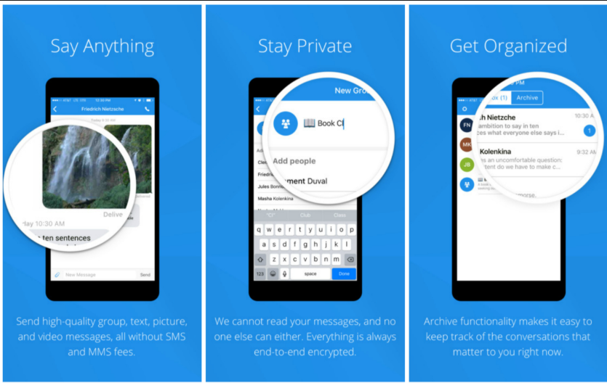
If not WhatsApp, what else?
Signal (free app) is more secure; encrypted end-to-end
Can have group
audio calls
You can send out
messages that will
disappear after a
set time
Notes:
Say: If you decide not to use WhatsApp, there are other free options. Signal is one good option.
Review slide.
There are also other options, like Gliph, if Signal is not a good fit for you.

Slide 71
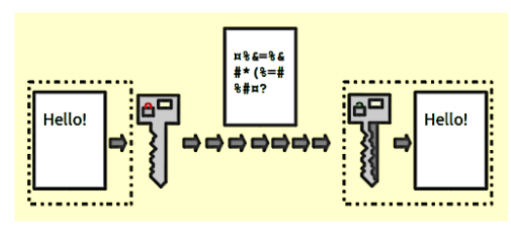
Encryption and document protection
Consider encryption (Veracrypt lets you create a secret folder not visible unless you know how to look for it)
Consider changing file names on your computer
  Instead of “MSM outreach_X location”
  Use “Project activities_Code name for X location”
What is encryption?
https://medium.com/searchencrypt/what-is-encryption-how-does-it-work-e8f20e340537
Notes:
Say: We don’t just need to protect ourselves and our beneficiaries on social media and when we’re texting, we also want to protect their data wherever it’s stored. Encryption and document protection are part of this.
Encryption is a process that encodes a message or a file so that it can only be read by those with the “key” to that file. There are free encryption options like Veracrypt. It lets you create a secret folder that is only visible to those who know how to look for it.
You can also do less complex things to protect data. For example, change the file names on your computer. Don’t call something “MSM outreach in New York City” instead call it “Project Activities_Code name for New York.”
Review slide contents.

Slide 72
Activity S. Linking Problems to Solutions
Problem | Answer | Solution options
Online outreach workers are receiving unwanted sexual advances |  | A. Include guidance on what online workers can share, including names/photos/locations
Online outreach workers are being stalked by clients |  | B. Provide scripts to guide online conversations and respond to sexual advances
Clients are blackmailing peers using screen shots from online outreach conversations |  | C. Use closed Facebook (or other platform) groups and have a process to verify individuals’ identities before they join
 |  | D. Share names/photos of habitual harassers so that they are not engaged in online programming
 |  | E. Have policies that prevent workers from having romantic relationships with clients
A, B, C, D, E
A, B, C, D, E
A, B, C, D, E
Notes:
See the Facilitator’s Handbook for more detailed instructions.
Say: Now let’s think about a few specific problems we might encounter. I’m going to read the first problem and all the solutions. You use the chat to enter in the letters of the solutions that could work to solve problem 1. You can choose more than one letter.
Read problem one and all the solutions. Get chat answers. Ask a few people to explain their selection. Advance slide to show answers.
Read problem two. Ask a few people to explain their selection. Advance slide to show answers.
Read problem three. Ask a few people to explain their selection. Advance slide to show answers.
End by explaining that many solutions can solve or mitigate several problems. We don’t need one solution per problem. And not all digital solutions require the help of a software developer.

Slide 73

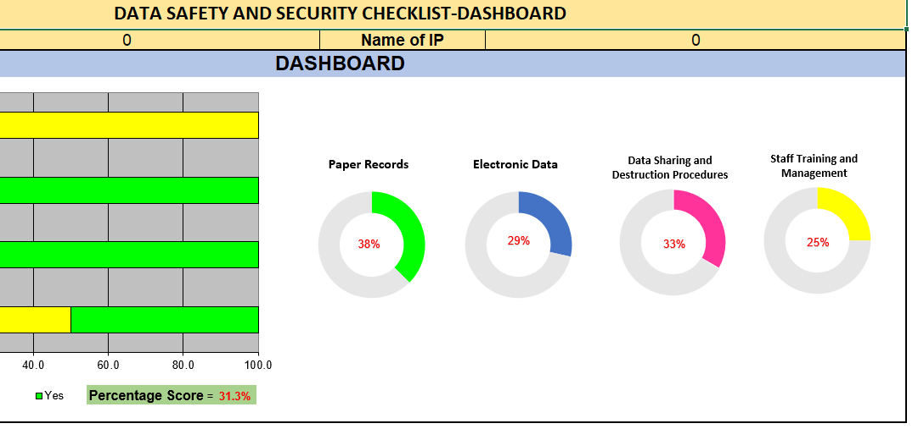
Additional tools and guidance: Strategic information
EpiC and LINKAGES developed a dashboard for self-assessment and guidance on the security of strategic information
Visit: https://www.fhi360.org/resource/implementer-and-data-security
Notes:
Say: EpiC and LINKAGES have developed tools that are designed to help you keep data safe within your program. You can download them here:
Ensuring compliance with the LINKAGES Data safety and security checklist: https://www.fhi360.org/sites/default/files/media/documents/data-safety-guidance.pdf
LINKAGES Data safety and security checklist:
https://www.fhi360.org/sites/default/files/media/documents/data-safety-checklist-1.xlsx
Ensuring compliance with the EpiC Data safety and security checklist: https://www.fhi360.org/resource/implementer-and-data-security
EpiC Data safety and security checklist:
https://www.fhi360.org/resource/implementer-and-data-security

Slide 74
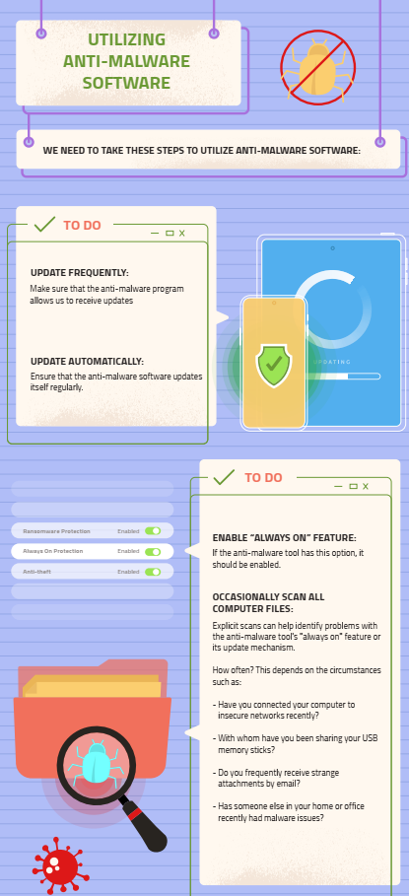
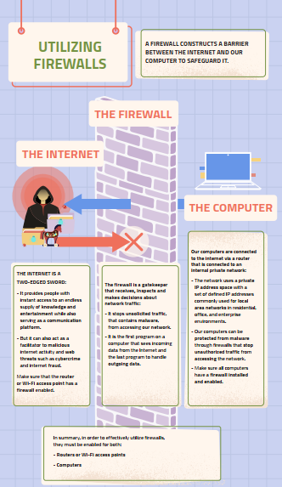
Additional tools and guidance: General online security
In collaboration with LINKAGES, the Arab Foundation for Freedoms and Equality developed a virtual digital security training that helps both program implementers and beneficiaries use the internet safely.
The self-paced and
live trainings can be
found here:
https://afemena.org/digital-security-sessions/
Notes:
Say: If you’re interested in learning more about operating securely online, you can take an asynchronous or live training from the Arab Foundation for Freedoms and Equality. It helps the user learn about and mitigate everyday risks found online.

Slide 75
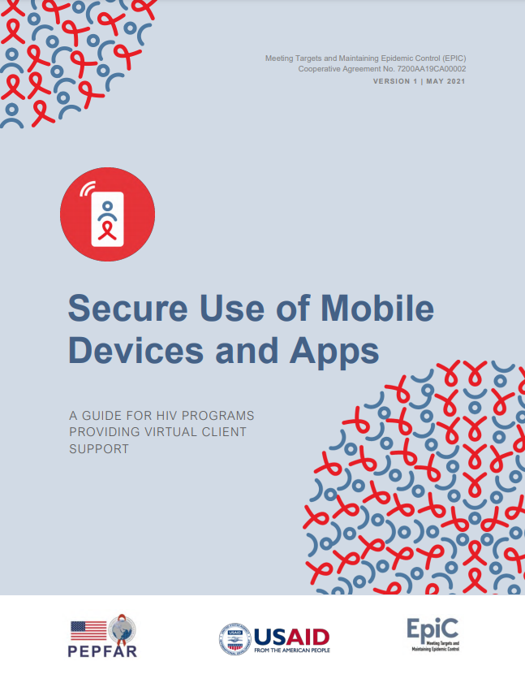
Additional tools and guidance: Secure use of mobile devices and apps
Supports organizations in the secure use of mobile devices and apps
Topics:
  Choosing devices
  Deploying/managing devices
  Client privacy and protection
  Virtual case management
Website: https://www.fhi360.org/sites/default/files/media/documents/resource-secure-mobile-devices-apps.pdf
Notes:
Say: There is also specific guidance, from EpiC and LINKAGES, on purchasing or managing devices and apps. This guidance is meant to support organizations with their selection and management of mobile devices and apps for staff who provide virtual client support, as provided by outreach workers, case managers, or clinical staff. It covers a range of considerations around accessibility, affordability, and functionality, and includes a special emphasis on security and mitigating risk. It includes chapters on
1. Choosing Devices
2. Deploying and Managing Devices
3. Client Privacy and Protection
4. Virtual Case Management

Slide 76
Review our own capacities and plan for skill sharing
Notes:
Say: Now we’ve covered what I have to share about building your skills. It’s your turn to teach one another.

Slide 77
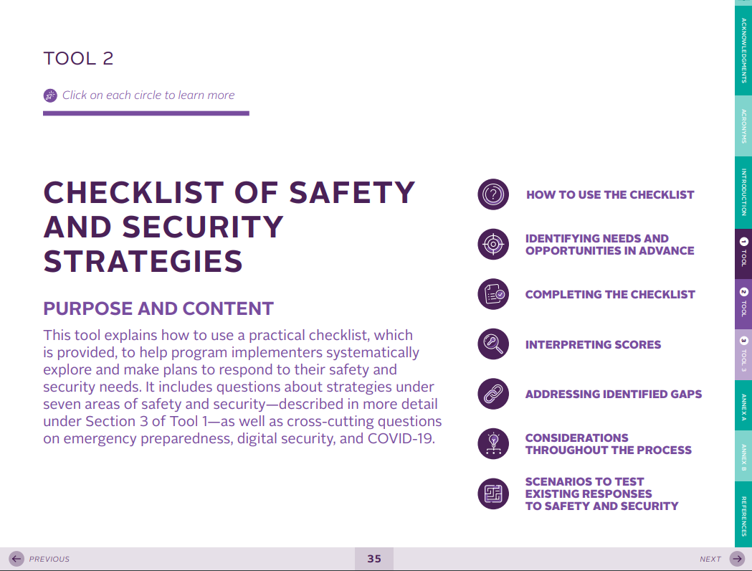
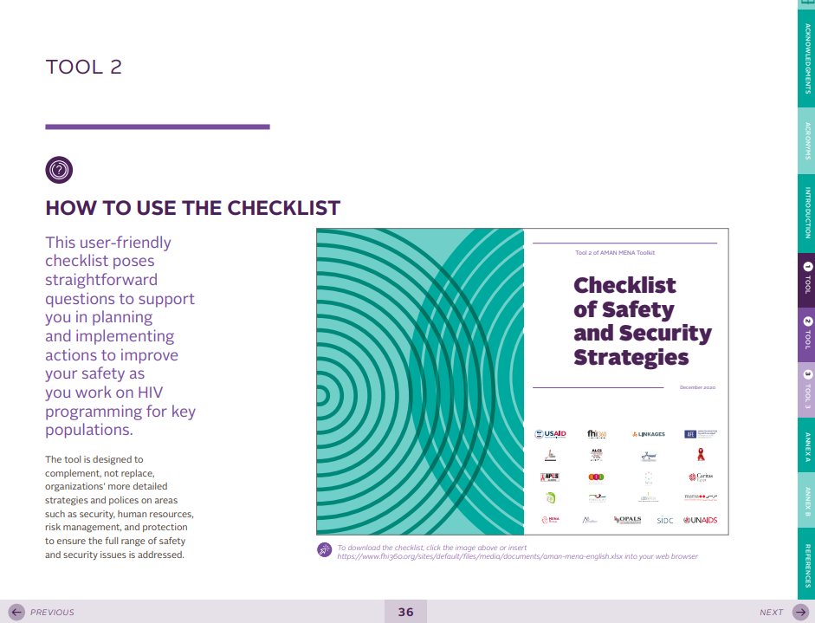
Session Objectives
Review collective responses to the security assessments (checklists).
Assign each implementing partner to a skill to be presented in the next session.
The checklist that each partner should fill out is part of the AMAN MENA (Secure in MENA) toolkit. A hyperlink to the checklist can be found at the start of Tool 2 in the toolkit, available in Arabic, English, and French. All three toolkits can be found here: https://www.fhi360.org/resource/aman-mena-toolkit
Notes:
Say: In this session we will look at your collective responses to the security checklists and then we’ll choose one skill for each implementing partner to teach to the others. You’ll have time to prepare what you teach before we come back together for our third session.
Everyone should have already completed a checklist to review your security strategies. A hyperlink to the checklist can be found in the AMAN MENA toolkit, which is available in French, English, and Arabic. The hyperlink to the checklist is at the start of Tool 2.

Slide 78
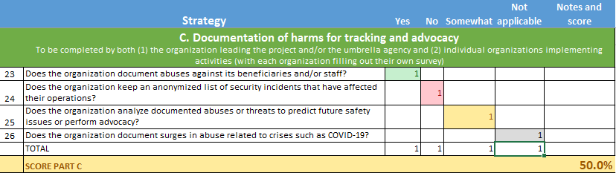
Step 1
Each implementer completes a checklist of existing security activities
Train implementers together on prioritizing risks and security activities; develop security plans
Support implementers to develop (and ideally fund) priority security efforts
Areas of security assessed in the checklist
Cultivating and sensitizing external allies
Influencing public perception of the project or organization
Documenting harms for tracking and advocacy
Protecting offices, drop-in centers,
and other physical locations
Keeping workers safe during physical and digital outreach
Developing functional and institutionalized security protocols, including for emergencies
Keeping data and communications safe
Cross-cutting: emergency preparedness, digital safety, COVID-19
Notes:
Say: As you remember, at the beginning of this workshop we filled out the checklist. It was organized according to the domains above. And for each domain you answered questions about the strategies you employed. You each got a score in each domain. For example, this organization’s score was 50% for documentation of harms for tracking and advocacy. Those scores help you compare across domains and see how you’re doing in each area.

Slide 79
Activity T (part 1). IP Teaching Assignments
Notes:
See the Facilitator’s Handbook for more detailed instructions.
The graphs here should be replaced with the checklist scores you collected in advance.
Say: Here we can see our collective scores on the security checklist. We note that all organizations had some strong areas and some gaps.

Slide 80
Activity T (part 2). IP Teaching Assignments
Look at the area you will be teaching
Pick at least one strategy from within this area that you would like to share with others
Create four slides
  Title slide: Organization name and
  topic name
  How to implement this strategy
  Any tools to support implementation
  Results of anecdotal evidence on how this strategy helped
You will have 10 minutes to present and then 5 minutes for questions
Presentations will be at X time on Y date
Assignments:
??? = public perception (A)
??? = external allies (B)
??? = documenting harms (C)
??? = protect physical sites (D)
??? = protect outreach (E)
??? = protocols (F)
??? = data and communication (G)
??? = emergencies (CC1)
??? = digital security (CC2)
??? = COVID-19 (CC3)
Notes:
Say: The very best way to improve our security strategies is to learn from others operating in similar contexts. We’re going to do that by assigning each of you to teach a security strategy to your peers during the next session. You can see the assignments here.
Please look at the domain you’re been assigned. Pick a security strategy from that domain. Create four slides about that strategy. They should cover:
Title slide: organization name and topic name
How to implement this strategy
Any tools to support implementation
Results of anecdotal evidence on how this strategy helped
You will have 10 minutes to present next time we’re together. Then your colleagues will have 5 minutes to ask you questions.
Share the time/date of this event.

Slide 81
Activity T (part 3). Example
The CSO, “Health for One and All” is assigned to Domain C: Documentation of harms.
The CSO looks at the strategies under C
and chooses at least one to share with the larger team.
Notes:
Say: This example helps us to understand what I mean by picking a strategy within the domain. This organization, “Health for One and All” was assigned domain C.
You can see from their checklist responses that the strategy they are fully implementing is number 23, “the organization documents abuses against its beneficiaries/staff,” so this is the strategy they will present on.

Slide 82
Day 2 closing
Notes:
Say: So, now that we understand the assignments going forward, we will end the second day.

Slide 83
Session Objective
Complete Day 2 evaluation
Notes:
Review slide.

Slide 84
Activity U. Day 2 Closing
Notes:
See the Facilitator’s Handbook for more detailed instructions.
Say: Thank you for visiting Menti to share your opinions on the day. We will continue to seek to improve based on your feedback.
A follow-up email will include slides from today, including a reminder about your homework assignment.
Type menti.com and the code into the chat.

Slide 85
Strengthening the Security of
HIV Service Implementers Working with Key Populations
A virtual training for
organizational leadership
DAY 3
Notes:
Say: Today will be all about group presentations. We will not have formal content from a facilitator.

Slide 86
Session Objectives
Share a security strategy assigned to your CSO.
Ask questions about all presented strategies to gain understanding of implementation, and pros and cons of the strategy.
Notes:
Say: This session is often the one that participants remark is most useful. Each IP will be sharing a security strategy per the instructions given last time. After the IP presents for 10 minutes, there will be 5 minutes for questions and answers.

Slide 87
Activity V. Implementing partner presentations
Each should have
  Title slide: Organization name and topic name
  How to implement this strategy
  Any tools to support implementation
  Results of anecdotal evidence on how this strategy helped
Notes:
See the Facilitator’s Handbook for more detailed instructions.
This slide describes the four slides that each organization should prepare in advance for this session. It will be removed from the training once you have the slides from all IPs.

Slide 88
Strengthening the Security of
HIV Service Implementers Working with Key Populations
A virtual training for
organizational leadership
DAY 4
Notes:
Say: We have arrived at the final day of our training! Welcome back.

Slide 89
Day 2 recap and Special Session reflections
Notes:
Say: Let’s talk about what we covered on day 2 and reflect on the special session you just attended.

Slide 90
Session Objectives
Reflect on strategies presented during the special session.
Remember the topics covered on Day 2.
Notes:
Review slide.

Slide 91
Activity W. Key takeaways
Thinking of the skills and strategies you learned from your colleagues during the last session, share a few ideas that you plan to use at your organization.
Notes:
See the Facilitator’s Handbook for more detailed instructions.
Say: Let’s begin with the special session. Could we please have two to three volunteers to reflect on what they learned in the last session? In particular, I’d like to know what you believe you can use at your own organization.
After several people have shared, note that we all bring a lot of practical knowledge to this work. None of us are starting from scratch. And as you saw last time, you can all learn a lot from one another. This training is just the first part of that work.

Slide 92
Activity X. Remembering Day 2
Menti.com
Notes:
See the Facilitator’s Handbook for more detailed instructions.
Say: Please go to Menti.com to answer questions on Day 2.
Type the link and code into the chat.

Slide 93
Using what you’ve learned: Security challenge scenarios
Notes:
Say: Now that we have learned quite a lot, let’s put our knowledge to use on more complex case studies.

Slide 94
Session Objectives
Brainstorm what your organization could do if faced with a variety of security challenges.
Discuss whether the “possible solutions” after each scenario would be appropriate in the local context.
Notes:
Say: In this session, you’ll work with others at your organization to think about how to respond to a specific security challenge. Then you’ll report out to the group. Finally, I’ll share some possible solutions, and you’ll comment on whether these could also be appropriate.

Slide 95
Eight security incident scenarios
Local religious leaders claim that your organization is promoting sin by distributing condoms and lubricants. As a result, there is an increase of
physical and verbal abuse against peer educators.
A worker reports that he has been harassed by another worker.
An outreach worker is arrested while distributing condoms; she is held
by police.
After an HIV outreach activity at a hot spot, a beneficiary puts photos of the outreach workers and KP members on Facebook and tags them.
Your organization’s office is raided; police take all the files and computers.
A hostile article about your organization is printed in the newspaper. It gives the address of your clinic and includes photographs of two of your clinicians.
A beneficiary threatens one of your peer outreach workers with blackmail. The beneficiary says he will tell the outreach worker’s parents that the worker is gay.
A nurse goes to the home of a man named by an index client. The man responds violently. He attacks the outreach worker (ORW) and gives the ORW several injuries. He also holds the ORW against his will for three hours.
Notes:
Say: Here are the eight scenarios we’ll be covering. I will assign each organization to cover one of these scenarios.

Slide 96
Activity Y. Using what you’ve learned
IP name | Case Study
 | 1
 | 2
 | 3
 | 4
IP name | Case Study
 | 5
 | 6
 | 7
 | 8
What can you do now?
What could you have done, before this issue occurred, to mitigate or prevent the harms caused?
After the group presents their answers, some possible solutions will be shown. The presenting group should respond to the possible solutions, noting whether any possible solutions are inappropriate/irrelevant in their setting or could be good additions to what they already presented.
Notes:
See the Facilitator’s Handbook for more detailed instructions.
Say: I will now assign each IP to one case study/scenario. I am pasting all the case studies/scenarios into the chat for easy reference.
Paste case studies/scenarios into the chat.
Assign each IP to a case study by typing this information onto the slide.
You will have five minutes to discuss what could you do now and what could you have done in advance.

Slide 97
Activity Y. Scenario 1
Local religious leaders claim that your organization is promoting sin by distributing condoms and lubricants. As a result, there is an increase of physical and verbal abuse against peer educators.
What can you do now?
What could you have done, before this issue occurred, to mitigate or prevent the harms caused?
Notes:
Say: Let’s begin with our first scenario. Could the first team please present?

Slide 98
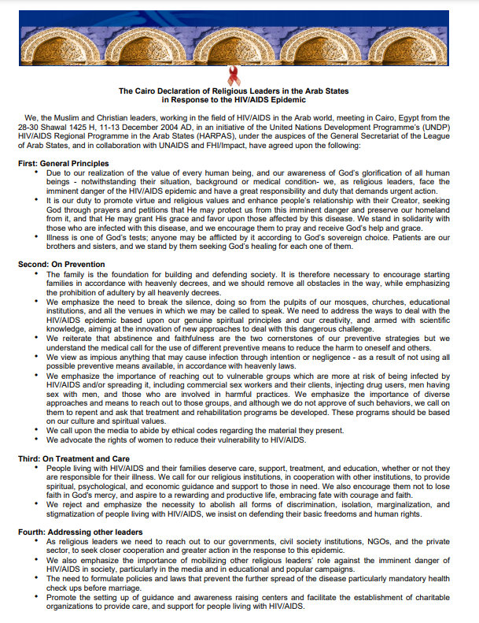
Scenario 1 – Possible solutions
In advance:
  Work with religious leaders to explain your work. Providing health care to the most vulnerable aligns with the teaching of most major religions. Religious leaders can be powerful advocates for HIV programs.
  Have a security incident tracking log so that it is clear which areas are seeing increased abuse.
After the incident:
https://www.fhi360.org/resource/cairo-declaration-religious-leaders-arab-states-response-hivaids-epidemic-pdfs-arabic-and
  Provide support to impacted peer educators (including mental and physical health care, legal, other psychosocial).
  Reduce outreach activities in particularly impacted areas, at least temporarily.
  Report back to the donor with the issue, proposed responses, and any anticipated changes in ability to meet objectives/targets.
  Ask local health officials to reach out to religious leaders and/or to convene a meeting where it is possible to explain the nature of your work and its alignment with government objectives related to public health.
Notes:
Say: Thanks so much to our first team. Here are some possible solutions. You covered many of these. I am going to go over them. If I mention a solution that you don’t think would be appropriate in your context – which is very possible, security is always contextual – then please let me know after I finish.
Review slide.

Slide 99
Activity Y. Scenario 2
A worker reports that he or she has been harassed by another worker.
What can you do now?
What could you have done, before this issue occurred, to mitigate or prevent the harms caused?
Notes:
Say: Now for team 2.

Slide 100
Scenario 2 – Possible solutions
In advance:
  Create codes of conduct for staff; develop policies to address grievances that ensure multiple levels of accountability, such as complaints directly to the board, and socialize all workers on the policies as part of on-boarding
After the incident:
  Follow existing policies to address the harassment without putting the victim at risk of retaliation OR develop new policies if no relevant policies exist
  Retrain workers on the code of conduct (or provide an
  initial training)
  Offer mental health support to the person who was harassed
Notes:
Say: Thanks so much to our second team. Here are some possible solutions. You covered many of these. I am going to go over them. If I mention a solution that you don’t think would be appropriate in your context – which is very possible, security is always contextual – then please let me know after I finish.
Review slide.

Slide 101
Activity Y. Scenario 3
An outreach worker is arrested while distributing condoms and is being held by police.
What can you do now?
What could you have done, before this issue occurred, to mitigate or prevent the harms caused?
Notes:
Say: Now for team 3.

Slide 102
Scenario 3 – Possible solutions
In advance:
  Work with local authorities to receive permission for all outreach activities, and train senior and front-line law enforcement officers on their role in the HIV response, including creating an enabling environment for outreach activities.
  Train outreach staff to explain the nature of their activities to law enforcement and provide them with official documentation (such as ID cards or letters from local authorities or the Ministry of Health) describing their purpose.
  Identify lawyers who can support the organization as needed if issues arise.
After the incident:
  Call allied lawyers or an in-house attorney to follow up immediately (if there is no funding for a lawyer and no opportunity to engage a lawyer pro bono, reach out to Dignity for All [focused on LGBT communities], Frontline Defenders, The Lifeline Embattled CSO Assistance Fund, or other funds
  for support).
  If contacts with the police exist, call these individuals to discuss next steps.
  If there is a desire to make the issue more publicly visible (for example, by activating allies), ensure that this case is thoroughly investigated before taking this step.
Notes:
Say: Thanks so much to our third team. Here are some possible solutions. You covered many of these. I am going to go over them. If I mention a solution that you don’t think would be appropriate in your context – which is very possible, security is always contextual – then please let me know after I finish.
Review slide.

Slide 103
Activity Y. Scenario 4
After an HIV outreach activity with KP members, a beneficiary posts photos of the outreach workers and community members on Facebook and tags them.
What can you do now?
What could you have done, before this issue occurred, to mitigate or prevent the harms caused?
Notes:
Say: Now for team 4.

Slide 104
Scenario 4 – Possible solutions
In advance:
  Inform people who come to any events whether the space is photo-friendly (this can also help beneficiaries who see others taking photos to remind them of policies or report them as needed).
After the incident:
  If the photos are posted without negative intent, reach out to the person to take them down and explain the importance of not posting such photos in the future.
  If an individual knowingly violated clear policies or will not take down photos, do not allow them to participate in future events.
  Report the individual to Facebook administrators who can suspend their profile.
  Notify those who were identified and explain the steps being taken to address the issue. Provide them with support as needed if the posting causes emotional or physical abuse.
Notes:
Say: Thanks so much to our fourth team. Here are some possible solutions. You covered many of these. I am going to go over them. If I mention a solution that you don’t think would be appropriate in your context – which is very possible, security is always contextual – then please let me know after I finish.
Review slide.

Slide 105
Activity Y. Scenario 5
The organization’s office is raided by the police, and police take all the files and computers.
What can you do now?
What could you have done, before this issue occurred, to mitigate or prevent the harms caused?
Notes:
Say: Now for team 5.

Slide 106
Scenario 5 – Possible solutions
In advance:
  Protect all technology that includes stored information with passwords and encryption.
After the incident:
  Create a plan that describes what will happen to support those named if data are leaked.
  Reach out to senior allies within the police force to give you advice on how to proceed. For example, clarify what will be done with these materials and encourage them not to misuse or share medical files and other personal information.
  If the seizure was not legal, consider contacting a lawyer to challenge materials taken without a warrant.
  Report back to the donor with the issue, proposed responses, and any anticipated changes in ability to meet objectives/targets.
Notes:
Say: Thanks so much to our fifth team. Here are some possible solutions. You covered many of these. I am going to go over them. If I mention a solution that you don’t think would be appropriate in your context – which is very possible, security is always contextual – then please let me know after I finish.
Review slide.

Slide 107
Activity Y. Scenario 6
A hostile article about your organization is printed in the newspaper; it gives the address of your clinic and includes photographs of two of your clinicians.
What can you do now?
What could you have done, before this issue occurred, to mitigate or prevent the harms caused?
Notes:
Say: Now for team 6.

Slide 108
Scenario 6 – Possible solutions
In advance:
  Connect with local authorities and law enforcement to explain, in conjunction with a Ministry of Health (MOH) official, the nature of your organization’s activities.
  Register your organization.
  Work to build relationships with powerholders, such as religious leaders or local authorities, who can defend your organization.
  Have a clear policy that describes how your organization interacts with journalists and use press statements instead of interviews. In an interview, comments made by your organization’s staff or members may be distorted or taken out of context.
After the incident:
  Increase security at the clinic.
  Inform allied local authorities of the issue and ask for their support in case violence against the organization or individual providers occurs.
  Support the clinicians to relocate briefly or change their responsibilities (such as only having them work during day shifts or stop doing community-based activities) if they believe they will be in danger.
  Have the MOH write an article clarifying the role of the organization and its importance to the health of the community.
Notes:
Say: Thanks so much to our sixth team. Here are some possible solutions. You covered many of these. I am going to go over them. If I mention a solution that you don’t think would be appropriate in your context – which is very possible, security is always contextual – then please let me know after I finish.
Review slide.

Slide 109
Activity Y. Scenario 7
A peer outreach worker at your organization is blackmailed by a beneficiary who threatens to tell the worker’s parents that the worker is gay.
What can you do now?
What could you have done, before this issue occurred, to mitigate or prevent the harms caused?
Notes:
Say: Now for team 7.

Slide 110
Scenario 7 – Possible solutions
In advance:
  Have a clear code of conduct for program participants that includes expectations of confidentiality and describes consequences of a failure to meet these expectations.
  Talk to peers and other staff about the risks they may face, including in their personal lives, because of their work and help them decide whether they wish to take on a role that may increase the chances their families or friends will discover their KP-status if it is not already known.
After the incident:
  Support the mental health of the worker by providing active listening and linking them to a counselor, if desired.
  Offer to help facilitate a conversation with the worker and their parents,
  if desired.
  Explain the local legal context (for example, is the beneficiary’s action illegal) and options to the worker; these include no action (blackmail is often not carried out) and blocking the beneficiary on social media and phone. Once the worker decides on an option, provide support as relevant as they carry out their choice.
  Prevent the beneficiary from returning to any future program events.
Notes:
Say: Thanks so much to our seventh team. Here are some possible solutions. You covered many of these. I am going to go over them. If I mention a solution that you don’t think would be appropriate in your context – which is very possible, security is always contextual – then please let me know after I finish.
Review slide.

Slide 111
Activity Y. Scenario 8
An outreach worker (ORW) goes to the home of a man named by an index client. The man responds violently. He attacks the ORW and gives the ORW several injuries. He also holds the ORW against his will for three hours.
What can you do now?
What could you have done, before this issue occurred, to mitigate or prevent the harms caused?
Notes:
Say: Now for team 8.

Slide 112
Scenario 8 – Possible solutions
In advance:
  Offer several index testing modalities (with IPV screening to inform selection).
  Have clear guidance on when home visits should occur (e.g., person visited must give consent in advance), and how these visits should be carried out (e.g., always in pairs).
  Have a system in place to track workers conducting outreach (e.g., know where they are going, expected arrival and return; consider tracking
  using GPS).
  Offer medical insurance to workers and/or develop a system for them to receive free medical care if injured on the job.
After the incident:
  Have the supervisor alert leadership of the ORW’s late return.
  Connect the ORW to free treatment of injuries.
  Provide the ORW with psychological resources.
  Contact police to file a report against the perpetrator (if in line with
  ORW’s wishes).
  Place potential client on a “no contact” list for future reference.
Notes:
Say: Thanks so much to our final team. Here are some possible solutions. You covered many of these. I am going to go over them. If I mention a solution that you don’t think would be appropriate in your context – which is very possible, security is always contextual – then please let me know after I finish.
Review slide.

Slide 113
Activity Z. Reflections on the Scenarios
Q: Thinking about the eight scenarios we have just discussed, why are actions taken before the security challenge so important?
A: There are three major reasons:
When you have a security plan in place before a security challenge occurs, you can respond more quickly and in a more organized/efficient way than if you try to develop a plan while in the middle of a crisis.
Security planning puts structures and relationships in place that prevent security challenges from happening or makes them less harmful if they do occur.
It is much less costly (time and money) to prevent a security incident than to respond to one.
Notes:
See the Facilitator’s Handbook for more detailed instructions.
Say: Thank you for reflections. They have been excellent. It really demonstrates for us how much we know about our own contexts. Since all security is contextual, we each have expertise in what will work for ourselves.
I’d like to end with one final reflection that is not just about what to do but when to do it. Thinking about the eight scenarios we have just discussed, why are actions taken before the security challenge so important?
Ask for a few volunteers. Allow them to unmute and share responses.
Advance the slide and review the answer on the screen.
Ask if there are any questions.

Slide 114
Final reflection on security scenarios
If your organization has specific concerns that were not covered here, write each one down. Then, do this exercise using those concerns.
Plan now to avoid negative consequences later!
X
UNPREPARED
Notes:
Say: In conclusion, you all have learned a lot and brought a lot to this training. If your organization has specific concerns that were not covered here, write them down. Then do this exercise together. You can generate more thoughtful and creative answers during a relatively calm period.
Please plan now to avoid issues later. It is very easy to go from unprepared to prepared.
Advance slide.

Slide 115
Risk assessment formula
Notes:
Say: It’s time now to think about our priorities. We have identified many things we could do to improve our security; how do we decide which ones to prioritize?

Slide 116
Session Objective
Become familiar with the formula for determining the likelihood that a given harm will occur.
Notes:
Say: In this session we will become familiar with a formula for determining the likelihood that a given harm will occur. This will help us decide which harms to prioritize when we create security plans. It will also help us decide which vulnerabilities we can limit and which we cannot.

Slide 117
Trade-offs
Limiting an attacker’s access, resources, and motivations can have trade-offs for you as an individual and as an organization.
How do you decide what vulnerabilities to accept?
Notes:
Say: Before I show you the formula, one of the things we have to consider is trade-offs. Limit a potential attacker’s access, resources, and motivations could have trade-offs for either individuals, organizations, or both. For example:
An organization may decide to limit peer educators’ outreach efforts in order to keep them from being accessible to attackers. But this also limits access for clients. Peer educators cannot limit access to themselves completely and still do jobs such as provide instructions on how to use condoms appropriately.
A clinic that serves men who have sex with men may consider removing their address from their website so that they are more difficult to find. This may keep potential attackers from finding them but may also keep potential clients from finding them.
We need a way to decide which vulnerabilities to accept.

Slide 118
Take action to make the risk low
Threats – you can assess these indications and can perhaps change them over time, but you have limited control over them (external)
Vulnerabilities – inherent to you/your community; some you can control, others you cannot (internal)
Capacity – what you constantly want to work to increase (internal)
Include threat assessment questions
Include what potential attackers need (access, resource, motive, impunity)
Threats
X
Vulnerabilities
Risk of something
=
Capacities
Includes security strategies catalogued in the checklist
Notes:
Say: Let’s go over a formula that can help us answer the questions of which areas need more investment and which vulnerabilities we will attempt to limit. You see reminders of our definitions at the top. We covered these the first day. These are to remind us what each term in the formula refers to.
This formula helps determine the risk of something. It is calculated by thinking about the threats that suggest this “something” will occur multiplied by the vulnerabilities that make us more vulnerable to it and then divided by the capacities that could keep it from occurring.
You also see boxes that tell you where and how you can find this information. The threats can be quantified, as desired, by using the threat assessment questions. These were presented on Day 1. The vulnerabilities can be calculated by thinking about all of the things a potential attacker needs and which of those are available in your case. Finally, the capacities can come from the strategies you catalogued in the checklist.

Slide 119


We want to go from this...
To closer to this
Threats
Existing Capacities
New Capacities
Threats
Vulnerabilities
Existing Capacities
Vulnerabilities
Threats and vulnerabilities far outweigh capacities
Capacities are equal to or greater than threats and vulnerabilities
Notes:
Say: Here is another way to think of it, we want to go from this scenario, where the threats and vulnerabilities outweigh the capacities, to this (advance slide) where the vulnerabilities are lessened, and new capacities are added to the old ones.

Slide 120
Formula for calculating risk
Threats
X
Vulnerabilities
Risk of something
=
Capacities
Threats = 5
X
Vulnerabilities = 10
Risk of something = 25
=
Capacities = 2
Threats = 5
X
Vulnerabilities = 8
Risk of something = 20
=
Capacities = 2
Threats = 5
X
Vulnerabilities = 8
Risk of something = 8
=
Capacities = 5
Realistically, risk never goes to zero and situations change quickly. This tool gives you a relative sense of how likely different harms are so you can compare one risk to another and compare your own level of risk over time.
Notes:
Say: Looking at it numerically, we can see how the risk of something changes based on changes to vulnerabilities and capacities. Changes to threats also change the total, but since the threats are often outside of our control, we’ll focus on changing the vulnerabilities and the capacities.
Advance slide.
In the red formula, the vulnerabilities are 10 and the capacities are 2. The threats are 5. Advance slide. The risk of this specific thing occurring is 25.
Advance slide.
If we lower the vulnerabilities from 10 to 8 and keep the capacities the same, we still lower the risk. Advance slide. Now the risk is 20.
Advance slide.
If we also increase our capacities from 2 to 5, we see an even bigger change. Advance slide. Now the risk is 8.
Please note that this tool is just for conceptualizing the risks faced. You don’t have to actually enter numbers into it for it to be useful. It simply describes the relationships between all of these factors. It’s also important to remember that risk never really goes to zero. This tool gives you a relative sense of how likely different harms are, compared to one another, but threats, vulnerabilities, and capacities constantly evolve so it’s not meant to definitively determine that a given harm could never occur.

Slide 121
Risk Assessment Example
Threats
X
Vulnerability
Risk of something
=
Capacity
Pick a specific risk (location, activity, person)
  Our CSO is worried that our peer ORWs will be physically assaulted during outreach
Consider threats that make the risk likely
  Verbal abuse, including threats of physical violence, occurred in the past; the perpetrators are often the bar owners. Verbal threats are increasing.
Name your vulnerabilities
  Outreach is done by sex workers; it occurs at night; transport is on foot
Name your capacities
  Peer outreach workers wear ID cards that show they are connected to the Ministry of Health and include a phone number to reach a locally trained police officer; peers go out in pairs; peers have phones with pre-paid airtime in case they encounter issues
Notes:
Say: Let’s use this formula in a real-life situation.
Advance slide.
Here we think about a specific risk. In this case, our CSO is worried that ORWs will be physically assaulted during outreach. Note that I’m including the type of worker I’m worried about, the place that I’m concerned about, and the specific activity they’ll be engaged in.
Advance slide.
Now look at the threats that are making this risk seem likely to occur. We have had verbal abuse, including threats of physical violence, in the past. We know that the perpetrators are bar owners. Verbal threats are increasing. As you remember, when threats increase or become more systematic over time, that let’s us know that this is a threat that could be more serious.
Advance slide.
Now let’s look at vulnerabilities. Our outreach is done by sex workers and occurs at night. Sex workers move around on foot. All of these things increase access to the ORWs while also limiting impunity. For example, there may be fewer witnesses at night who could help or hold someone accountable if an attack occurred.
Advance slide.
Finally, let’s look at our capacities. The ORWs wear ID cards that show they are connected to the Ministry of Health. The ID cards include a phone number of a trained police officer. The peers go out in pairs and have phones with pre-paid airtime so they can seek help quickly.
Right now, the situation seems a bit risky.

Slide 122
Activity AA. Risk Assessment Example
Threats
X
Vulnerability
Risk of something
=
Capacity
Pick a specific risk (location, activity, person)
  Our CSO is worried that the ORWs will be physically assaulted during outreach
Consider threats that make the risk more or less likely
  Verbal abuse, including threats of physical violence, occurred in the past; the perpetrators are often the bar owners.
Name your vulnerabilities
  Outreach is done by sex workers; it must occur at night; transport is on foot
Name your capacities
  Peer outreach workers wear ID cards that show they are connected to the Ministry of Health and include a phone number to reach a locally trained police officer; peers go out in pairs; peers have phones with pre-paid airtime in case they encounter issues
Discussion: What could you do to reduce vulnerabilities and increase capacities?
Notes:
See the Facilitator’s Handbook for more detailed instructions.
Say: So let’s discuss, imagine that you’re the program manager. What do you do to limit the vulnerabilities and/or increase the capacities of these ORWs in order to avoid physical attacks?
Give a few minutes for participants to think. Call on volunteers.

Slide 123
Activity AA. Risk Assessment Example
Threats
X
Vulnerability
-1
Risk of something
=
Capacity
+4
Pick a specific risk (location, activity, person)
  Our CSO is worried that the ORWs will be physically assaulted during outreach
Consider threats that make the risk more or less likely
  Verbal abuse, including threats of physical violence, occurred in the past; the perpetrators are often the bar owners.
Name your vulnerabilities
  Outreach is done by sex workers; it must occur at night; transport is on foot
Name your capacities
  Peer outreach workers wear ID cards that show they are connected to the Ministry of Health and include a phone number to reach a locally trained police officer; peers go out in pairs; peers have phones with pre-paid airtime in case they encounter issues;
--------- by taxi
peers have a noncontroversial message to describe their work; peers’ whereabouts are tracked via logbook and GPS; peers have pre-identified safe havens in each neighborhood they work in; sex workers are accompanied by a known and respected escort from the area
Notes:
See the Facilitator’s Handbook for more detailed instructions.
After calling on volunteers, advance to show possible solutions.
Review each solution and point to the changes in the number of vulnerabilities and number of capacities at the top right.

Slide 124
Security planning
Notes:
Say: We are now coming to the session where you decide how to make all that you’ve learned work for you.

Slide 125
Session Objectives
Recognize the elements of a security plan and practice using the template to develop your own.
Identify your top three risks and create a security plan for each by considering vulnerabilities, existing capacities, and needed capacities.
Notes:
Review objectives.

Slide 126
Security planning
Risk (of something):
Threats | Vulnerabilities | Existing capacity | Required capacity
A break-in at the clinic with client records stolen
High
Outreach workers have been followed back to clinic by yelling groups who say we promote homosexuality
Threatening messages graffitied onto clinic
We are in a neighborhood with little street traffic in the evenings
We do not have any security guards at the clinic after 5 pm
We don’t have a way to monitor visitors during the day
Staff do not always lock up patient charts
Windows and doors do not have bars; can be broken with rocks
We have a security guard while the clinic is in operation (9 am-5 pm)
We have the USAID and MOH logo on our sign
We have introduced ourselves and explained our work to senior law enforcement officers working in the district
We have locked cabinets to store all paper client records
We use UICs and keep mostly encrypted electronic information
Visitor monitoring logs
Retraining for all staff on safe document storage (clean desk policy)
Talk to landlord about the nature of our work
Install physical security measures for windows and doors
Create log for security challenges to track trends; consider using it to advocate with donor for funds for increased security presence
Notes:
Say: I will begin with an example of a security plan. Please note that security plans should be developed for those risk that you think are most important to address. They give you a structure to think about what you already have in place and what you’d like to add or remove.
In a security plan, it’s important to start with a specific risk. Here, we’re looking at the risk of a break-in with client records stolen.
Advance slide
We begin by capturing our threats. If we’re creating a security plan for something, it’s probably because the threat is a serious one. Here we see that the organization has decided that the threat level is high. They have provided some information about why they decided it was high below. (Review text under threats.)
Advance slide
Now let’s look at their vulnerabilities. (Review text under vulnerabilities.)
Advance slide
Next, we look to see what we already have in place to protect ourselves. (Review text under existing capacity.)
Advance slide
And finally, we think about what else we need to invest in to increase our capacity and remove our vulnerabilities. (Review text under required capacity.)

Slide 127
Security planning with low cost/no cost options
Risk (of something):
Threats | Vulnerabilities | Existing capacity | Required capacity
A break-in at the clinic with client records stolen
High
Outreach workers have been followed back to clinic by yelling groups who say we promote homosexuality
Threatening messages graffitied onto clinic
We are in a neighborhood with little street traffic in the evenings
We do not have any security guards at the clinic after 5 pm
We don’t have a way to monitor visitors during the day
Staff do not always lock up patient charts
Windows and doors do not have bars; can be broken with rocks
We have a security guard while the clinic is in operation (9 am-5 pm)
We have the USAID and MOH logo on our sign
We have introduced ourselves and explained our work to senior law enforcement officers working in the district
We have locked cabinets to store all paper client records
We use UICs and keep mostly encrypted electronic information
Visitor monitoring logs
Retraining for all staff on safe document storage (clean desk policy)
Talk to landlord about the nature of our work
Install physical security measures for windows and doors
Create log for security challenges to track trends; consider using it to advocate with donor for funds for increased security presence
Notes:
Say: Now let’s analyze our required capacities just a bit. Because we may not have financial resources that we can begin to use immediately, it’s important to indicate which activities are low or no cost. You can see that I’ve done that here with blue arrows. (Read all text that is pointed to with a blue arrow).
The only required capacity that is not low or no cost is installing physical security measures, such as bars and locks, on the doors and windows. And even this specific activity may be able to go forward if the final activity is successful and I am able to use information on our ongoing and past security challenges to advocate for more donor funds that are earmarked for security.

Slide 128
Activity BB. Local Example
Risk (of something):
Threats | Vulnerabilities | Existing capacity | Required capacity
XXXX
XXXX
XXXX
XXXX
XXXX
XXXX
XXXX
XXXX
XXXX
Notes:
See the Facilitator’s Handbook for more detailed instructions.
Say: Now we need a brave volunteer to help us create a security plan for your organization. We need someone who can help us fill out the attached security planning template.
Have a volunteer give answers while you type onto the slide.

Slide 129
Activity CC. Your Priority Risks
Brainstorm your organization’s biggest security risks
Select your top three risks
Develop a security plan for each of your three biggest risks
  Consult the checklist you completed to understand your current capacities and to get ideas for what more can be done
Complete the security plans and send them to XXXX by XXXX for feedback
Notes:
See the Facilitator’s Handbook for more detailed instructions.
Replace green text with relevant information.
Say: Now it’s your turn. Work with others from your organization to brainstorm your organization’s biggest risks. Decide together which are the most important to address with security plans. You can use the risk assessment formula to help you make this decision.
Once you have selected your top three risks, you will create a security plan for each one using the format we just went over. When you’re cataloguing your existing capacities and trying to brainstorm capacities that you want to invest in, refer to the checklist you completed for ideas.
This activity will be completed after the training is done. Please send your security plans to XXX by XXXX date for feedback. We will send you a template by email.

Slide 130
Next steps
Notes:
Say: Let’s take a moment to talk about next steps. You already know that you need to develop three security plans, but there are a few more steps that will help you succeed.

Slide 131
Session Objectives
Discuss opportunities for immediate no and low-cost action, continued cross-CSO learning, linking security activities into ongoing violence prevention and response, and seeking international support.
Identify action steps to finalize and build buy-in for security plans at each CSO.
Notes:
Review objectives.

Slide 132
Finalizing and funding plans
Finalizing security plans can include
  Getting buy-in from others at your organization
  Asking other stakeholders what specific commitments they will make (landlords, LINKAGES/EpiC, Ministry of Health, etc.)
Many actions will be no cost or very low cost
  Those that require funding should be documented to help inform future COP planning and opportunities from other funders
Notes:
Say: Once you have developed your security plans, present them to others at your organization to get buy-in. If you are working with partners who will play a role in your security plans, ask them what specific commitments they are willing to make and document those in the plan. For example, a National AIDS Committee may be willing to let you use their logo on your peer educators’ identification cards or willing to convene a meeting with local law enforcement to discuss your projects’ objectives.
Remember that while some activities will require funds, there are many things that can be done with little or no cost.

Slide 133
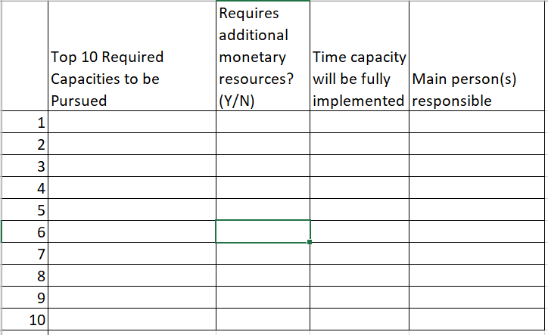
Activity DD. Action Planning
After completing your security plans, select from the capacities that you need to build.
Pick 10.
Fill out the action plan
and return it to XXXXX.
If one of your plans is
to roll this training out
to a wider group at your
organization, develop
your own policies and standard operating procedures on security before that training.
Notes:
Say: To help keep yourself on track in implementing your security plans, use this action planning tool. Not only will it help you chart your progress and make progress, it also explains when additional resources are required. That information can be used in discussions with the donor about how to fund security adequately.
Finally, consider how you will make any organizational security efforts known to workers for your organization. For example, how will workers know where to go if a security challenge occurs? How will they know what to do to avoid such challenges to begin with? To help workers answer this question, it may be useful to use some of the slides from this training to discuss ideas such as assessing the seriousness of a threat with all workers.
However, because it’s the organization’s responsibility to keep workers safe, you should not give this training as it is to workers. That would be asking them to be responsible for their own security. Instead, you should revise the training so that it helps workers understand the organizational policies and protocols meant to protect them. So, instead of giving them an example of an online outreach worker who is being stalked and asking what could be done to prevent the situation, review the organization’s polices designed to prevent stalking and then ask participants to apply this protocol to a real-life situation they may find themselves in. This requires that you develop SOPs and protocols relevant to security before rolling this training out to others if you do not have them already. We will provide you with a document to help inform your SOPs on security in a follow-up email.

Slide 134





Opportunities for Support (funding)
Notes:
Say: If you do need resources, it is also possible to get them from other sources, apart from the donor contributing to the HIV program. These can all be sources of funding to IPs, depending on your work. You will receive a one-page list of when each of these funding sources can be used and how to access the funding following today’s session.

Slide 135
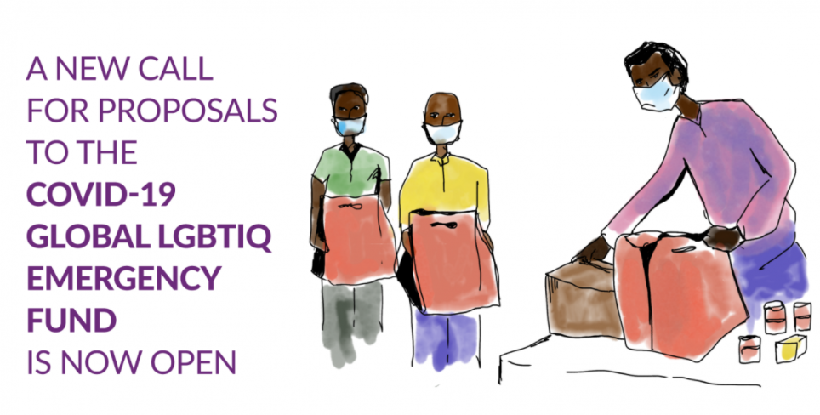
New opportunities during COVID-19
https://outrightinternational.org/outright-covid-19-global-lgbtiq-emergency-fund
Funding can cover:
Food scarcity, medium- and long-term livelihood generation
Movement resilience
Combating violence: (GBV, domestic violence, and family violence), can include mental health support
Human rights violations documentation
Notes:
Say: Finally, some new sources of funding are becoming available during COVID-19. This source is from Outright International.
It can be used to cover the following for LGBTIQ organizations dealing with the following as a result of COVID-19:
Food scarcity, medium- and long-term livelihood generation, and poverty reduction
Movement resilience, including core support for LGBTIQ organizations whose existence is threatened due to immediate loss of funding linked to COVID-19.
Combating violence that the pandemic has exacerbated, such as gender-based violence, domestic violence, and family violence. Mental health support could be considered as well.
Human rights violations documentation can also be included.
If participants know of other funding sources, they can also share those—along with contact information—in the chat.

Slide 136
Reflections and closing
Notes:
Say: Thank you to everyone for their time throughout this training. Let’s end with a few reflections.

Slide 137
Session Objective
Share thoughts on and evaluate the workshop; provide closing reflections.
Notes:
Review the objective.

Slide 138
Activity EE. Evaluation and Post-Test
An evaluation of our training can be found here: XXXXXX
The post-test can be found here: XXXXXX
Notes:
See the Facilitator’s Handbook for more detailed instructions.
Paste in links to the evaluation and post-test here. Both will likely need to be completed post-training. Remind participants that completing the post-test and scoring 85% or more is required to receive a certificate.

Slide 139
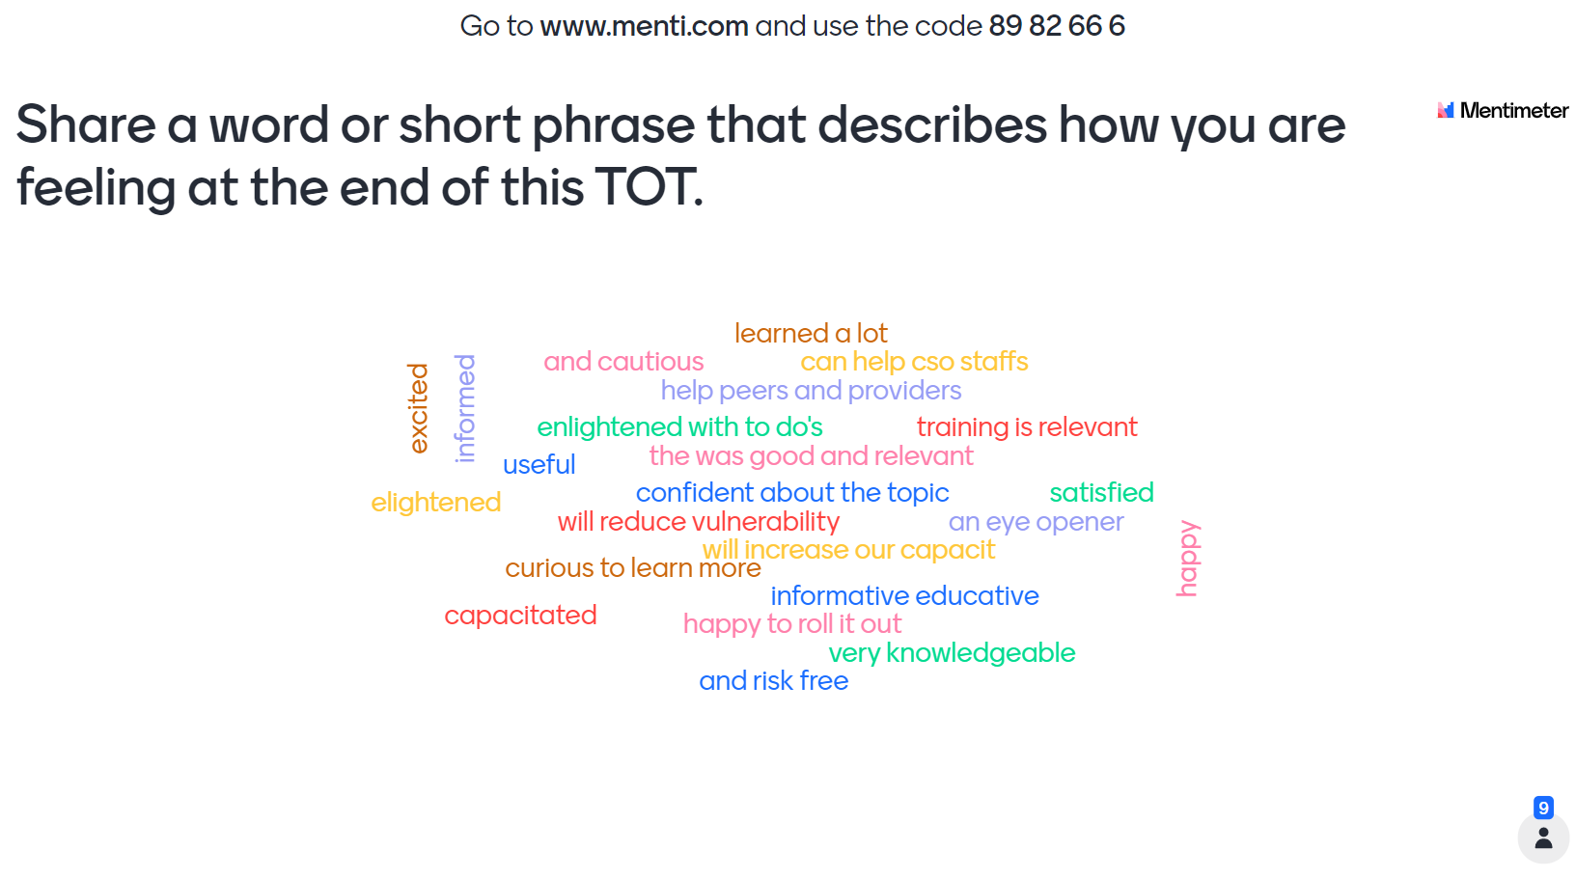
Activity FF. In Your Own Words
Notes:
See the Facilitator’s Handbook for more detailed instructions.
Use menti.com to collect participant responses. Type menti.com and the code into the chat.

Slide 140







Acknowledgments

