Slide 1
Notes:
The facilitator’s guide for this curriculum can be downloaded from:
https://www.fhi360.org/resource/providing-care-and-support-children-female-sex-workers-training-orphan-and-vulnerable

Slide 2
Participant introductions
Name
Position
Organization
Motivation to participate in the training

Slide 3
Participant expectations
Instructions:
Write one or two things you expect to learn in this training on different sticky notes
When you are done, post your sticky notes on the flip chart

Slide 4
Training learning objectives
By the end of the training participants will:
Understand stigma and discrimination toward FSWs and how it impacts their children.
Have a more empathetic attitude toward FSWs and their children.
Understand the unique risks experienced by FSWs and their children, particularly the risk of HIV infection, and the health and social services they need.
Have increased awareness of the challenges to finding and delivering services to CFSWs and the strategies they can use to overcome these challenges.
Understand and adopt principles and values that make services safe and acceptable for FSWs and their children.
Be able to develop an action plan for their organizations to deliver services to CFSWs and their families that are safe, acceptable, and child- and KP-friendly.

Slide 5
Learning activities
Module 1: Understanding the Risks and Vulnerabilities of Children of FSWs Exploring our beliefs and attitudes toward FSWs and their children Understanding stigma toward FSWs and its impact on their children The realities and challenges of FSWs The risks and vulnerabilities of children of FSWs | Module 2: Delivering Safe and Acceptable Services to Children of FSWs and Their Families Addressing the vulnerabilities and needs of CFSWs and their caregivers Strategies for finding and reaching CFSWs and their families with services Principles and values for delivering safe and acceptable services to CFSWs and their families Action planning to provide safe and acceptable services to CFSWs and their families

Slide 6


Learning methods
Discussions in large and small groups
Work in Small Groups
Brainstorming
Case Studies
Presentation
Notes:
Credits:
Group by Kevin from the Noun Project
Notary by Gerald Wildmoser from the Noun Project
Brainstorming by Vectors Point from the Noun Project
Magnifying glass by Bonegolem from the Noun Project
Presentation by Luis Prado, US from the Noun Project

Slide 7


Review of training agenda
Notes:
Credits:
https://www.freepngimg.com/thumb/clock/1-stopwatch-png-image.png
https://cdn.pixabay.com/photo/2016/03/31/19/50/checklist-1295319_960_720.png

Slide 8

Group rules
Notes:
Credit: https://www.thebluediamondgallery.com/handwriting/images/rules.jpg

Slide 9

Icebreaker
Instructions:
Pick a piece of paper from the bag (without looking)
Based on the color of the piece of paper you picked, share:
Red: Place where you were born
Yellow: Your favorite music
Orange: Your favorite food
Green: Place or country you would like to visit
Purple: The most embarrassing thing that ever happened to you
Notes:
Credit: https://www.pngall.com/wp-content/uploads/2016/09/Jigsaw-Puzzle-PNG-Picture.png

Slide 10
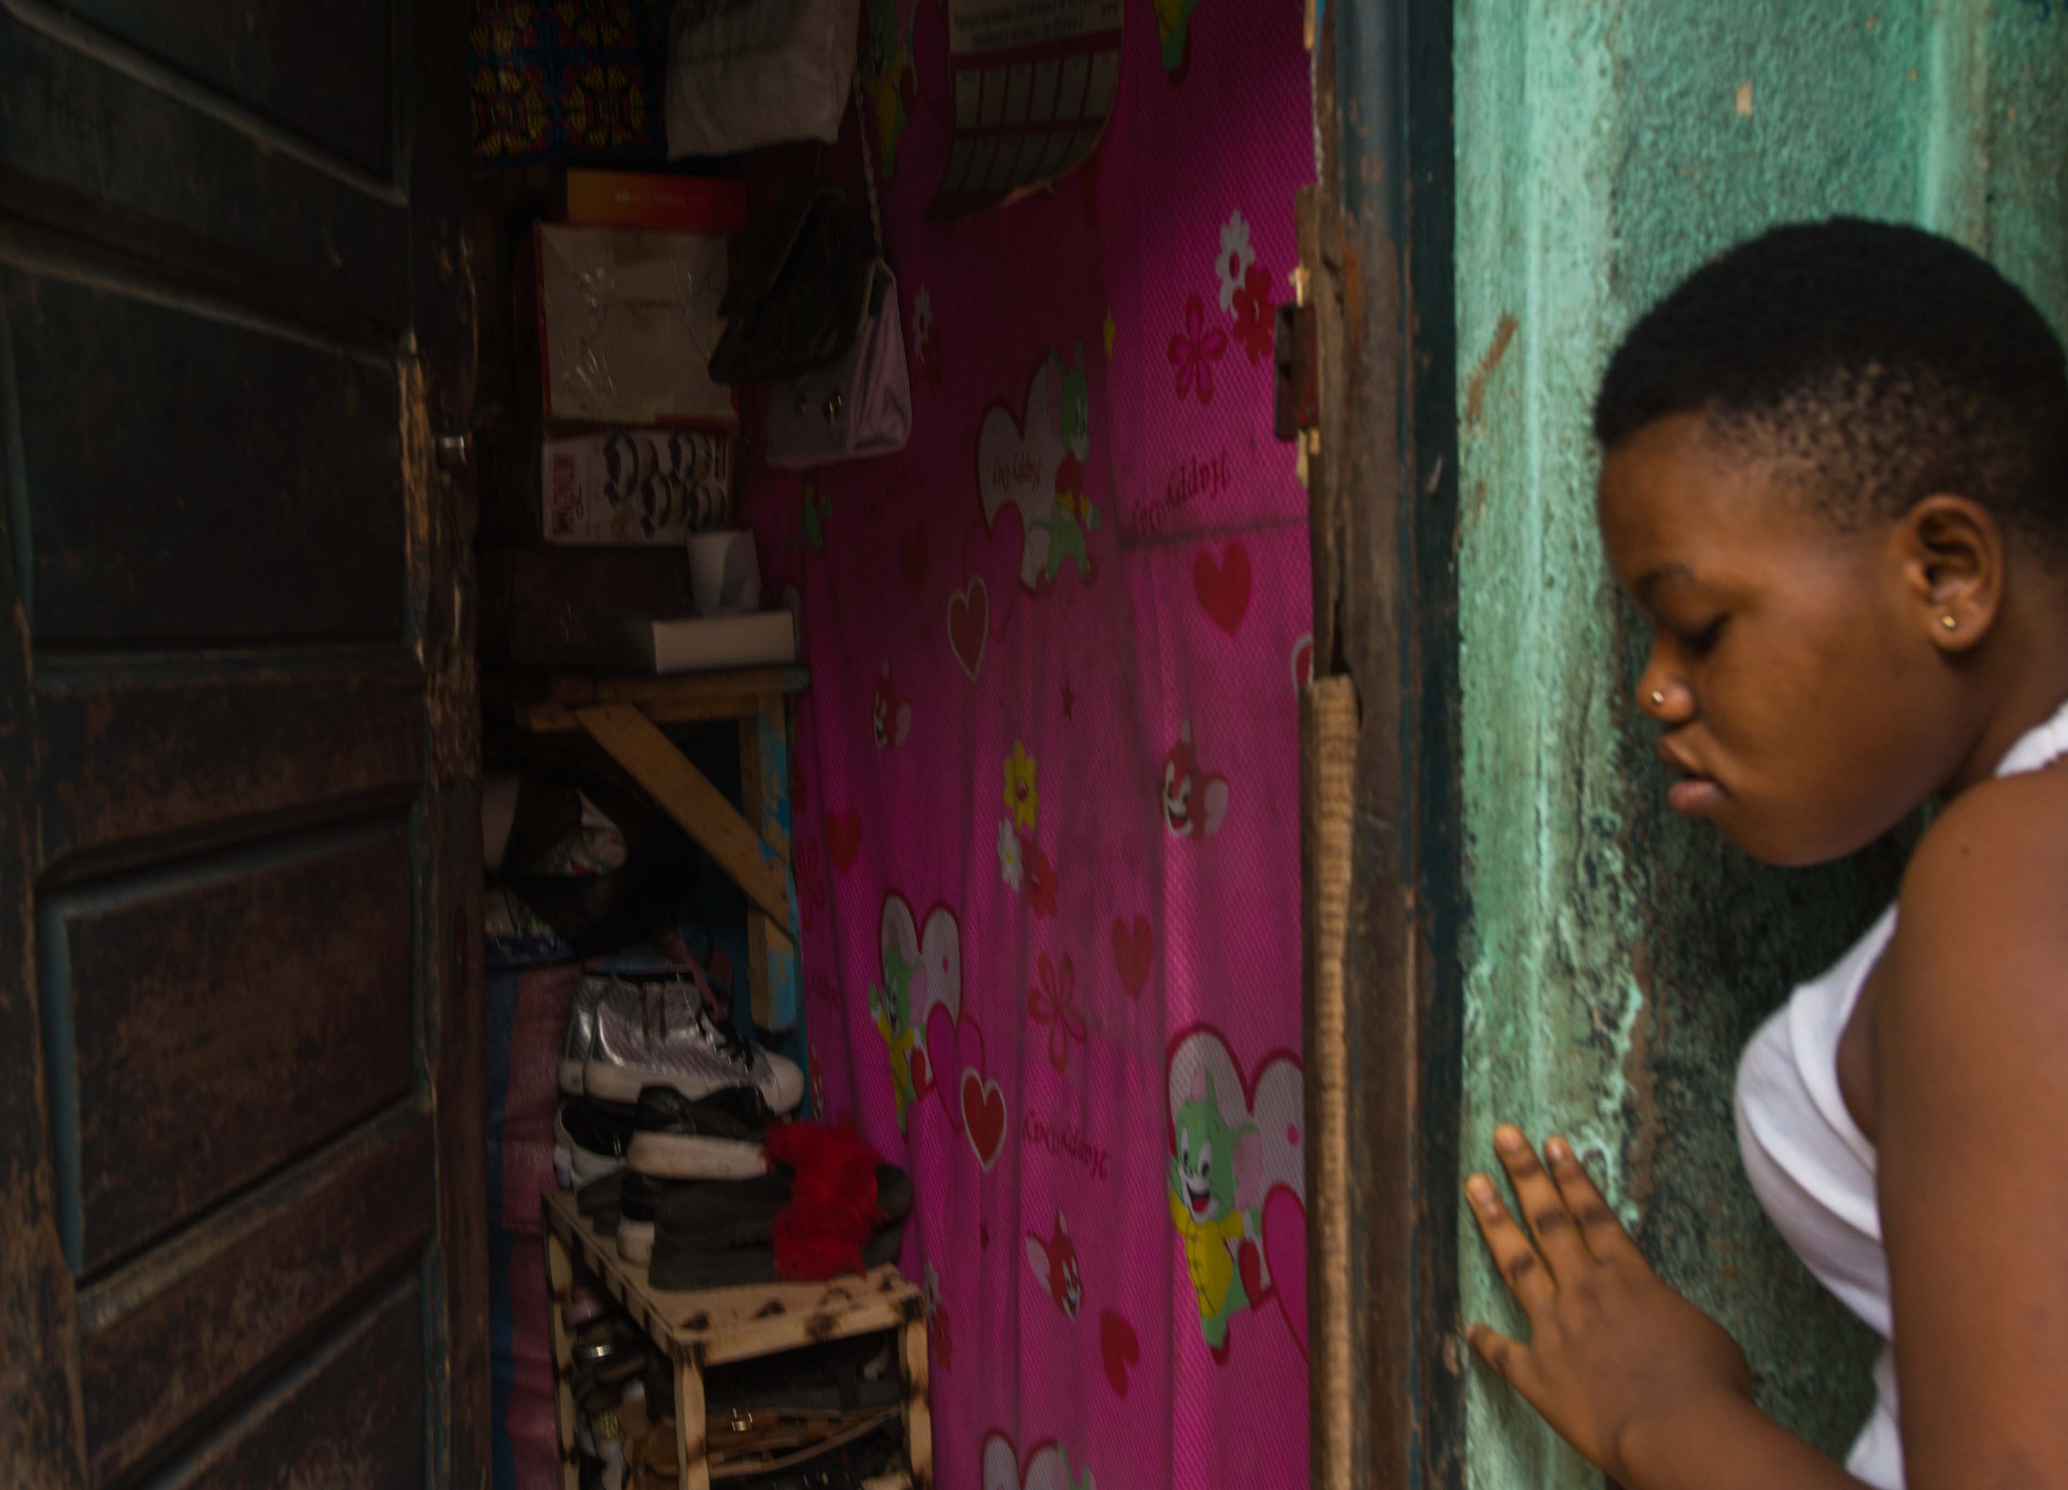
U.S. government’s anti-prostitution pledge
The anti-prostitution pledge was established in 2003.
Prohibits USG-funded organizations from promoting and advocating in favor of the practice of prostitution or in favor of the legalization of prostitution.
It does not prohibit organizations from providing health and social services to sex workers and their children.
Notes:
Credit: Moustafa Cheaiteli for FHI 360; Adjame Bracodi, Cote d’Ivoire

Slide 11
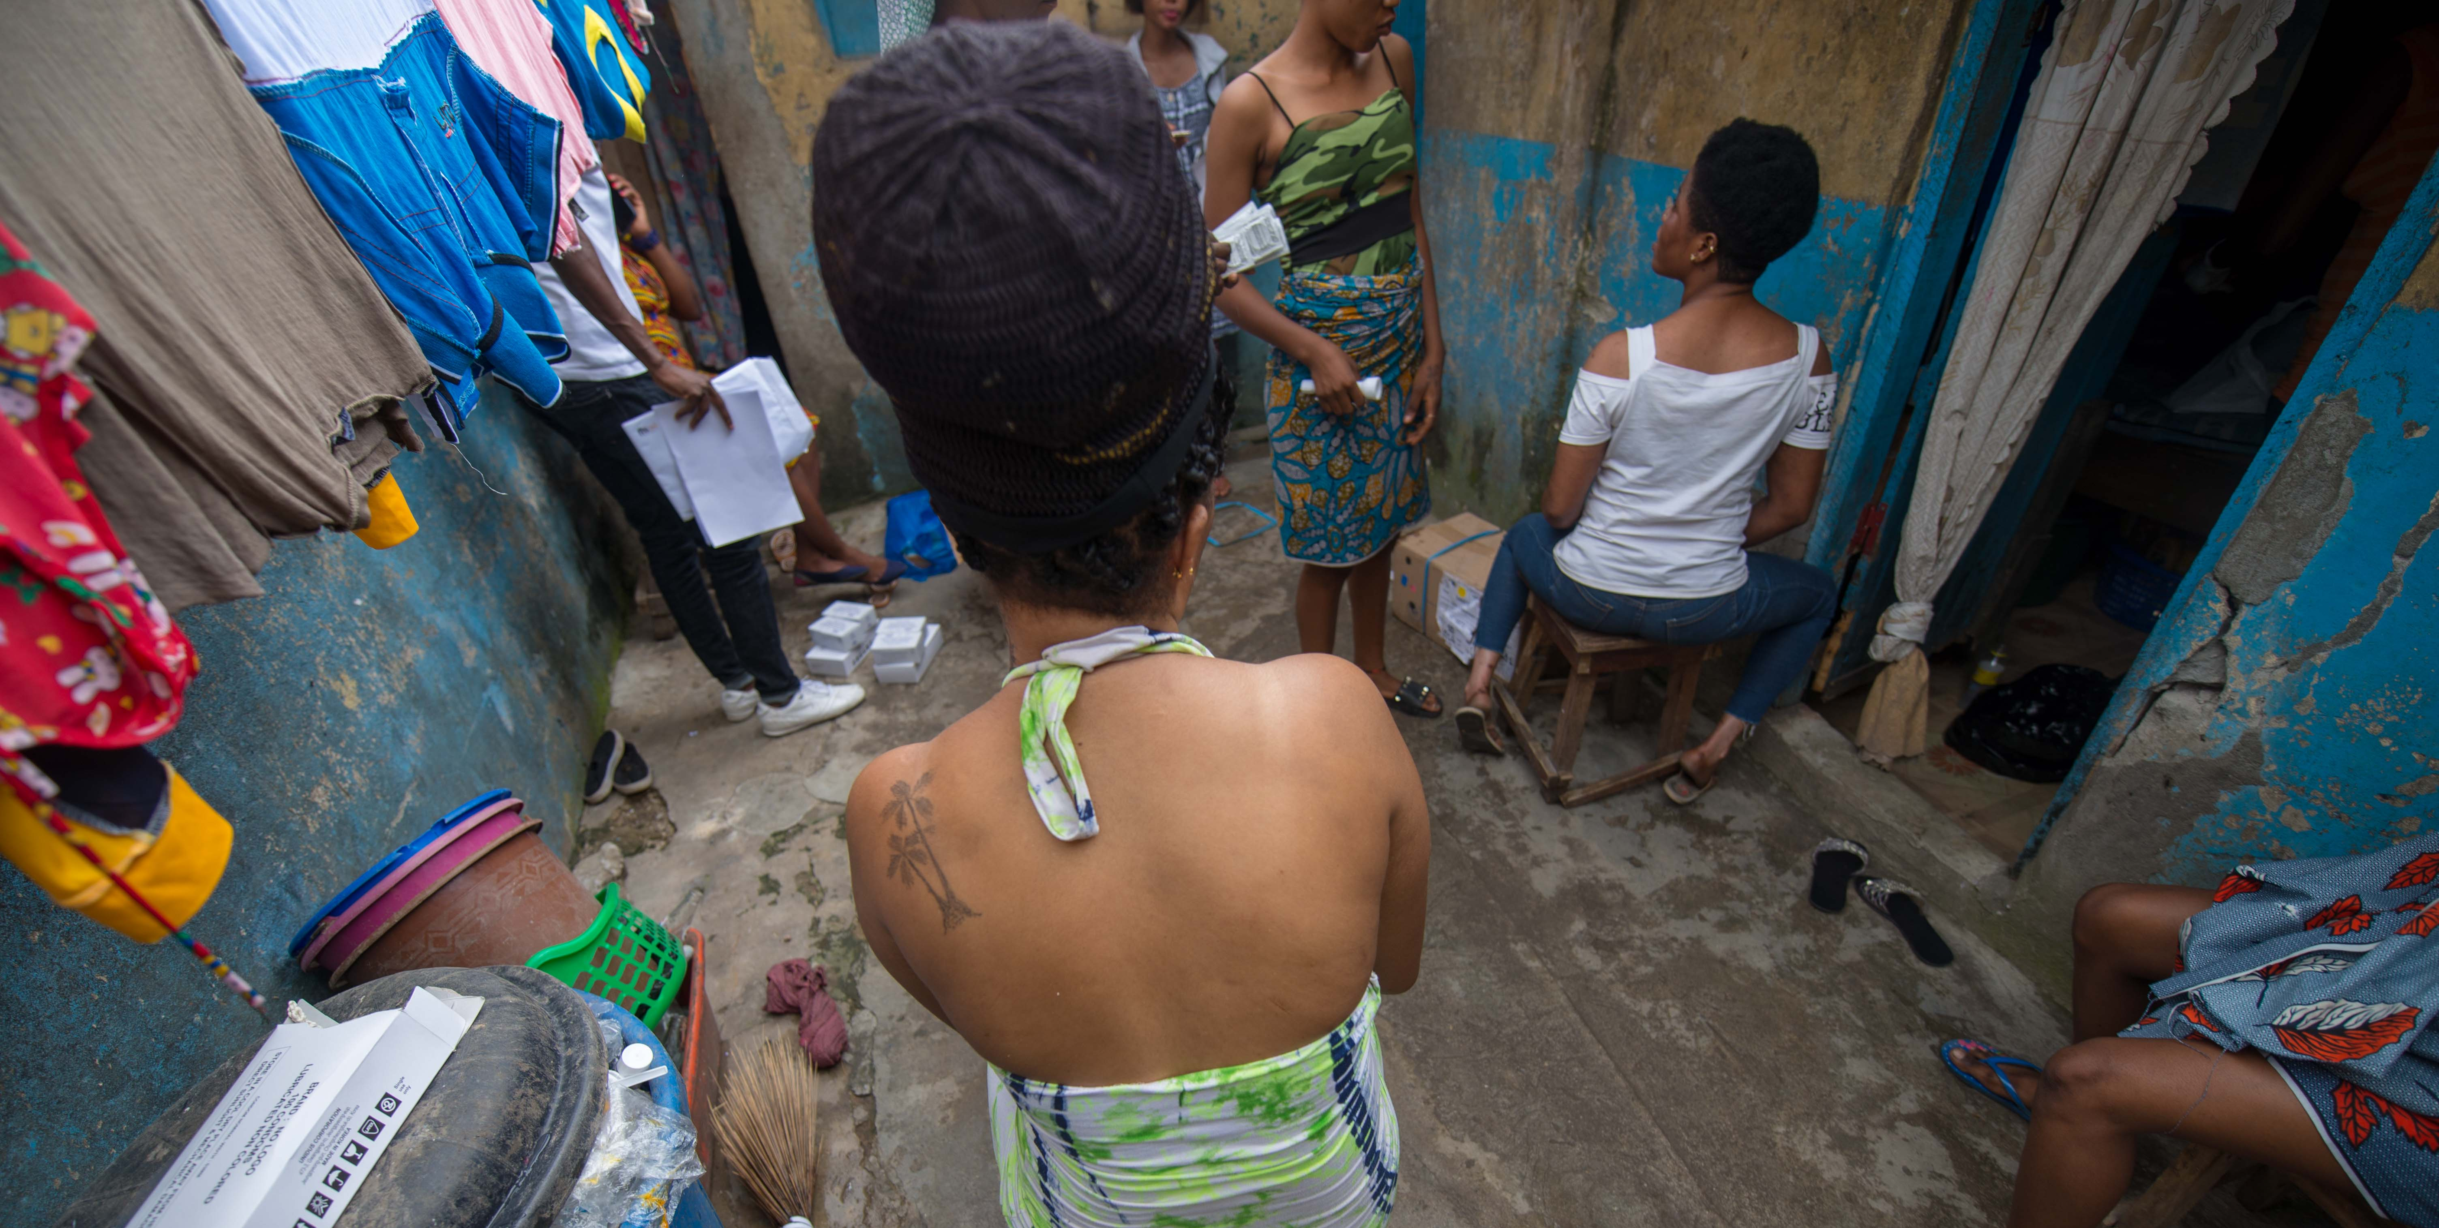
Module 1: Understanding the risks and vulnerabilities of children of FSWs
Notes:
Credit: Moustafa Cheaiteli for FHI 360; Adjame Bracodi, Cote d’Ivoire

Slide 12

Exploring our beliefs and attitudes toward FSWs and their children
Instructions for “Vote with Your Feet” exercise:
Listen and reflect on the value statement stated by the facilitator.
Indicate whether you agree, disagree, or are unsure about the statement by moving to the respective sign. This is called “Voting with your feet.”
There are no right or wrong answers. You are entitled to have your own opinion.
You can change your mind after you have “voted.”
Notes:
Credit: This Photo by Unknown Author is licensed under CC BY-NC-ND

Slide 13


What is stigma?
It is a mark of disgrace, shame, or disapproval that results in an individual being rejected, discriminated against, and excluded from participating in different areas of society.
It is a form of prejudice that creates fear, anger, and intolerance toward other people.
Notes:
Credit: Rejected by Adrien Coquet from the Noun Project

Slide 14

What is discrimination?
It is stigma put into action.
It is the unfair and unjust treatment of an individual based on certain attributes.
Notes:
Credit: Rejected by Adrien Coquet from the Noun Project

Slide 15
The process of becoming stigmatized
A person or group is seen as being “different” based on certain traits
Social norms and values link the trait with being undesirable
People with the undesirable trait are labeled and this label becomes their sole defining characteristic
The labeled person loses status in their community, is blamed for social problems, and becomes a subject of discrimination
15
Notes:
Appearance (e.g., skin color, weight, physical disability)
Cultural values or beliefs (e.g., religious views, cultural customs)
Social identity or behavior (citizenship, sexual orientation, occupation)
Credit: Rejected by Adrien Coquet from the Noun Project

Slide 16
Types of stigma
Social/public stigma: When society endorses negative stereotypes and prejudices.
Self-stigma: When a person internalizes social/ public stigma and suffers diminished self-esteem.
Stigma by association: Stigma suffered by a person who is associated with a stigmatized person (e.g., family members or friends of a stigmatized person)
Structural stigma: Institutional policies or societal structures that result in decreased opportunities for certain groups of people.
Notes:
Credit: Rejected by Adrien Coquet from the Noun Project

Slide 17
Forms of discrimination
Physical/social isolation (e.g., forced to eat alone, prevented from having physical contact with others)
Physical and verbal violence, harassment or bullying
Denial of basic human rights (e.g., inability to get a job or a place to live, or have access to basic services)
Notes:
Credit: Rejected by Adrien Coquet from the Noun Project

Slide 18
Impact of stigma and discrimination
Feelings of rejection and isolation, shame and self-doubt
Psychological distress and depression
Lower self-esteem
Disruption of family relationships
Inability to obtain employment, housing
Reluctance to seek out services
Doubt about own abilities to achieve goals in life
Overall poor quality of life
Notes:
Credit: Over thinking by Gan Khoon Lay from the Noun Project

Slide 19

Impact of stigma on children of FSWs
Questions for discussion in small groups:
Based on what you learned about the different types of stigma, what type of stigma do you think children of FSWs experience?
What forms of discrimination might children of FSWs experience at home, at school, or in the community in general?
How do you think these experiences of stigma affect these children emotionally and socially?
Notes:
Credit: Notary by Gerald Wildmoser from the Noun Project

Slide 20
Our experiences with stigma and discrimination
Why?
How?
Instructions and questions for personal reflection:
Think about a time when you felt mistreated or rejected for being different in any way:
Why did this happen?
How did you feel?
How did this experience affect you?
Write down any thoughts, feelings, or words that you associate with this experience.
Notes:
Credit: Conversation by FBianchi from the Noun Project

Slide 21
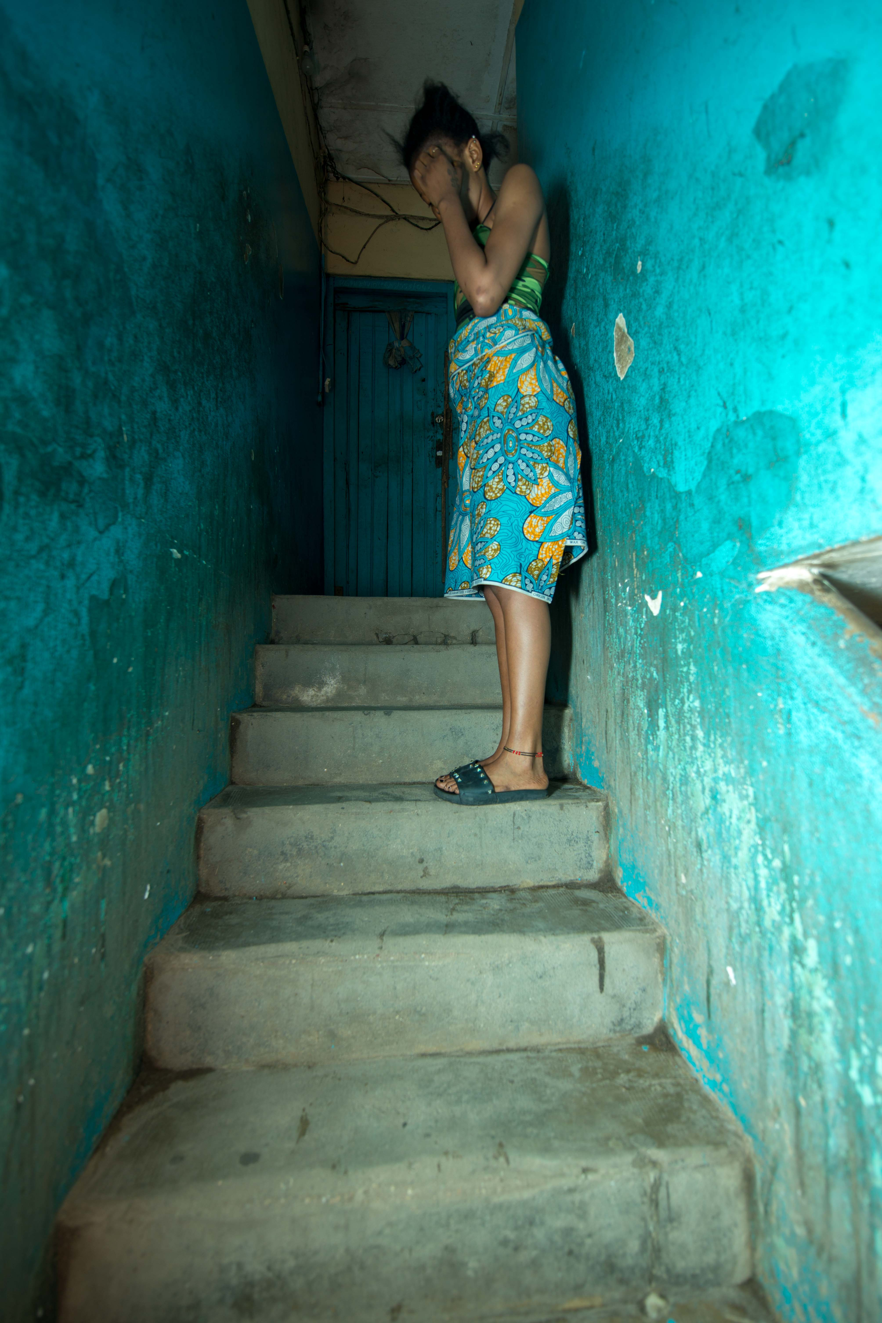
Root causes of stigma toward female sex workers
There are social taboos or norms against mixing money and sex.
Because sex workers get paid to perform sexual acts, they are labeled as immoral.
The stigmatization of sex work permeates all aspects of society. It is a mark of disgrace and social discrediting. Derogatory terms such as “prostitutes,” “hookers,” and “whores” are often used to describe sex workers.
One of the key root causes of sex work-related stigma is criminalization of sex work.
Notes:
Credit: Moustafa Cheaiteli for FHI 360; Adjame Bracodi hot spot, Cote d’Ivoire

Slide 22
Root causes of stigma toward female sex workers
There are four global legal systems regarding sex work, and all of them contribute to the stigmatization of FSWs:
The full criminalization of sex workers, which brands then as criminals.
The partial criminalization of sex work, which does not punish the buying and selling of sex, but does punish all activities around it (e.g., brothels) – and drives sex workers to work alone.
The criminalization of buyers of sex (e.g., in Nordic countries). While this model aims to eliminate sex work, it only drives sex workers into more secretive activities.
The legalization of sex work (e.g., in some states in the U.S.). It segregates and marginalizes sex workers by creating special restrictions such as the need to register, have regular health checks, and purchase a mandatory license.
Source: Berthe, Paul. The stigmatization behind sex work. 2018 May 4. [Internet]. Montreal: Samuel Centre for Social Connectedness. Available from: https://www.socialconnectedness.org/the-stigmatization-behind-sex-work/.

Slide 23
Stories of sex workers
Questions for reflection and discussion in pairs:
What are some of the reasons across the stories why women started to sell sex?
What types of abuse against these women did you see repeated in the different stories?
What thoughts or feelings did you experience as you were reading the stories of these women?
After reading these stories, have your thoughts or attitudes toward FSWs changed in any way? If so, how?
Notes:
Credit: Conversation by FBianchi from the Noun Project

Slide 24
Issues faced by sex workers
Questions for reflection and discussion in pairs:
What did you learn about FSWs and the issues they face that you didn’t already know?
How can the issues FSWs face affect their children? For instance, how do each of the following situations affect children?
Being afraid to test for HIV
Not being able to access health care
Being evicted from their homes
Not being able to provide food for the family
Being raped and beaten and not having support
Notes:
Credit: Conversation by FBianchi from the Noun Project

Slide 25
Risks experienced by children of FSWs
Instructions for small group exercise:
Read the data in handout 3 on children of FSWs (under the PEPFAR OVC domain your group selected) in silence.
Based on the data presented in the handout, discuss and agree on the main risks for children under the domain.
Include the risks in the first column of a table that has the format on the right. List each risk in a separate row. You will complete the second column (interventions and services) in another exercise.
Select a note taker and presenter for your group.
You will have 20 minutes for this exercise.
PEPFAR Domain:
Risks | Interventions and Services
Notes:
Credit: Notary by Gerald Wildmoser from the Noun Project

Slide 26
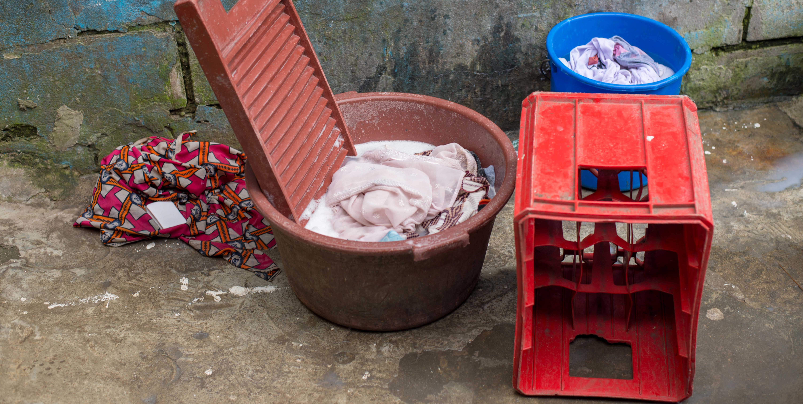
Module 2: Delivering safe and acceptable services to children of FSWs and their caregivers
Notes:
Credit: Moustafa Cheaiteli for FHI 360; Adjame Bracodi, Cote d’Ivoire

Slide 27
Developing a service package for children of FSWs and their families
Instructions for the small group exercise:
Identify the interventions and services that can help reduce or eliminate each of the risks identified by your group.
After group members agree on an intervention or service, include it in the column on the right side of the table.
Remember that, in line with the socioecological approach, interventions and services to reduce child vulnerability can focus on the child, the child’s family, or the community in which the child lives.
You will have 20 minutes for this exercise.
PEPFAR Domain:
Risks | Interventions and Services
Notes:
Credit: Notary by Gerald Wildmoser from the Noun Project

Slide 28
Referral relationships for service delivery to children of FSWs and their families
Key Referral Relationship for Serving CFSWs
PEPFAR OVC Domain:
Intervention or service | Service provider | Action needed to establish a linkage or referral relationship
Instructions for small group exercise:
List each of the services children of FSWs and their families need and that your organization/program is not able to provide in the first column of the table.
Identify the community organizations/ programs, groups, or individuals that can provide services and support, then list them in the second column of the table.
Identify the actions your organization/program needs to take to establish a linkage/referral relationship with each service provider and include them in the table.
You will have 20 minutes for this exercise.
Notes:
Credit: Notary by Gerald Wildmoser from the Noun Project

Slide 29
Challenges to identifying and delivering services to FSWs and their children
Instructions for small group exercise:
Based on what you have learned about the lives of FSWs and their children, discuss in your group the challenges you could face in finding these children and delivering services to them and their families. Refer to handouts #2-3 to identify these challenges, if needed.
Write at least three challenges on a flip chart page. Make sure all group members agree with them.
You will have 15 minutes for this exercise.
Notes:
Credit: Notary by Gerald Wildmoser from the Noun Project

Slide 30
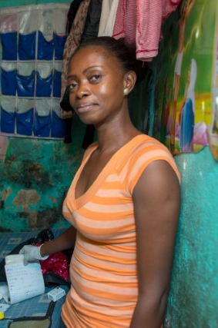
Challenges to find and deliver services to FSWs and their children
Resistance to disclose personal information due to fear of others (children, relatives, neighbors) finding out about their sex worker status.
Resistance to seek/accept services due to fear of being mistreated by service providers.
Work/rest schedule. Most FSWs work during the night and rest during the day.
Pimps. FSWs usually work with pimps who are perceived to be dangerous and in control of FSWs’ lives.
Notes:
Credit: Moustafa Cheaiteli for FHI 360; Adjame Bracodi, Cote d’Ivoire

Slide 31
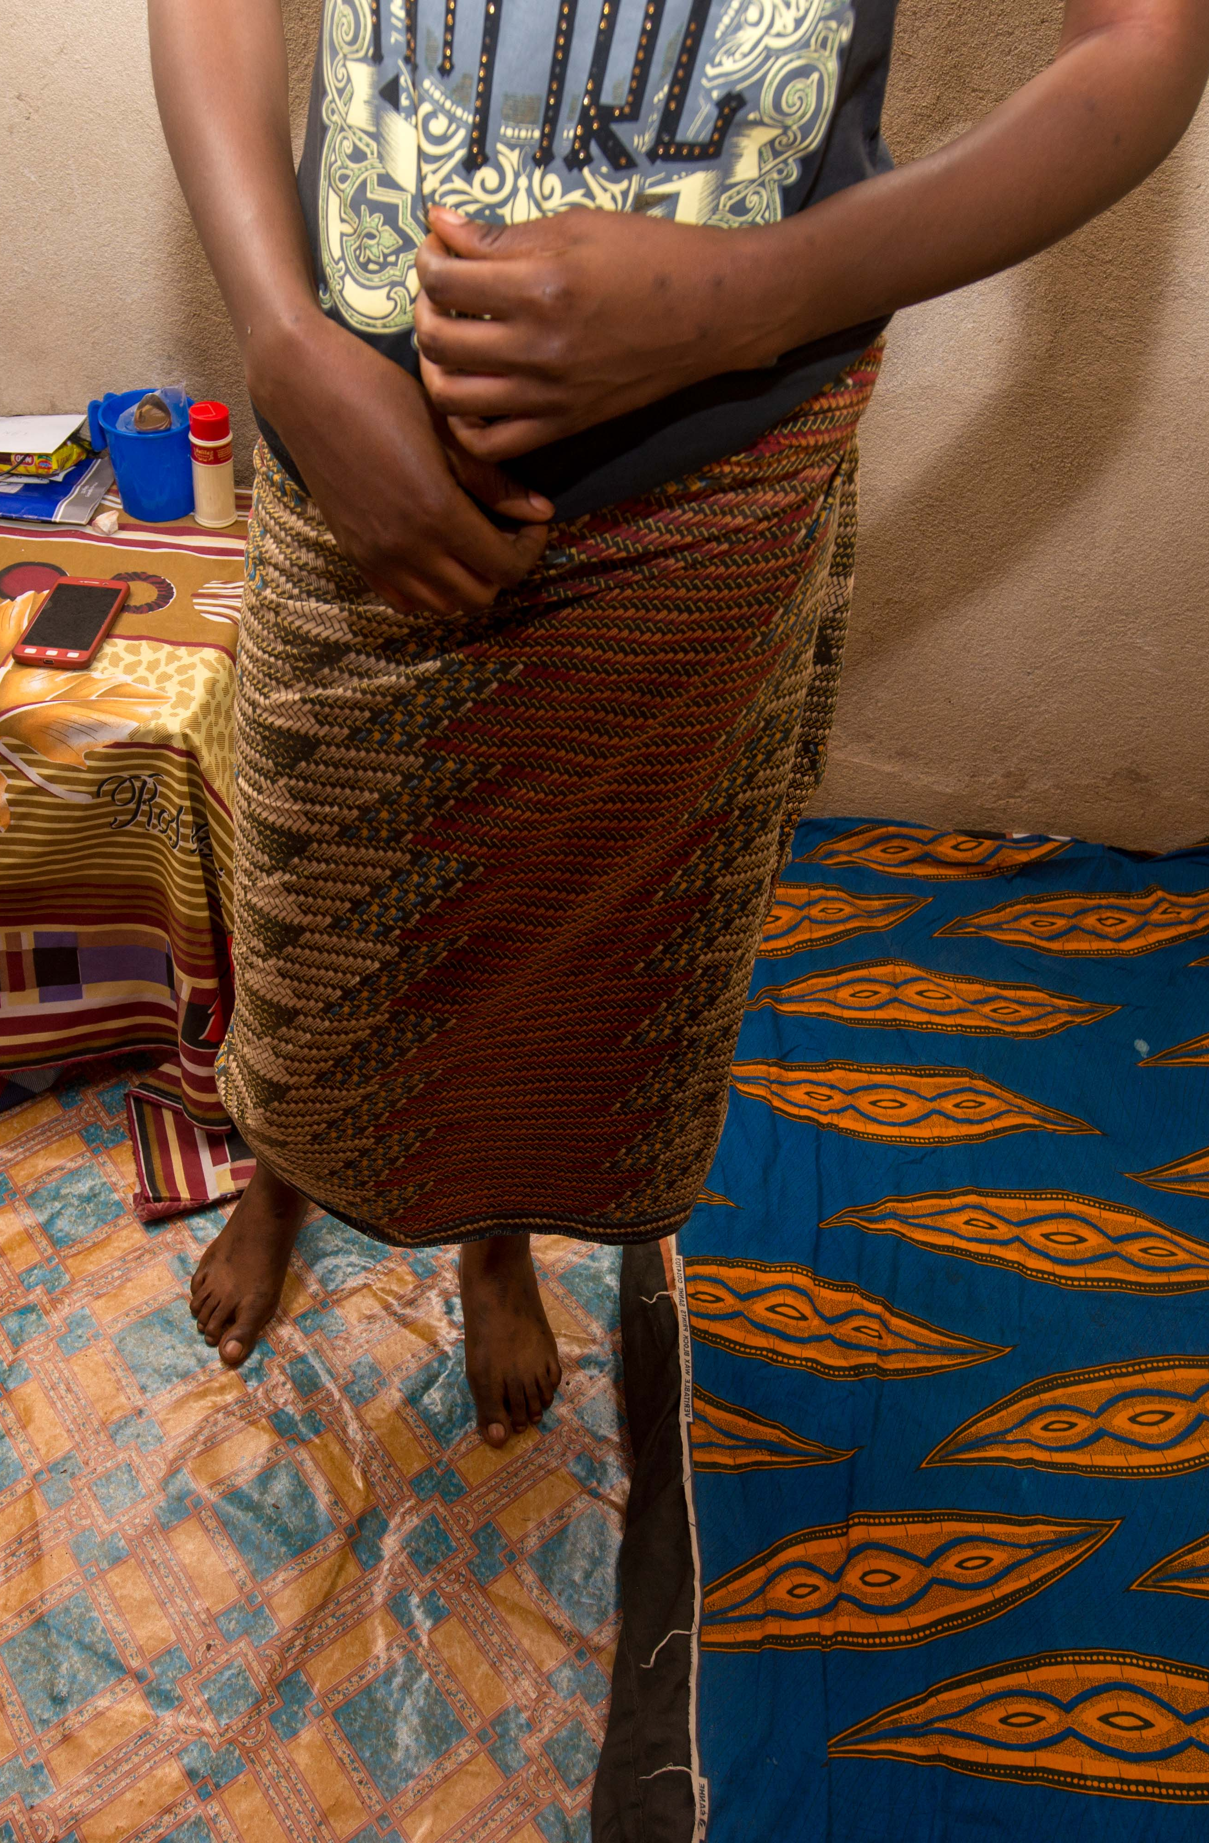
Challenges to find and deliver services to FSWs and their children
Mobility. Many FSWs relocate frequently (1) to find new clients or in response to high client demand in new hot spots; (2) to avoid harassment, or (3) for socioeconomic reasons.
Many children of FSWs do not live with their mothers. Children are often sent to live with relatives due to FSWs’ working hours, lack of child-care, etc.
Notes:
Credit: Moustafa Cheaiteli for FHI 360; Adjame Bracodi, Cote d’Ivoire

Slide 32
Strategies to overcome challenges to reaching children of FSWs
Instructions for small group exercise:
Discuss and agree on at least one strategy your organization or program could use to overcome each of the FSW-related challenges listed below:
Resistance to disclose personal/family information
Resistance to seek/accept services
Work/rest schedule
Pimps
Mobility
Children not living with their FSW mothers
Write each strategy on a flip chart page.
You will have 20 minutes for this exercise.
Notes:
Credit: Notary by Gerald Wildmoser from the Noun Project

Slide 33

Strategies to identify and reach FSWs and their children
Target geographic areas where sex work is more prevalent: urban and densely populated areas usually attract more sex workers.
Notes:
Credit: This Photo by Unknown Author is licensed under CC BY-SA

Slide 34

Strategies to identify and reach FSWs and their children
Partner with the key population (KP) programs:
KP programs know the FSW population well and the most effective ways to identify and reach them.
KP programs can carry out child mapping exercises among the FSWs they serve.
Notes:
Credit: https://cdn.pixabay.com/photo/2017/01/25/22/08/handshake-2009183_640.png

Slide 35

Strategies to identify and reach FSWs and their children
Use the right access points. In collaboration with KP programs, use a variety of hot spots (in addition to obvious sites such as bars, nightclubs, and brothels) to identify/reach FSWs, such as those listed below.
SITES
Bus and truck stops along main routes | Local beer sellers
Mining areas | Street vendors
Enterprises, agro-industries | Specific street hangouts
Border areas | Beach and tourist areas
Ports and river crossings | University and secondary school campuses
Weekly and nightly markets | Refugee camps
Hair dressing salons | Certain traditional ceremonies
Source: Joint United Nations Programme on HIV/AIDS (UNAIDS). Regional workshop on situation analysis of sex work in west and central Africa. 21-24 March 2000. [report]. Geneva: UNAIDS; 2001. Available from: regional.PDF (who.int).
Notes:
Credit: https://cdn.pixabay.com/photo/2016/03/22/04/23/map-1272165_960_720.png

Slide 36
Strategies to identify and reach FSWs and their children
Use a peer approach:
It is easier for trained FSWs to identify other FSWs who are mothers, build rapport, and gain their trust.
Involving FSWs as frontline workers could make outreach and service delivery to FSWs and their children easier.
FSWs are familiar with hot spots and can help trace FSWs loss to follow-up due to mobility.
Involving FSWs in efforts to support other FSWs and their families is empowering for them.
KP programs can help identify FSWs with the potential to become frontline workers (e.g., community case workers or outreach workers).
Notes:
Credit: Mother and child by Gan Khoon Lay from the Noun Project

Slide 37
Strategies to identify and reach FSWs and their children
Train/sensitize OVC community case workers to work with FSWs to ensure they:
Interact and communicate with FSWs in a respectful and nonjudgmental manner.
Establish rapport and gain FSWs’ trust.
Maintain FSWs’ sex worker status confidential.
Are flexible and accommodate the days, times, and locations of case management activities to FSWs’ needs.
Notes:
Credit: Communicate by Alice Design from the Noun Project

Slide 38


Strategies to identify and reach FSWs and their children
Use FSW/KP-friendly platforms to deliver services:
Drop-in centers (DICs) are safe and FSW-friendly spaces, where FSWs can relax, socialize, hold meetings, and receive services.
DICs are usually run by KP programs, but OVC programs can leverage them for service delivery to FSWs, especially to reach those with infants and young children.
Notes:
Credits:
Hands by Mourad Mokrane from the Noun Project
Hospital by iconpixel from the Noun Project

Slide 39
Strategies to identify and reach FSWs and their children
Work with relatives caring for FSW’s children:
Many FSWs send their children to live with relatives.
KP programs can obtain information from FSWs on the location of their children.
These children could be served by the OVC program if they are living within the program’s coverage area.
Notes:
Credit: Grandmother and granddaughter by Gan Khoon Lay from the Noun Project

Slide 40
Case study: Collaboration between a KP and OVC program
Instructions:
Read the handout.
Discuss and answer the following questions as a group:
Based on the case study, what are the benefits of a partnership for both programs?
Do you see any additional benefits beyond those described in the case study?
Can your organization/program also establish this type of partnership with a KP program here/locally? Why or why not?
Based on this case study, what are some of the steps or actions your organization/program should take to ensure a successful partnership with a KP program?
You will have 15 minutes for this small group exercise.
Notes:
Credit: Magnifying glass by Bonegolem from the Noun Project

Slide 41
Principles for delivering safe and acceptable services to FSWs and their children
Questions for discussion in small groups:
Do you agree with all of the principles in the handout? If not, which principles don’t you agree with and why?
Do you think your organization/program will be able to follow all of these principles? If not, which ones cannot be followed and why?
What gaps does your program or organization need to address in order to follow these principles?
Notes:
Credit: Notary by Gerald Wildmoser from the Noun Project

Slide 42


Personal values for delivering safe and acceptable services to FSWs and their children
Instructions for the gallery walk exercise:
Walk in silence around the room and carefully read each of the value statements on the walls.
As you read each value statement, reflect on the following:
What does the value statement mean to you?
What changes would you need to make to adopt this value?
Can you commit to letting this value guide your work with FSWs and their children?
You can read the value statements in any order you want, as long as you read and reflect on all 10 of them.
Gallery Walk

