Slide 1
Test to Treat for COVID-19:
Clinical Training for Health Care Workers
November 2022
EpiC COVID-19 Programs​

Slide 2
Training Elements
COVID-19: Overview & Current Situation
Testing for COVID-19: Who, When & How
Treatment & Management for COVID-19: Clinical Approach
Test to Treat: Further Questions & How to Operationalize
Triage, Infection Prevention & Control, & Referral Pathways for COVID-19 Patients
Focus in on Test to Treat: Evidence, Rationale & Practice
This training was developed in October 2022. It will be updated as the evidence evolves around COVID-19 testing and treatment.​
Notes:
This training slide deck is composed of 6 main elements, which can be used in sequence as listed, or can be used separately depending on the specific learner groups brought together for the training, and the specific objectives of the training. Overall, this training is focused on Test to Treat as a new component of quality treatment for COVID19 patients. While Test to Treat is the focus of this training, it also can and should be thought of as one component of an integrated strategy to care for all patients with COVID19. There will be focus on the appropriate usage of oral antivirals as therapeutics, as well as broader thinking about appropriate and safe care for patients with more severe case presentations, and those who do not meet eligibility criteria for oral therapeutics. This holistic approach is designed to implement Test to Treat, as well as care for ALL covid patients. Case studies and exercises throughout the training can be used to practice specific scenarios, and also work with a team to consider the processes and plan for the implementation of T2T.

Slide 3
COVID-19: Overview & Current Situation

Slide 4
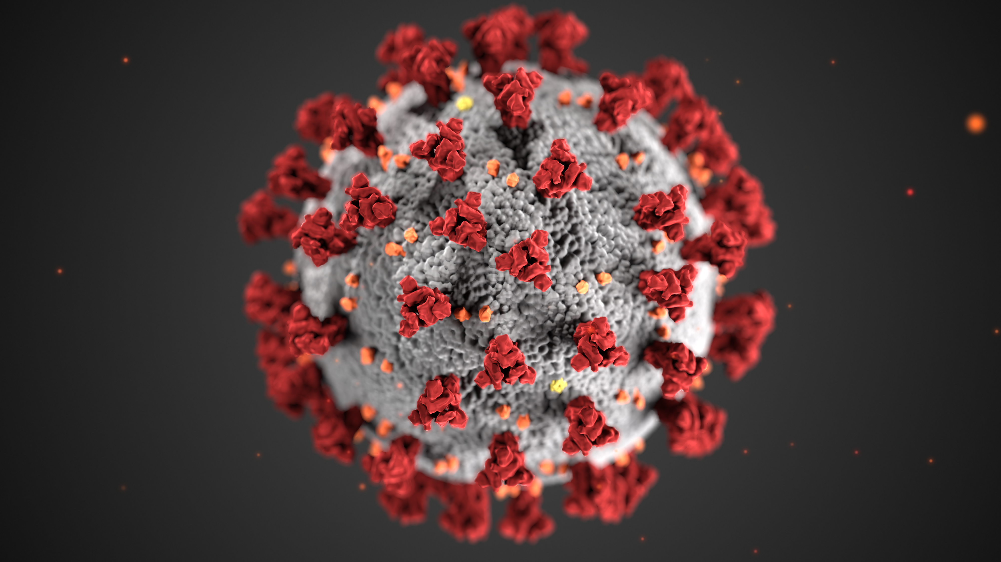
What is COVID-19?
Infection caused by SARS-CoV-2 (severe acute respiratory syndrome – coronavirus 2)
SARS-CoV2 is one type of coronavirus; responsible for ongoing infections around the globe
Notes:
This is a reminder slide, to bring everyone back to the reason we are here.
COVID 19 is the infection caused by SARS-CoV02.

Slide 5
Signs & Symptoms of COVID-19
Notes:
The spectrum of COVID-19 signs and symptoms.
Keep in mind that there are more or less common symptoms with the different variants of COVID-19, and things may well continue to change.
It is important that even though in many places, numbers of cases are down, COVID-19 is still present in most communities.

Slide 6
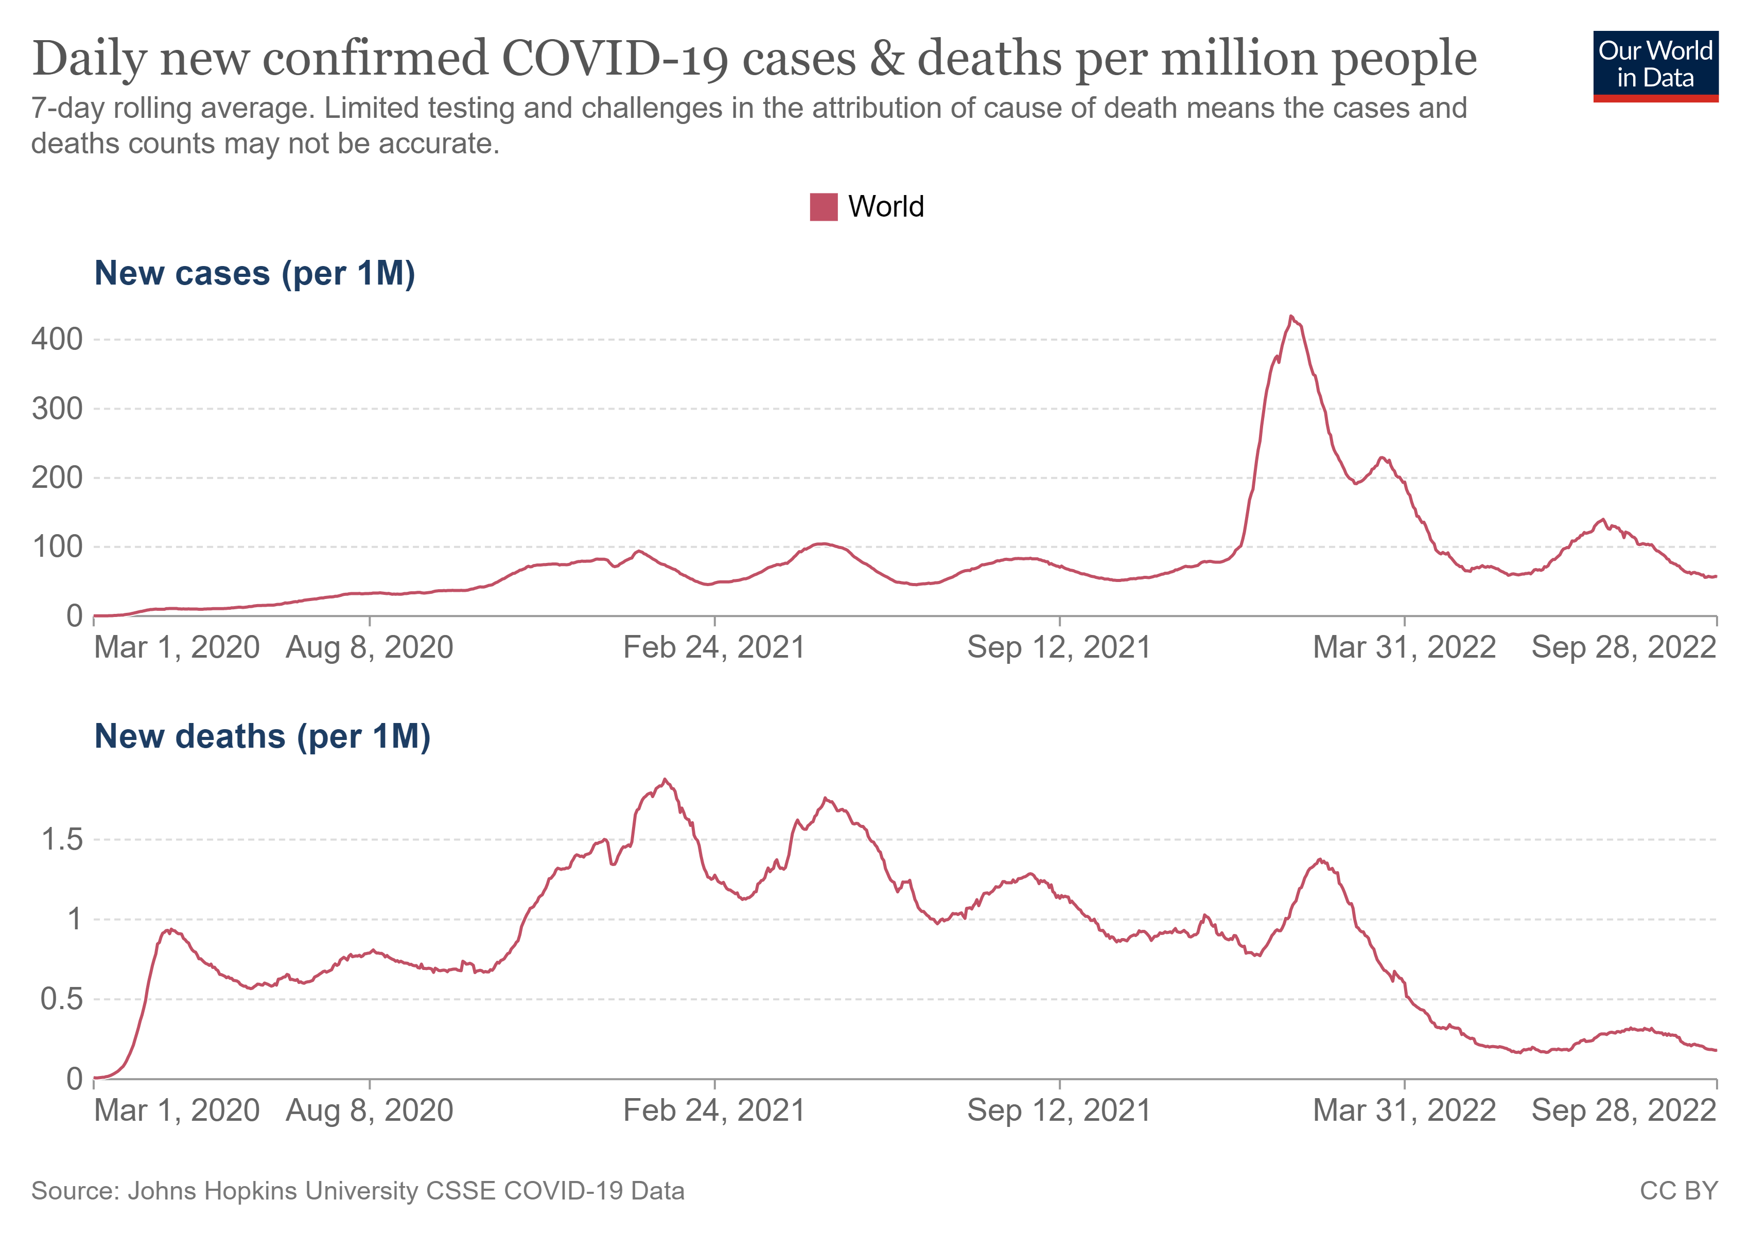
Timeline of the COVID-19 pandemic
As of Sept 2022, globally:
Total cases - 617 million
Total deaths - 6.54 million
Notes:
The pandemic is not over. These graphs depict the number of cases and number of deaths since March 2020. You can see various events and surges over that time, and thankfully the number of deaths per million has been going down since the spring of 2022. The total number of cases and total number of deaths is staggering, and continuing to increase. Advances in clinical medicine, diagnostics, health systems, and vaccine science have given us hope that COVID-19 is becoming less likely to be fatal or severe for most people.

Slide 7


Variants
Viruses like SARS CoV-2 continuously evolve as changes in the genetic code occur during replication of the genome.
A variant has one or more mutations that differentiate it from the other variants of the SARS CoV-2 virus.
Examples:
  Delta Variant: twice as contagious, increased impact especially on unvaccinated people
  Omicron Variant: even higher rate of transmissibility
What will the next variant be?
Notes:
Mutations and variants are very normal for any virus. All viruses change over time – including the virus that causes COVID-19. Most of the time, variants don’t impact how a virus works, or its ability to cause infection and disease.
Sometimes however, variants can:
make the virus spread more easily
affect how well a person responds to treatment for the virus
impact testing for the virus and how well it is picked-up
reduce the effect of vaccines against the virus
cause more severe illness from the virus.
A variant of concern is the name given to any variant of the COVID-19 virus (SARS-CoV-2) that behaves in any of the above ways.
Some variants can also have positive public health effects such as reducing a virus’s ability to spread. Variants can also disappear over time.
https://www.who.int/news-room/feature-stories/detail/the-effects-of-virus-variants-on-covid-19-vaccines

Slide 8
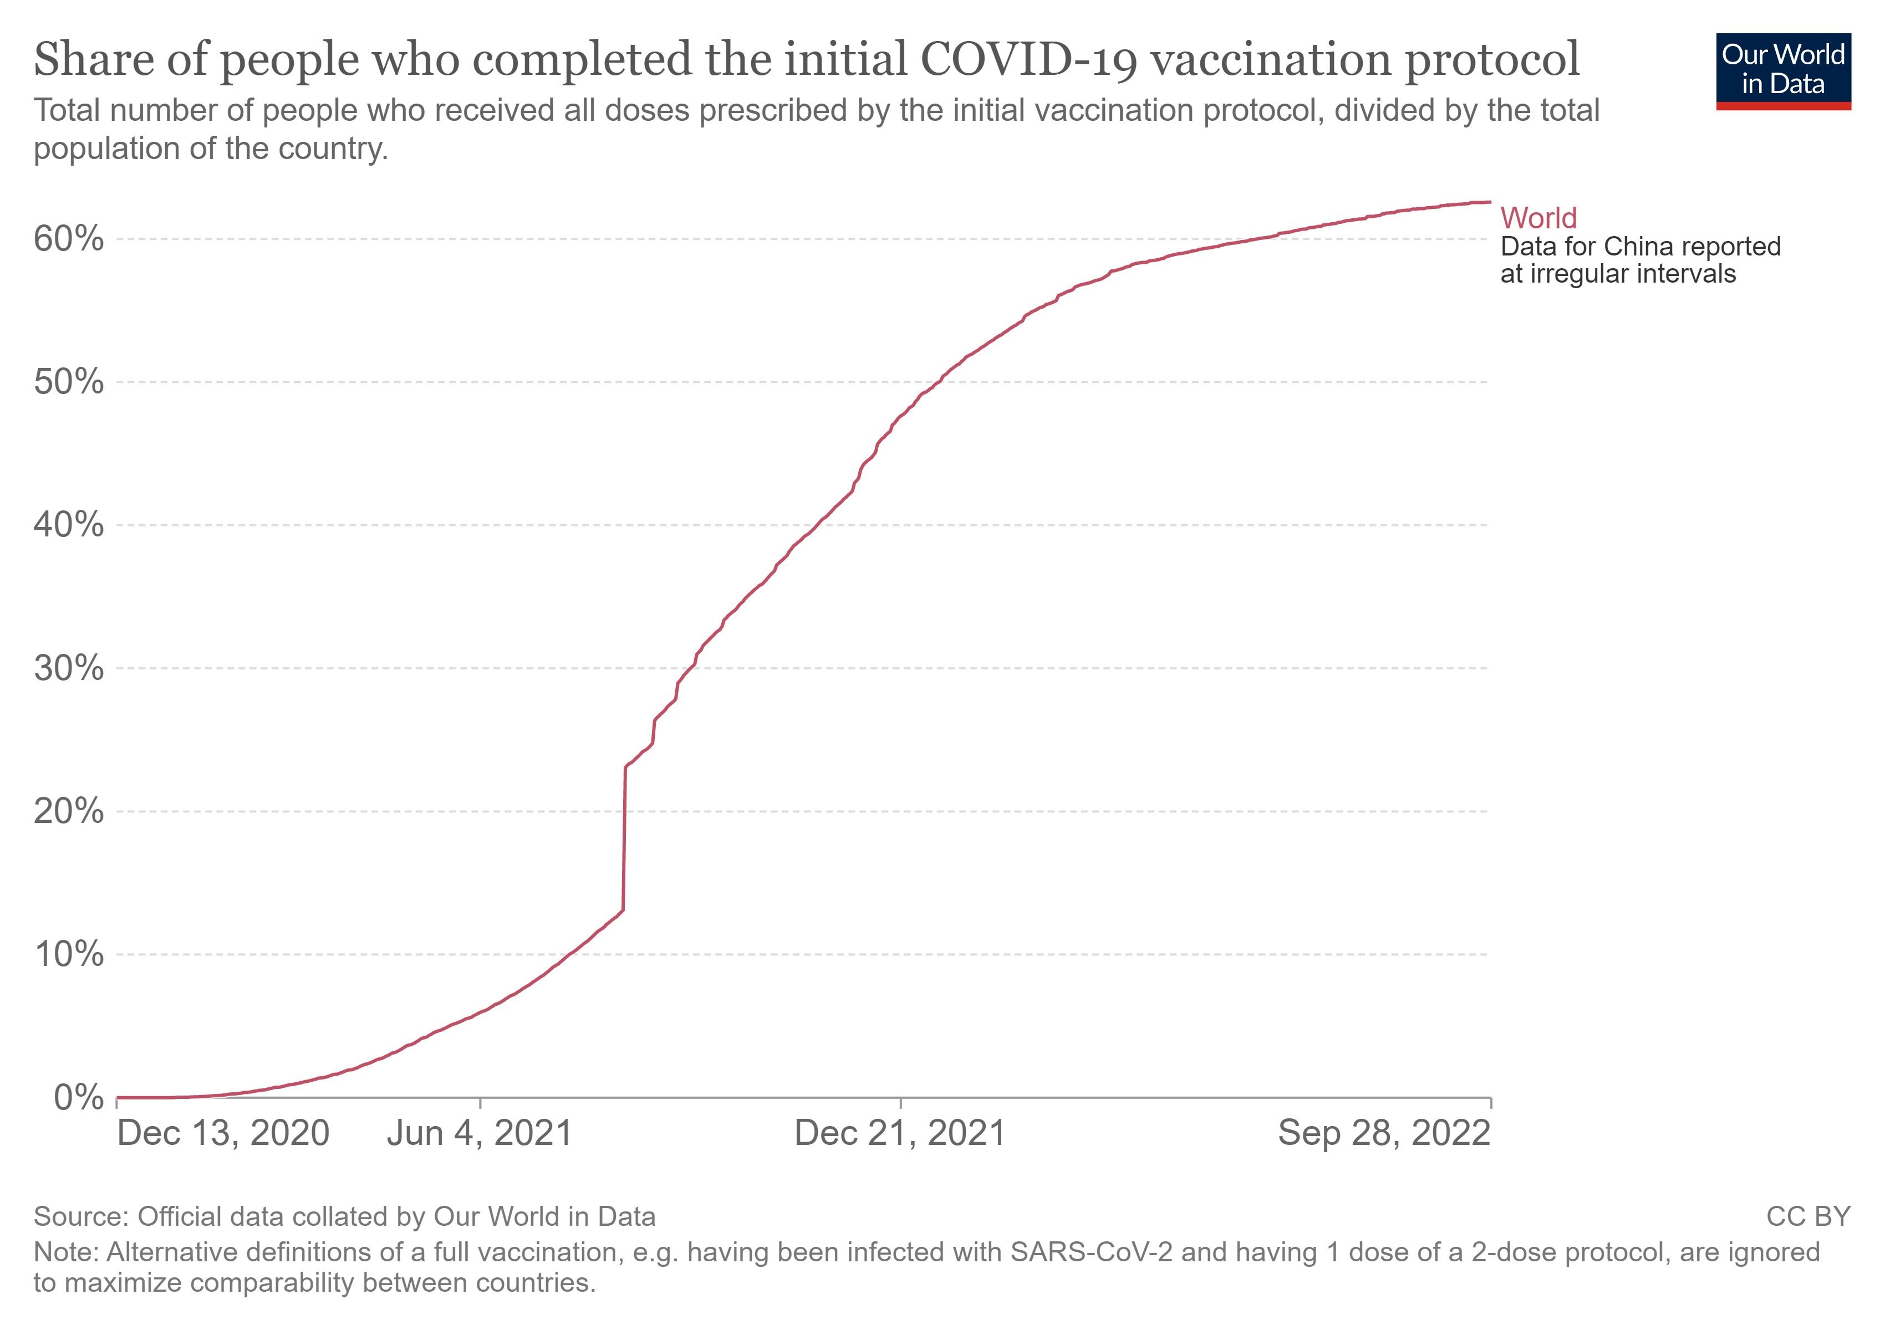
Vaccines
Available vaccines are safe and effective at protecting people from getting seriously ill, being hospitalized and dying.
Important tool to protect ourselves and our communities as we continue to fight against COVID-19.
Notes:
The development and distribution globally of COVID vaccines is an incredible scientific and public health achievement. There is still work to be done to reach targets, but the efforts as depicted on the graph above, preceded by the efforts to develop and test a vaccine for efficacy and safety, are nothing short of incredible.
The recognition of ongoing efforts to vaccinate as complementary to broad covid strategies including early identification of cases and initiation of treatment for vulnerable, eligible people will holistically provide a balanced approach towards prevention and care for COVID19.
https://www.who.int/emergencies/diseases/novel-coronavirus-2019/covid-19-vaccines

Slide 9
Evolving and Improving Treatment
Experience and evidence-based treatments are continuously improving with time.
Oral antivirals: Test to Treat links early diagnosis with oral antivirals for eligible patients
IV antivirals: another option for non-hospitalized patients and some hospitalized patients
Additional treatments such as monoclonal antibodies, anticoagulation, IL-6 inhibitors: depend on severity of illness
Systemic corticosteroids: improves outcomes for hospitalized patients requiring supplemental oxygen
Evidence Based Oxygen therapy: management of COVID-19 hypoxemia
Access updated COVID-19 guidelines and recommendations here
Notes:
We have learned a ton! There are many more tools available for effective treatment for patients with COVID-19. This training is focused on Test to Treat, and we will do a in depth discussion of effective diagnosis of these patients, with the 5-day time frame, and appropriate treatment of those patients who are eligible.
But remember – not everyone will need oral antivirals, and some people will need more advanced management for severe disease. Identification of cases of COVID-19 will allow for appropriate management of COVID-19, and appropriate management will continue to decrease death from COVID-19. These are just a few examples of treatment options, later in the training there will be more in-depth discussion of appropriate treatment options, and resources to stay up to date.

Slide 10

What’s to come
Ongoing spread of infection will continue to have episodic surges in different areas
Effective treatment of infected individuals, coupled with vaccination, are pillars of sustained COVID-19 response
Test to Treat: Discover & diagnose cases at the right time to provide appropriate treatment, prevent severe disease, and reduce further disease spread.
Notes:
It is hard to predict what will happen next. What we do know is that we have significant advances in diagnostics and therapeutics, in addition to vaccines & prevention. This training is focused on Test to Treat, a strategy aimed at discovering and diagnosing cases at the right time to provide appropriate treatment, prevent disease progression, and reduce further disease spread. It is one element of a broad approach of appropriate care and management for COVID-19, which will ultimately help us all, regardless of what happens next.
“We are in this together – and we will get through this, together.”

Slide 11
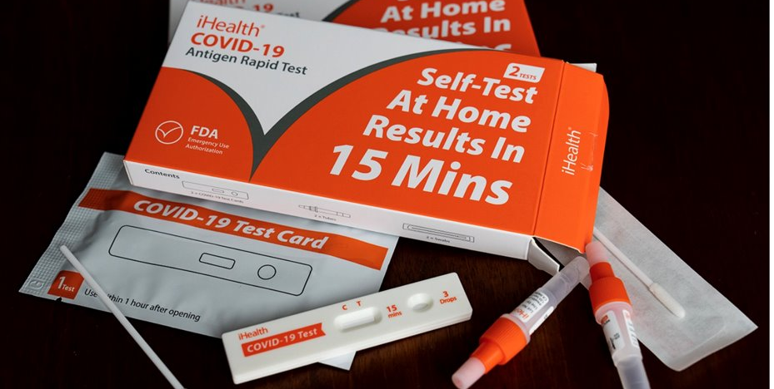
Testing for COVID-19: Who, When & How

Slide 12
Objectives
Identify indications for COVID-19 testing.
Discuss different types of tests and characteristics of each.
Describe effective strategies to increase testing in your community.
Notes:
Review objectives for this section of the training. Remember, these trainings modules may be used together or separately as appropriate for the specific scenario.

Slide 13
Who should get tested for COVID-19?
Anyone with any symptoms of COVID-19 infection should be tested – even if symptoms are mild.
Tests should be completed as soon as possible after symptom onset – definitely within the first 5 days of infection.
Maintain a high index of suspicion!
COVID Symptoms:
Cough
Fever
Fatigue
Loss of Taste & Smell
Shortness of Breath
Sore Throat
Runny nose/congestion
Body aches/muscle aches
GI symptoms: nausea/vomiting/diarrhea
A patient can have one or more of these. Be vigilant!
Not every cough is COVID – but it could be!
Know your patient’s COVID status, even with mild or minimal symptoms.
Notes:
It is important to test broadly – symptoms can be variable and mild, but broad testing will identify cases and for evaluation and treatment and will also prevent spread in the community.

Slide 14
What about people with mild symptoms?
Yes! Test patients with mild or minimal symptoms! Maintain a high level of suspicion.
While some of the newer variants may be mild in their initial presentation, these still could progress to severe disease and death in vulnerable people.
Testing for COVID-19 will help to:
  Efficiently identify positive cases
  Streamline opportunities to provide care for all COVID-19 patients
  Identify those at high risk of severe disease to propose appropriate treatment and follow up
  Effectively guide isolation and quarantine measures to prevent disease transmission
Notes:
Broad testing will help us to contain the disease, learn more about the disease and its spread, and also work to protect vulnerable populations.
Patients with COVID19 who are not themselves within the vulnerable population group, if unidentified, can potentially spread the disease to other people.
And patients who are within the vulnerable population group can be better treated and managed if identified early.

Slide 15
What about people who are vaccinated?
Yes! All people with symptoms should be tested!
Fully vaccinated people can still contract COVID-19, be contagious, and sometimes develop more significant disease (especially those with clinical vulnerabilities)
Clinically vulnerable COVID-19 patients, even if vaccinated, can still benefit from oral antiviral therapies, or other indicated therapies.
All patients – vaccinated or unvaccinated – will benefit from education and monitoring.​
Notes:
Vaccination is hugely successful in preventing severe and critical illness from COVID. However, it does not prevent ALL of these cases, and especially vulnerable patients, even when vaccinated, can still have clinically significant disease. Remember, testing provides information -- which can guide next steps, including isolation, monitoring, and possible treatment options.
The more we test, the more we know, and the better equipped we are to contain and treat the disease.

Slide 16
Different types of tests
Preferred test: Rapid Antigen Test (Rapid Diagnostic Test)
Pros: fast, most sensitive in symptomatic patients, less expensive, relatively easy to use
Cons: less sensitivity in asymptomatic patients
Recommend repeat/serial testing or confirmatory PCR testing for symptomatic patients with negative Antigen (Ag) Results
Alternative test: PCR (polymerase chain reaction), or NAAT (Nucleic Acid Amplification Test)*
  Pros: overall better sensitivity
  Cons: Longer turnaround time, more complex processing;
  NOT the ideal for Test to Treat, but depends on local availability
  Should be considered for symptomatic individuals with negative Antigen results.
* PCR is one type of NAAT test
Notes:
Rapid Antigen Tests are the preferred strategy for testing – considering their ease of use, fast turnaround time, and good test characteristics in symptomatic patients. Rapid Antigen tests are becoming more and more widely available, and while authorization for use depends on local guidelines, broad usage is becoming more common around the globe.
PCR tests do have a higher overall sensitivity, but are much more complex and have a much longer time for processing, between hours to days.
A few key tips:
Symptomatic patients with negative rapid tests should have repeat antigen testing, and may consider confirmatory PCR testing.
The sensitivity of rapid antigen testing is much less in asymptomatic patients – this strategy is really best for symptomatic testing, less good for screening tests.

Slide 17
Why are Rapid Antigen Tests ideal for T2T?
Faster results = faster access to care.
With COVID-19 test results available on-site, symptomatic patients can be offered immediate access to evidence-based care, including oral antivirals for eligible patients.
Patients who have some COVID-19 symptoms but are seeking care for other health issues can be confidently screened and, if negative, cared for appropriately.
You CAN offer oral antivirals to patients with a positive PCR test result – as long as they are within 5 days of symptom onset and meet eligibility criteria.
NOTE: Different regions will have different testing policies. Please refer to your local guidelines.
Notes:
Rapid antigen tests are preferred for Test to Treat because the time frame for efficacy of oral antivirals is within 5 days of symptom onset. Possible eligibility for T2T is one component, but effective monitoring, management, and isolation guidelines are best started early in the course of COVID19 infection.
Therefore, early diagnosis and information can best inform treatment, including T2T.
Please note, the last two points as well:
You CAN offer oral antivirals to patients with a positive PCR test result – as long as they are within 5 days of symptom onset and meet eligibility criteria
Different regions will have different testing policies so be sure to refer to your local guidelines.

Slide 18
Early testing is better!
Early identification of positive cases allows for effective isolation possibly decreasing transmission.
Early identification of positive cases facilitates appropriate treatment – including oral antivirals and other management strategies as clinically appropriate.
Window for initiating oral antiviral therapy is within 5 days of symptom onset.
Notes:
As stated on the slide, early identification is better!

Slide 19
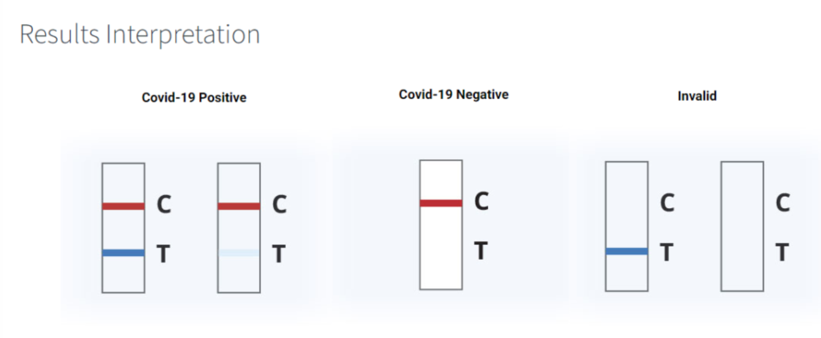
How to perform a rapid test:
Make sure to read the instructions on the box, tests may vary in instructions.
Wash your hands thoroughly with soap.
The kit comes with three main items: a collection swab, a test strip and a small vial of liquid.
Open the collection swab and insert it into each nostril, rotating five (5) times against the inner wall. You should insert the swab ½ to ¾ of an inch into the nostrils.
Open the large cap and insert your swab into the vial, then stir the swab for 30 sec.
Squeeze the sides of the vial against the swab as you pull it out.
Open the test strip. You’ll see that it has both a “C” and a “T,”.
Open the smaller, top cap on the vial of liquid, then squeeze four (4) drops of your sample into the collection area of the strip.
Set a timer for 15 minutes. Don’t disturb the test strip during this time.
Read your test.
Notes:
These instructions will be similar for most types of rapid tests, However, it is essential to familiarize yourself with the instructions for the specific type of test you will be using as there will be some variation.
Please note, a positive test has two lines, a negative test has ONLY the control line, and an invalid test will have only the test line or no lines at all.

Slide 20
More about testing….
Who can perform a rapid test?
  This will depend on local guidelines.
    In some cases, people can perform rapid tests at home
    In some cases, a trained HCW will perform the test, sometimes at home, at a clinic or pharmacy, or a facility.
When should someone perform a rapid test?
  If a person has any symptoms of COVID-19, TEST!
  If a person has symptoms, but their test yesterday was negative, TEST AGAIN!
20
Notes:
Be sure to check your local guidelines – and it could be very valuable to bring those local guidelines to the actual training.
The guidelines for who can perform a test will vary in different locations, and will likely change over time.
Please discuss the local guidelines for your area at this time, and consider the potential strategies for your clinic or health care facility to optimize the testing options to best reach and serve their communities, particularly the most vulnerable populations and people they serve.
Remember - only symptomatic patients are eligible for Oral Antiviral therapy, so while testing and identifying close contacts can be important, for T2T eligibility, patients need to have symptoms.

Slide 21
Consider Community Based Testing
Rapid Diagnostic Tests can be conducted outside of clinical and laboratory settings by trained operators e.g. using the SARS-CoV-2 Antigen RDT Training Package or by individuals as part of self-testing.
Testing should focus on symptomatic individuals.
Testing can also focus on vulnerable individuals.
Patients with more concerning symptoms should be evaluated formally by a health care worker, either by telemedicine or at a local facility or clinic.
Notes:
Different countries will have different policies, practice and strategy regarding testing. It is important to consider your own country’s policies, and also consider how rapid tests are currently being used, and opportunities for usage in the future.
World Health Organization policy is supporting community based testing, and more details regarding an implementation strategy can be found here: https://www.who.int/publications/i/item/9789240017740
WHO has also put out a training package for Rapid diagnostic Testing which can be found here: https://extranet.who.int/hslp/content/sars-cov-2-antigen-rapid-diagnostic-test-training-package

Slide 22


Increasing demand for testing
“Know your Status”
COVID-19 is a treatable disease, and early identification can help to monitor illness, also prevent others from becoming ill.
Early identification of cases can enable effective treatment at home for eligible patients to prevent the illness from becoming more severe.
The pandemic is not over - continued vigilance can help to contain local outbreaks and sustain effective response.
Notes:
This is another time for group discussion.
What is happening in the community where you work/live?
Are people sick with COVID19? Are people testing for COVID19?
Are there existing outreach campaigns to assure people with signs or symptoms of COVID are encouraged to and able to access testing?

Slide 23
Triage, Infection Prevention & Control, & Referral Pathways for COVID-19 Patients

Slide 24
Objectives
Define triage and components of an effective triage system.
Understand importance of integrating universal infection prevention and control into triage planning & operations.
Understand triage and cohorting in the context of COVID-19, more specifically in the context of Test to Treat.
Analyze clinical cases to develop strategies to apply triage concepts to your own clinical environment.
Organize strategies for your clinical setting for either discharge planning or transfer to a higher level of care.

Slide 25

Triage: To sort
Goal: To accurately and safely identify and prioritize the sickest patient
To safely and effectively categorize patients according to severity of illness while also considering IPC
Notes:
The term “triage” comes from the French verb trier, meaning to separate, sort, shift, or select. Initially applied during wartimes with their implied scarcity of resources, standardized triage is routinely used and considered the standard of care.
The basic concepts of triage become more complicated to apply in the context of COVID-19 (and other contagious diseases) because of the added need to separate suspected COVID-19 patients from other patients, while always prioritizing the safety of clinical staff.

Slide 26
Tools Questions
Clinical Impression
Vital Signs
Focused History
Physical Space
Experience
Who performs triage?
Where?
With what tools?
Average waiting time?
Separate COVID-19 facility? Or one emergency care facility?
GOAL: Match the right patient to the right resources in the right place at the right time.
Notes:
Training, the ability to assess clinical impression, and experience are essential for the person responsible for triage. If possible, someone with at least a few years of clinical experience should be put in the triage role, depending on who is available on your team.
The types of providers who perform triage vary by clinical setting — they are nurses in many settings, and technicians or paramedics in others.
Think about your own clinical environment. Who first encounters a patient? Do you have a place where triage is conducted? Who is responsible for checking vital signs? Where are the tools to take vital signs? Do you have formal training on triage? Do you have a formal process for triage?

Slide 27
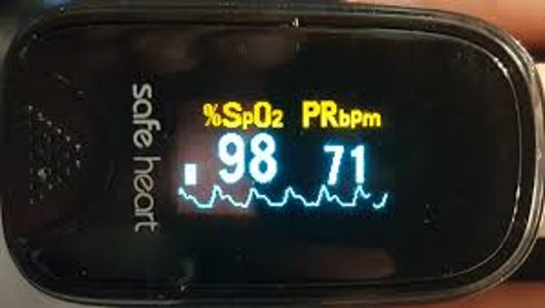
Recommended equipment
Pulse oximeter
Blood pressure cuff/heartrate monitor
Thermometer
Reference guide for normal and abnormal vital signs
Video link: How to Use a PulseOximeter
Caveat: There is some evidence demonstrating decreased accuracy of pulse oximeters in patients with darker skin. Be attentive to other emergency signs and find more information at openoximetry.org.
Video link: How to Take Vital Signs
Notes:
Ideally, you should have the equipment necessary for triage available for use during this module for the purposes of demonstration and practice.
Please keep in mind, this equipment and measurements are usually used for triage & vital sign measurements in facility based settings. For Test to Treat, particularly considering home settings or other clinical settings without this equipment, patients can be screened for mild and moderate symptoms without the listed equipment.
The slide also has links for videos that may be useful. However, please point out to participants that the videos may not display full IPC protocols. Also, remind all participants of the importance of universal masking and IPC.

Slide 28
Vital signs: Adults
Normal Vital Signs in Adults
Core Temperature | 98.6 F; 37 C
Heart Rate | 60 - 100 Beats per minute
Respiratory Rate | 12 - 18 Breaths per minute
Blood Oxygen | 95% - 100%
Blood Pressure | 90/60 - 130/89
Notes:
This slide is a reference tool showing the normal vital signs in adults.
While normal blood pressure is 120/80, there is a range of normal as there is with all vital signs.
Normal blood pressure can range from 90/60 - 130/89.

Slide 29
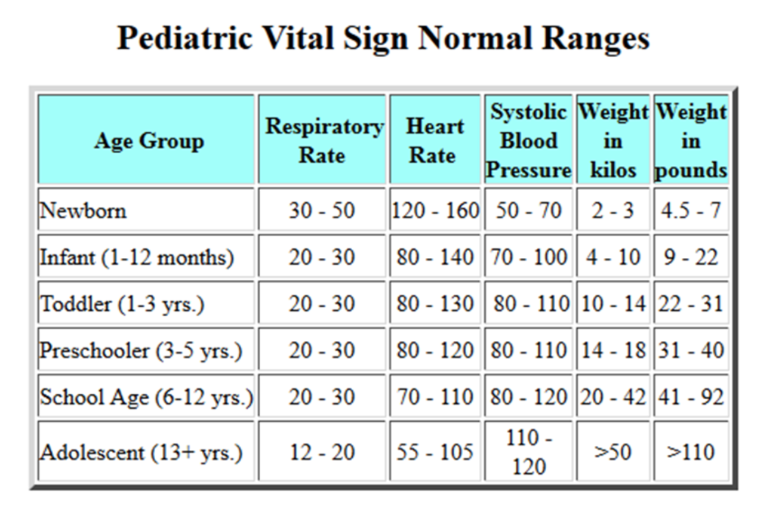
Vital signs: Pediatrics
Notes:
This reference tool shows the normal ranges of vital signs in pediatric patients. Please note that the normal ranges for children change as they grow. Because these ranges are hard to remember, it is best to post a chart or have a chart available for quick reference during triage.

Slide 30
Infection Prevention & Control
Universal infection prevention and control is essential!
Consider every patient COVID-19 positive until proven otherwise.
The ideal IPC for all undifferentiated patient encounters is:
  Respirator masks with higher filtration (N95, FFP2, FFP3, or equivalent) recommended
  Eye protection
  Gloves
  Gowns
  Regular hand hygiene
Universal masking is recommended in health facilities (for patients and health care workers).
Notes:
There are many resources that present the principles and practices of IPC related to COVID-19.
We encourage the facilitator to access and review local guidelines as part of this session, if time allows.
However, the most important point to emphasize is the critical importance of universally high levels of personal protective equipment use with undifferentiated patients — including both those who are symptomatic and screen positive, as well as those coming to the clinical setting for other reasons. Personal safety during triage is essential, especially given the high levels of positivity and transmissibility of the omicron variant, or other possible variants that may emerge in the future.

Slide 31
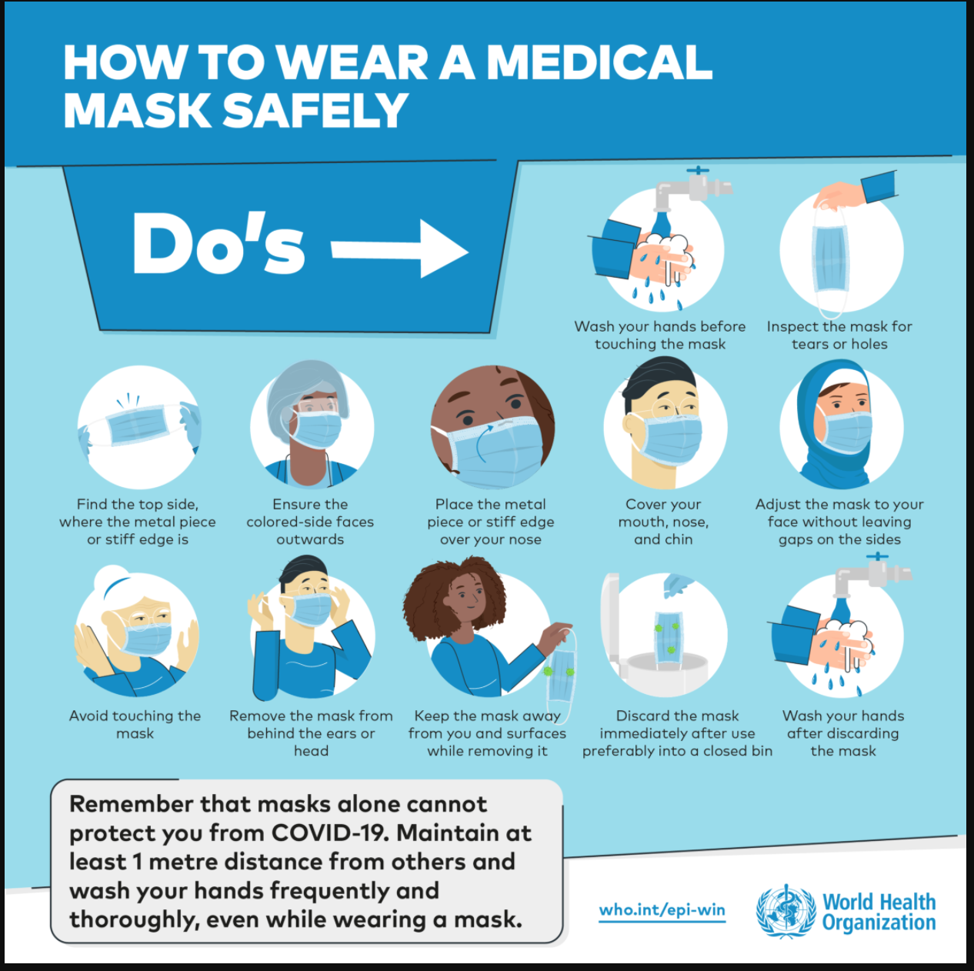
IPC resources
WHO:
Infection Prevention and Control Resources
Open Critical Care: Infection Prevention and Control Trainings
Notes:
This slide provides links to additional IPC resources.

Slide 32
IPC with COVID-19 variants
New variants of COVID-19 are emerging regularly, challenging and requiring updates to our practices.
For example, the omicron variant is more transmissible than previous variants, and updated guidelines recommend using increased levels of protection
Stay safe by keeping up-to-date as the pandemic and related recommendations evolve.
Notes:
Reiterate the importance of a heightened level of IPC with the new COVID-19 variants and continued caution with the possibility of new variants in the future.

Slide 33
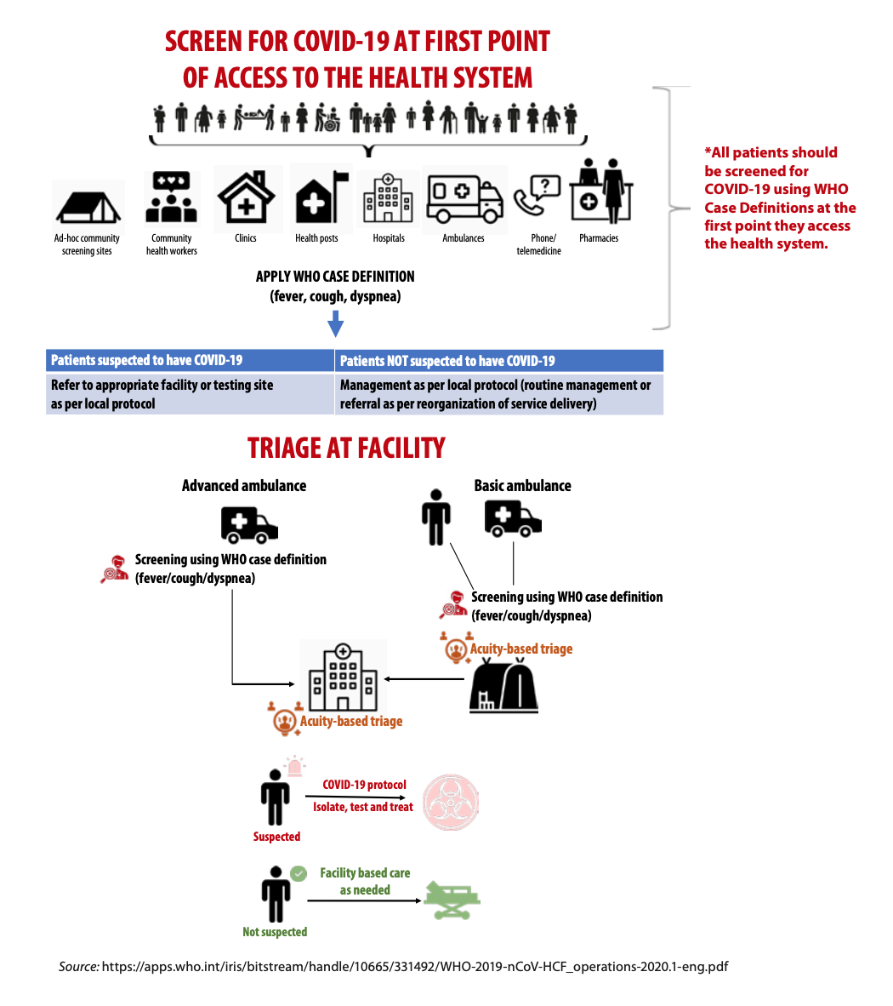
Screening
Universal screening for all patients entering the health facility
Dedicated screening at initiation of triage
Screen for both the presence of symptoms and/or recent exposure
Screen for symptoms consistent with new variants
Notes:
Screening should be initiated at the first point of entry for the health care facility. This is universal, meaning that it applies to everyone — staff, patients, and physicians. It can include temperature screening, symptoms, and close contacts. Universal masking should be maintained. Protocols relevant to local guidelines can be applied, while keeping in mind the importance of isolation and quarantine, particularly for unvaccinated individuals and those at higher risk of severe disease. Remember, the health care facility is designed to provide care to people who are at risk, so a high level of caution is needed.

Slide 34
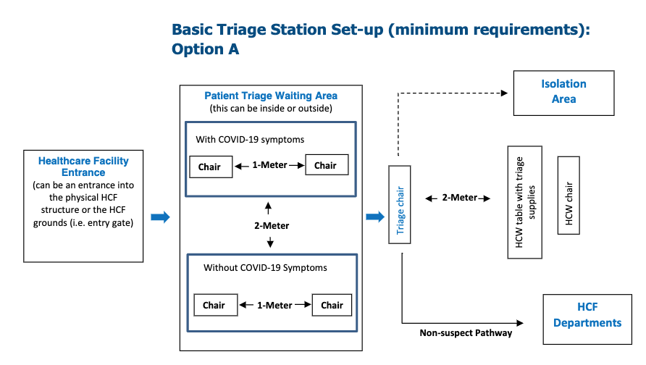
Physical Cohorting: Basic triage
Notes:
This slide shows a schematic for basic triage to initiate the isolation and care of patients.
Physical cohorting should be maintained when possible to separate patients who do and do not have symptoms of COVID-19. Of course, there will also be asymptomatic patients who test positive, so universal precautions are important. Conversely, not every person with a fever, shortness of breath, or cough will have COVID-19 as their diagnosis.

Slide 35
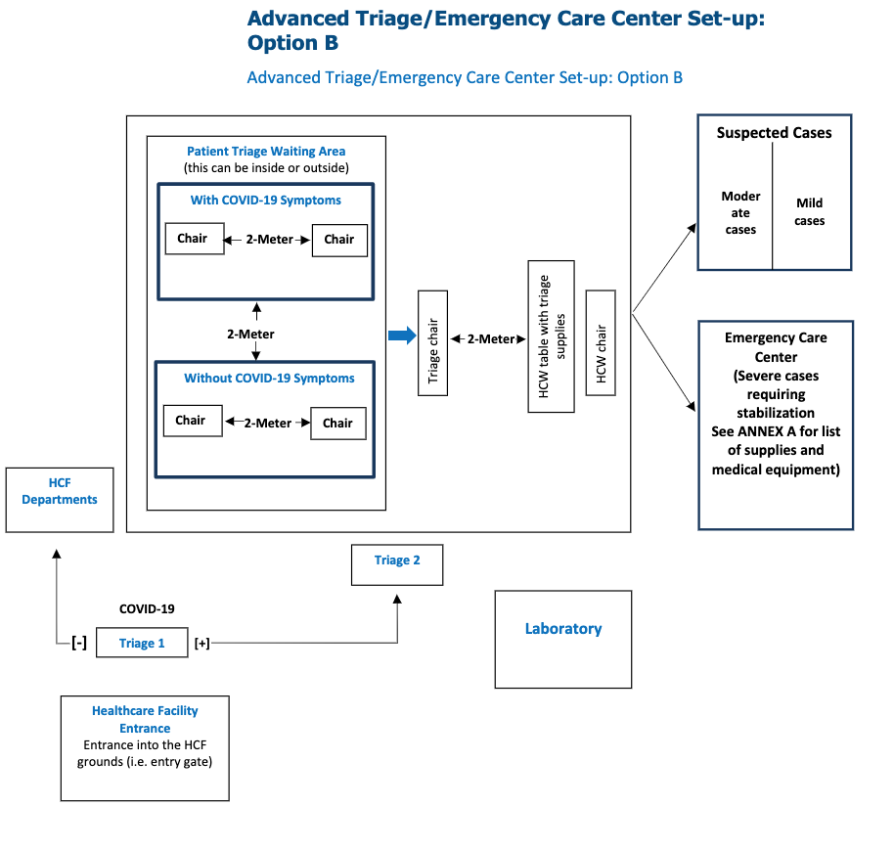
Physical Cohorting:
Advanced triage or emergency care center
Severe cases requiring stabilization
Notes:
This schematic takes triage to a more advanced level — beyond the initial separation of symptomatic and asymptomatic patients to divided levels of clinical care based on severity of symptoms. Mild and moderate suspected cases may (or may not) need some further testing, whereas severe cases require immediate stabilization.

Slide 36
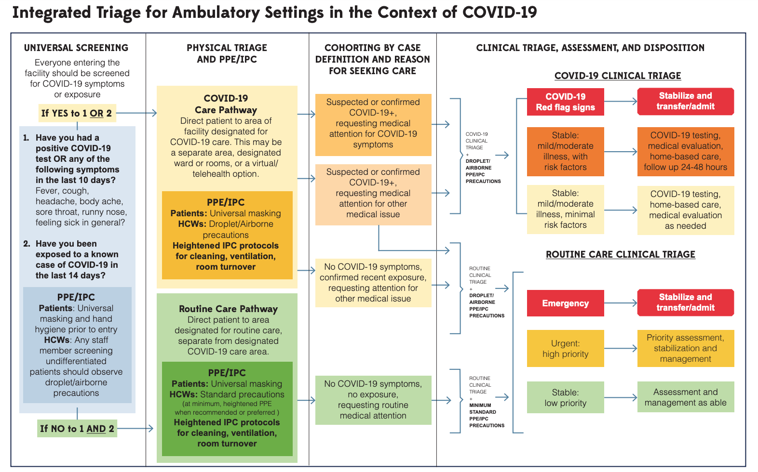
Integrating physical and clinical triage in the context of COVID-19
LINK here to the algorithm and more information.
Notes:
This diagram depicts an integrated approach to physical and clinical triage. The COVID-19 pandemic has necessarily focused on cohorting and the separation of symptomatic and exposed patients from asymptomatic and unexposed patients. However, a holistic approach must integrate the importance of prioritizing “red-level” patients, whether red-level status is due to COVID-19 or other concerns. Here, the goal is to provide a framework for an integrated approach to physical and clinical triage.
As you look at this diagram, it is very important to remember a few things:
1. Any RED patient (COVID-19 suspected or not) should move immediately to a resuscitation area for clinical evaluation and treatment.
2. IPC/PPE should be maintained for all patients, regardless of screening or test results — although higher levels of PPE should be maintained for very symptomatic, suspected, or confirmed positive patients.
3. All patients require full clinical evaluation. This is particularly important for patients in the yellow/orange zone who are stable but have risk factors and moderate illness. These patients require a detailed evaluation, as they may be eligible for close follow-up and may end up needing hospitalization. The purpose of triage is to categorize patients in terms of priority for evaluation; clinical evaluation contributes to the final patient disposition.

Slide 37
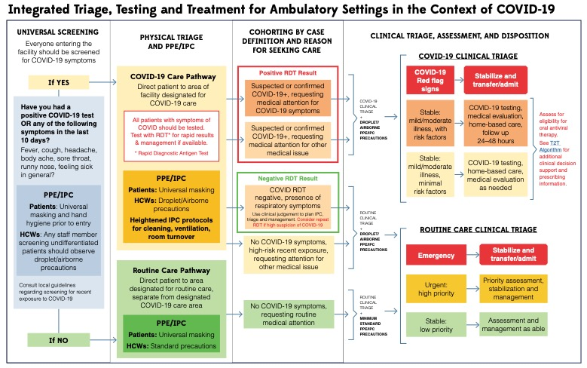
Integrated Triage with Test to Treat
Notes:
This graphic provides an updated view of integrated triage, incorporating Test and Treat as an important component to consider.
Few important elements to consider:
If available, rapid testing for symptomatic individuals can help to confirm positive infections. IPC should be maintained for health care workers even in the presence of a negative test.
All patients should be managed according to evidence based guidelines – the opportunity to provide oral antivirals to confirmed positive, symptomatic patients, within 5 days of symptom onset is one pillar of COVID-19 care and treatment. Patients with severe and critical illness should still be stabilized and transferred, and those with mild and moderate illness who do not require hospitalization but also are not eligible for oral antivirals should be managed supportively and according to updated evidence based guidelines.

Slide 38
Integrated Triage in Context of T2T
Maintain universal screening, cohorting, IPC
Real time testing for symptomatic patients
If severe symptoms – will need hospitalization
If mild to moderate symptoms plus positive test, then evaluate for eligibility for treatment with an oral antiviral.
Notes:
Important take home points for T2T reiterated.

Slide 39

Clinical triage: Focus on COVID-19
Chief complaint/initial impression
  Does this patient look unwell?
  Does this patient have increased work of breathing?
  Is this patient confused or does the patient have an altered level of consciousness?
Red flag signs:
  Severe shortness of breath
  SpO2 94% or lower
  Dyspnea (trouble breathing) at rest and/or with exertion
  Severe and/or unrelenting chest pain
  Severe weakness
  Altered level of consciousness, e.g., lethargy, confusion, giddiness
Notes:
As you are initially evaluating the patient, consider their general appearance. Is the patient visibly short of breath, working hard to breathe, cyanotic, or confused? If so, the patient should be immediately moved into a red zone/resuscitation area, and the next steps of patient evaluation by the appropriate team should be initiated. Think ahead — the person doing the triage should usually not be the person conducting the next steps of resuscitation and stabilization, but in some cases there is no other option. Consider your environment, and plan for what makes the most sense given the resources you have.
The “red flag” symptoms should raise a higher level of concern. When a patient who appears ill or has unstable vital signs also has red flag symptoms, this raises higher levels of concern. However, even if a patient does not appear clinically unstable, these red flag symptoms require further consideration and often further investigation.

Slide 40
Clinical triage: Focus on COVID-19
Additional important information:
  Age
  Past medical history
  High-risk comorbidities:
    Chronic diseases: diabetes, sickle cell disease, HTN, CKD
    Obesity (BMI >= 30 kg/m2)
    Chronic kidney disease (stage 3b or worse)
    Tuberculosis
    Chronic lung disease
    Immunocompromised (e.g. HIV)
  Pregnancy
  COVID-19 vaccination status
Notes:
Age >= 65 is a risk factor for disease progression, regardless of vaccination status; or 50 – 64 and unvaccinated
Age ≥ 50
BMI ≥ 30 kg/m2
Pregnancy
Diabetes
Sickle cell disease
Neurodevelopmental disorders
Chronic kidney disease, stage 3b or worse
Cardiovascular disease, hypertension, or lung disease
Immunocompromising condition (e.g. HIV)
Tuberculosis
Clinician-determined medical condition, or demographic factor presumed to place the patient at high risk for disease progression

Slide 41
Clinical triage: COVID-19
Case definitions:
Asymptomatic infection: Individuals who test positive for SARS-CoV-2 using a virologic test but who have no symptoms consistent with COVID-19
Mild illness: Individuals who have any of the signs and symptoms of COVID-19 (such as fever, cough, sore throat, malaise, headache, muscle aches, loss of taste and smell) but have no shortness of breath, dyspnea, or abnormal imaging (e.g., chest X-ray)
Moderate illness: Individuals who show evidence of lower respiratory disease but maintain oxygen saturation (SpO₂) of ≥94% on room air at sea level
Severe illness: Individuals who have an SpO₂ of <94% on room air at sea level, respiratory rate >30 breaths per minute, or lung infiltrates >50%
Critical illness: Individuals with respiratory failure, septic shock, and/or multiple organ dysfunction
Notes:
These case definitions are useful to review and consider as you encounter COVID-19 patients. Note the emphasis on vital signs as essential data points
Remember, mild and moderate symptomatic illness are targets for consideration for Test to Treat. All patients should be evaluated for disease severity and need for initiation of treatment.

Slide 42
Clinical triage: Non-COVID-19 patients
Do not forget:
Other patients also need access to health care!
Not every fever or cough is COVID-19.
Not every patient with shortness of breath has COVID-19.
AND
Every patient with any other type of medical complaint may also have COVID-19.
Bottom Line
Triage all patients while taking universal IPC precautions to protect yourself and others.
Rely on your clinical training to treat the whole patient; COVID-19 is one of many possible diagnoses.
Notes:
While this training and our focus is on COVID patients, remember, any patient may arrive at the clinic or facility in need of evaluation and care.
This patient may have COVID or may have another issue, and we are working to strengthen the health system to care for all of these possible things.
Maintain a high level of personal protection with appropriate IPC, and maintain a broad differential diagnosis when initially evaluating and caring for patients.

Slide 43
Practical Case Scenarios:
Case 1:
It is your first day working as the triage officer.
What personal protective equipment (PPE) should you be wearing during your duties today?
What tools do you want to have available to help you triage?
Notes:
To prepare for your first day doing triage, you will need PPE and triage tools. PPE for undifferentiated patients should include a respirator mask, face shield/eye protection, gloves, and gown. Tools include pulse oximeter, HR/BP monitor, and normal vital sign charts for reference.

Slide 44
Case 2:
Your first patient is a 34-year-old man coming to the clinic with a fever, cough, and malaise.
What are your initial actions?
What do you want to know?
What tools do you need?
Notes:
For this patient, you need more information. But first, you want to be sure you are in your appropriate PPE. You should be wearing a respirator mask, gloves, face shield or eye protection, and a gown.
Then you want to develop an initial impression. How does this patient look? Do they have increased work of breathing? Do they appear pale or cyanotic?
If you have tools such as pulse oximetry and monitors to obtain vital signs, you will need those tools. Think ahead. What else might you need?

Slide 45
Case 2: More information
Initial impression:
  Patient is not in any acute distress, he is speaking in complete sentences, with no obvious increased work of breathing.
Vital signs:
  HR 89, BP 140/70, RR 14, SpO₂ 99%, temperature 38.5°C
What is your next step?
Notes:
This patient has a reassuring triage. He does have signs and symptoms of COVID, but his vital signs and clinical appearance are reassuring. He does not meet criteria for severe illness. In a full clinical evaluation, you will need to obtain a more extensive history and complete a full physical exam to determine if he needs any further testing or treatment. You will need to consider risk factors for eligibility for oral antivirals. For now, he can triage into the mild/stable category of patients and await a full clinical assessment to determine a plan.

Slide 46
Case 3:
Your next patient is a 54 yo female with cough, fever, and malaise.
What are your initial actions?
What do you want to know?
What tools do you need?
Notes:
You need more information for this case. But first, you want to be sure you are in your appropriate PPE. You should be wearing a respirator mask, gloves, face shield or eye protection, and a gown.
Then you want to develop an initial impression. How does this patient look? Do they have increased work of breathing? Do they appear pale or cyanotic?
If you have tools such as pulse oximetry and monitors to obtain vital signs, you will need those tools. Think ahead. What else might you need?

Slide 47
Case 3: More information
Initial impression:
  Pt has some increased work of breathing, with only the ability to answer questions with short answers.
  She is not able to stand up or walk without assistance.
Vital signs:
  HR: 115; BP: 95/76; RR: 20; SpO2 91%; Temperature: 38.7
What is your next step?
Notes:
This patient is sick. She should be moved to a resuscitation area where you can stabilize her with oxygen therapy and immediate resuscitation. She screens positive for suspected COVID, and also for severe symptoms.
What tools do you have in your clinical area? Do you need help from another clinician? Do you have oxygen available?
Think ahead. How can you stabilize this patient? And if you need to move this patient to a higher level facility, what will you need to do? How can she safely get there, maintaining safety of the transport group along the way?

Slide 48
Treatment & Management for COVID-19: Clinical Approach

Slide 49
Objectives
Recognize clinical characteristics of COVID-19 patients.
Understand treatment options and management strategies.
Identify resources to access for updated clinical guidelines for COVID-19.

Slide 50


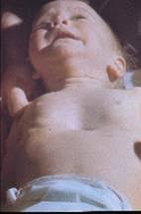
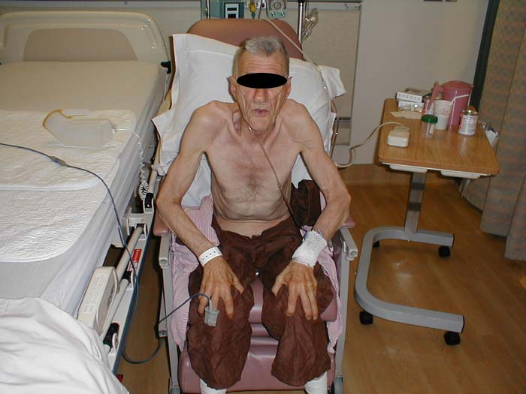
Initial assessment: The eyeball test
Before you see the patient, you have:
- Their screening questionnaire
- Their chief complaint
Your first assessment when you walk in the door:
Vital signs may be available to you before you approach a patient or during your initial assessment.
Notes:
As you know, you can learn a lot about your patient within the first few moments of their visit.
When approaching a patient in your facility, you should already have a lot of information from the screening questionnaire and their presenting complaint.
Are they sick? Are they here for symptoms of illness? Or are they here with other medical concerns and happen to have a mild cough?
When you walk in the door and lay eyes on the patient, you can make your first assessment about their clinical condition.
How would you assess each of these patients? Why?

Slide 51
Initial assessment:
History of present illness for respiratory symptoms
Date and onset of symptoms
Type and severity of symptoms: perform a complete review of systems if appropriate
Exposure to any sick people, especially in the home or workplace
Vaccination status
Remember: “Fully vaccinated” means > two weeks since the last dose of the series, preferably with recommended boosters
Past medical history, including comorbidities
  Determine risk factors for severe illness
  Start building a differential diagnosis for presenting symptoms
  Develop a plan of care that accounts for managing comorbid/chronic conditions (e.g., diabetes, CHF, HIV, or psychiatric disorders)
Social history, home/work environment, barriers to care
Notes:
1. Date of onset: are these symptoms new (within the past 7-10 days) or chronic? Does the patient have a chronic cough at baseline, but with a new fever? Determining the date of onset of acute viral symptoms will guide your recommendations about how long the patient should isolate.
2. Type and severity of symptoms
3. Exposure to sick people: Remember, COVID-19 can cause very mild symptoms, so even if someone in your home or workplace hasn’t tested positive or had severe illness, exposure may explain your patient’s current symptoms.
Vaccination status: Remember, people are only fully immunized two full weeks after their last recommended dose of their primary series.
Vaccinated people can get COVID-19, though their symptoms are typically less severe. Knowing a patient’s vaccination status still helps to inform your clinical assessment.
4. Past medical history, including comorbidities: You want to know the patient’s medical history to determine their risk of complications if they have COVID-19, to plan for their medical care for comorbid conditions, and to make a well-developed list of differential diagnoses to ensure you are rendering the best care. This will also help to assess for eligibility for oral antivirals in the case of mild or moderate COVID19 patients.
Cardiopulmonary conditions like chronic obstructive pulmonary disease (COPD), asthma, and congestive heart failure (CHF) are important to consider when developing a differential diagnosis and considering your patient’s risk stratification in the context of suspected COVID-19.
Chronic kidney disease, including patients with total renal failure/on dialysis, are at increased risk of complications.
Tobacco use or other smoke exposure may affect cardiopulmonary risk factors.
Obesity is a risk factor for complications of COVID-19.
Patients with diabetes may need medications adjusted to manager hyper- or hypoglycemic episodes; they are also at higher risk for complications of COVID-19 and should be monitored closely for signs of deterioration.
Any patient with a compromised immune system is at higher risk of severe COVID-19, including people with HIV/AIDS and on chemotherapy or other cancer treatments.
Screen for psychiatric and neuropsychiatric conditions, as these may mimic alterations in mental status or may affect a patient’s ability to give a complete history and understand a plan of care.
5. Social history: It is important to know your patient as a person. Even in a brief visit, you can assess important aspects of their lived experience, such as their living environment, support system, occupation, and access to necessities like food, clean water, and transportation. While this information may seem irrelevant to the clinical encounter, it is often essential to develop an effective plan of care.

Slide 52
Not every cough is COVID!
What does this mean, and why must we build a full differential diagnosis (even if we’re pretty sure the patient has COVID-19)?
Notes:
What does this mean, and why must we build a full differential diagnosis (even if we’re pretty sure the patient has COVID-19)?

Slide 53
Common presenting symptoms and differential diagnoses
Symptoms | Possible Diagnoses
Cough, shortness of Breath Fever Runny nose/congestion Sore throat Headaches/body aches/muscle aches Chest pain Confusion/altered mental status Loss of taste or smell* GI symptoms (nausea, vomiting/diarrhea)** | COVID-19 Other viral respiratory illness (adenovirus, rhinovirus, etc.) Community acquired pneumonia Acute coronary syndrome Acute kidney injury/renal failure Congestive heart failure (CHF) COPD/asthma flare GERD/reflux Alternative infectious causes (consider causes of fever in your community) Influenza Strep throat Seasonal allergies Stroke/CVA/TIA Electrolyte abnormalities Gastroenteritis ** Acute abdomen ** Pregnancy-related causes **
Notes:
Health care workers must balance the possibility that a sick patient is infected with COVID-19 with the possibility that they have something that is not COVID-19. Or they can be sick with COVID-19 and another medical problem! This can be confusing or overwhelming, but it is crucial to consider all possibilities when approaching a patient. If you only consider one diagnosis – you will only find one diagnosis – but patients can have various diagnoses, and sometimes have more than one thing going on at a time. It is important to stay open minded, and use your history and physical tools to narrow down the possibilities.
Additional notes: *Loss of taste and smell is a unique symptom for SARS-CoV-2 and a strong predictor of positive COVID-19 status. However, there are reports of a lower incidence of this symptom with the current Omicron variant.
**While GI symptoms like vomiting and/or diarrhea have been reported in 20-40% of COVID cases, these are rarely the only presenting symptoms (i.e., they are usually in addition to other symptoms like cough, respiratory symptoms). It is important to remember that GI symptoms can be COVID but can be many other disease processes that should be closely assessed and managed.

Slide 54
Case Definitions: COVID-19
Asymptomatic infection: Individuals who test positive for SARS-CoV-2 using a virologic test but who have no symptoms consistent with COVID-19
Mild illness: Individuals who have any of the signs and symptoms of COVID-19 (such as fever, cough, sore throat, malaise, headache, muscle aches, loss of taste and smell) but have no shortness of breath, dyspnea, or abnormal imaging (e.g., chest X-ray)
Moderate illness: Individuals who show evidence of lower respiratory disease but maintain oxygen saturation (SpO₂) of ≥94% on room air at sea level
Severe illness: Individuals who have an SpO₂ of <94% on room air at sea level, respiratory rate >30 breaths per minute, or lung infiltrates >50%
Critical illness: Individuals with respiratory failure, septic shock, and/or multiple organ dysfunction
Notes:
Again, these case definitions are useful to review and consider as you encounter COVID-19 patients. Note the emphasis on vital signs as essential data points
Remember, mild and moderate symptomatic illness are targets for consideration for Test to Treat. All patients should be evaluated for disease severity and need for initiation of treatment.

Slide 55
The majority of COVID-19 cases are mild or moderate — and that proportion may increase
ICU
Hospital Care
Primary Care and Community Care
5-10% of those evaluated in the hospital will develop severe COVID-19 and require critical care.
10-20% of patients will need evaluation and care at a hospital, usually to administer medical oxygen therapy.
60-70% of patients can be managed at the primary care level and safely recover at home. Encourage patients to contact the primary care center first for information, evaluation, and guidance from a nurse or doctor.
Isolation is key to prevent the virus from spreading while most patients recover at home.
Notes:
Even before the arrival of vaccination and other advances in medical management of COVID, the majority of COVID-19 infections did not require hospital care.
About 80% of positive COVID-19 patients have always mild or moderate symptoms; a priority for these patients is to keep them safe, comfortable, and away from others so they do not spread the disease, while identifying and treating those who are at higher risk of progression of disease. New treatments like oral antivirals are an important advance to prevent disease progression, coupled with early identification of COVID19 cases, and appropriate isolation and supportive measures to prevent additional disease spread.
Primary care systems should be ready to care for all patients safely and effectively. This includes COVID patients with mild symptoms as well as other patients who need other medical care.
Notes for graphic:
ICU: Fewer people contracting COVID-19 means fewer critically ill patients.
Hospital care: You may see patients coming directly from the community or referred from the primary care center.
Primary care and community center: Of patients testing positive, 80-90% can self-isolate at home. Some of those will benefit from additional treatment, and these patients should be assessed for vulnerabilities and eligibility for Oral Antivirals. Some of these patients will only need observation for symptom resolution. Isolation is key to prevent the spread while patients recover at home.

Slide 56
Initial questions
Does this patient have COVID-19?
  Rapid Antigen Tests should be completed to confirm status. Or check the results of a recent PCR test or rapid test performed at home.
  If YES
Does this patient have severe symptoms?
  Dyspnea, SpO2 ≤ 94%, new supplemental O2 requirements, confusion, respiratory distress, need to additional labs or imaging
  Severe patients require a higher level of care or admission to a hospital
  Mild and moderate patients should be assessed for eligibility for oral antivirals.
Has this patient had symptoms for less than 5 days?
Notes:
A rapid test performed at home or at another facility can be sufficient to confirm a positive case of COVID19 (confirm with local guidelines).
This patient will still need to confirm the symptom onset of less than 5 days, and that the test was done within that time frame as well.

Slide 57
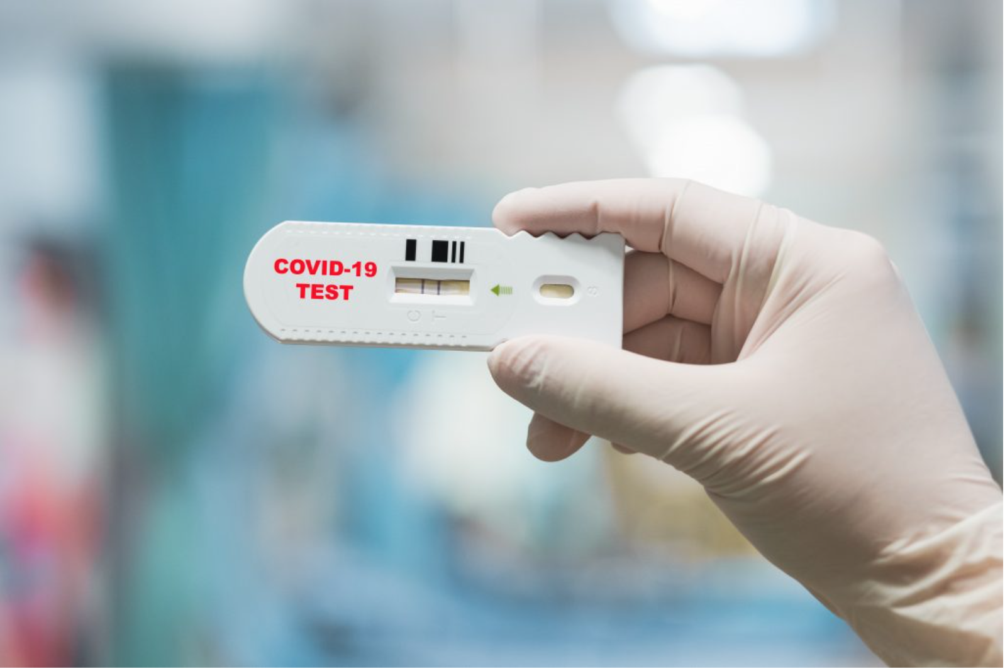
COVID Rapid Antigen Test Results
Notes:
This test is positive!

Slide 58
Treatment Approaches
Severe/Critical Illness:
  Will need inpatient care – may need to arrange for transfer
  Interventions may include:
    Oxygen, titrated & delivered as indicated
    Dexamethasone: if new oxygen requirement
    Consider Remdesivir
    Consider Tocilizumab or Baricitinib
    Anticoagulation
    Symptomatic Treatment
    Additional treatments per updated clinical guidelines
Mild/Moderate Illness:
  Usually can be monitored at home for progression vs. resolution
  Consider eligibility for Oral Antivirals – Test to Treat
  Symptomatic Management/Supportive Care
Notes:
Remember, there are treatments we can offer to COVID19 patients – including oral antivirals for eligible patients with mild & moderate illness, as well as other treatments for more severe cases.
Can ask the group to name treatments they know of, treatments that are available in their local facility or other locations.

Slide 59
Test to Treat: Identify and Treat Eligible Patients
Aim: Identify symptomatic patients within 5 days of symptom onset who meet eligibility criteria – and treat them!
Consider:
  Universal precautions & IPC
  Any severely ill patients are treated safely and appropriately
  Pathway of care for more severely ill patient?
  Monitoring of symptom resolution for less severely ill patients
Notes:
This is the basic description of the T2T strategy.
Remember, it is not an independent entity, but fits within the general care of patients with COVID19.
T2T is the best care strategy for COVID19 patients who meet eligibility criteria – and we should be working hard to identify these patients so they can have the best possible clinical outcomes!

Slide 60
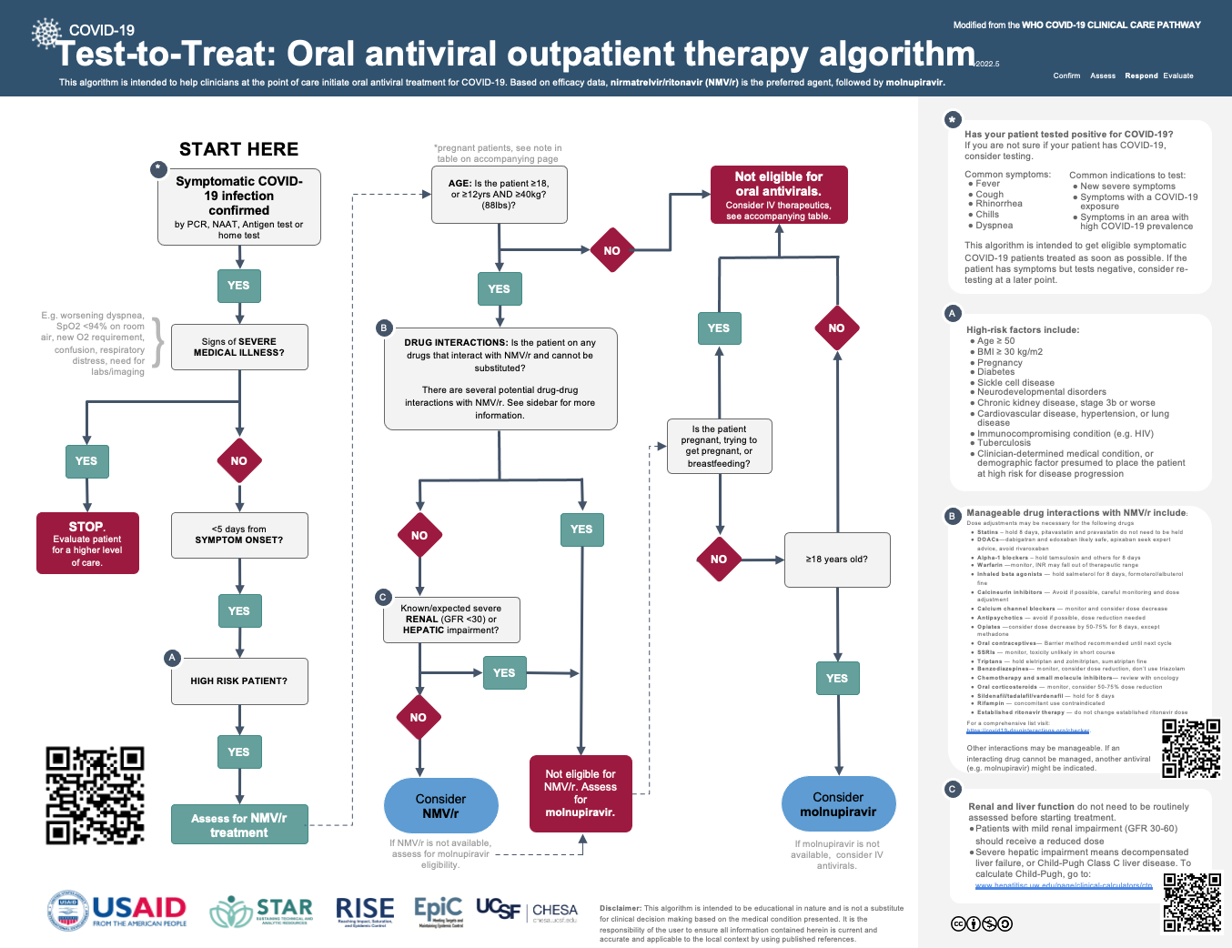
Test to Treat Algorithm
Notes:
Does the patient have symptomatic COVID-19 infection that is confirmed?
Does the patient NOT have signs of severe medical illness? Remember – if they do have severe illness they need to be treated, stabilized as needed, and admitted to the hospital or transferred as necessary in a safe way.
Is this less than 5 days since symptom onset. If YES the proceed through the algorithm.

Slide 61
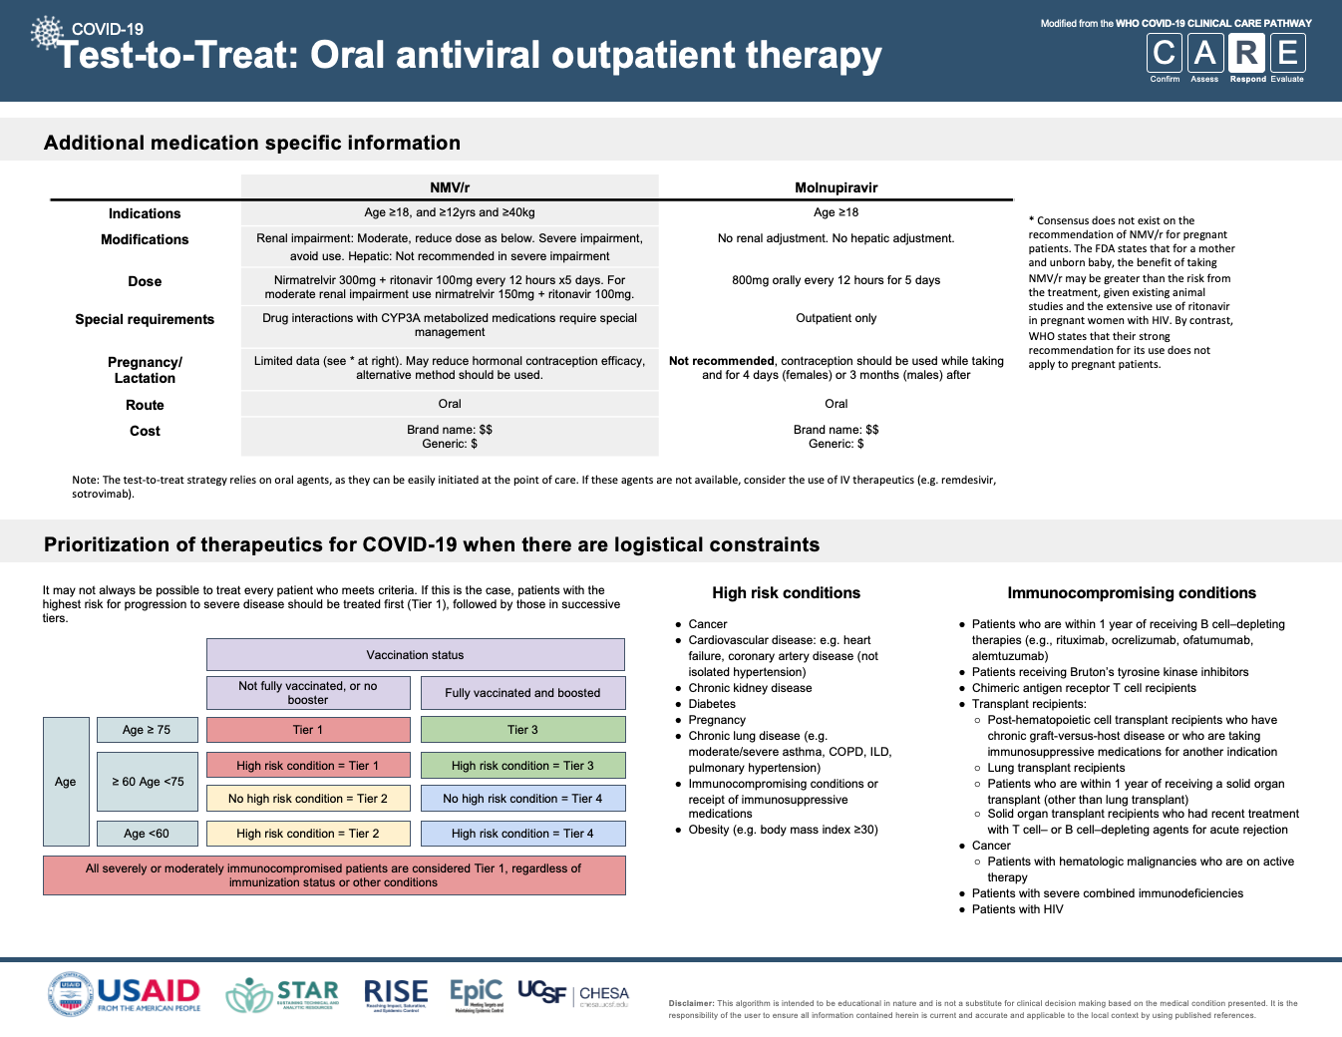
Notes:
This second page of the Test to Treat guide provides additional specific guidance regarding dosing of Paxlovid (Nimatrelvir/ritonavir) and Molnupiravir.
It also provides a framework to consider prioritization of therapeutics if there are medication shortages or other logistical constraints – prioritizing treatment for the most vulnerable populations who are proven to have the most significant change in outcomes when treated.

Slide 62
What if my patient does not meet criteria for T2T?
This does not mean we cannot help this patient-- proceed with usual standard of care!
Consider standardized approach to monitoring in the community – home based care with check in points.
Supportive care for symptom control.
Isolation for disease containment.
Patients requiring higher level of care need to be stabilized & admitted or transferred.
Notes:
We want to treat as many people as possible who meet eligibility criteria. But remember, if a patient does not meet criteria then we should not prescribe the medications. At the same time, this does not mean we have nothing to offer.
Mild and moderate patients will benefit from various supportive measures (acetaminophen, cough medications, other symptom management) – and monitoring for disease progression.

Slide 63
Evidence-Based Therapy for COVID
Evidence is rapidly changing as more treatments are available. It is important to stay up to date with both National Guidelines and Global Guidelines
These resources are excellent to stay up to date with COVID therapeutics and guidelines:
  NIH COVID-19 Treatment Guidelines
  Open Critical Care
  Therapeutics and COVID-19: Living Guidelines
Also check your local and national guidelines regularly.
Notes:
Here are additional resources for regularly updated evidence based therapy for COVID19.
The science is changing, we all are working to keep up to provide the best care to our patients at all times.
You can use this time to access these resources, discuss different approaches to integration of evidence based practice in various clinical settings, as well as look at, review, and discuss national guidelines.

Slide 64
Focus in on Test to Treat: Evidence, Rationale & Practice

Slide 65
Objectives
Review prescribing recommendations, including indications and contraindications, for oral antivirals.
Build confidence and competence to manage eligible patients with oral antiviral therapy.
Apply knowledge of Test to Treat to various case scenarios.

Slide 66
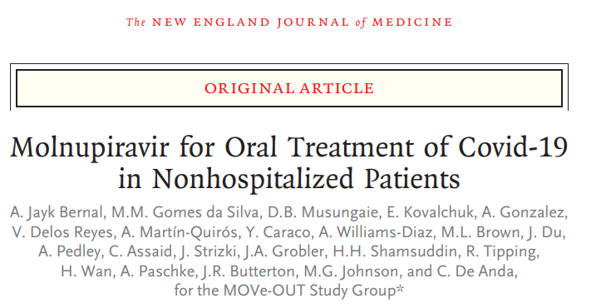
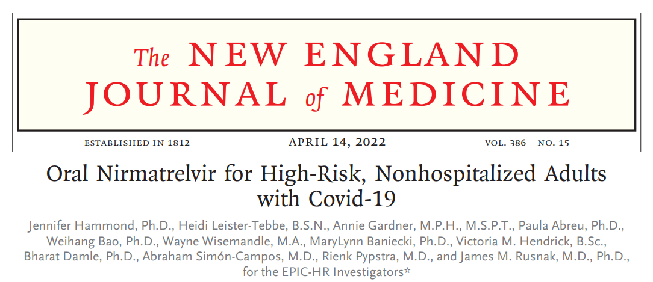
Background: Evidence Base
Nirmatrelvir (NMV) plus Ritonavir (Paxlovid^{R}) demonstrated 88% risk reduction of progression to severe Covid-19 compared with placebo in symptomatic, unvaccinated, non-hospitalized adults.
Early treatment with Molnupiravir (Lagevrio) reduced the risk of hospitalization or death in at-risk, unvaccinated adults with Covid-19 by 30%-50%.
Dec. 2021: Both medicines were approved with Emergency Used Authorization (EUA)
April 2022: WHO released recommendations the use of oral antivirals for the treatment of patients diagnosed with mild-to-moderate COVID-19 at high risk for severe COVID-19
66
Notes:
These studies are some of the initial evidence base to support the use of oral antiviral medications in COVID19 patients.
The medicines are still approved under an Emergency Use Authorization – but there are also global guidelines as described from the WHO that support the use of oral antivirals for at-risk patients with mild-moderate COVID-19.
Pfizer’s paxlovid is prequalified by WHO, as is Hetero’s generic molnupiravir.

Slide 67
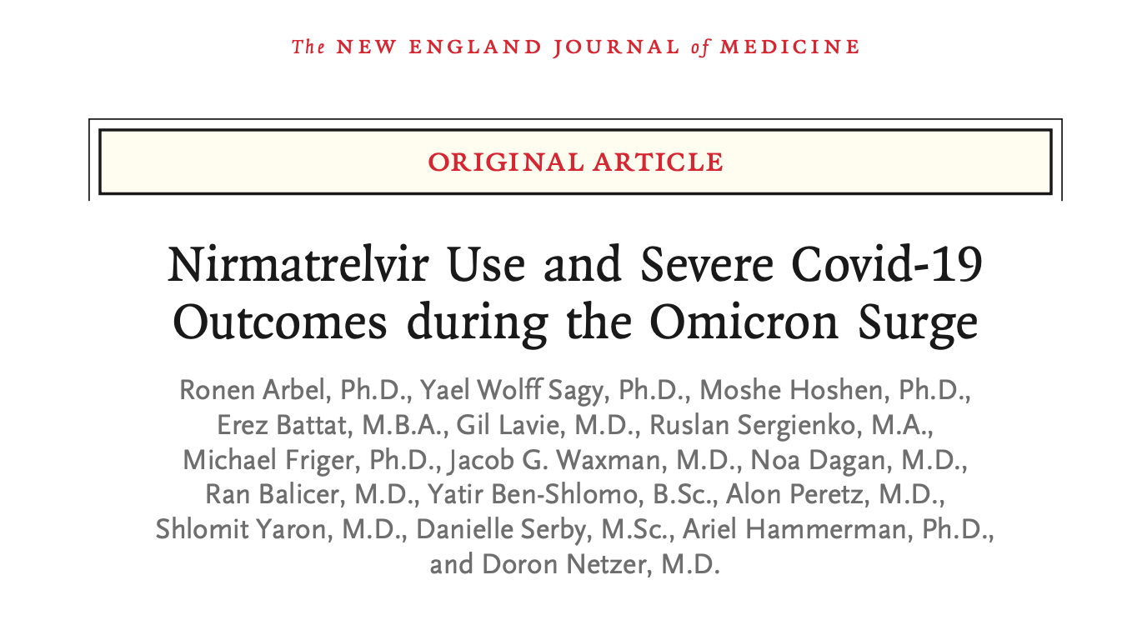
Evolving Evidence Base
Evolving variants
Still significant reduction of hospitalization and death in patients > 65 with omicron surge
Expect ongoing studies as evidence base is quickly evolving
Test to Treat as a strategy to improve access to care has a strong evidence base (HIV, etc.)
Arbel R, Wolff Sagy Y, Hoshen M, Battat E, Lavie G, Sergienko R, Friger M, Waxman JG, Dagan N, Balicer R, Ben-Shlomo Y, Peretz A, Yaron S, Serby D, Hammerman A, Netzer D. Nirmatrelvir Use and Severe Covid-19 Outcomes during the Omicron Surge. N Engl J Med. 2022 Sep 1;387(9):790-798. doi: 10.1056/NEJMoa2204919. Epub 2022 Aug 24. PMID: 36001529.
67
Notes:
Remember, the evidence is continuing to evolve and studies are continuing to monitor the efficacy of oral antivirals with new variants, increased uptake of vaccination, etc.
Global guidelines based on evidence continue to see important outcomes in vulnerable, eligible populations with timely initiation of oral antivirals for COVID19.
Additionally, this strategy to improve access to care is a known model for HIV, TB and other disease processes, and has a broader impact on strengthening health systems.

Slide 68
Test to Treat Algorithm
Notes:
This is the Test to Treat Algorithm.
Work through this algorithm now, in the teaching session. See where the important decision points are, and for the first part of this session we are going to discuss Nirmatrelvir/Ritonavir – also known as Paxlovid. The star marks the point in the algorithm where you have screened in for consideration of treat to treat based on symptoms, absence of severe symptoms, and time frame. Then it is time to consider NMV/r.

Slide 69
First Line Treatment: Paxlovid (Nirmatrelvir/Ritonavir)
SARS-CoV-2 protease (3CLpro) inhibitor, thereby preventing cleavage of the viral polyprotein which is needed for viral proteins to become functional
Indications:
  Symptomatic, confirmed COVID-19
  Mild – Moderate symptoms
  Within 5 days of symptom onset
  Age > 12
  Weight > 40kg
  High Risk Criteria:
    Age > 50, especially those >= 65 or unvaccinated ages 50 – 64
    Comorbidities such pulmonary/lung disease, hypertension, diabetes, chronic kidney disease, immunocompromised state, HIV
    BMI > 30
Contraindications:
  > 5 days of symptoms
  Severe or Critical COVID-19
  Lack of symptoms
  Patients with severe kidney or liver disease (see T2T algorithm).
  Patients who are allergic to any of the ingredients in the medication.
  Patients who cannot swallow whole tablets. Oral antiviral medications should not be cut or crushed and must be swallowed whole.
  Patients taking a drug which is contraindicated with Nirmatrelvir/ritonavir unless the drug can be withheld or appropriately dose-adjusted.
Notes:
Paxlovid (nirmatrelvir/ritonavir) is the first line treatment for Test to Treat, and oral antivirals.
Listed here are the indications & contraindications.

Slide 70
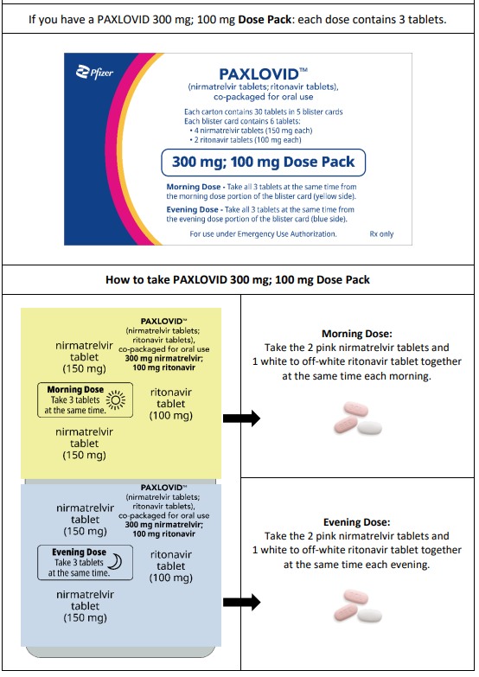
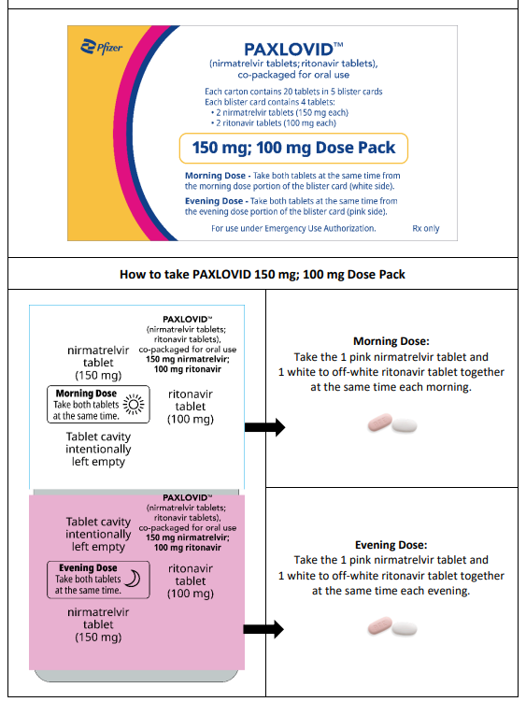
Focus In: Oral Antivirals for Test To Treat
Usual Paxlovid Dosing
Renal Dosing: GFR 30 - 60
Notes:
These are examples of typical packaging and dosing – including both usual dosing and then renal dosing.
Please note the renal dosing is half dose Nirmatrelvir (150mg), usual dose ritonavir (100mg)

Slide 71
Paxlovid: Patient instructions
Swallow the tablets whole. Do not chew, break, or crush the tablets.
Take PAXLOVID with or without food.
Do not stop taking PAXLOVID until the course is completed, without talking to your healthcare provider, even if you feel better.
If you miss a dose of PAXLOVID within 8 hours of the time it is usually taken, take it as soon as you remember. If you miss a dose by more than 8 hours, skip the missed dose and take the next dose at your regular time. Do not take 2 doses of PAXLOVID at the same time.
If you take too much PAXLOVID, call your healthcare provider or go to the nearest hospital emergency room right away.
If you are taking a ritonavir- or cobicistat-containing medicine to treat hepatitis C or Human Immunodeficiency Virus (HIV), you should continue to take your medicine as prescribed by your healthcare provider. Talk to your healthcare provider if you do not feel better or if you feel worse after 5 days.
Notes:
These are general patient instructions for Paxlovid.

Slide 72
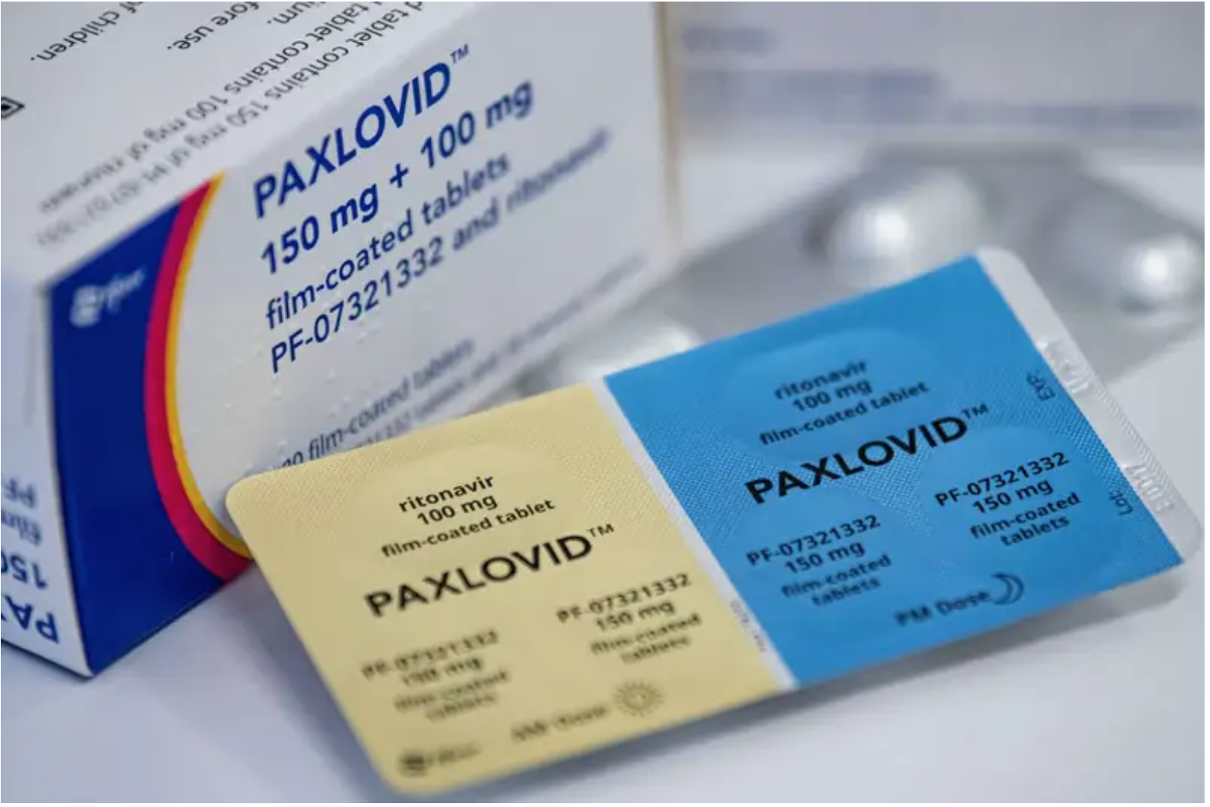
Paxlovid: Dose Pak
Notes:
Picture to help explain the dose pak/dosing instructions – the dose pack is designed to make it easy for patients to adhere to treatment!

Slide 73
Paxlovid: Contraindications & Side Effects
Do not take PAXLOVID if:
You are allergic to nirmatrelvir, ritonavir, or any of the ingredients in PAXLOVID.
You have significant liver or kidney disease (see algorithm).
Possible side effects of PAXLOVID:
Altered sense of taste; diarrhea; high blood pressure; muscle aches; abdominal pain; nausea; and feeling generally unwell
Hypersensitivity Reactions: hives; trouble swallowing or breathing; swelling of the mouth, lips, or face; throat tightness; hoarseness; skin rash
Hepatotoxicity: loss of appetite, yellowing of your skin and the whites of eyes (jaundice), dark-colored urine, pale colored stools and itchy skin, stomach area (abdominal) pain
Resistance to HIV Medicines: If you have untreated HIV infection, PAXLOVID may lead to some HIV medicines not working as well in the future.
May cause GI side effects if you are intolerant to lactose or galactose; or have lactase deficiency or glucose-galactose malabsorption -- nirmatrelvir contains a lot of lactose.
Notes:
These are typical contraindications and side effects.

Slide 74
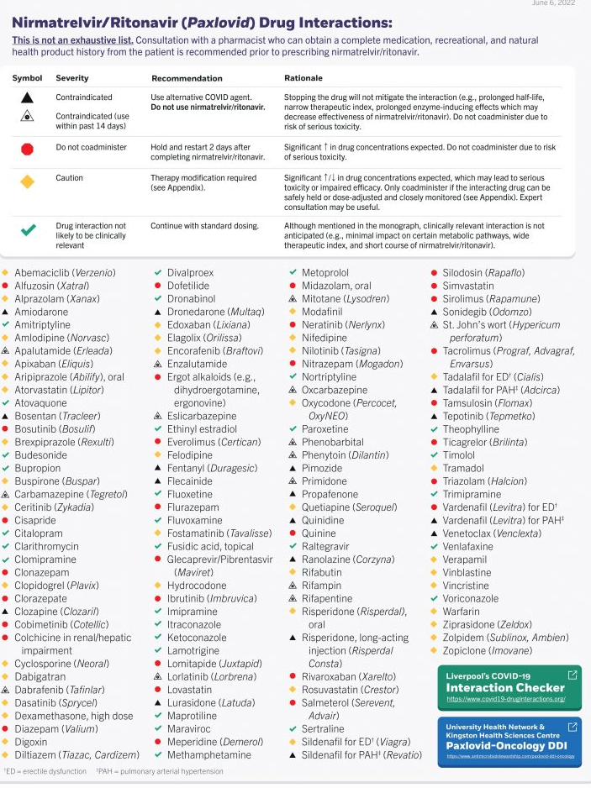
Drug-Drug Interactions
Don’t be intimidated by the list of potential drug-drug interactions with Paxlovid.
Most are rare or uncommon drugs
Most common drugs can be easily stopped during the time of treatment, or the dose reduced
Several resources to consult:
  COVID-19 DRUG INTERACTION CHECKER
  Your pharmacy team
Notes:
It is important to reinforce – while Paxlovid dose have a long list of drug-drug interactions, it is generally a safe medication!
The COVID-19 Drug interaction checker is linked – click on this link during the training and practice using it.
Add in typical medications for your patient population, and practice checking to see if there are issues with using Paxlovid.
While this list looks long and intimidating, it actually is pretty easy to navigate, and make recommendations for use of Paxlovid.
Also important to remember that this drug is only prescribed for 5 days – so sometimes a patient will need to stop a concurrent medication for those days and a few days afterwards, but it is not a long term treatment, but a short term intervention to improve outcomes.
This is manageable, and becomes easier with practice!

Slide 75
More information: Paxlovid dose adjustment
For example, if your patient is taking alprazolam…
Alprazolam is mainly metabolized by CYP3A4. Interaction studies with ritonavir have shown inhibition of alprazolam metabolism following the introduction of ritonavir but no significant inhibitory effect at steady state.
Therefore, Alprazolam concentrations may be increased by Ritonavir
A dose reduction during and 3 days after taking Paxlovid is recommended
Alternative therapies should be utilized during Paxlovid use and Alprazolam use can be resumed 4 days after the last dose of Paxlovid
If a patient is unable to tolerate the dose reduction or alternative therapy, the patient should be monitored for life threatening respiratory depression and somnolence
COVID-19 DRUG INTERACTION CHECKER
Notes:
A good case to work through – can also access the drug interaction checker aga.n

Slide 76
Paxlovid and pregnancy
Pregnancy is a risk factor for developing severe COVID-19, and pregnancy patients should discuss the risks and benefits of paxlovid with their health care provider.
Consensus does not currently exist on the recommendation of Paxlovid for pregnant patients. The FDA states that for a mother and unborn baby, the benefit of taking Paxlovid may be greater than the risk from treatment given existing animal studies and the extensive use of ritonavir in pregnant women with HIV.
By contrast, WHO states that their strong recommendation does not apply to pregnant patients.
Consult your local guidelines for specific recommendations and updated information.

Slide 77
Test to Treat Algorithm
Notes:
Marked here with a RED STAR is the decision point for molnupiravir – the second line oral antiviral.
If a patient meets criteria/eligibility for treatment, but cannot take NMV/r – this is when to consider molnupiravir.
For places with only Molnu available, you can skip to this place for now, but it is likely in the future that both of these drugs will be available, and therefore important to review the indications and contraindications for each of them.

Slide 78
Second Line Treatment: Molnupiravir
SARS-CoV-2 replication inhibitor
Indications
  Symptomatic, confirmed COVID-19
  Mild – Moderate symptoms
  Within 5 days of symptom onset
  Age > 18 years
  High Risk Criteria:
    Age >=65 regardless of vaccination status, or >50-64 if unvaccinated
    Comorbidities such as pulmonary/lung disease, hypertension, diabetes, chronic kidney disease, immunocompromised state, HIV
    BMI > 30
Contraindications:
  Pregnancy
  Children <18 years – possible risk of bone and cartilage toxicity
Notes:
Here are listed the indications and contraindications for Molnupiravir.
Important to note that pregnancy is a contraindication for molnupiravir which will be discussed further in a few slides.

Slide 79
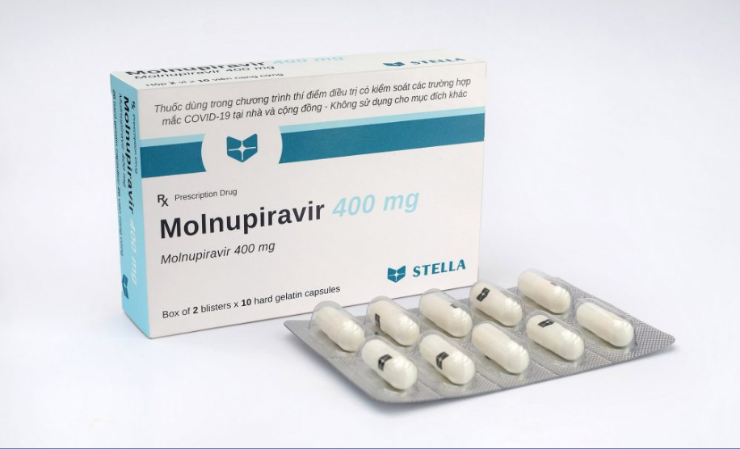
Focus In: Oral Antivirals for Test To Treat: Molnupiravir
Dosing Instructions:
  The dosage in adult patients is 800 mg (four 200 mg capsules) taken orally every 12 hours for 5 days
  Take MOLNUPIRAVIR with or without food.
  Complete the full 5 day course for maximum efficacy.
  Do not take for more than 5 consecutive days.
If you miss a dose:
  Less than 10 hours – take it, resume normal schedule
  More than 10 hours – wait till next dose, do not double up;

Slide 80
Focus In: Oral Antivirals for Test To Treat: Molnupiravir
Possible side effects of MOLNUPIRAVIR:
Hypersensitivity Reactions: hives; rapid heartbeat; trouble swallowing or breathing; swelling of the mouth, lips, or face; throat tightness; hoarseness; skin rash
Most commonly: diarrhea, nausea, and dizziness.
Occasional subsequent hematologic or chemistry abnormalities (seen in animal studies)
Notes:
The contraception recommendation is very important for prescribers of molnupiravir.
Contraception should be used during treatment as well as for 4 days after usage for females, and for 3 months after taking for males.

Slide 81
Molnupiravir and pregnancy
Molnupiravir is contraindicated in pregnancy
Contraception is recommended during treatment and for 4 days after treatment for females.
Contraception is recommended during treatment and for 3 months after treatment for males.
Breastfeeding is not recommended during treatment with molnupiravir and for 4 days after the final dose. A lactating individual should consider interrupting breastfeeding and consider pumping and discarding breast milk during treatment and for 4 days after the last dose.
Notes:
Good time for a discussion of how to counsel patients appropriately, particularly men who require longer duration of contraception after treatment with molnupiravir.

Slide 82
Practice Case #1
A 65 yo female comes into the clinic.
She has a cough, fever, and known contact with a family member who recently tested positive for COVID-19.
VS: HR: 88; Pulse ox: 97%; RR: 14; BP 120/70; Temp 37.6 C
Clinically well appearing without shortness of breath.
What do you want to know?
Notes:
Here are a series of practice cases for health care workers.
How can you start down the algorithm for Test to Treat?

Slide 83
Practice Case #1: Continued
Does this patient have Covid?
  Rapid antigen test is positive.
Does this patient have severe symptoms?
  No – her symptoms fit within the mild category.
Has she had symptoms for less than 5 days?
  Yes – her symptoms started 2 days ago.
Next step: evaluate eligibility for Oral Antiviral Treatment
Notes:
3 important questions.
Answers are positive – now continue down the algorithm.

Slide 84
Practice Case #1: Continued
Is this patient a high-risk patient?
  Yes – she meets age criteria.
Does she also take medications that could be contraindicated or require adjustment?
  No – she does not take any other medications.
Does she have known kidney or liver disease?
  No – she does not have other known illnesses.
This patient can take Paxlovid!
Notes:
This case (and the subsequent cases) provide the opportunity to discuss the steps in patient evaluation - including criteria for treatment with oral antivirals, essential questions to ask (such as other medications and health issues).
For some places where different medications are available (for example, molnupiravir is available and paxlovid is not) this learning can be extended by thinking – is this patient a candidate for molupiravir? In this case, yes - if paxlovid is not available and molnupiravir is available, then the patient is a candidate for molnupiravir.

Slide 85
Practice Case #2
A 35 yo male comes into the clinic.
He has a cough, fever, and known contact with a family member who recently tested positive for COVID-19.
VS: HR: 112; RR: 24; SpO2: 90%; BP 110/70; Temp 37.6
Appears short of breath, speaking in 3-5 word sentences; able to answer questions with normal mental status
Notes:
What are your starting questions as you evaluate this patient?
Any red flags?

Slide 86
Practice Case #2: Continued
Does this patient have COVID?
  High likelihood. Should perform a test if available to confirm. Clinically high risk so consider positive.
Does this patient have severe symptoms?
  Yes – he is unstable – his oxygen saturation is low and work of breathing is high. He needs medical oxygen and admission vs. transfer.
Next step: Initiate treatment if available, with oxygen; consider admission vs. transfer; consider additional treatments (depending on environment)
Notes:
This is a great opportunity to consider what is the plan for management of a severe case of COVID?
What resources are available in your clinical space? What is a safe plan for transfer if transfer is necessary?
Take a few minutes to discuss and plan for this scenario.

Slide 87
Practice Case #3
A 27 yo female comes into the clinic.
She has a cough, malaise, and has recently rode the bus with a group of people who were coughing.
VS: HR 89; RR: 12; SpO2: 98%; BP 120/73; Temp 36.5
Appears stable, able to answer questions appropriately, no increased work of breathing, does not have shortness of breath

Slide 88
Case #3: Continued
Does this patient have COVID?
  Rapid test results in your clinic confirm COVID-19.
Does this patient have severe symptoms?
  No, she meets the case definition for mild COVID-19.
Has she had symptoms for less than 5 days?
  Yes – symptom onset was 3 days prior
Next step: evaluate eligibility for Oral Antiviral Treatment

Slide 89
Case #3: Continued
High Risk Criteria:
  Age ≥ 65 regardless of vaccination status; or 50 - 64 if unvaccinated
  BMI ≥ 30 kg/m2
  Pregnancy
  Diabetes
  Sickle cell disease
  Neurodevelopmental disorders
  Chronic kidney disease, stage 3b or worse
  Cardiovascular disease, hypertension, or lung disease
  Immunocompromising condition (e.g. HIV)
  Tuberculosis
  Clinician-determined medical condition, or demographic factor presumed to place the patient at high risk for disease progression
This patient does not meet any of these criteria:
No indication for Paxlovid
Notes:
For a 27yo female, you may want to inquire about method of contraception and/or date of last menstrual period to assess if pregnancy is possible in this otherwise low risk patient.
Consider offering a pregnancy test if it will change the clinical decision making.

Slide 90
Practice Case #4
A 45 year old male comes into the clinic.
He has a cough, malaise, and has recently been at a church where 5 other people were subsequently diagnosed with COVID
VS: HR 93; RR 14; SpO2: 96%; BP 125/83; Temp 38.0
Appears stable, able to answer questions appropriately, no increased work of breathing, no shortness of breath

Slide 91
Case #4 Continued
Does this patient have COVID?
  Yes – confirmed by rapid antigen test.
Does this patient have severe symptoms?
  No, he meets the case definition for mild infection
Has he had symptoms for less than 5 days?
  Yes – his symptoms started yesterday.

Slide 92
Case #4 Continued
Is this patient a high-risk patient?
  Yes – on further history you learn the patient had chronic kidney disease, with his last GFR was 45;
Does he also take medications that are contraindicated or require adjustment?
  He only takes metoprolol
  Can check https://www.covid19-druginteractions.org/checker to see if there are interactions.
What is the appropriate plan for this patient?
This patient is a candidate for PAXLOVID! Should be given at renal dosing, half dose nirmatrelvir.
Notes:
Note – confirmatory blood work is not necessary or recommended for patients with chronic kidney disease.
Can decide based on thorough history, physical, and prior medical records.

Slide 93
Practice Case #5
A 55 year old female comes into the clinic.
She has malaise, a fever, sore throat & congestion for the past 2 days.
VS: HR 85; RR 14; SpO2: 97%; BP 117/75; Temp 38.4
Not in any acute distress, awake, answering questions, no increased work of breathing or shortness of breath.

Slide 94
Case #5 Continued
Does this patient have COVID?
  Yes – confirmed by rapid antigen test.
Does this patient have severe symptoms?
  No, she meets criteria for mild symptoms.
Has she had symptoms for less than 5 days?
  Yes, her symptoms started 2 days ago.

Slide 95
Case #5 Continued
Is this patient a high-risk patient?
  Yes – on further history, you learn she has significant liver disease, described before as Child-Pugh Class C
What is an appropriate plan for this patient?
This patient cannot take Paxlovid, but she is a candidate for Molnupiravir – based on risk factor with no other contraindication.
Prescribe Molnupiravir!
Notes:
Molnupiravir is NOT contraindicated in patients with advanced liver or kidney disease.
This link is a calculator for determining liver disease severity. https://www.hepatitisc.uw.edu/page/clinical-calculators/ctp
If you are unsure about exact classification but have other reason to believe it is severe, then you can opt for molnuipiravir.
As this patient is post-menopausal –you confirmed with her – she does not require additional counseling regarding pregnancy or contraception.

Slide 96
Practice Case #6
A 54 year old male comes into the clinic.
He has a fever, sore throat, congestion. He also has a mild cough, and 3 other people in his home have been sick in the last few days. Symptoms started 2 days ago.
VS: HR 76; RR: 12; SpO2: 98%; BP 118/65; Temp 37.9
Patient is not having trouble breathing, his lungs are clear, he is alert and oriented, no acute distress.

Slide 97
Case #6 Continued
Does this patient have COVID?
  Yes – confirmed by rapid antigen test.
Does this patient have severe symptoms?
  No – he does not meet criteria for severe disease, his oxygenation is normal.
Has he had symptoms for less than 5 days?
  Yes – his symptoms started 2 days ago.

Slide 98
Case # 6 Continued:
Is this patient a high-risk patient?
  Yes – on further inquiry, you learn he has diabetes, high cholesterol, and HIV
Does he also take medications that could be contraindicated or require adjustment?
  Yes – he takes Biktarvy (Bictegravir/ Emtricitabine/ Tenofovir alafenamide) for HIV which is well controlled, metformin for diabetes, and simvastatin for his cholesterol.
Does he have severe kidney or liver disease?
  No, he does not have severe kidney or liver disease.
This patient qualifies for Paxlovid!
He needs to adjust his dose of simvastatin (discontinue 12 hours to first dose of Pax, during the 5d treatment, and for 5 days afterward).
Notes:
Walk the group through this case.
High risk so qualifies for Paxlovid
No true contraindication.
Can use https://www.covid19-druginteractions.org/checker – Liverpool drug interaction checker to see what medication adjustment is needed.
With simvastatin, the patient needs to discontinue use of simvastatin at least 12 hours prior to initiation of Paxlovid, during the 5 days of Paxlovid treatment and for 5 days after completing Paxlovid.

Slide 99
Case # 7
A 32 year-old male comes into the clinic.
He has a cough, sore throat, nasal congestion. He has numerous family members with COVID, and he himself had a positive COVID test earlier in the day by a community health worker.
VS: HR – 88; BP 145/87; SpO2 – 96%; RR 14; Temp 38.2
He appears clinically stable without dyspnea, his lungs are clear, he is alert and oriented.

Slide 100
Case #7 Continued
Does this patient have COVID?
  Yes – confirmed by rapid antigen test, prior to arrival, does not require additional confirmatory testing.
Does this patient have severe symptoms?
  No, he meets criteria for mild symptoms.
Has he had symptoms for less than 5 days?
  Yes – he has had symptoms for 3 days.

Slide 101
Case #7 Continued
Is this patient a high-risk patient?
  Yes – on further inquiry, you learn he has significant kidney disease and his doctors have said he is close to dialysis.
Does he also take medications that could be contraindicated or require adjustment?
  No – he does not have any medication interactions. You double check his list with the online interaction checker.
Does he have severe kidney or liver disease?
  Yes – he has severe kidney disease.
This patient cannot take Paxlovid, but he is a candidate for Molnupiravir – based on risk factor with no other contraindication.
Prescribe Molnupiravir! And counsel regarding contraception!
Notes:
This patient with severe kidney disease is not a candidate for Paxlovid – you do not need to confirm blood work, can determine based on clinical presentation.
This patient can be a candidate for molnupiravir – but keep in mind the importance of counseling regarding contraception with prescription of molnupiravir. Specifically, for men, barrier contraception should be used for 3 months after taking this medication. This will be included on the patient information sheet provided to the patient, but should be reiterated by the clinician/health care worker as specific instructions at time of prescription.

Slide 102
Test to Treat: Further Questions & How to Operationalize

Slide 103
Objectives
Understand common questions around the implementation of Test to Treat.
Appreciate the benefit of T2T for health systems strengthening.
Plan for implementation of T2T in your clinical setting.

Slide 104
How can Test to Treat improve the experience of my clinical team?
Having the opportunity to offer better treatments to patients is EXCELLENT and MOTIVATING– especially with the ongoing stress of the pandemic.
Reducing the burden on health systems, and therefore workload, by having less people hospitalized with severe COVID.
Streamlined, efficient workflow can translate to better patient care across disease processes (not just COVID).
Improved access to testing and identification of cases
104
Notes:
The opportunity to offer an effective treatment for patients with COVID19 – and prevent worsening of disease is awesome – it is great to have a treatment available. This is one part of improving care for all COVID patients, and subsequently supporting the health care system in responding to the pandemic and preparing for whatever is coming next.
This is not a stand alone thing – it is integrated, quality care.

Slide 105
How can Test to Treat for COVID-19 improve experiences for patients in the future?
T2T for COVID-19 will build our capacity to apply similar approaches of early diagnosis and initiation of treatment for ALL patients
  Future COVID-19 variants may have more severe manifestations, in which case T2T would have tremendous potential impact.
Early diagnosis and initiation of treatment can change the course of disease for other illnesses in addition to COVID-19.
  For example, early identification and treatment of acute infections like pneumonia or urinary tract infections can prevent progression to more severe infection.
105
Notes:
Early diagnosis and treatment is a lifesaving approach to many different diseases. This includes COVID19, as well as other acute infections such as pneumonia or UTIs, there is precedent among other public health efforts including HIV or TB.
Creating opportunities for success with this framework has great potential, and if the next variant or iteration of COVID is more severe, having this framework in place could have tremendous impact.

Slide 106
Consider your clinical setting
What is the current process for caring for COVID-19 patients?
  When, why, how do they engage in care?
  Who is part of the care team?
  How is this working well for patients?
  How is this working well for the care team?
  How could it be improved for both patients and the care team?
How can you actualize Test to Treat in your clinical setting?
Notes:
This is a brainstorming opportunity.
It will feed into a planning activity – that will hopefully empower clinical teams to return to their work environments with ideas to operationalize Test to Treat, and support other processes to streamline care for other patients as well.

Slide 107
Implementation Guide – at the Service Delivery Venue
Leadership
  Need facility leadership & administrative buy-in
Organizational
  Material availability
  Policy Development
  Safe and effective streamlining of care
Quality Monitoring
  QI processes
  Pharmacovigilance
Staffing
  Prescribing clinicians – knowledge & capability
Individuals
  Knowledge of COVID-19
  Availability of services & demand for testing
Find the
Implementation Guide
here
Notes:
The implementation and integration of test to treat into regular clinical services is not a simple process.
There are numerous factors to consider, at various levels.
The linked implementation guide is designed to identify factors and support countries as well as service delivery venues to systematically consider and address the issues necessary to implement Test to Treat.
Consider these factors, and consider what has already happened at your facility, and what action steps you can identify to focus on.
https://opencriticalcare.org/wp-content/uploads/2022/06/Implementation-Guide-Test-to-Treat-July-2022-ipycid.pdf

Slide 108
Planning Activity:
Divide up into small groups, ideally grouping persons from the same facility together
Identify a goal for this activity:
  Can be complex or one element of a bigger process
  For example, consider the whole process for a patient arriving at the clinic/health facility, with signs and symptoms of COVID – what happens next?
  OR… consider the process for a patient who is prescribed Paxlovid – what happens next?
    How do they fill their prescription?
    What is the process for monitoring for symptom resolution?
Notes:
This activity is designed to allow for planning and consideration of the process, among the participants in the training/group.
Consider the current scenario, and consider what is necessary for Test to Treat.
Think about strengths, gaps and opportunities. Think about the space, and the healthcare workers working in that space. Think about the patients, and strategies to optimize patient care.
As a facilitator, you can consider accessing the full process mapping PPT and facilitator guide from the EpiC Clinical Pathways Guide (available as an annex).

Slide 109
Planning Activity: Continued
Work as a team
Create a diagram or flow chart (map)
Trouble shoot bottleneck areas
Take this map back to your actual clinical area – and see how it works?
  Where does this perform well?
  What are areas for potential improvement?
  When is it time to bring the team together, and revise & update?

Slide 110
Conclusion:
Stay up to Date! Information continues to evolve related to Oral Antivirals & Test to Treat
World Health Organization: Living Guidelines:
  https://www.who.int/publications/i/item/WHO-2019-nCoV-therapeutics-2022.4
Africa CDC Test to Treat Guidelines:
  https://africacdc.org/download/covid-19-test-to-treat-guidelines-for-african-union-member-states/
Open Critical Care: Test to Treat Algorithm & Implementation Guidelines:
  https://opencriticalcare.org/
COVID Treatment Guidelines:
  https://www.covid19treatmentguidelines.nih.gov/
Notes:
In conclusion, remember to stay up to date as information regarding COVID19 care, including oral antivirals and Test to Treat continues to evolve. These are some good resources for staying up to date, and we encourage you to continue to stay updated with national guidelines as well as these global guidelines.

Slide 111




EpiC is a global cooperative agreement dedicated to achieving and maintaining HIV epidemic control and supporting COVID-19 and monkeypox response. It is led by FHI 360 with core partners Right to Care, Palladium, and Population Services International (PSI).

