Slide 1
Session 6 Decentralized Drug Distribution of Antiretroviral Therapy in the Private Sector: Demand Creation and Client Enrollment

Slide 2

Learning objectives
By the end of this session, participants will be able to:
Discuss how to create demand for private sector DDD of ART
Identify clients who qualify for DDD enrollment
Describe the process for enrolling clients into DDD of ART

Slide 3
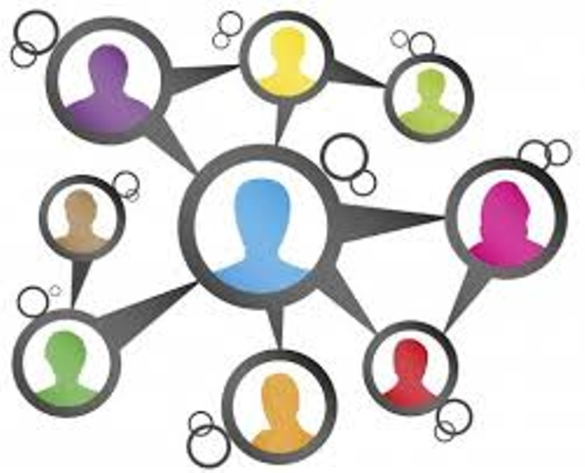
What is demand creation?
An evidence-based approach that tailors messaging and activities to specific geographic locations and communities for the most effective results

Slide 4

Who should be involved in creating demand for different models of DDD of ART?
Demand creation should involve everyone who provides care and treatment to people living with HIV in both health facilities and communities, including:
Clinicians (doctors, clinical officers)
Nurses
Counselors
Pharmacists and pharmacy technicians
Other health facilty staff
Community health workers
Peer educators

Slide 5

Baseline knowledge required
To create demand for DDD of ART, health care providers and other relevant stakeholders need a clear understanding of:
What decentralized service delivery (DSD) is and what DSD options are currently available
How DDD of ART fits into DSD
Main advantages of DDD of ART
DSD
DDD
Notes:
This Photo by Unknown Author is licensed under CC BY-ND

Slide 6
DSD of HIV care
DSD is a client-centered approach that:
Simplifies and adapts HIV services across continuum of care to reflect needs and preferences of various groups of people living with HIV
Reduces unnecessary burden on health system

Slide 7

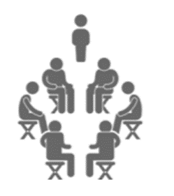
Current DSD options
Facility-based individual models: Fast-track refills Multi-month prescriptions | Out-of-facility individual models: Mobile outreach Fixed community distribution points Home delivery (by health care worker or lay community worker)
Groups managed by health care workers: ART adherence clubs/ART refill groups (community- or facility-based) Patient adherence groups Youth clubs, family clubs | Client-managed groups: Community ART groups Community adherence groups Peer-support groups

Slide 8
Additional DSD option
DDD of ART through private sector outlets:
Is another DSD option
Increases service efficiencies and impact
Addresses barriers to access, e.g., long distance/transportation to health facilities, inconvenient hours, long waiting times
Reduces stigma and discrimination associated with accessing HIV care and treatment services at facilities

Slide 9
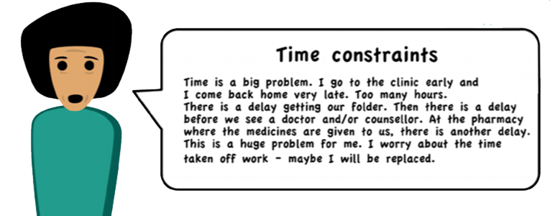
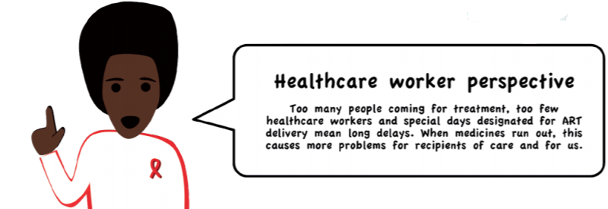
DSD/DDD benefits everyone

Slide 10
Key principles of demand creation for DDD of ART
Create demand for DDD of ART while respecting informed choice.
Sensitize staff in public health facilities about DDD models and provide them with all relevant information and tools.
Inform associations/groups of people living with HIV about availability of DDD models and involve them in demand-creation activities.
Develop and share information, education, and communication (IEC) materials.
Encourage clients using DDD of ART to share their experiences with others.

Slide 11
Role of client engagement in demand creation for DDD of ART
Client engagement (a participatory approach with clients) is central to demand creation, encourages ownership, and includes:
Seeking to understand client concerns and problems (e.g., through focus group discussions), with different DSD models designed to address the problems identified
Identifying peer leaders/community volunteers who are key change agents and involving them in demand-creation activities
Tailoring communication messages, trainings, and other materials to target key stakeholders, including clients

Slide 12
Creating demand for DDD of ART among clients
To create demand among clients:
Disseminate information on available DDD of ART models at health facilities and in the community.
Ensure that all providers understand the advantages of DDD of ART and can explain the model to eligible clients.
Features of DDD models that clients may find attractive:
Reduced waiting time at health facility and fewer visits
Ability to pick up medication after normal operating hours at convenient location
Convenience and ease of access
Quality of care
Notes:
To ensure patients are enrolled into the DDD model, it is crucial that the information on the availability of the model is disseminated both at the health facility and the community.

Slide 13
Key resources needed for demand creation of DDD of ART
Training and orientation plan for health providers on DDD of ART models, including advantages and eligibility criteria
Dissemination/demand-creation plan to promote DDD of ART as an option to eligible people living with HIV at health facilities and in community
Targeted IEC materials detailing DDD of ART and its advantages

Slide 14
Demand-creation activities at different levels of care
WHERE | WHAT | WHO
Waiting area at health facility | Provide health talks informing clients of DDD of ART as one DSD model available at health facilty Escort interested clients to health facilty reception, counselor, or clinician (as per client flow in health facility) for further evaluation of eligibility | Health providers, community workers/peer educators
Medical records | Review client files to identify potentially eligible clients and flag their files for further evaluation | Medical records officer
Psychosocial support | Provide adherence monitoring and support Explain advantages of DDD as part of DSD for clients not yet enrolled Verify potential eligibility (e.g., good understanding of adherence) and escort clients to clincian for further evaluation and enrollment | Psychosocial support counselors
Consultation room | Review evaluation done by counselor and complete eligibility assessment Reinforce messages on advantages of DDD Offer DDD to eligible clients Assist client in selection of preferred DDD outlet Provide prescription and referral to DDD outlet Advise client on next clinic visit | Clinicians
Health facility pharmacy | Adherence monitoring and support/quality services to ART clients Provide infomation to community members on availability and advantages of DDD model as part of DSD | Pharmacist/ pharmacy technicians
Community | Disseminate information in community on availability of DDD. Refer interested clients to health facility for further evaluation and enrollment. | Community health workers, peer educators

Slide 15
Identification of clinically stable clients
Public facility staff are responsible for identifying clients eligible to receive ARV refills at a DDD outlet instead of hub facility
Criteria for “clinically stable clients” vary slightly from country to country, but generally include:
Being on ART for 1 year (or at least not less than 6 months)
No adverse drug reactions that require regular monitoring
No opportunistic infections
Not pregnant or breastfeeding
Appreciation of need for lifelong adherence, understands U=U (undetectable=untransmittable)
Evidence of treatment success (consecutive undetectable viral load measures, CD4 counts above 200 cells/mm3 if no viral load monitoring)

Slide 16
Devolvement of clients to private pharmacy
The devolvement of clients to a private pharmacy entails:
Hub facility staff present private pharmacy model as one of several DSD models and explain how it works
Willing clients provided with list of pharmacies from which to select DDD outlet
Clients sign informed consent form agreeing to be devolved to pharmacy of their choice
Hub facility provides client with prescription for maximum number of months, but not beyond next scheduled clinic visit/viral load sample collection based on national guidelines
Client goes to private pharmacy for subsequent refills
During next clinic visit (every 6 or 12 months), client returns to hub facility for clinical assessment and new prescription

Slide 17
Devolvement of clients to private pharmacy (cont.)
DSD/DDD models adaptable and flexible, work in parallel so that clients can move among them over course of lifetime
Clients allowed to switch back to hub facility at any time
Clients referred back to hub facility if no longer meet criteria of “clinically stable”
All clients, regardless of health status, continue to have clinical consultations at hub facility as part of their package of care

Slide 18
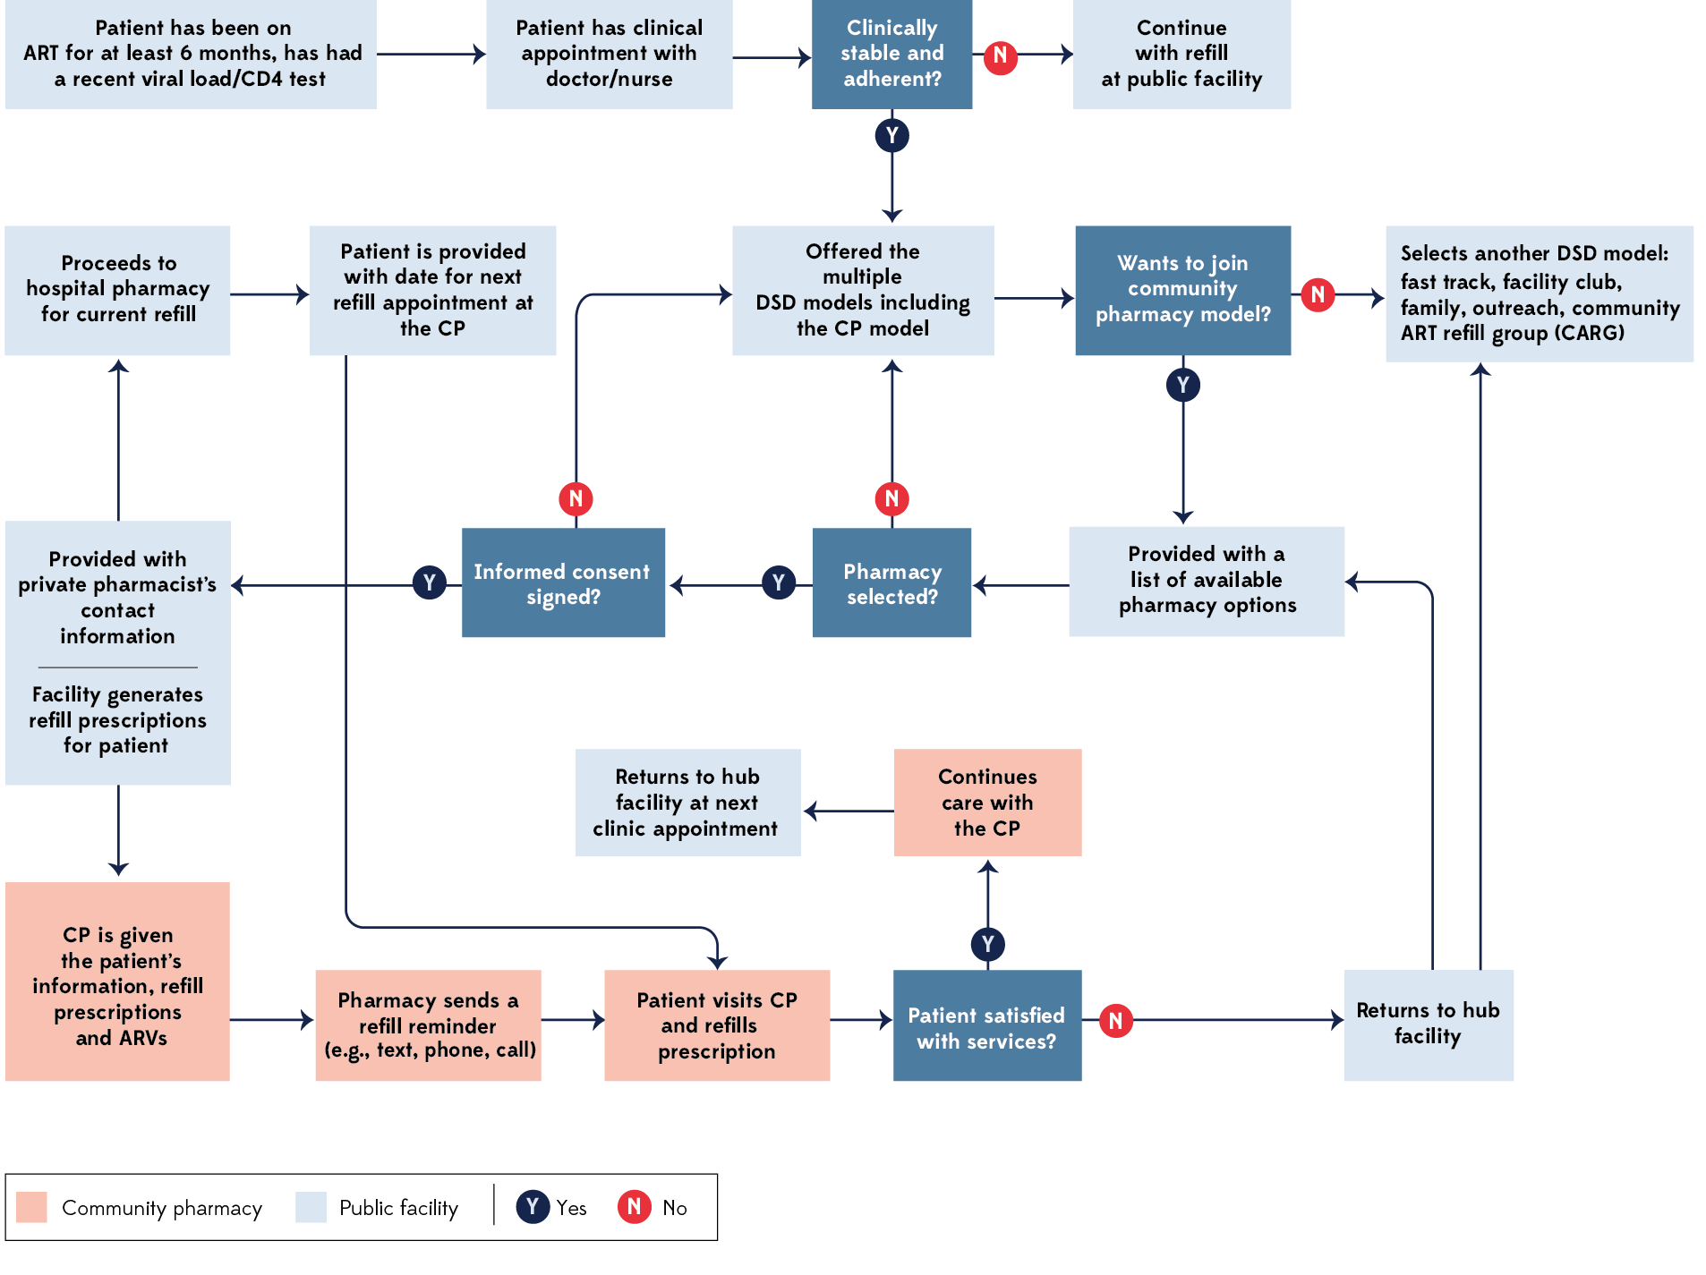
Illustrative pathway for enrolling clinically stable clients into DDD of ART models
Notes:
Diagram available as handout

Slide 19

Activity
Practice filling out the forms used by the program for referring clients to DDD outlets for their ARV refills.
In countries where an electronic referral system is used, practice using it.

Slide 20

Client rights
Empowered and informed communities of people living with HIV will need to demand DSD of ART as part of their right to access the best possible treatment and care.
To demand it, they must know about it, understand it, and be able to assess the impact it will have on their lives and treatment.

Slide 21
“It’s not about everybody getting the same thing. It’s about everybody getting what they need in order to improve the quality of their situation.”
Cynthia Silvia Parker, Interaction Institute for Social Change

