Slide 1



Slide 2
Call from Anonymous Foundation
Remove financial barriers to most effective long-term reversible methods
  Promote LARC use
Provide no-cost contraception & make a population impact:
  Teen pregnancy
  Repeat abortion procedures

Slide 3
MYTHS Regarding IUCs Survey of
St. Louis Women (N=1,665)
50% of women surveyed believe IUC is SAFE
  Common safety concerns:
    Pelvic Pain 36%
    Infertility 30%
    Cancer 14%
    STDs 11%
61% underestimate the effectiveness
Hladky, et al. Obstet Gynecol 2011

Slide 4
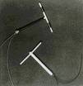

Contraceptive Cohort Study
Recruit 10,000 participants over 4 years
  Remove cost barriers to long-term methods
    Copper IUD (ParaGard)
    LNG IUD (Mirena)
    Implant (Implanon)
  Participant choice
    2-3 years follow-up
    Assess continuation, satisfaction
  Population outcomes

Slide 5
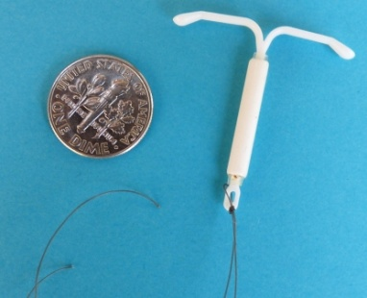
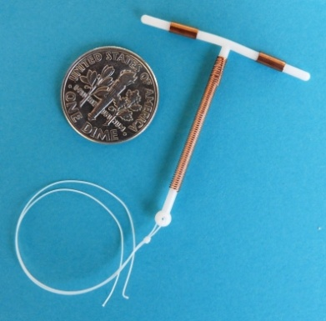
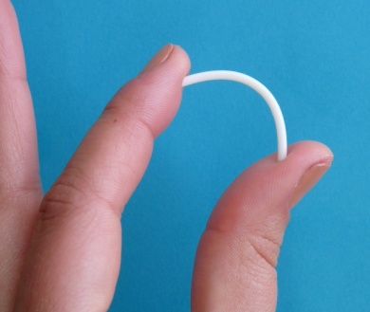
Long-Acting Reversible Contraception
LNG-IUS 99% effective 20 mcg levonorgestrel/day Up to 5 years | Copper T IUD 99% effective Copper ions Up to 10 years | Subdermal Implant 99% effective 60 mcg etonogestrel/day Up to 3 years

Slide 6
CHOICE: Recruitment Sites

Slide 7
CHOICE: Inclusion Criteria
14-45 years
Primary residency in STL City or Country
Sexually active with male partner
(or soon to be)
Does not desire pregnancy during next 12 months
  Desires reversible contraception
Willing to try a new contraceptive method

Slide 8
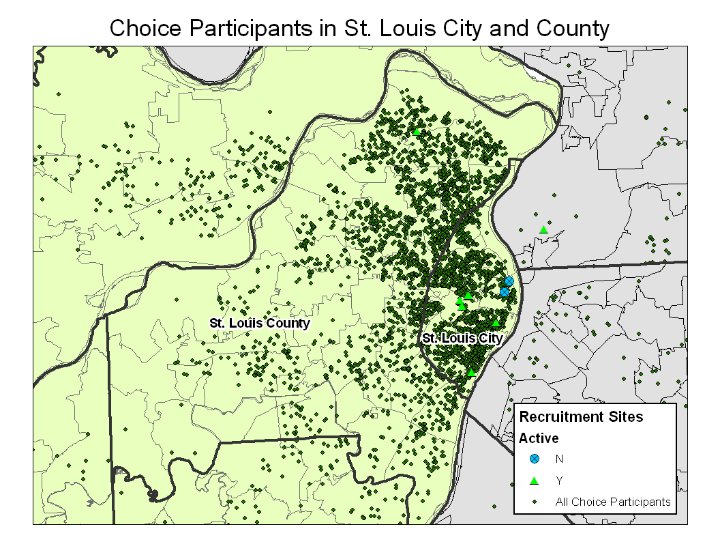

Slide 9
Study Recruitment
Location | 9,256
2 Abortion clinics | 17%
8 Community clinics | 14%
University-based research clinic Word-of-mouth Provider referrals | 69%

Slide 10
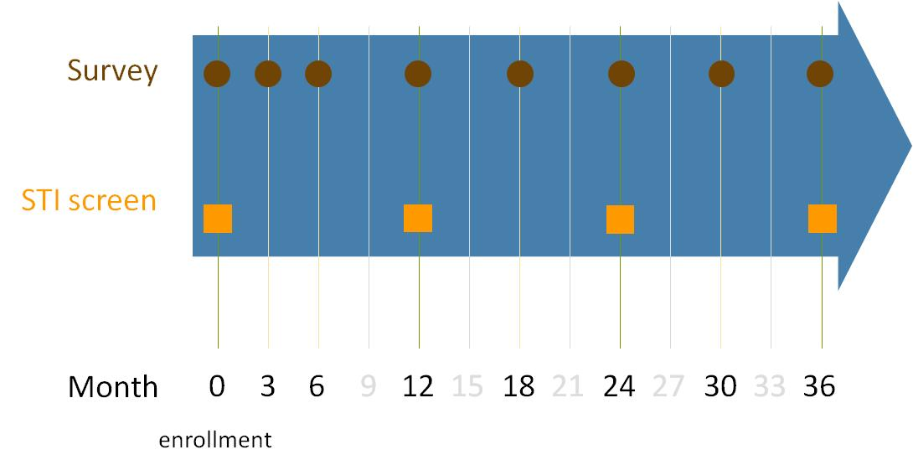
Contraceptive CHOICE Project:
Study Details
ELIGIBLE
Tiered
Contraceptive Counseling
94% 87% 81%
LNG-IUS
Cu-IUD
Implant
DMPA
Pills
Patch
Ring
Other
Secura G, Am J Obstet & Gynecol 2010
Madden T, Contraception 2012

Slide 11
Baseline Characteristics
Age (years) | N | %
14-17 | 485 | 5.2
18-20 | 1548 | 16.7
21-25 | 3559 | 38.5
26-35 | 3029 | 32.7
36-45 | 635 | 6.9
2,033
Race | n | %
Black | 4660 | 50.6
White | 3861 | 41.9
Other | 693 | 7.5

Slide 12
Baseline Characteristics
(N=9,256)
SES | n | %
Public assistance | 3442 | 37.2
Trouble meeting basic needs | 3639 | 39.3
Insurance | n | %
None | 3782 | 41.1
Private | 3957 | 43.1
Public | 1455 | 15.8

Slide 13
Baseline Characteristics
Parity | N | %
0 | 4375 | 47.3
1-2 | 3885 | 50.0
3+ | 996 | 10.7
Unintended pregnancy | 5857 | 63.2
History of STI | 3746 | 40.5

Slide 14
LARC Acceptance
 | %
LNG-IUS | 46.0
CuT380A | 11.9
Implant | 16.9
DMPA | 6.9
Pills | 9.4
Ring | 7.0
Patch | 1.8
Other | <1.0
75%

Slide 15
Choice of LARC Methods in Adolescents

Slide 16
Evaluation of CHOICE
Outcomes
  Short term:
    Effectiveness
    Continuation & satisfaction
  Long-term
    Population-based outcomes
      Unplanned pregnancies:
        Repeat abortions
        Teen births

Slide 17
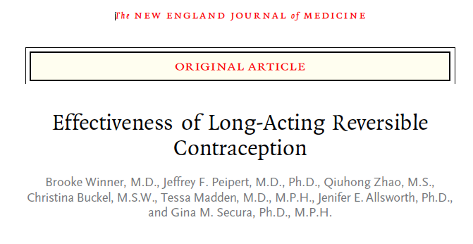
NEJM CHOICE Publication

Slide 18
Unintended Pregnancy Rates in
CHOICE Cohort
August 2007 through July 2011
  615 reported pregnancies
      459 (75%) unintended
      334 contraceptive failures

Slide 19
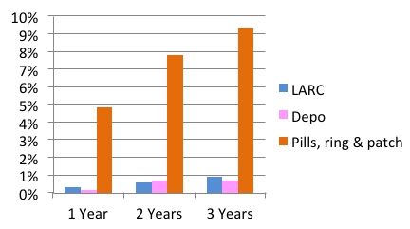
Unintended Pregnancy by Contraceptive Method
HR_{adj} = 22.3 (95% CI 14.0, 35.4) TWENTY-FOLD DIFFERENCE!
Winner, et al. NEJM 2012.

Slide 20
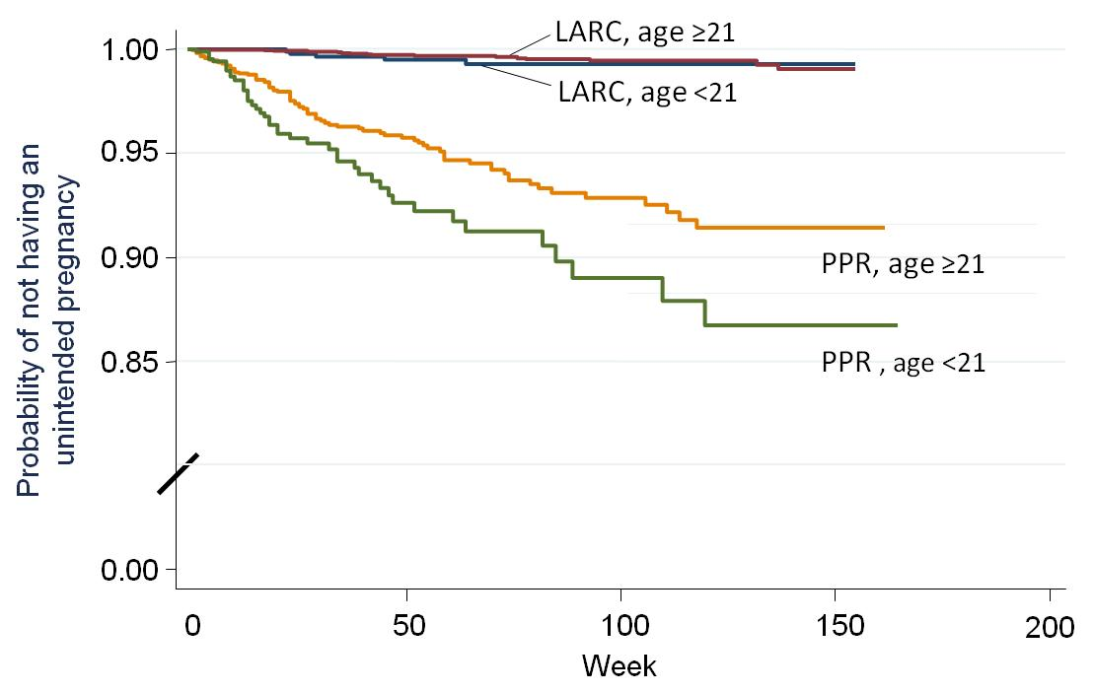
Method Failure by Age
HR_{adj} = 1.9;
95% CI 1.2, 2.8
Winner NEJM 2012

Slide 21
12- & 24-Month Continuation: Overall Cohort
Method | 12-Month (%) | 24-Month (%)
LNG-IUS | 87.5 | 78.9
Copper IUD | 84.1 | 77.3
Implant | 83.3 | 68.5
Any LARC | 86.2 | 76.6
DMPA | 56.2 | 38.0
OCPs | 55.0 | 43.5
Ring | 54.2 | 41.1
Patch | 49.5 | 39.9
Non-LARC | 54.7 | 40.9

Slide 22
Contraceptive CHOICE Project
Population Outcomes

Slide 23
Abortion Data: RHS

Slide 24
Repeat Abortion 2006 - 2009
P-value
KC:STL 0.32 0.93 0.31 0.02

Slide 25
Percentage of Abortions that are Repeat Abortions
P-value
KC:STL 0.32 0.93 0.31 0.02 <0.001

Slide 26
Pregnancy Outcomes:
CHOICE Compared to U.S.
 | CHOICE Annual Rate | U.S. Rate | Reduction
Pregnancy | 39.4 | 108* | 63%
Unintended pregnancy | 29.6 | 52* | 43%
Abortion | 10.4 | 19.6^ | 47%
All rates per 1,000 women 15-44 years
* 2006 data
^ 2008 data
CHOICE Data: Unpublished; U.S. Data: Finer 2011, Jones 2011
Notes:
Can make comment about new teen birth rate of 34.3 which means a reduction of 52%

Slide 27
NEJM CHOICE Publication

Slide 28
Teen Outcomes:
CHOICE Compared to U.S.
 | CHOICE Annual Rate* | 2008 U.S. Rate* | Reduction
Pregnancy among sexually active teens | 34.0 | 158.5 | 64%
Birth | 19.4 | 94.0 | 63%
Abortion | 9.7 | 41.5 | 65%
*All rates per 1,000 teens 15-19 years
Secura et al. NEJM 2014.
CHOICE Data: Unpublished; U.S. Data: Kost 2012
Notes:
Can make comment about new teen birth rate of 34.3 which means a reduction of 52%

Slide 29
Pregnancy Rates: Sexually Experienced U.S. Teens Compared to CHOICE Stratified by Race
U.S.
CHOICE
White White Black Black
Secura et al. NEJM 2014.

Slide 30
The Secret: 3 Key Ingredients
Education regarding all methods, especially LARC
  Reframe the conversation:
    start with the most effective methods
Access to providers who will offer & provide LARC
  Dispel myths and increase the practice of evidence-based medicine
Affordable contraception
  Institute of Medicine recommendation, Affordable Care Act, Medicaid Expansion, local funders

Slide 31

Thank you

Slide 33
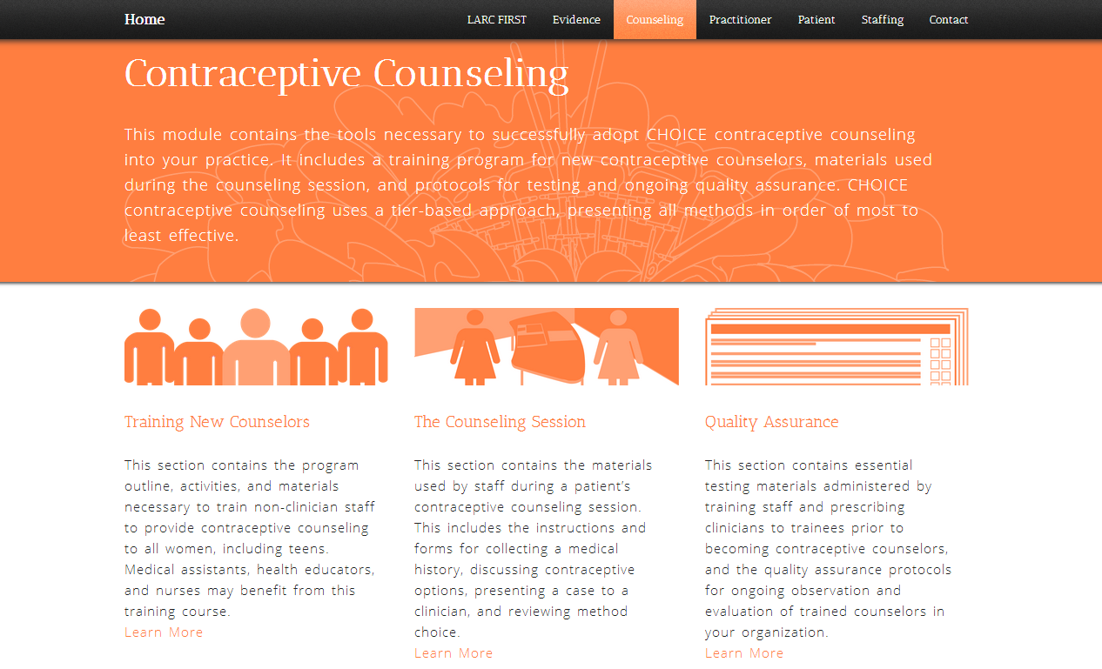
LARC First Resource Center

Slide 34
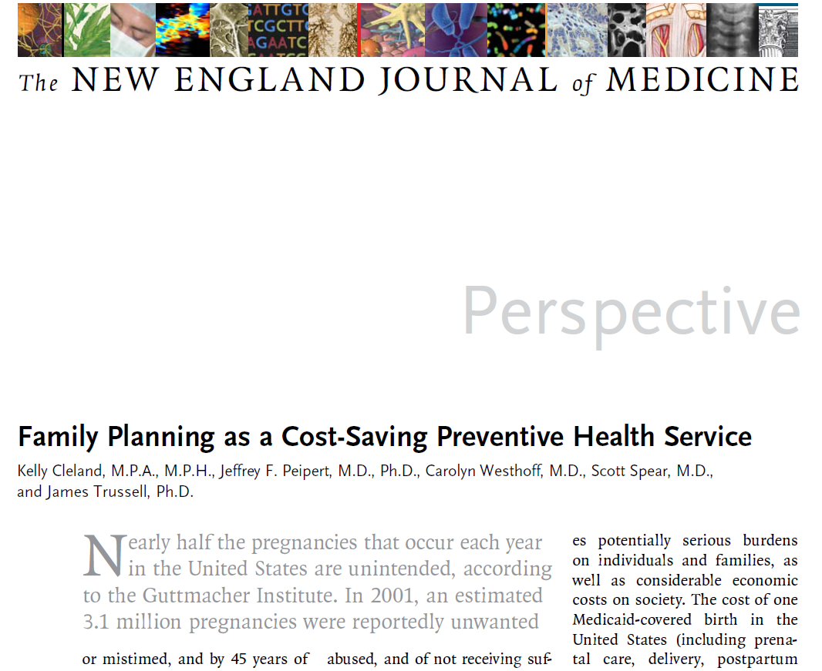
Can CHOICE Help Shape Policy?

Slide 35
Take-Home Messages
CHOICE Methods:
  Education, Access, Cost
    Evidence-based counseling
  LARC-friendly providers
    IUDs rarely contraindicated
    Same-day insertion

Slide 36
Take-Home Messages
LARC Methods are THE most effective
  Increased use of LARC will
    Decrease abortions and unintended pregnancies
    Decrease racial/SES disparities

