Slide 1
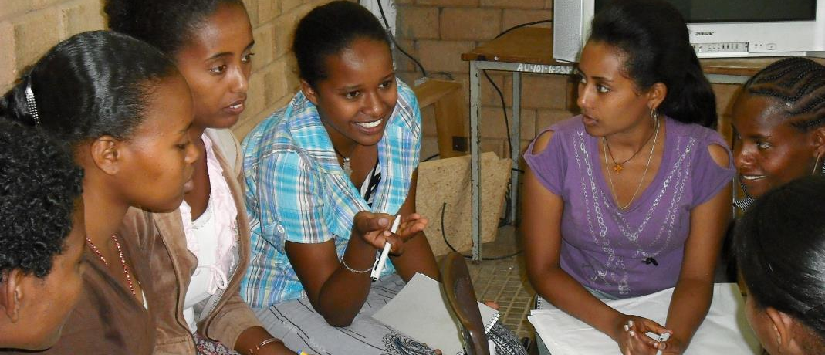
Tackling the Tough Questions: Political and Community Support
Kidest Lulu, Pathfinder International Ethiopia

Slide 2
Supportive Policies

Slide 3
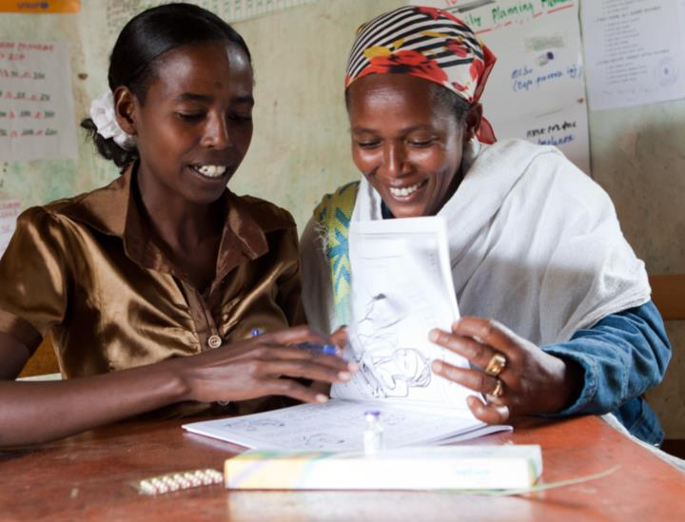
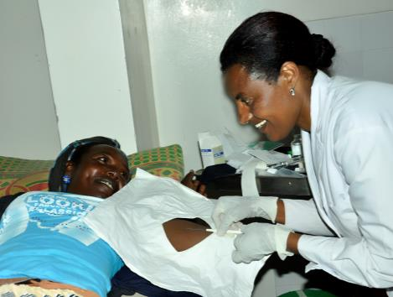
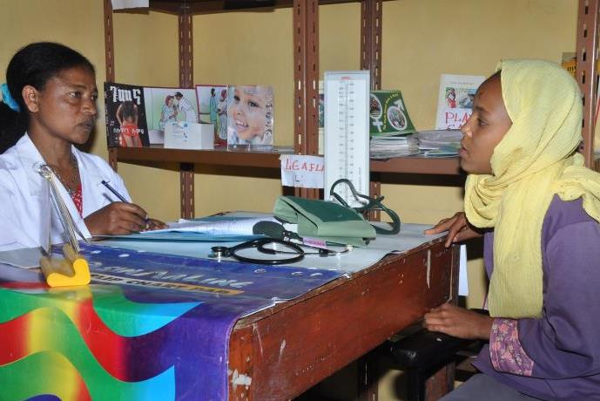
Tasksharing with HEWs
Backup services
Increasing LARC Access
YFS providers trained in LARC

Slide 4
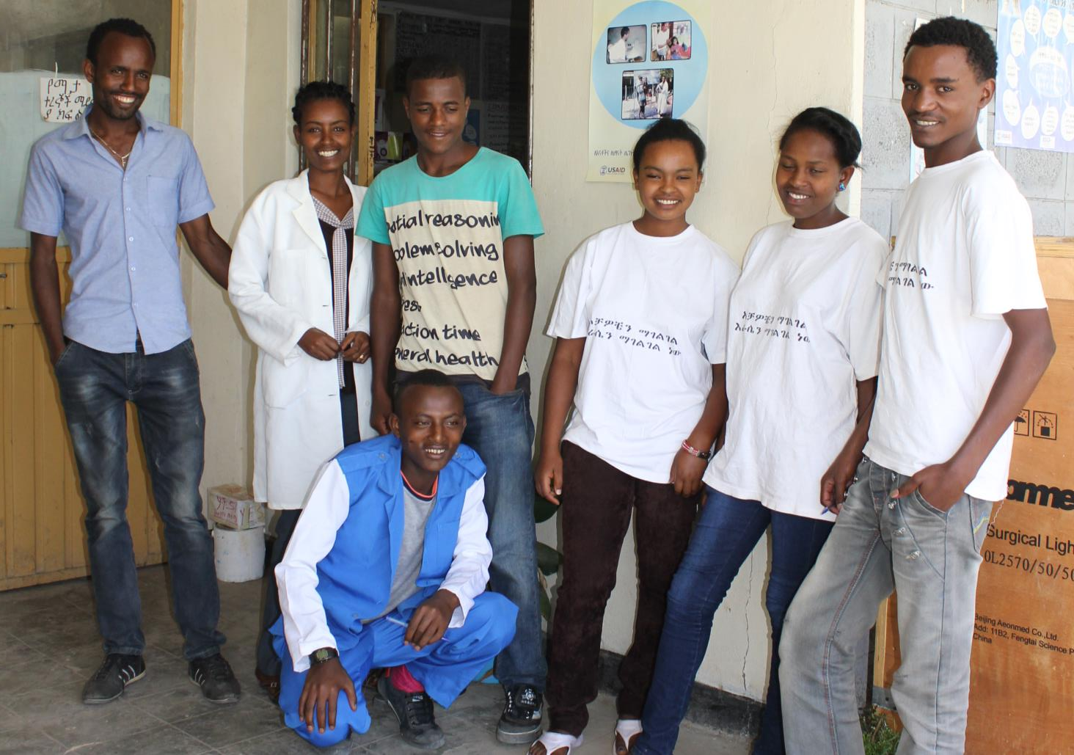
Community Mobilization Through Peer Educators

Slide 5
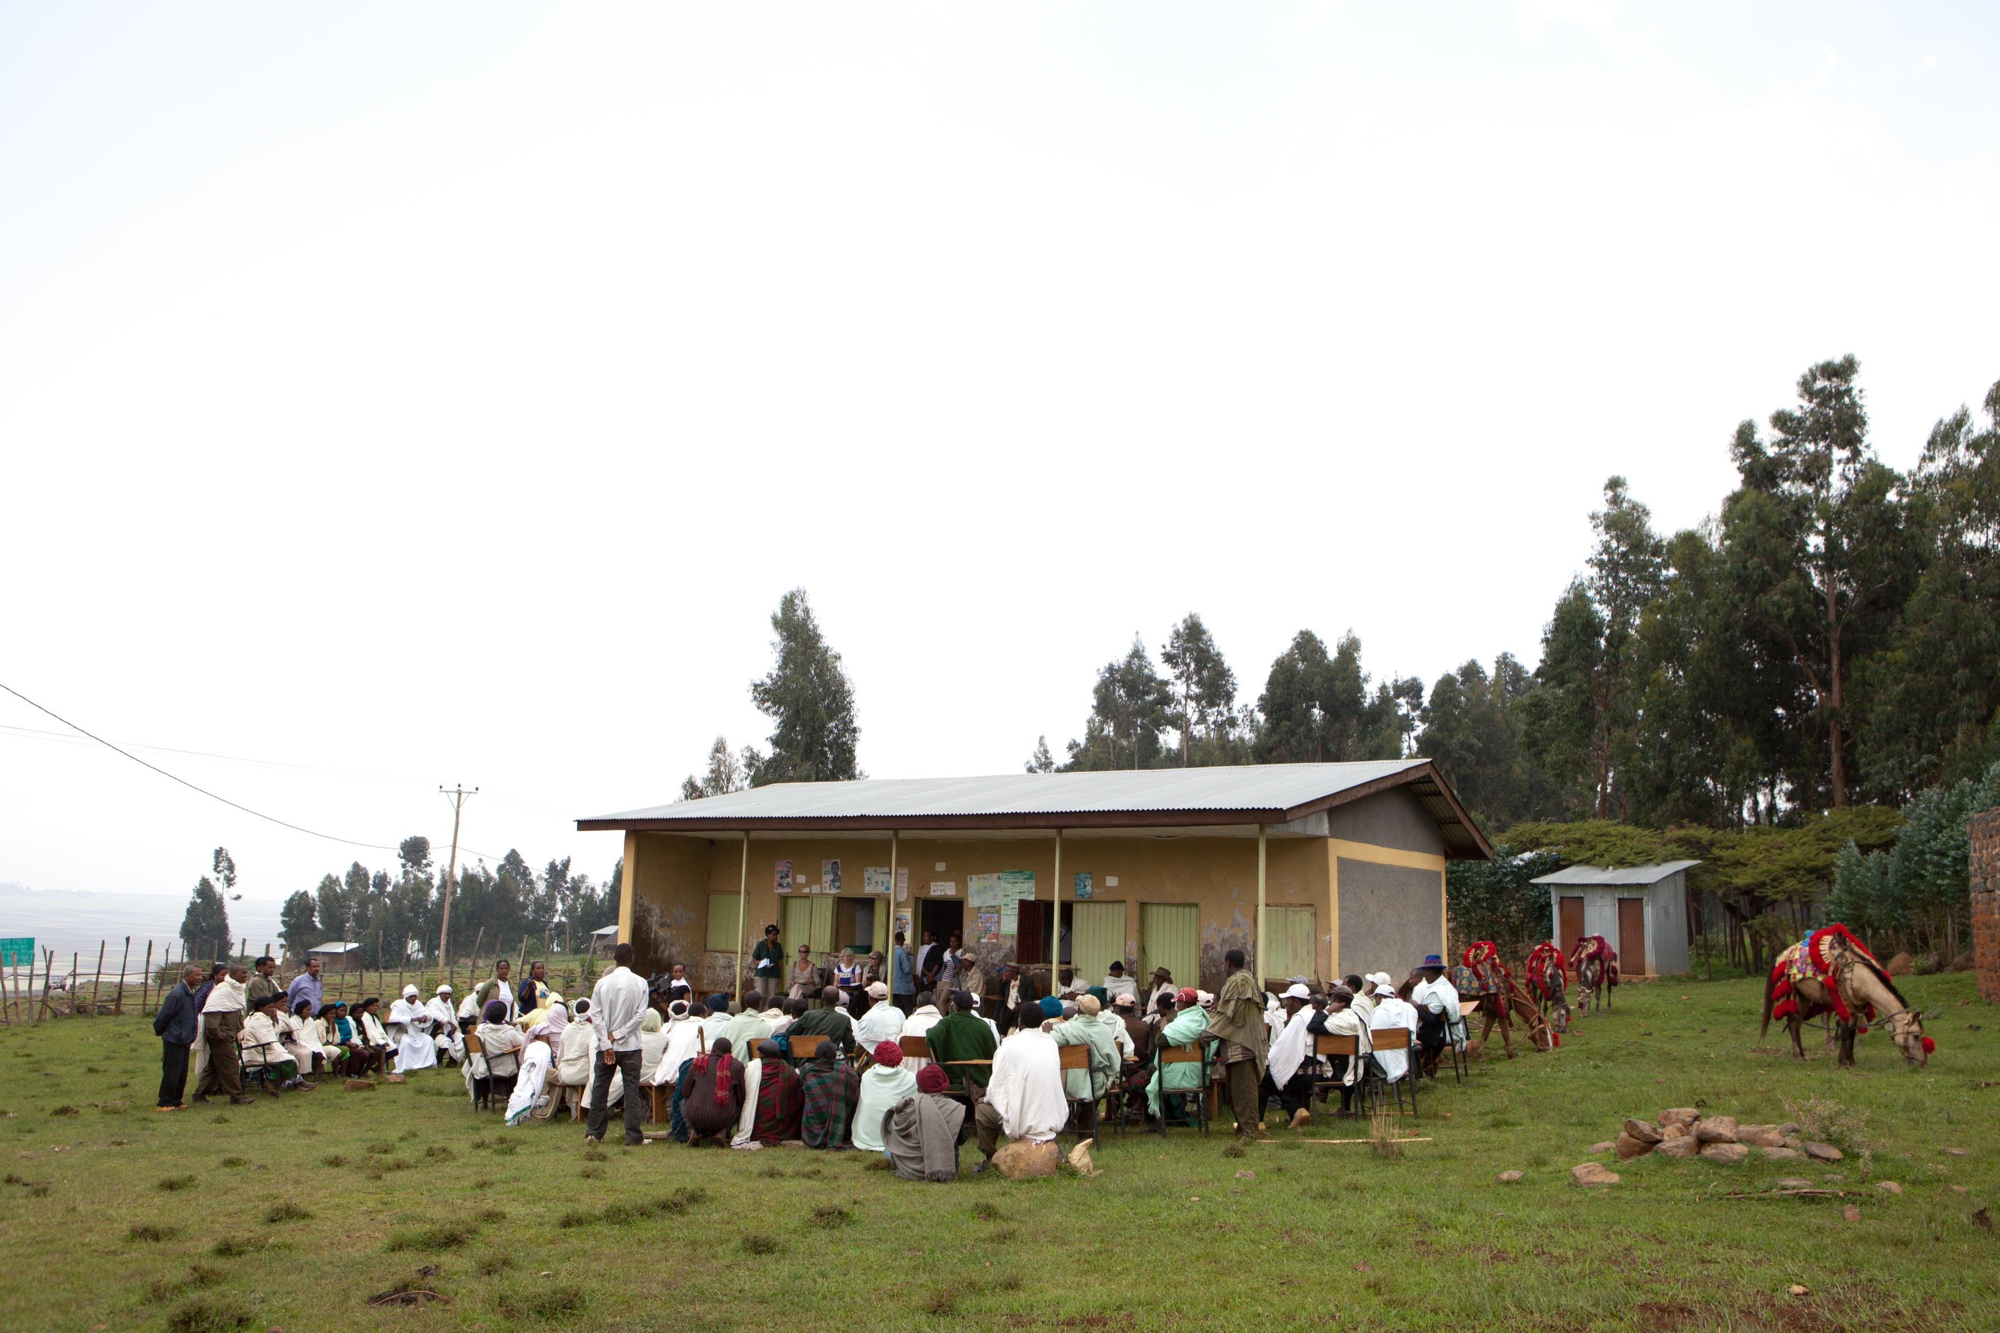
Involving the Community

Slide 6
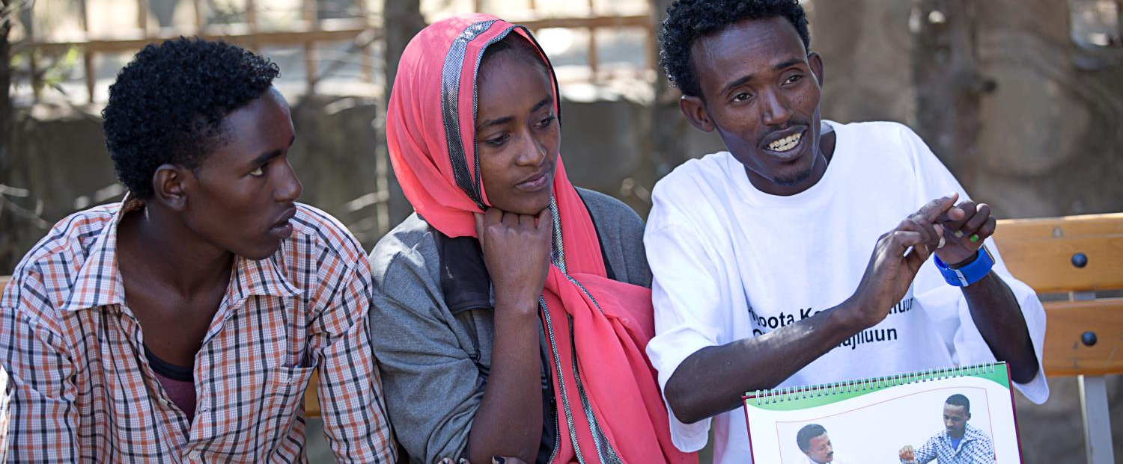
For more information contact Kidest Lulu
KLulu@pathfinder.org

